Slide 1
Crop monitoring using FAPAR
Carla Barroso, Célia Gouveia
IPMA, 25/07/2018

Slide 2
Motivação
http://eo.belspo.be/Docs/Resources/Presentations/BrightSide2016/08_JeanPierreGoffart&IsabellePicard_Sentinel2forPotato.pdf

Slide 3
Procedure
Go to lsa-saf.eumetsat.int
Get Data -> Archived Products
(MTFAPAR) - Fraction of Absorbed Photosynthetic Active Radiation
Area: MSG-Disk
Start Date: 2017/Jan/01 00:00
End Date: 2017/Dec/31 23:59
36 files of type HDF5_LSASAF_MSG_FAPAR-D10_MSG-Disk_201701050* found!
Add to basket
On windows explorer you find the folder tree:
C:/Pretoria/TEMA_1/
/scripts
/H5_DATA
/GEOTIFF_DATA

Slide 4
Convert the LSA SAF hdf5 files contained in folder/H5_DATA to geotiff format
Open the python console: ctrl+Alt+p
Drag the script C:/Pretoria/TEMA_1/scripts/importa_data_reproj_FVC.py to the Qgis python console.
This will make the script to run, converting all LSA SAF hdf5 files within the H5_DATA to geotiff format, and reprojecting.
The output is stored in C:/Pretoria/TEMA_1/ GEOTIFF_DATA/ (the convertion and reprojection of all files should take around
Open the LSASAF files converted to geotiff in Qgis
Go to the folder containing the reprojected geotiff files (C:/Pretoria/TEMA_1/ GEOTIFF_DATA/) click on the files with filenames terminating on “_rep” and drag them to Qgis.

Slide 5
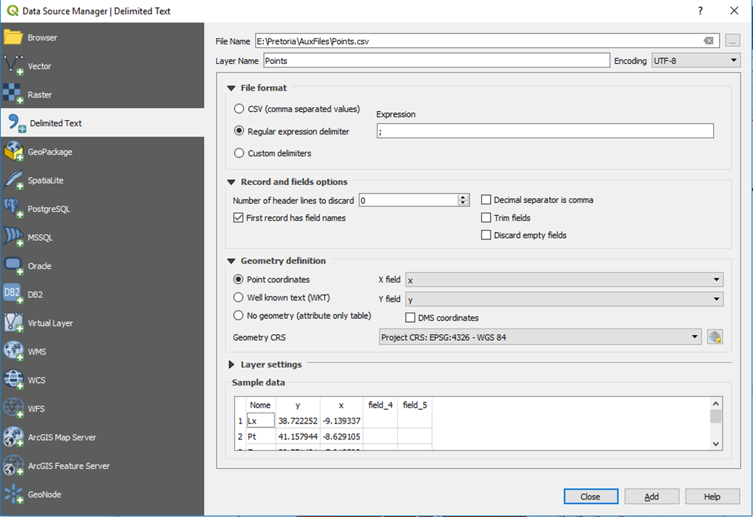
In QGIS, in the Layers window
drag the names of the files assuring that the dates are ordered from the oldest (at the top) to the most recent (at the bottom), like illustrated in the following figure:

Slide 6
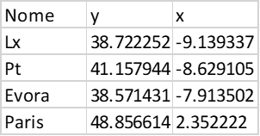
Extract data for given lat, lon point coordinates
Produce a csv file with the following format:
Name, lat, lon
Exemplo

Slide 7
Extract data for given lat, lon point coordinates
Produce a csv file with the following format:
In Qgis select Layer->Add Layer->Add Delimited Text layer
On the window Dialog box that pops up (Data Source Manager|Delimited texto), select the options as in the figure bellow:

Slide 8
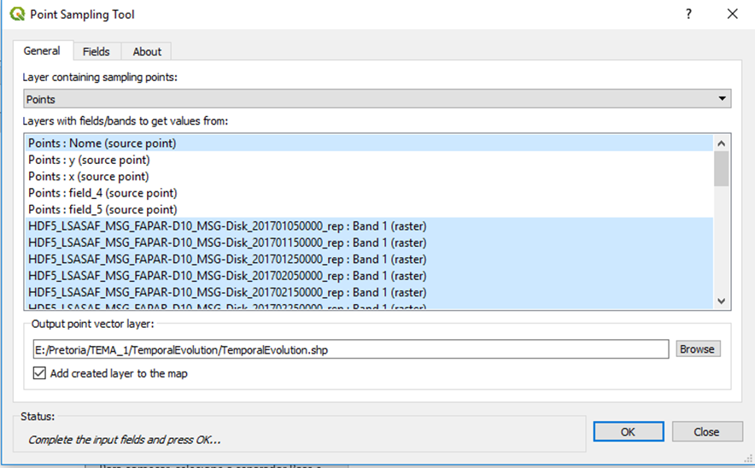
Select Plugins->Analyses->Point Sampling Tool
In the dialog box that is opened, select the options as in the figure:

Slide 9
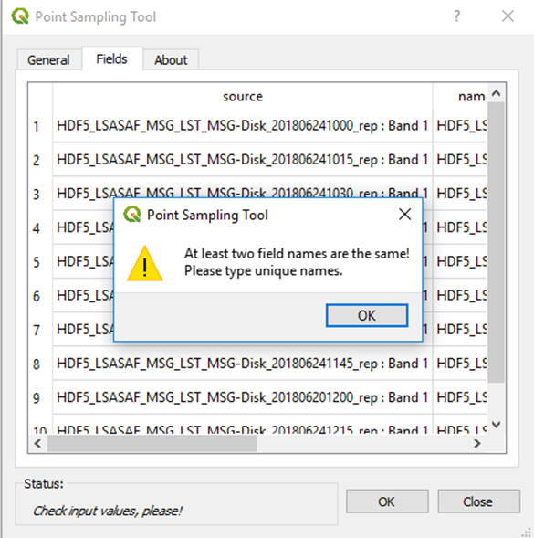
Select Plugins->Analyses->Point Sampling Tool
When you click in the Ok button the following message is shown:
So you need to click in the OK button and then double-click in the name of each datafile and change it (for instance to a,b,c,…or 1,2,3,…):

Slide 10
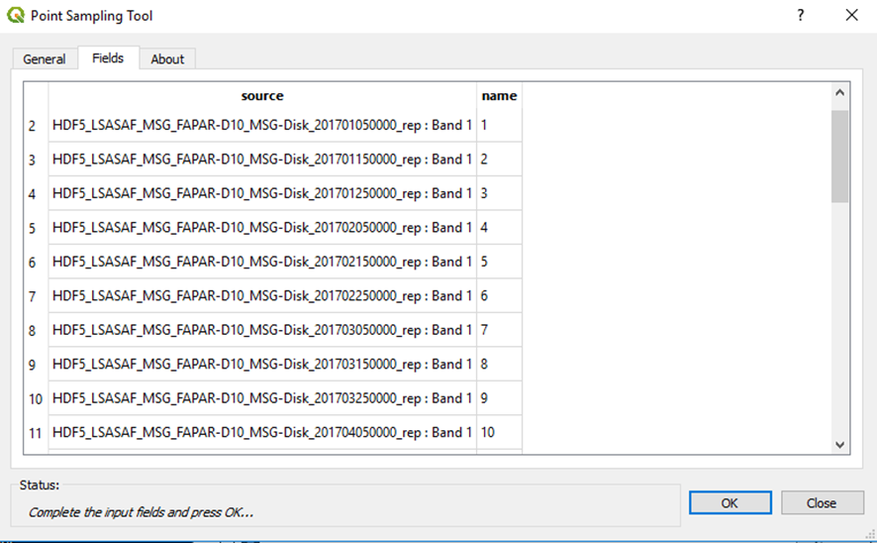
Select Plugins->Analyses->Point Sampling Tool
Finally select an output filename with extension .shp and click Ok.

Slide 11
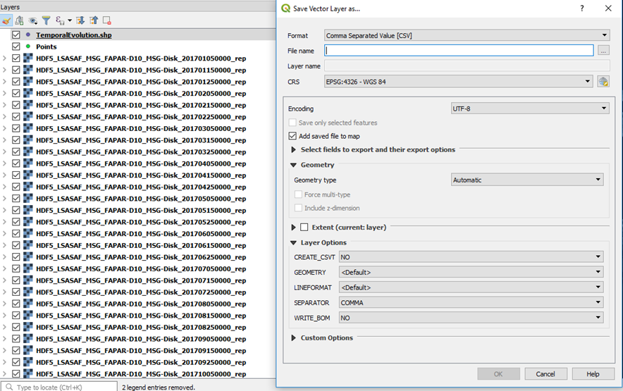
Select Plugins->Analyses->Point Sampling Tool
The created shapefile is automatically opened in the Qgis layers window. Click on it with the mouse right button and select Save as…A Save Vector Layer window will pop up, and you will be able to save the .shp file as a CSV:

Slide 12
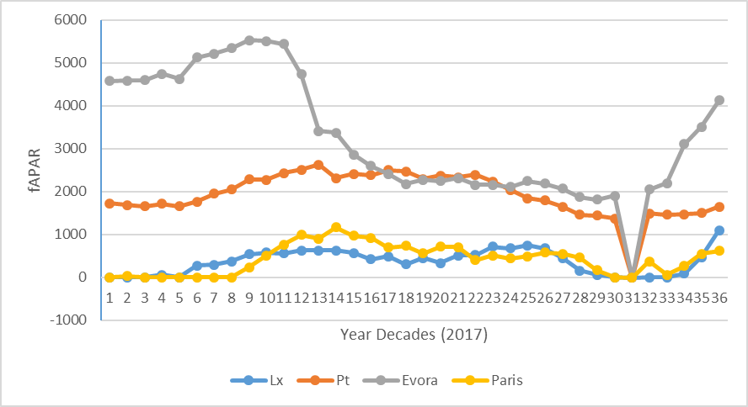
Open an excel spreadsheet. Go to Data ->Obtain External Data.
Select the previously saved .csv file. Open the file as comma separated fileds. You should get the data as:
Create a 2D line graph, such as in the next example:

Slide 13
THANK YOU!

