Slide 1
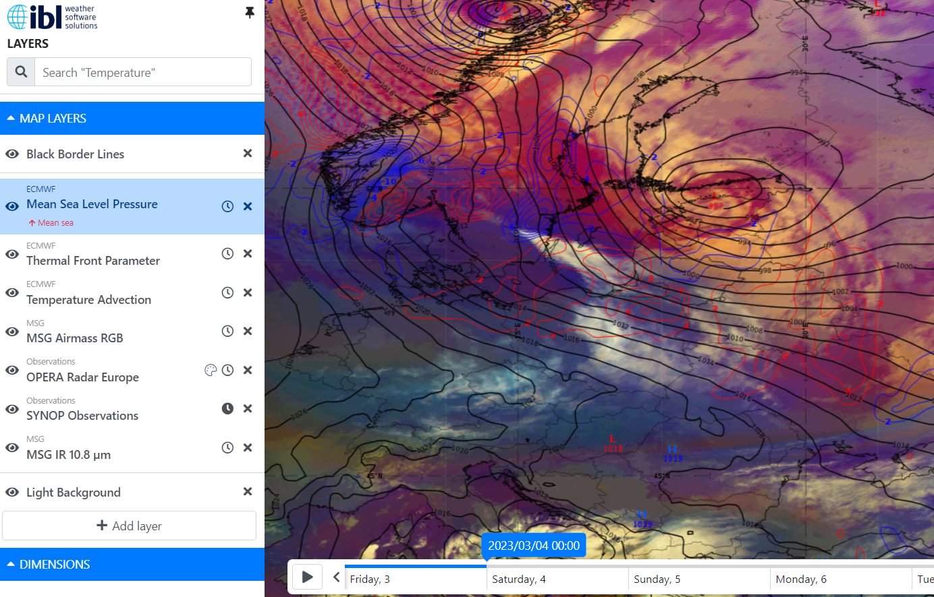
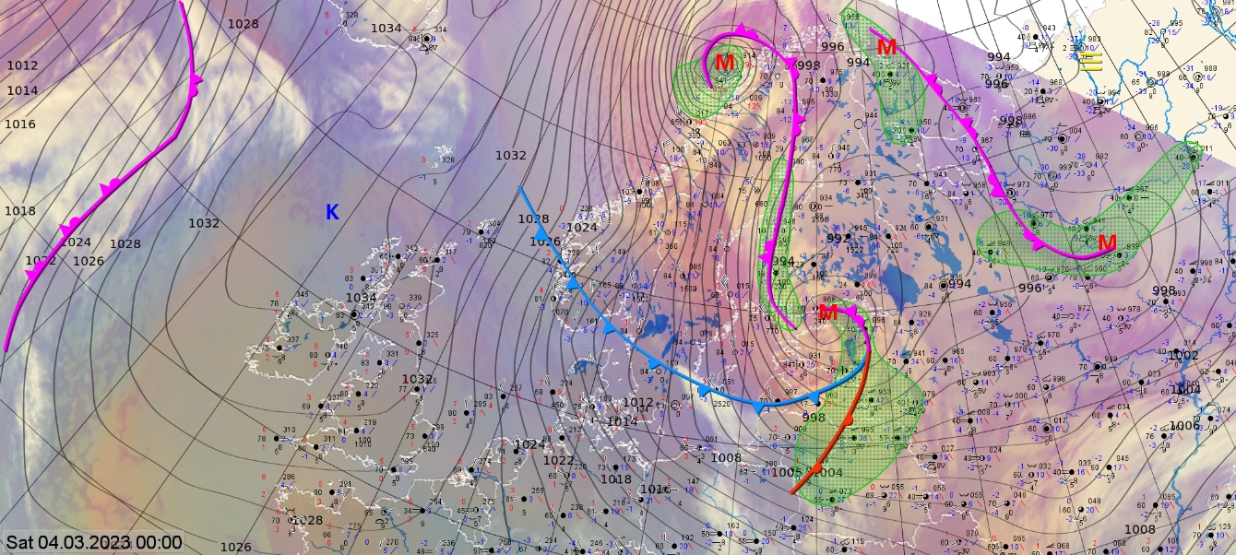
Norwegian cyclone model 04.03.2023 00 UTC
We can see Norwegian cyclon model in this image
Consequences:
slippery roads
poor visibility
power outages
branches breaking under the weight of wet snow
Add here 1-2 additional images (NWP/ Sounding/Vertical Cross Section/Observation/ Photo of the event, etc) describing the case.
Airmass RGB with mean sea level pressure and temperatuure advection. On the right opera radar and SmartMet chart with fronts, synop and satellite image.
ET cyclon cloud system.
Strong winds on Western coast of Estonia. Snow in mainland Estonia and rain on western coast of Estonia. Poor visibility.
Kaido Ennok Estonian Environment Agency

Slide 2
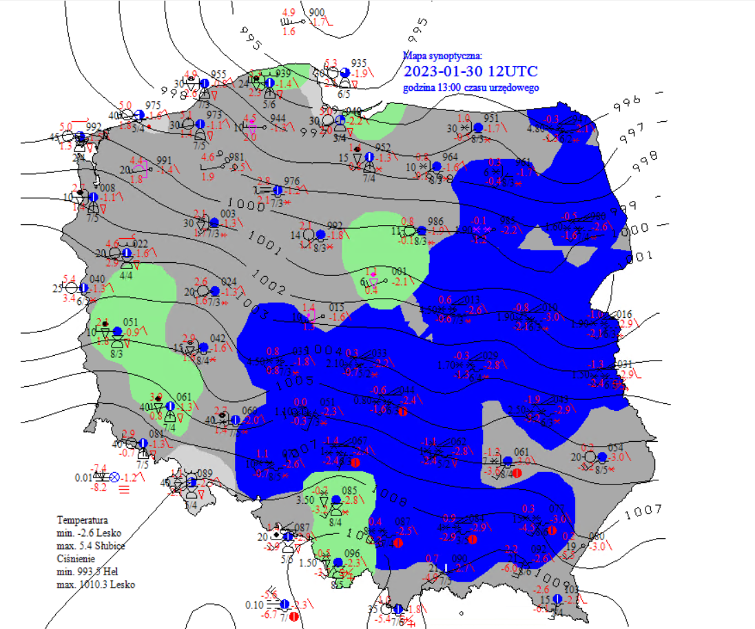
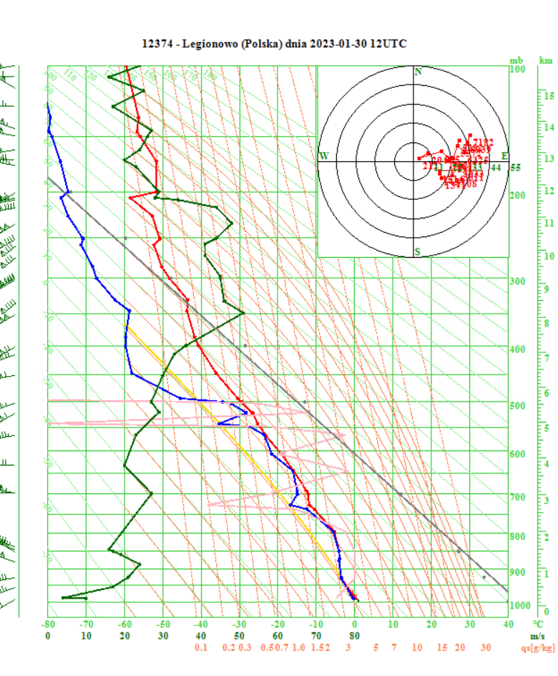
Occlusion Cold Conveyor Belt – 30/01/2023
We can see Occlusion Cold Conveyor Belt in this image.
Weather hazards:
- heavy snowfall ( low visibility – dangerous for aviation and traffic )
- strong wind gusts
Airmass RGB 30.01.2023 12:00 UTC
We can see:
-a multi-layered frontal cloud band associated with the cold front
-a lower cloud spiral which seems to penetrate from below the higher cloud band associated with the cold front
Małgorzata Koper, IMGW (Poland)

Slide 3
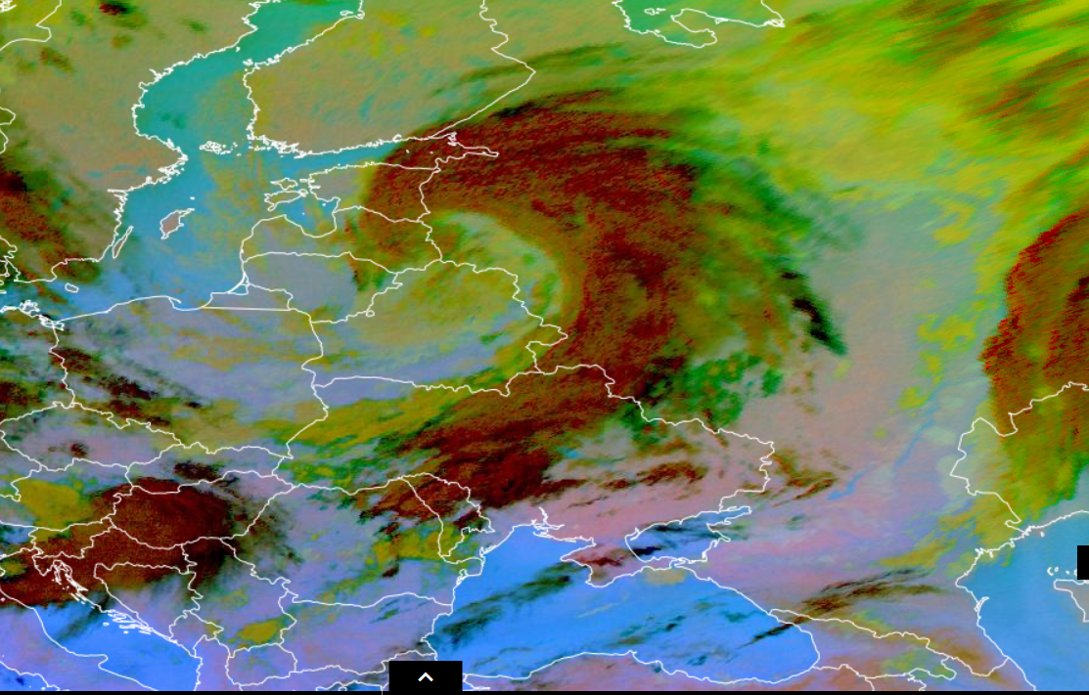
Conceptual Model – cold front in cyclone.
-strong wind
-heavy rain
-low temperature
Airmass RGB and Dust RGB 05/10/2023 21:00 UTC.
On this products we can see a strong cyclone moving from west to east across the Baltic county. His front also moving across Ukrane and change the weather.
Alla Bilozerova, Ukrainian Hydrometeorological Center

Slide 4
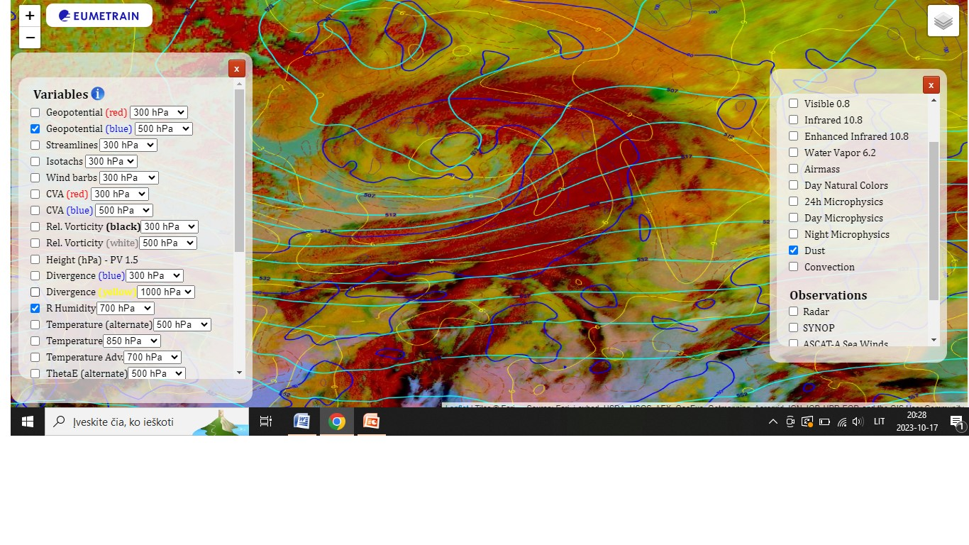
Title : 2023-03-07 – 21:00 UTC
Airmass RGB 2023-03-07 21:00 UTC with thermal front parameter . Southern cyclone cloud system. With strong winds and heavy rain in western part of Lithuania.
Giedrė Andruškienė

Slide 5
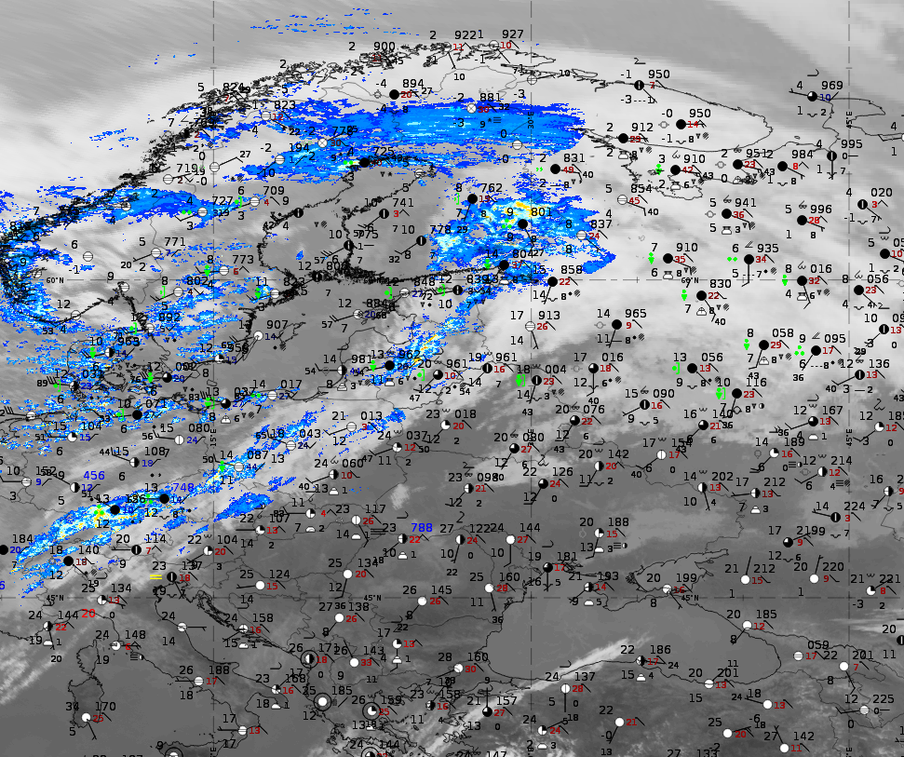
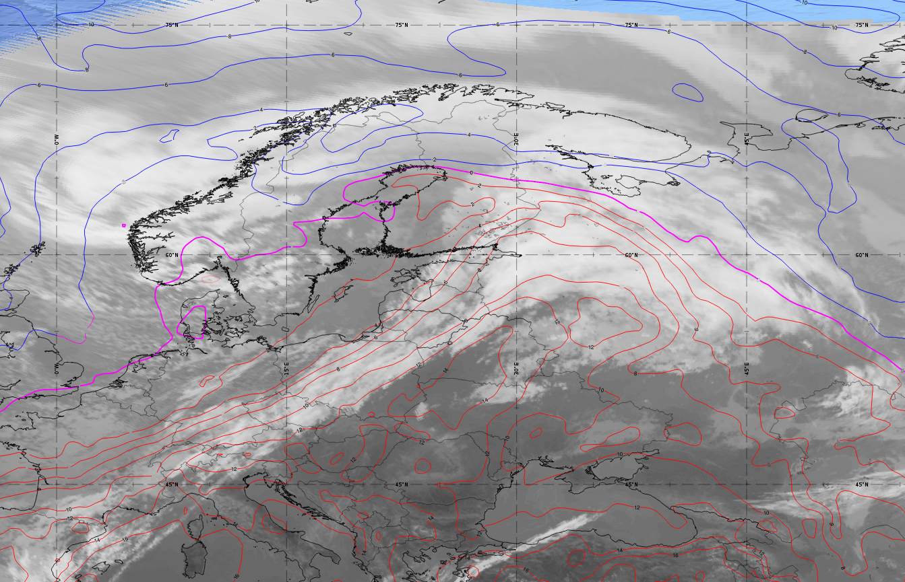
Title : [Ana Cold Front] – [14.10.2023 12:00]
The cold front with a sharp temperature contrast.
Frontal system will bring heavy snowfall across western-southwestern Norway, northern Sweden, and Finland.
Dangerous weather for aviation - high winds, heavy rain and snow, low visibility.
Airmass RGB with geopotential hight 500hPa and thermal front parameter.
Powerful Arctic intrusion of cold air mass from the north.
Ilona Nigale Latvian Air Force weather observer
Notes:
Hello! This is my very first attempt to use satellite imagery, so I tried the best.

Slide 6
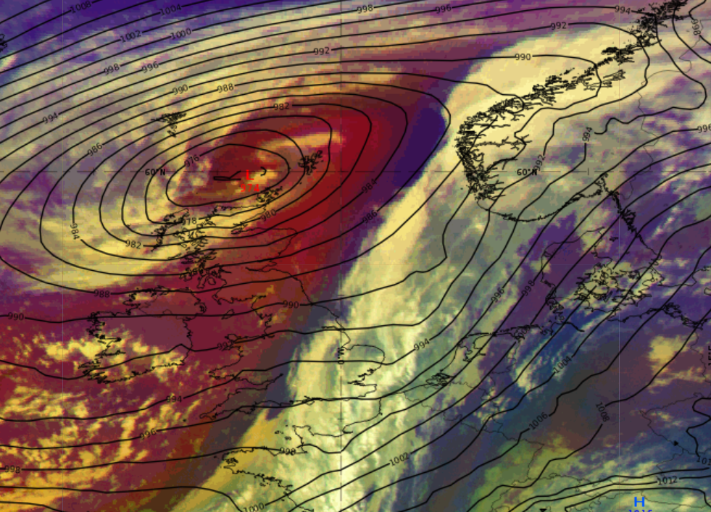
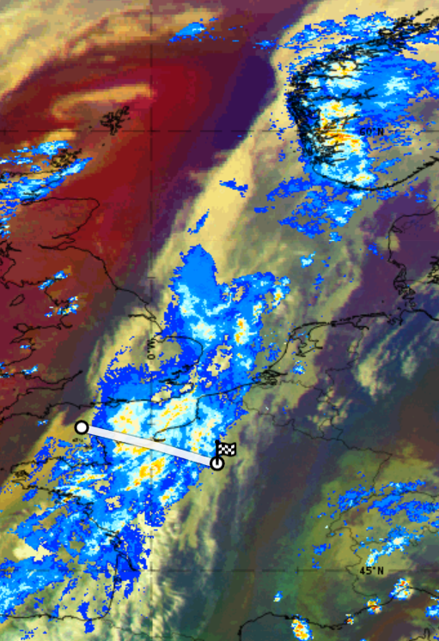
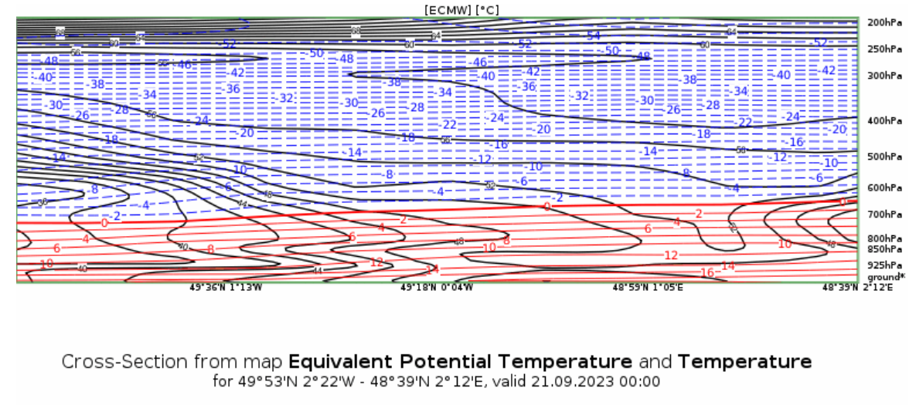
[Cold front ahead of ET cyclone] – [21.09.2023 00UTC]
We can see a cold front ahead of the low.
Behind the frontal cloud system , there is a strip of cold, followed by cold and dry airmass near the center of the low. Ahead of the front the airmass is warmer.
The MSG Dust RGB showcases ochre colors leading the cloud system indicating to an ana cold front.
Heavy rainfall, sudden drop in temperature and thunderstorms are associated with this case.
Intense rainfall was recorded by OPERA radar in multiple places along the frontal system, most intense in Southern Norway and northwestern coast of France. The following day there was there were thunderstorms along the front in easter France and western Germany.
This satellite image is retrieved from ePort. The used products are MSG Airmass RGB and ECMWF mean sea level pressure.
It showcases a low with its through positioned to northeast. Starting from the through an impressive cloud system stretches to southwest and eastwards.
Katriin Käärik, Estonia Environment Agency

Slide 7
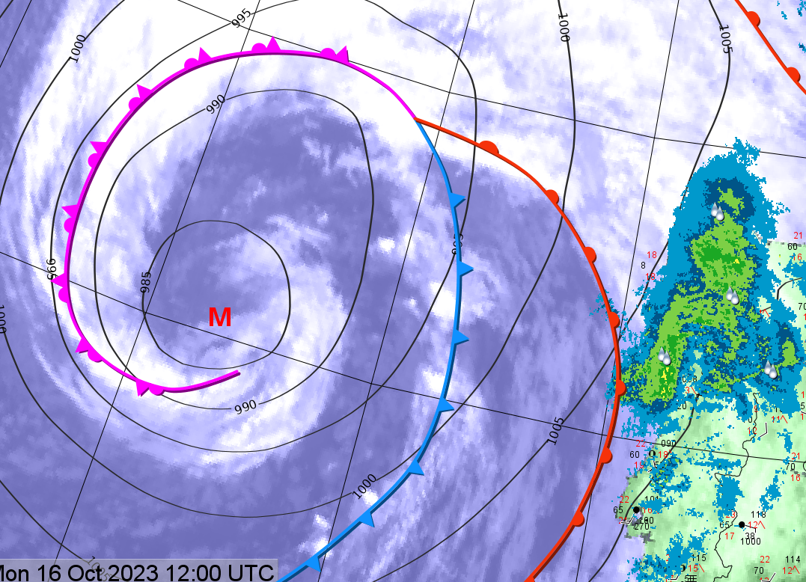
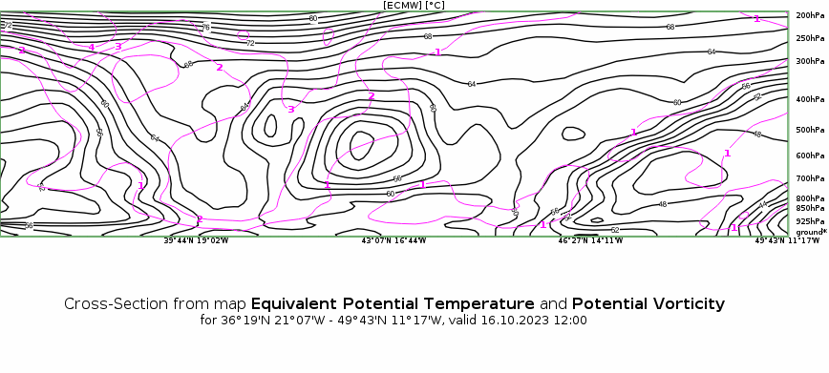
Norwegian type cylogenesis – [17.10.23]
There are two major visible Conceptual Models in this picture – The Norwegian type cyclogenesis (slow initial phase, no separation of warm sector by cold front – excluding SK type cyclone (observed previous stages over the ocean);
Warm Front Shield – thick cloud cover in warm sector, ascending and increasing towards the occluded spiral (strong warm conveyor)
Hazards: Thunderstorms within the occluded area, in the warm sector, visible convection cells in the cold front, Strong winds in the descending jet area (brown/red, at the edge of the spiral on the cyclonic side)
Above – Warm front induced rain over Portugal
On the left – High PV values on the inner spiral of the cyclone (purple)
Product: Airmass RGB, 16.10.23, 12:00 UTC
On the Picture, an ET Cyclone that formed over the Atlantic is moving east towards the Iberian peninsula. On the Airmass RGB product, the cold, dry airmass intrusion is very visible behind the cold front and spiraling into the matured cyclone Center.
Karl Erik Krepp, Estonian Enivronment Agency

Slide 8
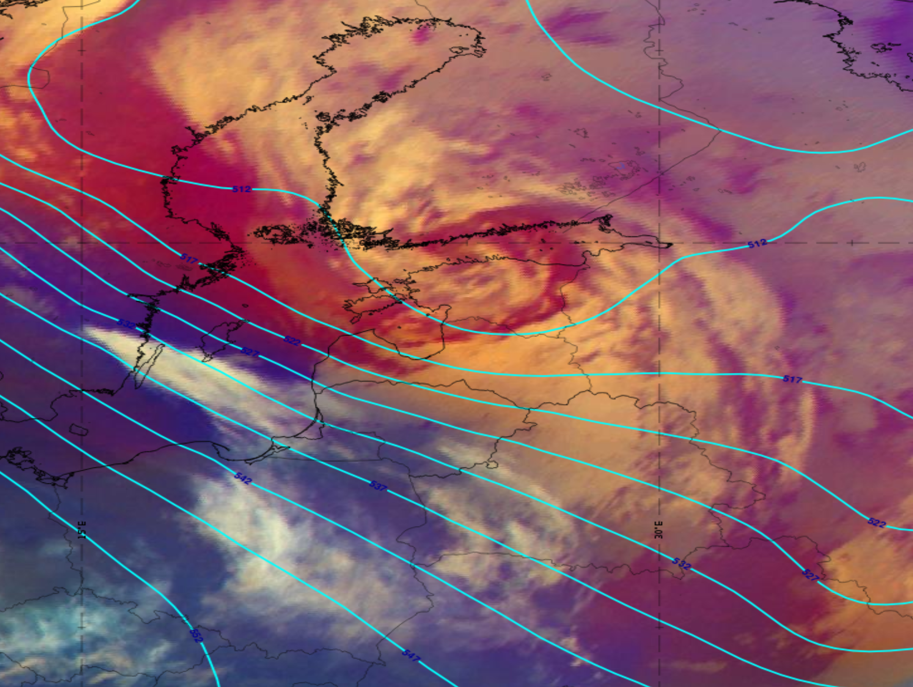
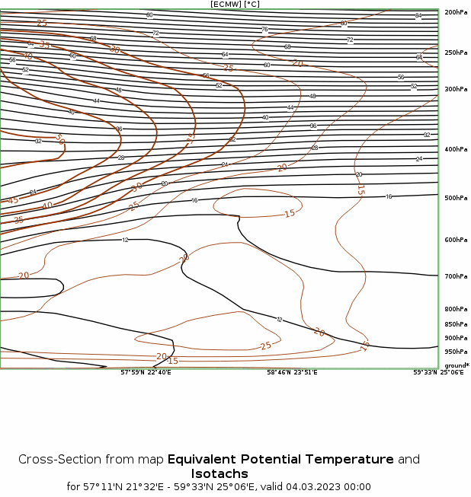
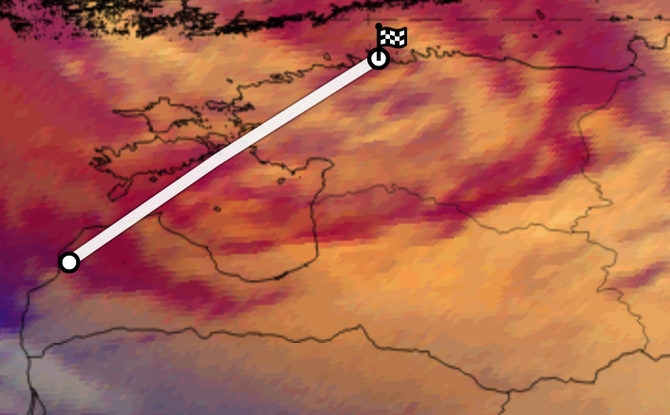
Cyclogenesis Norwegian type over the Baltic countries – March 4, 2023
The satellite image shows the Dissipation stage of the Norwegian type Cyclogenesis Conceptual Model.
The weather observations & consequences in Latvia:
- At night the snow cover in the eastern part grew by 5-7 cm, by day in the whole country by 5-9 cm, locally by 10-13 cm;
- Wind gusts 15-19 m/s, in the central and western parts 20-24 m/s;
- Widespread power outages;
- Accidents on the roads due to snowfall, snow accumulation on the roads and black ice (the air temperature at night and by day was -2...+2°).
Airmass RGB with geopotential 500 hPa (00UTC March 4, 2023)
The bright, white colors depict clouds. The centre of the low is located over the Gulf of Finland, the Occlusion cloud band spiraling several times around it. The dark brown stripe within the cloud spiral represents cold and very dry sinking air.
Karina Rozkova, LEGMC

Slide 9
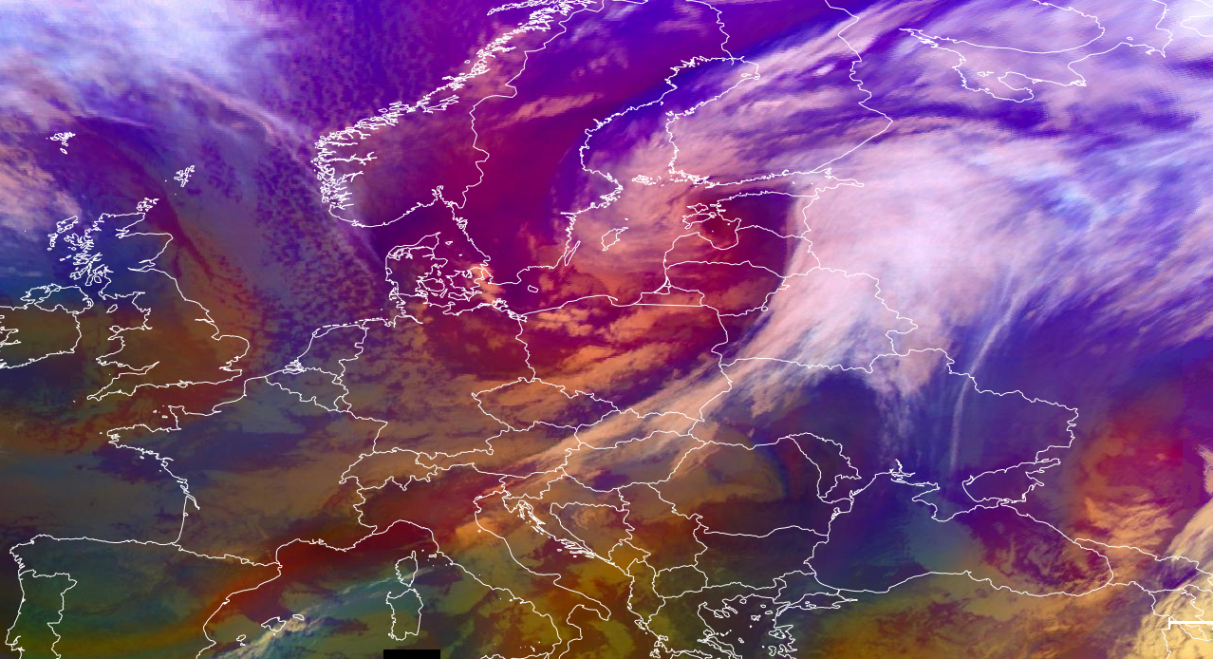
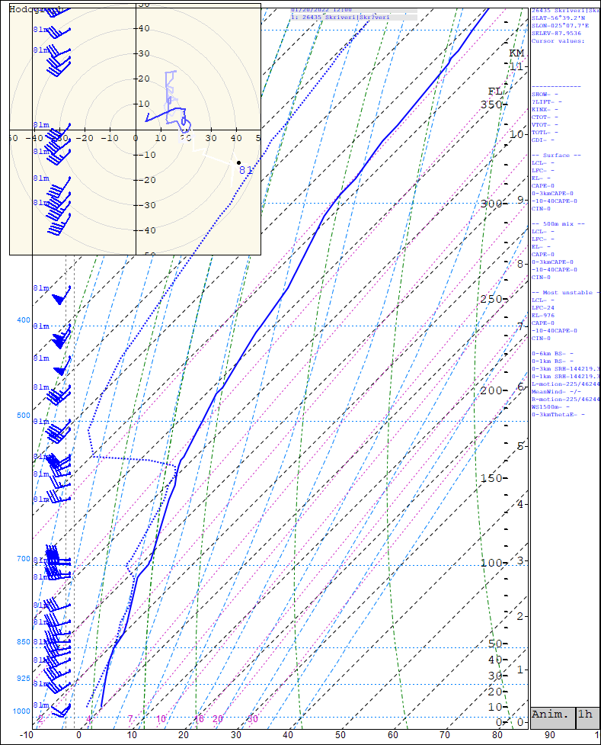
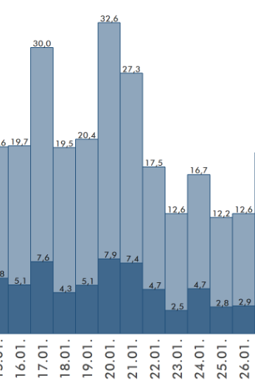
Ana Cold front – 20.01.2022
This image is significant to Ana cold font which was moving over the Poland and Baltics.
It brought strong winds, and snowfall to various regions. The cold front was characterized by a sharp boundary between cold, dense air masses and warmer air masses, leading to significant temperature contrasts.
On this day the wind gusts reached up to 32 m/s that led to
Airmass RGB – 20th of January 2022 09:00 UTC
In this image you can see cyclone in it`s advanced stage
In this image you can clearly see thick inversion layer, which was captured by radiosonde from Meteo station in Skrīveri. This also was a clear indicator of convective clouds forming.
Alise Leitāne, NAF AF meteorological obsever

Slide 10
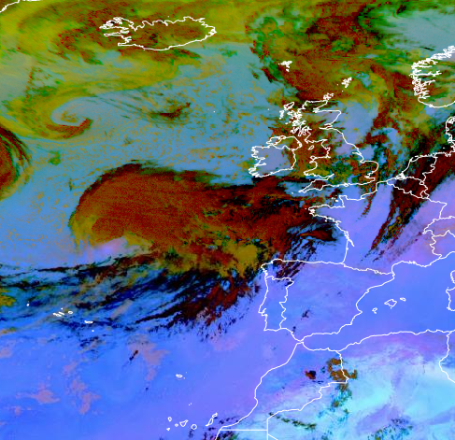
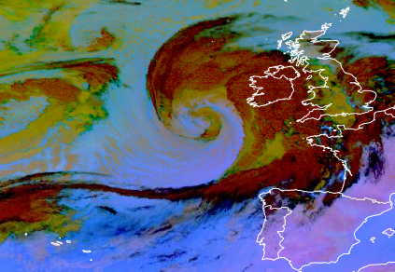
Title : Rapid Cyclogenesis – [27.09.2023 17:15]
We can see Rapid Cyclogenesis CM.
Weather effects asociated with Rapid Cyclogenesis –
intense precipitation,
thunderstorms,
strong wind/ strong wind gusts,
very strong falls/rises in pressure.
(28.09.2023 6:15) hours later a mature stage storm can be observed.
Dust RGB – MSG – 0 degree, 27.09.2023 17:15.
In this Dust RGB we can see a rapidly developing storm in the atlantic ocean. In the Eumetview all stages of storm development can be observed in Dust and Airmass RGB. This picture shows the already advanced stage – could has started to spiral, the centre of the cloud is blue, which means that it is cloud free.
Kristaps Veitners, LEGMC

Slide 11
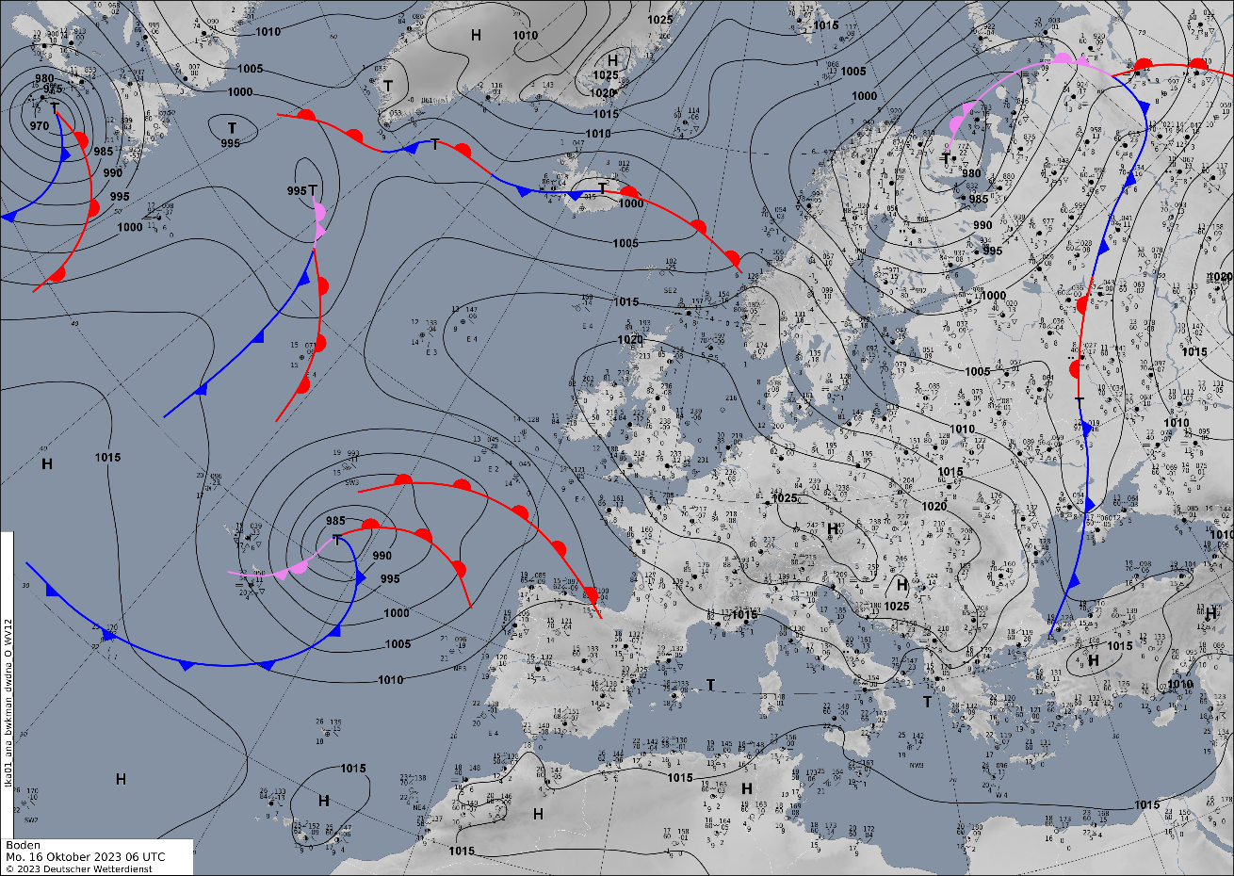
Title : [Norwegian type] – [16 Oct 2023 07:00 UTC]
Conceptual Model – Norwegian type
Weather hazards in this case
- strong wind and wind gust
- heavy rain
- different temperature wich related with frontal system
1
2023 Oct 16 07:00 UTC
Airmass RGB In the Airmass RGB image, the greenish colors in front of the cloud band represent warm air masses; the blue band represents cold air masses. Most often, such images show clouds Cumulonimbus (Cb).
1. Sinoptic map with frontal system on the cyclone
Diana Kryvobok, Ukrainian Hydrometeorological Center

Slide 12
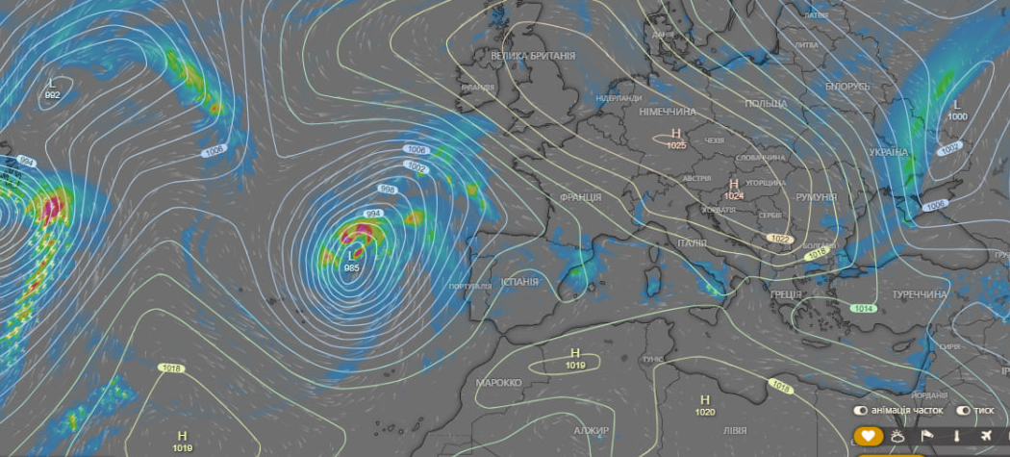
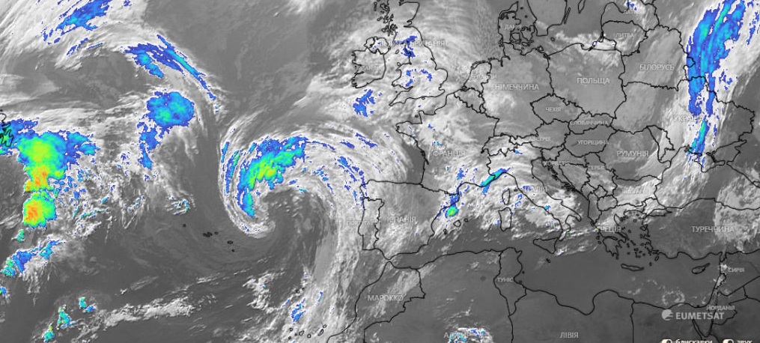
2
3
2023 Oct 16 07:00 UTC
Figure 2 NWP witch shows thunderstorms in a cyclone
3. INFRA+ satellite image
Diana Kryvobok, Ukrainian Hydrometeorological Center

Slide 13
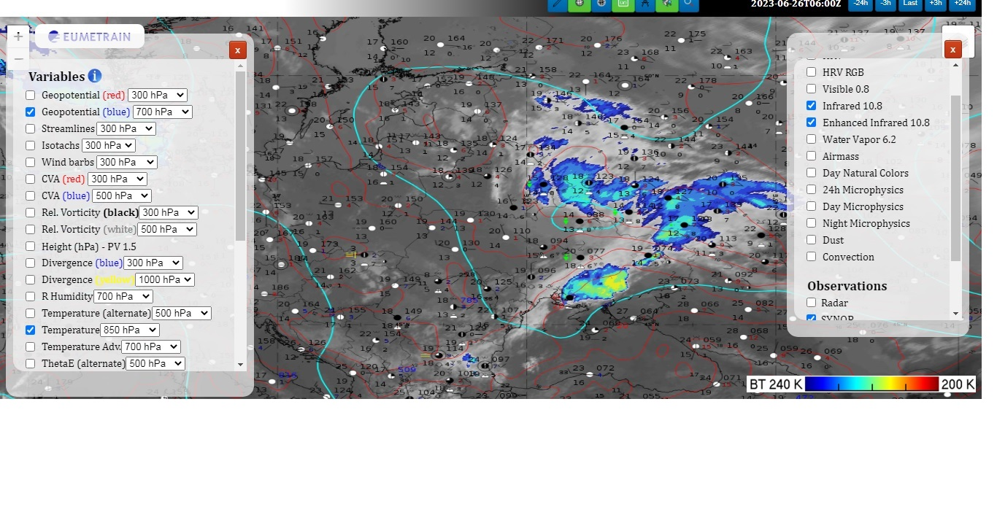
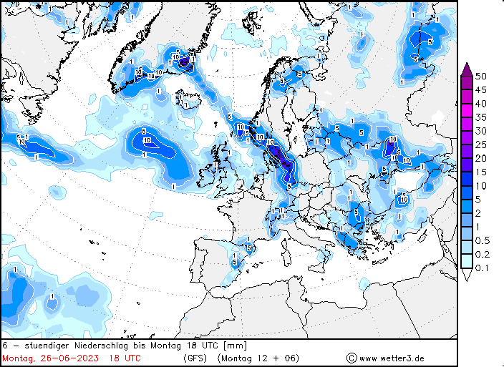
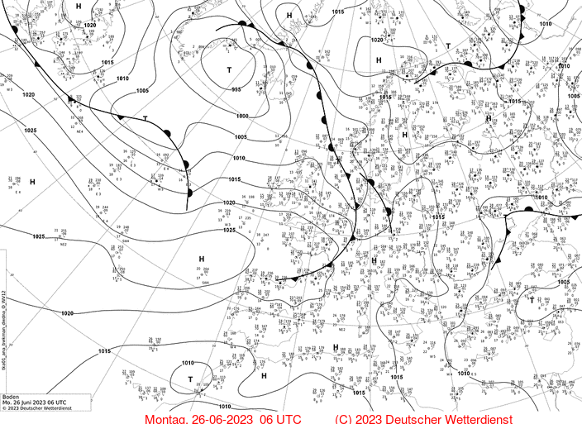
Front Wave – 26.06.2023
Convective phenomena: thunderstorms, hail, heavy showers.
Airmass and infrared imagines. Frontanalyse of DWD.
It was very havy convective phenomenas in south of Ukraine and it moved to east. Forecast of precipitation.
Serhii Mysnyk. Ukraine. UkrHMC

Slide 14
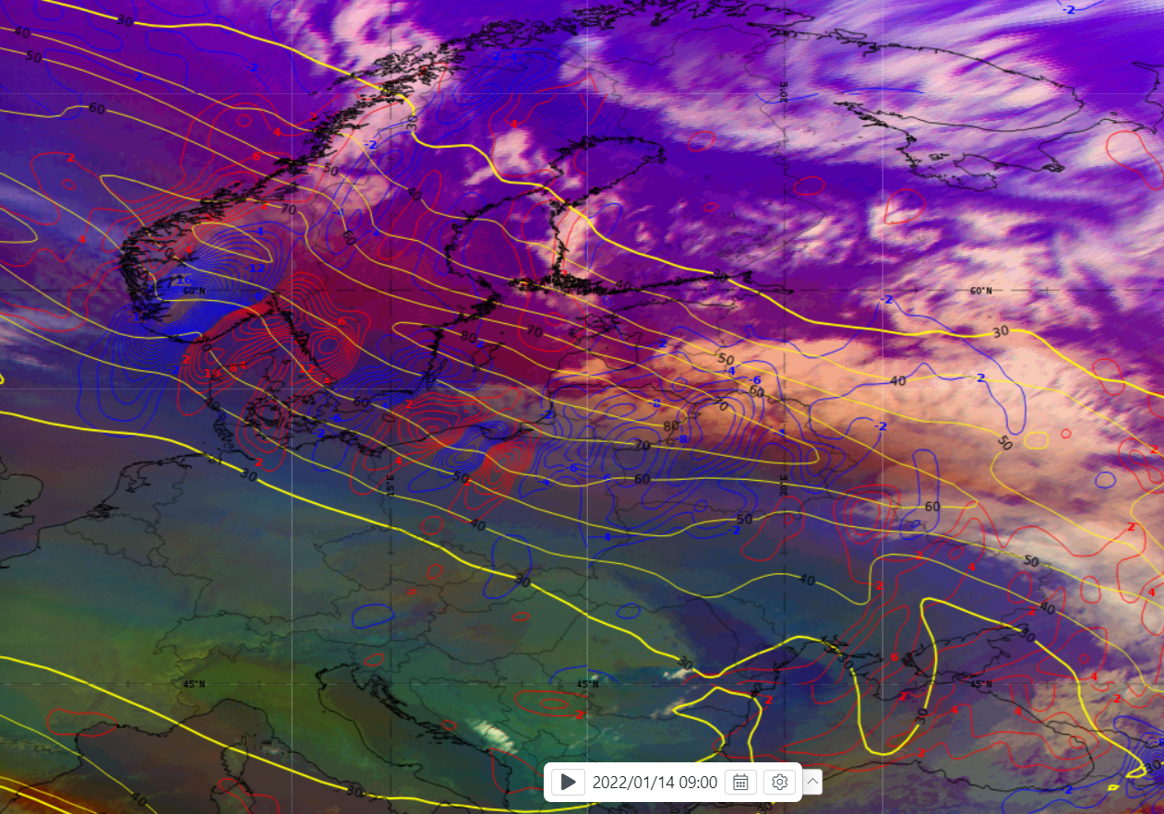
Cold Front (Ana type) Conceptual model – 2022.01.14 09 UTC
This Cold Front moving from north to south through Lithuania and creates fast moving convective squall line.
Consequences of this Cold front (Ana type):
Very strong (25-30 m/s), locally hurricane force winds (up to 35,5 m/s) was measured;
Thunderstorm, graupel was observed;
Trees downed, powerlines outages, significant damage to private and public infrastructure.
We can see Cold Front (Ana type) Conceptual model in these images over Lithuania (images above and on the right).
Airmass RGB, MSLP, Thickness 500-1000 hPa, TFP in image above; Airmass RGB, Isotachs 300 hPa, Temperature advection 700 hPa in image on the right.
There we can see:
dry stratospheric air intrusion (orange color) over and behind the frontal cloud band;
some TFP parameter patches in the front of the frontal cloud band;
crowding zone of equivalent thickness in the frontal cloud band;
strong jet, almost paralel to frontal cloud band orientation;
strong cold air advection in frontal cloud band.
Tadas Kantautas, LHMS, Lithuania

Slide 15
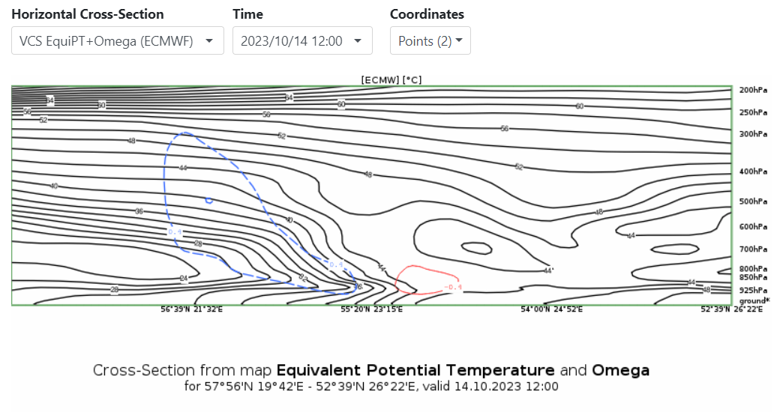
Cold front crossing Central/Eastern Europe – 14.10.2023
One of recent cases - cold front crossing Eastern/Central Europe
There was some squalls under the clouds and short-range heavy rainfall, but at least in Latvia there was not any significant damages
For omega parameter there is negative values with the frontal zone (red colour), but behind front there is positive values (blue colour)
14.10.2023.
Airmass RGB and ThetaE paramater 850hpa
JANIS KLEPERIS

Slide 17
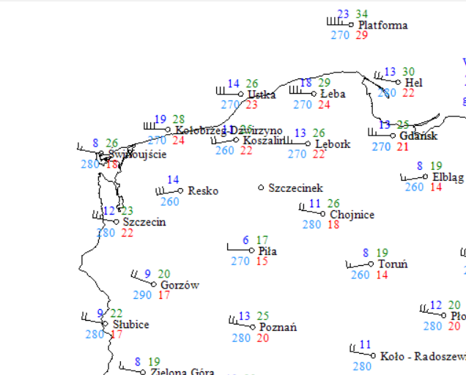
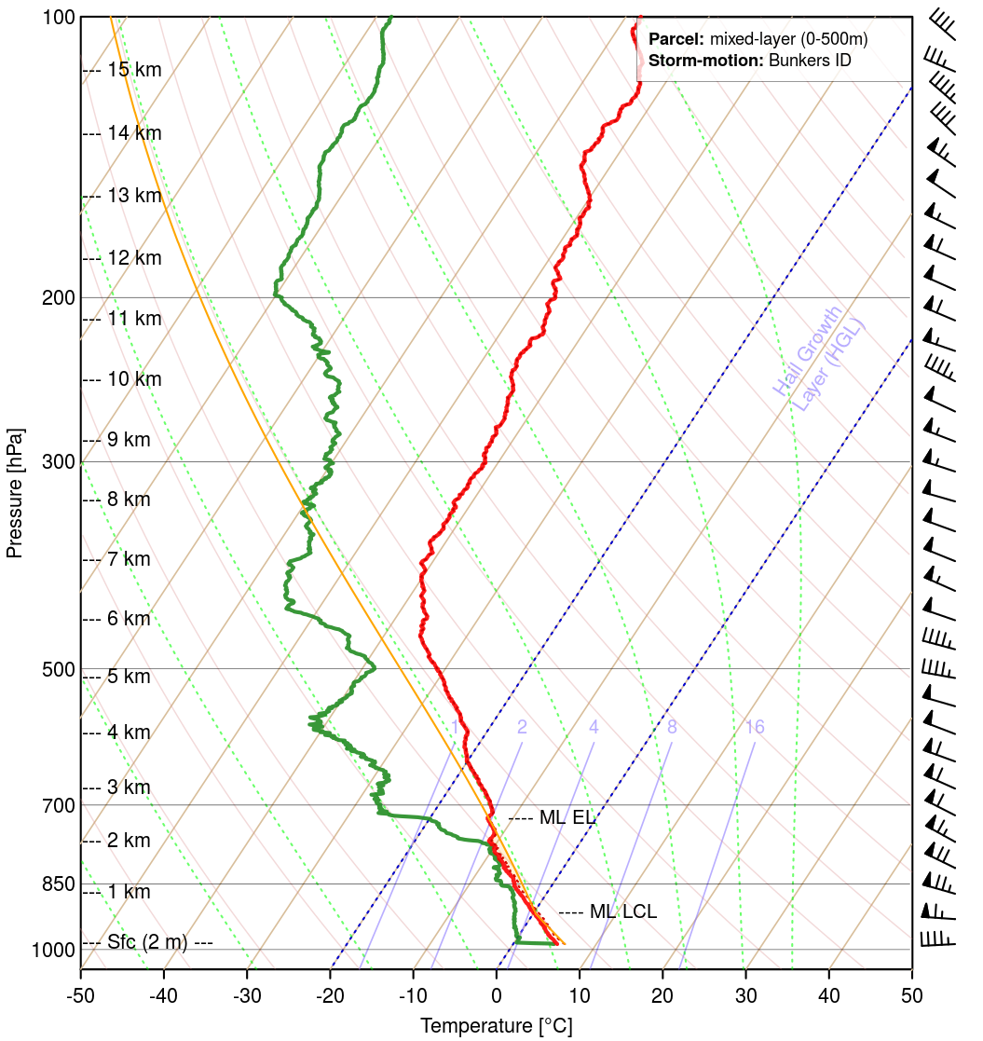
Rapid Cyclogenesis + Cold Front Conceptual Model 30.01.2022
ET Cyclone in mature stage with cold front stretching from Central Baltic to S Europe. Cold front visible as a white curved stripe with a darker edge behind it, which stands for cold and dry air advection. Eye of cyclon located over Central Baltic, visible as an wrapped darked and lighter strips, which are dry stratospheric air and hight clouds.
In this dynamic case strong wind gusts over Poland, Germany and Baltic States are possible as well as high waves oves S Baltic and even flooding in costal regions of Lithuania and Latvia due to strong western winds and sea level rise.
.
Wind gusts (green) in m/s
reaches and exceeds 30m/s even at night
Data from Polish stations IMGW
Satellite VW 6.2 µm + isotachs 300mb 30.01.2022
Intrusion of dry air appears on VW image as well as the strong jet stream on model isotachs- affecting weather over Central and E Europe. Cyclone eye and frontal structure well seen in VW image and also on the other satellite products.
Dry intrusion, low tropopause
Strong wind in whole profile
Air sounding from Łeba (Polish coast station)
Jakub Majchrzak, Institute of Meteorology and Water Management

Slide 18
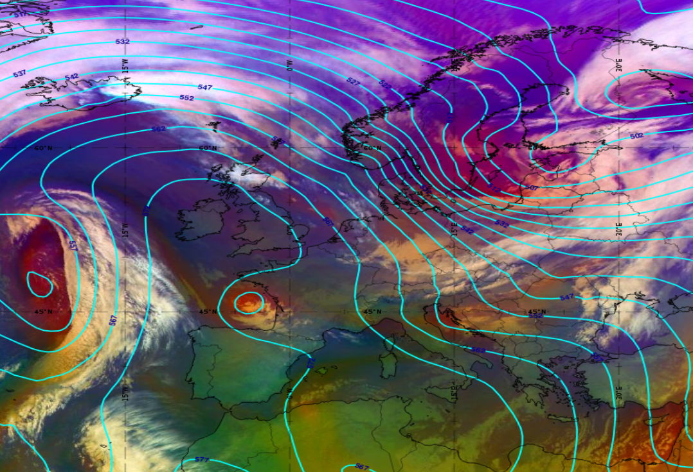
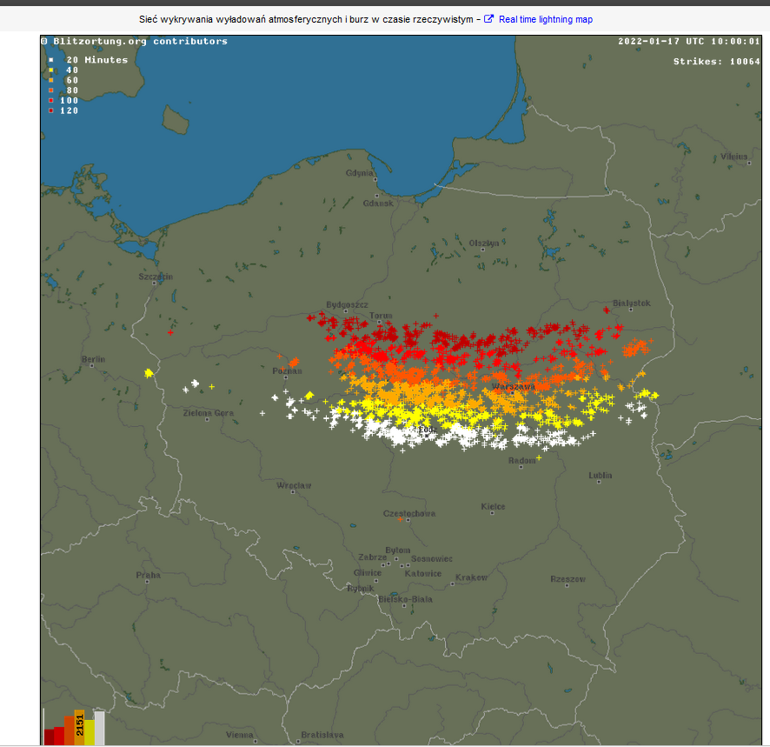
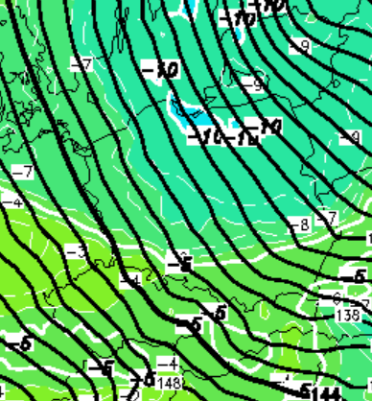
Active cold front – [17.01.2022 06:00 UTC]
The cold front in Poland drew cold and unstable air into Poland, wchich caused the strongest „winter” thunderstorms in polish history.
Strong and dynamic airflow in cyclone area was one of main storm-developing factors. Another one was thermal contrast between air masses, that is visible on 850 hPa temperature.
Airmass RGB + Geopotential 500 hPa:
- convenctive clouds in south-east Poland
- sharp pressure gradient
- dry and cool air behind front
- thunderstorms observed in Poland during the day
- snowfall, rainfall and graupel observed
Michał Kowalczuk, Institute of Meteorology and Water Management

Slide 19
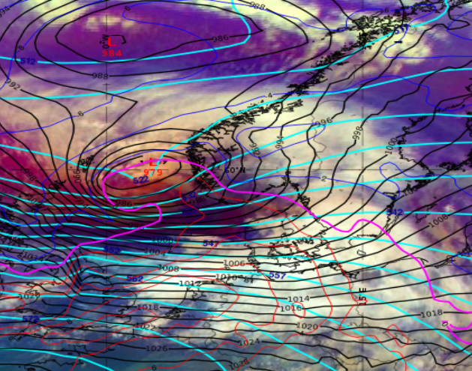
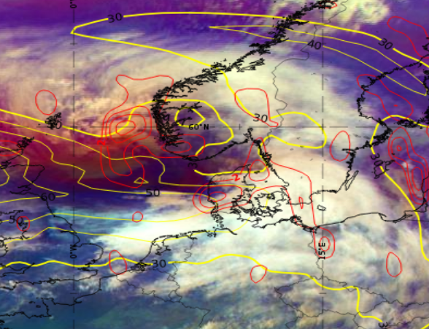
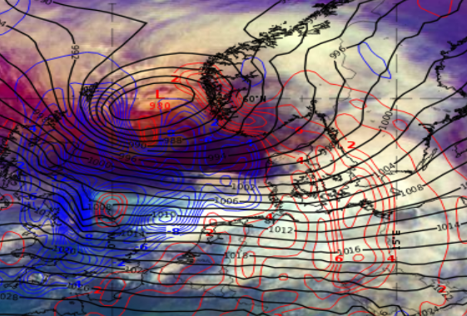
Shapiro-Keyser – 2023.02.17 09 UTC
Mature ET cyclone stage (Shapiro-Keyser Conceptual model) over Southwest of Norway
Wind gusts up to 40-45 m/s in open and Coastal areas
Above: Strong cyclonic vorticity advection (red) at jet level 300 hPA (yellow)
Right: Temperature advection at 850 hPa: cold air penetrates warm inflow that circulates around the low
Airmass RGB with 500hPa geopotential height (cyan), MSLP (black), Temperature at 850hPa
Upper-level trough in connection to deep surface low
Warm core inside cyclone centre
Saulius Šatas, LHMS, Lithuania

