Slide 1
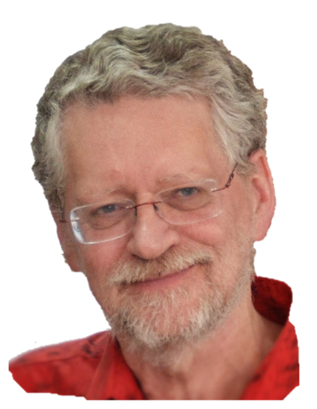
It’s all about
performance
change in
Ian Bell
iandbell@fastmail.fm
Ensure your speakers are turned on
1 November 2012

Slide 2
Plan for change
with a
Think-Do-Feel
Table
Ian Bell
iandbell@fastmail.fm
1 November 2012

Slide 3
Plan for change
with a
Think-Do-Feel
Table
Planning a presentation
Planning a training session
A submission or request

Slide 4
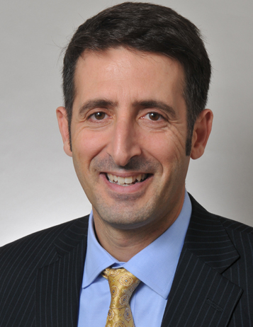
Adapted and expanded from:

Slide 5
Exercise: For a topic you teach or present
What is the topic?
What changes do you want to achieve as a result of your session?
How did you decide this?
Were you clear about all the changes you wanted?
Are they changes in performance?

Slide 6
One systematic approach is to
use a Think-Do-Feel table

Slide 7
Identify changes
you want to occur as a result of your session
What is the current status?
and where do we want them to be?
Now
After
Think
Do
Feel
Notes:
Identify where they are at now and where we want them to be

Slide 8
How do you
capture these ideas to aid in your planning?
Create a Think-do-feel table
Now
After
Think
Do
Feel
Notes:
Identify where they are at now and where we want them to be

Slide 9
Use a Think-Do-Feel Table to focus your planning on change
 | Now | After
Think | What do people think about this topic now? | What do you want them to think?
Do | What, if anything, they people do now? | What do you want them to do?
Feel | How do people feel about this training? | How do you want them to feel?
Notes:
Examples of “Feel” (motivation)
I don’t want to do this training
I know I should give up smoking/lose weight/work better but …
This is too hard …
I don’t really care about improving my work/what the clients want
I’m happy coasting on the “OK plateau”

Slide 10
The audience may have multiple starting points
 | Now* | After
Think | What do people think about this topic now? | What do you want them to think?
Do | What, if anything, they people do now? | What do you want them to do?
Feel | How do people feel about this training? | How do you want them to feel?
* Different learners may have different starting points
Notes:
Examples of “Feel” (motivation)
I don’t want to do this training
I know I should give up smoking/lose weight/work better but …
This is too hard …
I don’t really care about improving my work/what the clients want
I’m happy coasting on the “OK plateau”

Slide 11
Some (of many) possible examples
 | Now* | After
Think | I don’t know how to do this I think I can do this (but I can’t) It’s difficult, an art I’ve always done it this way This isn’t relevant for me | These ideas will help me in my work There is a systematic approach I can master this
Do | Nothing Do the wrong thing Do it the wrong way Do it but could improve | Apply the ideas – knowledge, procedures, decision making
Feel | No strong feelings Disengaged Apprehensive Resistant to change Strongly opposed Enthusiastic Overwhelmed | Motivated, keen to become proficient Confident Excited/enthusiastic Supported
* Different learners may have different starting points

Slide 12
Example: This session – Planning for change
 | Now* | After
Think | Teaching and presentations should concentrate on content I don’t know a simple way to plan for change | These ideas will help me in my planning There is a useful, systematic approach
Do | Don’t consider change when planning Consider changes but don’t have a systematic process | Apply the think-do-feel table when planning training and presentations
Feel | No strong feelings Frustrated that my sessions aren’t as effective as I would like | Keen to try I’m not sure if this works but I’ll give it a try
* Different learners may have different starting points

Slide 13
Create a Think-do-feel table for your topic
 | Now | After
Think
Do
Feel
Please share your results

Slide 14
Use the Think-Do-Feel Table to work out how to
bring about the change
 | Now | After
Think | What do people think about this topic now? | What do you want them to think?
Do | What, if anything, they people do now? | What do you want them to do?
Feel | How do people feel about this training? | How do you want them to feel?
Why do they think, act and feel this way?
What would make them change?
What is stopping them?
Notes:
Examples of “Feel” (motivation)
I don’t want to do this training
I know I should give up smoking/lose weight/work better but …
This is too hard …
I don’t really care about improving my work/what the clients want
I’m happy coasting on the “OK plateau”

Slide 15
How we can bring about the change
Why do they think and act this way?
That’s the way they have always seen it done
It’s a new idea
They don’t understand the need (or context)
It will mean more work for them
They tried it once and it didn’t work
What would make them change?
(What’s in it for them?)
Plenty of examples
A structured workshop to gain experience
Understanding the context or why it’s needed

Slide 16
Do this for your topic
Why do they think and act this way?
_____________________________________________
_____________________________________________
_____________________________________________
_________________________________________
_____________________________________________
_____________________________________________
What would make them change?
(What’s in it for them?)
What is stopping them from changing?

Slide 17
Please share your table
 | Now | After
Think
Do
Feel
Please share your table with the group and let us know if you find this to be a useful tool.
Why do they think and act this way? ______________________
What would make them change? _________________________
(What’s in it for them?)
What is stopping them from changing? ____________________
See the accompanying Examples PowerPoint and Word document

