Slide 1
It’s all about Performance
Tools for Trainers
Part 2: Learning and training environments
Ian Bell
2 November 2012
iandbell@fastmail.fm

Slide 2
A Learner’s
perspective

Slide 3
Student Centred Learning Framework
☺
Trainers
Stakeholders
☺
Workplace
Required performance
Learning experiences
People
Resources
Experts
Colleagues

Activities
Personal learning environment

Competencies – performance criteria
Current performance
Competencies – performance criteria
Infrastructure
Learning strategy
Course
Systems

Practice
☺
Learner

Assessment
Needs
Motivation
Preferences
Health
Personality
Habits
History:
- knowledge, skills, experiences
Culture
Self awareness
♥
Learning needs
Learning needs
Performance gap
Performance gap
Evaluate
Notes:
From a learner’s perspective

Slide 4
Student Centred Learning Framework
☺
Trainers
Stakeholders
☺
Workplace
Required performance
Learning experiences
People
Resources
Experts
Colleagues

Activities
Personal learning environment

Competencies – performance criteria
Current performance
Competencies – performance criteria
Infrastructure
Learning strategy
Course
Systems

Practice
☺
Learner

Assessment
Needs
Motivation
Preferences
Health
Personality
Habits
History:
- knowledge, skills, experiences
Culture
Self awareness
♥
Learning needs
Learning needs
Performance gap
Performance gap
Evaluate
Notes:
This slide was duplicated so that I could add some extra narration

Slide 5
An Instructor
or Trainer’s
perspective

Slide 6
Current performance
Trainer’s Role Supporting Learning
Plan, organise
Analyse
Create or select
Evaluate
Corporate learning environment
Deliver
Performance gap
Training needs
Training team
A D D I E*
Infrastructure
1 or more people

Assessment
Course
Systems

☺☺
Competency-based training objectives
Practice
Competency-based training objectives
Resources
Learning model
People

Learners
Trainers
Activities

Training activities
Required performance
☺
☺
Stakeholders
Learners
On-the-job performance
*ADDIE – Analyse, Design, Develop, Implement, Evaluate

Slide 7
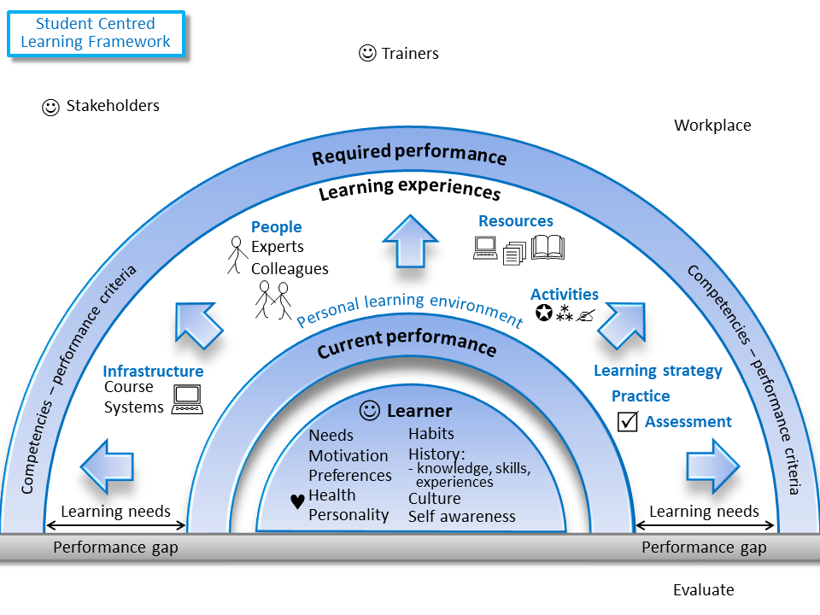
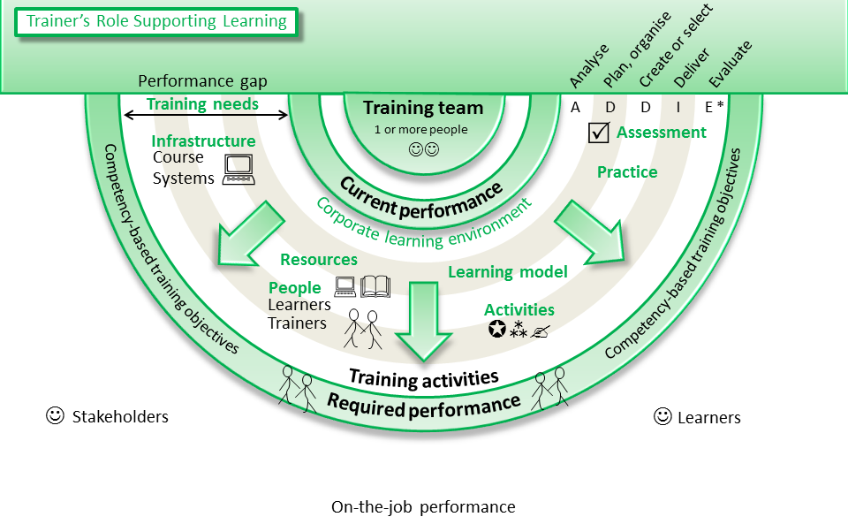
The trainer’s role is to support the learners

Slide 8
All learners

Slide 9
All learners

Slide 10
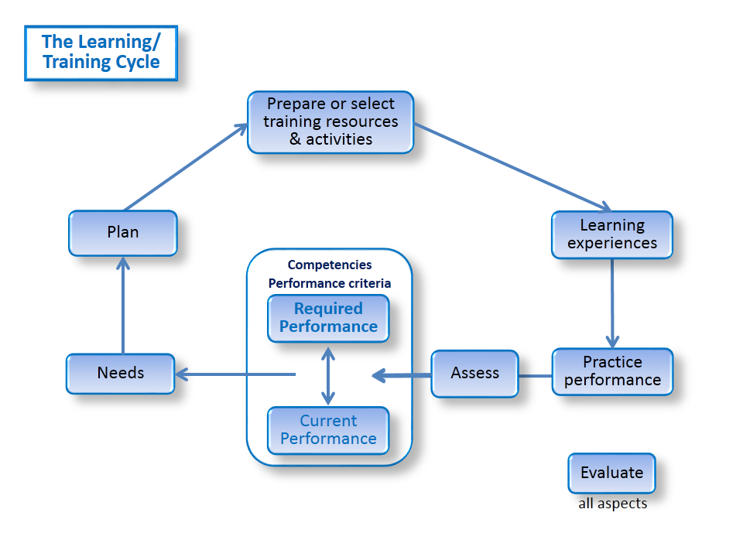
Focus on performance
Learner’s perspective
Consider the learning environment from learner’s and trainer’s perspectives
Trainer’s perspective

