Slide 1
LSA SAF Satellite Application Facility on Land Surface Analysis Carla Barroso

Slide 2
Land Surface Analysis SAF
LSA-SAF Main Objective
Satellite Products
Land Surfaces & Land-Atmosphere interactions
focusing primarily EUMETSAT satellites

Slide 3
LSA SAF Consortium
10 Institutions/ 8 Countries
IPMA (Portugal) – Leading Institution
MF (France)
RMI (Belgium)
IDL (Univ Lisbon)
KCL (King’s College London)
KIT (Karlsruhe Inst Technology)
UV (Univ Valencia)
VITO (Flemish Inst Technological Res)
ARSO (Slovenian Env Agency)
NIMH (Bulgarian Inst Met and Hyd)
IPMAHost
Distributed Product Development & Validation: All
Data Production, Archiving & Dissemination: IPMA, VITO

Slide 4
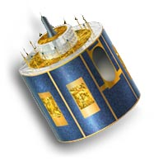
LSA SAF Portfolio - MSG
Surface Radiation Budget
Vegetation State
DSSF
↓Surface Short-wave Flux
DSLF
↓Surface Long-wave Flux
Fraction Vegetation Cover
LST
Land Surface Temperature
ALBEDO
fAPAR
LAI
LSE
Land Surface Emissivity
Wild Fires
Water Stress
Fire Detection
Fire Risk Map
Evapotranspiration
Fire Radiative Power
Reference Evapotranspiration

Slide 5
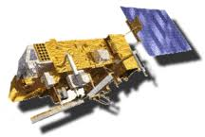
LSA SAF Portfolio - Metop
Surface Radiation Budget
Vegetation State
Fraction Vegetation Cover
LST
Land Surface Temperature
ALBEDO
fAPAR
LAI
LSE
Land Surface Emissivity
NDVI
Wild Fires
Water Stress
Fire Detection
Fire Risk Map
Fire Radiative Power

Slide 6
Land Surface Analysis SAF
LSA-SAF products generation
Near real time
Data records (2004-2015)
MSG Land Surface Temperature
MSG Fire Radiative Power
MSG Daily & 10-day Surface Albedo
MSG Daily & 10-day Fraction of Vegetation Cover
MSG Daily & 10-day Leaf Area Index
MSG Daily & 10-day Fraction of Photosynthetic Active Radiation
Normalized Difference Vegetation Index CDR since 2008

Slide 7
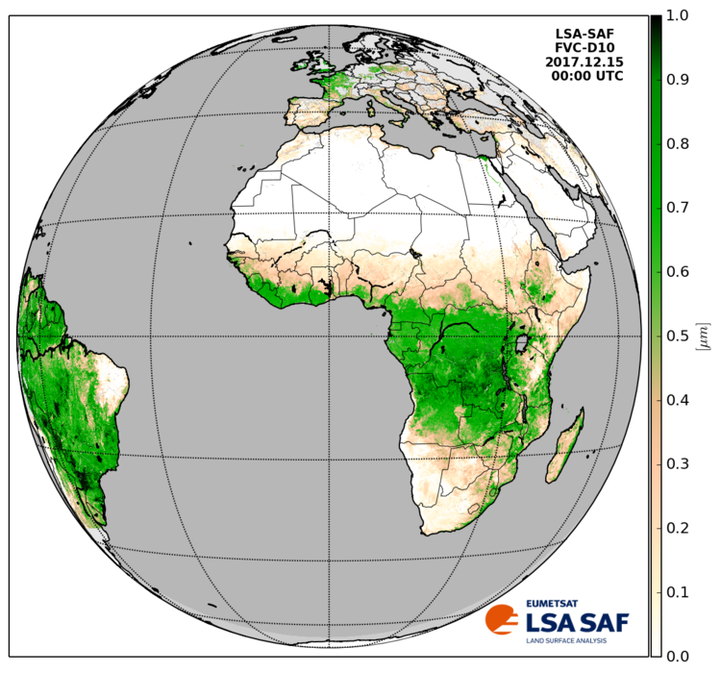
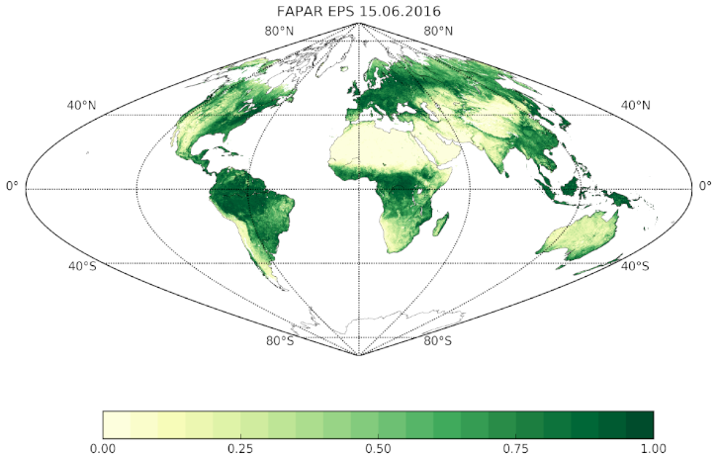
Land Surface Analysis SAF
LSA-SAF products data characteristics
MSG derived products: Geostationary projection
Metop derived products: Sinusoidal projection (~1 Km x 1 Km)
Data Format: HDF5
http://lsa-saf.eumetsat.int

