Slide 1
LSA SAF data for African Applications Carla Barroso & Célia Gouveia

Slide 2
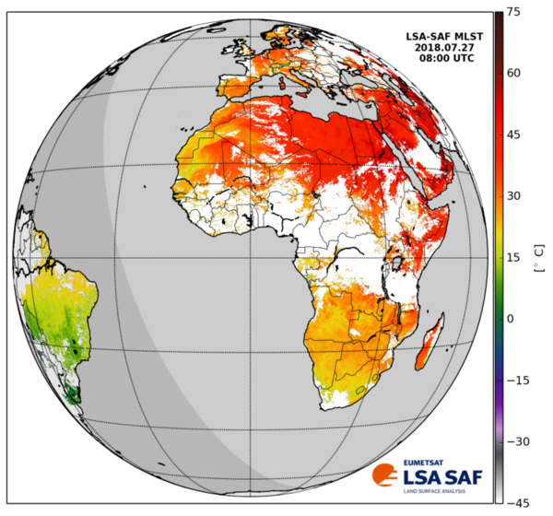
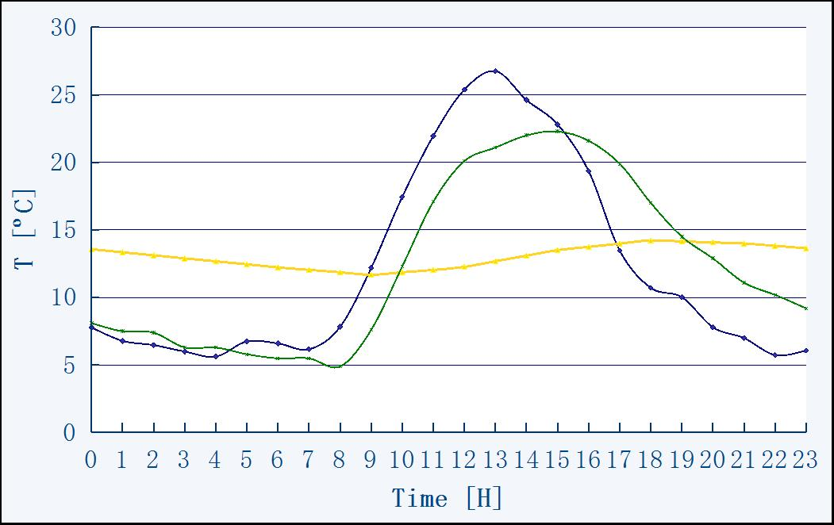
LAND SURFACE TEMPERATURE - LST
Land Surface Temperature (LST) is the radiative skin temperature over land.
LST ≠ Tair ≠ Tsoil
LST retrieval - based on clear-sky measurements from MSG system in the thermal infrared window (MSG/SEVIRI channels IR10.8 and IR12.0)
Available ≥ 2004
Frequency: 15 min.
To learn more about LST:
Introduction to LST Tutorial @eumetrain.org
LST Applications @eumetrain.org
All information about LSA SAF MSGLST Product@LSASAFWebsite

Slide 3
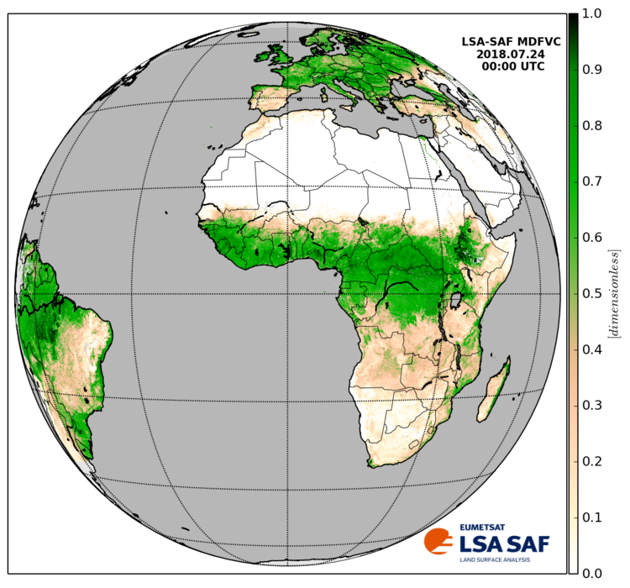
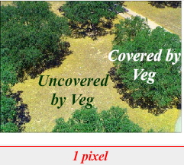
FRACTIONAL VEGETATION COVER – FVC
FVC accounts for the amount of vegetation distributed on a flat background
FVC retrieval – uses surface reflectance information from MSG SEVIRI channels 0.6 μm, 0.8 μm &1.6 μm
Frequency: Daily & 10-days
Available ≥ 2004
To learn more about FVC:
LSA SAF Vegetation Module@eumetrain.org
Applications @eumetrain.org
All information about LSA SAF MSGFVC Product@LSASAFWebsite

Slide 4
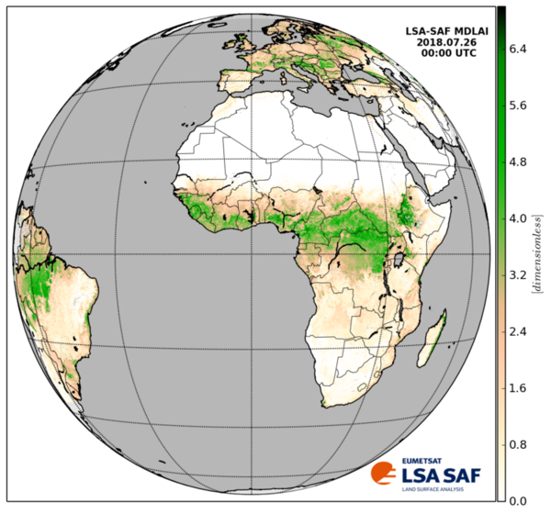
LEAF AREA INDEX - LAI
LAI provides complementary information to the FVC, accounting for the surface of leaves contained in a vertical column normalized by its cross-sectional area. It defines thus the area of green vegetation that interacts with solar radiation determining the remote sensing signal, and represents the size of the interface between the vegetation canopy and the atmosphere for energy and mass exchanges.
LAI retrieval – uses surface reflectance information from MSG SEVIRI channels 0.6 μm, 0.8 μm &1.6 μm
Frequency: Daily & 10-days
Available ≥ 2004
To learn more about LAI:
LSA SAF Vegetation Module@eumetrain.org
Applications @eumetrain.org
All information about LSA SAF MSGLAI Product@LSASAFWebsite

Slide 5
FRACTION OF ABSORBED PHOTOSYNTHETIC ACTIVE RADIATION - fAPAR
fAPAR represents the fraction of incoming solar radiation in the photosynthetically active radiation (PAR*) spectral range (0.4 - 0.7 μm) that is absorbed by the green parts of the canopy.
*The intercepted PAR is the energy enabling the biochemical productivity processes of plants.
A deficit in soil moisture will prevent the normal radiation interception by the plant leaves, thus a decrease in fAPAR.
fAPAR retrieval –The product is based on MSG SEVIRI channels 0.6 µm and 0.8 µm.
Frequency: Daily & 10-days
Available ≥ 2004
To learn more about fAPAR:
LSA SAF Vegetation Module@eumetrain.org
Applications @eumetrain.org
All information about LSA SAF MSGfAPAR Product@LSASAFWebsite

Slide 6
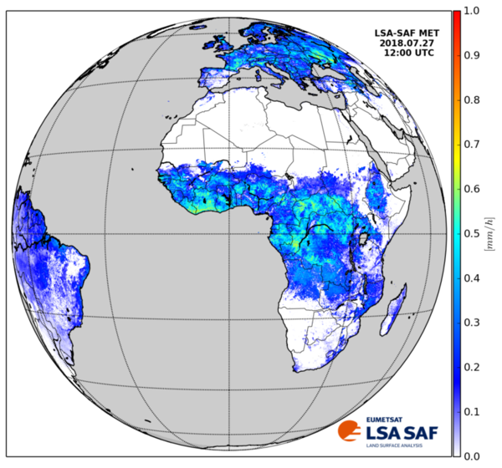
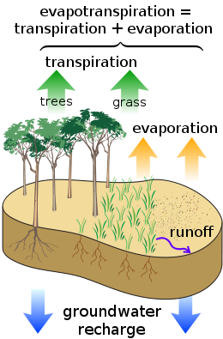
EVAPOTRANSPIRATION – ET
ET accounts for the flux of water evaporated at the Earth-atmosphere interface (soil + vegetation + water bodies) and transpired by vegetation through stomata in its leaves as a consequence of photosynthetic processes.
Frequency: 30 min. & Daily
Available ≥ 2005 (30 min.) & ≥ Dec 2010 (Daily)
To learn more about ET:
All information about LSA SAF MSGET Product@LSASAFWebsite
For ET applications read the next slides

Slide 7
CLARIFICATION OF CONCEPTS
Natural Evapotranspiration (ET)
= Actual evapotranspiration (AET)
= Real evapotranspiration (ETR)
Evaporation of natural surfaces + plant transpiration
Potential Evapotranspiration (PET)
Maximum evapotranspiration for a given climate and continuous vegetated surface (no hydric stress)

Slide 8
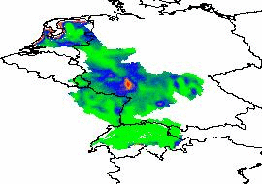
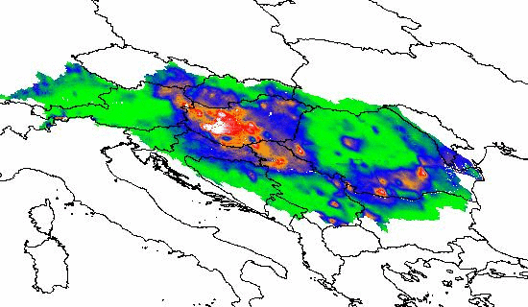
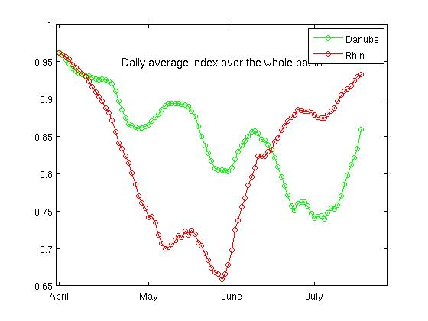
SPRING 2011
AET
Meteorological drought
Europe, Spring 2011
Drought index (%) =
PET
Danube river basin
Rhin river basin

Slide 9
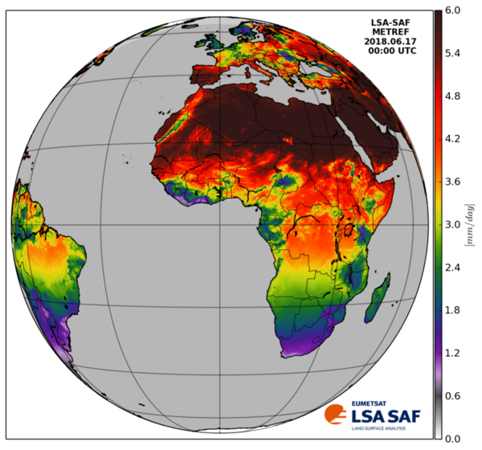
REFERENCE EVAPOTRANSPIRATION – ETREF
Reference evapotranspiration, ETREF, is the evapotranspiration rate from a clearly defined reference surface.
The concept was introduced to allow the estimation of the evaporative demand of the atmosphere independently of crop type, crop development or management practices.
Frequency: Daily
Available ≥ August 2006
To learn more about ETREF:
All information about LSA SAF MSGET Product@LSASAFWebsite

