Slide 2
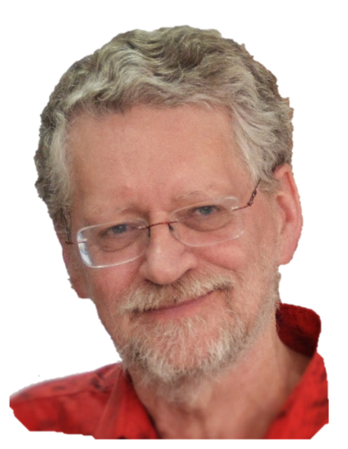
Plan for change
with a
Think-Do-Feel
Table
Planning a presentation
Planning a training session
A submission or request
Ian Bell
iandbell@fastmail.fm

Slide 3
CALMet Online 2014 Think-Do-Feel Table
 | Now | After
Think | What do people think about CALMet Online now? | What do we want them to think?
Do | What, if anything, do they do now? | What do you want them to do?
Feel | How do people feel about this event? | How do you want them to feel?
Notes:
Examples of “Feel” (motivation)
I don’t want to do this training
I know I should give up smoking/lose weight/work better but …
This is too hard …
I don’t really care about improving my work/what the clients want
I’m happy coasting on the “OK plateau”

Slide 4
Think-Do-Feel Table - Planning for Change
 | Now | After
Think | "Yet another online event." "The topics are not very relevant to me." "The format is not appealing." "This event stay similar each year" "As the expert in the field, no chance to have my expertise improved, no new approach could be learnt. " "This event no longer fit for me, no longer my arena" | "It is an online event that will help me in my job." "It will connect me with other people struggling with same problems." "It will be attractive and easy to join without any costs. " "It will be a great chance to meet old colleagues and acquainted and welcome some new colleagues"

Slide 5
Think-Do-Feel Table - Planning for Change
 | Now | After
Do | Listen passively to some session. Make note of the event, but not actively try to join it. | Enthusiastically register and be hungry for more information. Send wishes about topics we want to learn more. Apply and take into use the materials and new applications we have seen and tried during the event. Contribute actively in giving feedbacks, advises and more than that, share expertises which could inspire others to apply the lesson learned. Find opportunity to mapping new persons attended that potentially to be involved as the local expert in the recent activities/projects

Slide 6
Think-Do-Feel Table - Planning for Change
 | Now | After
Feel | Feel indifferent. Feel unmotivated. Feel powerless to make the event worthwhile to attend. Feel bored. | Empowered and enthusiastic about training. Feel being a part of a community and not lonely. Feel refreshed after the session.

