Slide 1
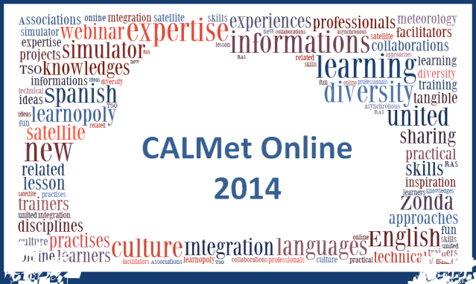
CALMet Online 2014
Vesa Nietosvaara (EUMETSAT)
Roro Yuliana Purwanti (BMKG)

Slide 2




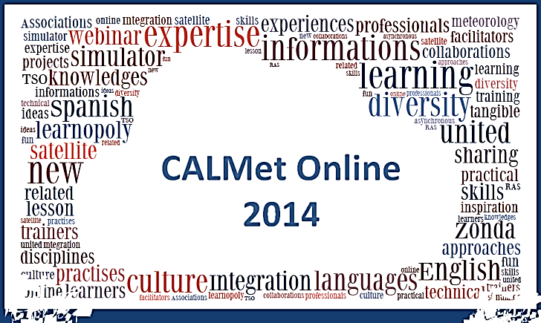
CALMet in brief
Notes:
Beginning in 2010, CALMet Online is conducted to filling the gap between two CALMet Conferences and to provide opportunity for participants who can not attend the face-to-face symposium

Slide 3

CALMet Working Group
Co-Chair: Heleen ter Pelkwijk (KNMI)
Co-Chair: Patrick Parrish (WMO)
Program Committee Co-Chair: Bruce Muller (UCAR/COMET)
Ian Bell (Australian Bureau of Meteorology-retired)
Laurent Borrell (MeteoFrance)
Roger Deslandes (Australian Bureau of Meteorology)
Ednaldo Oliveira Dos Santos (UNEMET Brasil)
Liesl Dyson (University of Pretoria)
Hamidou Hama (EAMAC)
Mark Higgins (EUMETSAT)
Wilfried Jacobs (DeutscherWetterdienst)
Vibeke Kristensen (Norwegian Meteorological Institute)
Vesa Nietosvaara (EUMETSAT)
Eduard Podgayskiy (Russian State Hydrometeorological University)
Roro Yuliana Purwanti (BMKG)
Graciela Angela Rolon (Servicio Meteorologico Nacional Argentina)
Luciane Veeck (WMO-CGMS Virtual Lab)
Maja Kuna (EUMETSAT)
Bernadette Connell (CIRA)
Notes:
As to support the CALMet activities, there is CALMet Working Group. But for CALMet Online 2014, there is a sub-working group established and consists of 9 personnels from all over the world and come from some institutions.

Slide 4

About the Event
Goal and Objectives
To demonstrate a variety of online learning approaches and try new things
Dates
Event : October – November 2014 (8 weeks)
Number of Activities/ Themes/ Groups : 6
Duration/ activity : 1-3 weeks (intro, activities, discussion)
Target Participants & Contributors
Worldwide contributions , groups of each WMO RA
Global audience, but addressed as well the regional interest.
Format
Asynchronous mode (time zone and technology issue),
A few live sessions (Kick-off, Closing, possible regional discussions)
Technology
EUMETSAT Moodle available for activities and communication,
CALMet Commons as launch site and for post-event discussions.
Instead of live meetings, video and audio clips will be used.

Slide 5

CALMet Online 2014
http://www.calmet.org/p/calmet-online-2014.html

Slide 6
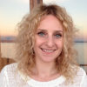
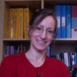

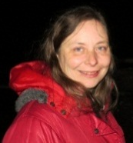

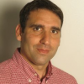
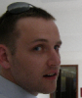
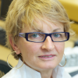
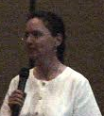
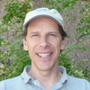
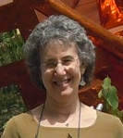


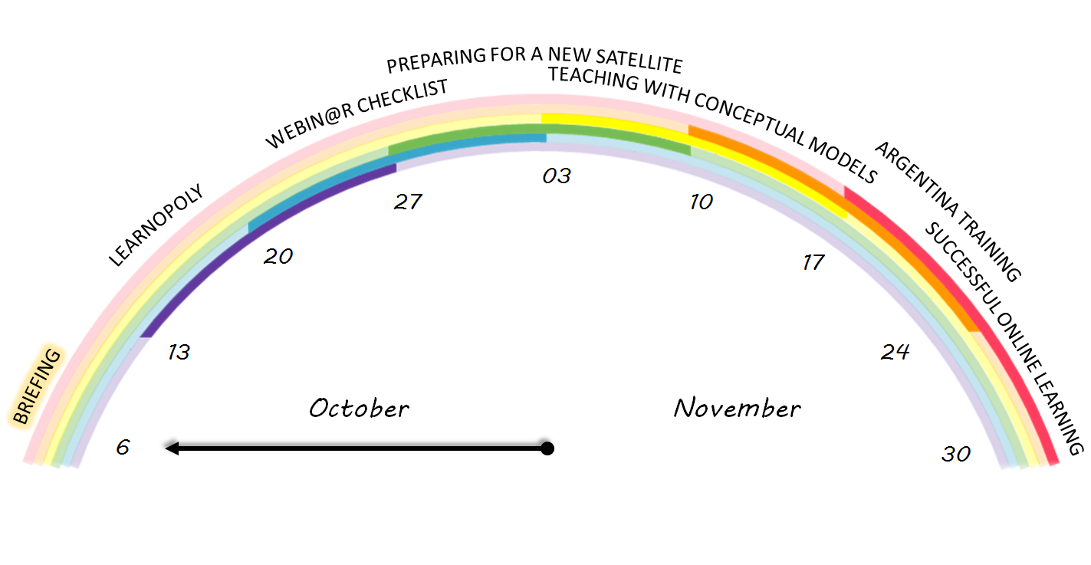
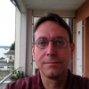


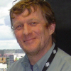
Contributors
Lorena
Lorena
Marianne
Graciella
Ana
Diverse in Culture – United in Learning

Slide 7
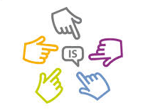
Sessions
Briefing. Sarah Kimani (IMTR).
Learnopoly. Patrick Parrish (WMO) and Maja Kuna (EUMETSAT).
Webin@r Checklist. Maja Kuna (EUMETSAT), Luciane Veeck (VLab), Anna Ghelli (ECMWF), Ivan Smiljanic (EUMeTrain), Alessandro Chiariello (EUMETCAL).
Preparing for a new satellite: new and old challenges mixed with opportunities. Bernadette Connell (CIRA).
Teaching with Conceptual Models. Marianne Weingroff (COMET) and Bruce Muller (COMET).
Experience Zonda: an example of a Conceptual Model applied on a simulator - Experiencia Zonda: ejemplo de Modelos Conceptuales aplicando Simuladores. Graciela Rolón (Servicio Meteorológico Nacional - Argentina).
Experience in Distance Learning in Meteorology - Experiencias en Enseñanza a Distancia. Moira Doyle, Elizabeth Castañeda, Leonor Bonan, Lorena Gonzalez and Ana Pittaro (Department of Atmospheric and Oceanic Sciences of the University of Buenos Aires).
Succesful Online Learning : what strategies do we need? Roger Deslandes and Bodo Zeschke (Bureau of Meteorology, Australia).

Slide 8


