Slide 1
Russian Federation Regional Focus Group (2013-2014)
Larisa Nikitina
Aviamettelecom of Roshydromet,
Russian Federation

Slide 2
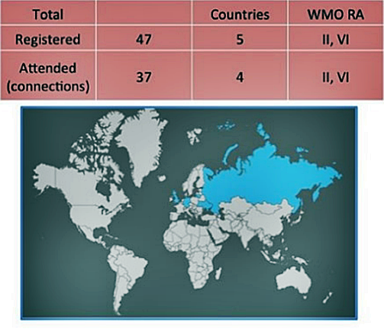
Russian Federation VLab June 5, 2013 Virtual Round Table on Aeronautical Meteorological Competences
http://www.wmo-sat.info/vlab/virtual-table/

Slide 3
Resume on the Russian Virtual Round Table on AMP Competences
1. Was this event interesting for you? Have you received any new and useful info?

Slide 4
Resume on the Russian Virtual Round Table on AMP Competences
1. Was this event interesting for you? Have you received any new and useful info?
2. Please rate the session on the following criteria:

Slide 5
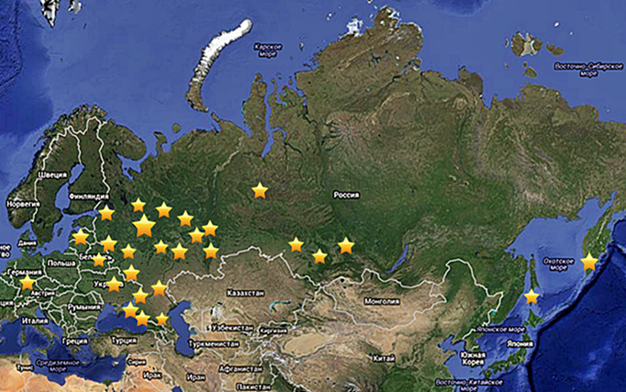
Russian Federation VLab July 12, 2013 The first Russian RFG meeting
Around 100 people in 60 connections.
3 countries – Russia, Ukraine, Belarus (WMO RA IV)

Slide 6
The summary of the first Russian RFG meeting
1. Will it be interesting for you to continue that format of RFG meetings?

Slide 7
The summary of the first Russian RFG meeting
1. Will it be interesting for you to continue that format of RFG meetings?
2. Please let us know what new information would you like to discuss during the meetings (briefly)?

Slide 8
June 12, 2014 The 9 international EUMETCAL Workshop Russian language on-line session “Meteorological Competency and Learning Solutions”
35 people insitu and on-line.
7 countries – Russia, Ukraine, Georgia, Kazakhstan, Azerbadzan, Lithuania, Estonia.

Slide 9
Resume on the Russian language session
1. Was this session informative interesting? Have you got any interesting or useful information?

Slide 10
Resume on the Russian language session
1. Was this session informative interesting? Have you got any interesting or useful information?
2. Here you can write any comments regarding the session:
Thank you for the informative session. I`ve learned about webinars, links to sites with trainings and tests.
I would like to participate in the following sessions.
Was useful to know about the education at the University via internet, the Information about the experience of creating system of the distant training at RSHU.
I hope there will be more and more sessions like that one.

Slide 11
Need for the e-learning:
Russian geographical distance (1\6 part of world landscape);
Collaboration between professionals (more then 2000 forecasters);
Centrally collected training resources (libraries) in Russian language;
New products and techniques short time delivery;
E-learning save time and money.

Slide 12
Challenges and perspectives:
Challenges:
Internet connection and technical problems;
Different local time (9 and 11 times zones);
Hard to find free time to join (especially when on shift);
Missing the real contact and talks with other colleagues and trainers.
Perspectives:
Methodological Council;
On-line meetings of MG;
On-line briefings of RFG.

Slide 13
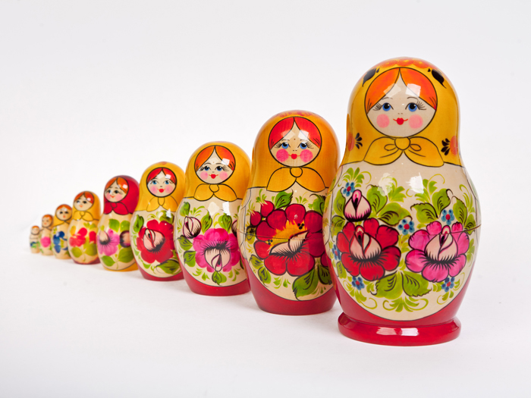
Thank you for your attention! Спасибо!
Russian meteorologists go on line!

