Slide 1
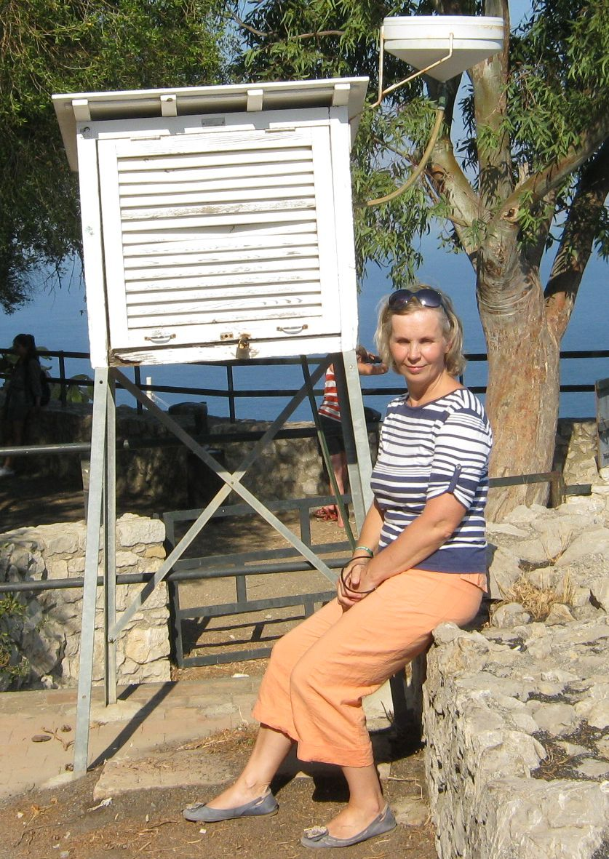
My thoughts and experience on Conceptual Models
Izolda Marcinonienė
LHMS

Slide 2
Introduction to CM world
Mini course on CM using SatRep material (http://www.eumetrain.org/satmanu/SatManu/main.htm)
Fellowship on CM at ZAMG (Austria)
Eumetcal blended courses (a participant)

Slide 3
Benefit and usage of CM
Better understanding of atmospheric process:
How the event will develop
Evident help in forecasting
Very useful for analysis of severe storms (after the event)
Helps to keep relationship between meteorologists and scientists:
Eumetcal blended courses (a presenter)
Creation of simulator (hazardous weather phenomena
developement)

