Slide 1
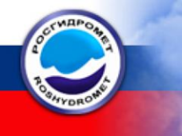
Start of Russian
Regional Focus Group
Russian meteorologists go online
Larisa Nikitina
Roshydromet, Russia
Toulouse, August 2013
Notes:
I am Larisa Nikitina, the Chief of Forecast Verification and Methodological group, “Aviamettelecom of Roshydromet” (Russian civil aviation weather service).
12 July 2013 Russian Virtual Laboratory started the first on-line session of Russian Regional Focus group.
In this presentation I will try to tell why it was so important and what benefits and challenges we`ve got so far.

Slide 2
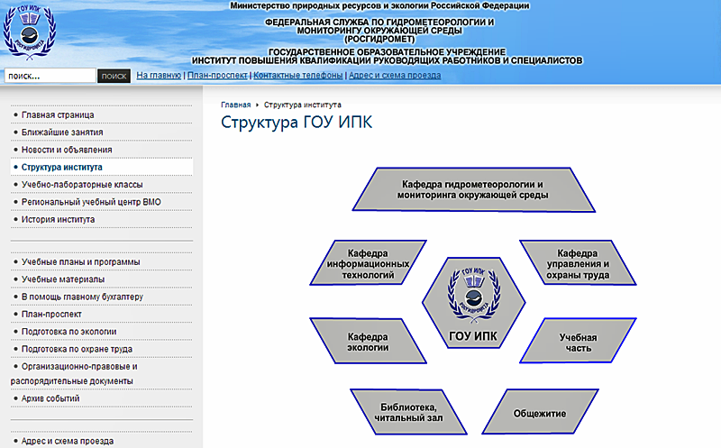
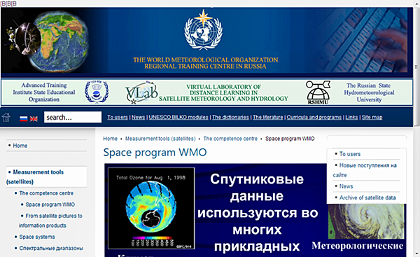
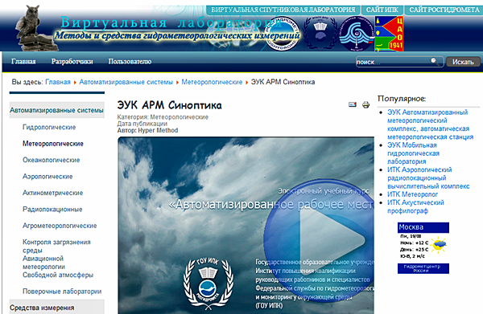
REGIONAL BACKGROUND:
Roshydromet corporate training
Russian Vlabs:
Distance learning in Satellite
Meteorology and Hydrology
Advanced Training Institute (ATI)
+
Equipment and Measurements
in Hydrometeorology
Notes:
The current system of Roshydromet specialists' corporate training and professional development is based on single institution, Roshydromet Advanced Training Institute (ATI), that is in Moscow and still planes 5 Regional Training Centres (RTCs) working under ATI supervision. Together with the on-line training materials of the Russian Vlab for satellite meteorology education and training and the newly developed Vlab of modern meteorological equipment it forms Russian professional training resources.
In the era of ever increasing information and new forecasting technics, the need for re-trained specialists grows up, and now it becomes clear that the existing Russian professional training system is needed to be enhanced somehow.
1.ATI annual training capacity is about 800 specialists per year – not only forecasters and meteorologists but also the technicians and the management/administration staff.
2. Almost all meteorologists in Russia are geographically dispersed and cant be easily get together in one place for classroom studies.
Obviously we need a new training approaches.

Slide 3
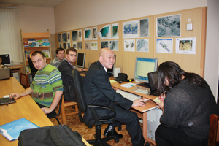
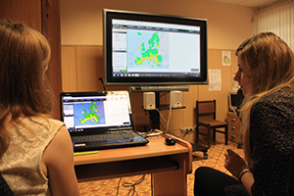
We need a New Training Approach
vs
?
ATI classroom course
RFG weather briefing
Maximum use of Internet:
Russian geography;
Centrally collected training resources (libraries);
New products and technics short time delivery;
Collaboration between professionals;
E-learning save time and money.
Notes:
Traditionally, ATI activities are carried out via classroom courses. Now the focus is more on web content, e-learning, “blended learning” courses, with the maximum use of Internet because:
All Russian regions can be easily reached via the Internet or other desistance learning schemes to share and improve knowledge;
A lot of elements from centrally collected training resources (libraries) can be integrated into courses by trainers and used by trainees;
Within a short time interval the new products and technics (e.g. NWP, satellite) can be delivered.
Online discussions and Internet based ‘weather briefings’ can play a very important role in collaboration between professionals. It is the easiest and fastest way to know the working experiences of the other colleagues;
E-learning courses (based upon large virtual classrooms) can be accessed by more persons, recorded and re-used, so that training become more cost effective, can save time and money.

Slide 4
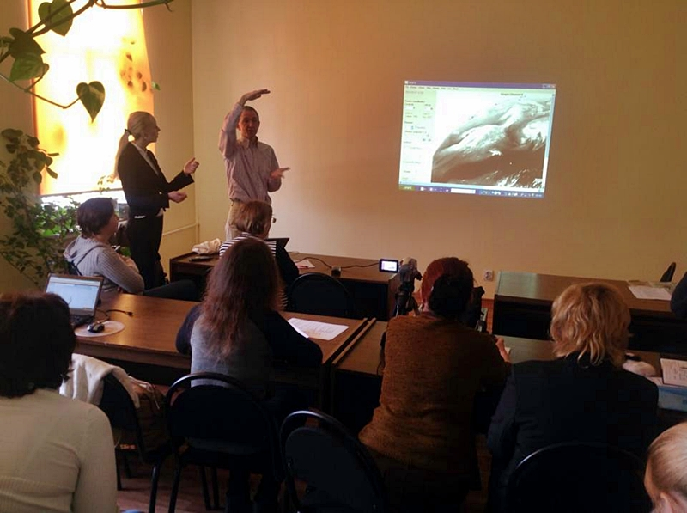
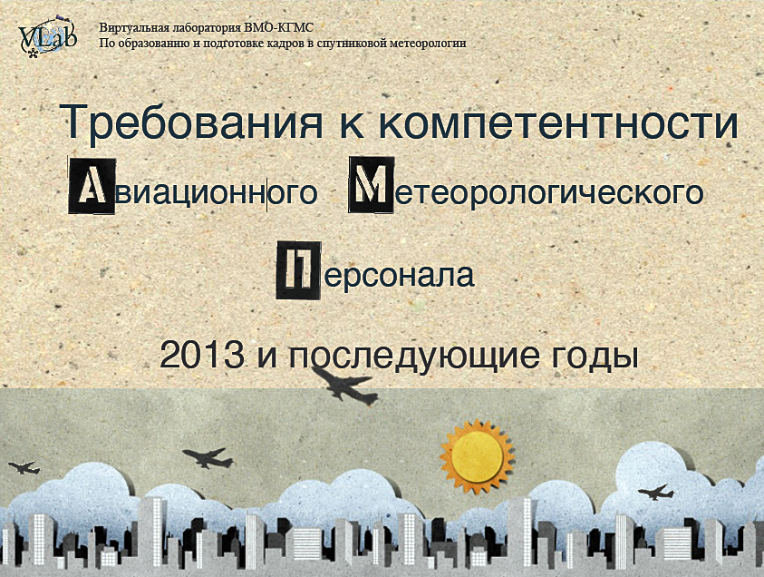
We were inspired by these events:
“Using Satellite Products in Meteorology and Oceanography”,
April 1-6, 2013, Kaliningrad
Virtual Round Table on WMO Aeronautical Meteorological Competences,
Russian VLab, July 5, 2013
Notes:
For Russian region who has not yet on-line meetings, the number of very positive developments took place this year.
Firstly, the face-to-face training event “Using Satellite Products in Meteorology and Oceanography” has been organized jointly by the Roshydromet Advanced Training Institute, the Russian State Hydrometeorological University (VLab CoEs in Russia) and hosted by Immanuel Kant Baltic Federal University (BFU) in Kaliningrad on April 1-6, 2013. EUMETSAT took active part in the event, contributing with lecturers. The course has been attended by more than 20 participants from few Russian cities, from Estonia and Uzbekistan.
It was there when Russian specialists were introduced to the VLab RFG concept, and some off-class discussions led them to think of organizing a similar event in Russian language. But there still were some doubts - would Russian meteorologists be ready to use the web-conferencing system?
The answer was given when VLab initiated the sequence of Virtual Round Table Events on WMO Aeronautical Meteorological Competences, including the discussion in Russian language. The event took place online on June 5 and had 37 connections from 4 countries.
The event was very well accepted by Russian forecasters who were happy to get support from WMO and share their opinion on the issue. Now after successful Russian Virtual Table people got ready for such events, they have learned the format of web-conferences and were interested to continue the discussions and virtual meetings.

Slide 5
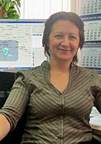
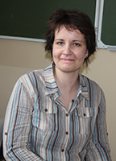
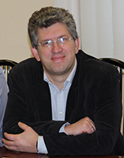
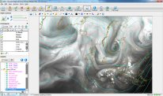
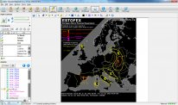
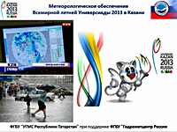
The first Russian RFG meeting 12 July 2013:
Larisa Nikitina
Kristina Petraityte
Eduard Podgaiskii
Screenshots
Notes:
Following the success of the first online meeting, Russian CoE teamed up with specialists from Aviamettelecom and EUMETSAT organized the first Russian RFG meeting, which took place on 12 July 2013 and had more than 60 connections from all over Russia, Ukraine and Belarus.
The first RFG meeting was more a trail and organization session, as it was a new format of online briefings for Russia, especially for those forecasters who have never used this kind of distant events before. The main idea of the first session was to introduce Russian forecasters with distant Weather Briefings in the world and to start Russian meteo professionals discussions .
I was invited to led the first Russian RFG session as I had a small experience while taking part in World Wide Weather Briefings event organized by Eumetrain.
Firstly we introduced the RFG concept to the audience of Russian meteorologists. Then Edward Podgaiskii from Russian State Hydrometeorological University has contributed with an overview of VLab activities, and Kristina Petraityte from EUMETSAT presented in very decent Russian the recent Weather Briefing she led for European RFG. The session was concluded with my presentation on Meteorological Service for Universiade in Kazan, July 2013, that was the test event for future Sochi 2014 Olympics Weather Service.

Slide 6
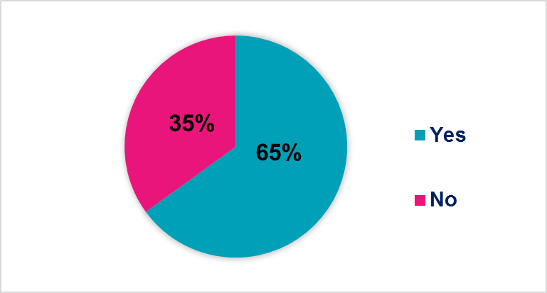
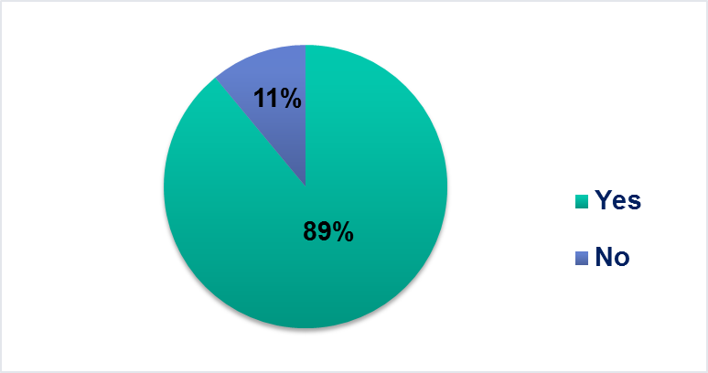
The summary and feedback of Russian RFG meeting:
1. Around 100 people in 60 connections.
Not only Russia (Ukraine – 3 people, Belarus – 5 people)
2. Have you ever participated in any other on-line sessions?
3. Was this event interesting for you?
Have you received any new and useful information?
4. Are you interested in new on-line meetings? Do you wish to participate?
Notes:
1. In the follow-up questionnaire, most people reported they attended the session in the class, so overall participation is estimated around 100! Not only Russia (Ukraine – 3 people, Belarus – 5 people)
2. The most participants have not the experience in such on-line events or have only participated in previous Virtual Table event.
3. But the most answers (89%) show the big interest and the big positive responses after the meeting.
4. 82% of respondents are ready and wish to continue the meetings in regular basis. And there is no negative responses at all.

Slide 7
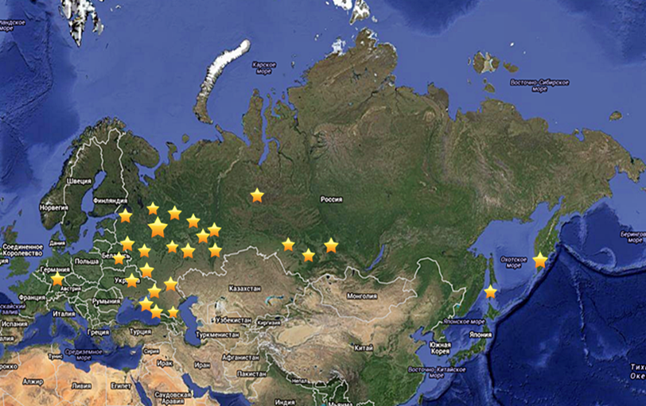
Benefits and Challenges:
Benefits:
60 connections from 4 countries;
Around 100 participants;
Big interest in more materials and new products;
New ideas and inspiration for work.
Challenges:
Internet connection and technical problems;
Different local time (11 times zones);
Hard to find free time to join (especially when on shift);
Missing the real contact and talks with other colleagues and trainers.
The first session 12.08.2013
Notes:
Having more than 60 sites connecting from 4 countries in the very first session and all positive responses are a big success.
At the same time it shows a big interest in Russia for this type of meetings and e-learning.
There are some lessons learned from the very first session.
Internet connection and technical problems (the need of VLab SABA system);
Different local time (11 times zones) – (2 regional sessions? – for European and Siberian territories);
Hard to find free time to join (especially when on shift) – administrative decisions?;
Missing the real contact and talks with other colleagues and trainers – blended courses?
As I am involved in Sochi 2014 Olympics Weather Service, for the next session in October we are planning the connection to Sochi Olympics forecasters training, where the most recent information about new equipment's and forecasting technics will be.

Slide 8
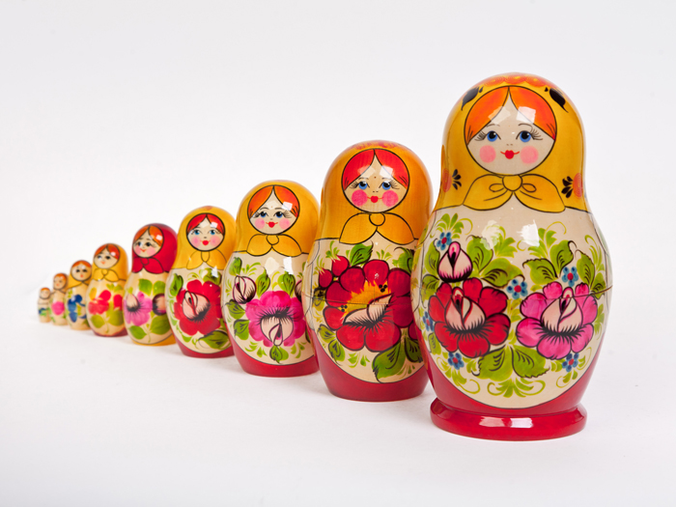
Thank you for your attention! Merci!
Russian meteorologists go on line!
Notes:
I hope that after the success of the first session more people soon will be involved in using distant meetings and VLab facilities to get new information in the world of meteorology.
And we will be happy and will appreciate other organization and online communities to collaborate with our Russian RFG to make the this program most interesting and effective.
Thank you for your attention!

