Slide 1
Group-based exercise
EumetCAL radar course 2013

Slide 2
Warning for Convective Hazards
Hazard | Physical process | Parameters used to diagnose & forecast | Radar Products Radar Signatures
Large Hail
Damaging Wind
Heavy Precipitation
Tornado

Slide 3
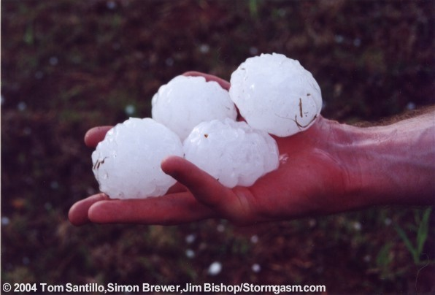
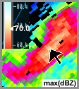
Hail: (> 2cm diameter) Physical process
Strong updraft; hail embryos reside in regions of high super-cooled liquid water in hail growth region (-10 C to -30C); WBFZL / FZL low enough so that significant melting of hailstone does not occur.
Radar Signatures for hail
Reflectivity: Strong low-level reflectivity gradient Storm-top displacement WER, BWER Hook echo / Pendant TBSS (radar artifact) 50dBZ echo through hail growth layer Velocity: Mid-level rotation Strong storm-top divergence
Parameters used to diagnose/forecast hail
Buoyancy: CAPE, SLI, CIN FZL / WBFZL height
Deep-layer Shear: 0-3km, 0-6km
Hail is more likely to reach the ground when the FZL height is <= 3.4km.

