Slide 1
The EUMETSAT Satellite Applications Facility on Land Surface Analysis
Luís Pessanha & LSA SAF consortium
Portuguese Sea and Atmosphere Institute luis.pessanha@meteo.pt

Slide 2
OUTLINE
LSA SAF
Mission
Concept for CDOP-3
Consortium
CDOP-3: Work Breakdown Structure
Service & Portfolio
Dependencies & Links with other SAFs
Links with Programs

Slide 3
LSA SAF Mission
Objective
To be a leading centre for retrieval of information on land surfaces from remote sensing data, with emphasis on EUMETSAT satellites.
Purpose
To provide NRT & offline products and user support related with land surface variables:
surface radiation, both long- and short-wave components;
vegetation, including state, stress and wild fires;
the energy budget at the surface.

Slide 4
SHORT VIEW OF PRODUCTION AND PRODUCT EXAMPLES
LSA SAF - MSG Products
Energy Balance
Radiation
Vegetation
SW
LW
Wild Fire
State
Water stress
Albedo
Downwelling SW
(Aerosol)
LST
Emissivity
Downwelling LW
Detection
Emitted Power
Risk Burnt Areas
Veg. Fraction
LAI/FAPAR/NDVI
Evapotranspiration
Ref Evapotranspiration
Energy Fluxes at the Surface - GPP/NPP (Gross/Net Primary Production)

Slide 5
LSA SAF CONCEPT FOR CDOP-3
Continuity of the service provided during CDOP-1 and CDOP-2 & Product/ Portfolio Evolution according with user requirements and considering new data and instruments:
1) Ensure the continuity of a reliable near real time and offline service, with emphasis on
A smooth transition to MTG-based operations
The improvement of system and product quality monitoring
Maintaining an efficient user support service
2) Provide homogeneous datasets for products developed in CDOP-1 and CDOP-2
Maintain re-processing capabilities for MSG and AVHRR/Metop for a subset of products (identified by user requirements)
Provide careful characterization of product uncertainty
3) Explore the capabilities of forthcoming EUMETSAT satellites
Developing and/or adapting existing algorithms to MTG-FCI
Designing new products for sensors on-board EPS-SG, which will be more suitable for land surface monitoring, VII and 3MI.

Slide 6
LSA SAF CONSORTIUM
CDOP-2
IPMA (Portugal) – Leading Institution
MF (France)
RMI (Belgium)
IDL (Univ Lisbon)
KCL (King’s College London)
KIT (Karlsruhe Inst Technology)
UV (Univ Valencia)
VITO (Flemish Inst Technological Res)
CDOP-3
IPMA (Portugal) – Leading Institution
MF (France)
RMI (Belgium)
IDL (Univ Lisbon)
KCL (King’s College London)
KIT (Karlsruhe Inst Technology)
UV (Univ Valencia)
VITO (Flemish Inst Technological Res)
ARSO (Slovenian Env Agency)
NIMH (Bulgarian Inst Met and Hyd)
8 Institutes / 6 Countries
10 Institutes / 8 Countries

Slide 7
CDOP-3 LSA SAF PORTFOLIO
GEO
LEO
SEVIRI/MSG
AVHRR/EPS
Radiation: LST & Emissivity; Albedo (& Aerosol); Surface Downwelling Fluxes
Vegetation Parameters
Energy Fluxes
Fire Products
Radiation: LST; Albedo
Vegetation Parameters
Fire Products
CDOP-2
CDOP-3
Radiation: Albedo, BRDF
Vegetation Parameters
FCI/MTG
VII/EPS-SG
3MI/EPS-SG
CDOP-4

Slide 8
LSA SAF - USERS
User Community
Surface modelling / Hydrology
Forest & Agriculture Applications
Environmental / Climate monitoring
NWP / Air quality
Renewable Energy (solar)

Slide 9
LSA SAF - USERS
Registered for regular/offline acquisition of LSA SAF Products
EUMETCast: > 1000 in Jul 2015
LSA SAF website: > 1500
ftp NRT dissemination 20-30
UMARF
Data Accessibility & length of Product Data Records, as major factor determining product usage:
Re-processing – High priority
Improve data access & data usage
User friendly format & projection
Allow extraction of time-series for user defined area
Improve efficiency in data delivery

Slide 10
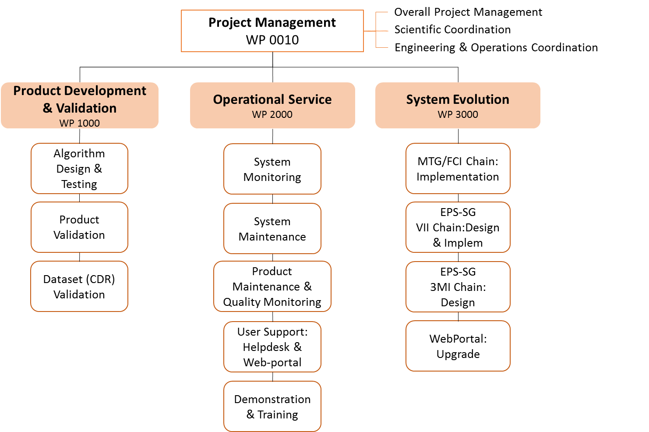
LSA SAF WORKBREAKDOWN STRUCTURE

Slide 11
CDOP-3 LSA SAF SERVICE
Land SAF
System I
Land SAF
System II
CDOP-2
MSG
EPS
EPS (NDVI)
CDOP-3
MTG - FCI
EPS - SG VII
Sfc Radiation
EPS - SG VII
VEGA
EPS - SG 3MI
QA: Comparison with in situ data
Assessment of Product Applications
Statistics of Products against climatology
Eastern Europe Drought Monitoring
http://www.dmcsee.org/

Slide 12
LSA SAF – LINKS WITH OTHER SAFS & EUM
Dependencies
NWC SAF – Cloud mask
Current Sensors: SEVIRI, AVHRR
Future sensors: FCI, Metimage
EUM – Cloud mask
Future sensors: 3MI
Software – minimum 3 months prior to operations
FCI Prototype no later than Q2 2018
MetImage Prototype in Q3 2020
Product – Information to be distributed with level >1 data.
“prototype” to be distributed with test data.

Slide 13
LSA SAF – Links with other SAFs & EUM
Cooperation
CM SAF
LST - Bridging between datasets derived from different sensors MVIRI, SEVIRI, FCI; All-weather LST
Evapotranspiration – CM-SAF CDR compatible with LSA SAF ops (ICDR)
Cloud Mask – Extending the SAF-NWC Cloud mask
EUM
Aerosol AOD over land; sub-daily temporal scales – Development within the LSA SAF.
O3M (ACU) SAF
Compare Sun Induced Fluorescence (GOME-2) and LSA SAF VEGA and GPP products
H-SAF
Processing of AVHRR and SEVIRI Snow Cover Products – Input needed on
- operations within the LSA SAF, during CDOP-3
- plan for transfer of operations: paralell processing; tests

Slide 14
LSA SAF – Links with other Programs
Copernicus Global Land
LSA SAF LST used as input for Copernicus global LST product
EPS/AVHRR products used as backup for Copernicus service
Copernicus Atmospheric Monitoring Service
SEVIRI fire products (FRP) used as input for fire emissions

Slide 15
LSA SAF – CDOP-3 Proposal
July: Draft Proposal for discussion within consortium & SAF Network
September – October: Final Version

Slide 16
http://landsaf.ipma.pt

