Slide 1
Kalman Filter simultaneous retrieval of surface emissivity and temperature from SEVIRI data
Applied Spectroscopy
Giuliano Liuzzi, Guido Masiello, Carmine Serio and Sara Venafra.
School of Engineering, University of Basilicata, Potenza
Presented by Carmine Serio

Slide 2
Brief outline
Background
Aim and scope
Basic methodology
Results with emphasis on potential land cover change detection applications
Conclusions

Slide 3
Why we developed the KF for SEVIRI
The work originated within EUMETSAT (P. Watts)
Objective: To study and formulate a general strategy to apply spatial and temporal constraints to the estimation of geophysical parameters from radiance measurements made from geostationary platforms, to apply the strategy to a particular example problem and to recommend a way forward to more general application to MTG FCI imager and IRS sounder data.
The study was also motivated by the quest of methodologies capable to perform a dimensionality reduction of the data space
In NWP the numbers of observations varies considerably, but global models perhaps assimilate of order 10⁶ observations per 12 hour window. With SEVIRI the number of observations is of order 10⁸ per 15 minutes.

Slide 4
Background
Continuity is felt important in order to dynamically separate emissivity from temperature. In order words, try to exploit the different variability time scale of the two: minutes for temperature, days for emissivity.
Dimensionality reduction is felt important also in view of MTG: FCI and IRS mission

Slide 5
Kalman Filter
KF is an assimilation system (may incorporate the basic physics involved in the problem: radiative transfer and dynamics).
Acting on the dynamics, we can put appropriate constraint in order to take advantage of the different time scale of emissivity and temperature.
Exploiting the time sequential architecture of KF, the dimensionality of the data space is kept scalar in time, i.e., observations are processed as they come and are not accumulated as it would be in an ordinary static Optimal Estimation method.

Slide 6
KF development for SEVIRI, funding
Studies have started since since 2011 and funded by
EUMETSAT
“Study on space-time constrained Parameter Estimation from Geostationary data”, Contract # EUM/CO/11/4600000996/PDW:
“Kalman Filter estimation of surface temperature and emissivity from SEVIRI", contract EUM/CO/14/4600001329/PDW
The RITMARE flagship project, National Research Council, CNR

Slide 7
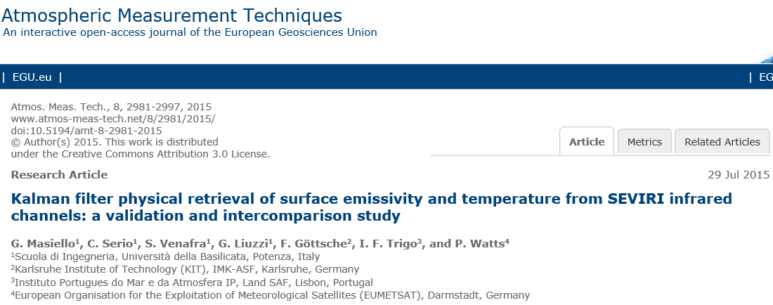
KF development for SEVIRI, publications

Slide 8
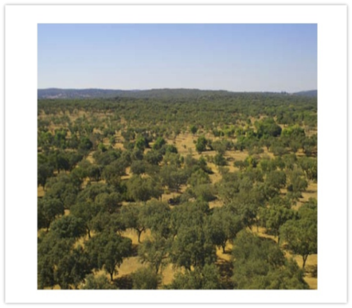
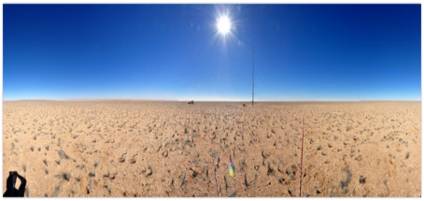
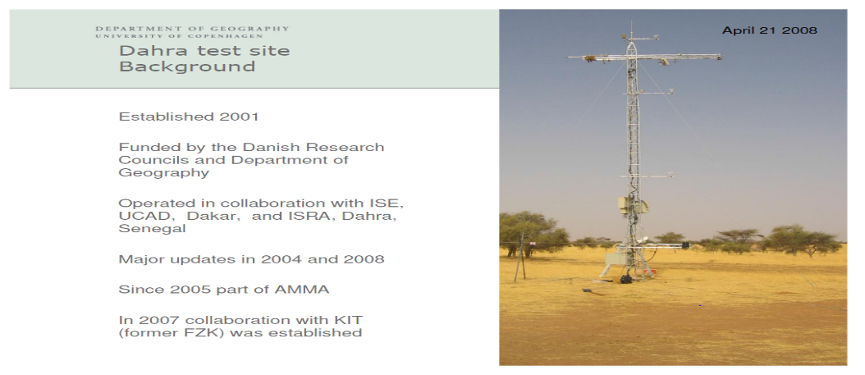
Acknowledgements
Isabel Trigo, Instituto Portugues do Mar e da Atmosfera IP, Land SAF, Lisbon, Portugal
Frank M. Göttsche, Karlsruhe Institute of Technology (KIT), Karlsruhe, Germany

Slide 9
Kalman filter
analysis
at time t
observation equation
state/evolution equation
update or analysis
forecast
covariance of ƞ_{t}
forecast
at time t
Application to SEVIRI window channels, for the retrieval of Surface Temperature (Ts) and emissivity (ε)
Masiello, G. et al. 2013, Atmos. Meas. Tech., doi:10.5194/amt-6-3613-2013

Slide 10
Forward Model
σ-SEVIRI is a monochromatic radiative transfer model:
It computes Spectral High-resolution quantities
Then it convolves them with the SEVIRI ISRF
The code is suitable for general purpose
It takes into account both Specular and Lambertian reflection
It is based on look-up table of optical depth + interpolation procedure
Simple dependence of the Optical Depth with respect to the Temperature and the gas concentration
Analytical derivative, Fast and Accurate
Specular and Lambertian models for the reflected radiance term

Slide 11
Further constraint, maximum-minimum channel emissivity difference
Three bands
Four bands

Slide 12
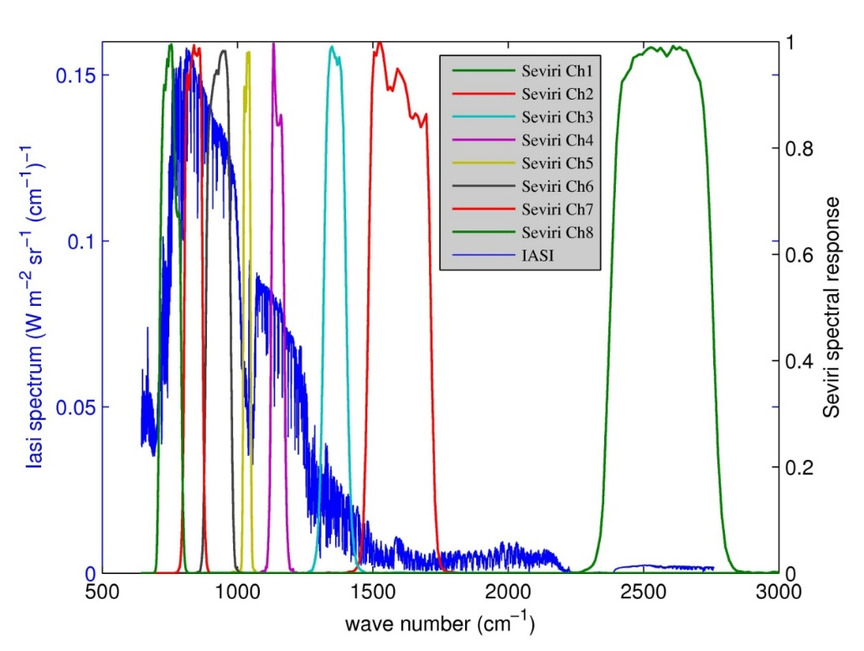
SEVIRI spectral response functions over-imposed to a typical IASI spectrum
Ch. 7 @ 12 μm
Ch. 6 @ 10.8 μm
Ch. 5 @ 9.7 μm
Ch. 4 @ 8.7 μm

Slide 13
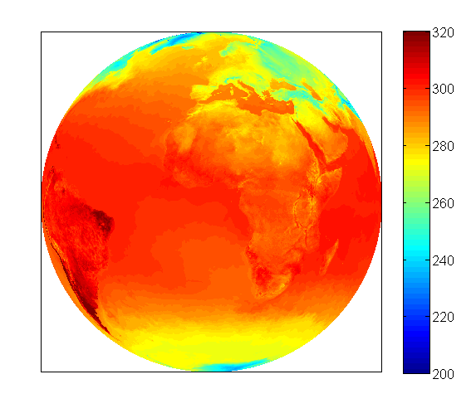
Background Information, Atmospheric State
ECMWF Operation Analysis from MARS platform.
High spatial Resolution (0.125x0.125)
91 Pressure levels until June 25th 2013
137 Pressure levels from June 26th 2013
SKT, Skin temperature
SP, Surface Pressure
TCC, Total Cloud Cover
T, Temperature
Q, Specific Humidity
O3, Specific Ozone
ECMWF, Surface temperature

Slide 14
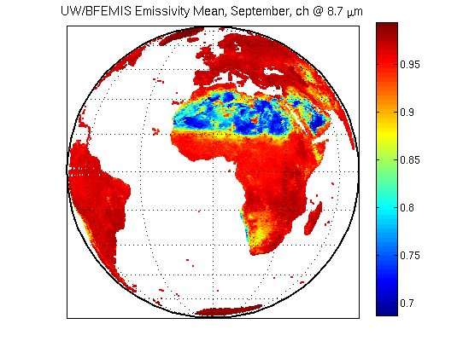
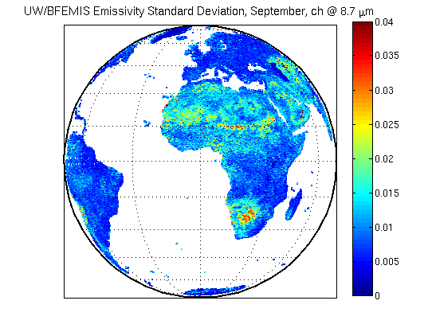
Background Information, Emissivity
UW/BFEMIS, database, Monthly mean and covariance computed for the 10 years period 2003-2012.
ECMWF, Skin temperature

Slide 15
Results from the three LSA SAF validation stations Comparison with in situ Surface Temperature
 | Mean difference with in situ data (°C) | Standard deviation of the difference (°C)
Dahra Jan.-to Oct. 2011 | -0.70 | 0.96
Evora Jan. to Dec. 2010 | +0.91 | 1.62
Gobabeb Jan. to Dec. 2010 | +0.86 | 1.18

Slide 16
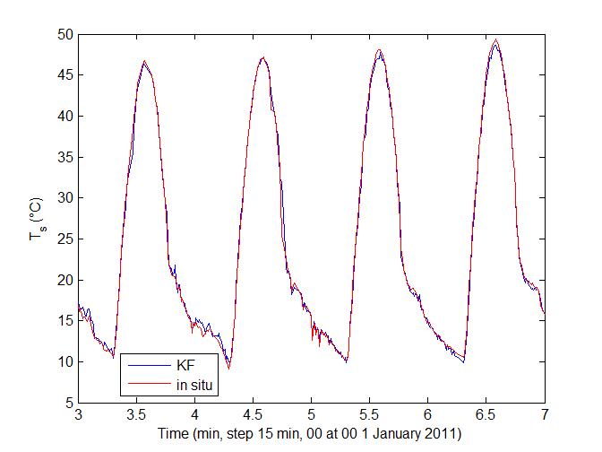
An example from Dahra station

Slide 17
Emissivity Retrieval (Evora Station)

Slide 18
Emissivity Retrieval (Gobabeb Station)

Slide 19
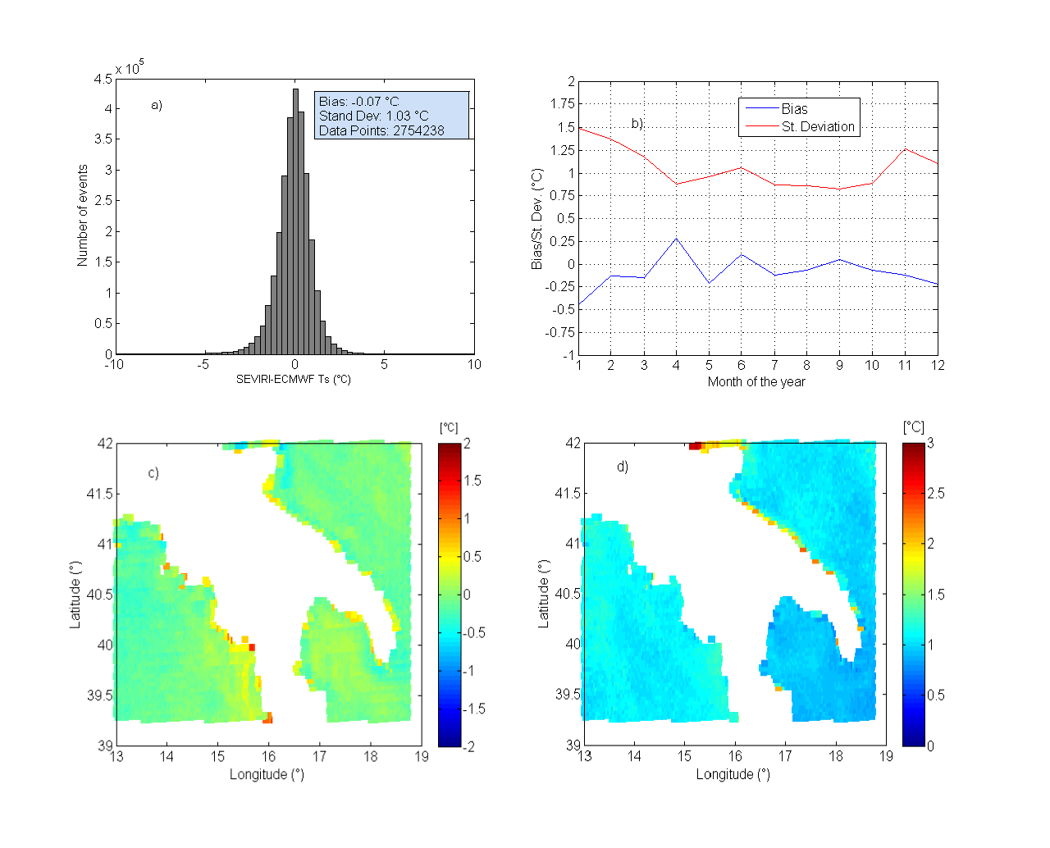
Comparison with ECMWF data show excellent agreement (statistics based on 2,754,238 data points)

Slide 20
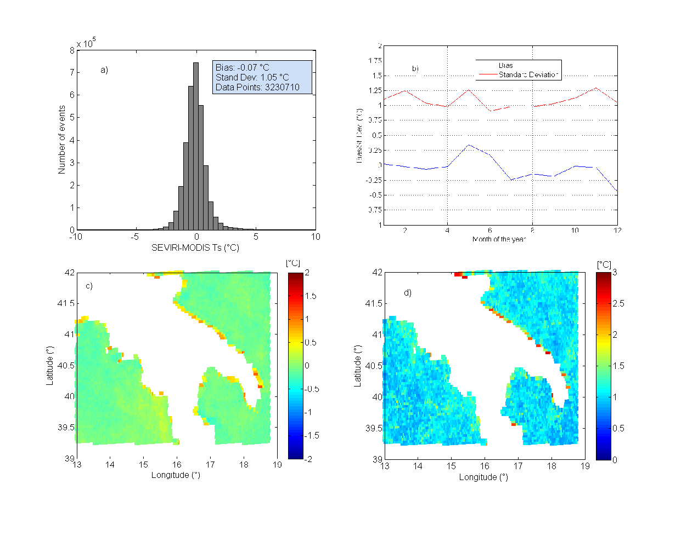
Comparison with MODIS shows a bias of 0.07 K and a standard deviation of 1.05 K (statistics based on 3,230,710 data points)

Slide 21
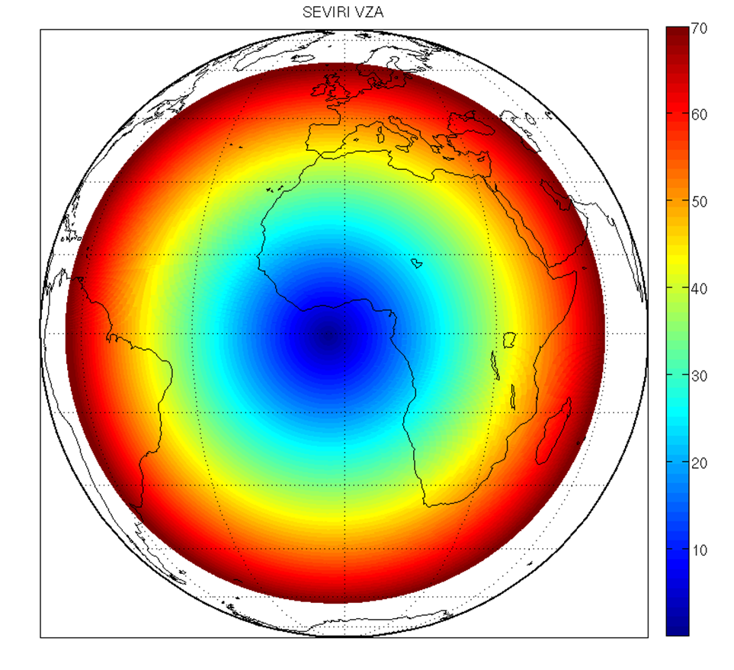
Applications to Full Disk and Regional scale
MSG-9 and MSG-10 SEVIRI Pixels with VZA <= 70°
Full Disk Definition an Applications

Slide 22
November 2007 surface temperature

Slide 23
November 2007, Emissivity at 8.7 μm

Slide 24
November 2007, Emissivity at 10.8 μm

Slide 25
November 2007, Emissivity at 12.0 μm

Slide 26
November 2007, Checking differences vs UW/BFEMIS

Slide 27
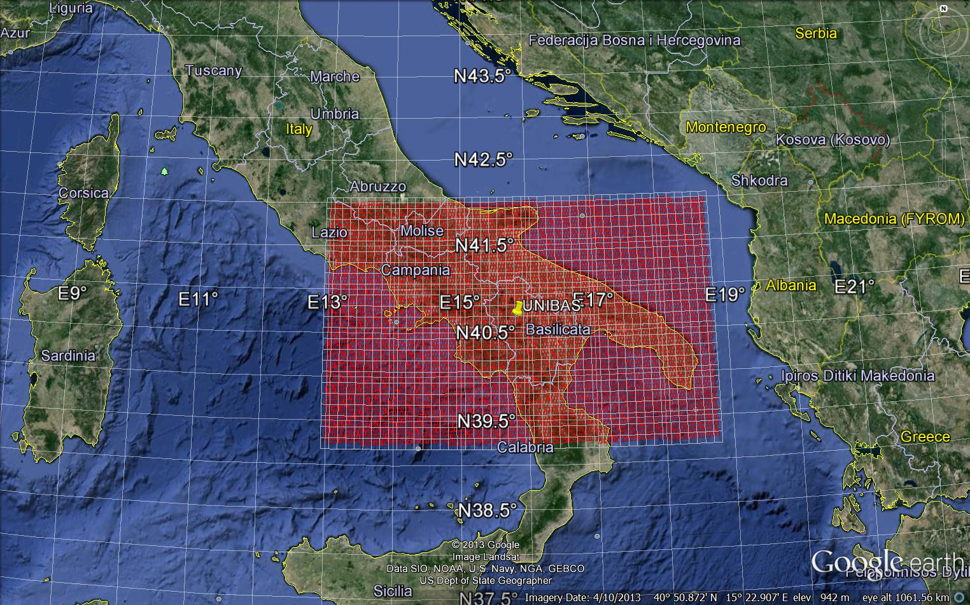
Applications to the regional scale Case Studies: Basilicata
MSG-10 SEVIRI Pixels with
13 ≤ Lon ≤ 18.875
39.25 ≤ Lat ≤ 42
9643 Pixels
4374 Over Land
5269 Over Sea
SEVIRI observations recorded during the whole year 2013

Slide 28
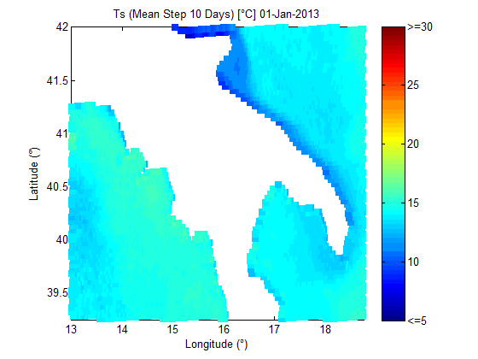
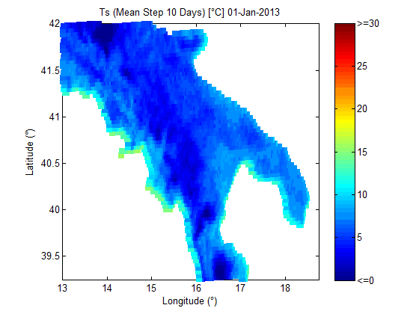
Retrieved Skin Temperature, whole year 2013
http://www2.unibas.it/gmasiello/assite/Basilicata_2013_TsSea.gif
http://www2.unibas.it/gmasiello/assite/Basilicata_2013_TsLand.gif

Slide 29
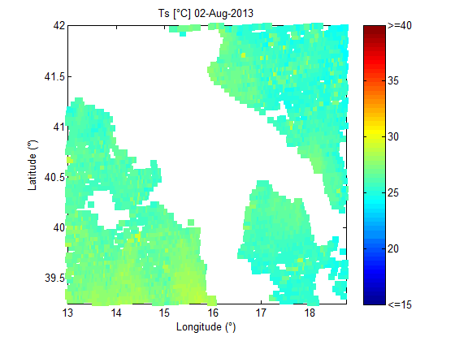
Retrieved Skin Temperature, 1 Day of August
http://www2.unibas.it/gmasiello/assite/basilicata_Aug_2013.gif

Slide 30
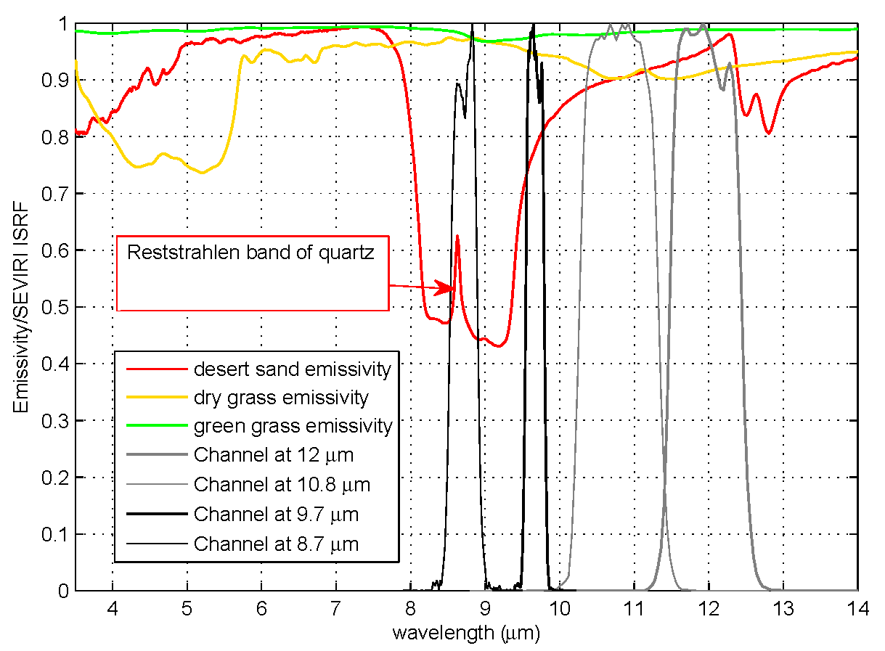
Land cover change detection with infrared SEVIRI channels

Slide 31
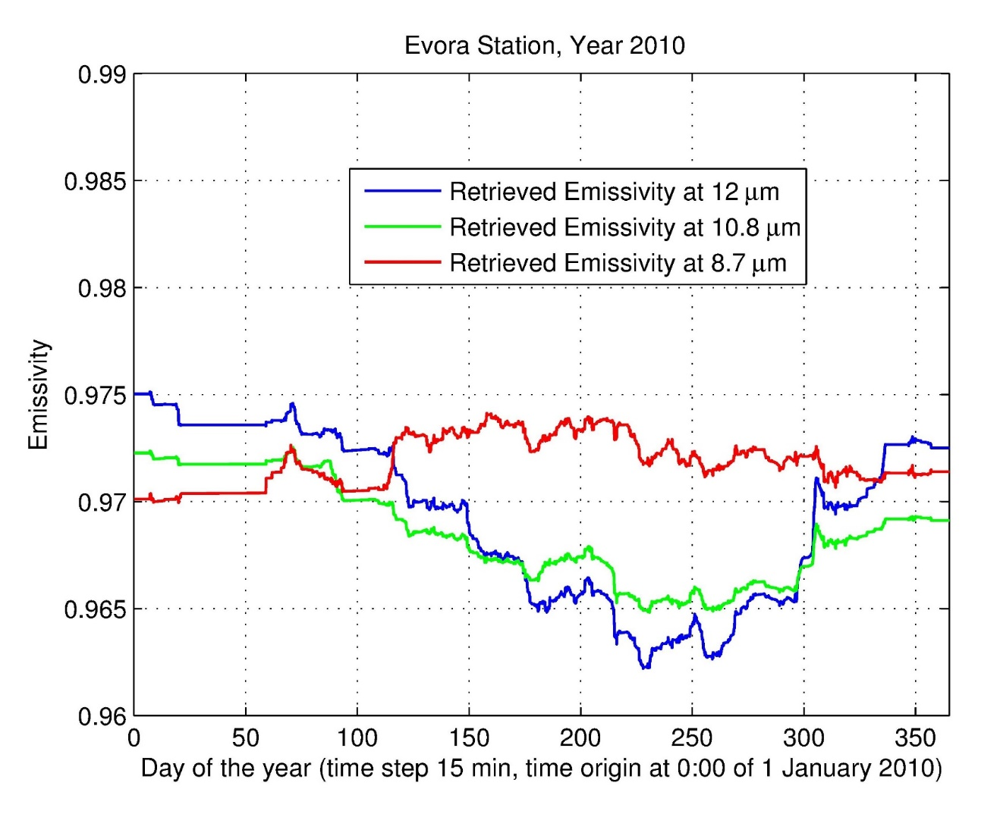
Land cover change detection, an example from Evora, Portugal

Slide 32
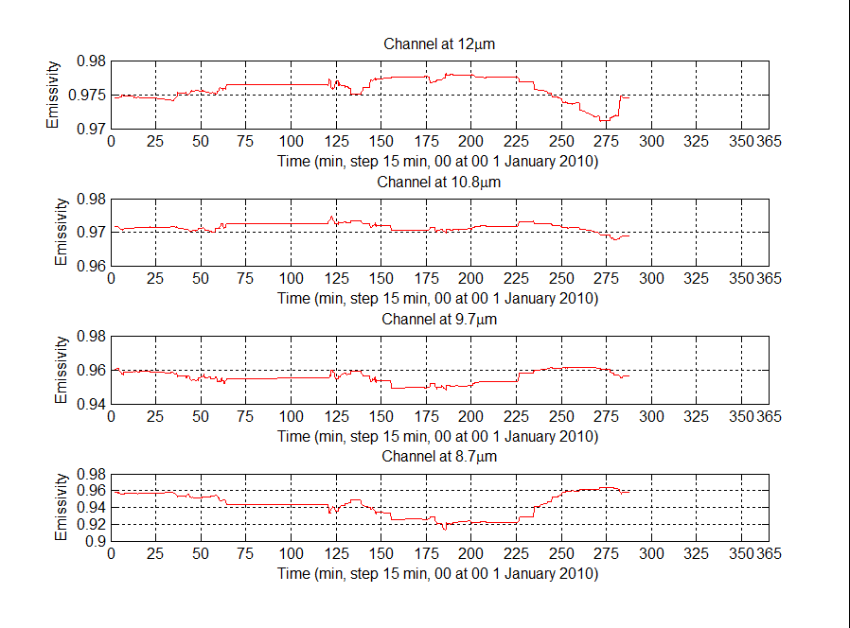
Land cover change detection, an example from Dahra, Senegal

Slide 33
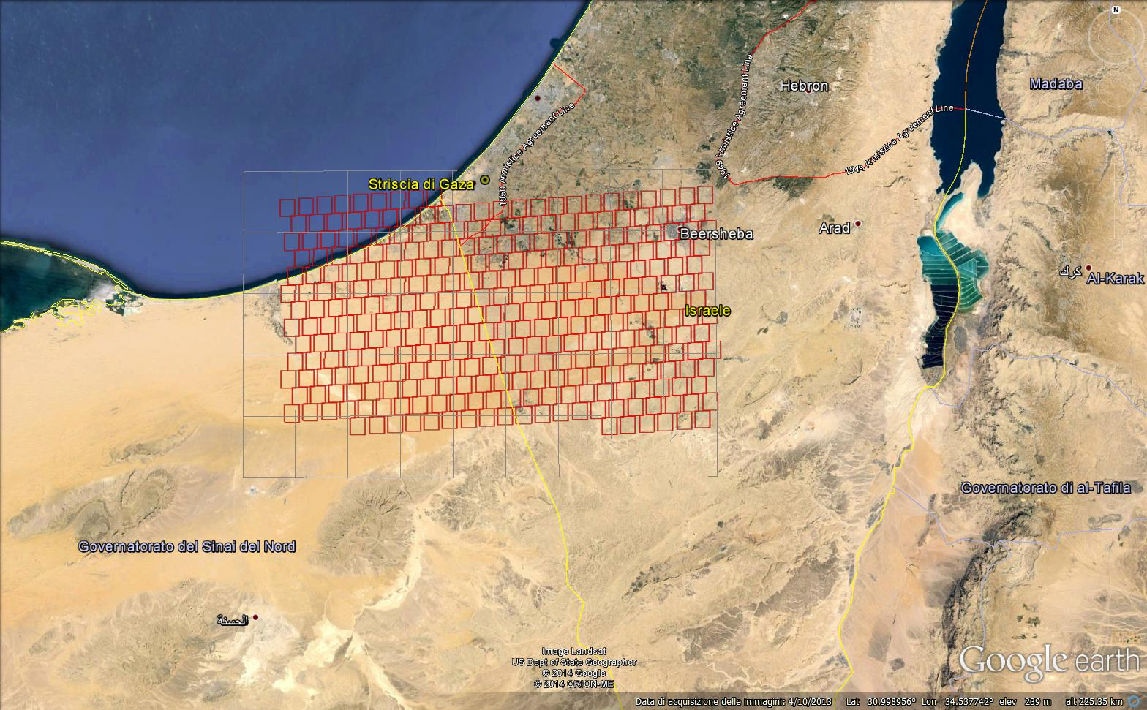
Application to the regional scale: Negev (Israel)
SEVIRI observations recorded from May to September 2013
Notes:
Because of grazing and wood gathering activities the dunes in the Negev have been covered by biocrusts and consequently have been stabilized

Slide 34
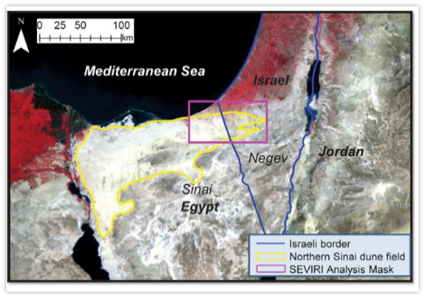
Work in collaboration
Diurnal Emissivity Dynamics in Active Sand Dunes vs. Dunes Stabilized by Biocrust
Offer Rozenstein¹, Nurit Agam¹, Carmine Serio², Guido Masiello², Sara Venafra², Stephen Achal³, Eldon Puckrin⁴, and Arnon Karnieli^{1∗}
Jacob Blaustein Institutes for Desert Research, Ben-Gurion University of the Negev, Sede Boker Campus 84990, Israel.
School of Engineering and CNISM, Potenza Research Unit, University of Basilicata, Potenza, Italy.
ITRES Research Ltd. #110, 3553 31st Street N.W. Calgary, Alberta, T2L 2K7, Canada.
Defence Research and Development Canada (DRDC) - Valcartier, 2459 de la Bravoure, Québec, QC, G3J 1X5, Canada.

Slide 35
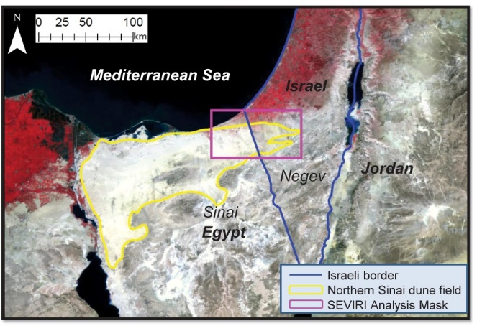
Anthropogenic activity on the Israel side has changed surface emissivity

Slide 36
The emissivity change is very well captured by SEVIRI channel emissivity at 8.7 μm
Map of the area
SEVIRI channel emissivity at 8.7 μm

Slide 37
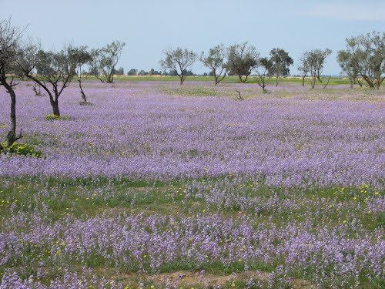
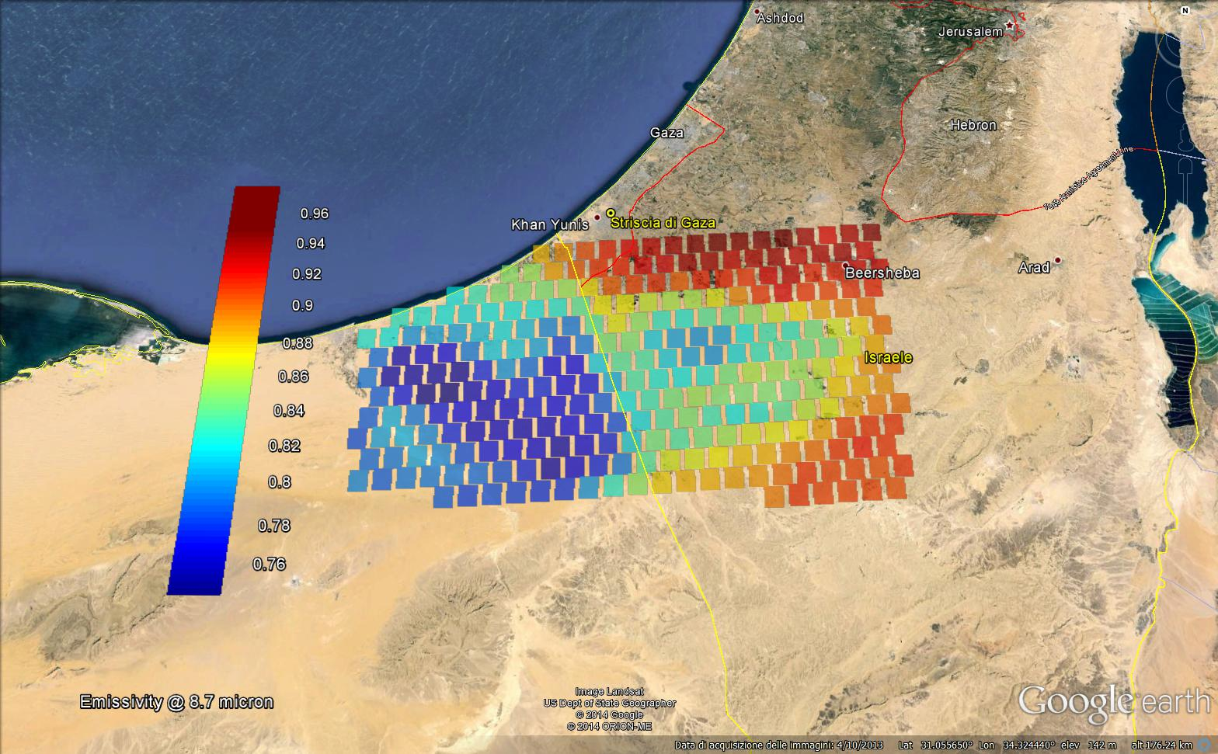
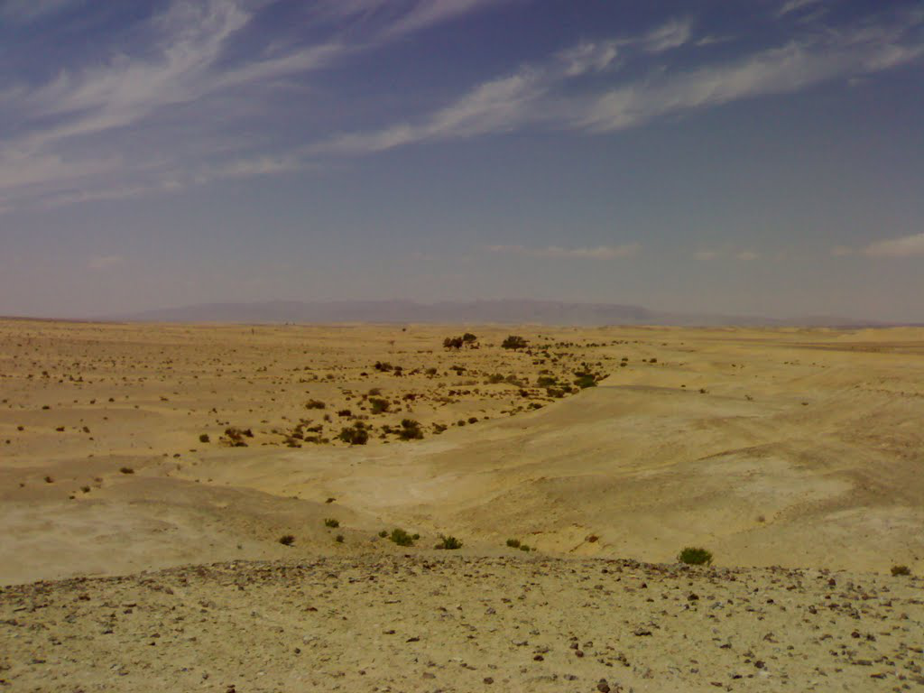
Negev (Israel) case study
Emissivity @ 8.7 µm for August 2013

Slide 38
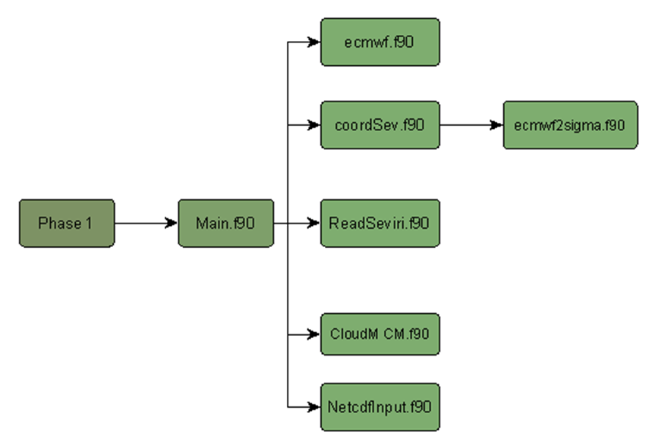
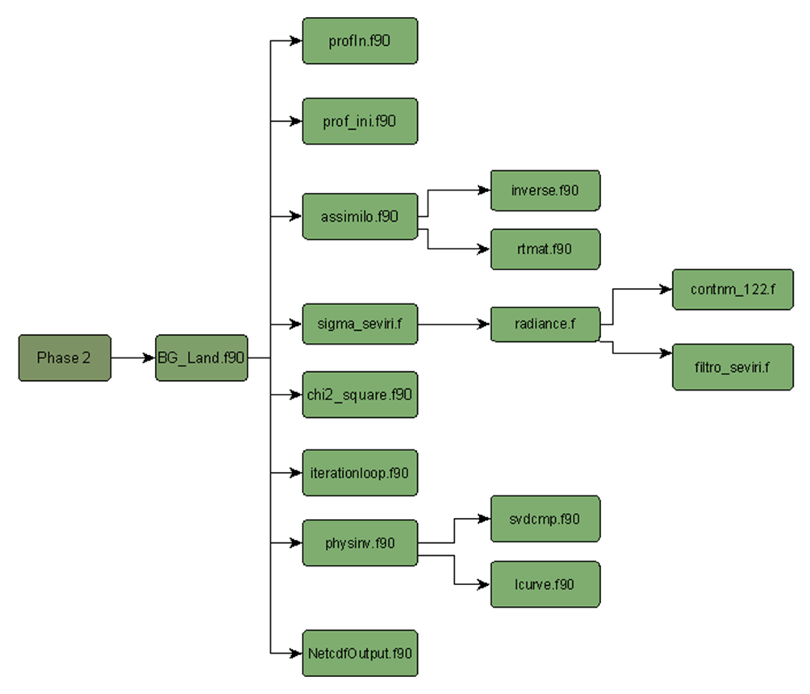
The code has been developed in Fortran language and installed at EUMETSAT

Slide 39
The code can run from the level of the single pixel up to the SEVIRI full disk scale
Single Pixel
Full disk

Slide 40
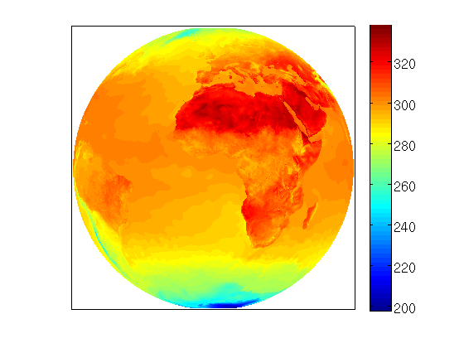
Full Disk (data input for one day cycle)
ECMWF
|Latitude|<=82°; |Longitude|<=82°;
step 0.125°
Nlat=1313; Nlon=1313
Nlev=91 or 137
Parameters:
T,W,O (Nlev), SKT
Nlat*Nlon*(3*Nlev+1)
(4.7x10⁸ or 7.1x10⁸)×5
SEVIRI
(Nrow=3395)×(Ncol=3389) ×96 ×8;

Slide 41
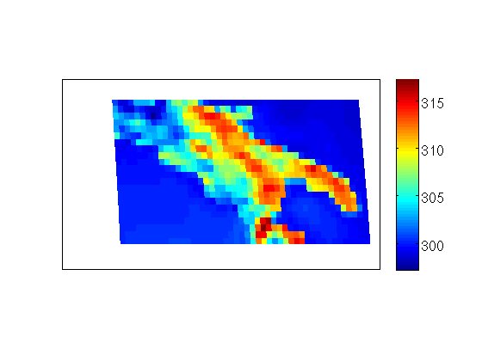
Regional Area (one day cycle)
ECMWF
39.5°<=Latitude<=42°; 13<=Longitude<=18.75°;
Step 0.125°;
Nlat=23; Nlon=47
Nlev=91 or 137
Parameter:
T,W,O (Nlev), SKT
Nlat*Nlon*(3*Nlev+1)
(3.0x10⁵ or 4.5x10⁵)×5
SEVIRI
(Nrow=166)×(Ncol=71) ×96 ×8;

Slide 42
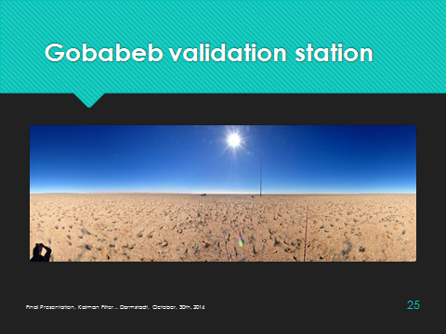
Single Pixel (one day cycle)
ECMWF
Latitude=round(Latsev*8)/8
Longitude=round(Lonsev*8)/8
Nlat=1; Nlon=1
Nlev=91 or 137
Parameter: T,W,O (Nlev), SKT
3*Nlev+1
(274 or 412)×5
SEVIRI
(Nrow=1) ×(Ncol=1)×96×8;

Slide 43
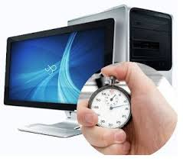
Performance
CPU Intel Xeon E5 2697 12 Core 2.7 GHz 30MB 150W
128 GB of RAM
It takes about 1÷1.3 minutes to retrieve (Ts,ε) for one pixel for a whole month

Slide 44
Conclusions and remarks
The KF retrieval system can be used at the regional or global scale.
On regional scale the system can be run in real time and, therefore, used together with statistical image tools for natural and anthropic hazard alarms. Off-line, it could be used for risk assessment analysis and for land cover change detection.
KF has the unique feature to simultaneously retrieve surface emissivity and temperature
SEVIRI emissivity maps do not exist yet. KF could provide full disk monthly emissivity maps
The emissivity maps could be used as additional input for land use / land cover change analyses and would be beneficial for many T_{s} statistical retrieval algorithms for SEVIRI, which largely rely on the availability of the channel emissivity at 10.8 μm and 12 μm.
This availability would improve the exploitation of the European geostationary platforms and also lead to a better exploitation and improved usage of other European satellite systems.

Slide 45
CINFAI-CNISM-UNIBAS-IMAA/CNR applied spectroscopy group http://www2.unibas.it/gmasiello/assite/as/home.html

