Slide 1
4th SALGEE workshop
MODIS GPP/NPP products:
Assessing the land CO₂ sink from space
Ana Bastos
Laboratoire des Sciences du Climat et de l’Environement
LSCE, CEA-CNRS-USVQ, France
www.seos-project.eu

Slide 2
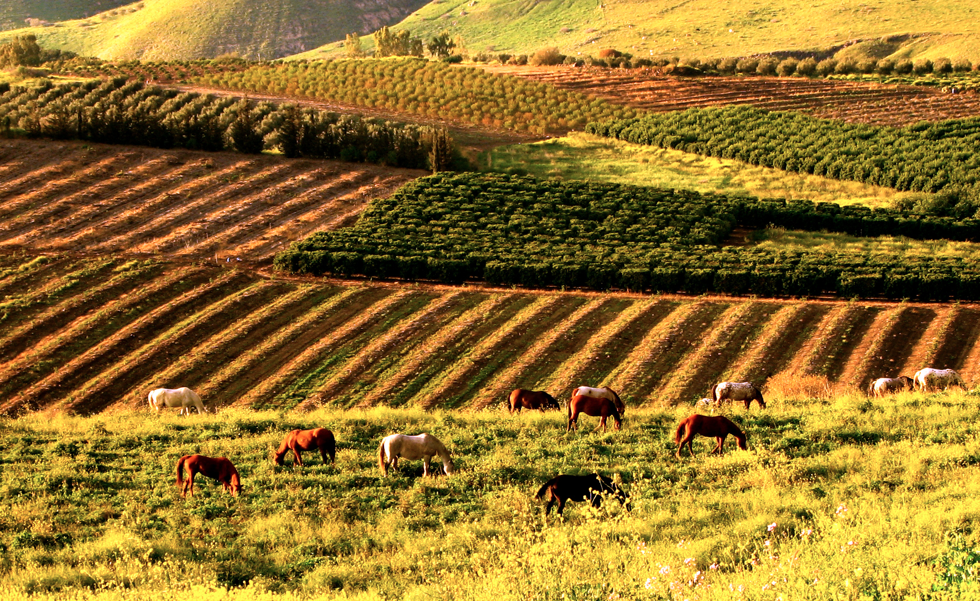
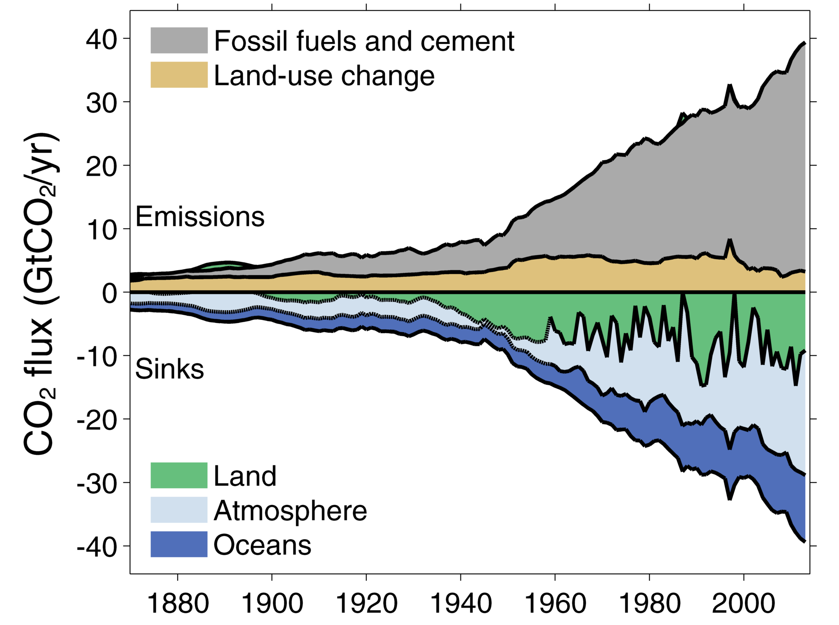
Why do we need global GPP/NPP?
Vegetation productivity is the source of the food, fiber and fuel available for human consumption
Global land ecosystems remove about 30% of anthropogenic CO₂ emissions every year
… but we still don’t know how they will respond to climate change
… partly because we don’t fully understand their present trends and drivers
Global carbon budget 2014

Slide 3
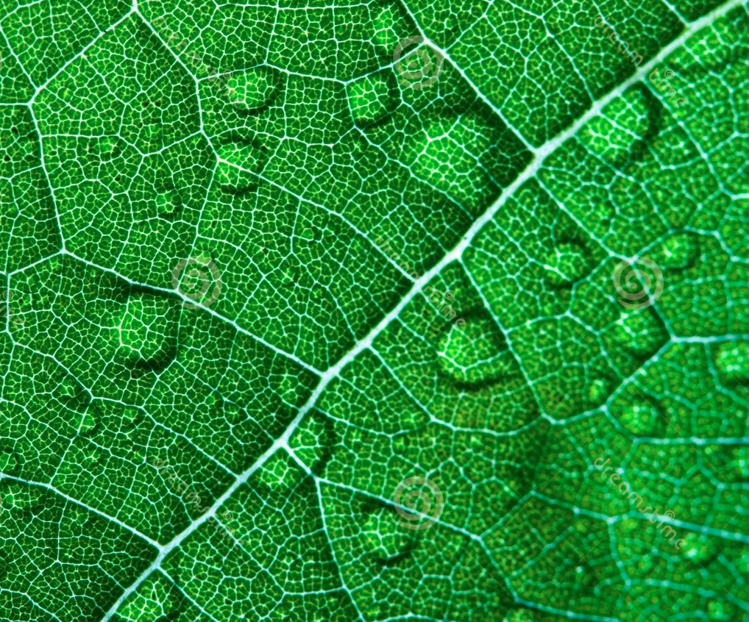
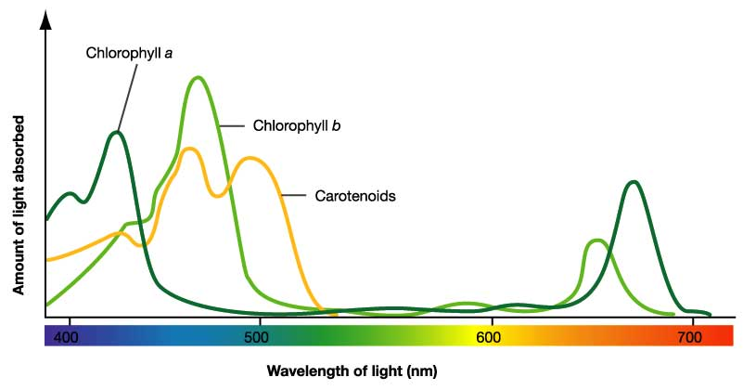
Photosynthesis
www.uic.edu

Slide 4
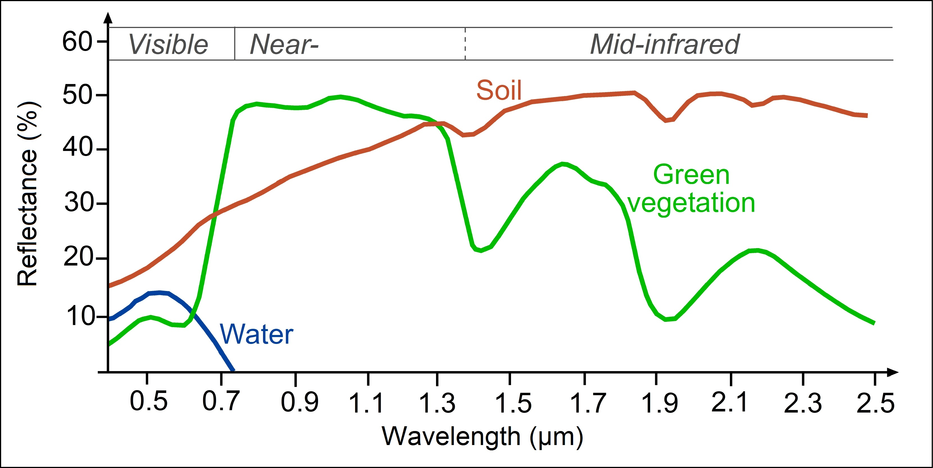
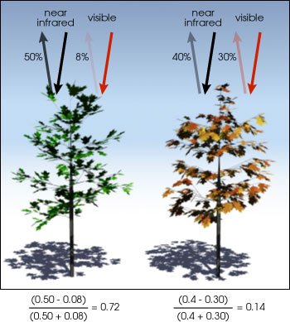
Spectral signature of vegetation
www.seos-project.eu
earthobservatory.nasa.gov
fPAR

Slide 5
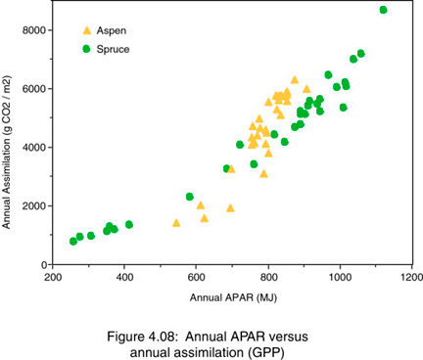
Estimating GPP from light absorption
Unstressed vegetation (Monteith 1972):
CO₂ assimilation
∝
Solar energy absorbed during the growing-season
GPP = ε * APAR
Light use efficiency
APAR = PAR * fPAR
NASA-GSFC
LAI
Most vegetation indices
Notes:
APAR depends on the amount of leaf canopy

Slide 6
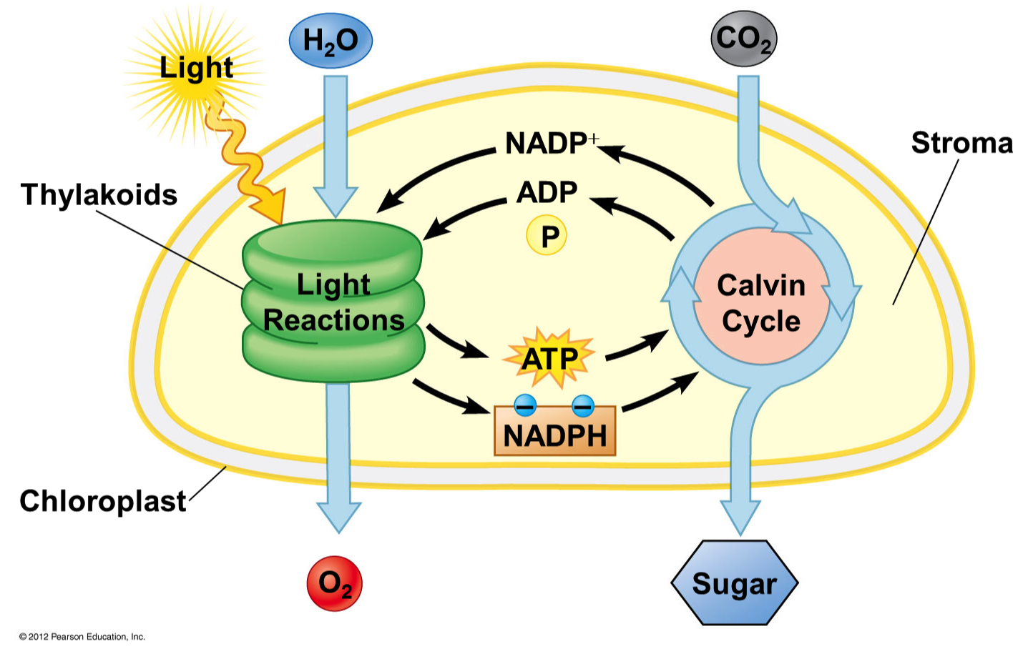
Light use efficiency

Slide 7
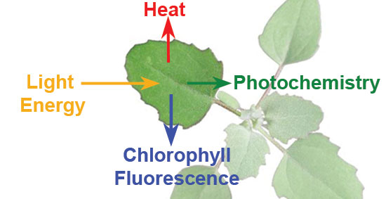
Light use efficiency
Stress (heat, frost, drought)
Nutrient limitation

Slide 8
Calculating GPP from satellite data
CO₂ assimilation (productivity) by plants is related to the amount of absorbed sunlight
GPP = ε * APAR
It is possible to estimate the fraction of photosynthetically active radiation absorbed from satellite (PAR from meteorology)
APAR = PAR * fPAR
ε differs between vegetation types, and ε is not always optimal (e.g. temperature/water stress, nutrient limitation)

Slide 9
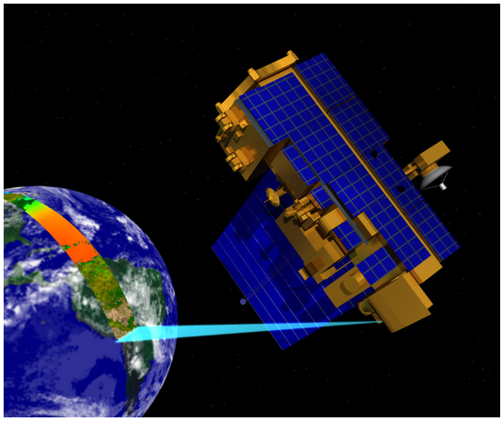
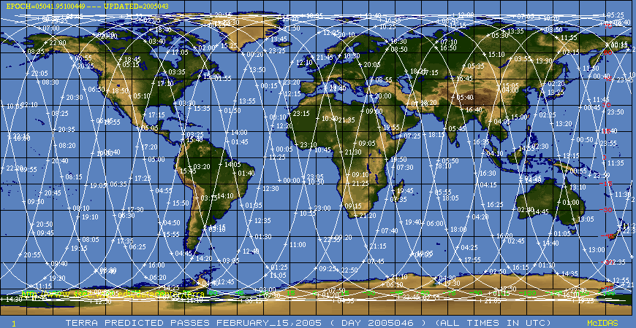
MODerate resolution Imaging Spectroradiometer
On board of NASA’s TERRA & AQUA
36 spectral bands from 0.4 µm to 14.4 µm
Spatial resolution 250m – 1km
Cover the global surface every 1-2 days
Vegetation related products:
NDVI+EVI (MOD13)
LAI+fPAR (MOD15)
GPP+NPP (MOD17)

Slide 10
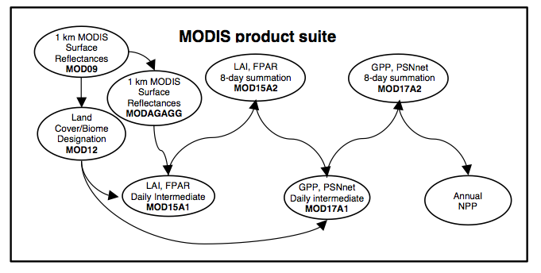
MODIS GPP and NPP
PLUS
Climate Daily Tmin,Tday,Tavg, VP, SWrad from 6-hr
Biome Properties Look-Up Table (BPLUT): variability in ε, respiration
! Over the years there have been improvements/changes to the algorithm

Slide 11
MODIS daily GPP and NPP
Running et al 1999
GPP:
CO₂

Slide 12
MODIS daily NPP
Running et al 1999
GPP:
CO₂
Daily net uptake:
PSN_{net} = GPP – R_{lr}
R leaves:
CO₂
R fine roots:
CO₂

Slide 13
MODIS daily NPP
Running et al 1999
GPP:
CO₂
Daily net uptake:
PSN_{net} = GPP – R_{lr}
R leaves:
CO₂
R fine roots:
CO₂

Slide 14
MODIS daily NPP
Running et al 1999
PROVIDED IN 8-daycomposites

Slide 15
MODIS annual NPP
Growth:
CO₂
Maintenance:
CO₂
PSN_{net}
Year j
Year j+1

Slide 16
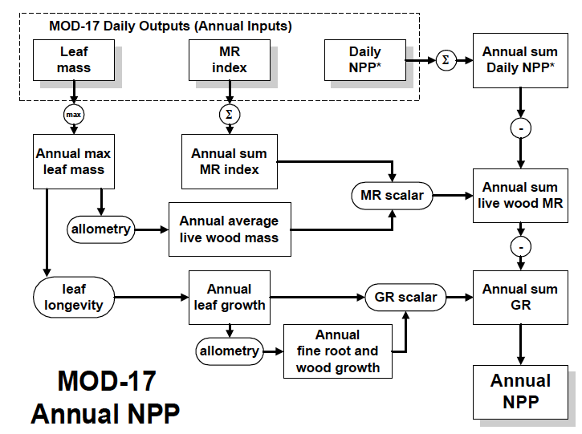
MODIS annual NPP
Running et al 1999

Slide 17
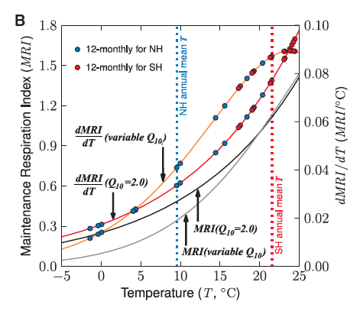
Maintenance respiration – C5 modifications
Zhao & Running 2010
Notes:
Q10 variable for leaves to account for acclimation
Q10 = 2 for roots

Slide 18
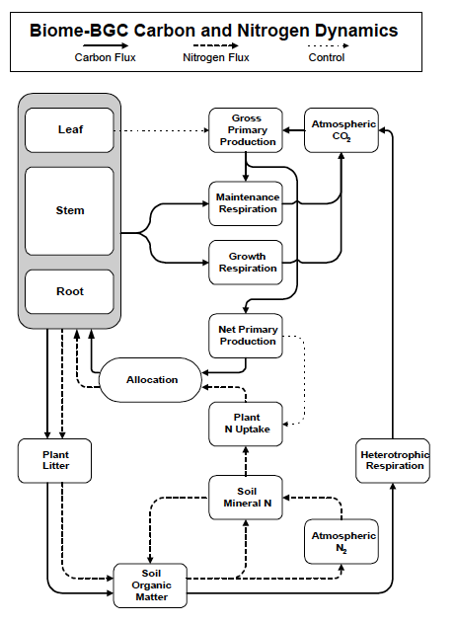
BLUT parameterization
Running et al 1999

Slide 19
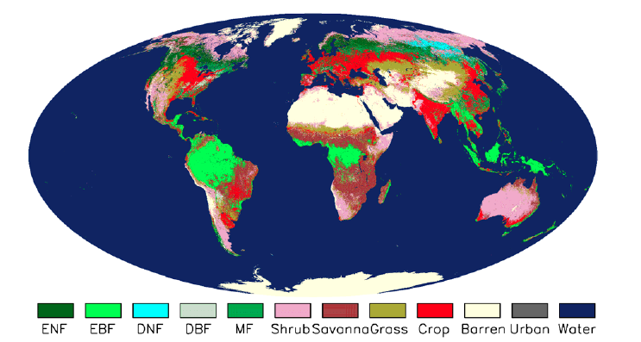
BLUT parameterization
Zhao & Running 2010

Slide 20
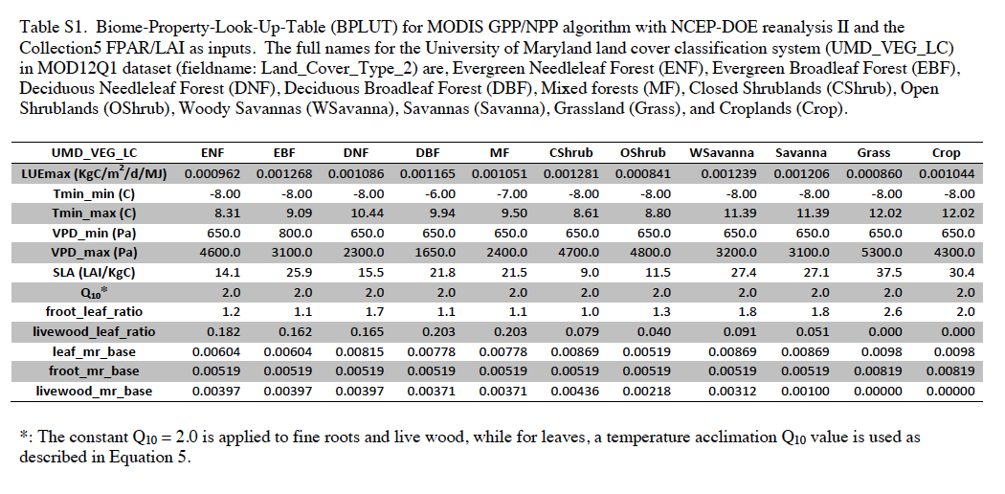
BLUT parameterization (Col.5)
Zhao & Running 2010

Slide 21
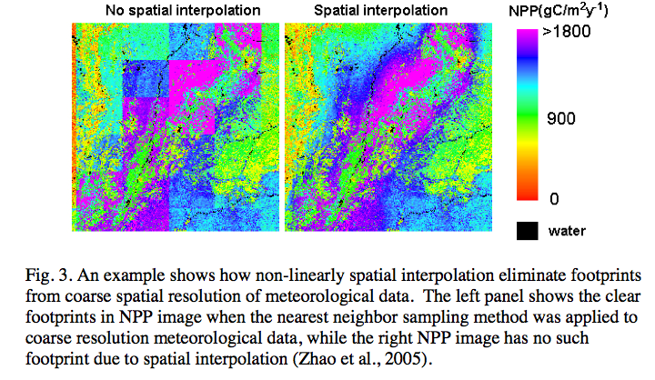
Climate
Non-linear spatial interpolation from coarse grid to 1km resolution
Zhao et al 2005
Notes:
Non-linear spatial interpolation

Slide 22
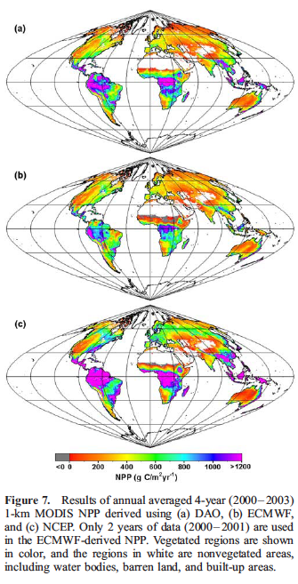
Climate
Sensitivity to different meteorological datasets
In earlier versions, meteorology from DAO was used.
In Collection 5, meteorological data are from NCEP/DOEII Reanalysis.
Zhao et al 2006
Notes:
Non-linear spatial interpolation

Slide 23
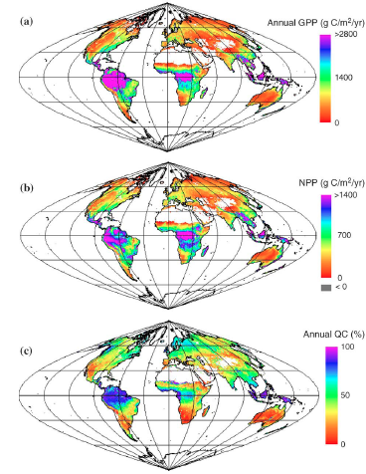
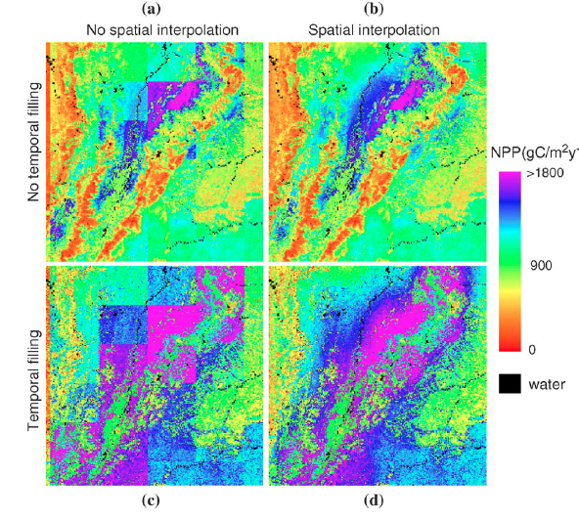
Global annual GPP and NPP products
Quality control flag:
Zhao et al 2005

Slide 24
Validation
Collection 4.5: comparison with flux-tower data from AMERIFLUX
Heinsh et al 2006

Slide 25
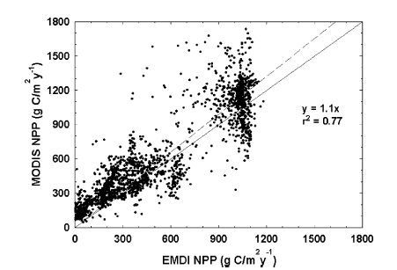
Validation
Collection 4.5
Collection 5
Zhao et al 2005
Zhao and Running 2011

Slide 26
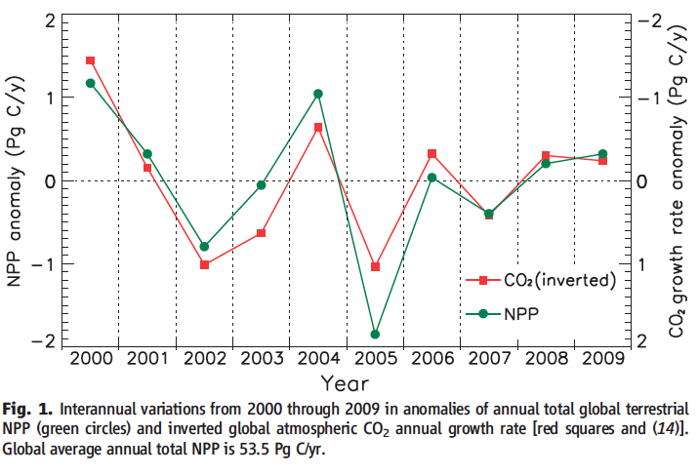
Global MODIS NPP and the land sink
Zhao & Running 2010

Slide 27
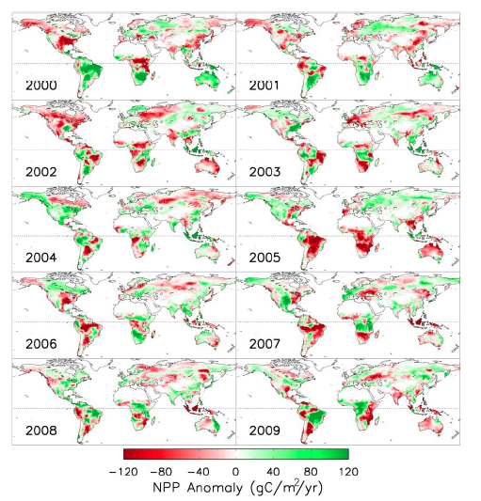
Global MODIS NPP and the land sink
Disturbance
… next talk
Zhao & Running 2010

Slide 28
Thanks!
Thanks to Steven W. Running for insights & comments

