Slide 1
4th SALGEE workshop
Studying vegetation dynamics under disturbance using MODIS products.
Ana Bastos
Laboratoire des Sciences du Climat et de l’Environement
LSCE, CEA-CNRS-USVQ, France

Slide 2
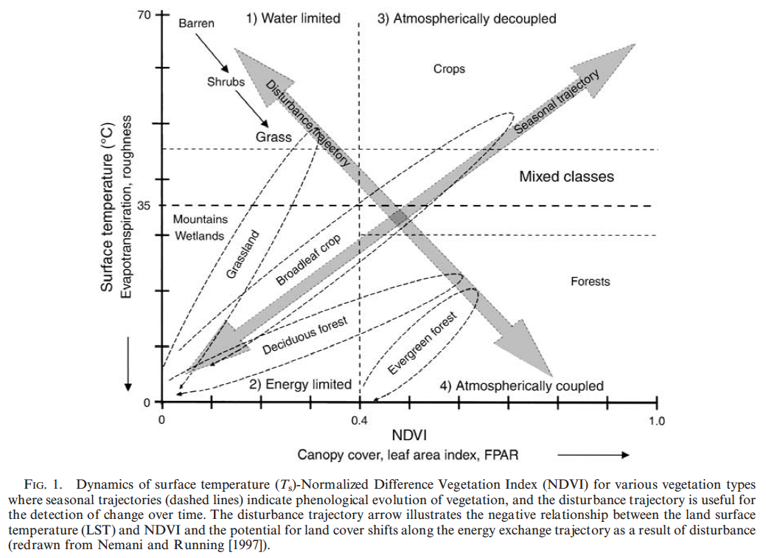
Disturbance detection
Mildrexler et al 2007

Slide 3
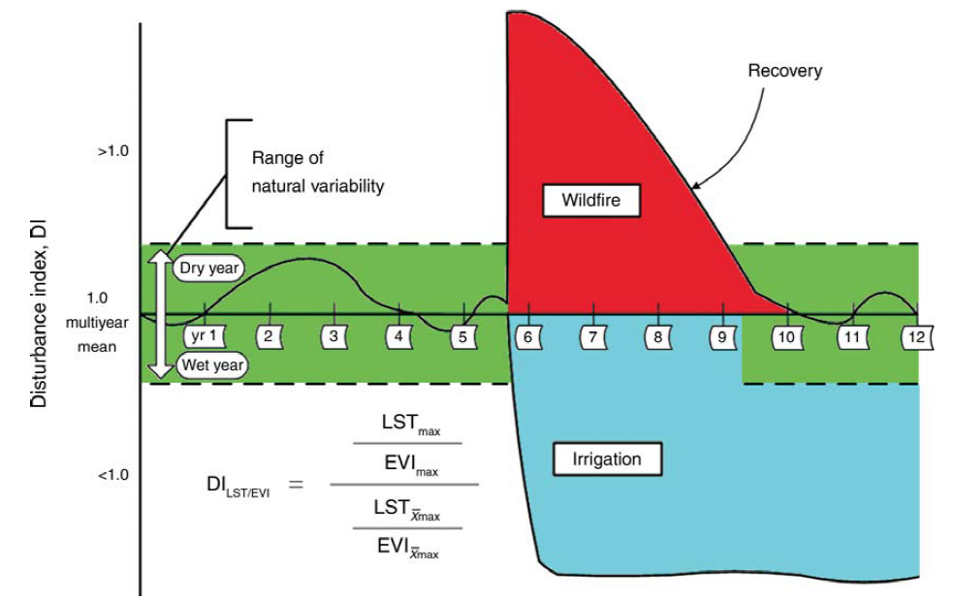
Disturbance detection
Mildrexler et al 2007
Notes:
DILST/EVI is the disturbance index (DI) value, LSTmax is the annual maximum eight-day composite LST, EVImax is the annual maximum 16-day EVI, LSTXmax is the multiyear mean of LSTmax, and EVIXmax is the multiyear mean of EVImax. DILST/EVI is a
dimensionless value that, in the absence of disturbance, approaches unity

Slide 4
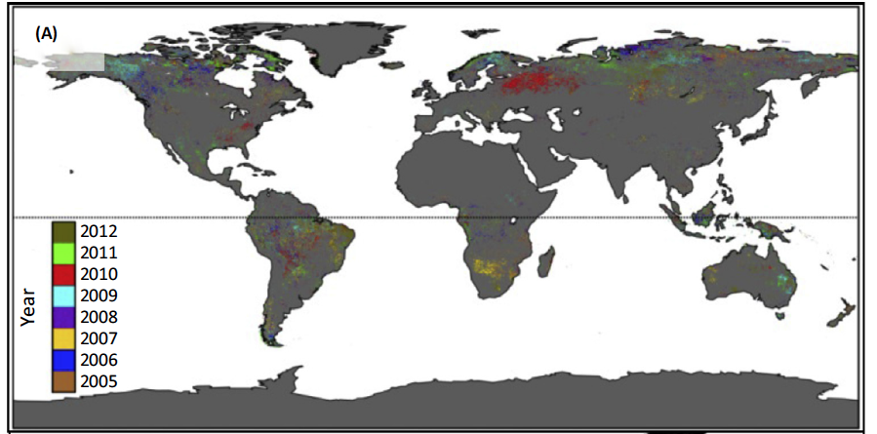
Disturbance detection
The Moderate Resolution Imaging Spectrometer (MODIS) Global Disturbance Index (MGDI; 500 m)
Fires
Insect outbreaks
Heatwave/fires
Droughts
Fires
McDowel et al 2015
Notes:
Fires (Mildrexter et al 2007)
Insect outbreaks (Coops et al 2009)
Droughts 2005 and 2010
(Philips et al 2009, Lewis et al 2011

Slide 5
MOD17 and disturbance: a few examples
2005 drought in Amazonia
2003/10 heatwaves in Europe
Oil and gas extraction

Slide 6
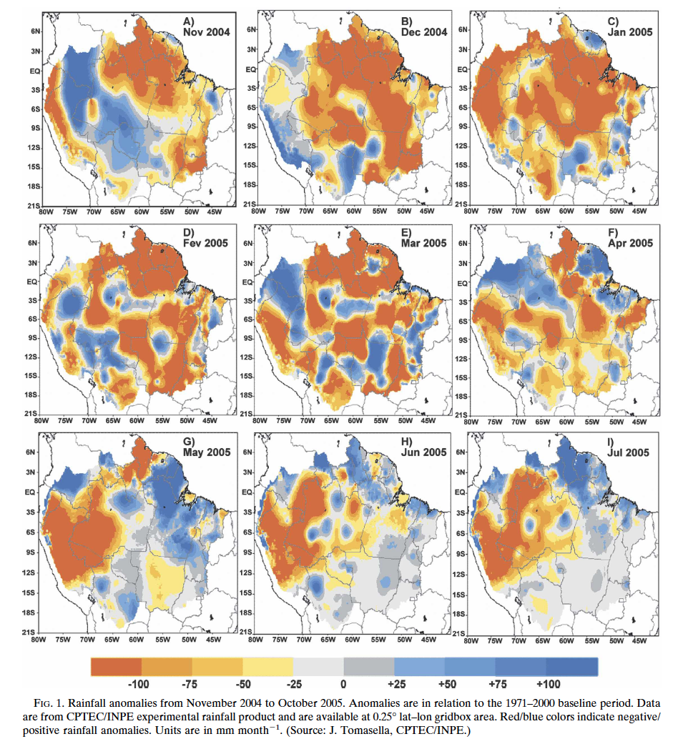
2005 drought in Amazonia
Marengo et al 2008

Slide 7
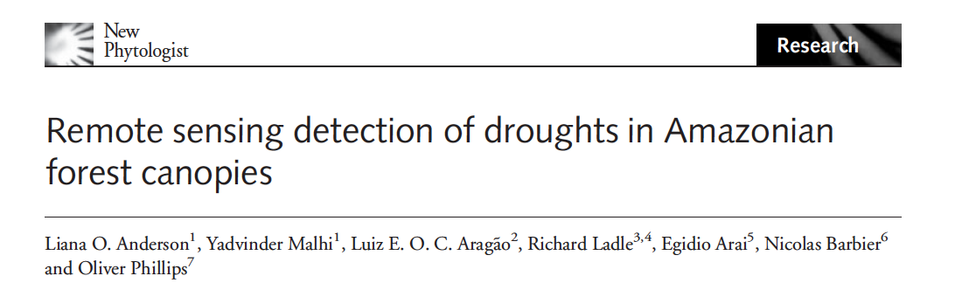
2005 drought in Amazonia
Science 2007
Geophysical Research Letters 2010
Science 2010
New Phytologist 2010

Slide 8
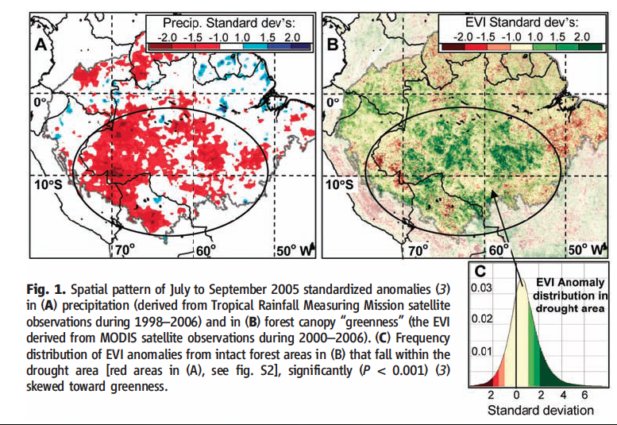
2005 drought in Amazonia
Saleska et al. 2007

Slide 9
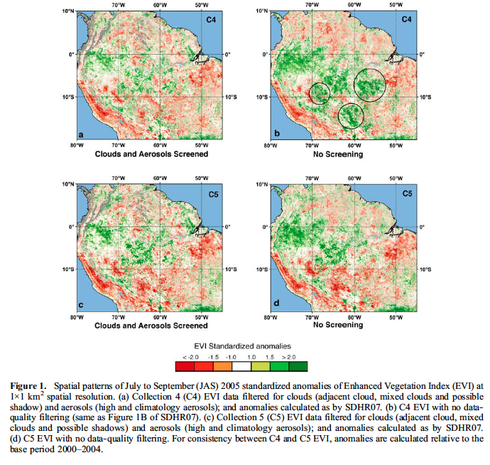
2005 drought in Amazonia
Samanta et al 2010

Slide 10
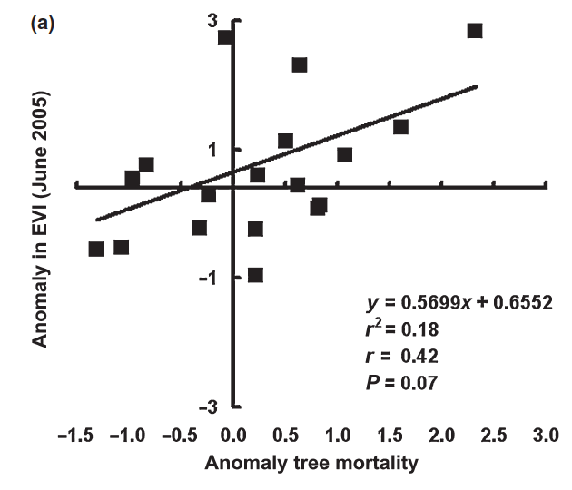
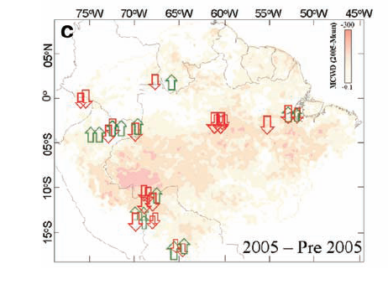
2005 drought in Amazonia
Anomalies in annual aboveground biomass change and tree mortality from site observations
Anderson et al 2010
Structural changes in canopy
Philips et al 2009

Slide 11
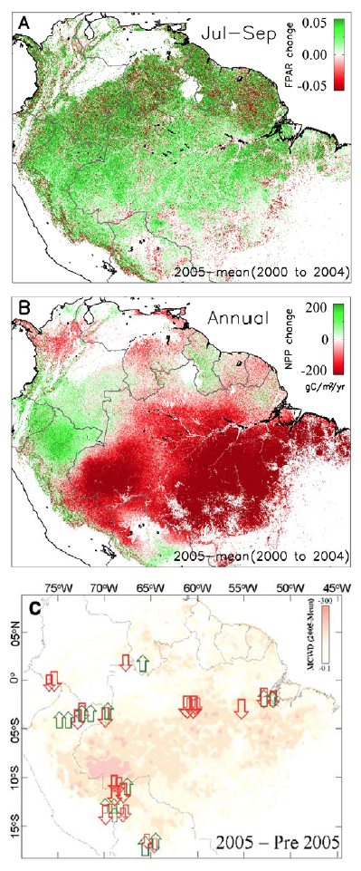
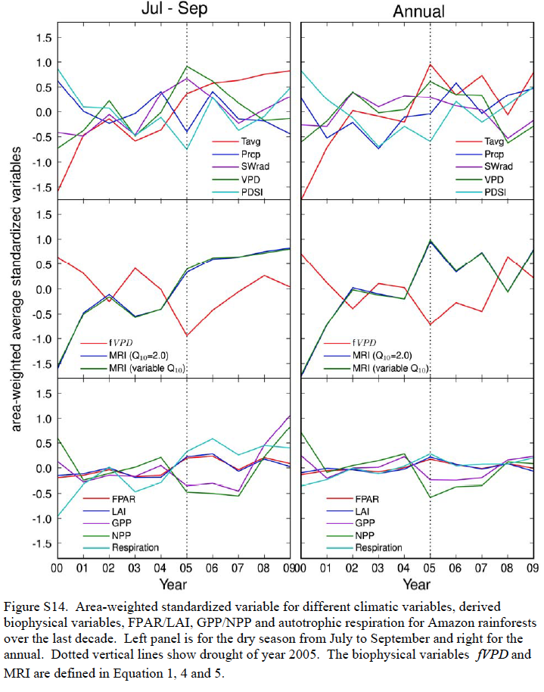
2005 drought in Amazonia
Zhao & Running 2010
fPAR dry season
?
Annual NPP
Aboveground biomass change
site observations (Philips et al. 2009)

Slide 12
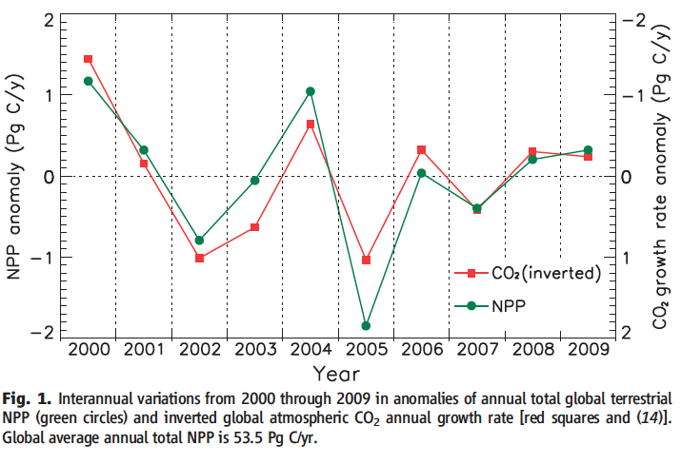
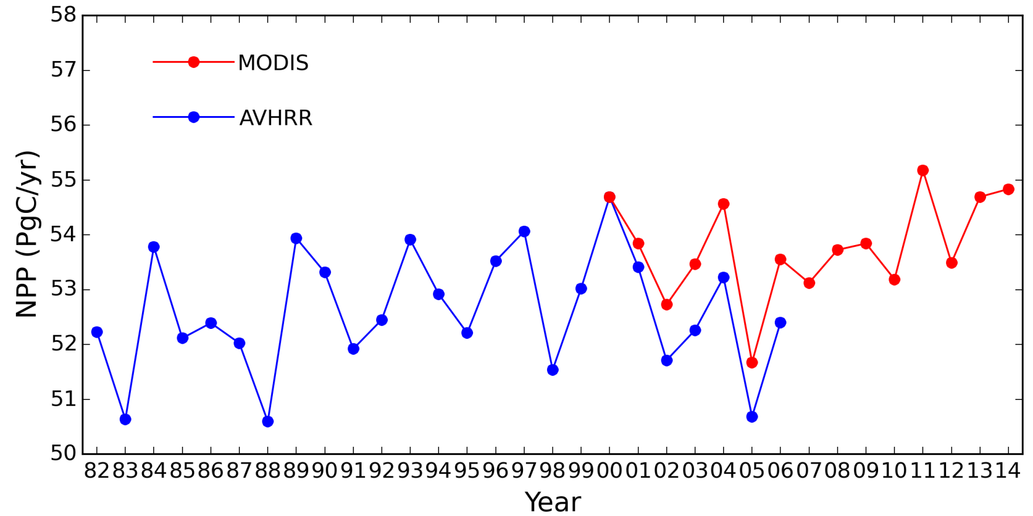
2005 drought in Amazonia
The effect of the drought in 2005 led to a stronger than average increase of CO₂ in the atmosphere
Zhao & Running 2010
Even for an extended record, 2005 is one of the years with lowest global NPP (the other ones associated with strong El-Niño events)
Courtesy of
Steven W. Running

Slide 13
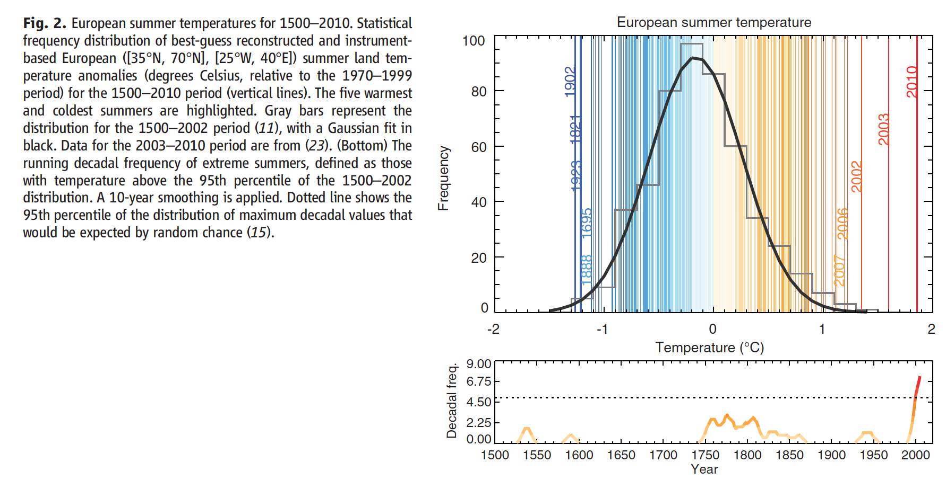
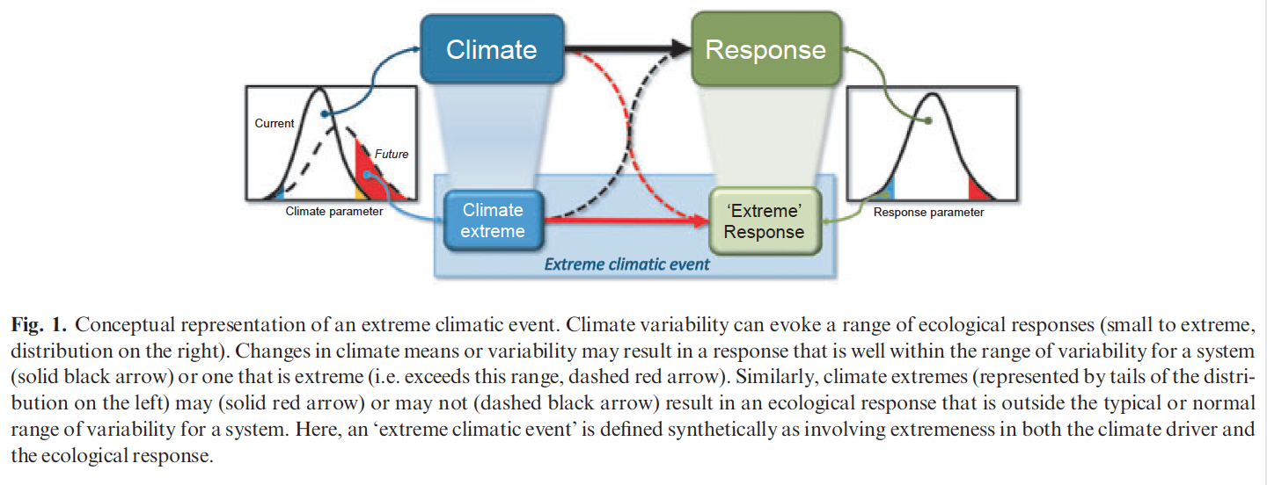
European heatwaves
Climatic extremes… ecological too?
Smith, 2011
Barriopedro et al, 2011

Slide 14
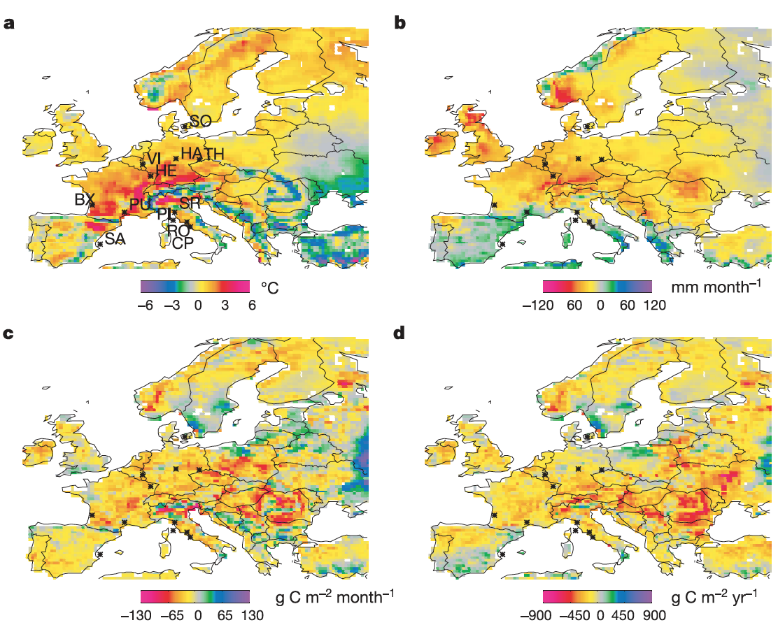
European heatwaves
2003 HW in western Europe
Heatwave preceded by lower than average precipitation
Also referred as
“drought” in several works about HW03
July-Sep
temperature
Annual
precipitation
July-Sep NPP Annual NPP
ORCHIDEE ORCHIDEE
Ciais et al, 2005

Slide 15
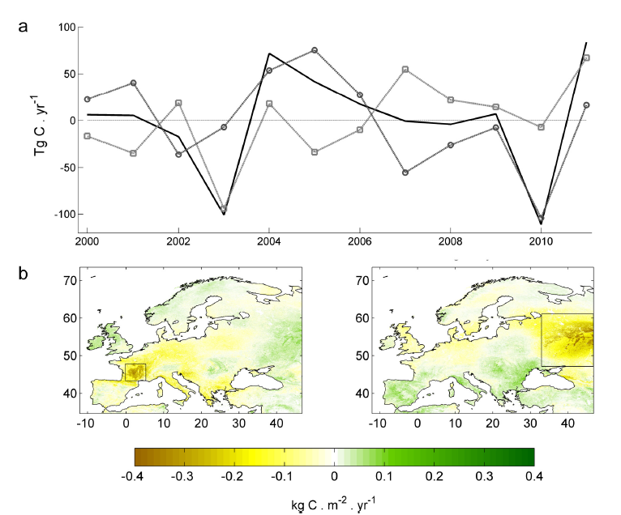
European heatwaves
Annual NPP anomalies in Europe (MODIS)
Similar impact on the continental scale
HW10
HW03
HW03:
widespread low NPP
HW10:
more localized but stronger NPP anomaly
Bastos et al, 2014

Slide 16
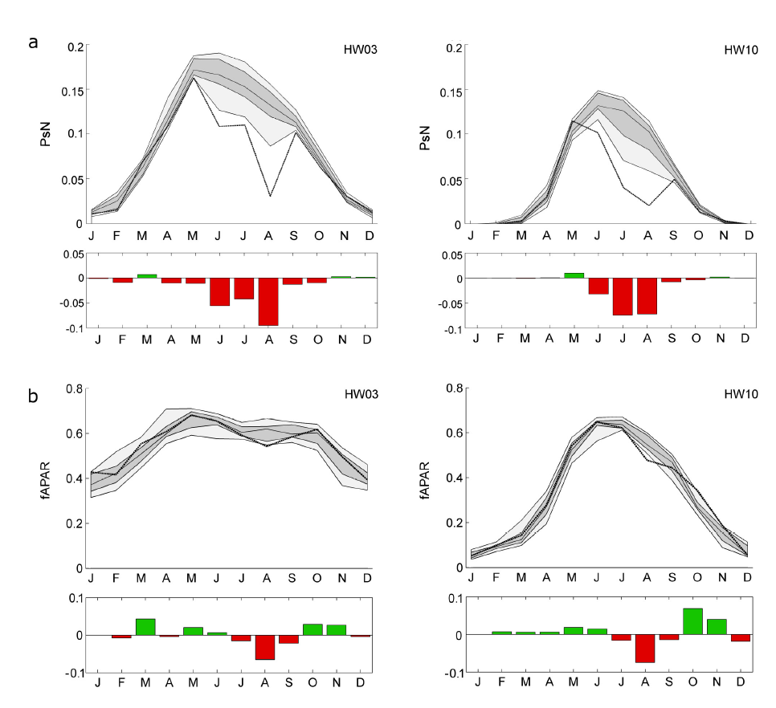
European heatwaves
Ecological extreme
…response to drought or heatwave?
fAPAR hardly captures an “extreme response”
Bastos et al, 2014

Slide 17
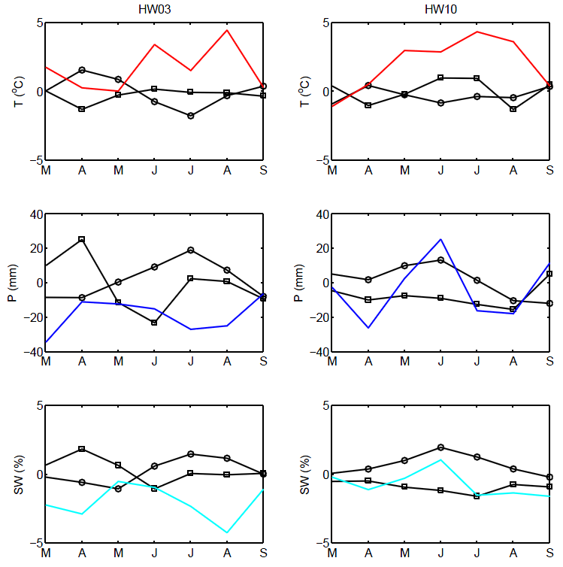
European heatwaves
Ecological extreme
…response to drought or heatwave?
Bastos et al, 2014
Best years (most productive)
Worse years (least productive)
Temperature
Precipitation
Soil water content
Temperature
Precipitation
Soil water content
2003
Extreme high temperature and water deficit
2010
Extreme high temperatures but not water stress
HW03:
water AND temperature stress
HW10:
Temperature only

Slide 18
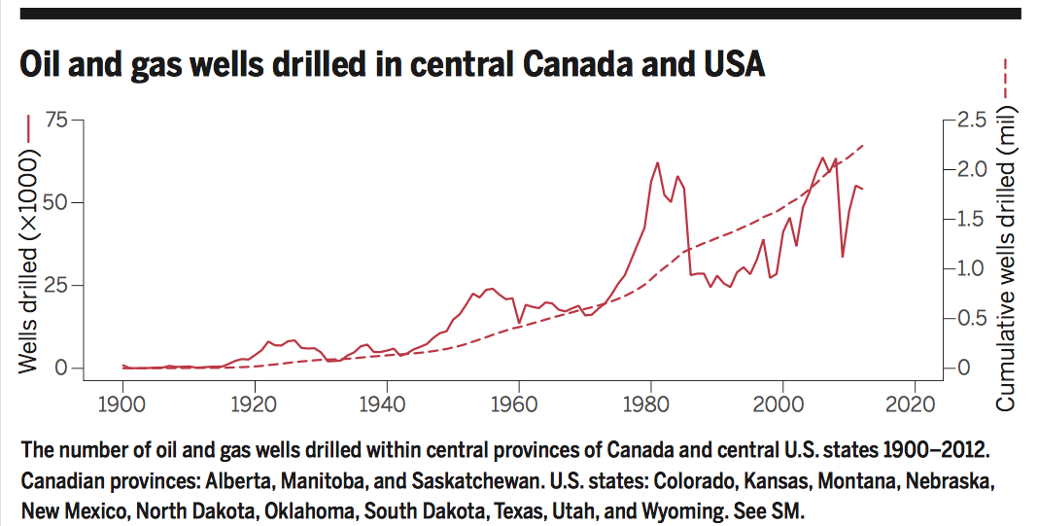
Human disturbance – oil & gas extraction
Allred et al, 2015
From 2000 – 2012
50,000 new wells / year

Slide 19
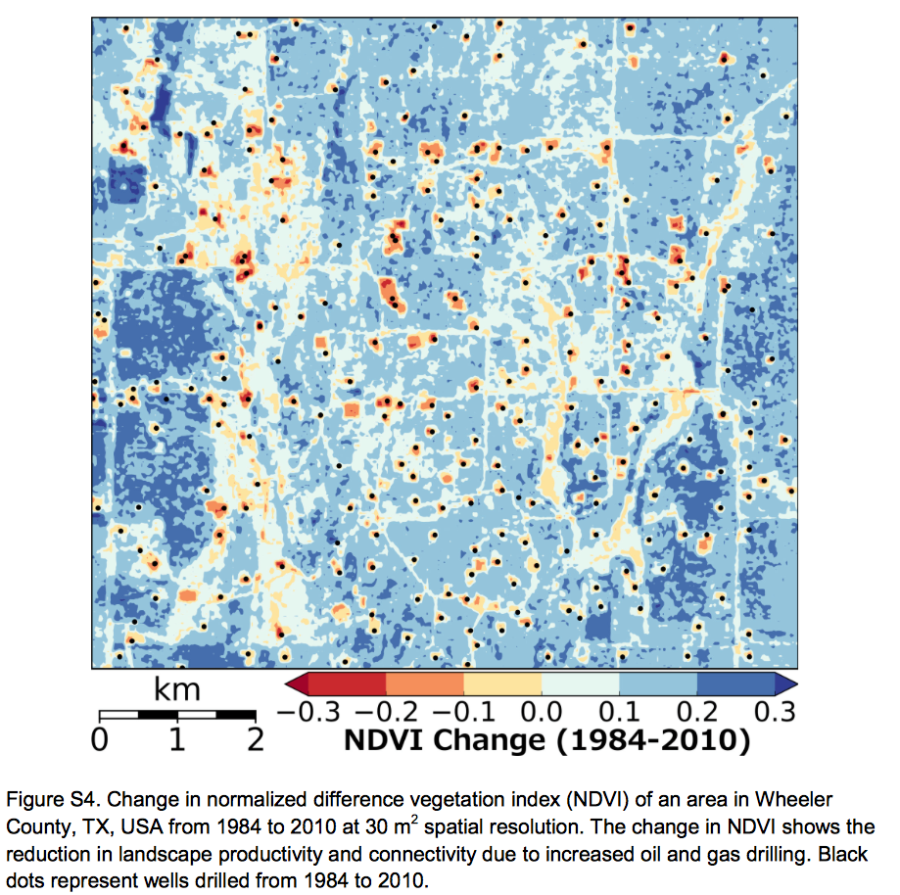
Human disturbance – oil & gas extraction
Allred et al, 2015
3 million ha land lost
4.5 Tg C of NPP lost / yr

Slide 20
Remarks
The continuous monitoring of vegetation activity enables detection of large-scale disturbances…
… and estimate large-scale spatio-temporal patterns of variability of global vegetation
…which helps better understanding the relationship between vegetation stress and climate drivers
… or human impact on ecosystem services
MOD17 GPP/NPP products appear to capture more realistically the impact of drought & heat extremes on vegetation that simple radiometric indices (fPAR or NDVI)

Slide 21
Thanks!
ana.bastos@lsce.ipsl.fr
Thanks to Steven W. Running for insights & comments

