Slide 1
the Fire Risk Mapping product of the lsa saf: application to forest management
Carlos C. DaCamara, Sílvia A. Nunes, Miguel M. Pinto, Teresa J. Calado, Teresa L. Rosa, Tiago M. Oliveira and Rui Almeida
Presentation by Sofia Ermida

Slide 2
INTRODUCTION
Representing more than 85% of burned area in Europe, the Mediterranean is one of the regions of the world most affected by large wildfires.
In Mediterranean Europe, fire is a natural phenomenon linking climate, humans and vegetation.
Fire activity is therefore conditioned by natural and anthropogenic factors.

Slide 3
INTRODUCTION
Natural factors include topography, vegetation cover and prevailing weather conditions.
Weather conditions are linked to several atmospheric mechanisms working at different temporal and spatial scales.
Rainy and mild winters followed by warm and dry summers lead to high levels of vegetation stress that make Mediterranean Europe particularly prone to the occurrence of fire events.
Extreme weather conditions (e.g. temperature, wind speed, fuel moisture and relative humidity) play a key role in the ignition and spread of wildfires.

Slide 4
INTRODUCTION
In Mediterranean Europe, land management practices and inadequate use of fire are crucial anthropogenic factors being responsible for about 90% of fire ignitions.
Anthropogenic factors also include fire management policies that comprise fire prevention, fire pre-suppression and fire suppression measures, which depend on topography, vegetation cover and prevailing weather conditions, and on resources employed.
Fire prevention requires adequate knowledge about wildfire potential assessment that comprises potential fire ignition, education, law enforcement and difficulty of control.
Wildfire potential assessment is usually based on fire danger rating systems which provide indices to be used on an operational and tactical basis in wildfire management decision support systems.

Slide 5
The FRm product
The Satellite Application Facility for Land Surface Analysis (LSA SAF) is currently disseminating the Fire Risk Mapping (FRM) product.
The rationale is to provide the user community with information on meteorological risk that will allow adopting the adequate measures to mitigate fire damage.

Slide 6
The FRm product
The FRM product consists of forecasts of fire danger over Mediterranean Europe based on a statistical procedure that combines information about fire history with daily meteorological data provided by the European Centre for Medium-Range Weather Forecasts (ECMWF).
Historical information about fire radiative power is available from the Fire Radiative Power (FRP) product of the LSA SAF.

Slide 7
The FRm product
Meteorological information is used to derive the set of components of the Canadian Forest Fire Weather Index System (CFFWIS) that has proven to be especially adequate to rate fire danger over the Mediterranean.
Levels of fire danger are then associated to probabilities of exceedances (i.e. of occurrence of fires exceeding specified magnitudes).

Slide 8
FRM for August 25, 2007

Slide 9
A brief description of Frm
The algorithm to derive FRM consists of 4 main steps:
1st step: Identification of regions with similar fire behavior.
Notes:
The described methodology eill focus on Portugal but the methods are the same for the rest of the mediterrânea europe
Fist step is identifying regions with the same fire behaviour

Slide 10
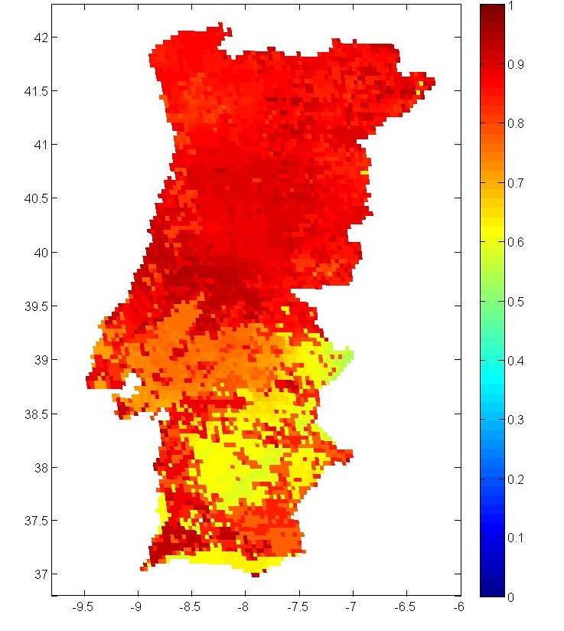
1st STEP
5
4
3
2
1
P(X>50 GJ | Event)
Notes:
First, for each pixel, the realized energy per day is calculated by suming the fire radiative power
Then for each pixel, we consider 67 km square arround the pixel and considering only pixels with the same vegetation type, we calculate the number of detected fires and the number with radiative power above 50Gj
Then we progressively increase the size of the square until the number of occurred fires is above 200
We calculate the conditional probability of having a fire radiating more then 50Gj by dividing the number of fire with radiative power above this value by the total number of fires
And the classes correspond to intervals of this probability, from 0 to 20, from20 to 40, etc

Slide 11
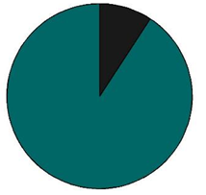
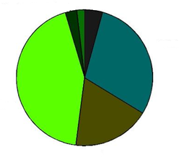
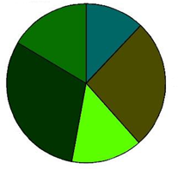
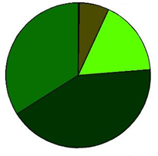
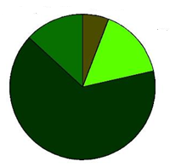
1st STEP
Needle leaved
Broad leaved
1
2
3
Mixed
Shrub
Cultivated
4
5
Notes:
This is the distributionof the vegetation types for each of the 5 classes. As expected, these are consistent: as the probability increases the classes starts to be dominated with cover types with more available biomass

Slide 12
A brief description of Frm
The algorithm to derive FRM consists of 4 main steps:
1st step: Identification of regions with similar fire behavior.
2nd step: Fitting of Pareto distributions.

Slide 13
2nd STEP
1
2
3
4
5
Notes:
Here we have the distribution of radiative power per day for each of the classes. There is a shift towards higher energy valueswich suggests using a pareto distribution

Slide 14
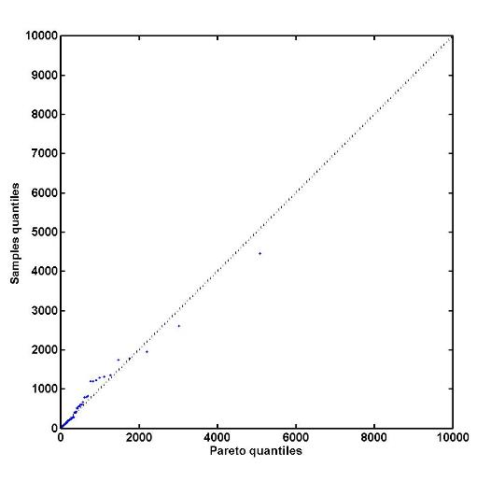
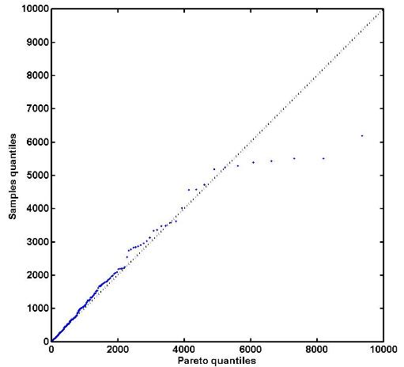
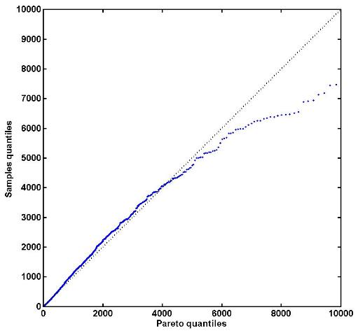
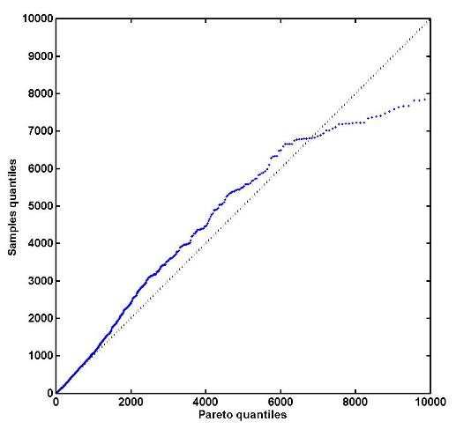
2nd STEP
1
2
3
4
5
Notes:
Here are the percentile plots of the fits. For classes 3,4 there is a overestimation of the power. This is related to the fact that Seviri sensor saturates at the 3.9 micron channel for relatively low values of energy, thus we believe that the model might be close to reality

Slide 15
A brief description of Frm
The algorithm to derive FRM consists of 4 main steps:
1st step: Identification of regions with similar fire behavior.
2nd step: Fitting of Pareto distributions.
3rd step: Introduce FWI as a covariate.

Slide 16
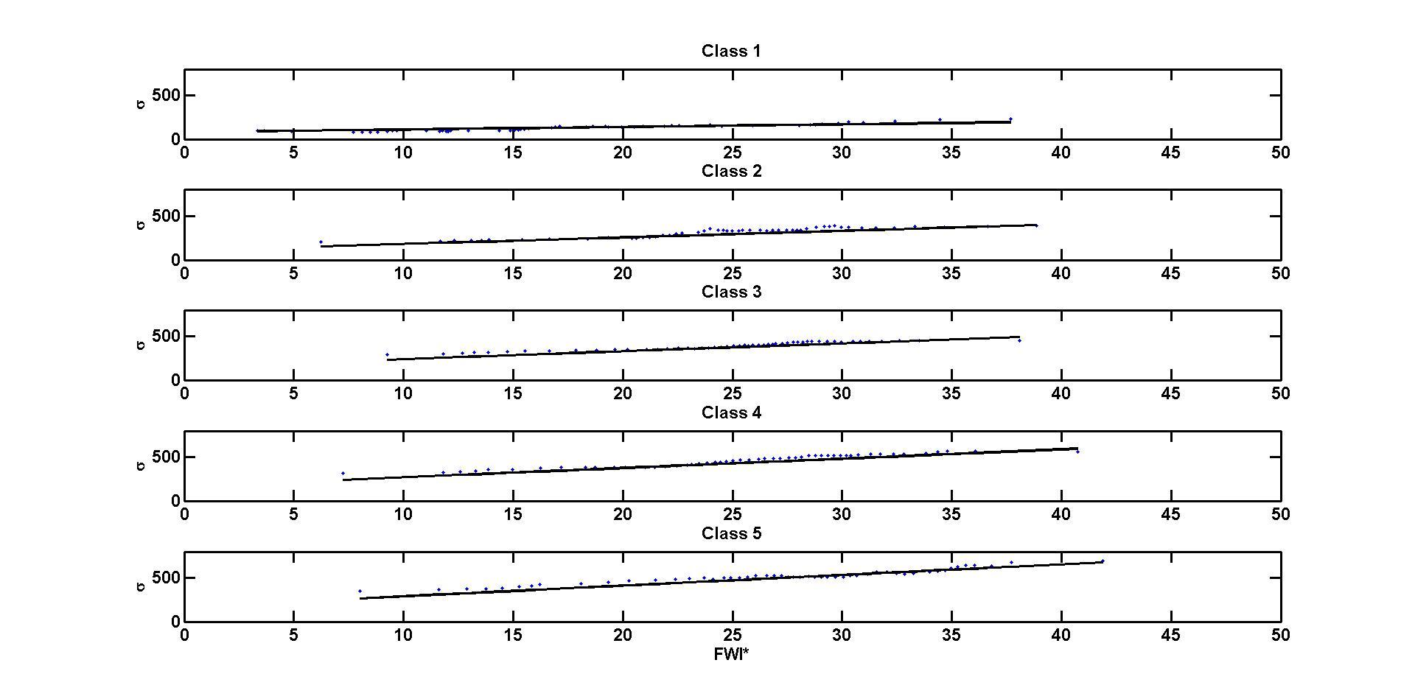
3rd STEP
1
2
3
4
5
Notes:
For each classe, the samples were stratified based on the fwi anomalies of the day. The results suggest that the scale parameter has a linear cependence on fwi anomalies and may be then used as a covarit

Slide 17
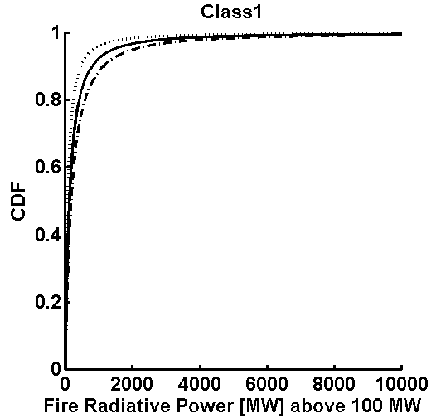
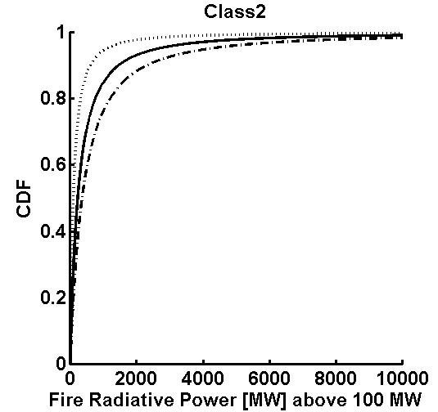
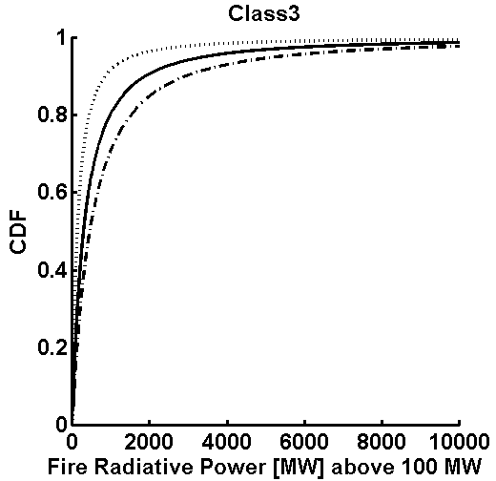
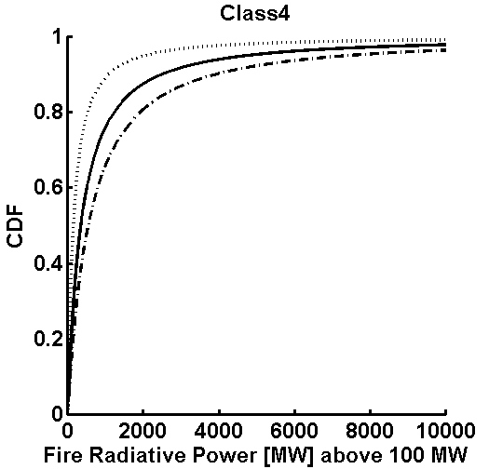
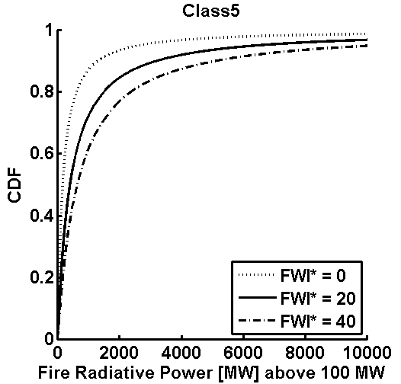
3rd STEP
1
2
3
4
5
Notes:
Here we have the cumulative distribution function for three values of fwi anom. The probability of exceedance increases with the classe, that is, the meteorology plays a more importante role for higher classes (as we have bigger fires and more forest)

Slide 18
A brief description of Frm
The algorithm to derive FRM consists of 4 main steps:
1st step: Identification of regions with similar fire behavior.
2nd step: Fitting of Pareto distributions.
3rd step: Introduce FWI as a covariate.
4th step: Compute probabilities of exceedance. Set fire risk classes

Slide 19
4th STEP
1
2
3
4
5
P(X>600 GJ l 100 GJ
Notes:
This is an esample where we have the probability of having a fire with realesed energy jabove 600Gj given that we have a fire that burned 100Gj
The lines mark the five risk classes defined empiricaly

Slide 20
4th STEP
Notes:
Example

Slide 21
APPLICATIONS TO FOREST management
Decision making on burning within the framework of agricultural and forest management practices is a delicate activity since wrong or uninformed decisions may trigger severe events associated to large damages.
The process will greatly benefit from knowledge about the statistical distributions of exceedances in fire radiative power, as well as of meteorological parameters and derived indices of fire danger.

Slide 22
APPLICATIONS TO FOREST management
Incorporation of such information into the FRM product is facilitated by the availability of historical information about fire radiative power from Fire Radiative Power (FRP) product of the LSA SAF.
Long-term information about meteorological parameters is also available from ECMWF reanalyses.

Slide 23
Tailoring the frm product
Institute for Conservation of Nature and Forests
Portucel Soporcel group
National Authority for Civil Protection
Notes:
This is a list of the main users of the product that give a constant feedback

Slide 24
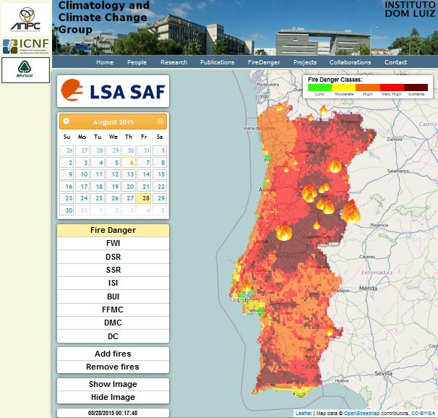
Tailoring the frm product
http://idlcc.fc.ul.pt/firedanger

Slide 25
Tailoring the frm product
Notes:
Lines show the value calculate for the day and colors are the percentile values for the day relative to a 30 year climatology
The fwi is closely related to the classes of risk, but these are sensitive to anomalies of fwi

Slide 26
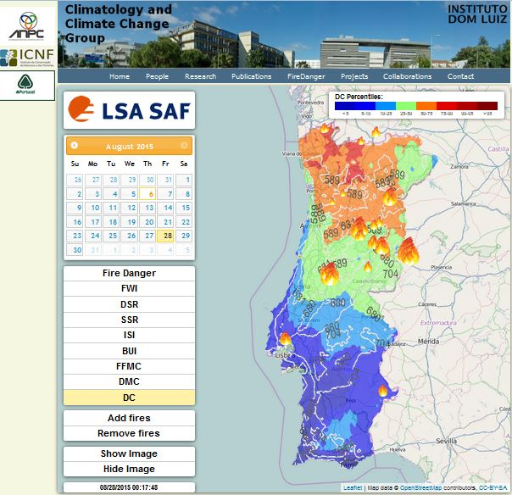
Tailoring the frm product
Notes:
– drought code, fazendo notar que o norte do país se encontra com percentis especialmente elevados (o que quer dizer que se tem de ter especial cuidado com o rescaldo, na medida em que DC elevado implica um decréscimo de humidade do sol com o aumento de profundidade

Slide 27
Tailoring the frm product
Notes:
DSR – que representa a dificuldade de se combater um grande incêndio

Slide 28
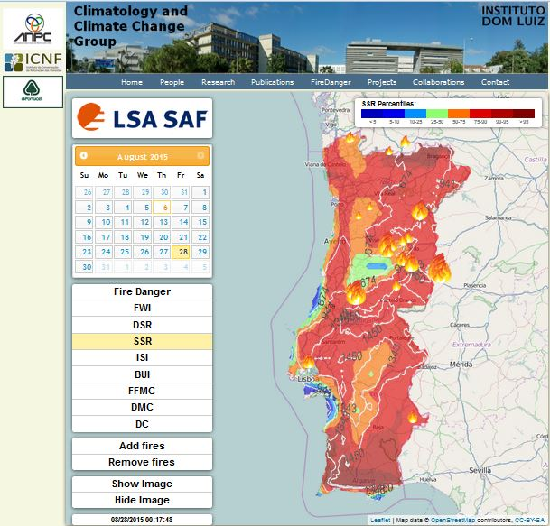
Tailoring the frm product
Notes:
SSR – DSR acumulado desde 1 Jan; notar uma zona do centro do país em que o SSR é baixo – isso poderá indicar que se trata de uma zona onde será menos provável a ocorrência de incêndios

Slide 29
A FIRST BALANCE
Access to spatial distributions
(no need to interpolate)
Data in a given pixel may be compared at each grid point with historical values
(saturation of indices is eliminated)
More adequate to be used by systems of authorization with random distributions over the country
Allows identifying values that appear as extremes (saturation of indices is eliminated)
Reduce the need to use physical variables to condition the behavior of meteorological indices
More stability and continuity in the data leading to a sounder use of the information
Adequate to the system of authorization of burning
Adequate to complement operational decisions in combat and surveillance
Adequate to complement decisions about when to use controlled fire
Advantages of the LSA SAF FRM Product
Notes:
is a first balance of the developed system made by eng rui almeida from the icnf

Slide 30
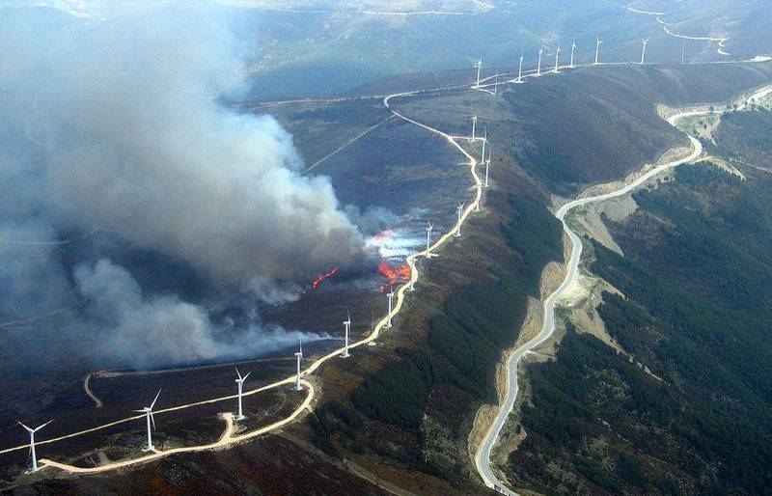
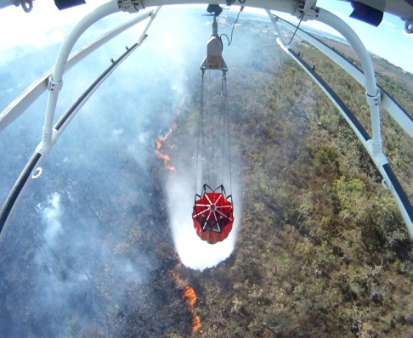
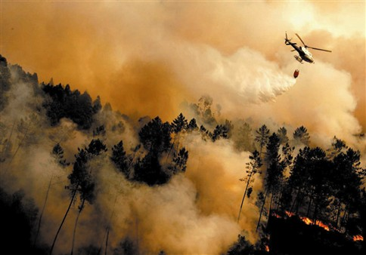
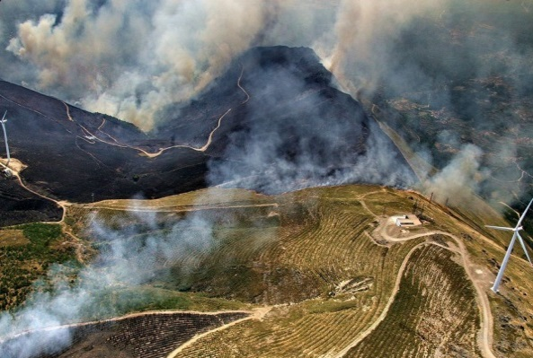
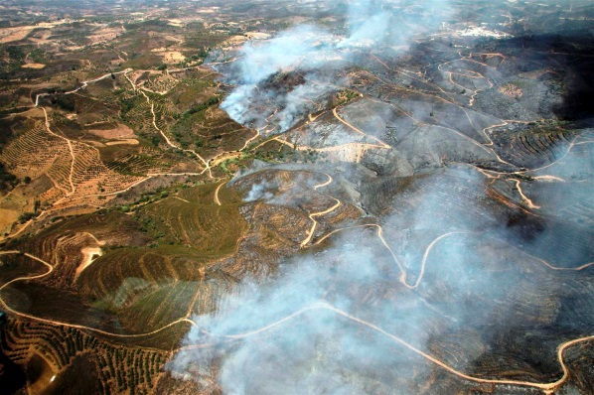
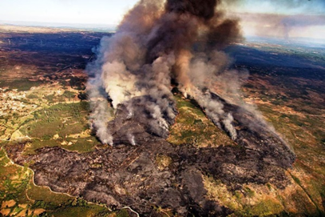
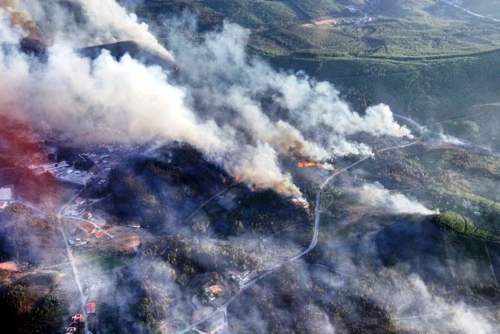
Thank you

