Slide 1

Overview of LSA SAF Programme
Status and perspectives for further developments
Luís Pessanha & LSA team
Portuguese Sea and Atmosphere Institute luis.pessanha@meteo.pt
Thanks to LSA-SAF Consortium

Slide 2
SUMMARY
SAF concept
SAF network
Overview of LSA SAF project
Short view of production and product examples
User community and applications
Validation: Product quality and service quality
System concept & dissemination system (details about user data assess)
Conclusions

Slide 3
SUMMARY
SAF concept
SAF network
Overview of LSA SAF project
Short view of production and product examples
User community and applications
Validation: Product quality and service quality
System concept & dissemination system (details about user data assess)
Conclusions

Slide 4

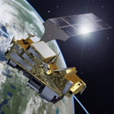


EUMETSAT SATELLITE SYSTEMS
MetOp-A
MetOp-B
MetOp-C
Meteosat-8 (MSG-1)
Meteosat-9 (MSG-2)
Meteosat-11 (MSG-4)
MTG-1
Meteosat-10 (MSG-3)
99
00
01
02
03
04
05
06
07
08
10
11
12
13
14
15
16
17
18
19
20
21
22
23
24
MSG
1-28/08/2002
2-22/12/2005
3-05/07/2012
4-17/07/2015
METOP
a-19/10/2006
b-17/09/2012
c-2017
The future…

Slide 5
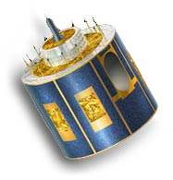
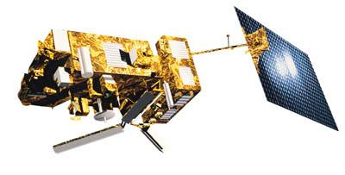

EUMETSAT APPLICATION GROUND SEGMENT
Data Acquisition
and Control
EUM/NOAA Polar Systems
Other data sources
EUM Geostationary
Systems
Data Processing
EUMETSAT HQ
Application Ground Segment
Meteorological Products
Extraction
EUMETSAT HQ
Archive & Retrieval
Facility (Data Centre)
EUMETSAT HQ
Satellite Application
Facilities (SAFs)
Centralised processing
and generation of products
Decentralised processing
and generation of products
USERS

Slide 6
EUMETSAT SATELLITE SYSTEMS
MetOp-A
MetOp-B
MetOp-C
Meteosat-8 (MSG-1)
Meteosat-9 (MSG-2)
Meteosat-11 (MSG-4)
MTG-1
Meteosat-10 (MSG-3)
99
00
01
02
03
04
05
06
07
08
10
11
12
13
14
15
16
17
18
19
20
21
22
23
24
Development Phase
Sep 1999
CDOP 1 Mar 2007 | CDOP 2 Mar 2012 | CDOP 3 Mar 2017 | CDOP n (5 years)
Continuous Development & Operations
MSG
1-28/08/2002
2-22/12/2005
3-05/07/2012
4-17/07/2015
Initial Operations Phase
Feb 2005
METOP
a-19/10/2006
b-17/09/2012
c-2017
The future…

Slide 7
SAF STRATEGIC ELEMENTS
SAF strategic is according with EUMETSAT rules and convention
Distributed system for R&D as well as operational services (processing, archive &distribution)
Cost-effectiveness and synergy between the central and distributed services
Free use of data for applications

Slide 8
SAF STRATEGIC ELEMENTS
Benefits for special users
Environmental monitoring
  Ecology, disaster monitoring and agricultural forecasting
  Ozone depletion and upper atmosphere chemistry
  Early warning of hazards
  Data for climate monitoring
Benefits for industry
  Sea transport, fishing and offshore industries
  Aviation, agriculture & construction
  Gas, water & electricity industries
Improved data for input to Numerical Weather Prediction
Short range forecasting of severe weather hazards
Availability of user software packages for operational applications

Slide 9
SUMMARY
SAF concept
SAF network
Overview of LSA SAF project
Short view of production and product examples
User community and applications
Validation: Product quality and service quality
System concept & dissemination system (details about user data assess)
Conclusions

Slide 10
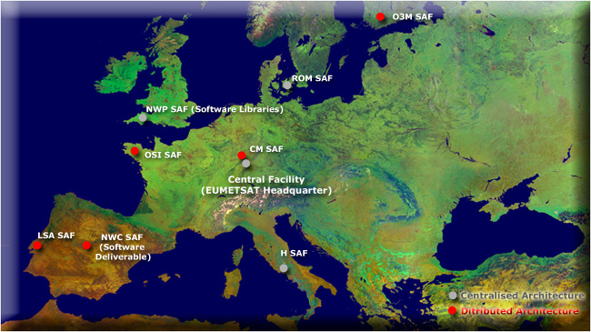
SAF NETWORK

Slide 11
SAF NETWORK
Member State
Cooperating State
Support to Nowcasting and
Very Short Range Forecasting
Ocean and Sea Ice
Climate Monitoring
Numerical Weather Prediction
Land Surface Analysis
Ozone and Atmospheric
Chemistry Monitoring
GRAS Meteorology
Support to Operational Hydrology
and Water Management
SAF Consortium Member
Additional Met Service Users
Objectives of the SAF Network
Improve EUMETSAT’s Member States exploitation of satellite data
Encourage the utilisation of existing skills and infrastructure in Member States and Cooperating States
Cost-effective exploitation: Services are distributed in the most appropriate way
Foster development of cooperation with non-Member States and other organisations
1
2
3
4
5
6
6
7
7
8
4
2
3
5
1
8

Slide 12
OVERVIEW
SAF concept
SAF network
Overview of LSA SAF project
Short view of production and product examples
User community and applications
Validation: Product quality and service quality
System concept & dissemination system (details about user data assess)
Miscellaneous (including CDOP3 challenge)
Conclusions

Slide 13
OVERVIEW OF LSA SAF PROJECT
LSA SAF Mission
Objective
  To be a leading centre for retrieval of information on land surfaces from remote sensing data, with emphasis on EUMETSAT satellites.
Purpose
  To provide NRT (up to 3 hours after observation) & offline products and user support related with land surface variables:
    surface radiation, both long- and short-wave components;
    vegetation, including state, stress and wild fires;
    the energy budget at the surface.

Slide 14
OVERVIEW OF LSA SAF PROJECT
Objectives of the SAF Network
Develop techniques that allow an effective use of MSG and EPS data related to:
  LAND
  LAND-ATMOSPHERE Interactions
  BIOSPHERIC Applications
Timely provide:
  Products
  User support

Slide 15
OVERVIEW OF LSA SAF PROJECT
EUMETSAT Satellite Applications Facility dedicated to algorithm development, validation and operational production of land surface related products based (primarily) on European meteorological satellites (MSG and METOP)
  Consortia with several Institutes and countries
  Continuous Development Operational Phase I (2007-2012)
  Continuous Development Operational Phase II (2012-2017)
  Continuous Development Operational Phase III (2017-2022)
Real time operations (i.e., some products are available every 15 min, ~1 hour after observed)
An efficient and modular real time operational system, to which new functionalities can be added on demand (plug-in concept)
Reviewed (~annually) by technical and scientific review panels

Slide 16














OVERVIEW OF LSA SAF PROJECT
CDOP-2 LSA SAF Consortium
IPMA (Portugal) – Leading Institution
MF (France)
RMI (Belgium)
KCL (King’s College London)
IDL (Univ Lisbon)
KIT (Karlsruhe Inst Technology)
UV (Univ Valencia)
VITO (Flemish Inst Technological Res)
  8 Institutes / 6 Countries

Slide 17
OVERVIEW OF LSA SAF PROJECT
Organisation principles
  Algorithms shall be developed at one of the participating Institutes (development distributed by the Consortium).
  Algorithms will be handed over to IPMA for integration and production as well as archive and distribution (operations centralized).

Slide 18
OVERVIEW
SAF concept
SAF network
Overview of LSA SAF project
Short view of production and product examples
User community and applications
Validation: Product quality and service quality
System concept & dissemination system (details about user data assess)
Miscellaneous (including CDOP3 challenge)
Conclusions

Slide 19
SHORT VIEW OF PRODUCTION AND PRODUCT EXAMPLES
LSA SAF - MSG Products
Energy Balance
Radiation
Vegetation
SW
LW
Wild Fire
State
Water stress
Albedo
Downwelling SW
(Aerosol)
LST
Emissivity
Downwelling LW
Detection
Emitted Power
Risk Burnt Areas
Veg. Fraction
LAI/FAPAR/NDVI
Evapotranspiration
Ref Evapotranspiration
Energy Fluxes at the Surface - GPP/NPP (Gross/Net Primary Production)

Slide 20
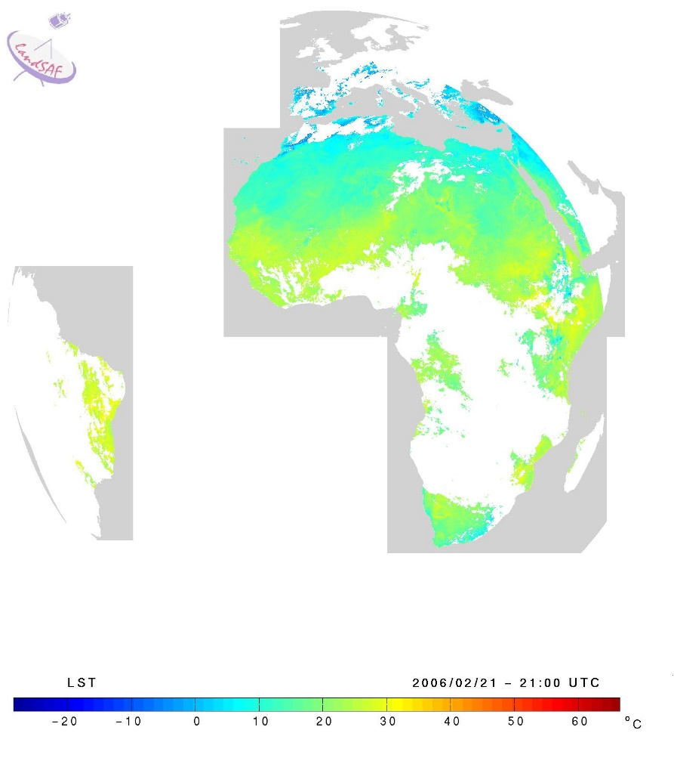

SHORT VIEW OF PRODUCTION AND PRODUCT EXAMPLES
MSG Products Characteristics
All products have a quality flag field associated
All products have a Product User Manual and a comprehensive Validation Report
NOW
MSG - production & distribution for 4 areas
  - Europe
  - N. Africa
  - S. Africa
  - S. America
SEVIRI resolution
Variable time resolution
  - 15 min to 10 days
EPS products:
  A big challenge to be done
  Global production will start this year (depending on the new system)

Slide 21
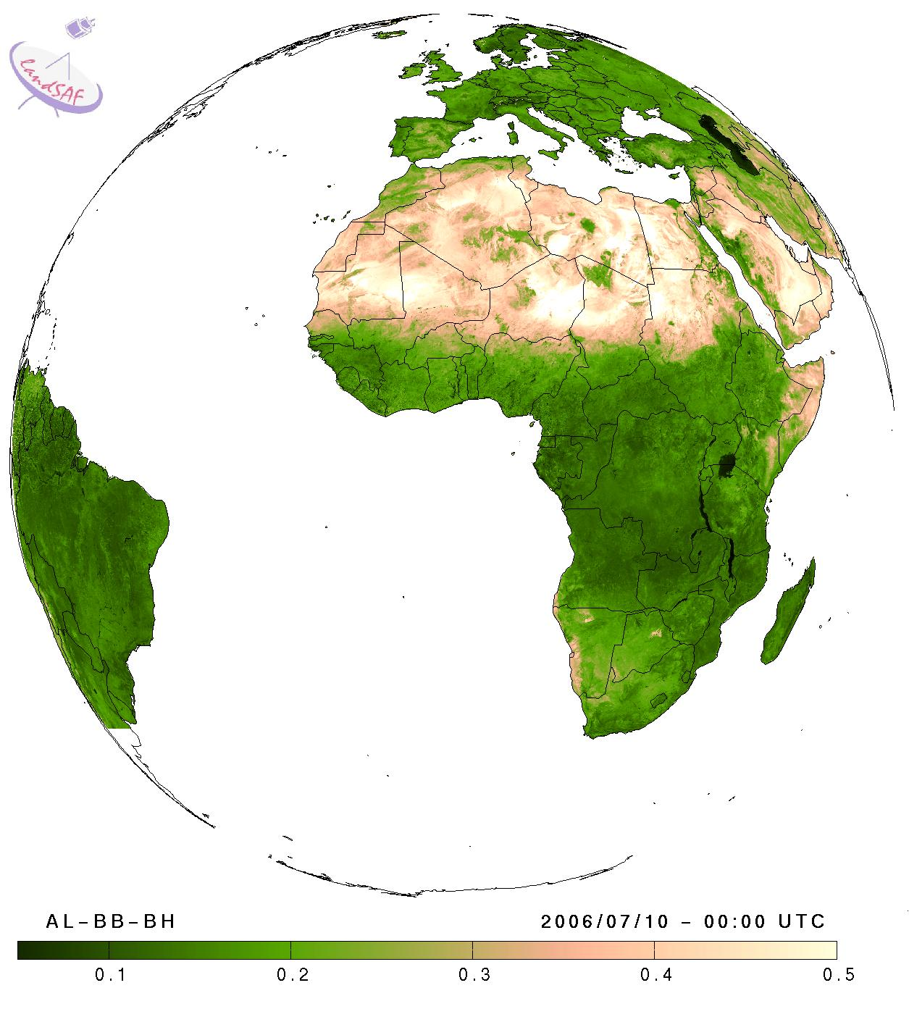
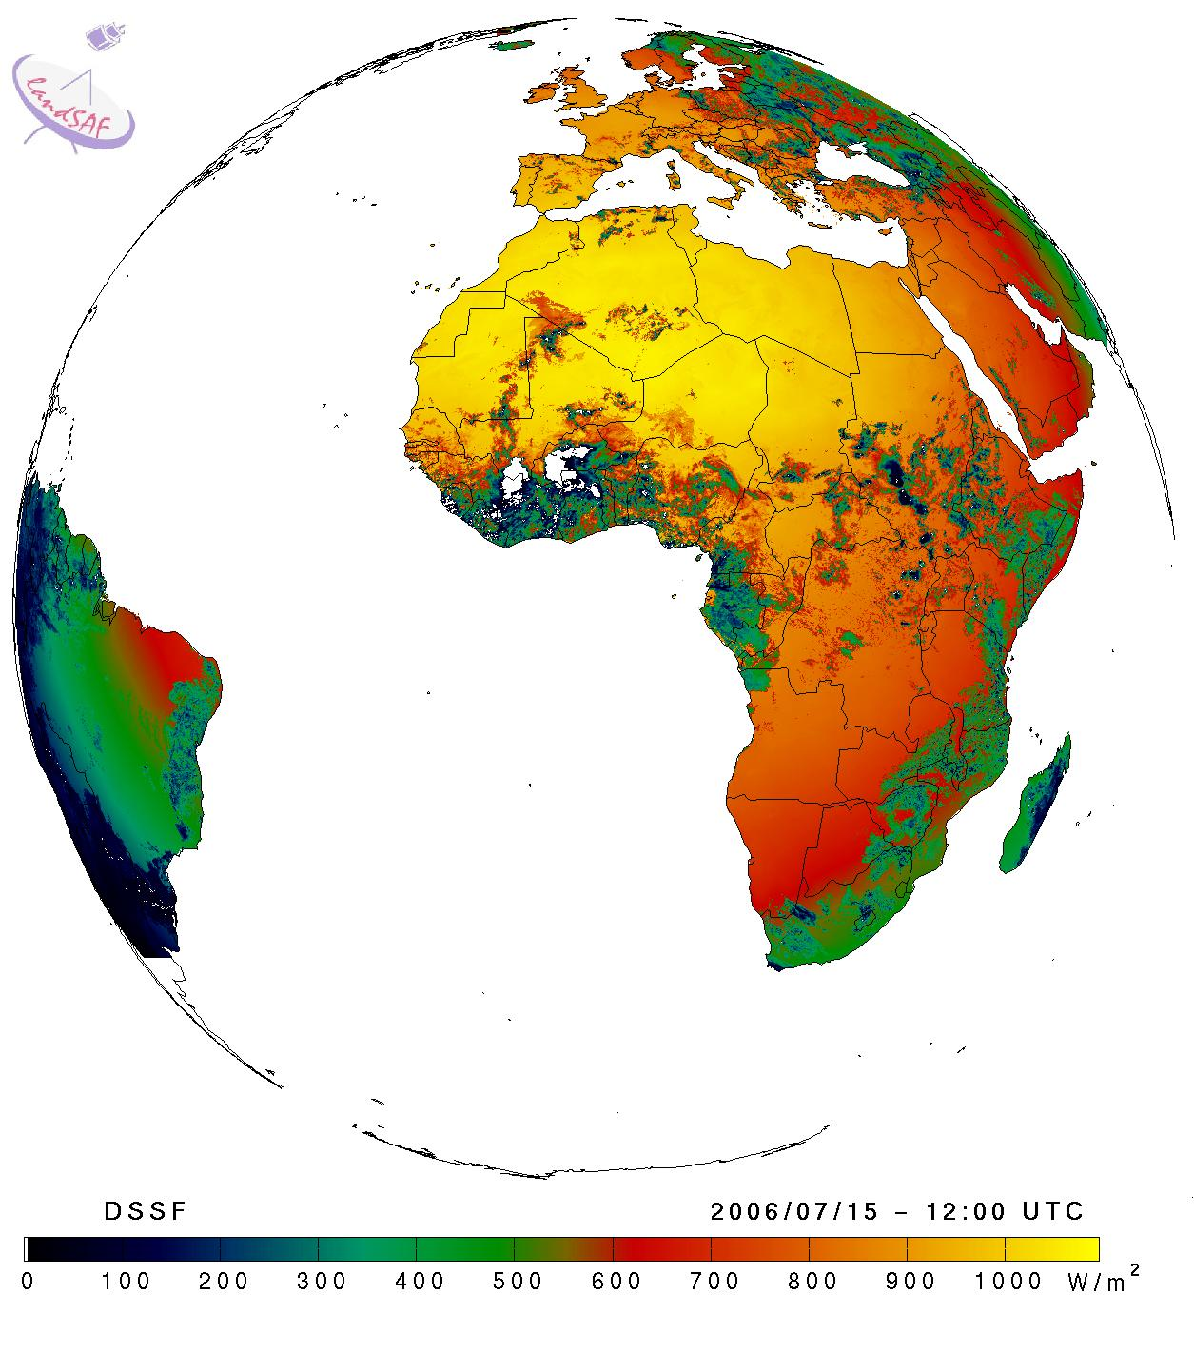
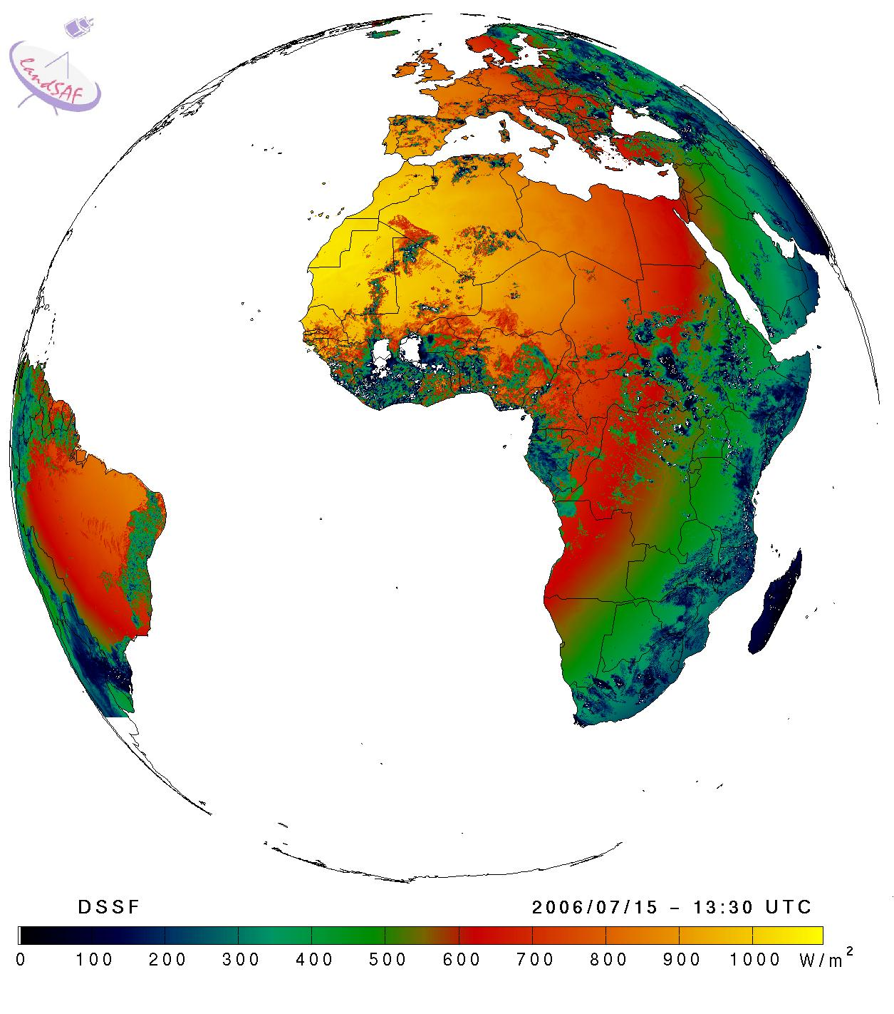
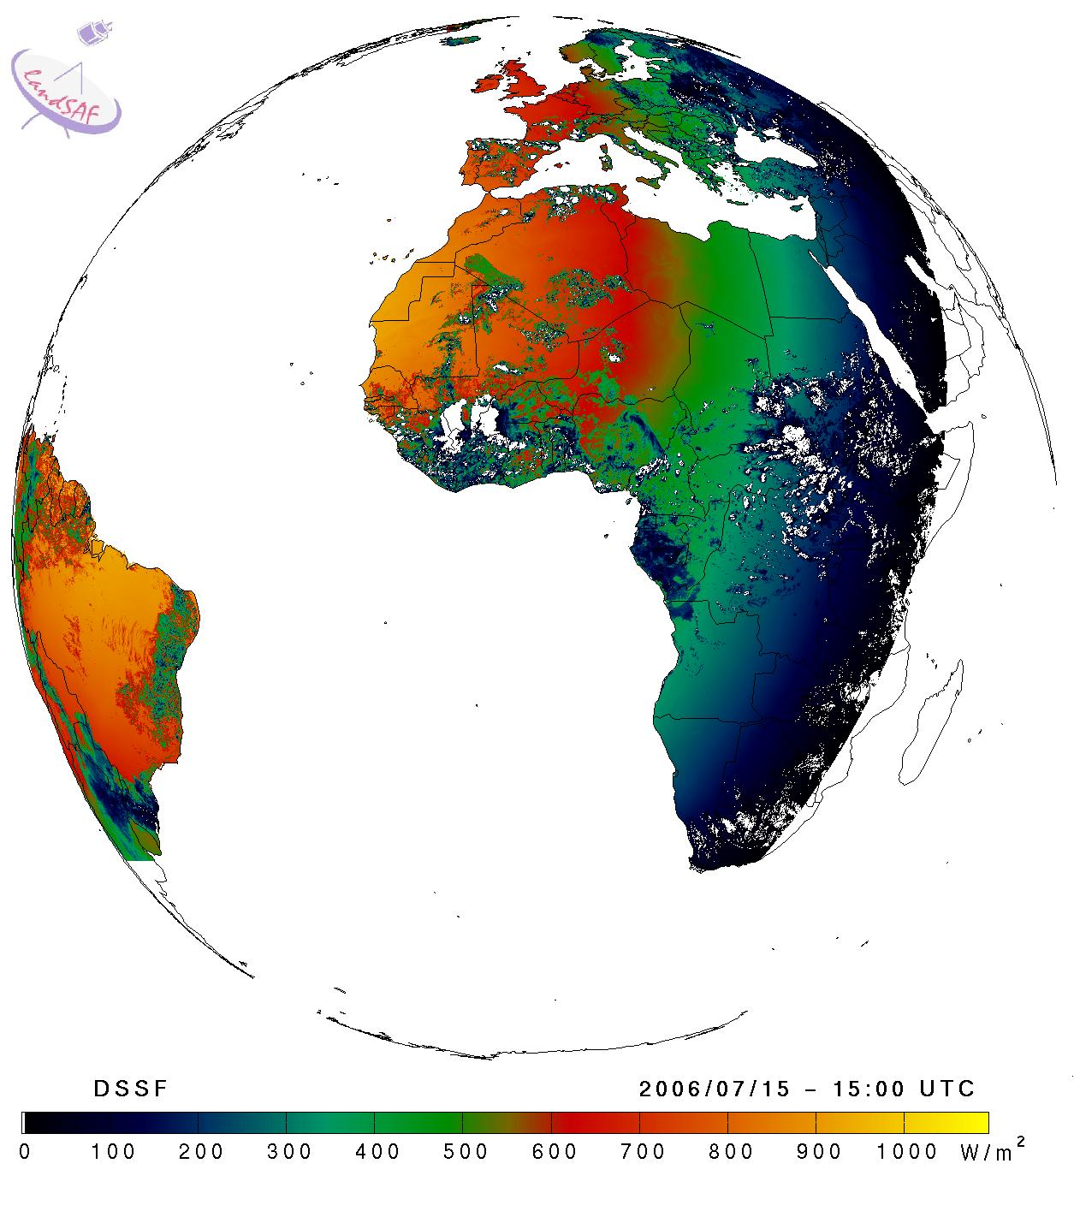
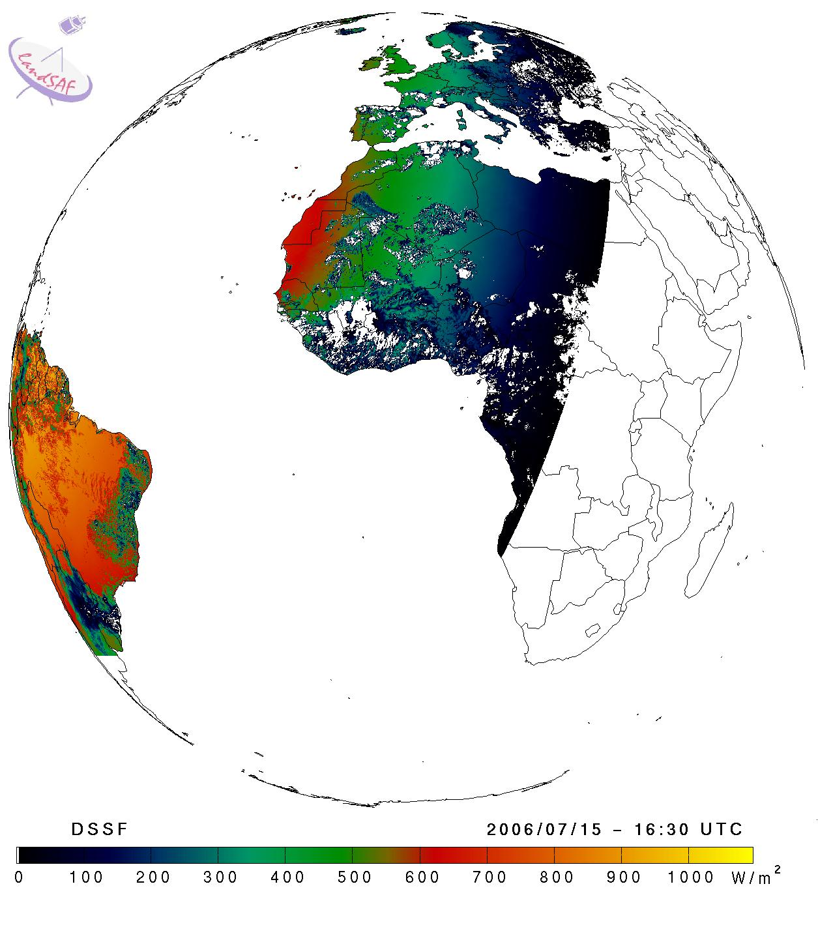
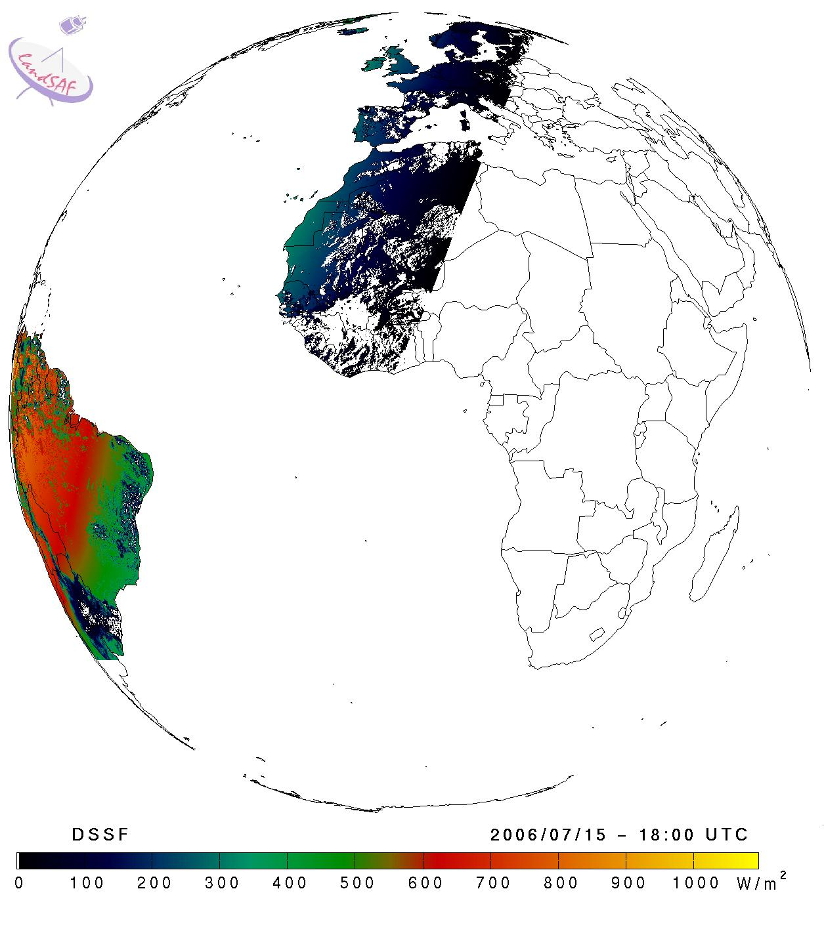
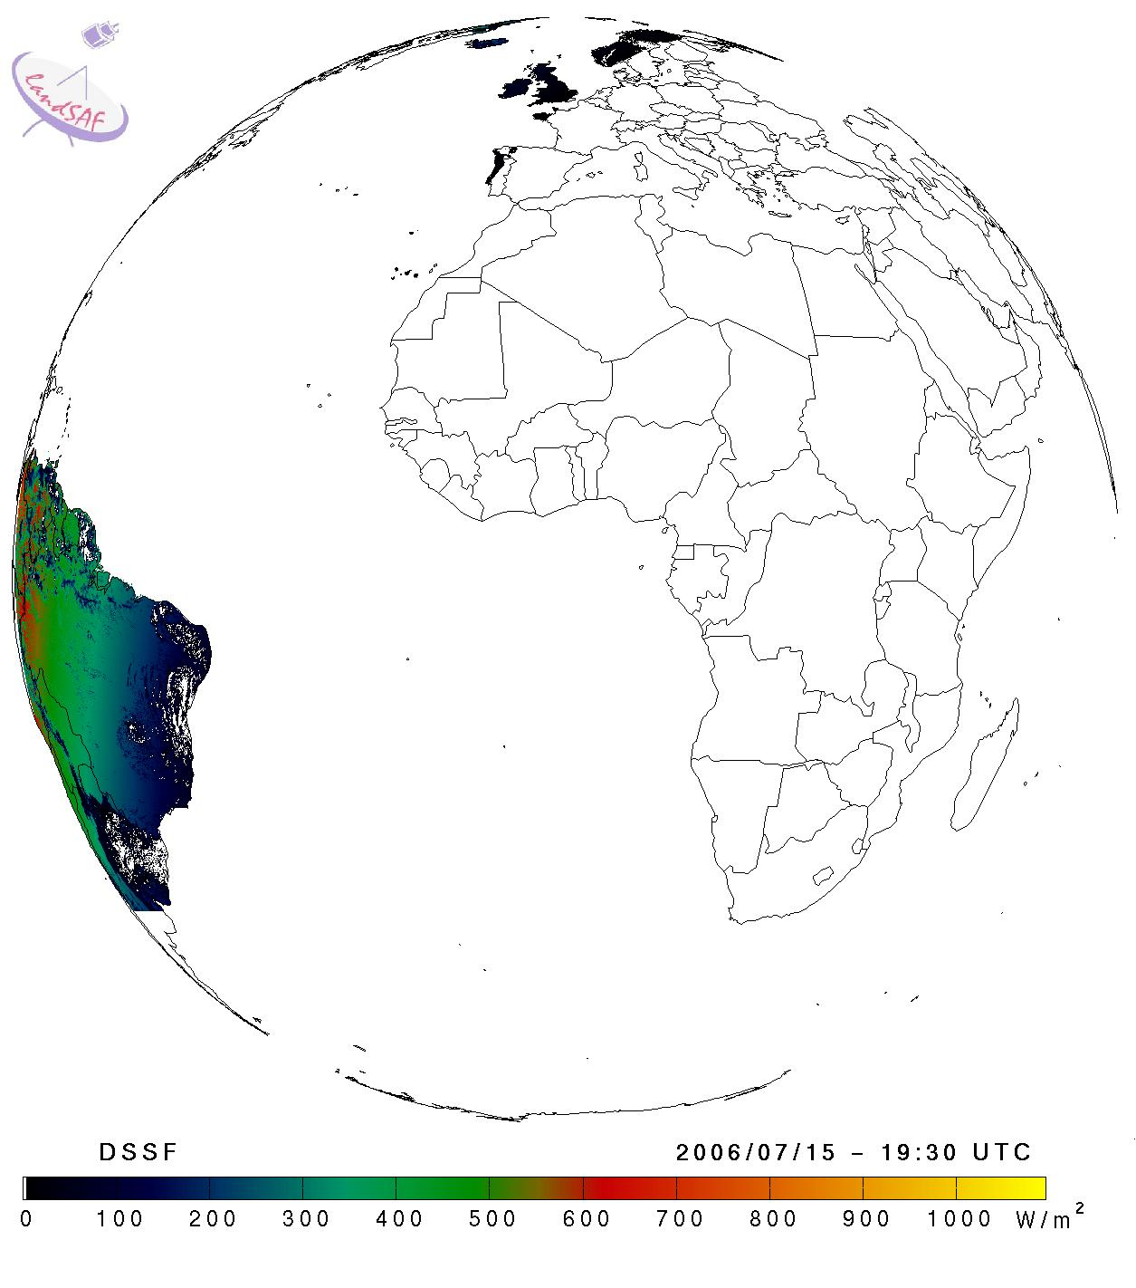
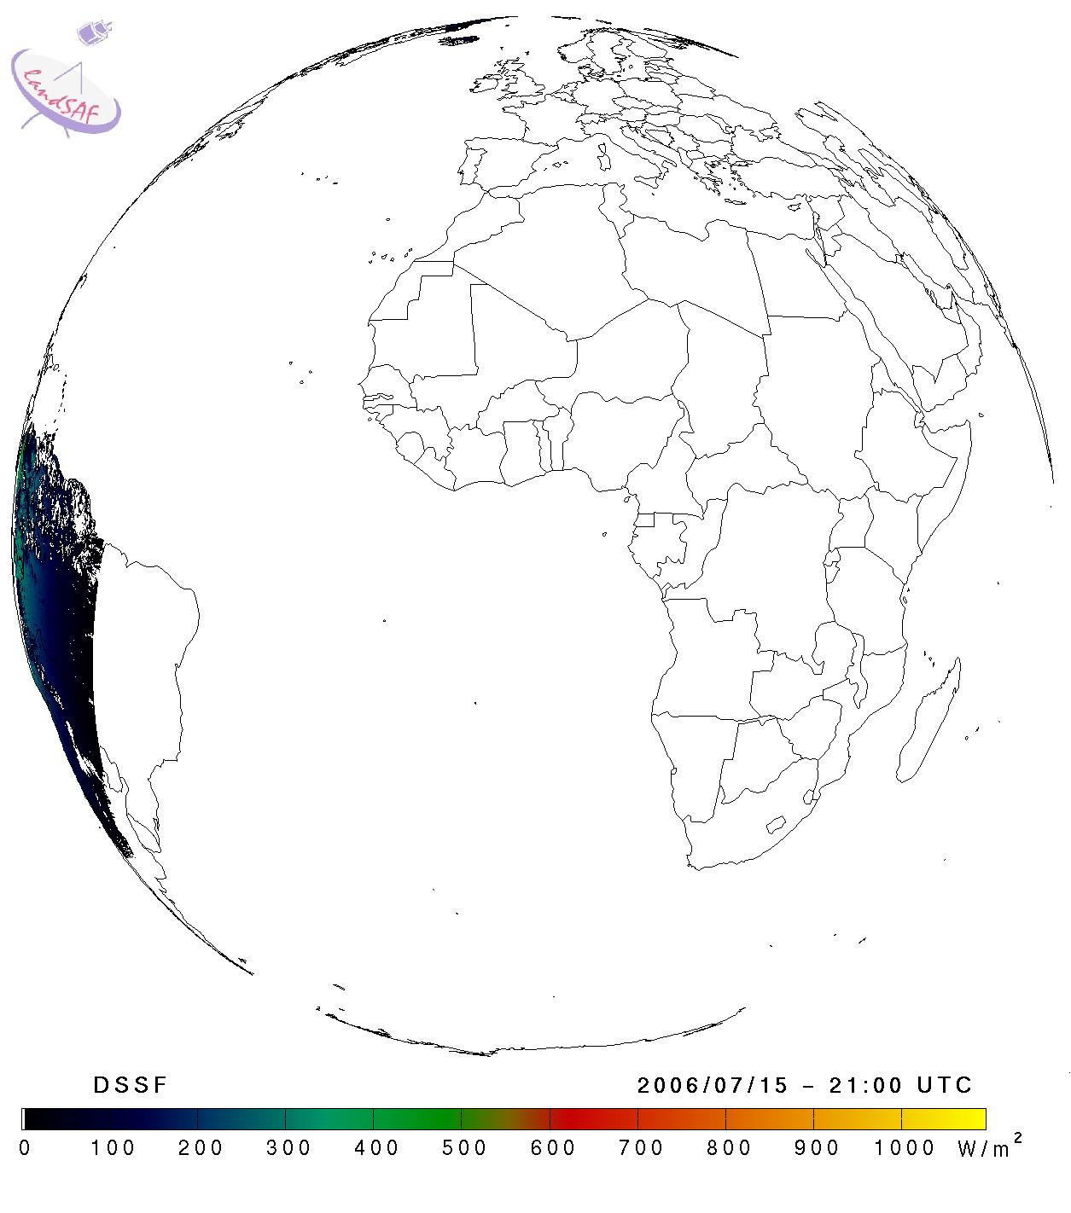
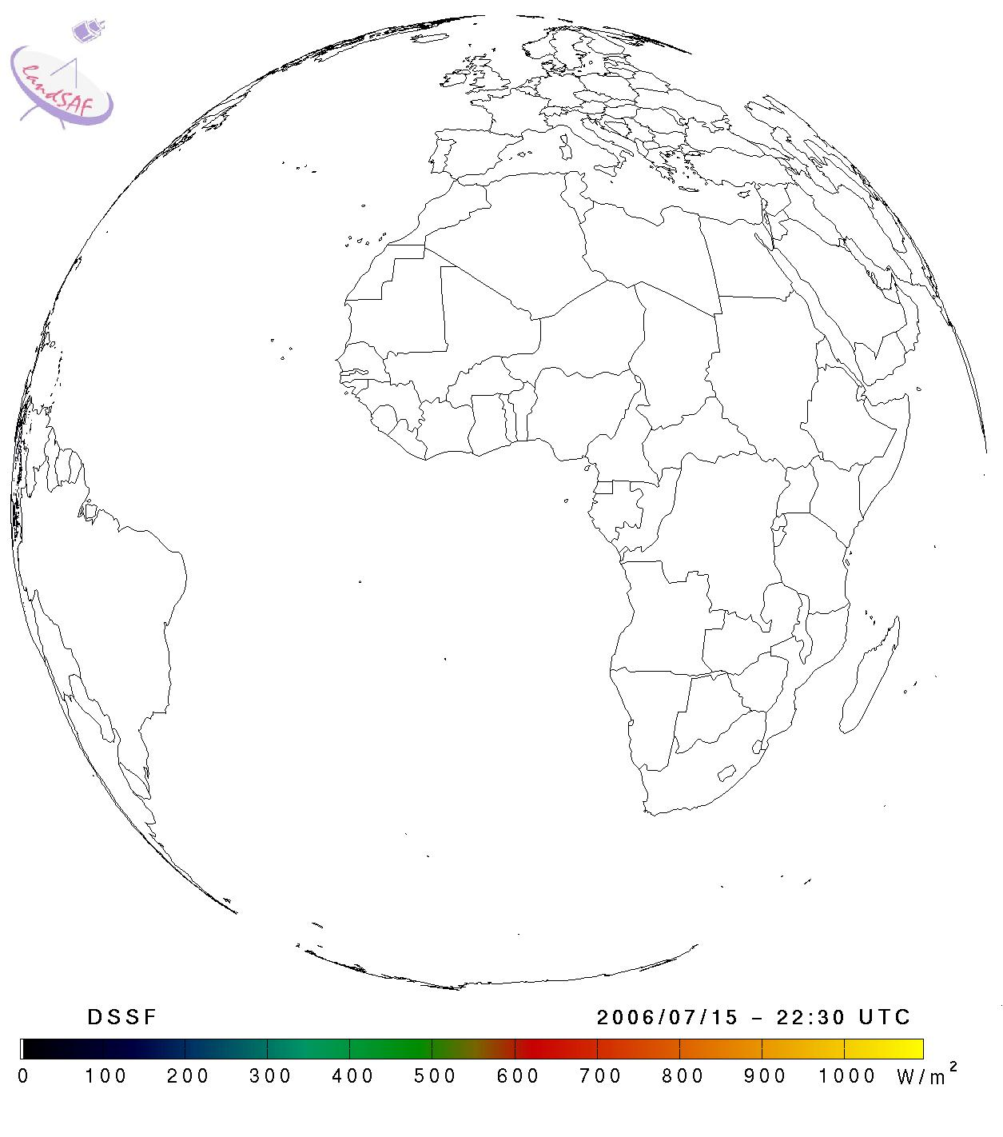
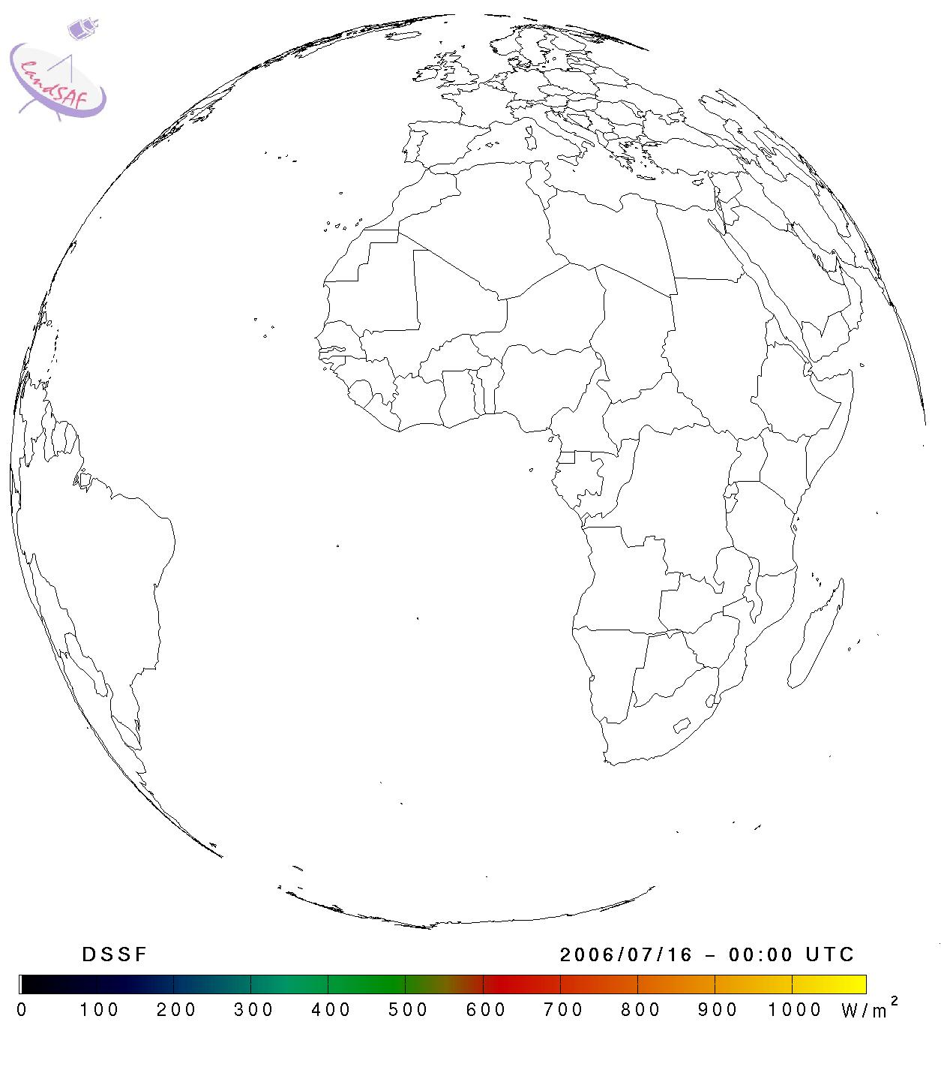
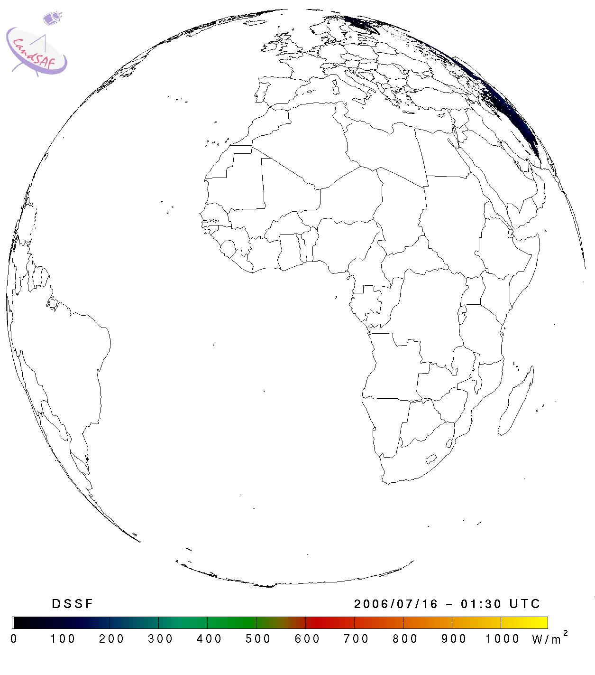
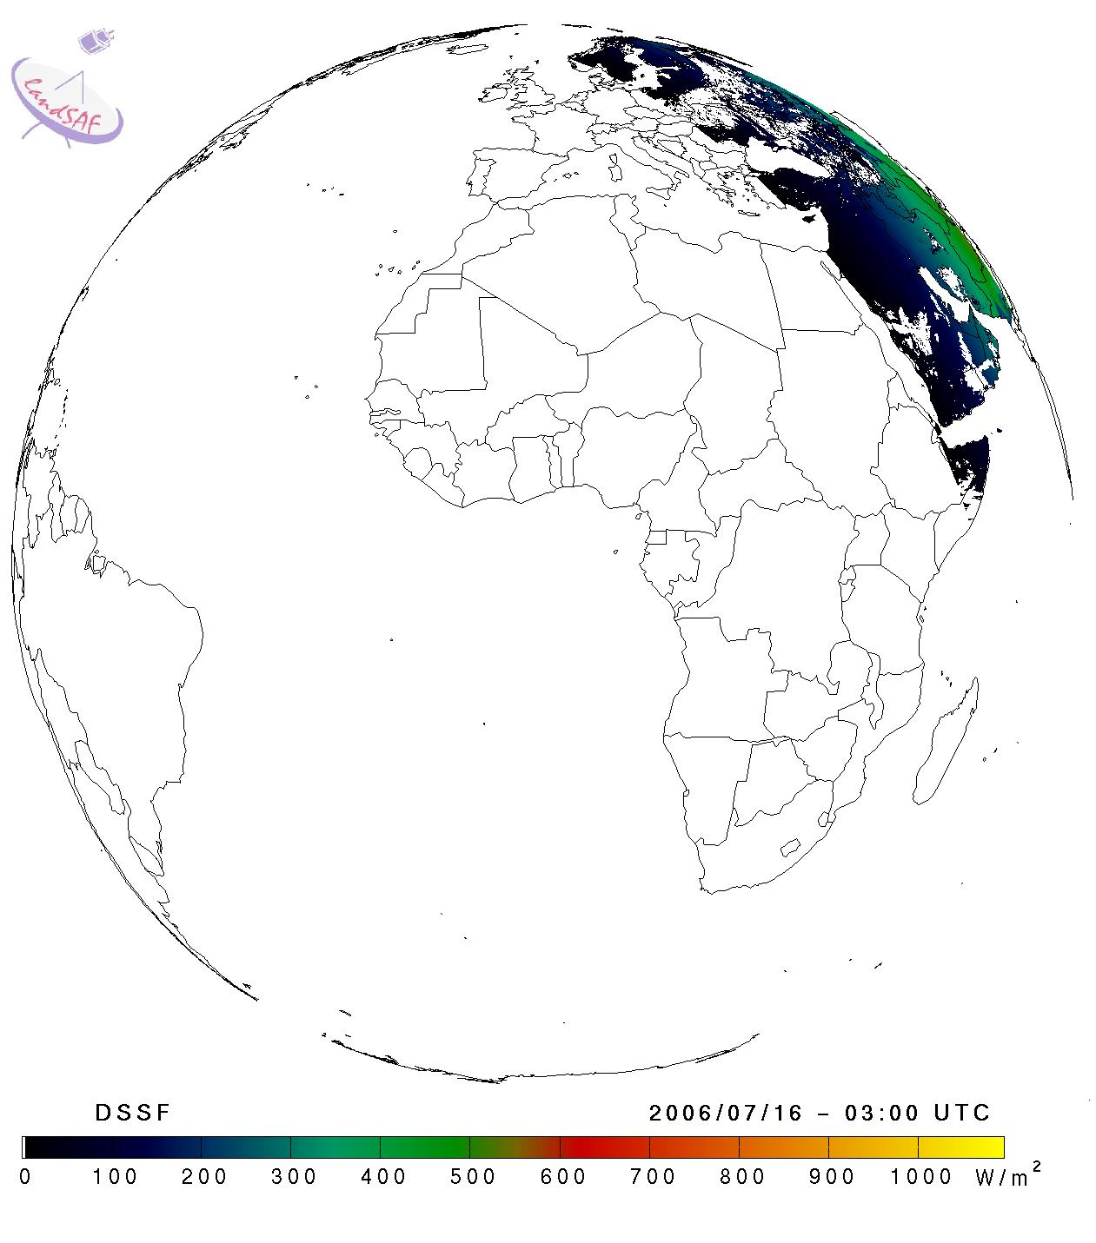
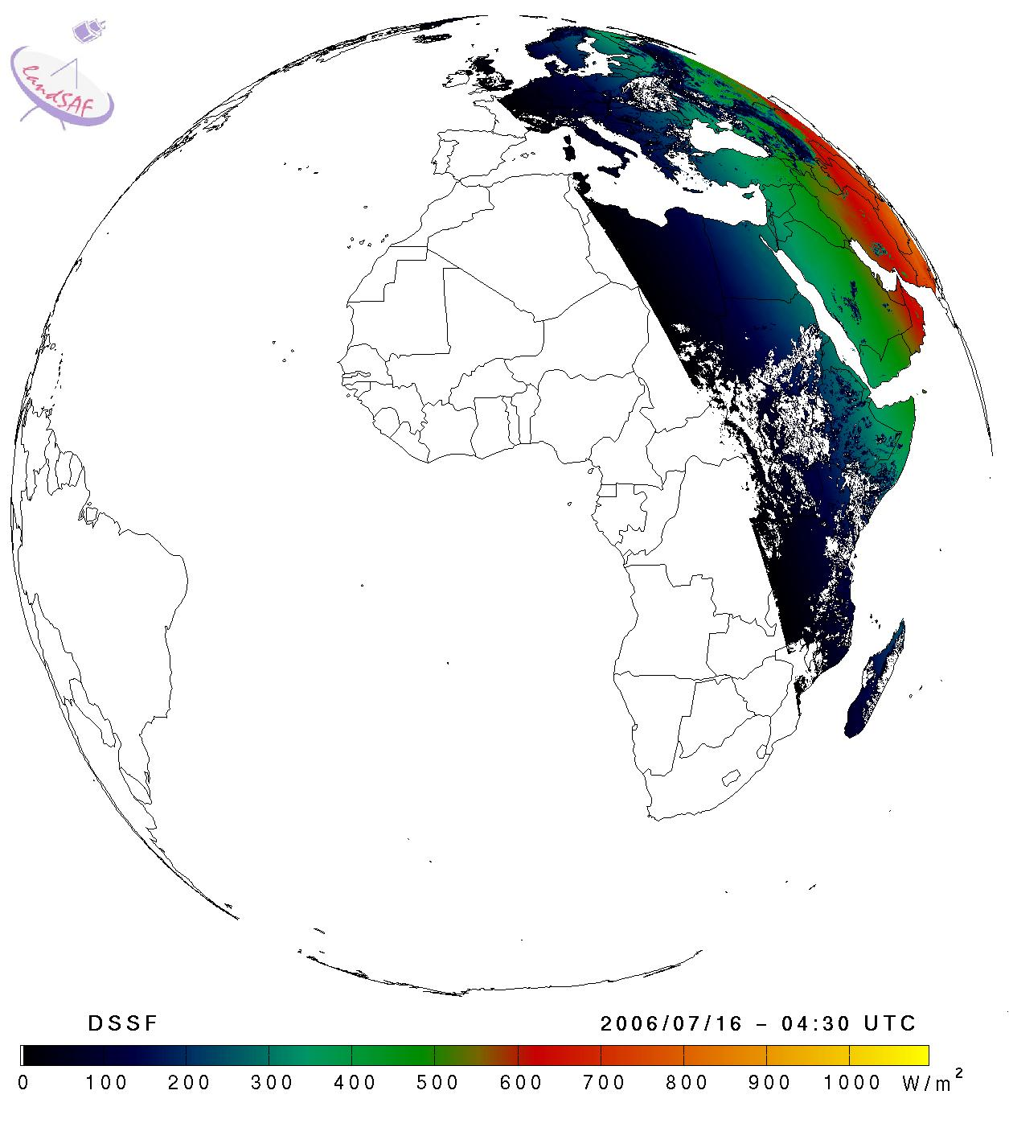
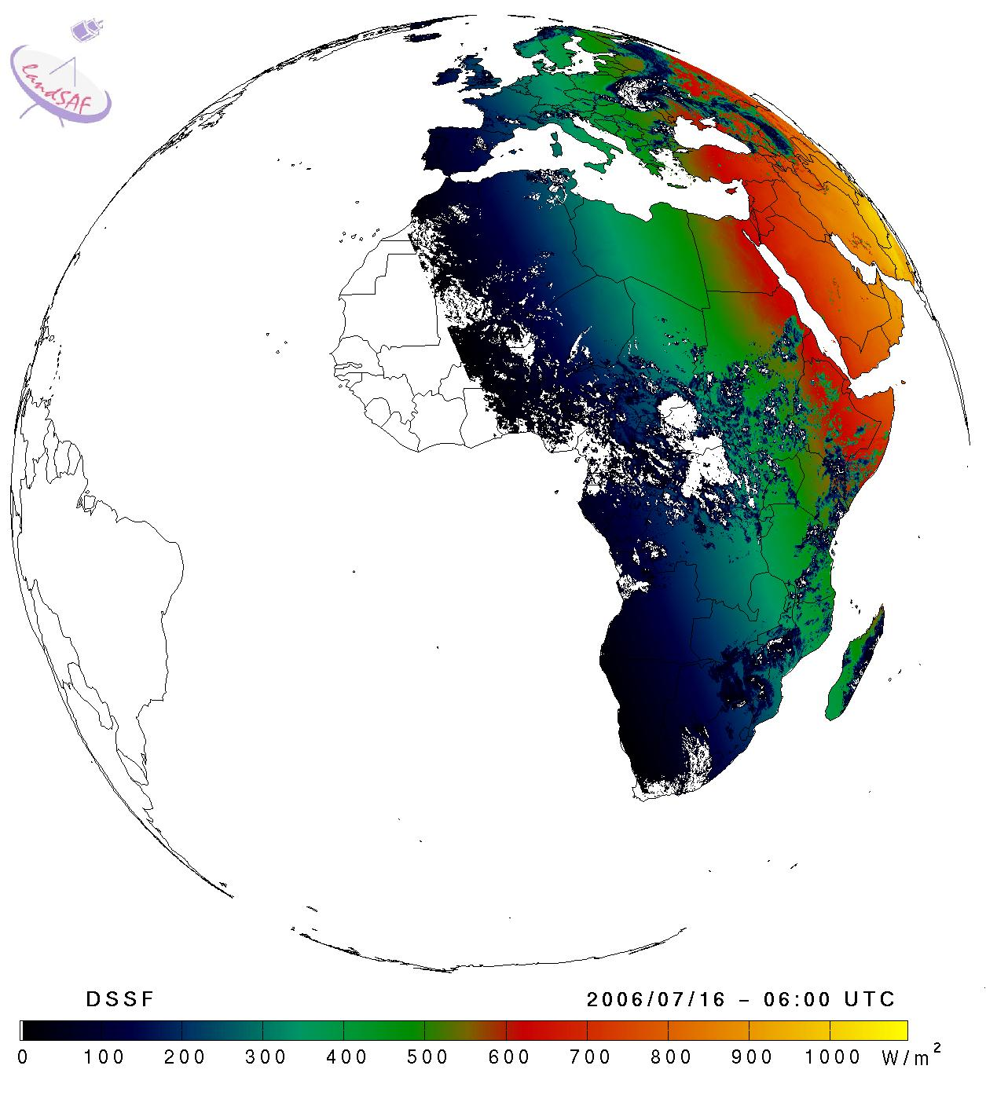
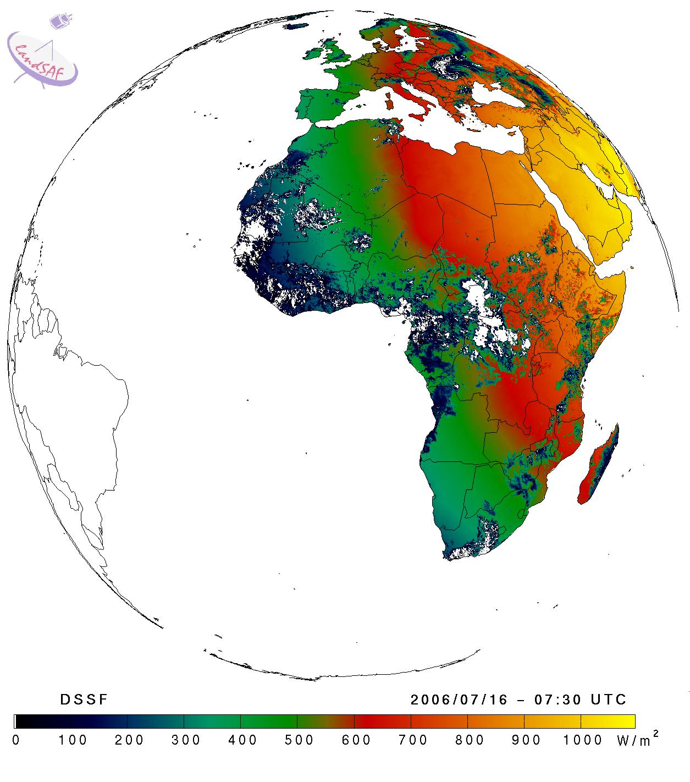
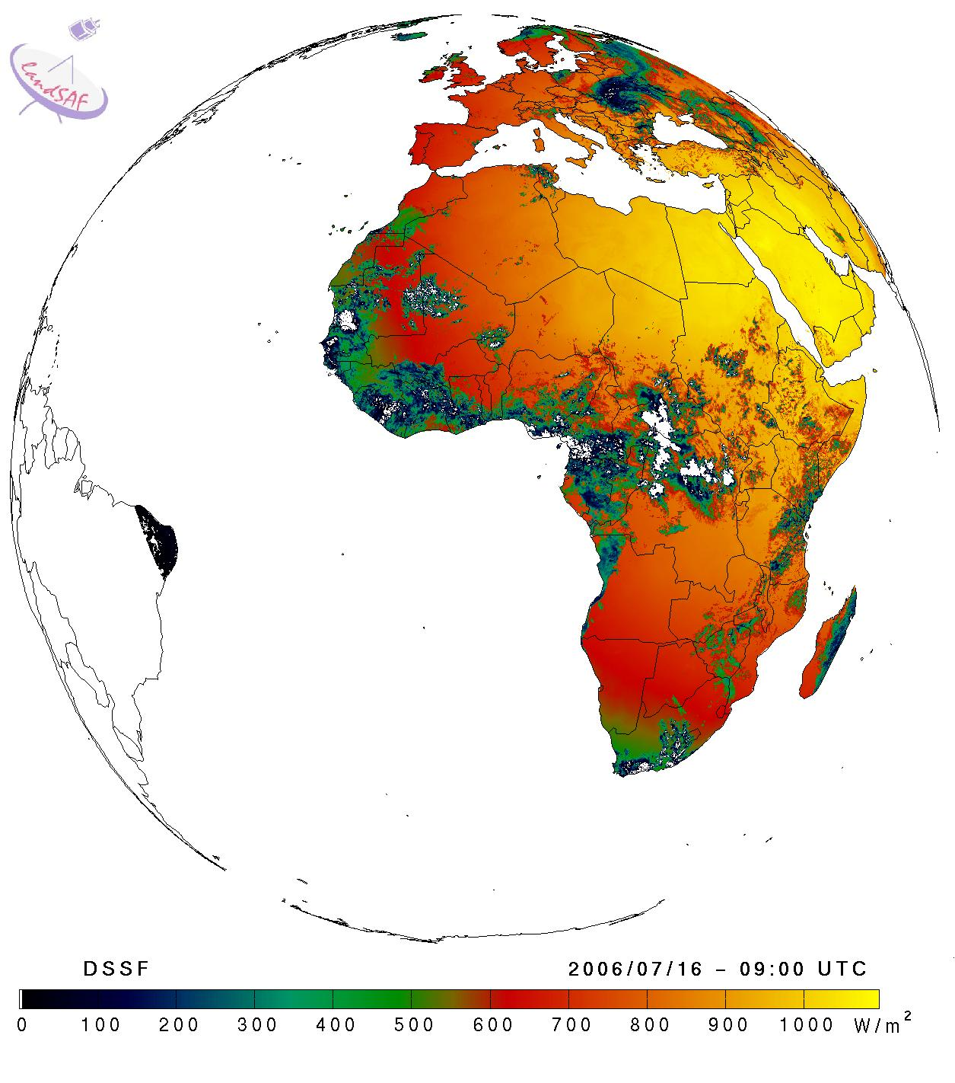
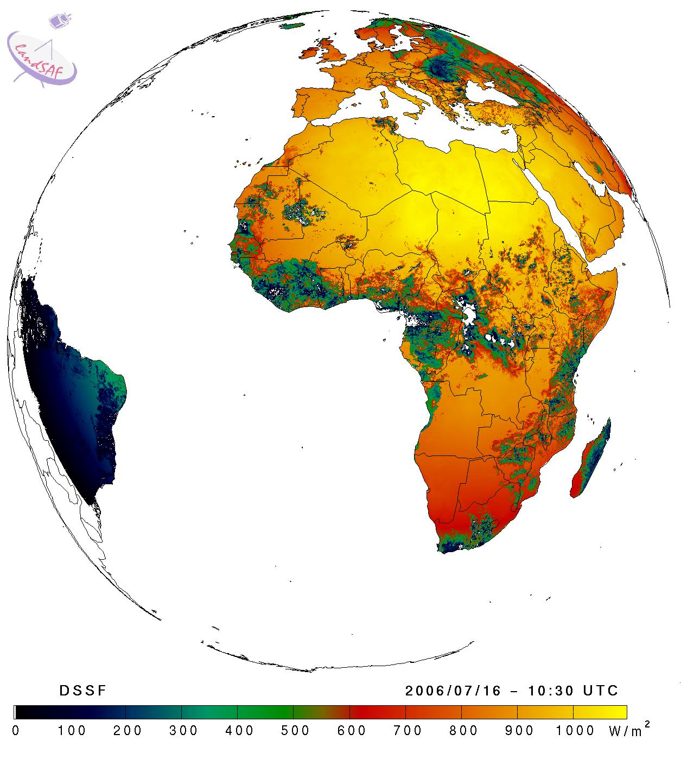
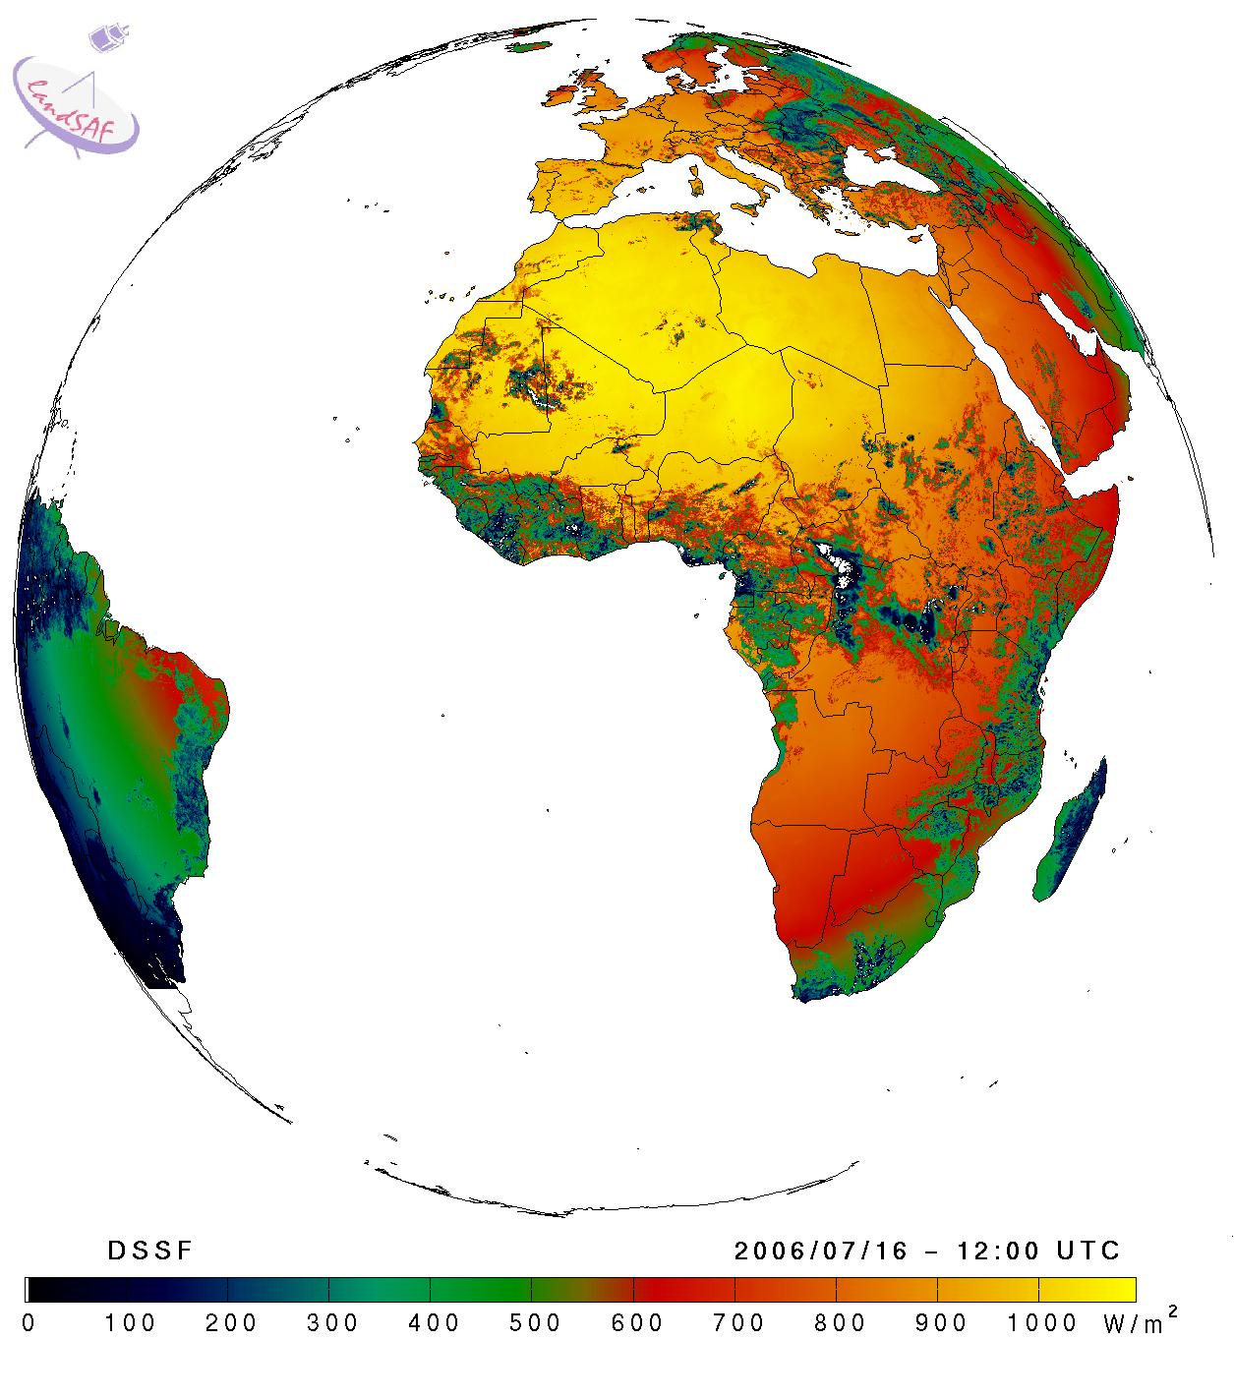
SHORT VIEW OF PRODUCTION AND PRODUCT EXAMPLES
MSG - Surface Radiation Budget: Shortwave
ALBEDO
Daily, 10-daily composites
Downwelling SW Flux
Every 30 min
15 Jul 2006 (12 UTC) – 16 Jul 2006 (12 UTC)

Slide 22
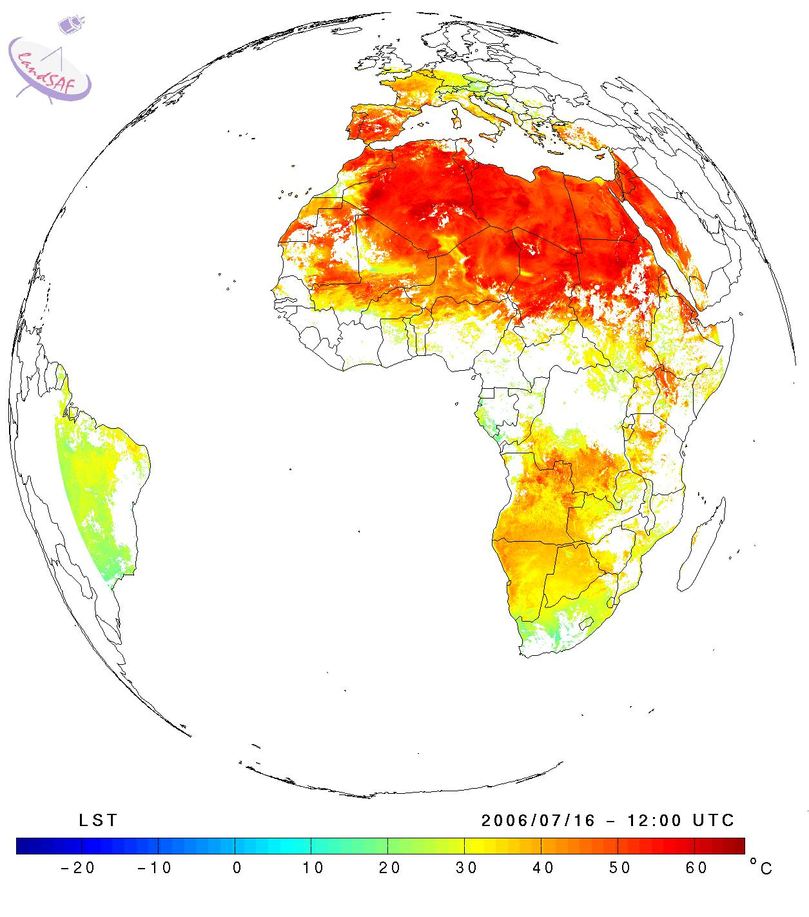
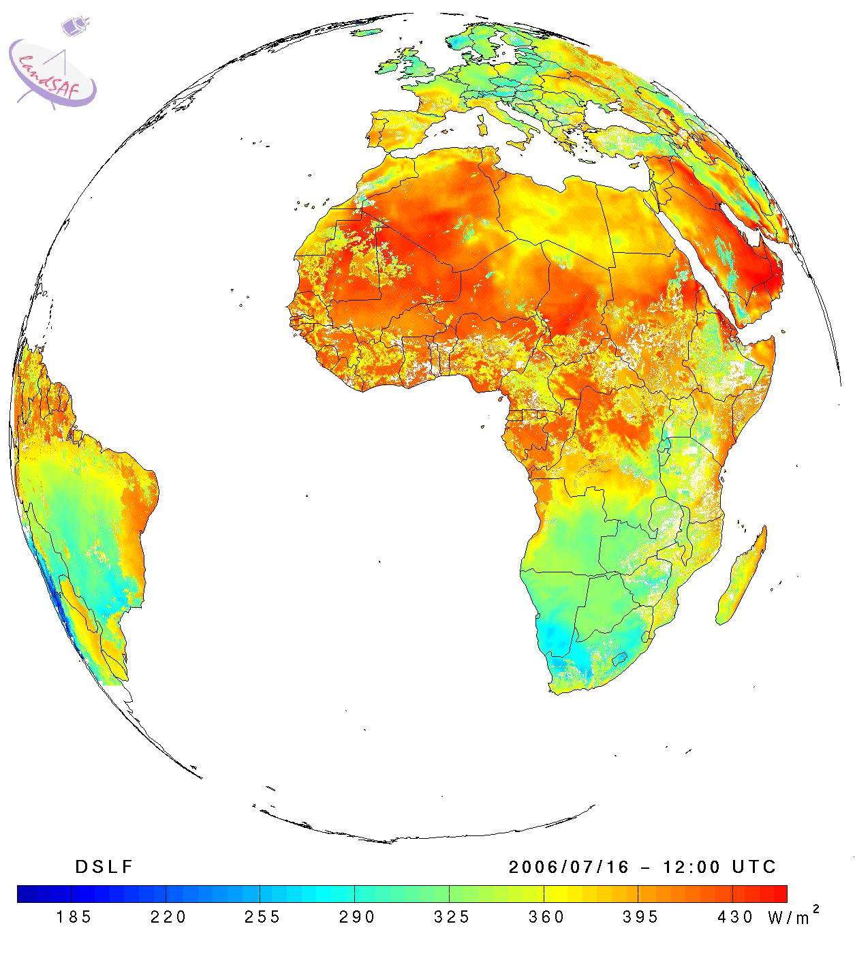
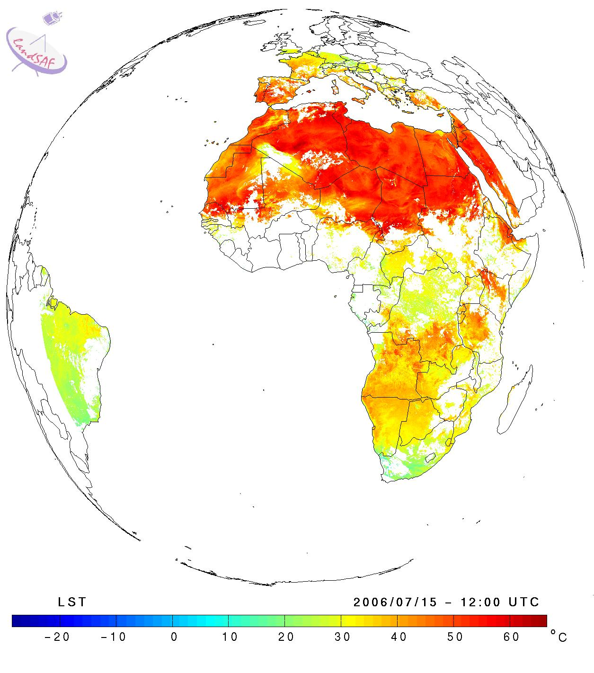
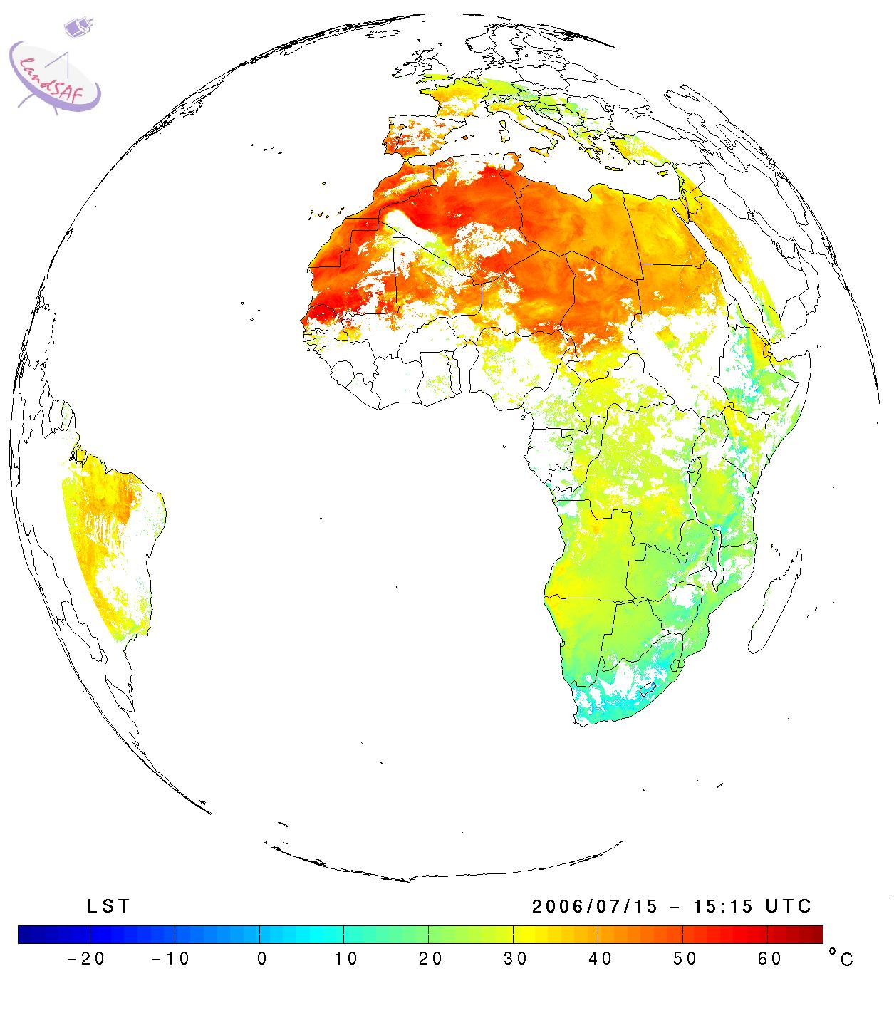
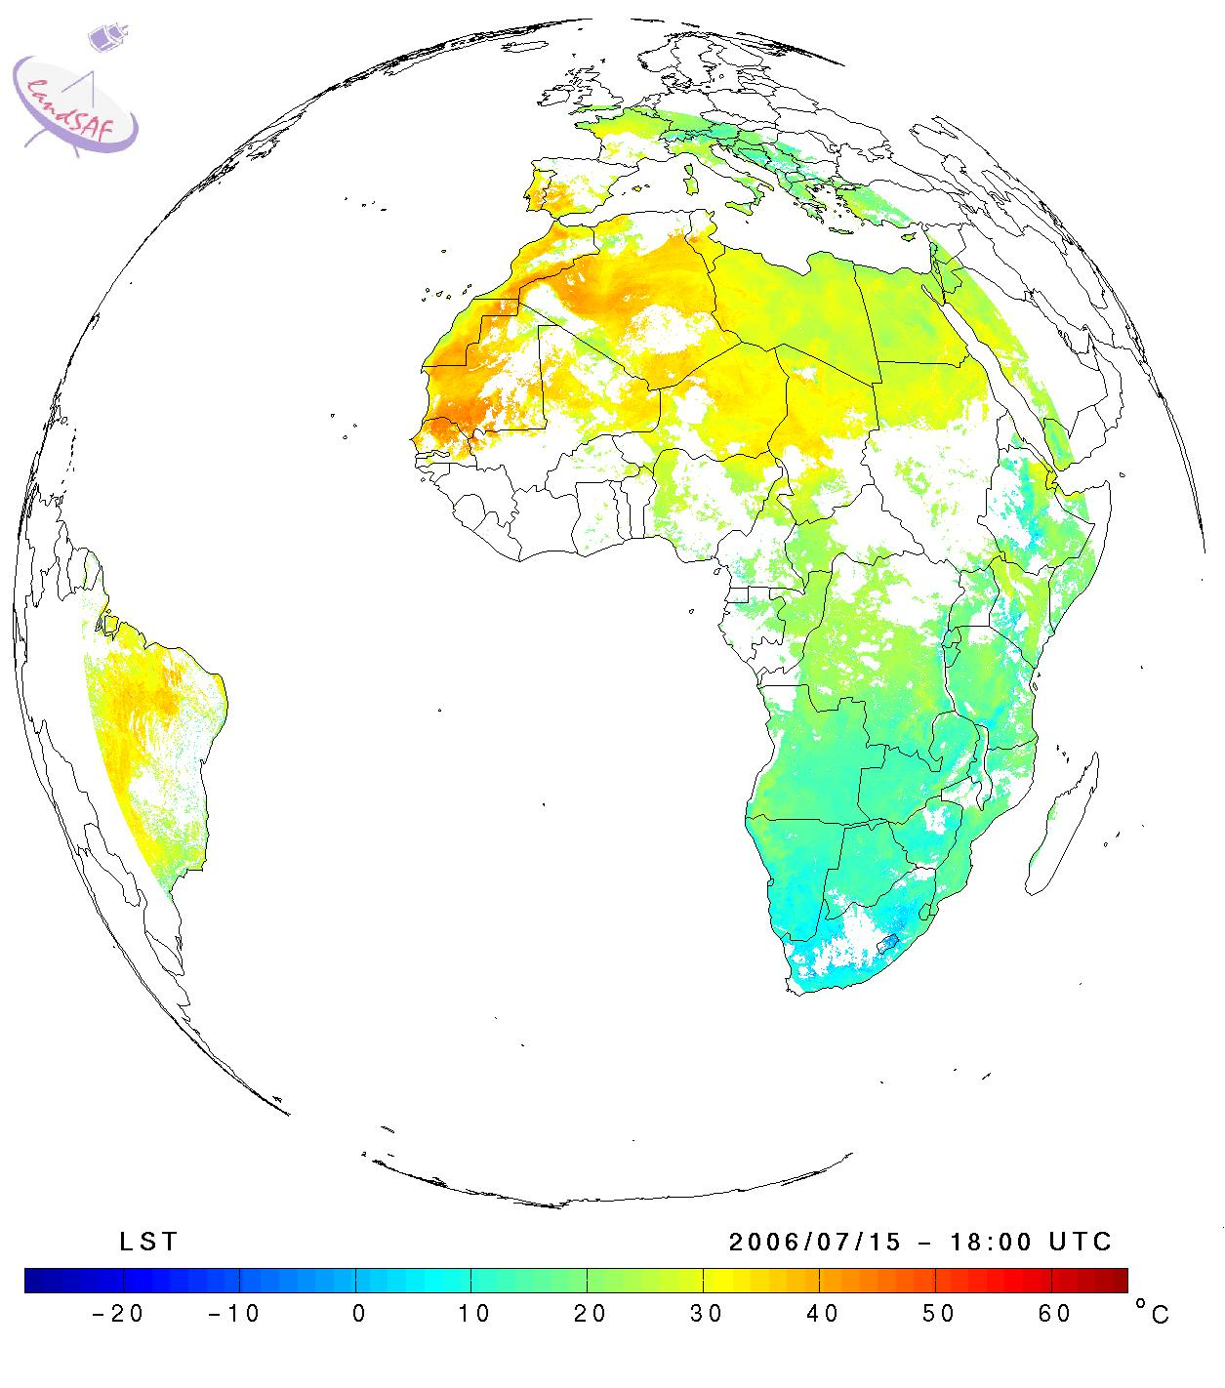
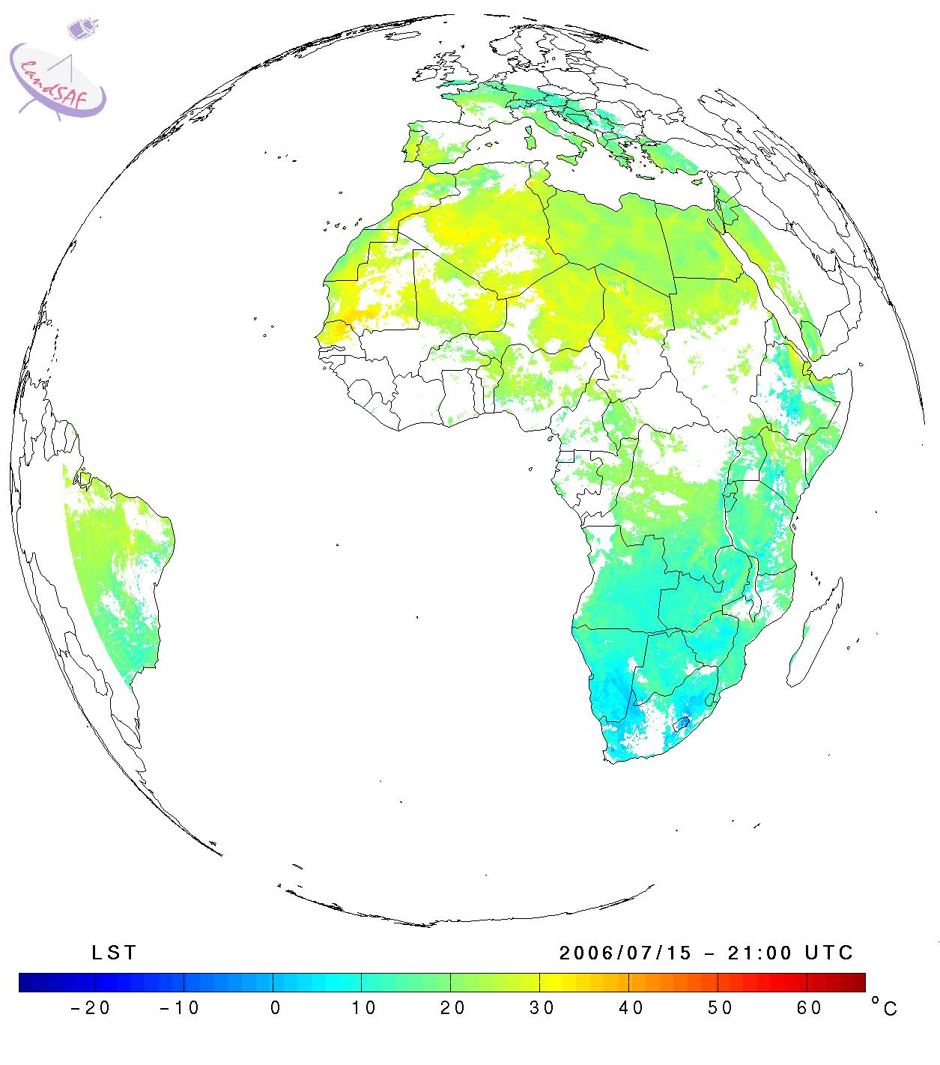
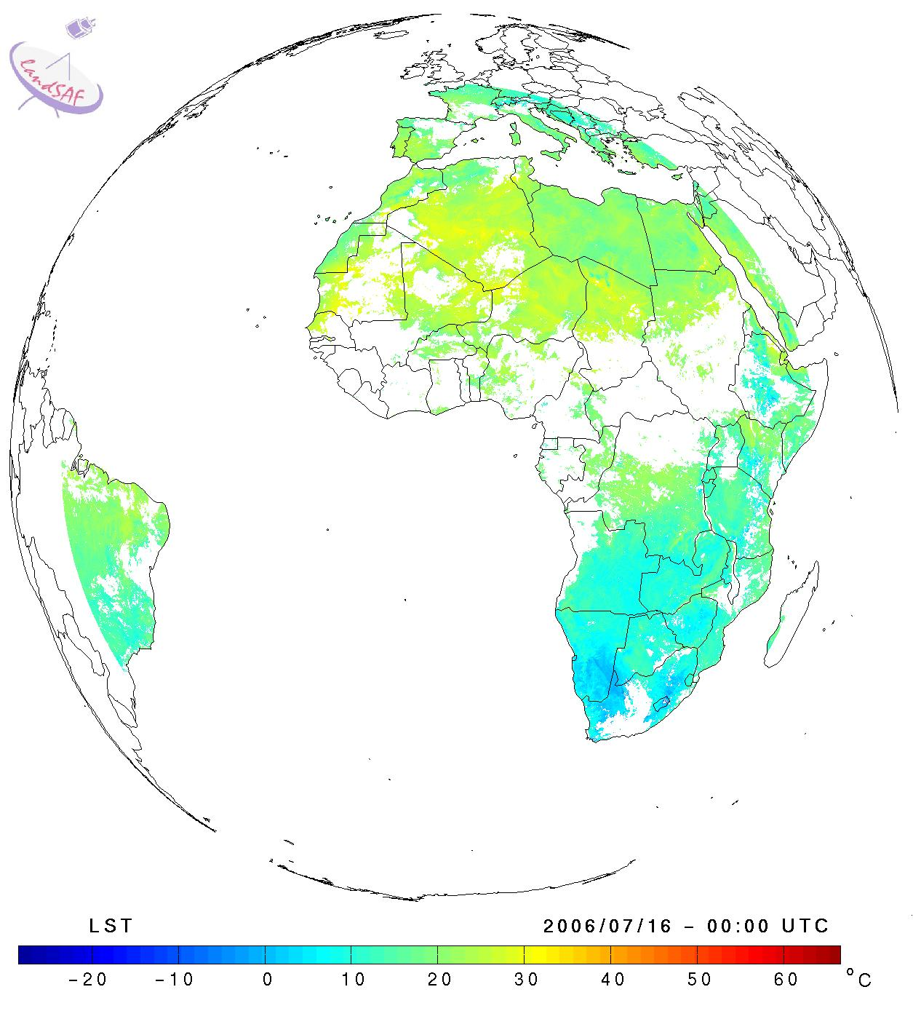
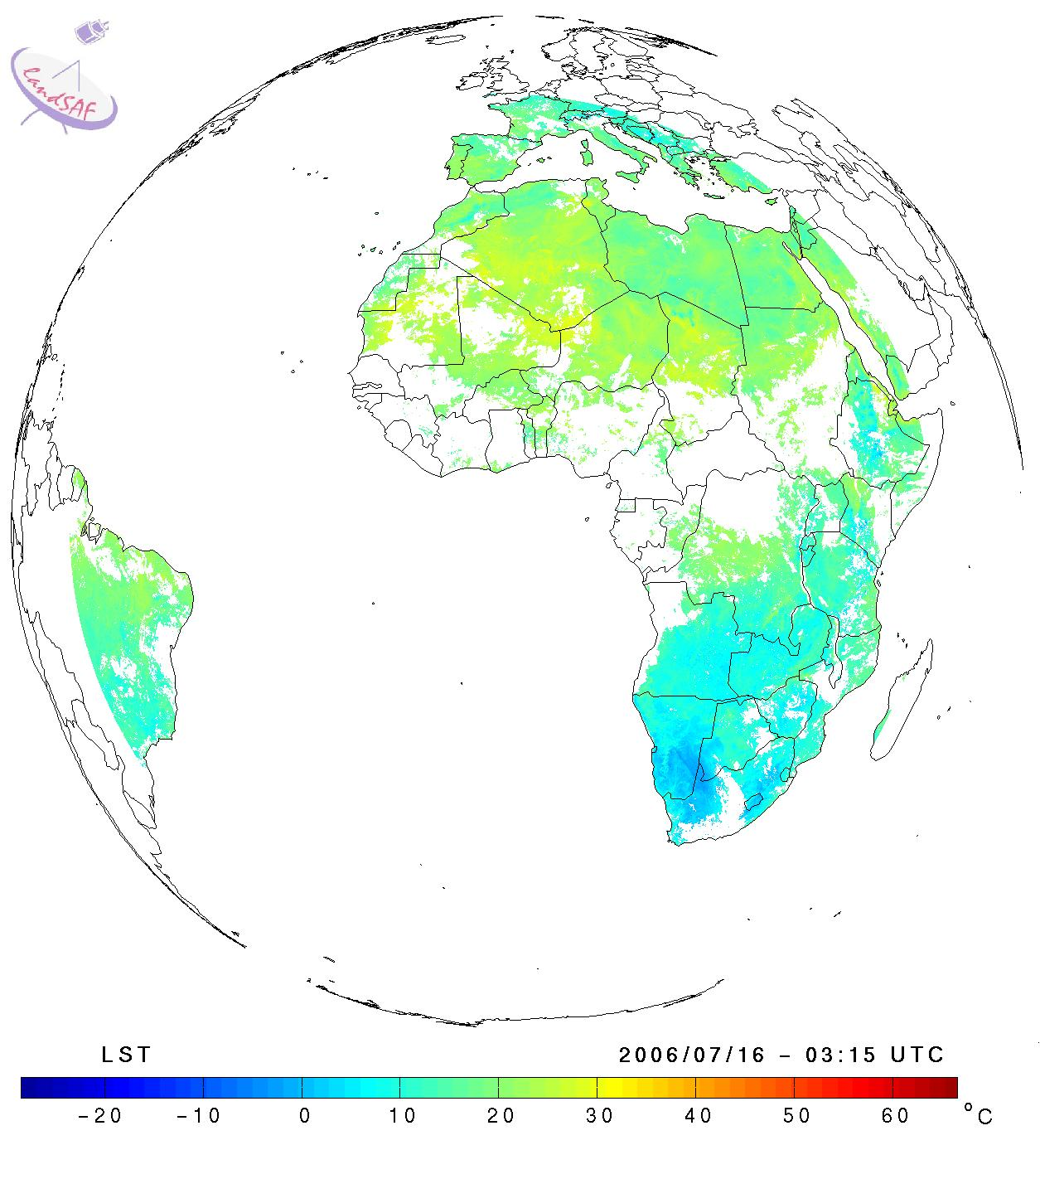
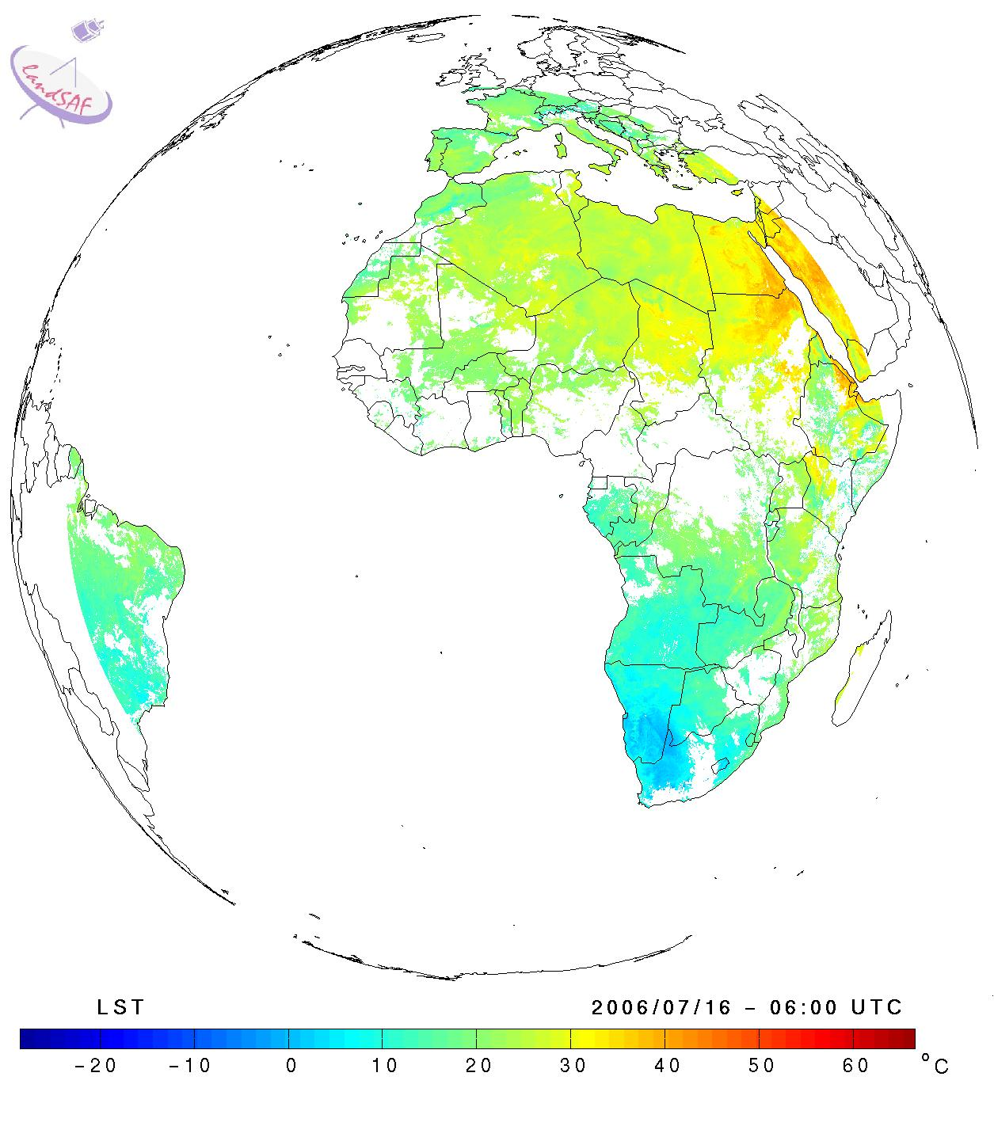
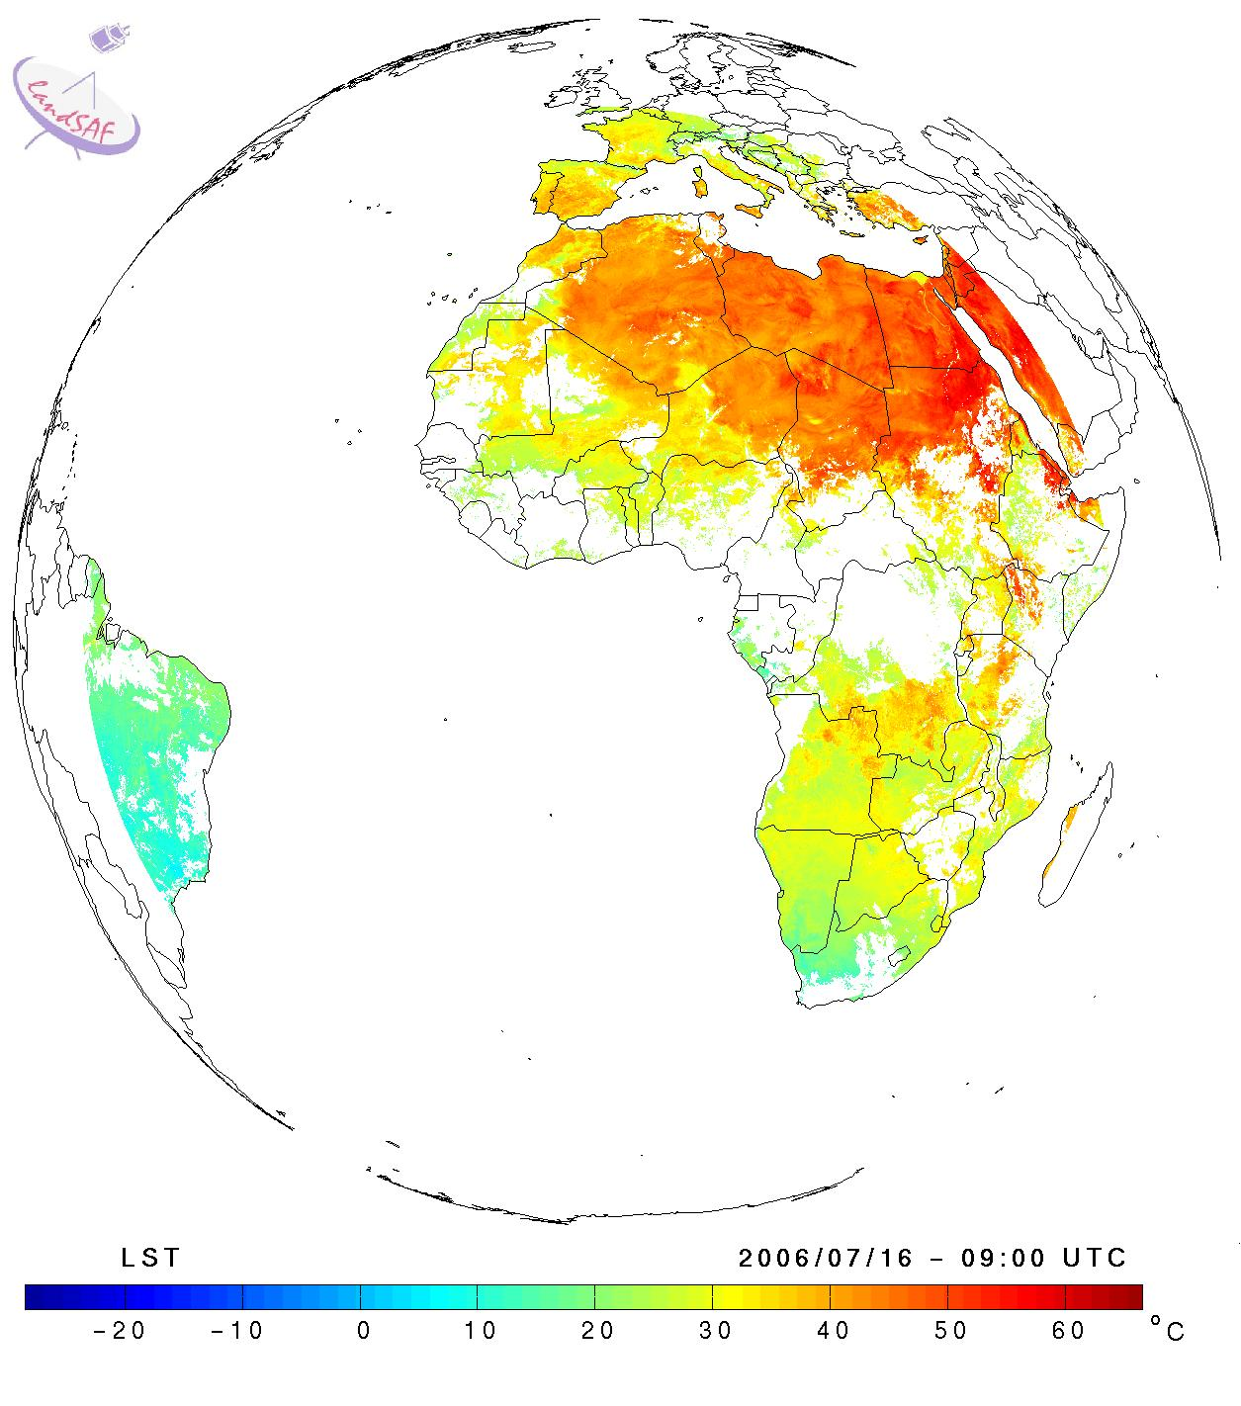
SHORT VIEW OF PRODUCTION AND PRODUCT EXAMPLES
MSG - Surface Radiation Budget: Longwave
Surface Temperature
Every 15 min
Downwelling LW Flux
Every 30 min
Emissivity
15 Jul 2006 (12 UTC) – 16 Jul 2006 (12 UTC)

Slide 23
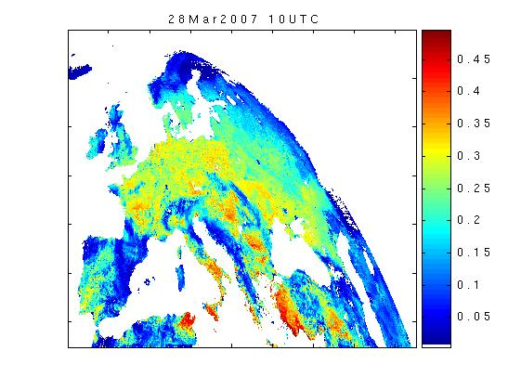
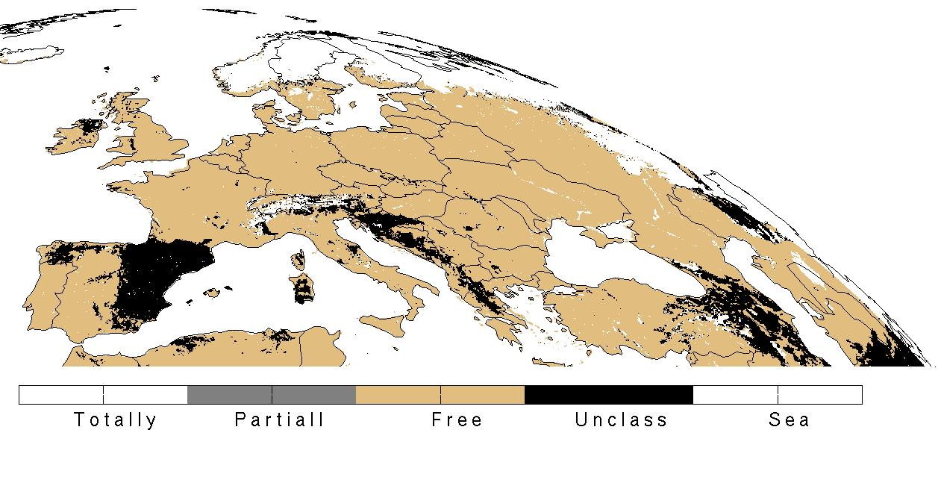
SHORT VIEW OF PRODUCTION AND PRODUCT EXAMPLES
Snow Cover (now a HSAF product)
MSG Water Balance
Evapotranspiration

Slide 24
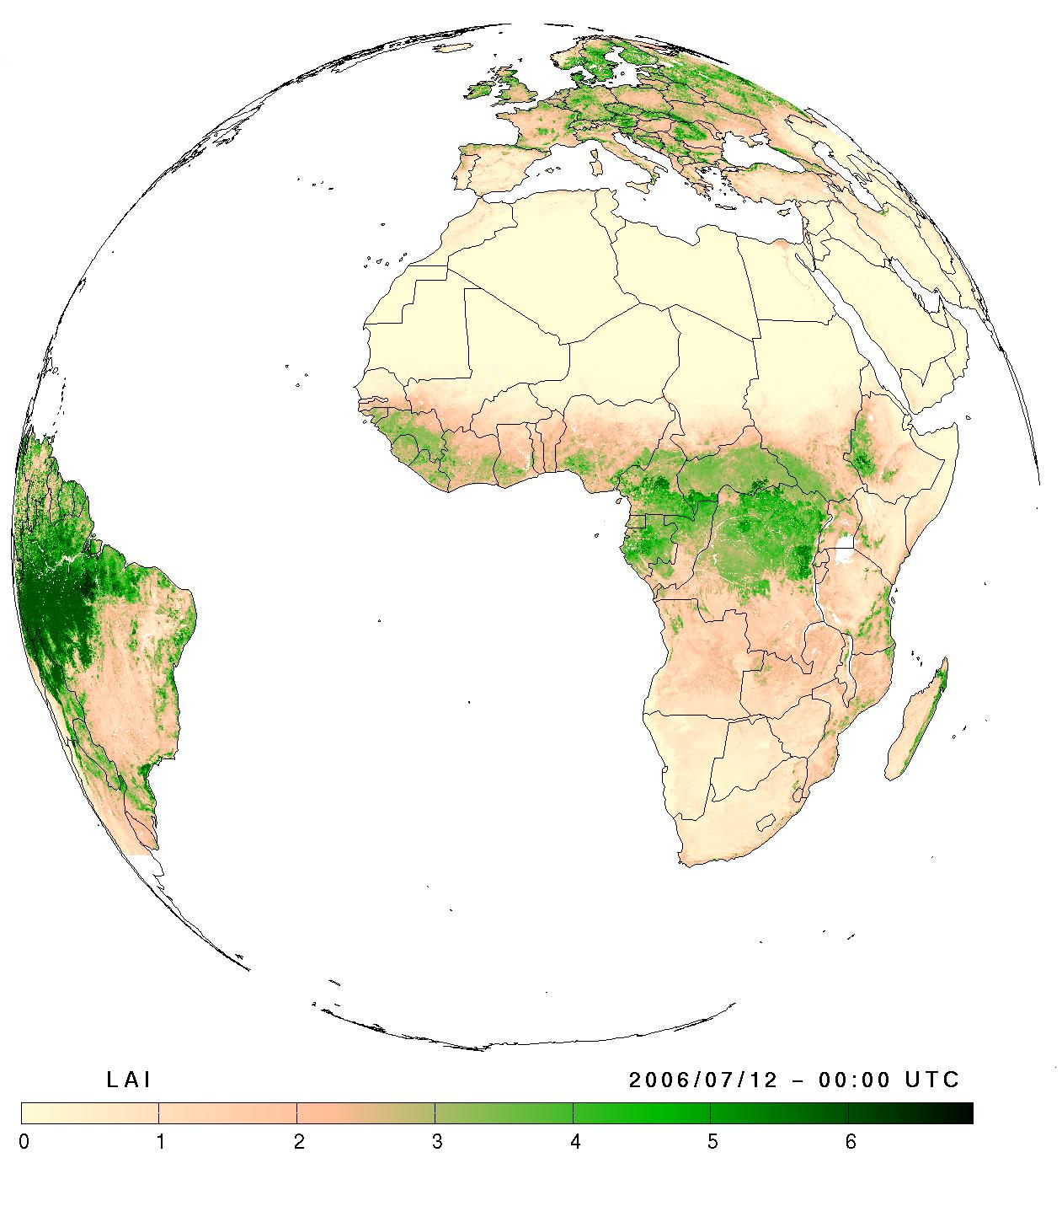
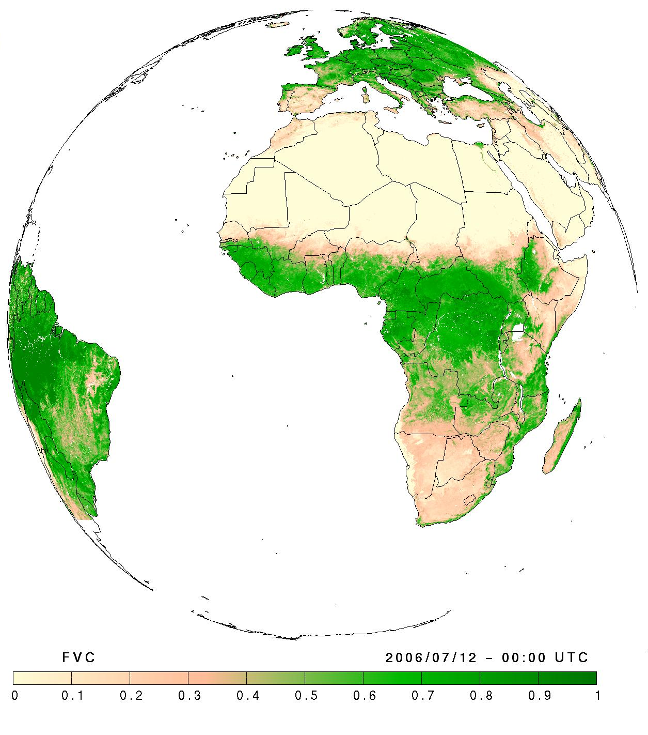
SHORT VIEW OF PRODUCTION AND PRODUCT EXAMPLES
MSG Vegetation Parameters
Fraction of Absorbed Photosynthetic Active Radiation (fAPAR)
Fraction of Vegetation Cover (FVC)
Leaf Area Index (LAI)
Fraction Veg Cover
LAI
July 2007

Slide 25
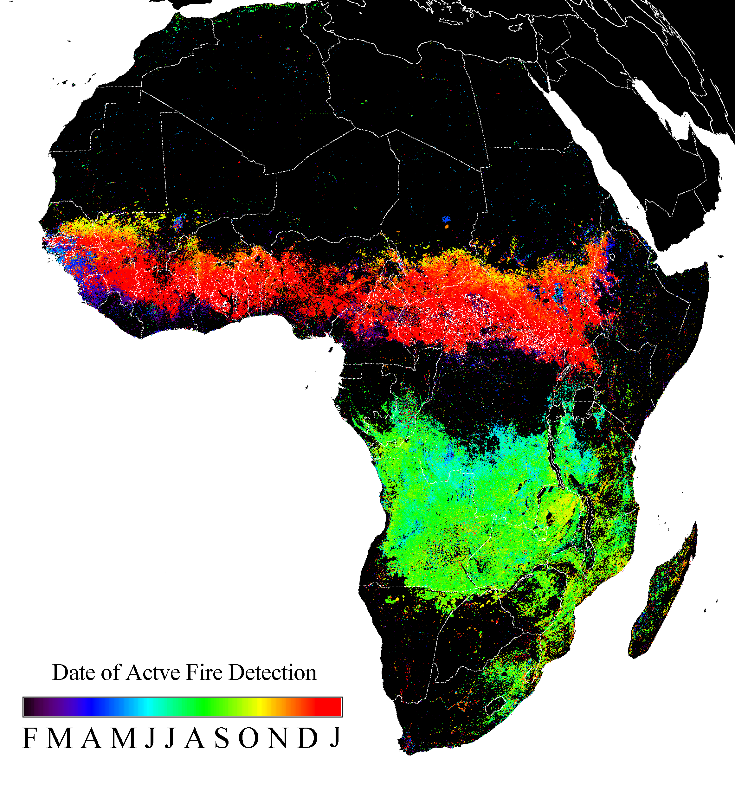
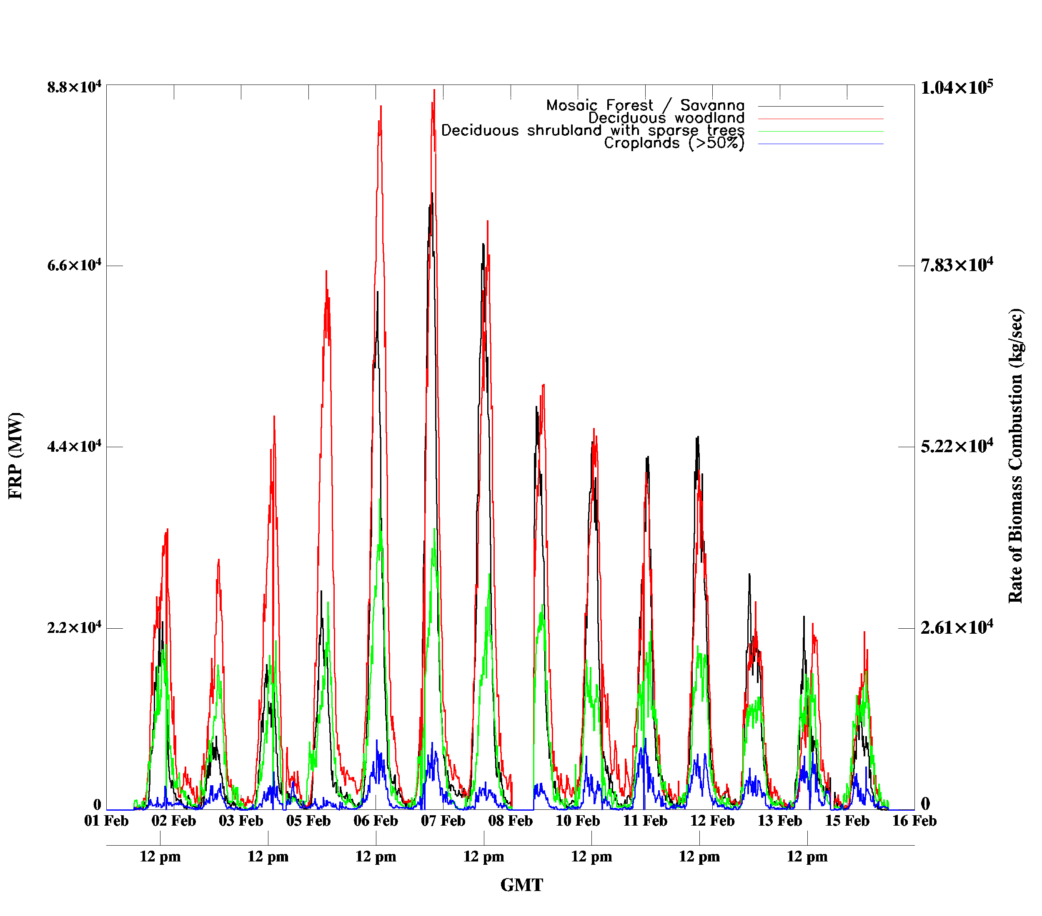
MSG Fire Radiative Power Seasonal & diurnal cycle
SHORT VIEW OF PRODUCTION AND PRODUCT EXAMPLES
SEVIRI 2004 Fire Detections
Sahel FRP
(2 weeks, Feb 04)
Biomass burning has strong seasonal cycle
Strong combustion rate diurnal cycle
Peak at > 100 tonnes/sec burnt
Thanks to M. Wooster, UCL & Y. Govaerts, EUM

Slide 26
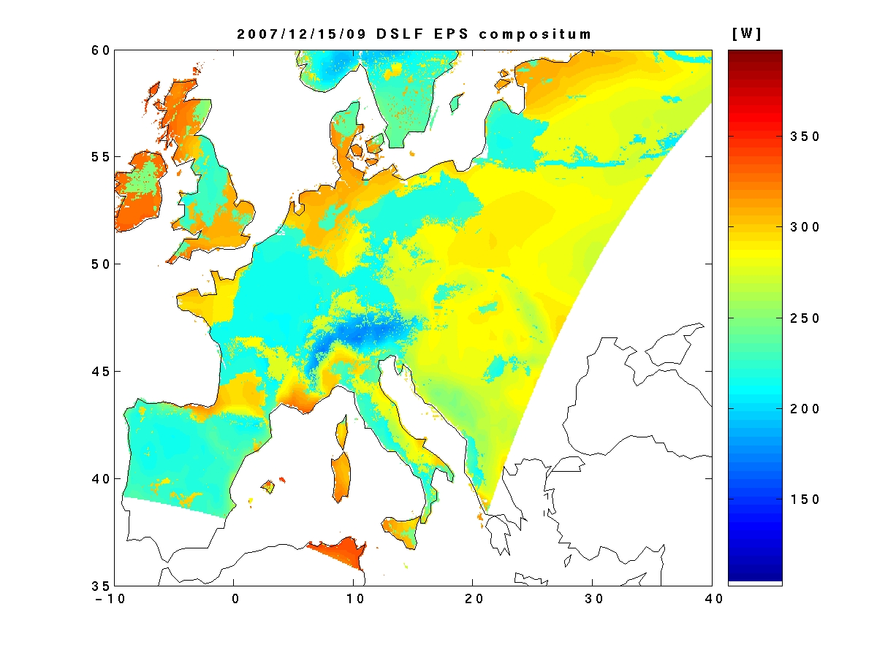
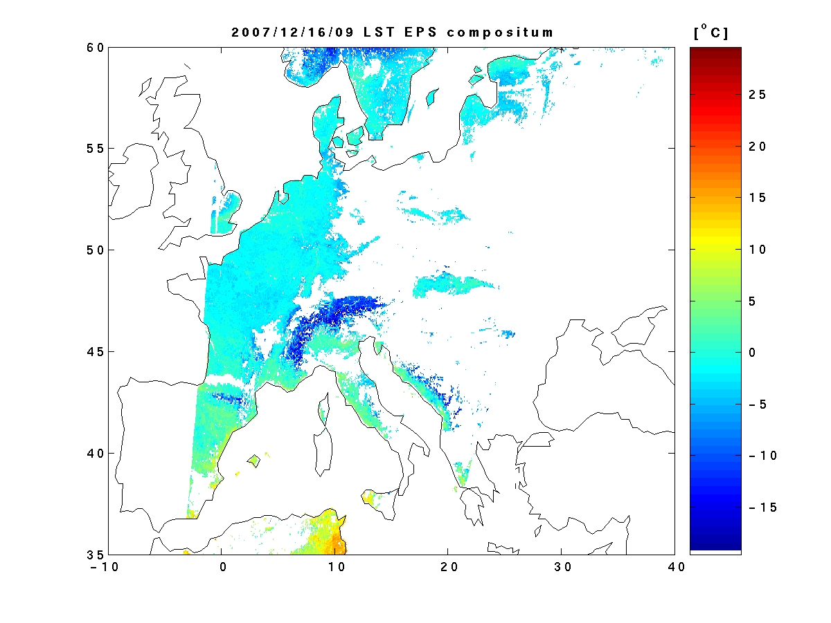
SHORT VIEW OF PRODUCTION AND PRODUCT EXAMPLES
AVHRR/MetOp Products not distributed at moment
16 Dec 2007 09 UTC
EPS Surface Temperature
15 Dec 2007 09 UTC
EPS Downwelling LW Flux
Generation Frequency – 12 h
Based on METOP/AVHRR, over land ...
Available for Europe since Jan 2008
Globally by the end of 2009

Slide 27
MAKING USE OF LSA SAF PRODUCTS
CLIMATE USE
The LSA SAF products time series are relatively short (products process started just in 2005).
With 10 years of data, it is already possible to start making some statistical work and to extract some conclusions
Reprocessing is an element crucial for extracting conclusions

Slide 28
OVERVIEW
SAF concept
SAF network
Overview of LSA SAF project
Short view of production and product examples
User community and applications
Validation: Product quality and service quality
System concept & dissemination system (details about user data assess)
Conclusions

Slide 29
USER COMMUNITY AND APPLICATIONS
LSA SAF operational (and some pre-operational) products are distributed for 4 windows via EUMETCAST. All products available offline and, sooner, just full disk file .
Users (> 500)
  Numerical Weather Prediction
    Update parameters, Assimilation & Forecast Verification (ECMWF, MF, INM, IPMA, …)
  Agriculture & Forestry (JRC)
  Research (e.g. AMMA, U. Leicester)
  Environmental Monitoring
  Hydrology
  (...)
Help desk
Regular workshops (2002, 2006, 2008, 2012, 2015) for user feedback and evolution of user requirements

Slide 30
USER COMMUNITY AND APPLICATIONS
Information to the user
Standardized set of documentation available on the web site
  Product Requirements Document
  Per product
    Algorithm Theoretical Basis Document
    Product User Manual
    Product Output Format
    Validation Report
  Service documents
    Service Specification
    Operations report (biannually)

Slide 31
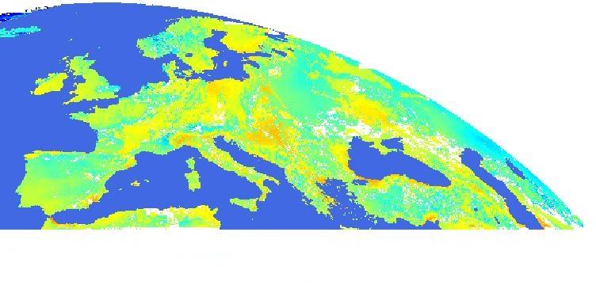
USER COMMUNITY AND APPLICATIONS
SELECTION OF A SUB-WINDOW
Example for Portugal
Selection (crop) of a sub-window (180 lines x 110 columns x 2 bytes)
Extract the selected binary data.

Slide 32
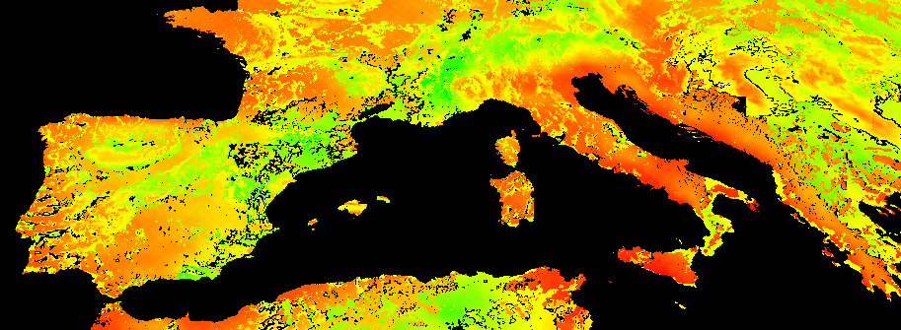
USER COMMUNITY AND APPLICATIONS
31 July 2007 – 12:00 UTC
DSLF
20 Feb 2006 – 12:00 UTC

Slide 33
USER COMMUNITY AND APPLICATIONS
Land Surface Temperature (LST)
Portugal (MSG) LST.
180 lines x 110 columns x 2 bytes
A LST 96 times/day (15 minutes interval)
31 July 2007 – 12:00 UTC

Slide 34
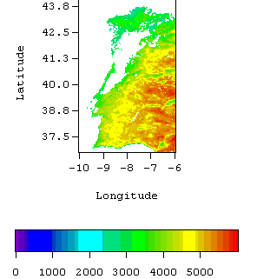
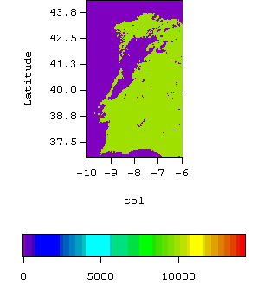
USER COMMUNITY AND APPLICATIONS
Land Surface Temperature (LST)
Example of a sub-window for Portugal
1 August 2006 12:00 UTC

Slide 35
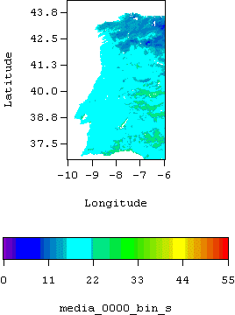
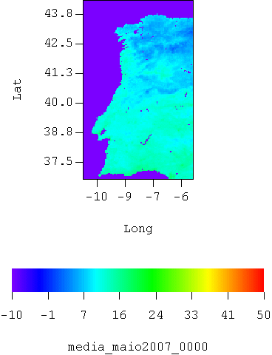
USER COMMUNITY AND APPLICATIONS
Animation of the daily average LST (15min)
Mean 2006
Mean 2007
August
May

Slide 36
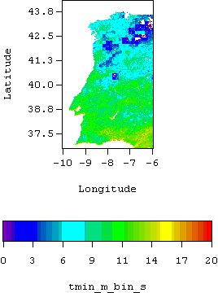
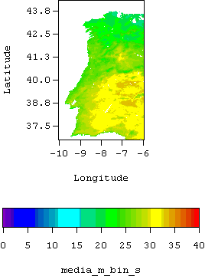
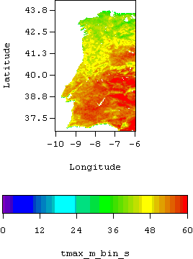
USER COMMUNITY AND APPLICATIONS
Min, Mean and Max LST
August de 2006

Slide 37
USER COMMUNITY AND APPLICATIONS
Min, Mean and Max LST
March 2007

Slide 38


USER COMMUNITY AND APPLICATIONS
Daily LST mean

Slide 39




USER COMMUNITY AND APPLICATIONS

Slide 40




USER COMMUNITY AND APPLICATIONS

Slide 41




USER COMMUNITY AND APPLICATIONS

Slide 42

USER COMMUNITY AND APPLICATIONS
VEGETATION PRODUCTS OVER PORTUGAL

Slide 43



USER COMMUNITY AND APPLICATIONS

Slide 44


USER COMMUNITY AND APPLICATIONS

Slide 45


USER COMMUNITY AND APPLICATIONS

Slide 46


USER COMMUNITY AND APPLICATIONS

Slide 47

USER COMMUNITY AND APPLICATIONS

Slide 48



USER COMMUNITY AND APPLICATIONS
FVC 2007

Slide 49



USER COMMUNITY AND APPLICATIONS
FVC 2008

Slide 50
USER COMMUNITY AND APPLICATIONS
Vegetation parameters are a general indicator of the presence, condition and magnitude of vegetation foliage
The vegetation parameters can be used as indicator of changes, allowing monitoring a region
The resultant image of the differences of FVC values between to different dates can be used to a view of vegetation changes

Slide 51


USER COMMUNITY AND APPLICATIONS
FVC - Percentil 98% 2007 - Percentil 98% 2008
2008 > 2007
2008 < 2007

Slide 52


USER COMMUNITY AND APPLICATIONS
FVC - Maximum 2007 – Maximum 2008
2008 > 2007
2008 < 2007

Slide 53
USER COMMUNITY AND APPLICATIONS
This study was applied just in two years, 2007 and 2008, with similar climatic conditions and was not yet applied in drought years
The threshold was not yet obtained to be considered as the best for retrieving changes in vegetation
The use of the products of the LSA SAF can be done by region / country.
It is useful for monitoring vegetation changes.
It seems a useful complement on risk desertification studies. In areas with already identified desertification problems, as Alentejo in Portugal, LSA SAF products can be particularly important.

Slide 54

USER COMMUNITY AND APPLICATIONS
Users:
Registered for regular/offline acquisition of LSA SAF Products
  EUMETCast: > 1000 in Jul 2014
  LSASAF website: > 1500
  ftp NRT dissemination 20-30
  UMARF (EUMRSAT Data Centre)

Slide 55


USER COMMUNITY AND APPLICATIONS
User Community
  Surface modelling / Hydrology
  Forest & Agriculture Applications
  Environmental / Climate monitoring
  NWP / Air quality
  Renewable Energy (solar)
Products Files downloaded from website / month
Mar 2014 – Apr 2015

Slide 56
USER COMMUNITY AND APPLICATIONS
Workshop:
The workshop aims to cover:
LSA SAF product characteristics and performances, and expected evolutions;
Recent advances in remote sensing techniques relevant to terrestrial surfaces, land-atmosphere interactions, and related applications;
The use of multi-sensor/ multi-platform, multi-temporal approaches to maximize information over heterogeneous or rapidly changing surface types;
New developments ongoing or envisaged for the exploitation of current and future sensors relevant to the above;
Applications of land surface products: examples, opportunities, challenges and statements of needs and user requirements
Post your requirements & Suggestions in the “Product Boards”
Notes:
These workshops are an excellent forum to discuss the adequacy of current satellite product performances and user requirements, and to establish the need for their further evolution to better support user needs.

Slide 57
USER COMMUNITY AND APPLICATIONS
Getting LSA SAF products
The steps involve are:
  Selecting a product and getting data (EUMETCast or Off-line)
  Having a tool to read and to access or extract data from the HDF5 files or NetCDF: freeware - HDFview will open both formats or Matlab, IDL, etc.
  Whenever necessary, extracting a sub-window allowing further processing

Slide 58

USER COMMUNITY AND APPLICATIONS
Displaying LSA SAF products

Slide 59

USER COMMUNITY AND APPLICATIONS
LSA SAF web site
http://landsaf.ipma.pt

Slide 60
OVERVIEW
SAF concept
SAF network
Overview of LSA SAF project
Short view of production and product examples
User community and applications
System concept & dissemination system (details about user data assess)
Validation: Product quality and service quality
Conclusions

Slide 61

USER COMMUNITY AND APPLICATIONS
LSA SAF Operational System
EUMETCast
AVHRR
ASCAT
SEVIRI
Retrieval
System
&
Pre-
Processing
Product
Generation
Post-
Processing
NRT
EUMETCast
EUM
Data Centre
RMDCN
ECMWF
ARCHIVE
Off-Line
native formats→ HDF5
radiances, BTs
temporal/spatial interpolation
cloud masking
...

Slide 62




USER COMMUNITY AND APPLICATIONS
Products Dissemination
LSA SAF users
User FTP server
EUMETCast server
UMARF dialog
FTP / SSH
pull mechanism
FTP push
mechanism
UMARF
EUMETCast
(FTP push mechanism)
LSA SAF FTP server
(safmil.ipma.pt)

Slide 63
USER COMMUNITY AND APPLICATIONS
Products Dissemination
Users
ftp
OFF-LINE
Format: HDF5
NRT
EUMETcast
Format will change soon to NetCDF. As HDF, is a set of software libraries and self-describing, machine-independent data formats, supporting creation, access, and sharing of array-oriented

Slide 64
OVERVIEW
SAF concept
SAF network
Overview of LSA SAF project
Short view of production and product examples
User community and applications
System concept & dissemination system (details about user data assess)
Validation: Product quality and service quality
Conclusions

Slide 65
VALIDATION: PRODUCT QUALITY AND SERVICE QUALITY
Validation
  Comparison with independent data
  Information on products compliance with user requirements
  Usually:
    Intercomparison with other satellite derived similar products
      MODIS
      AATSR
    Comparison with special Ground-Truth sites
      EVORA (Southern Portugal, since 2005)
      NAMIBIA, Senegal (since 2008)
      Field Campaigns (e.g., AMMA)

Slide 66
USER COMMUNITY AND APPLICATIONS
Navigation
All images can be navigated. It is possible to associate a pixel localization (line, col) to latitude/longitude.
Knowing a meteorological station location it is possible to obtain the correspondent pixel values.

Slide 67
VALIDATION: PRODUCT QUALITY AND SERVICE QUALITY
Comparing with in-situ station data
January 2007
Évora (town East of Portugal)
Faro (town South of Portugal)

Slide 68
VALIDATION: PRODUCT QUALITY AND SERVICE QUALITY
Comparing with in-situ data

Slide 69
CONCLUSIONS
LSA SAF products allow an effective use of MSG and EPS data related to:
    LAND
    LAND-ATMOSPHERE Interactions
    BIOSPHERIC Applications
The use of LSA SAF products is free, but need some development effort to make useful applications to specifics areas
Everyone interested of making use of these products are invited to make a visit to the LSA SAF site and/or contact us

Slide 70
http://landsaf.ipma.pt

