Slide 1
Assessment of Droughts on the Territory of the Republic of Moldova
Valentina Bildina,
Main forecaster
Matera, 1-3 September 2015

Slide 2
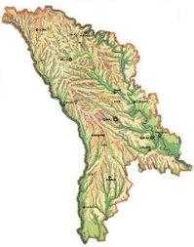
Republic of Moldova
The Republic of Moldova is a small state situated in the north-west of the Black Sea region, bordering Romania in the west and Ukraine in the est, north and south.
The territory represents a moderate hilly plateau, cut by a lot of streams and small rivers. The average elevation is 250-275 m, the highest point being the Balanesti hill – 429 m.

Slide 3
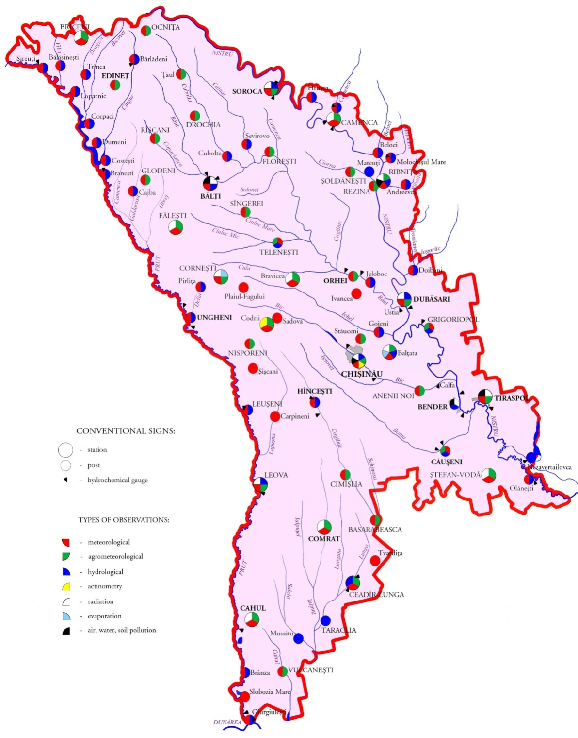
National observational network consists of 90 hydrometeorological stations and posts, including air, water and soil pollution control.

Slide 4
The climate of Moldova
Moderate-continental
Short, warm and nearly snowless winters
Long and hot summers
Small amount of precipitations in the warm period of the year
Positive factors: the abundance of light and warmth, the long lasting warm period and the soft winters
Negative factors: the drought and the weather variability
Notes:
The main factors influencing Moldova's climate, which is moderately continental, are the Black Sea, the Carpathian Mountains and the Eastern European Plain. The summers are warm and long, and the winters are relatively mild and dry. Annual rainfall, which ranges from around 600 millimeters in the north to 400 millimeters in the south, can vary greatly. The heaviest rainfall occurs in early summer and again in October; heavy showers and thunderstorms are common.
Mostly because of its mild and sunny climate the main branch of the economy of Moldova is agriculture. The population working in this field depend greatly on the weather, which brings us to the institution I am representing – the State Hydrometeorological Service.

Slide 5
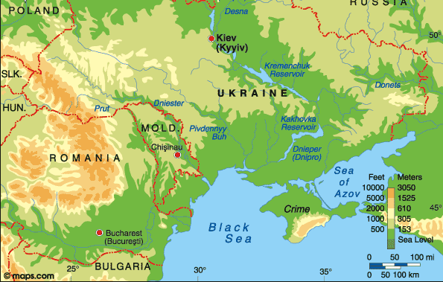
The main factors influencing the weather in Moldova
The Carpathian Mountains
The Black Sea
The Eastern European Plain

Slide 6
Most dangerous weather events
Heavy rainfalls
Ground frosts
Heavy snowfalls
Very high temperatures
Floods
Droughts

Slide 7
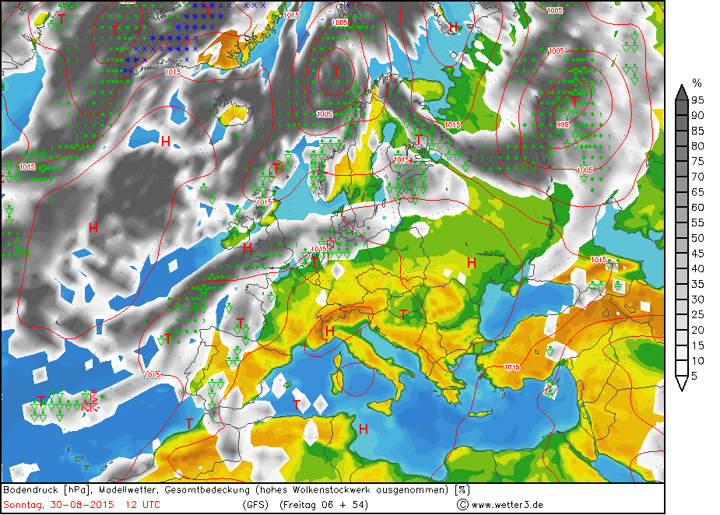
The main factors influencing droughts in Moldova
Meteorological drought
Anticyclone: Weather with high temperatures and little (or without) precipitation

Slide 8
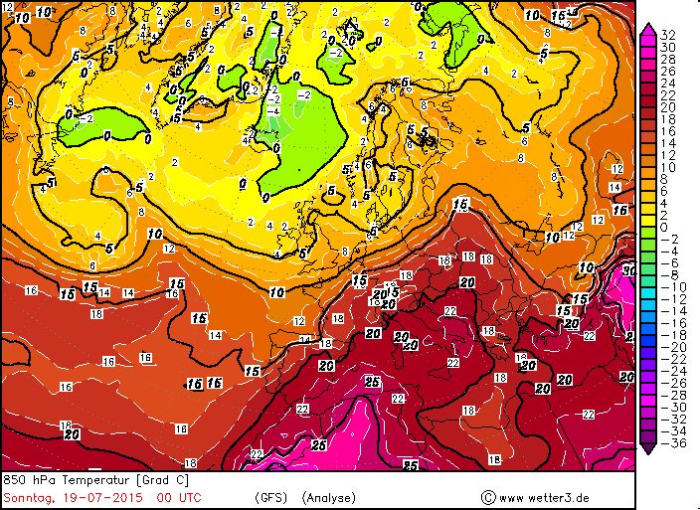
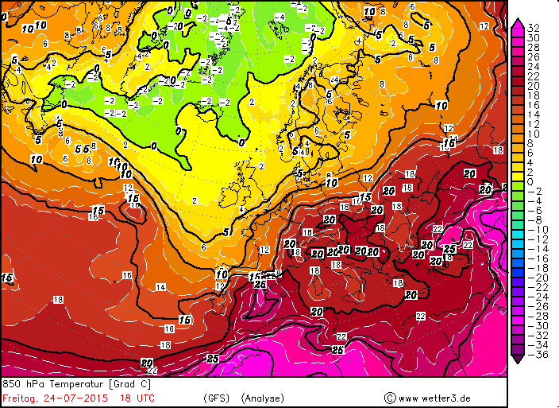
F
The heat in our region strengthens advection of hot and dry air from the Balkans or from the south of Russia
AT850: Hot air mass advection from SW or E

Slide 9
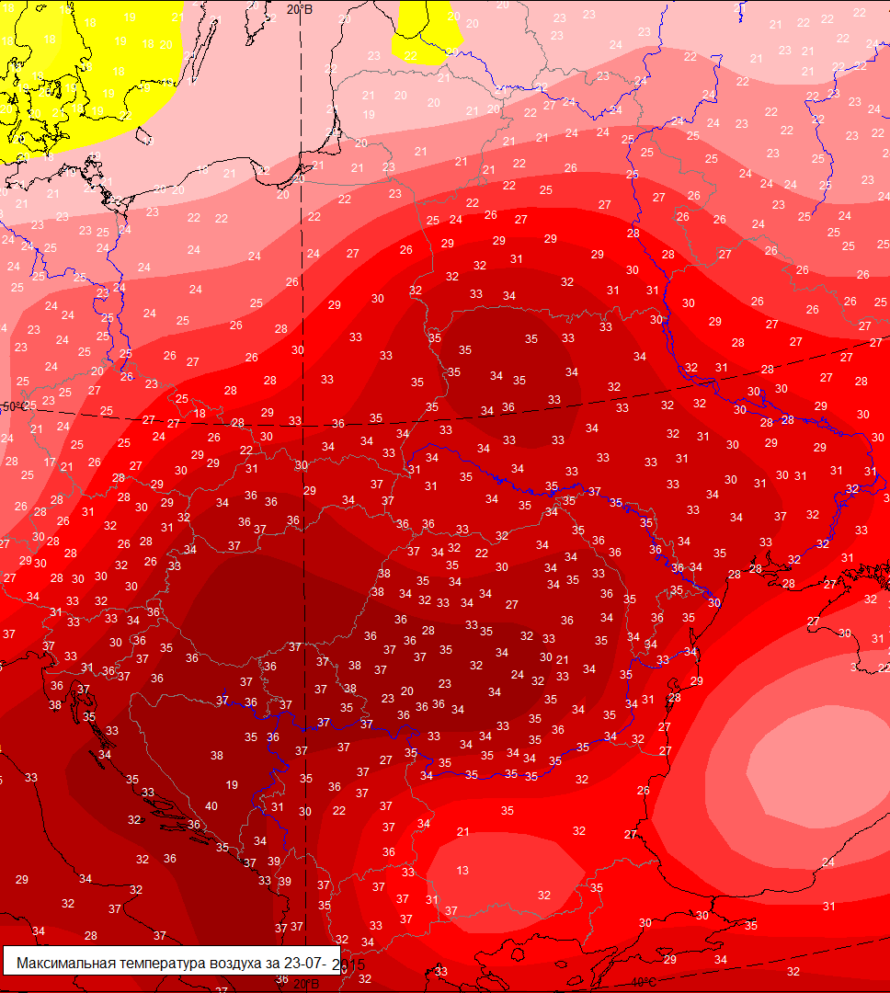
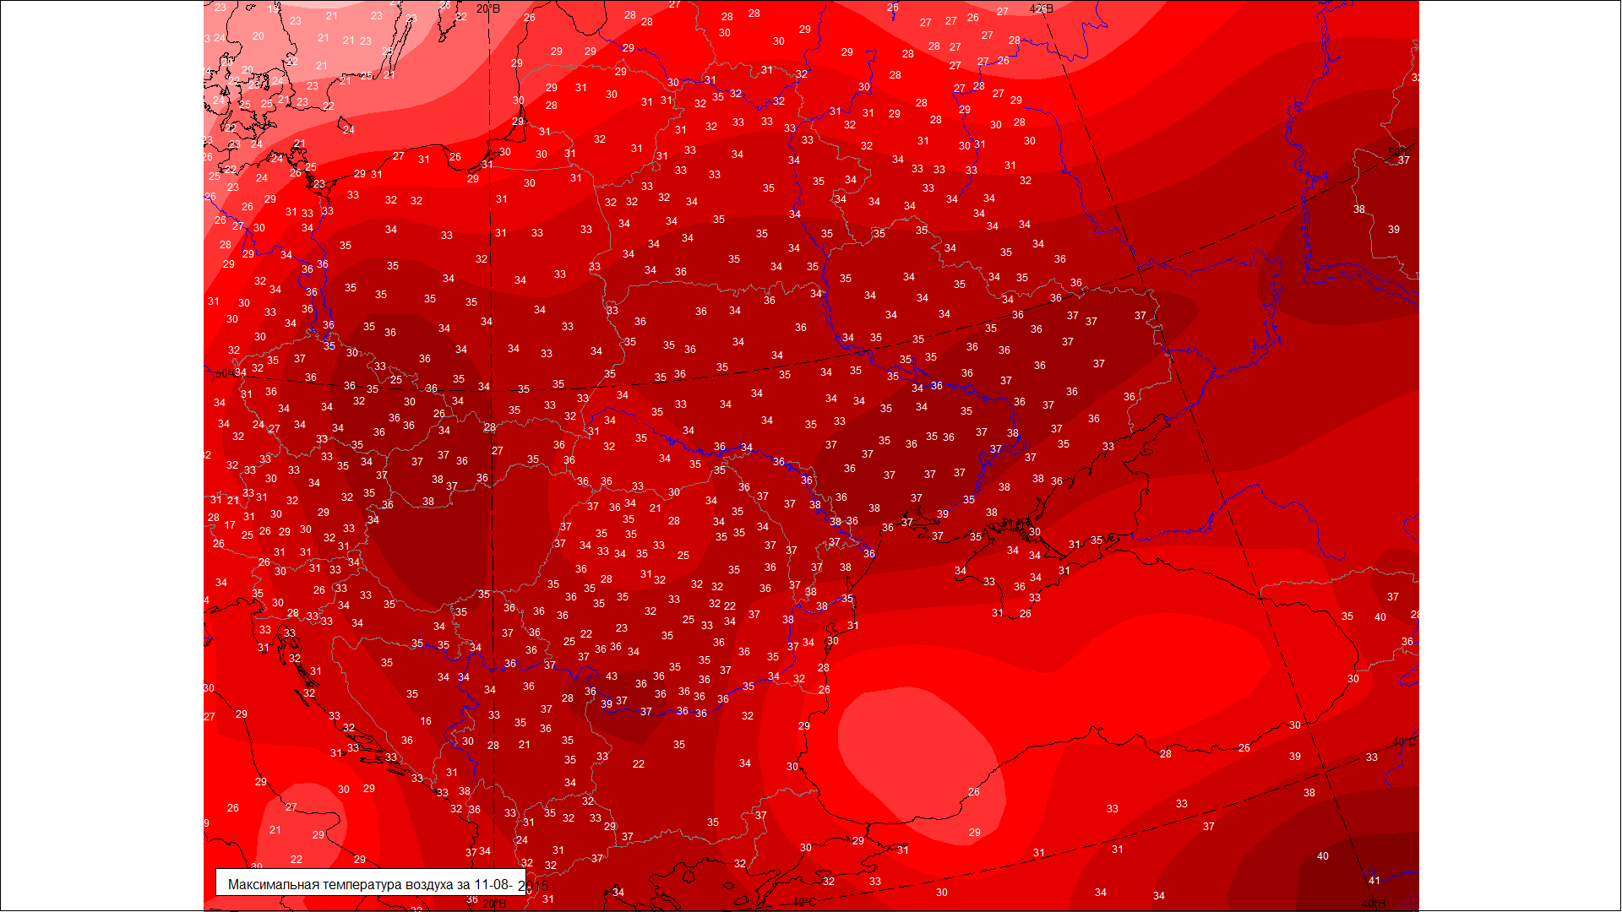
Temperatures at the surface increases more and all this leads to atmospheric drought

Slide 10
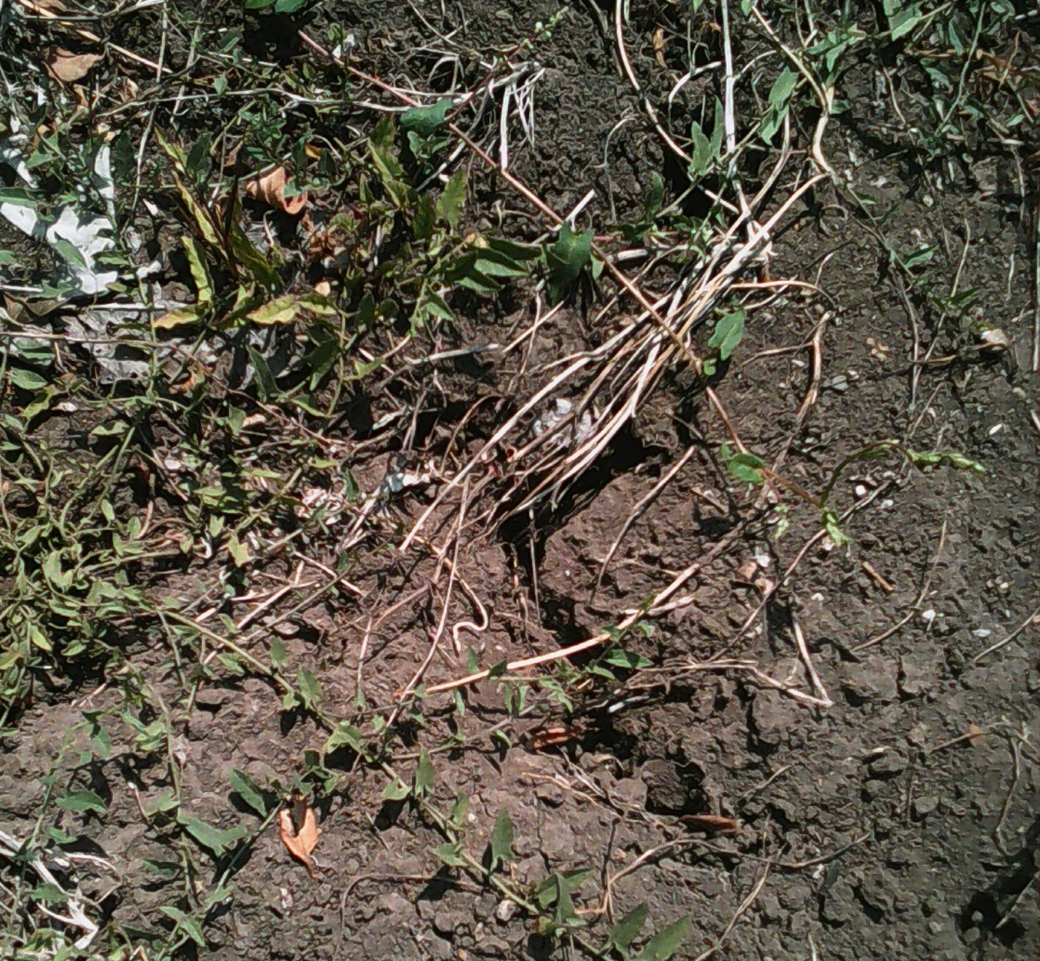
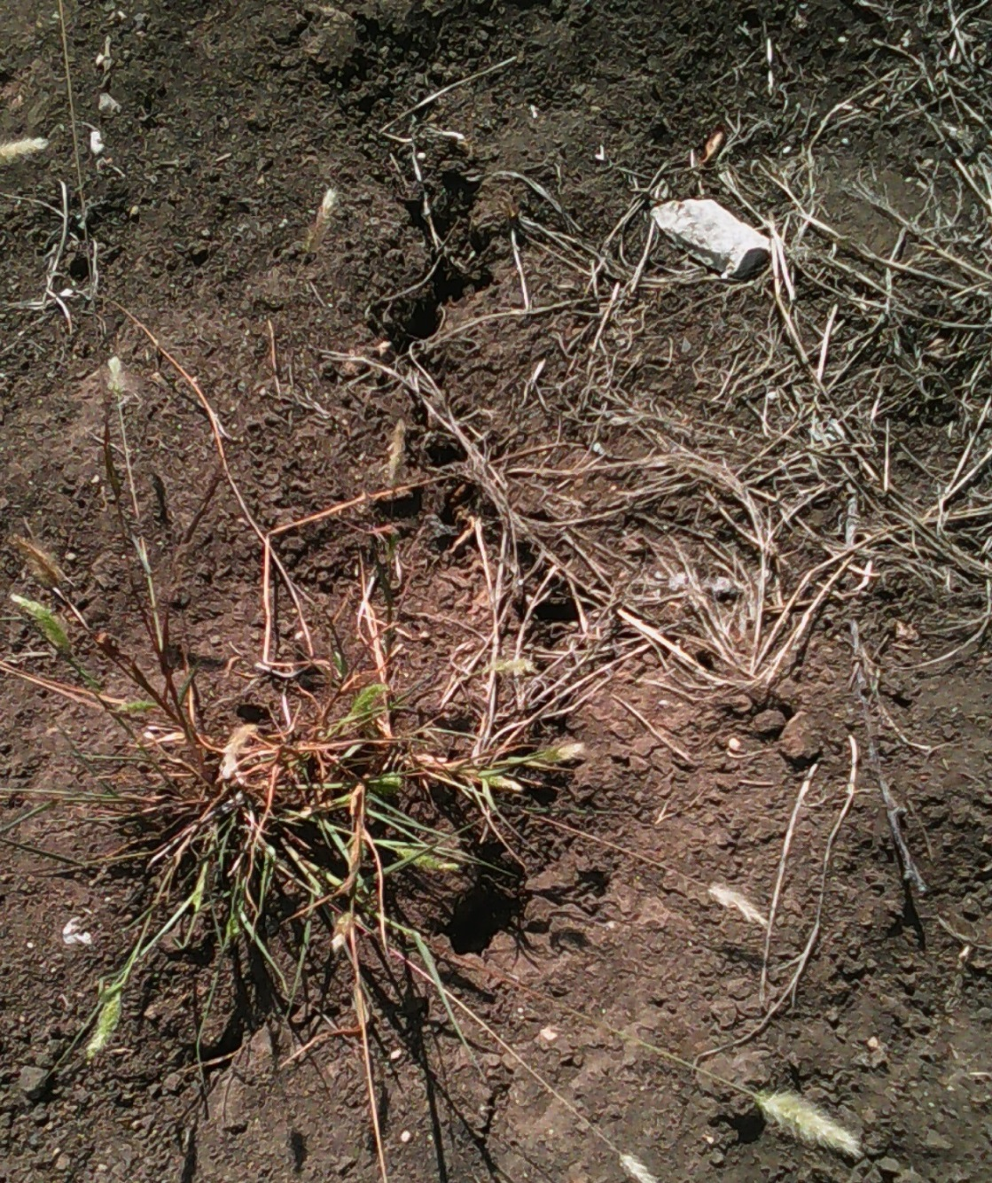
Long atmospheric drought is the cause of soil drought, and it depends on reserve of productive moisture in soil under various crops .
Moldova, August 2015

Slide 11
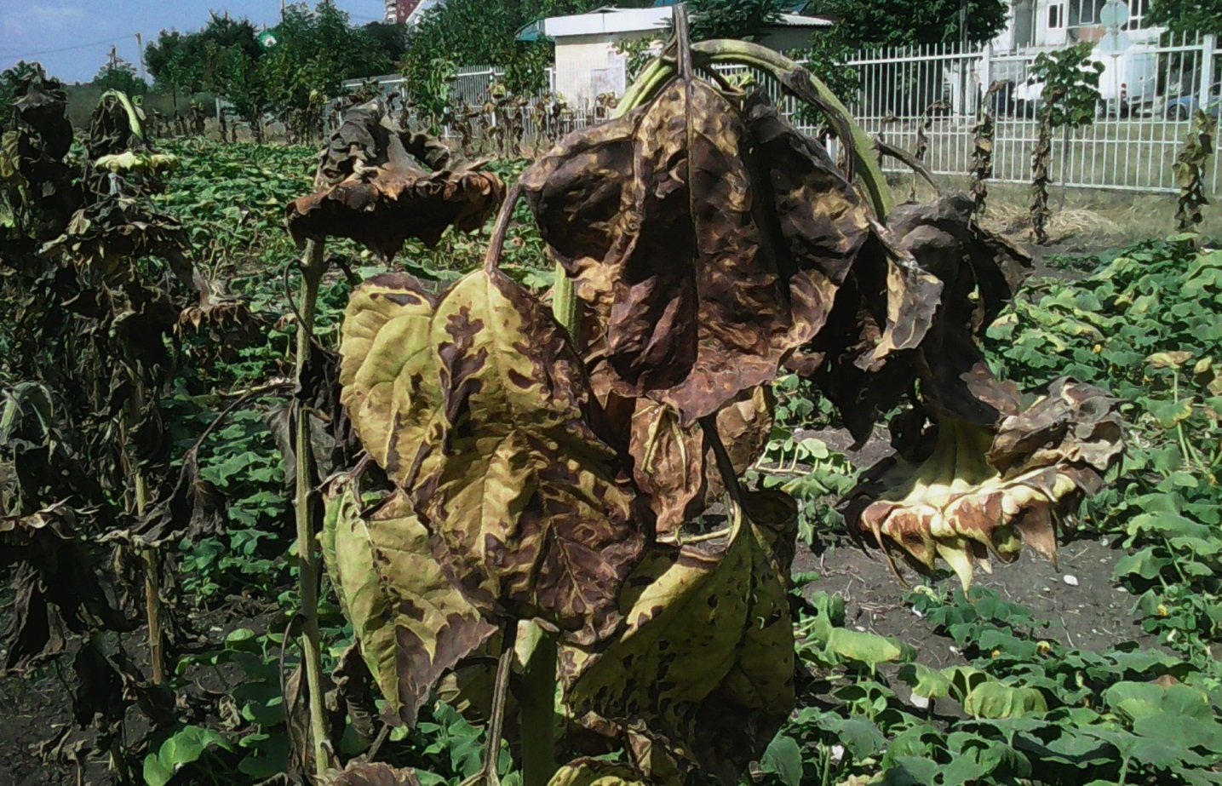
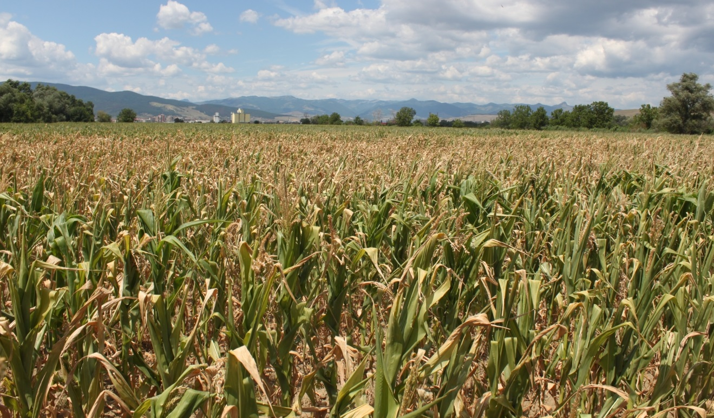
Long atmospheric and soil drought leads to agricultural drought, and it can be different for different types of crops
Moldova, August 2015

Slide 12
The Frequency of Droughts
Analysis of materials from National Fund of Hydrometeorological Data of State Hydrometeorological Service for the instrumental period of observations (y.y. 1890-2015) showed, that from 125 years severe droughts were reported for 23 years (during the growing season - from April to September).
Besides these, for 20 years there have been close to the dry conditions (droughts weak).

Slide 13
The Frequency of Droughts
Overall it constitutes 34% of the number of years of observations (on average once in 3 years).
During 2 years continuous droughts were recorded 3 times and during 3 years – 2 times
The frequency of droughts on the territory of the republic on average constitutes :
1 - 2 droughts in ten years at the north of the country,
2 - 3 droughts in central part,
5 - 6 droughts at the south of the country.

Slide 14
The Frequency of Droughts
In the last two decades droughts were reported more frequently and they are becoming more intensive.
In the period 1990-2015 on the territory of the republic were recorded 11 years (1990, 1992, 1994, 1996, 1999, 2000, 2001, 2003, 2007,2012, 2015) with droughts of different intensity which decreased the harvest of agricultural crops.
The 2007, 2012 and 2015 droughts were the worst in a series of nine dry periods to settle over the country since 1990.

Slide 15
The duration of droughts
The duration of droughts vary from several days to several months or even consecutive years (1945, 1946, 1947).
In 1990, 1992, 2003 droughts prolonged throughout the period of active vegetation (months IV - IX), in the remaining years were reported summer droughts.

Slide 16
Method of Drought Assessment
State Hydrometeorological Service, based on detailed analysis, after years of hydrothermal coefficient (CHT), has determined that:
CHT > 0,76 lack of drought,
CHT = 0,61-0,76 slight drought,
CHT = 0,51-0,60 average drought,
CHT ≤ 0,50 severe and strong drought.
CHT = R / 0,1 ∑ T , where
R – precipitations (mm)
T - temperature,ºC

Slide 17
The intensity of droughts
Droughts surfaces to :
10% - local;
11-20% – extensive;
21-30% – very extensive;
31-50% – extreme,
≥50% - catastrophic.

Slide 18
Assessment of Droughts according to Affected Area
Years | Spring |  | Summer |  | Autumn
 | Covered Surface, (%) | Type of Draught | Covered Surface, (%) | Type of Draught | Covered Surface, (%) | Type of Draught
1946 | 100 | catastrophic | 33 | extreme | - | -
1963 | 40 | extreme | 7 | local | 93 | catastrophic
1967 | 60 | catastrophic | 40 | extreme | 93 | catastrophic
1982 | 60 | catastrophic | - | - | 93 | catastrophic
1986 | 100 | catastrophic | 13 | extensive | 100 | catastrophic
1990 | 7 | local | 67 | catastrophic | 60 | catastrophic
1992 | 27 | extensive | 60 | catastrophic | 40 | extreme
1994 | 87 | catastrophic | 40 | extreme | 100 | catastrophic
1996 | 68 | catastrophic | 49 | extreme | 44 | extreme
2000 | 75 | catastrophic | 55 | catastrophic | 49 | extreme
2003 | 86 | catastrophic | 61 | catastrophic | 26 | Very extensive
2007 | 75 | catastrophic | 80 | catastrophic | -
2012 | 18 | extensive | 90 | catastrophic

Slide 19
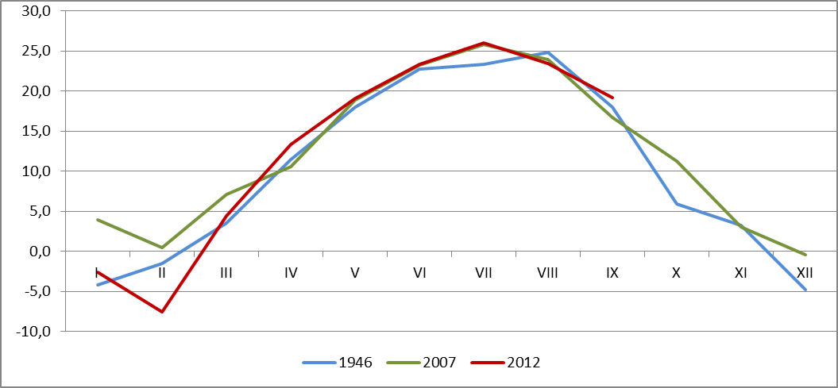
Comparative characteristics of droughts in 1946, 2007 and 2012 The average monthly air temperature recorded at MS Chișinău in 1946, 2007 and 2012

Slide 20
Comparative characteristics of droughts in 1946, 2007 and 2012 Monthly amount of rainfall recorded at MS Chisinau in 1946, 2007 și 2012

Slide 21
Comparative characteristics of meteorological parameters in the summer of 2007, 2012 and 2015
The average air temperature, °C | Deviation from the norm, °C | The rainfall amount, mm | In % of normal
2007
21,1..24,8°С | 3-4 | 10-105 | 10-75
2012
22,2..25,1°С | 4-5 | 40-105 |  | 25-75%
2015
20,9..23,4°С | 1-3 | 42-105 |  | 25-75%

Slide 22
The number of days with high temperatures (during the summer)
2007 | 2012 | 2015 (until 10th of August)
≥30°C – number of days (45-60) norm – (8-27zile) | ≥30°C – number of days (39-62) norm – (8-27zile) | ≥30°C – number of days (25-42 ) norm – (8-27zile)
≥35°C - number of days(15-22) norm – 1-2 | ≥35°C - number of days(16-35) norm – 1-2 | ≥35°C - number of days (3-17 ) norm – 1-2
≥40°C – number of days (1-7) norm – 0 | ≥40°C – number of days (1-3) norm – 0 | ≥40°C – number of days 0 norm – 0

Slide 23
Records recorded during the summer season 2012
The average temperature for the summer season was +21,7..+24,8°C, which is higher than normal values 3,0-4,5°C, on 70% from the territory of the country being reported for the first time during the entire period of observations, exceeding the previous record with 0,1-0,8°C.
On 7th of August was recorded the highest air temperature in summer season for the whole period of observations – +42,4ºC (Fălești), being with 0,9ºC higher than absolute maximum value previously recorded (2007).

Slide 24
Records registered during the summer season 2012
The number of days with the maximum temperature of air +30ºC and higher constituted 39-62 days (standard being 8-27 days), being reported for the first time during the entire period of observations.
The number of days with temperatures of +35ºC and higher constituted 16-35 days (the norm being 1-2 days), which is also reported for the first time during the entire period of observations.
The amount of rainfall during June-August constituted in the country 70-145 mm (35-70% from norm), values reported on average once in 5-15 years.

Slide 25
The drought of 2012
Taking into consideration weather conditions during June-August 2012, due to hydrothermal coefficient determination of Selianinov(CHT), it was established that on most of the country's territory (except extreme northern districts) it was observed severe and strong drought.
Hydrothermal coefficient for that period has averaged 0.5, which corresponds to the severe and strong drought.

Slide 26
The drought of 2012 June-July June-August June-September

Slide 27
Criteria for different indicators of drought
Drought Index | Categories of droughts
 | Intense drought (1st class) | Severe drought (2nd class) | Medium drought (3rd class) | Weak drought (4th class) | Without drought (5th class)
CHT | 0-0,19 | 0,2-0,39 | 0,40-0,60 | 0,61-0,75 | 0,76-5,0
Md (Shashco coefficient ) | 0-0,09 | 0,10-0,19 | 0,20-0,30 | 0,31-0,40 | 0,41-3,0
V, % (availability of moisture for Proterov) | 0-40 | 41-50 | 51-60 | 61-70 | 71-100
No (number of days with the relative humidity ≤30%) | 8-11 | 6-7 | 3-5 | 1-2 | 0
Nt ( number of days with Tmax >30 °С ) | 8-11 | 6-7 | 3-5 | 1-2 | 0
W (0-20 cm), mm | 0-5 | 6-10 | 11-15 | 16-20 | 21-70
W (0-50 cm), mm | 0-15 | 16-25 | 26-35 | 36-45 | 46-140
W (0-100 cm), mm | 0-25 | 26-40 | 41-60 | 61-80 | 81-280

Slide 28
www.meteo.md

Slide 29
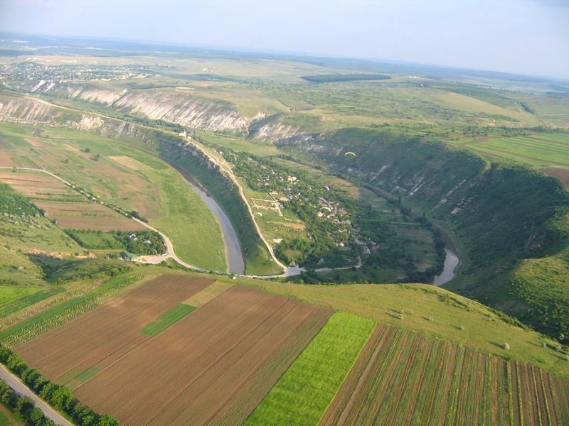
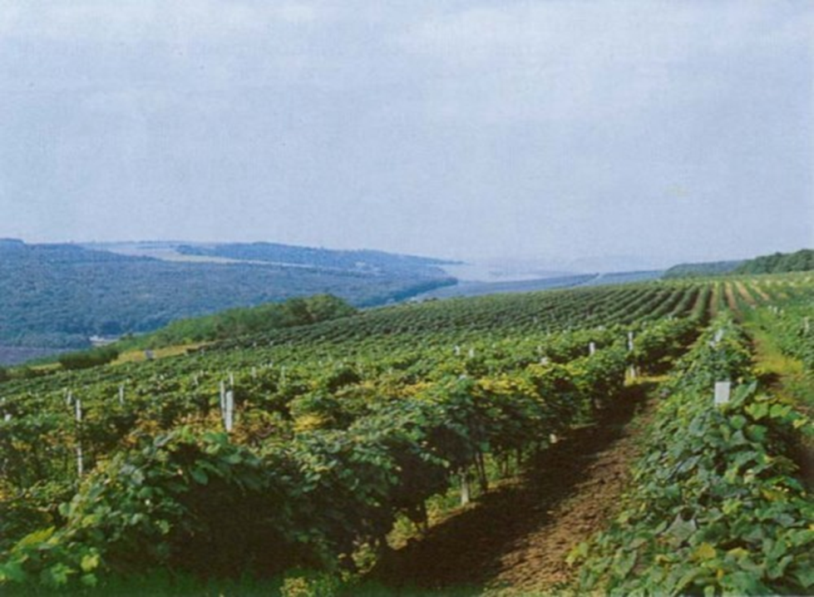
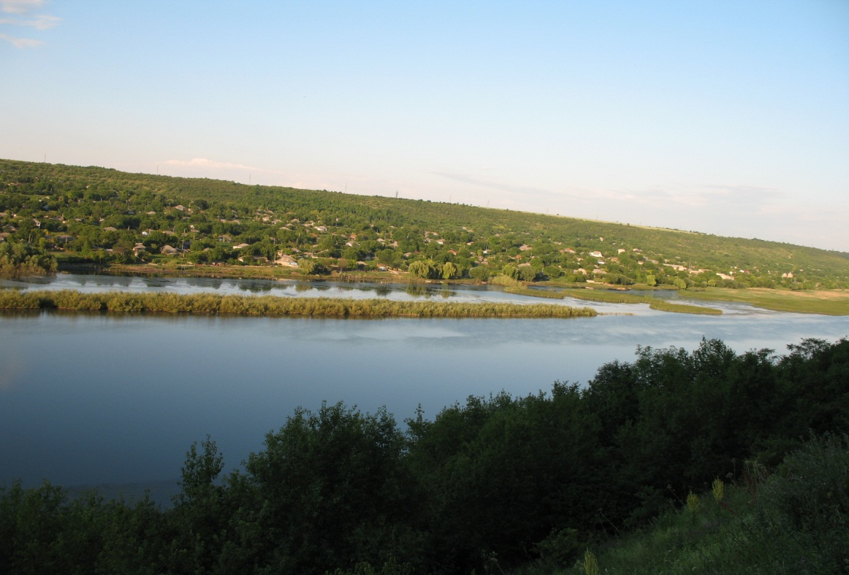

Slide 30
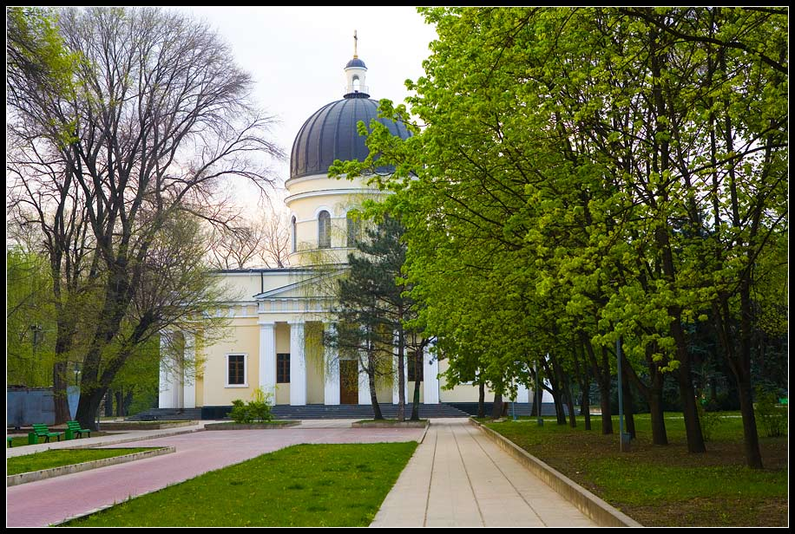
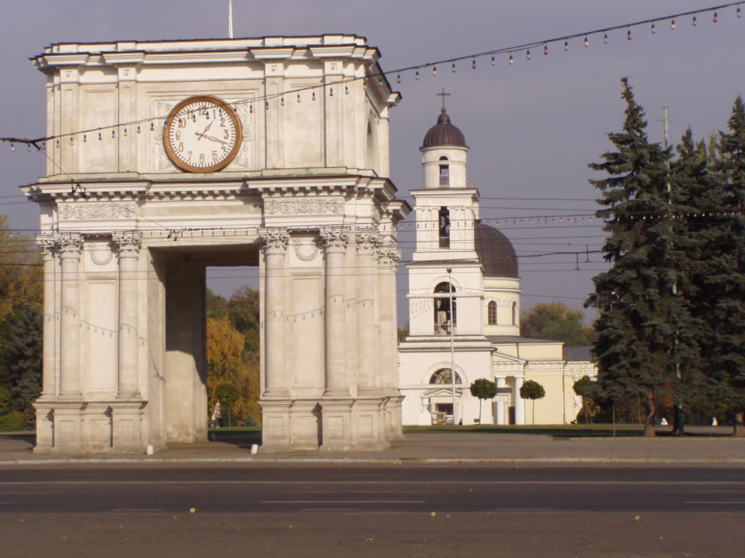
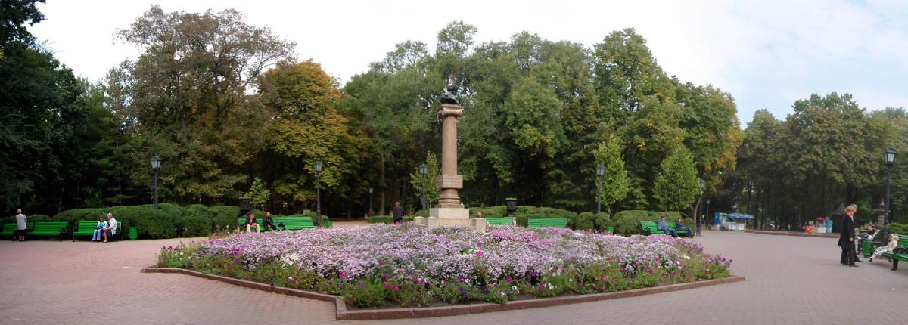

Slide 31
Thank you !

