Slide 1
SEVIRI Kalman filter methodology: retrieval exercises during intense forest fires
Applied Spectroscopy
Sara Venafra, Carmine Serio, Guido Masiello,
Giuliano Liuzzi, Maria Grazia Blasi
School of Engineering, University of Basilicata, Potenza, Italy

Slide 2
Outline
Description of SEVIRI instrument;
Implementation of Kalman filter (KF) methodology to apply temporal constraints in the physical retrieval of [Ts, ε] from SEVIRI infrared radiances;
Retrieval exercise during intense forest fires in Greece on August 2007;
Retrieval exercise during the big flare at COVA (Centro Olio Val d’Agri) on 28 September 2012;
Conclusions

Slide 3
Why we did the exercise of running KF during an intense fire
The objective is twofold:
Does KF remain stable during an anomalous, unexpected event?
If yes, provided that in the thermal infared channels are hardly saturated, can we say something about the dynamics of the fire?

Slide 4
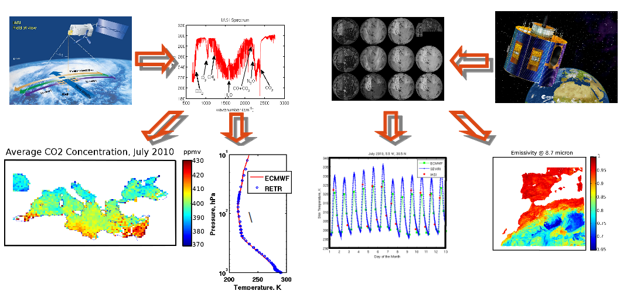
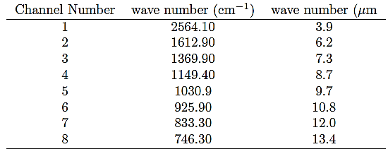
Instrument Description SEVIRI (Spinning Enhanced Visible and Infrared Imager)
Orbit Type: Geostationary
Time resolution: 15 minutes
Pixel Size: 3 Km x 3 Km

Slide 5
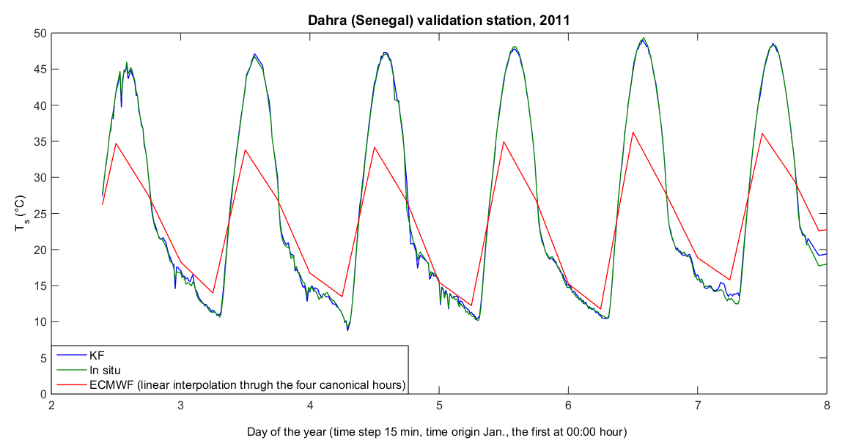
ECMWF LST does not work: example from the Dahra validation station

Slide 6
The retrieval framework
The SEVIRI forward model: σ-SEVIRI
The SEVIRI inverse model: δ-SEVIRI
Kalman Filter + simple persistence model
Lambertian Reflection
Specular Reflection

Slide 7
KF methodology + persistence model for surface temperature and emissivity retrieval
observation equation
state/evolution equation
analysis
at time t
update or analysis
forecast
forecast
at time t
covariance of ƞ_{t}
Application to SEVIRI window channels, for the retrieval of Ts and ε
Masiello, G. et al. 2013, Atmos. Meas. Tech., doi:10.5194/amt-6-3613-2013

Slide 8
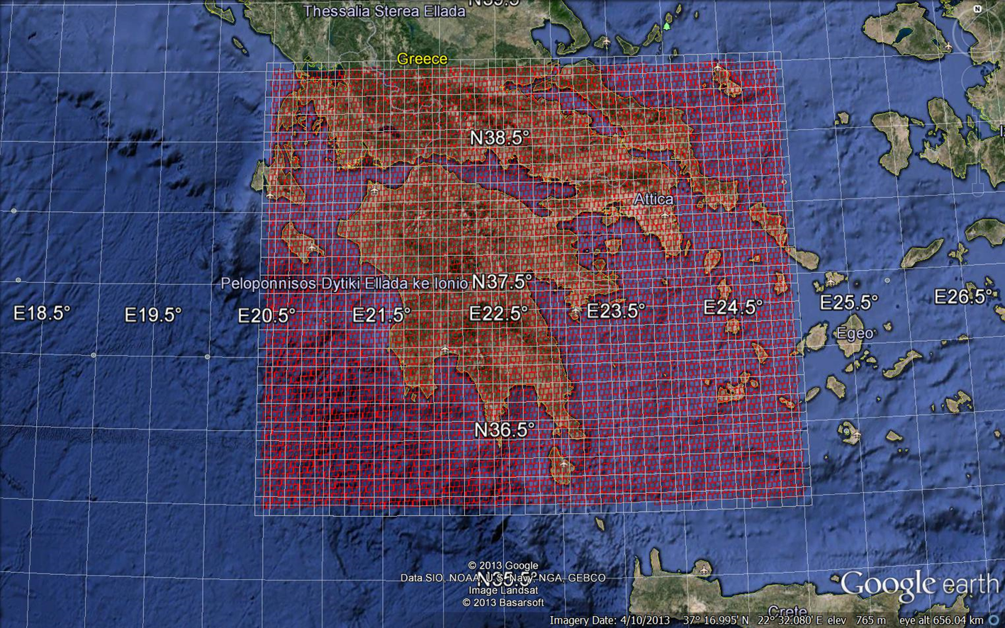
KF retrieval exercise in Greece: Intense Fire Events (1/4) Target Area
8619 MSG-9 SEVIRI Pixels
4047 over Land
4572 over Sea
Downloaded from
EUMETSAT UMARF
Platform
39 N
20.5 E
25 E
36 N
SEVIRI observations recorded during 2007:
23 August to 31 August

Slide 9
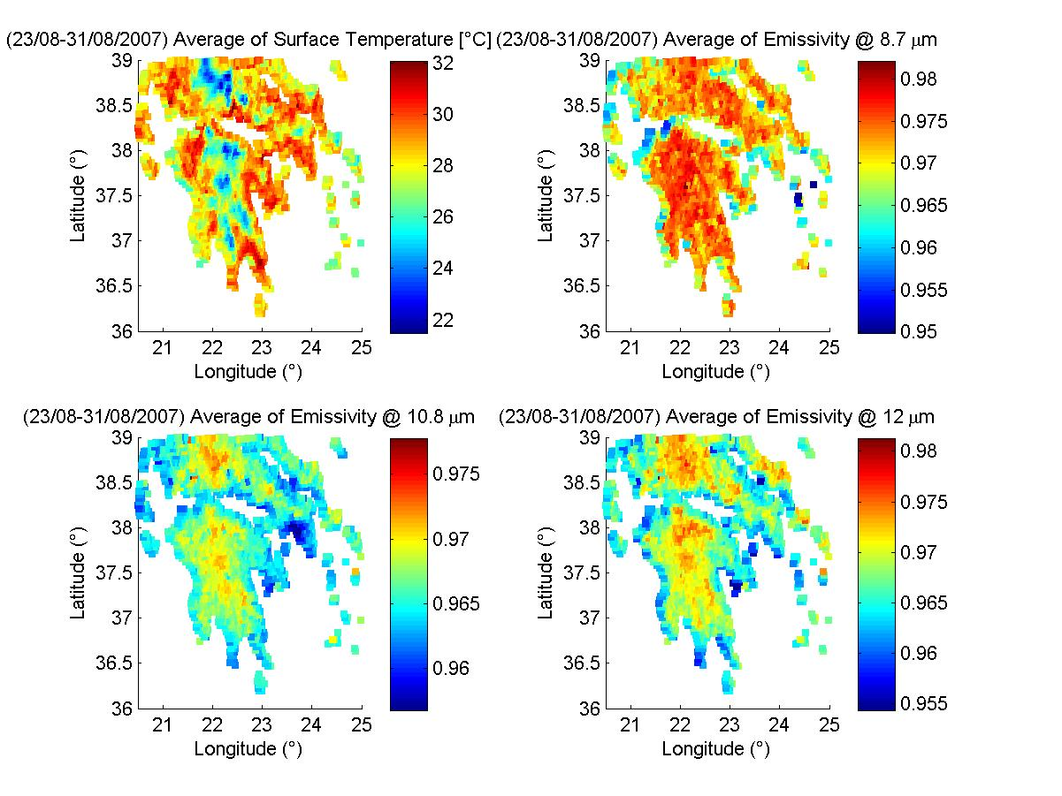
KF retrieval exercise in Greece: Intense Fire Events (2/4) Averaged retrieved Ts for 9 days (23 – 31 August 2007)

Slide 10
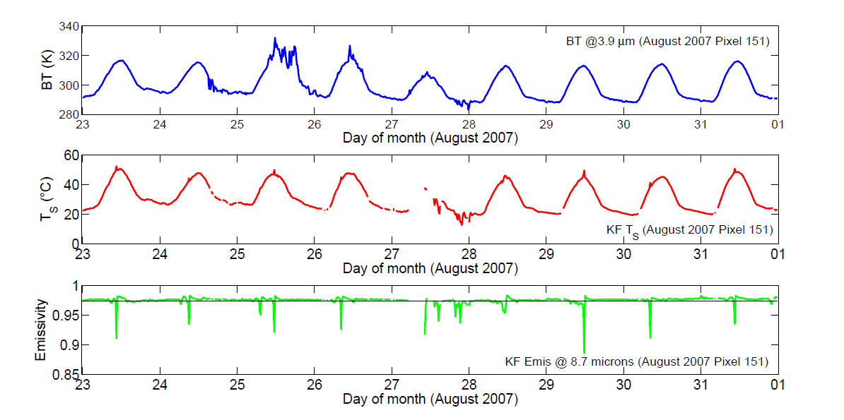
KF retrieval exercise in Greece: Intense Fire Events (3/4) Time Series on Forest Fires (23 - 31 August 2007)
Abrupt peaks in the retrieved skin temperature,
corresponding to sharp emissivity bumps, typical of a grey body

Slide 11
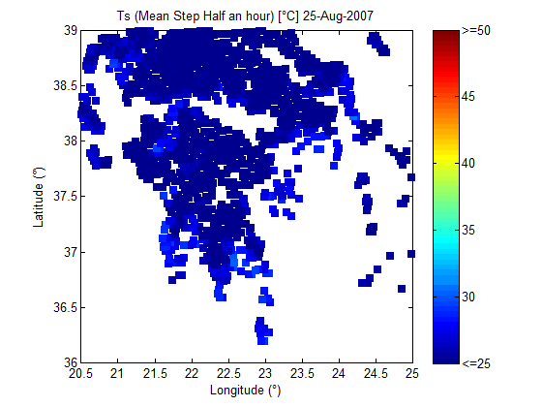
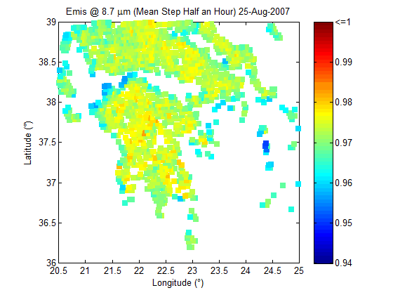
KF retrieval exercise in Greece: Intense Fire Events (4/4) Retrieved Ts-ε on 25 August 2007
RETRIEVED SKIN TEMPERATURE
RETRIEVED SURFACE EMISSIVITY
@8.7 μm

Slide 12
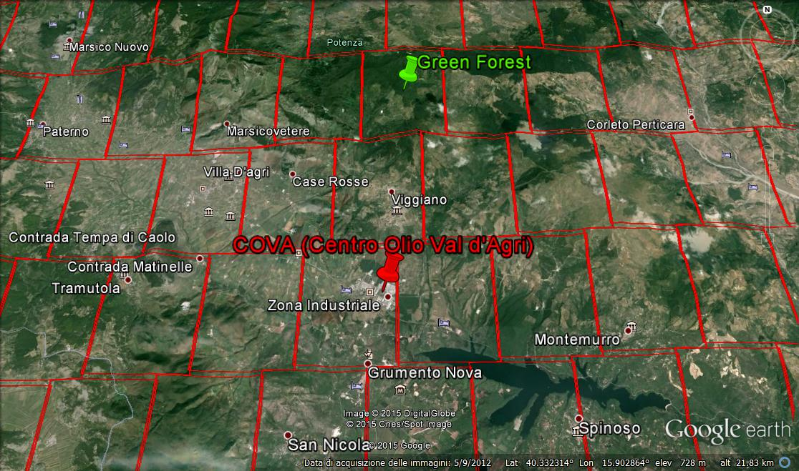
KF retrieval exercise in Basilicata: Big Flare Events (1/4) Target Area
COVA: Centro Olio Val d’Agri (40.3° N, 15.88° E)
Vegetated Pixel (40.4° N, 15.9° E)

Slide 13
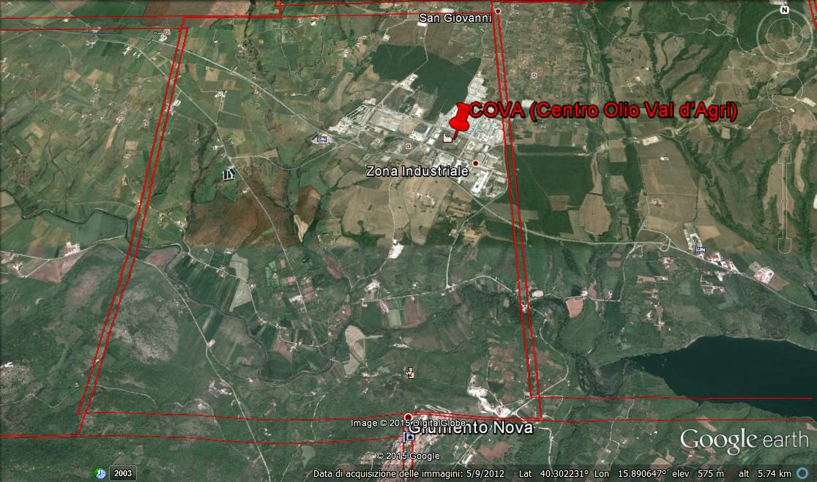
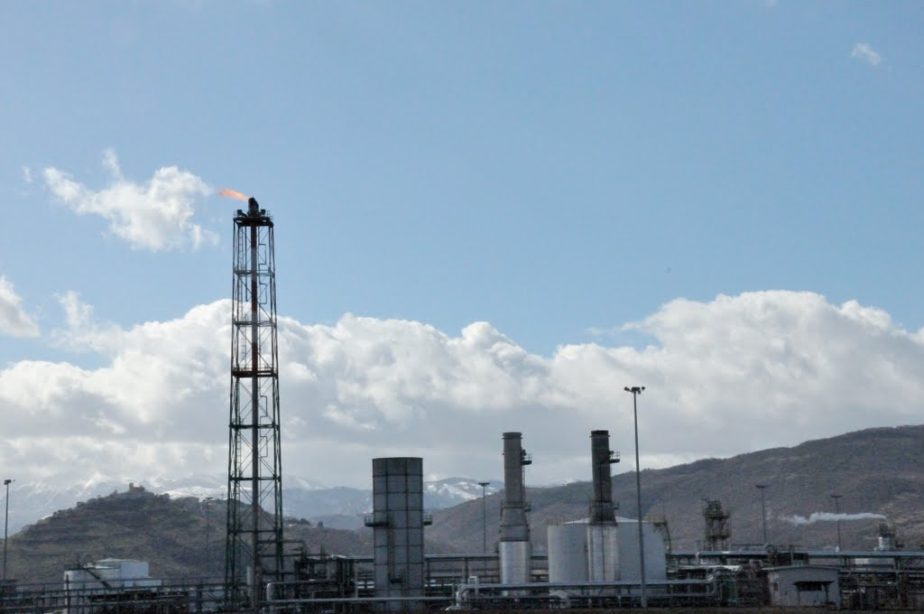
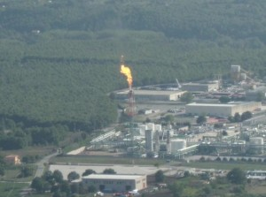
KF retrieval exercise in Basilicata: Big Flare Events (2/4) Target Area
SEVIRI Pixel including COVA:
Centro Olio Val d’Agri
COVA
Centro Olio Val d’Agri
Big Blaze in COVA
on 28 September 2012 at around 12:35 AM

Slide 14
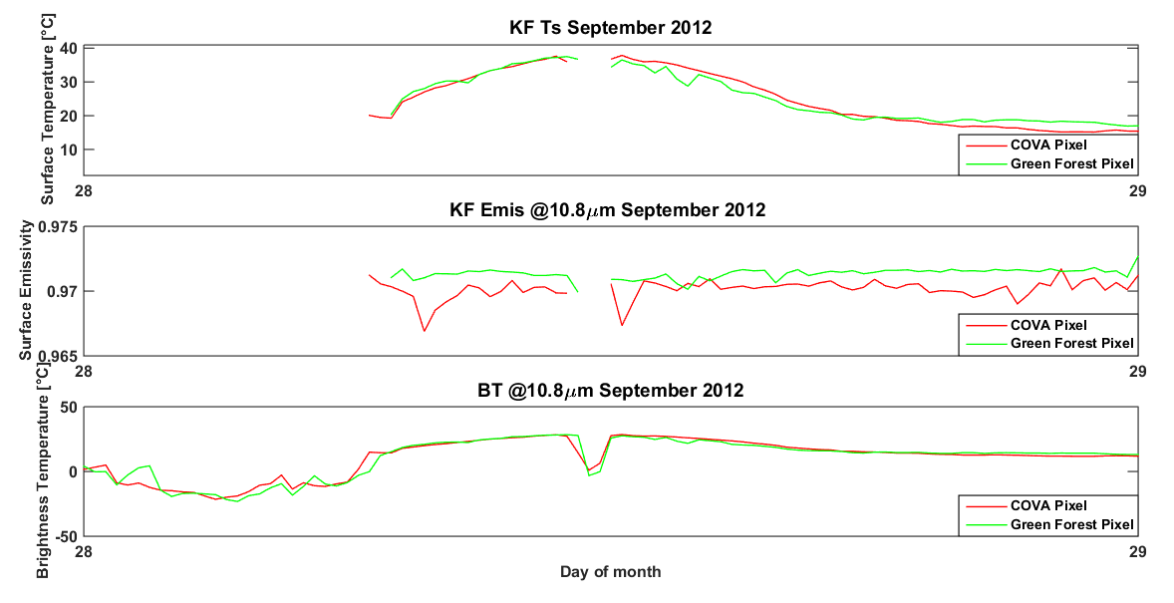
KF retrieval exercise in Basilicata: Big Flare Event (3/4) Time series of [Ts-ε] on 28 September 2012

Slide 15
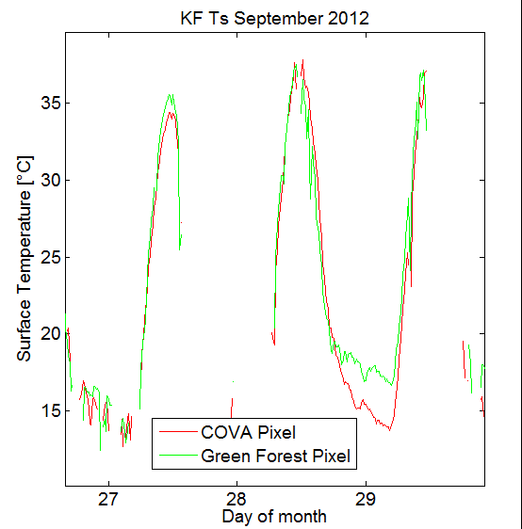
KF retrieval exercise in Basilicata: Big Flare Event (4/4) Time series of [Ts-ε] on 28 September 2012

Slide 16
Conclusions
We have shown a retrieval example on a challenging case related to Greek fires in August 2007;
We have shown a retrieval example on a challenging case related to big flare event in COVA in September 2012;
The developed software tool is very fast, making this very attractive for real-time applications.

Slide 17
Thanks for your attention

