Slide 1
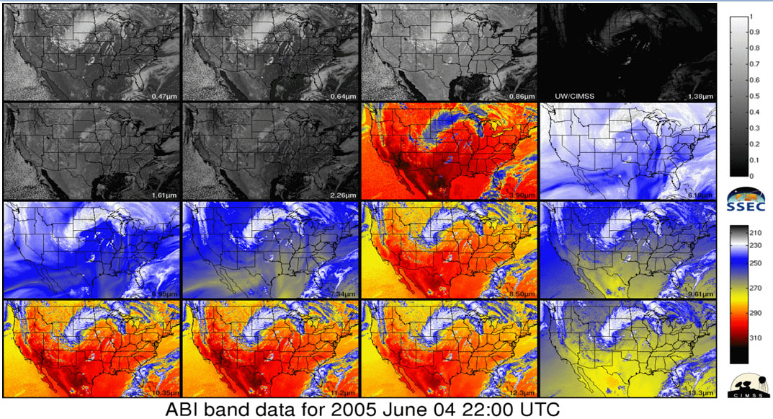
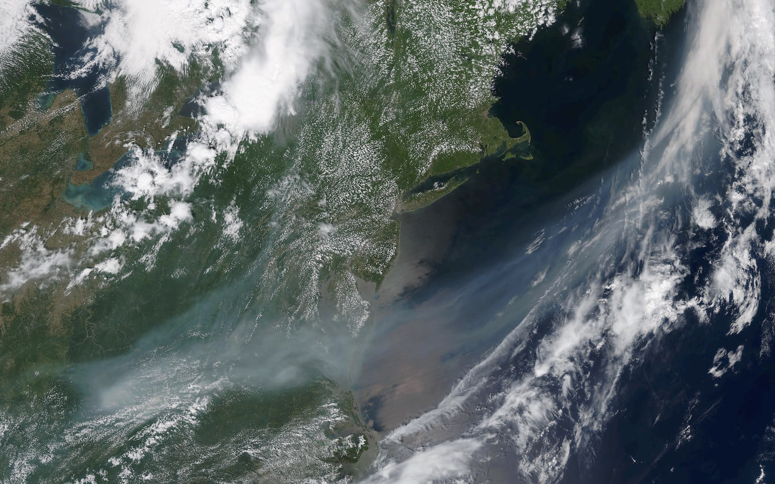
IPET-SUP-2/Doc. 13.3 GOES-R Training Plan for NOAA National Weather Service Forecasters
LeRoy Spayd,
NOAA/National Weather Service
Office of Chief Learning Officer (OCLO)
Anthony Mostek
Forecast Decision Training Division (FDTD/OCLO)
Presented at AMS, 14 January 2016:
https://ams.confex.com/ams/96Annual/webprogram/Paper282652.html

Slide 2
NOAA/NWS Satellite Training Plan
Contributors:
John Ogren - OCLO Acting Chief
Ed Mahoney, Brian Motta & James LaDue - OCLO
Regional Scientists
Satellite Liaisons
GOES-R Program
SOOs – Satellite Training Advisory Team (STAT)
Coop Institutes: CIMSS, CIRA, CIMMS (VISIT)
COMET
NASA/SPoRT, WMO, and others

Slide 3
GOES-R Training Timeline
2015
2016
Launch
Data?
2017 & Beyond
Making it
Stick
Continuous Learning
Prerequisites
Foundation
Application
Exercise
Training stages
Prerequisites – overall basics
Foundation – satellite specifics
Application – operational setting
Exercise – simulations, practice
Making it Stick – multi-situational, sharing
Continuous Learning – evolve and update

Slide 4
NOAA/NWS GOES-R Training Plan
Learning Objectives
Understand differences between legacy GOES & GOES-R
and satellites
Use GOES-R for NWS forecasts and warnings & Decision Support Services
Utilize satellite-based total lightning detection sources in forecast & warning operations (GOES Lightning Mapper - GLM)
Understand fundamental RGB and other satellite products

Slide 5
Foundational Training
GOES-R Introduction and SatMet Background Track (240 minutes)
- Basic principles of radiation (15 minutes)
- Basic operation of the GOES-R satellites (15 minutes)
- Spectral bands (90 minutes)
- Multichannel interpretation approaches (30 minutes)
- Baseline products (90 minutes)
Geostationary Lightning Mapper Track (40 minutes)
Mesoscale/Convection Track (120 minutes)
Synoptic Features Track (80 minutes)
NWP/Data Assimilation Track (30 minutes)

Slide 6
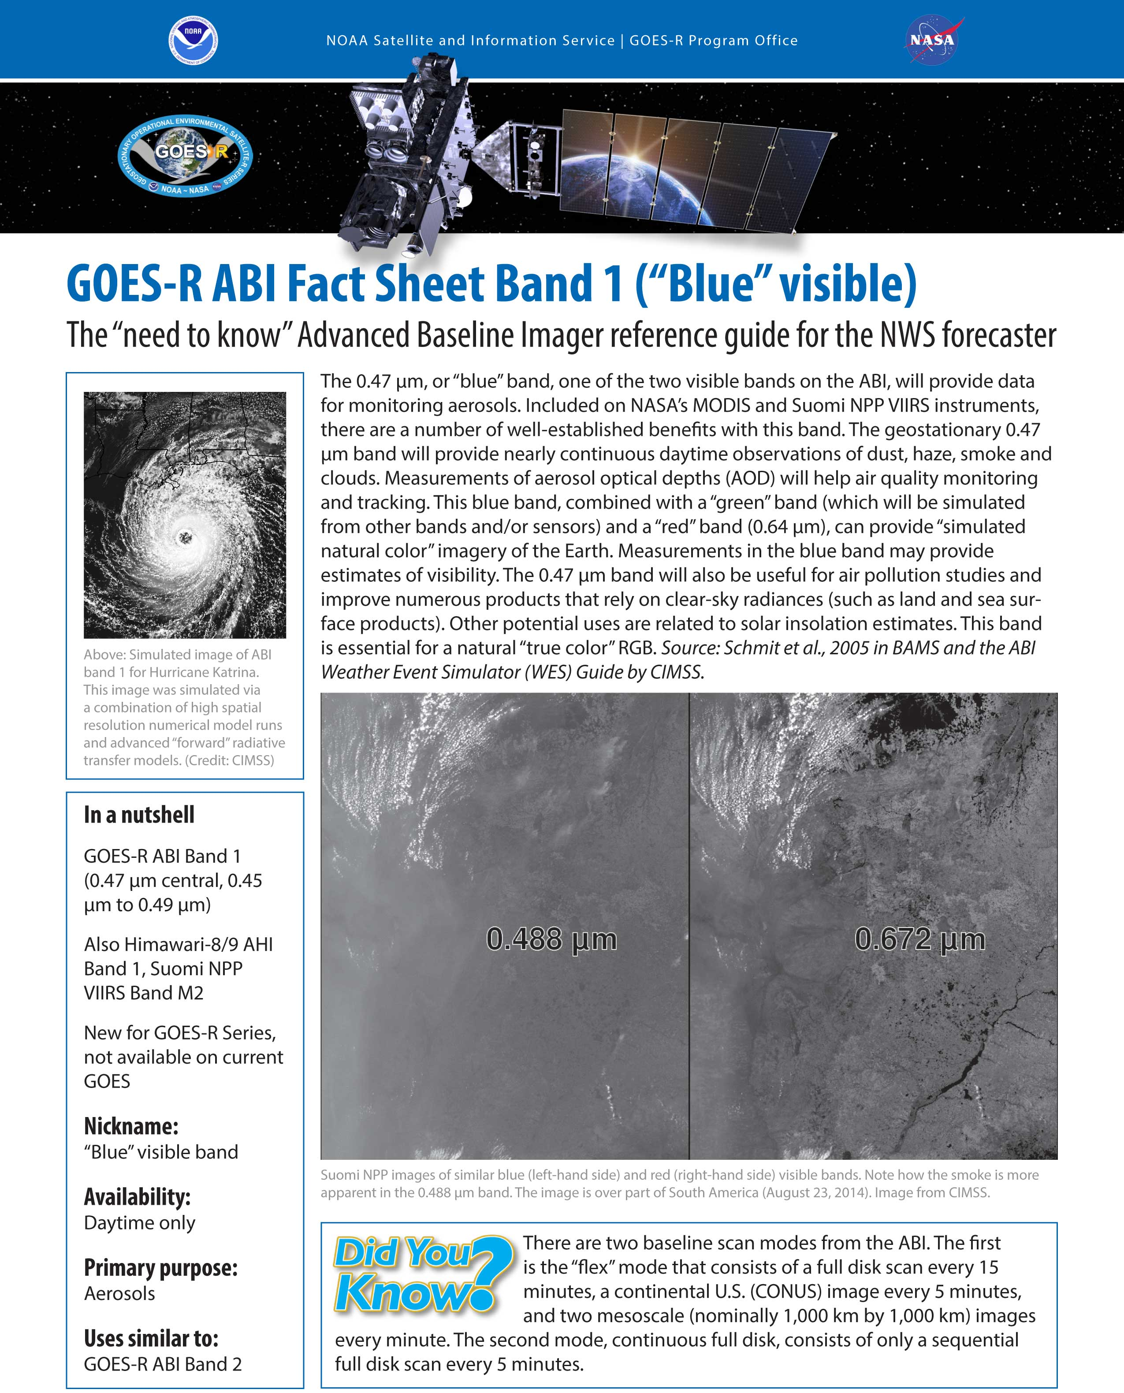
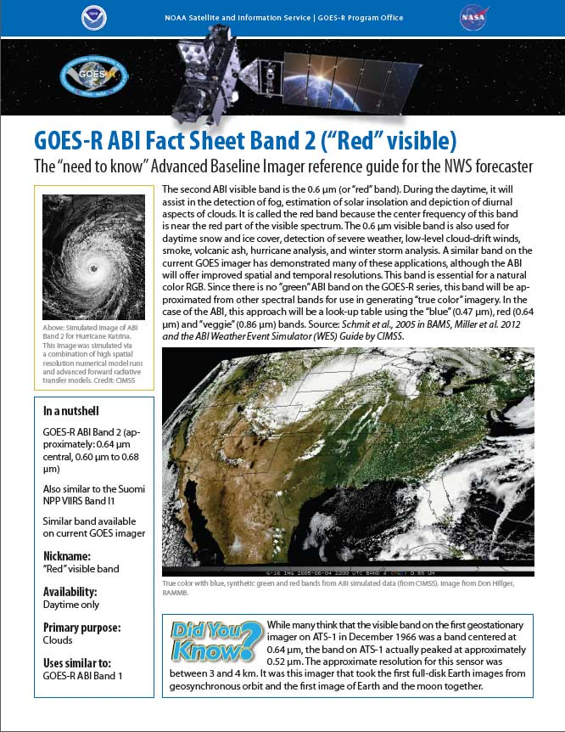
GOES-R ABI Band Fact Sheets
With examples from VIIRS
Thanks to Tim Schmit, George Tuggle, Michelle Smith, Carven Scott, and Bill Ward

Slide 7
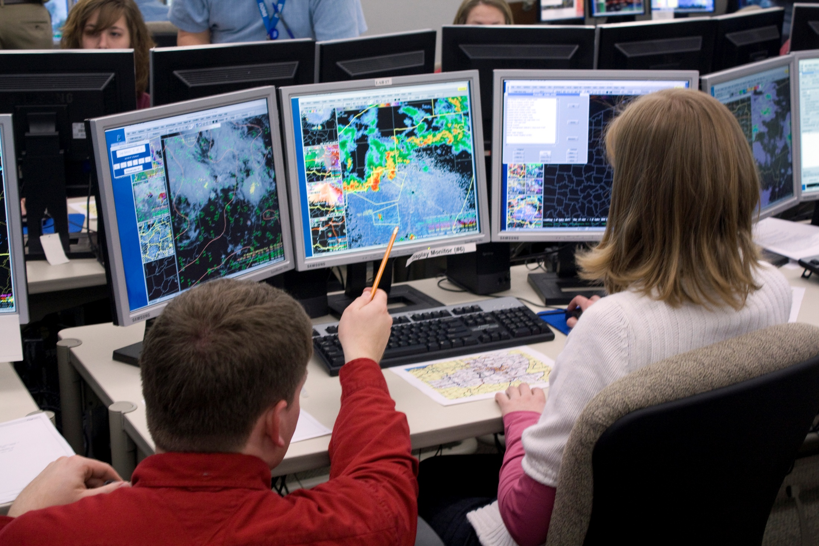
Satellite Training
Design Approach
Office
Satellite Facilitator
Performance Objectives
Applications
Training
WOC
Severe
WOC
Flash Flood
WOC
Winter Wx
Foundational Training
WSR-88D
WOC
Core WDM
DLOC
Learning Objectives
MRMS
Satellite
AWIPS-2

Slide 8
NOAA/NWS Satellite Training Plan
Event of the Week/Month:
Webinar promotes sharing of events/best practices
Participation & collaboration with experts (R2O, O2R, R2A)
Focus on interpretation of satellite data utilizing real events
Builds credibility & understanding among forecasters
Accomplished by leveraging expertise and satellite liaison
Note: Modeled after highly successful Dual-pol radar training
“Storm of the Month”.

Slide 9
Summary
NWS is working with all Training Partners to ensure all NOAA users are ready to use GOES-R
Goal is Improved Operational Performance
Accomplished via:
Foundational Training
Applications & Exercises
Blended Continuous Learning to Make-It-Stick

