Slide 1
User readiness for the next generation of meteorological satellites
Stephan Bojinski, Mikael Rattenborg
World Meteorological Organization (WMO)
Space Programme
VLab Management Group, 8th Meeting, 9-13 May 2016
WMO; OBS/SAT
Notes:
It includes an introduction to WMO and its programmes; provides a description of the WMO Space Programme and its coordination of international data dissemination and product generation; introduces WMO-supported training in satellite meteorology through the VLab; describes efforts by WMO to improve user preparation to the new generation of satellites 2014-2018; sets in context the Event in the Americas and internationally; presents results of a recent WMO survey on the use of satellite data for the Americas; summarizes online resources provided by WMO for informing and guiding satellite data users.

Slide 2
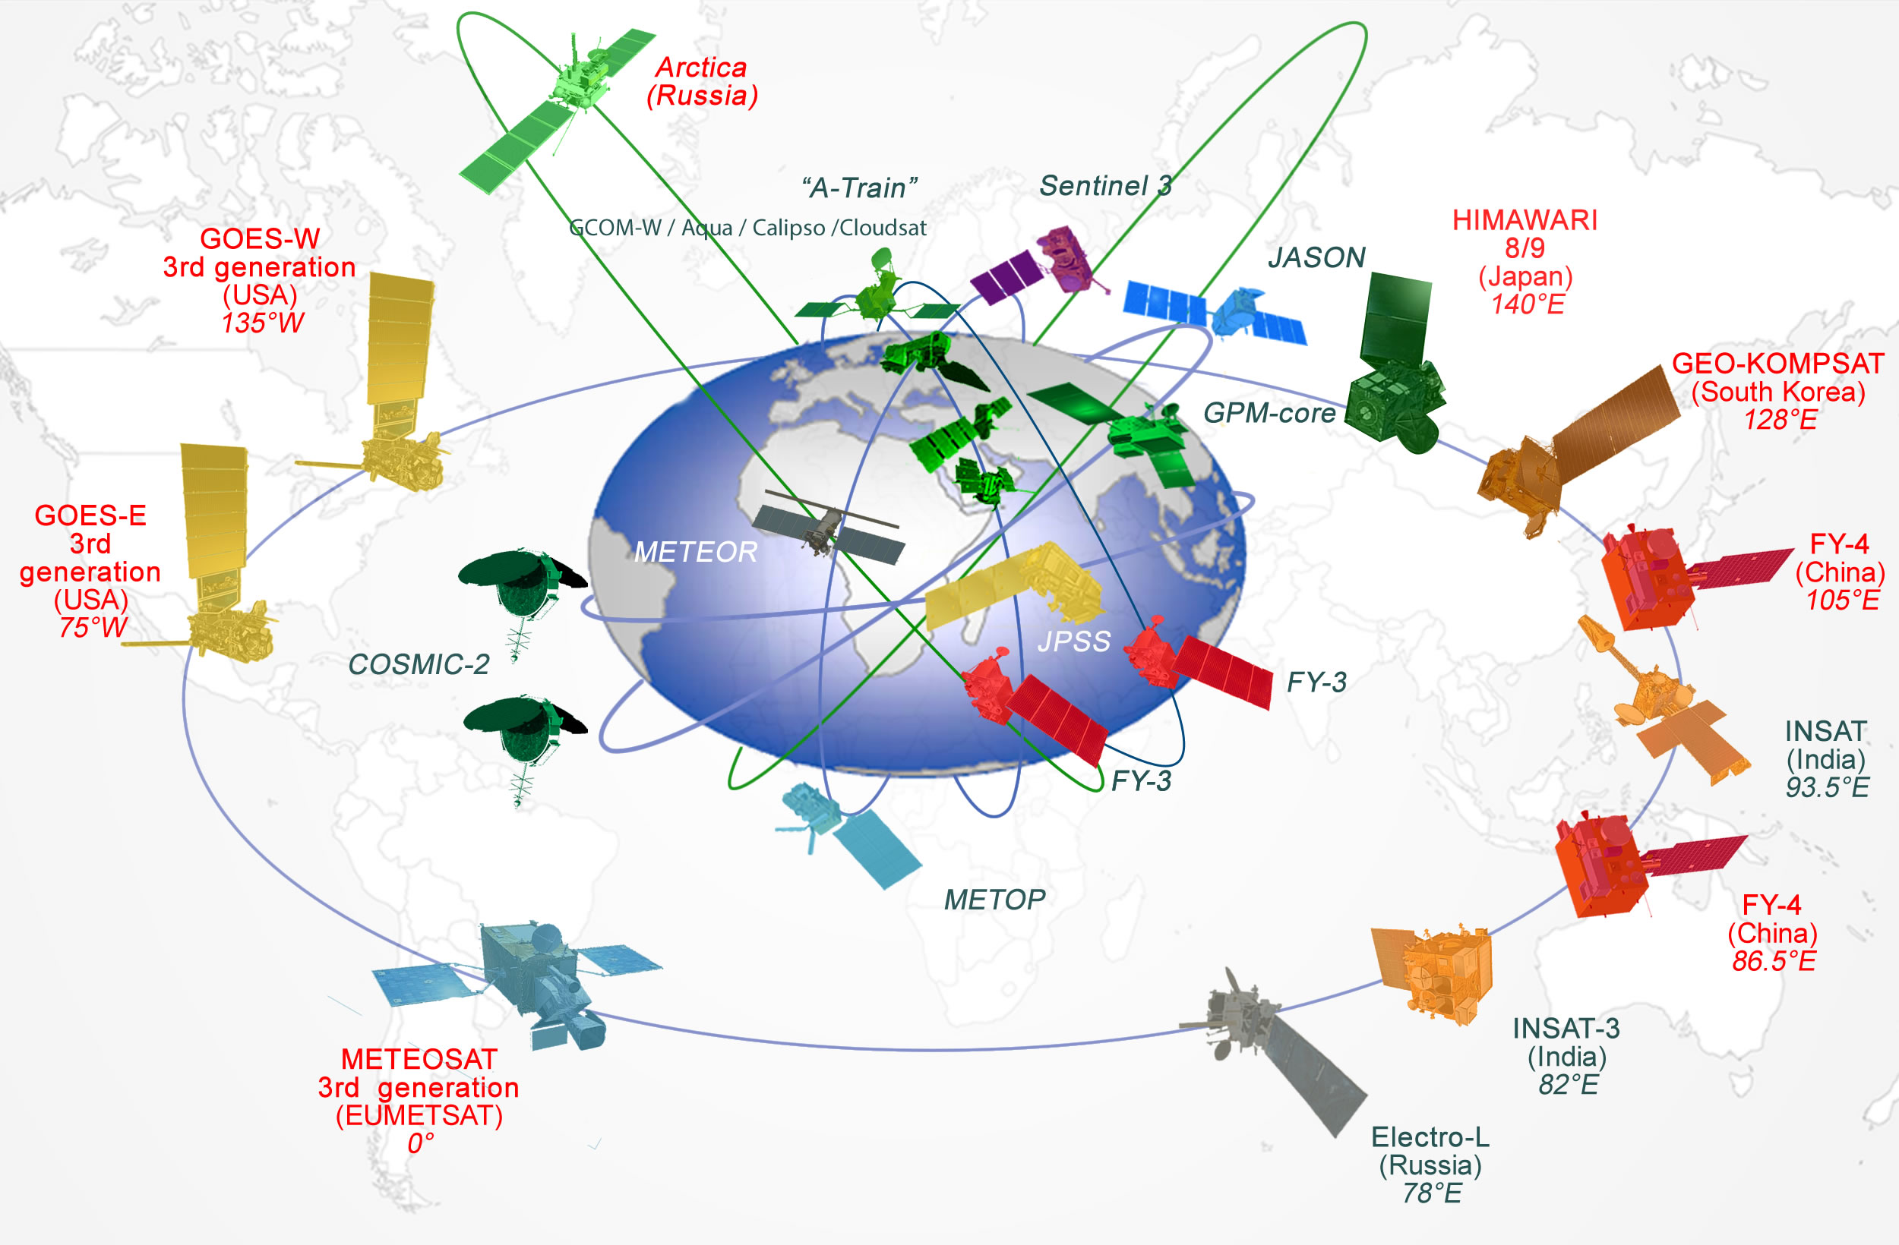
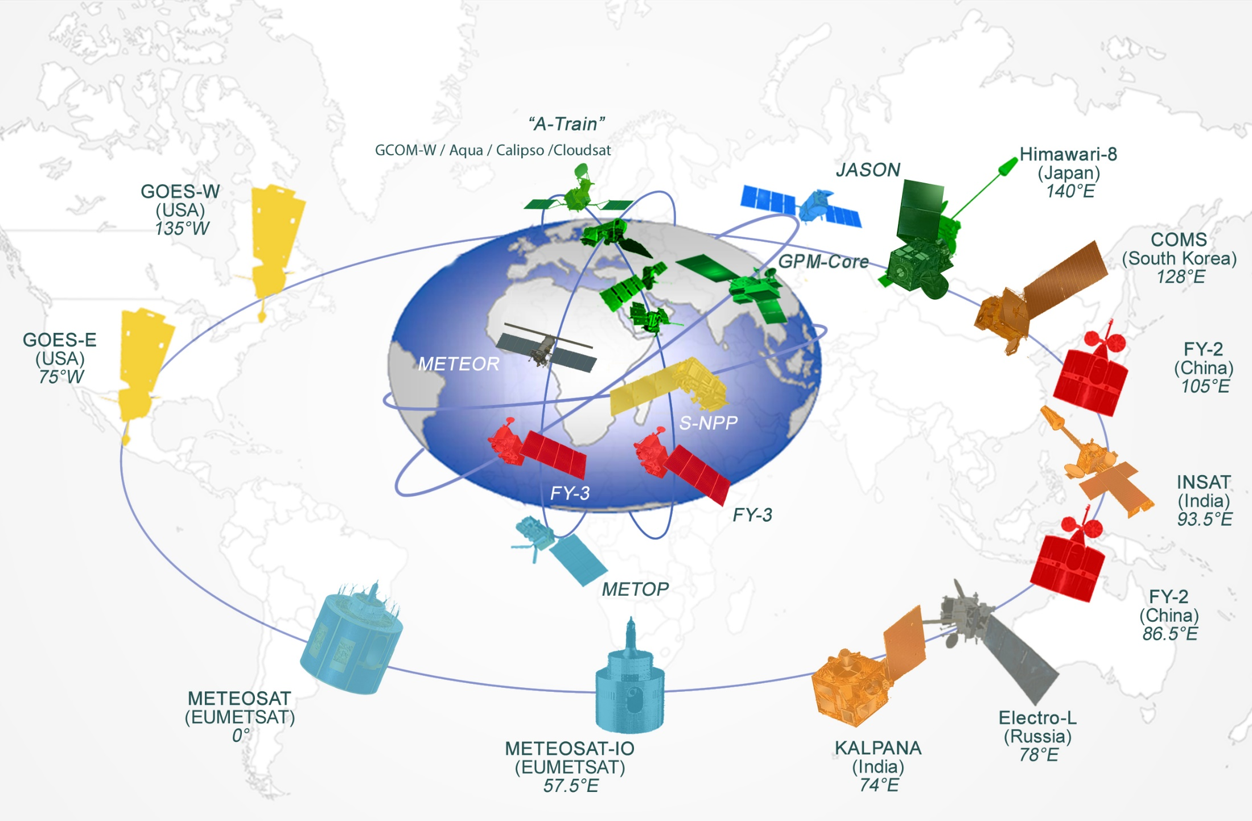
Space-based GOS 2015
2020
FY-3E in early morning orbit
New-generation
Geostationary
ALL WMO REGIONS CONCERNED!

Slide 3
Satellite | Operator | Launch date | Longitude | Imager | Number of spectral channels | Spatial resolution | Temporal resolution (full disk) | Sounder / Lightning Mapper
Himawari-8* | JMA | 7 Dec 2014 | 140E | AHI | 16 | 0.5-2km | 10min | - / -
Electro-L N2 | ROS-HYDRO-MET | 11 Dec 2015 | 78E | MSU-GS | 10 | 1-4km | 15min | - / -
INSAT-3DR | ISRO | 2016 | 74E | IMAGER | 6 | 1-8km | 30min | S / -
GOES-R | NOAA | 2016 | 137W | ABI | 16 | 0.5-2km | 15min | - / L
Himawari-9 | JMA | 2016 | 140E | AHI | 16 | 0.5-2km | 10min | - / -
FY-4A | CMA | 2017 | 86.5E | AGRI | 14 | 1-4km | 15min | S / L
Geo-KOMPSAT-2A | KMA | 2017 | 128.2E | AMI | 16 | 0.5-2km | 10min | - / -
GOES-S | NOAA | 2017 | 75W | ABI | 16 | 0.5-2km | 15min | - / L
MTG-I/S | EUMETSAT | 2019-21 | 9.5E | FCI | 16 | 0.5-2km | 10min | S / L
FY-4B | CMA | 2019 | 105E | AGRI | 14 | 0.5-4km | 15min | S / L

Slide 5
WMO Supporting User Readiness
Online portal SATURN (SATellite User Readiness Navigator)
  GEO (Himawari-8, GOES-R, Elektro-L N2, MTG, FY-4A, GEO-KOMPSAT-2A), LEO (FY-3E, JPSS)
  www.wmo-sat.info/satellite-user-readiness
Online training material on aspects of Himawari-8 and GOES-R has been made available through SATURN in English and Spanish (where available), in collaboration with the VLab and COMET/MetEd
2015-2019 Strategy of the WMO-CGMS Virtual Laboratory for Education and Training in Satellite Meteorology (VLab) places high emphasis on building capacity for the new generation satellites
Best practices – Reference User Readiness Project
WMO
Notes:
5

Slide 6
User Readiness Activities
Budgeting and planning
Research and Development
Development of NWP data assimilation
Data handling development and testing
Design and procurement of reception systems
Understand early where investments are necessary or unavoidable
Internal networks and IT capacity for archiving, visualization and processing
Data processing development and testing
Processing of direct broadcast data, monitoring and NWP assimilation
Generation of higher-level products for specific applications
Training and Capacity Building
Utilization and interpretation of L1 data and L2 products
Use of software tools (for processing, analysis, and assimilation)
Contributions to Calibration/Validation
Participation of NWP centres in instrument Cal/Val activities
Development of new or specially tailored products for specific application areas
User Activities

Slide 7
Deliverables from satellite agencies to Users
Instrument characterization
Spectral Response Functions as measured during on ground instrument testing
Product specifications
Scientific specifications of the product algorithms
Data access mechanism specifications
Software tools and test data
Information on formats, timeliness and expected data volumes, both for L1 and L2 products.
Needed 3 years before launch, both Direct Broadcast and DVB-based dissemination.
Increasing processing demand for the new satellites; impact on users systems is significant.
L1 pre-processing software for Direct Broadcast data
Challenges for advanced instruments, employing complex focal planes and multiple detectors
Operations plans and schedules
Long-term fly-out plan
User Notification and Feedback
2-way communications channels, information, user enquiries and feedback (Early!)
Use of regional user fora (e.g.; RAIDEG), Users Conferences and training events
Training resources
For new satellite systems the provision of training material from satellite operators is crucial.
The WMO-CGMS VLab plays a key role for online training material (multi language).
Test data
Routine operations schedule, incl routine dissemination

Slide 8
Reference User Readiness Project: Timeline of user activities and deliverables from satellite agencies (before L – 1y)
L-5y -> L-4y
L-4 y -> L- 3y
Initiation of user (e.g., NMHS) readiness project.
Identification of drivers for investment and running cost.
Human resources and budgets (investments and running costs).
Initial training
Overall specifications of user segment
L-3y -> L- 2y
GTS/RMDCN capacity.
Design of new data handling and processing functions.
Training on application areas
Specifications of instruments and their performance
Detailed specifications of NRT dissemination mechanisms amd data access
Data/product volume estimates and format definitions.
L1 pre-processing software for DB (preliminary version).
L-2y -> L- 1y
Procurement, installation and acceptance testing of systems.
Software design for data processing, including NWP ingest.
Information on radiative transfer models that support instruments
Synthetic test data
General description of instruments.
Long-term operations plan.
Simulated test data.
General description of NRT dissemination mechanisms.
Detailed specifications of L2 and L1 products to be available at start of operations (Day-1 products).
Proxy test data.
Plans for evolution of products after start of operations (Day-2 products).
Preliminary schedule for deliverables to users
Establish two-way communication channels with users
Planning for global data exchange
Start preparing 5 years before launch!

Slide 9
Reference User Readiness Project: Timeline of user activities and deliverables from satellite agencies (after L– 1y)
L-6m -> Launch
L-1y -> L- 6m
End-user training (forecasters)
Final testing
Technical systems training.
Full pre-launch instrument characterization information (including detailed SRFs, noise)
Realistic test data
Launch -> L + 6m
Full system and software testing (using pre-operational data).
Early dissemination
Instrument characterization, L1 pre-processing software for DB (operational version).
Start of routine User Support
L+ 6m -> L + 2y
Scientific data exploitation (iterative based on increased understanding of real data).
Post-launch training based on real data.
Declaration of user operational readiness
Operational L1 data dissemination, from both old and new satellites (as long as possible, but minimum until L+1y).
Final data formats
Direct Broadcast software
User system documentation
Routine operations schedules.
Updating of plans for launch and commissioning
Support to cal/val e.g., through NWP assimilation

Slide 10
Thank you for your attention
www.wmo-sat.info/satellite-user-readiness/

