Slide 1
Questions that might help you structuring your presentation:
Audience
Primary audience for the training
What are the main (3-5) questions that your audience might want to be answered?
Learning Needs
Overview of learning needs or goals
Performance/Learning Outcomes
Job competencies to be addressed by the training
Specific knowledge gaps being addressed, if known
Desired learning outcomes of the planned event
Content Scope
Provide a content outline consistent with learning objectives or outcomes

Slide 2
Monitoring Climate Change with Satellites

Slide 3
To introduce participants to climate change and the powerful role of satellite ‘Earth Observation’ (EO) technology in monitoring our changing climate and environment.

Slide 4
Questions that might help you structuring your presentation:
Audience
Primary audience for the training
What are the main (3-5) questions that your audience might want to be answered?

Slide 5
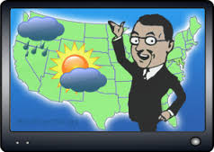
Overview of Training
Who is the target group?
Meteorological Personnel at the forefront of questioning on Climate Change (CC) and Climate Variability (CV).
Notes:
Meteorological Personnel are usually at the forefront of questioning on Climate Change (CC) and Climate Variability (CV) it is important that they are well equipped to adequately inform stakeholders.
This session will provide a recap of key terminology used in the field of climate studies and satellite meteorology and allow for the links to be explained.

Slide 6
Questions that might help you structuring your presentation:
Learning Needs
Overview of learning needs (should answer the questions the forecasters have and/or are getting asked about climate change frequently)
Performance/Learning Outcomes
Job competencies to be addressed by the training
Specific knowledge gaps being addressed, if known
Desired learning outcomes of the planned event
Content Scope
Provide a content outline consistent with learning objectives or outcomes

Slide 7
Overview of Training
What will the sessions provide?
A recap of key terminology
Orientation on the links between using satellite meteorology to better understand changing climate
Resource materials for future reference and support
Notes:
Meteorological Personnel are usually at the forefront of questioning on Climate Change (CC) and Climate Variability (CV) it is important that they are well equipped to adequately inform stakeholders.
This session will provide a recap of key terminology used in the field of climate studies and satellite meteorology and allow for the links to be explained.

Slide 8
Questions that might help you structuring your presentation:
Content Scope
Provide a content outline consistent with learning objectives or outcomes

Slide 9
Objectives
Module I
Review of main terminology and concepts
Review key atmospheric parameters and phenomena at the different scales which define climate trends
Links to resource materials

Slide 10
Objectives
Module II
Explain the role of satellites in monitoring climate change and variability
Provide an overview of main satellites
Obtain feedback and clarify any misconceptions related to the key concepts presented in the session
Links to additional resource materials

Slide 11
Module I - Definitions Climate
What is Climate?
A statistical look at weather including averages, ranges, variability, extremes, frequency of events, trends and patterns
Atmospheric conditions averaged over a long period of time according to the World Meteorological Organization (WMO) standards: 30yrs – 40yrs

Slide 12
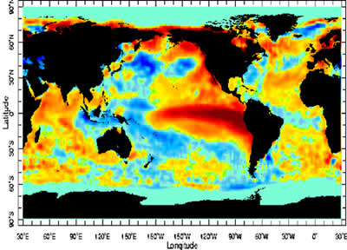
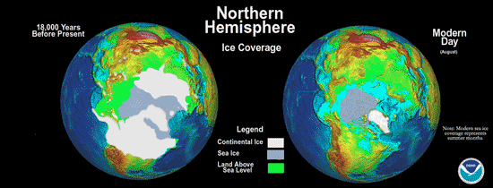
Module I - Definitions About Climate
Climate is expected to vary naturally
Climate Scales
Intra-to Inter Seasonal- Monsoon
Inter-annual- ENSO, NAO
Decadal – Pacific Decadal Oscillation
Long term- Ice Ages

Slide 13
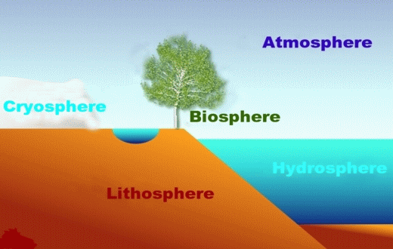
Module I - Definitions About Climate
Interaction between Earth systems contribute to climate
Atmosphere- (Mainly Troposphere and the Stratosphere)
Biosphere – (Ecosystems that form life on Earth)
Hydrosphere (Water system)
Cryosphere (Ice system)
Lithosphere (Land system)

Slide 14
Module I - Definitions About Climate
Natural factors controlling global climate
Latitude (influences sunshine)
Distribution of land and water
Ocean currents
Prevailing winds
Positions of high and low pressure areas
Terrain
Altitude

Slide 15
Module I - Definitions About Climate
The Global Climate Observing System (GCOS) fifty (50) measureable Earth system parameters vital for the detection and quantification of climate-related changes, known as the Essential Climate Variables (ECVs)

Slide 16
Module I - Definitions About Climate
ECVs
Atmosphere – temperature, wind speed and direction, cloud properties, GHGs
Terrestrial – River discharge, water use, groundwater, lakes, albedo
Ocean – temperature, salinity, currents, nutrients, ocean colour, sea ice
Around half are measurable largely from Space

Slide 17
Module I - Definitions Climate Variability
What is Climate Variability?
Denotes deviations of climatic statistics over a given period of time (e.g. a month, season or year) when compared to long-term statistics for the same calendar period. Climate variability is measured by these deviations, which are usually termed anomalies. (Source: World Meteorological Organisation)

Slide 18
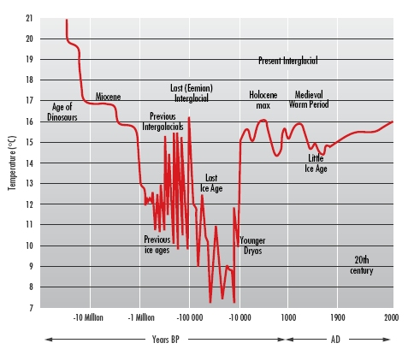
Module I - Definitions Climate Variability
What is Climate Variability?
Variations in the mean state and other statistics of the climate on all temporal and spatial scales, beyond individual weather events. (Source: IPCC Glossary of Terms - https://www.ipcc.ch/.../SREX..)
Source:http://www.bom.gov.au/info/GreenhouseEffectAndClimateChange.pdf

Slide 19
Module I - Definitions Climate Change
What is Climate Change?
A change in the state of the climate that can be identified by changes in the mean and/or the variability of its properties, and that persists for an extended period, typically decades or longer.
Change in climate over time can be due to natural variability or as a result of human activity.

Slide 20
Module I - Definitions Climate Change
What is Climate Change?
All forms of climatic inconsistency, but because the Earth's climate is never static, the term is more properly used to imply a significant change from one climatic condition to another.
Sometimes it is synonymously used with the term, 'global warming'; scientists however, tend to use the term in the wider sense to also include natural changes in climate.

Slide 21
NASA Images of Change Lyell Glacier, Sierra Nevada

Slide 22
NASA Images of Change “Qori Kalis Glacier, Peru”

Slide 23
Module I - Difference between climate change and climate variability
According to the WMO:
Climate variability - Changes that occur within smaller timeframes, such as a month, a season or a year
Climate change - Changes that occur over a longer period of time, typically over decades or longer
The persistence of "anomalous” conditions gives an idea of the differences

Slide 24
Module I - Definitions Earth Observations (EO)
What is Satellite EO Technology?
Earth observations (EO) provide unparalleled means for observing our complex planet through the use of techniques which map, measure and monitor ECVs to improve our understanding of atmospheric science, especially climate change.
Relates to satellite remote sensing which refers to optical imagery and photography, ‘geospatial’ and numerical data.

Slide 25
Surface Reflectance and Ocean Temperature from is from the Moderate Resolution Imaging Spectroradiometer (MODIS) on NASA`s Satellite

Slide 26
Tropical Storm Parma from MODIS on NASA’s Terra satellite and Typhoon Meter taken under two hours later by the MODIS instrument on NASA’s Aqua satellite.
Typhoon Meter and Tropical Storm Parma

Slide 27
Module I - Definitions Earth Observations (EO)
What is Satellite EO Technology?
Based on the principles of how electromagnetic radiation (EMR), such as sunlight, is reflected, transmitted and absorbed
Sensors on-board satellites can record the signatures of this EMR as it leaves the top of the atmosphere.

Slide 28
Recall: The Electromagnetic Spectrum

Slide 29
Module I - Definitions Earth Observations (EO)
What is Satellite EO Technology?
Depending on the type of information needed on the ECVs satellites can be tailored by varying their orbits and their ‘remote sensing’ instruments, to measure certain wavelengths of electromagnetic radiation at particular spatial scales and repetition rates.

Slide 30
Example of instrument payload Sentinel-3

Slide 31
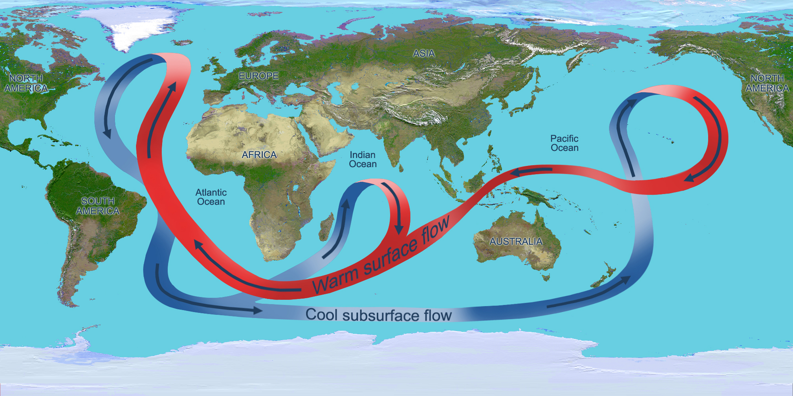
Information on ocean circulation from ocean-observing satellites

Slide 32
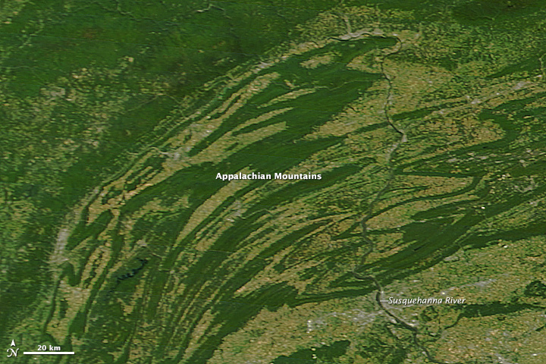
Annual Transformation of seasons captured by MODIS NASA’s Aqua satellite
October 21, 2013
September 17, 2013

Slide 33
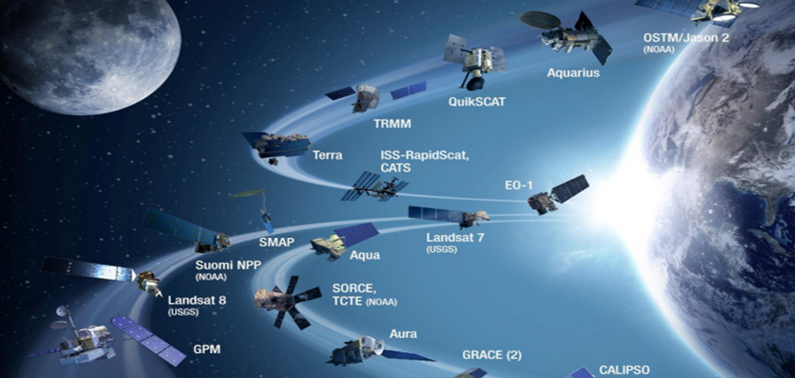
Module I - Definitions Earth Observations (EO)
The best data sets and results are obtained from combining many types of observing systems.

Slide 34
Module I Satellites

Slide 35
Module I Geostationary Satellites
Key Characteristics Fly at approximately 35,000 km above the Earth's surface. Match the Earth's rotation which allows them to hover over a fixed location above the equator.
Example METEOSAT , takes an image every 15 minutes. This high temporal resolution is a significant advantage when monitoring clouds and weather hence, these are used for weather monitoring and prediction, telecommunication and television broadcasting.

Slide 36
Module I Geostationary Satellites
Advantage Highest temporal resolutions Provide an ‘almost continuous’ view of the Earth
Disadvantage Provide a poor view of very high latitudes Coarse resolution due to the long distance from the Earth A ring of geostationary satellites is needed around the equator to provide full coverage of the entire Earth apart from the poles.

Slide 37
Module I Depiction of the Meteosat Satellite

Slide 38
Module I Polar Orbiting Satellites
Key Characteristics Fly in relatively low orbits, several hundred kilometres above Earth's surface. Observe most locations twice daily, except at higher latitudes where their orbits overlap and coverage is more frequent. Sun-synchronous orbits
Example The US LANDSAT series jointly managed by NASA and the U.S. Geological Survey has collected information about earth from space since 1972.

Slide 39
Module I Polar Orbiting Satellites
Advantage Provide high-resolution imaging across all latitudes which is important for observing atmospheric, land and ocean features
Disadvantage Can view a fixed location every 12 hours at a specific time of day or night which limits its ability to monitor day-night variations and rapidly changing weather at a useful interval.

Slide 40
Module I Depiction of the US Landsat Satellite

Slide 41
Module I Satellites
By leveraging the capabilities of both satellites, scientists can better understand the connections between weather and climate.
Blended satellite products, such as this SST product, take advantage of the strengths of both types of satellite, providing high-resolution global coverage and more frequent updates.

Slide 42
Resource Links
COMET MetEd Modules
https://www.meted.ucar.edu/training_module.php?id=895#.VqmMxn_GCn4
European Space Agency
http://www.esa.int/ESA
World Meteorological Organisation
http://www.wmo.int/pages/themes/topics_en.html
National Aeronautics and Space Administration
https://www.nasa.gov/
FutureLearn
https://www.futurelearn.com/about

Slide 43
Questions?
Contacts
Caribbean Institute for Meteorology and Hydrology (CIMH)
Ms. Kathy-Ann Caesar
kacaesar@cimh.edu.bb

