Slide 1
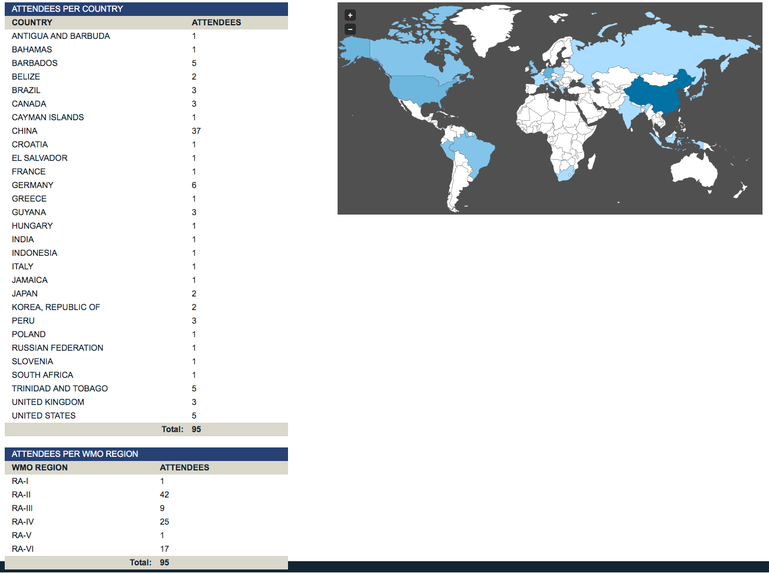
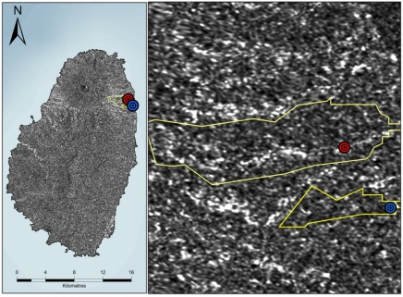
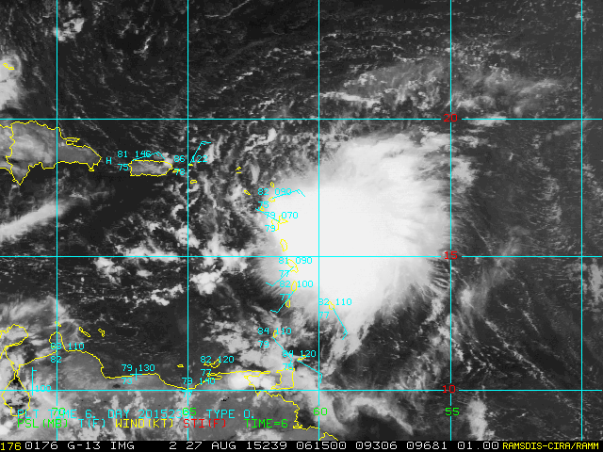
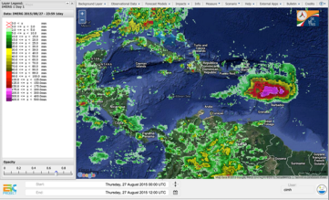
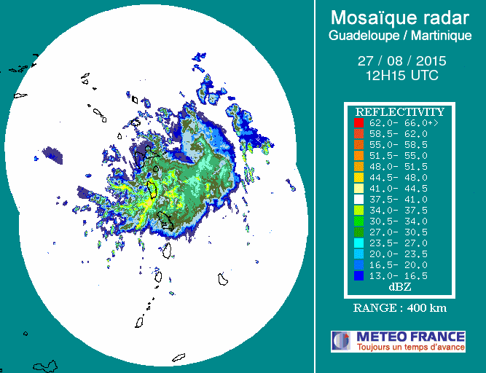
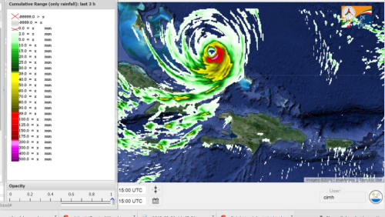
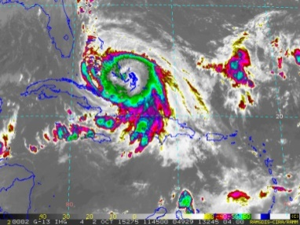
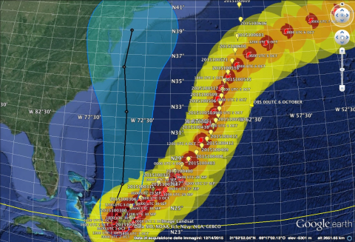
VLMG-8
A WMO Centre of Excellence (CoE) for Satellite meteorology
Main Achievements 2015 - Local Events
Aeronautical Continuing Professional Development (AeroCPD) - Online Learning Course – In 4 years, 45 operational forecaster were trained in aeronautical competency including Weather Satellite interpretation.
Caribbean Weather Discussion (CWD) – Monthly online discussions used for weather monitoring, teaching and Continuous Professional Development of Operational Forecasters. CWD includes special events such as : the onset and progress of tropical storms; the introduction of new products (e.g. GOES R) and to support Disaster Mitigation.
Preparing for Next Generation Satellites
– VLab Event Week
The Event featured 11 sessions of a selection of online sessions presented from 16 to 20 November 2015 by JMA, CMA, IMD, NOAA, CIRA, EUMETSAT, INPE, KMA and the COMET Program.
The Event gave a general update on what information and training is available regarding the Next Generations of satellites, as well as provided the opportunity for discussion among the participants.
The event was resounding success with 95 participants from 29 countries.
Information on the Event is available at http://www.wmo-sat.info/vlab/next-generation-of-satelliles/
Tropical Storm Weather Briefings 2015
CoE Barbados continue to provide weather briefings and discussions.
Weather briefings are prepared for the Caribbean Disaster Emergency Management Agency (CDEMA) and consist of storm and server weather updates, satellite imagery, CIMH WRF – Mesoscale Model output, hazard impact information .
The CIMH CWD also supports Severe briefings and makes use of the CIMH Caribbean Dewetra Platform –a real-time data and information integrated system for hydro-meteorological risk forecasting and disaster risk mitigation. It allows for the combination of data, forecast tools, procedures and expertise; and provides decision makers with high resolution and up-to-date information of the expected and observed risk and vulnerability.
The 2015 Hurricane season was a relatively quite one for the Caribbean, with only 3 of the 11 named storms affecting the region. However, two of the storms prove to be the deadliness of the season. These included Tropical Storm (TS) Danny, TS Erika (31 death and Hurricane Joaquin (30 deaths).
CIMH operates WRF runs, initialized by GFS model for 0000Z and 1200Z during the hurricane season. The 4 km WRF-ARW run (26 August 2015, 00UTC) produced a very skilled quantitative precipitation forecast (QPF,) both in the location and the quantity of 24 hour rainfall amounts which ranged between 250-300 mm, and were in good agreement with quantitative precipitation estimation (QPE) provided by Integrated Multi-satellite Retrievals for GPM (IMERG), thus confirming the relevance of the CIMH activities and of the DEWETRA platform services for the entire Caribbean region.
The WRF-ARW runs (1 October 2015 00UTC), exhibited great skill in predicting the track of Hurricane Joaquin, despite the GFS 0.5° model forcing, has been capable to “correct” the GCM predictions concerning the Hurricane Joaquin evolution resulting into a predicted track as it headed towards the open Atlantic ocean.
Hydrology CIMH – partners in the CEOS Flood Pilot project.
Satellite imagery from NASA is used to support various activities in hydrology.
identification of inundation areas resulting from flooding events;
identification of blockages in watercourses resulting from landslides;
identification of land cover/land cover changes and estimation of hydrological parameters;
Imagery also supports hydrological modelling by provided a visualization of watershed characteristics.
Using Satellite derived precipitation data to provide the potential for flood.
Developed from RadarSat images (before and after event) – Changes shown by white areas
Erosion assessment in St. Vincent after the December 2013 deadly flood event.
GEONETCast- America at CIMH 2016
The proposal for NOAA to support the installation of GEONETCast ground station has been long in coming;
The ground station has been installed at CIMH ;
Products available via GEONETCast the applications utilizing the existing ISCS antenna and modem;
Data resource site - a source of real time satellite data for the Member states of CMO
Education - GEONETCast products will be used in ALL CIMH courses.
Research - Products will be fully utilized in CIMH’s various research projects
Disaster Risk Management - GNC data for monitoring, response and recovery in disaster management
Monitoring Climate Change with Satellites
Virtual Round Table on Climate Change 2016
Goal
To introduce participants to climate change and the powerful role of satellite ‘Earth observation’ (EO) technology in monitoring our changing climate and environment.
Objectives
Review of main terminology and concepts of Climate
Review key atmospheric parameters and phenomena at the different scales which define climate trends
Explain the role of satellites in monitoring climate change and variability
Provide an overview of main satellites
Obtain feedback and clarify any misconceptions related to the key concepts presented in the session.
Who are the target groups?
Meteorological Personnel are usually at the forefront of questioning on Climate Change (CC) and Climate Variability (CV).
What will the session provide:
This will provide a recap of key terminology used in the field of climate studies and satellite meteorology and allow for the links to be explained
Future Plans
Launch of the CoE Barbados VLab Web page
Finalize and launch the Virtual Round Table on Monitoring Climate Change and variability with Satellites.
Virtual course for Meteorology for CAPE Level Geography Teachers
Relaunch of the AeroCPD in 2016 -2017
Continue to support and develop VLab Events
Continue the use of the virtual format to aid Disaster Risk Management efforts

