Slide 1
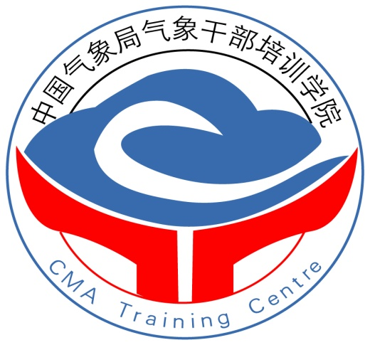
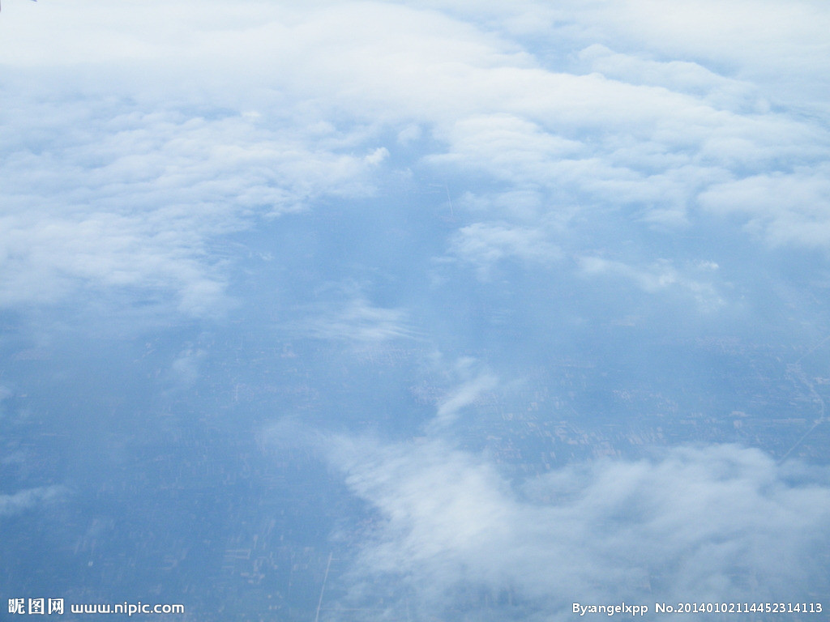
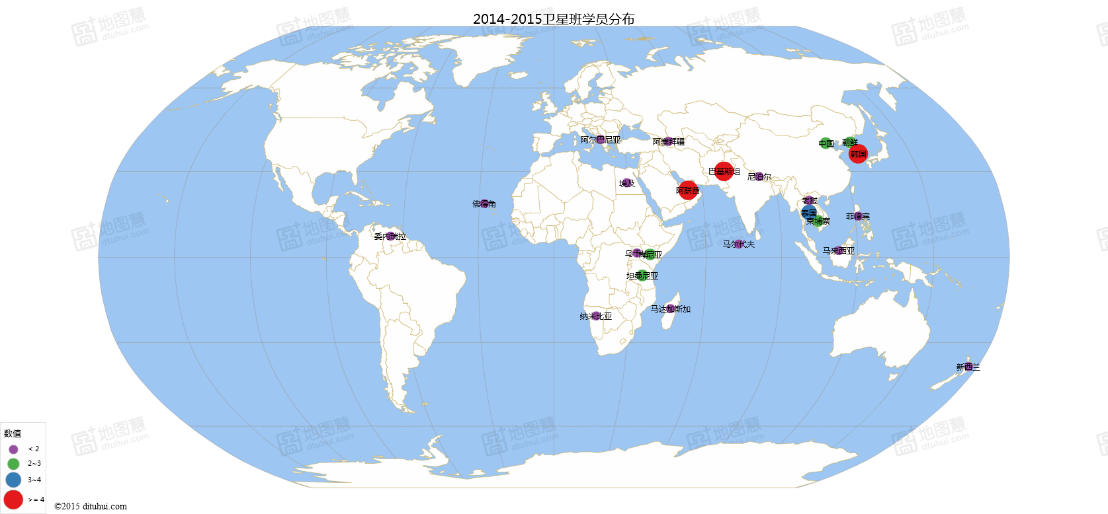
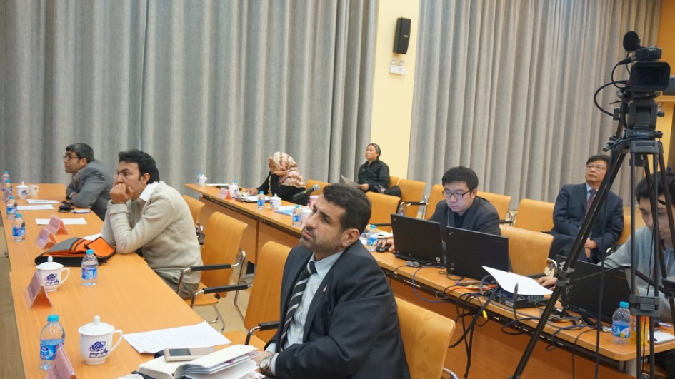
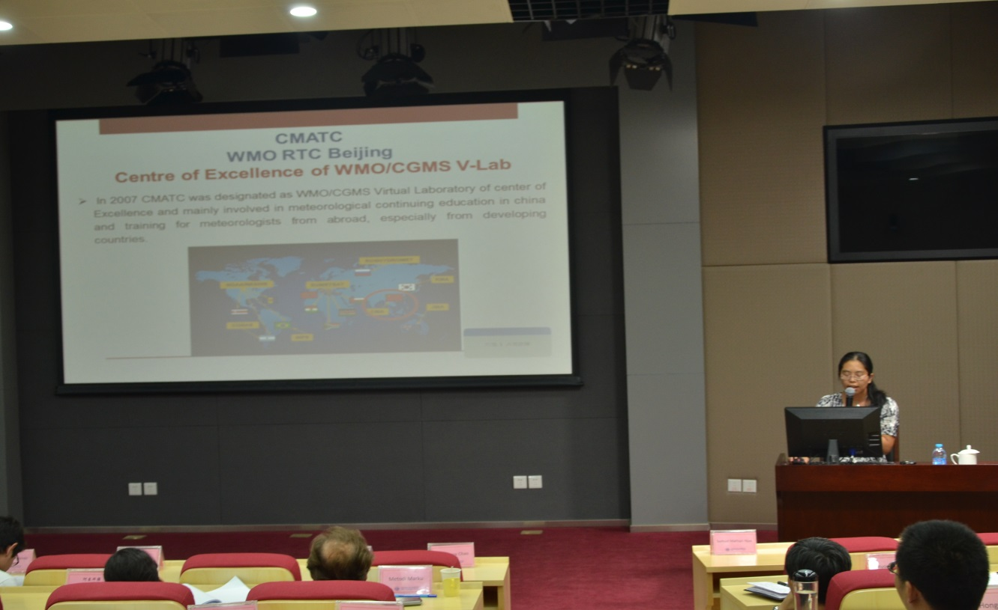
The Main Vlab Activities in China 2014-2015
China Meteorological Administration Training Centre
Abstract: China Meteorological Administration Training Centre (CMATC) was designated as WMO/CGMS Virtual Laboratory of Centre of Excellence in 2007. Since then, CMATC has been taking part in the VLab activities positively. From 2014 CMATC has held 16 domestic and 2 International training courses on satellite meteorology for weather forecasters, remote sensing staff etc. The total number of person·days on satellite training is 41834. CMATC also has made great progress in online and blended training. The new satellite data and technology were delivered in these trainings.
Fig. 1 Number of person·days in domestic and international satellite training
Fig. 2 Distribution of 44 trainees from 25 countries attending satellite training
Main Activities
Fig. 3 A VLab training course for AOMSUC-5 was held by CMATC and NSMC in Shanghai in 2014.
Combining the online real-time distance learning with the traditional face-to-face method, the blended training is used further. The lecturers can interact with the participants in the live broadcasting classroom via CMA Distance Learning System.
Fig. 4 Teachers giving lectures in the classroom and online for the training of AOMSUC-5 with 37 participants online.
CMATC held the 8th International Training Course on the Application of Meteorological Satellite Products in 2015, during which the technologies of Synchronous Classroom was used successfully.
I am in Germany
Fig. 5 Mr. Mark Higgins from EUMETSAT giving a lecture using CMATC’s Synchronous Classroom in the training.
Fig. 6 Introduction of VLab in trainings.
(continue)

Slide 2
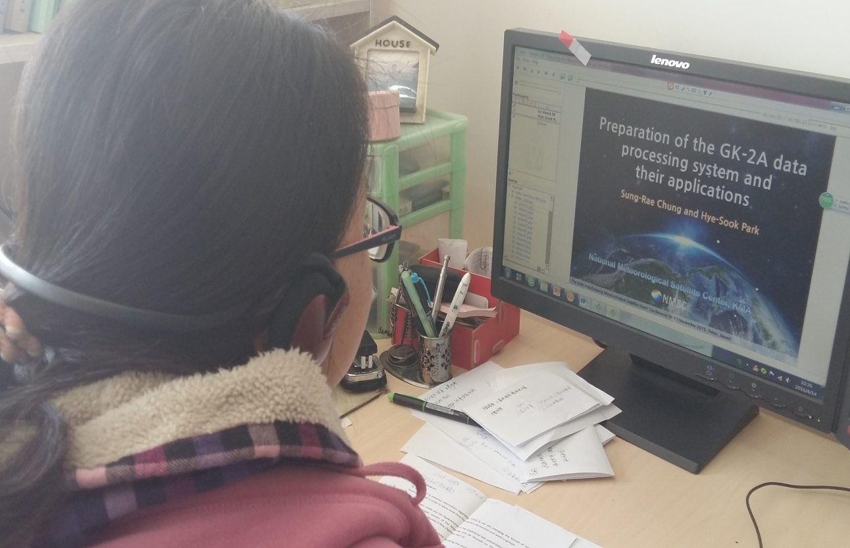
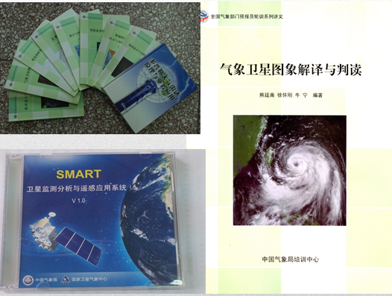
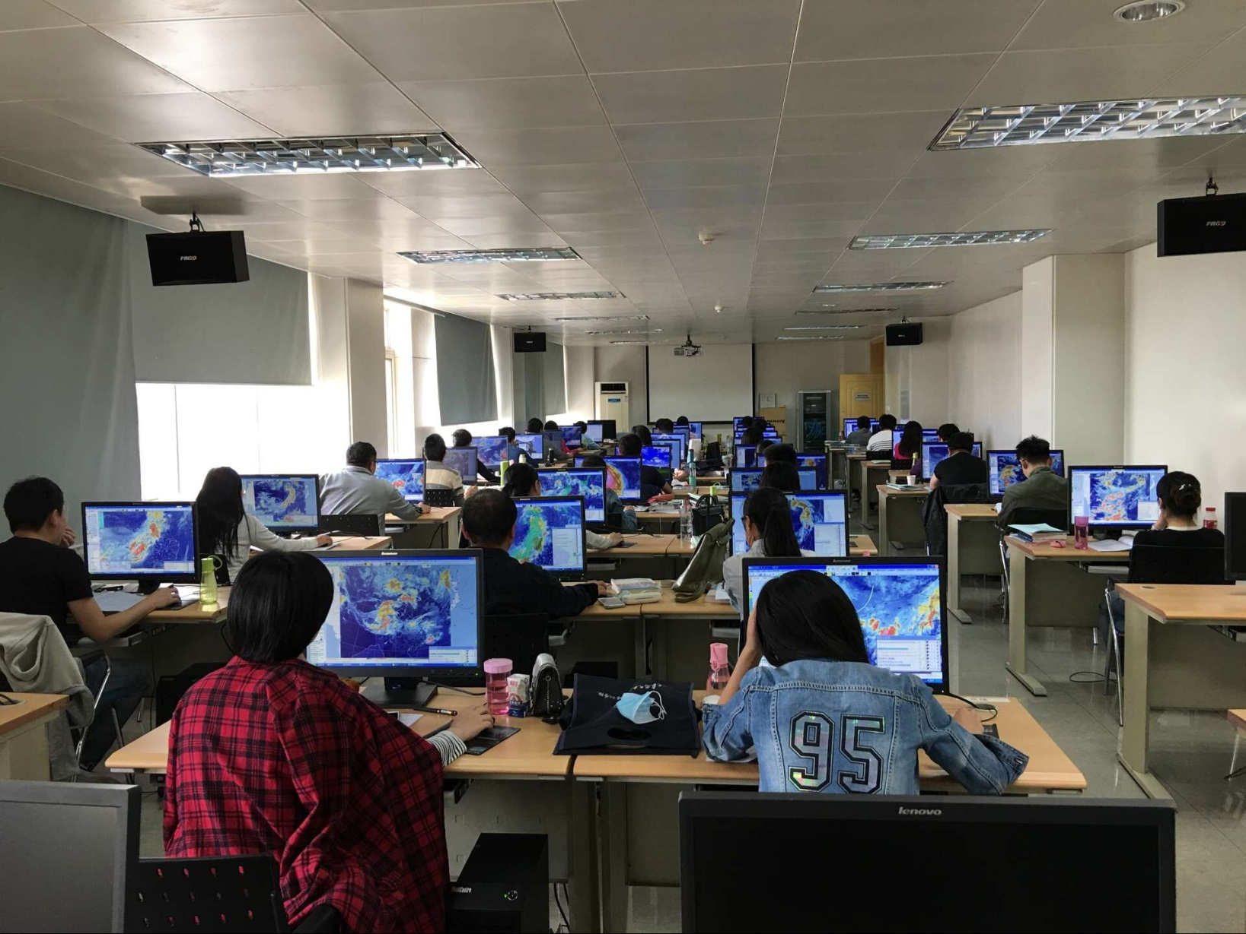
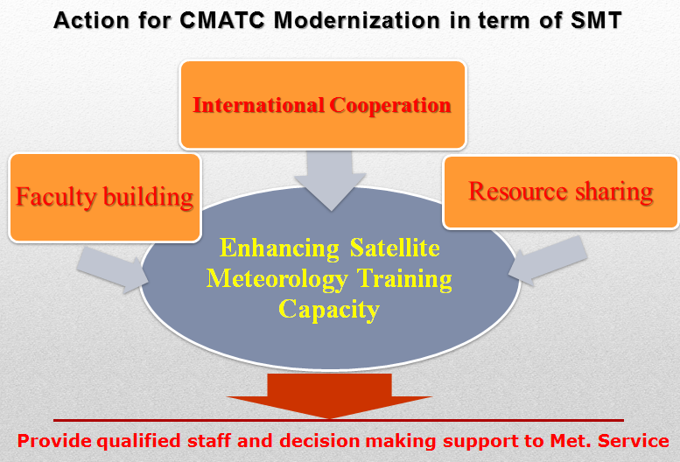
CMATC’ representative participated in CGMS-42 in 2014 and gave status report on the VLab activities in China and the future plan.
CMATC teachers attended the online training course on Prepare for the Next Generation of Satellite Image organized by WMO/CGMS in 2015.
Fig. 7 CMATC’s report in CGMS-42
Fig. 8 CMATC’s teachers learning(left) and giving a lecture on FY4 introduction online (right).
Capacity Building and Training Evaluation
Course Contents in domestic training on satellite
1 | Introduction about the Feng Yun-3 product
2 | Retrospect and Prospect of Feng Yun-4
3 | The features of weather systems in satellite image
4 | Analysis and forecast to deep moisture convection
5 | Introduction about the basic theory of satellite
6 | Application of satellite product in monitor and forecast of typhoon
7 | USE of satellite production (TBB,OLR and TRMM) in weather forecast
8 | Application of satellite production in monitor monsoon
9 | Introduction to the SWAP
10 | Application of satellite product in monitor the sandstorm
11 | Application of some derived data in precipitation estimation
12 | Brief introduction to the use of Himawari-8 product in weather analysis
Course Contents in international training on Satellite
1 | Current and Future Feng Yun System and Products | ZHANG Peng (NSMC)
2 | Retrospect and Prospect of Meteorological Satellite | XU Jianmin (NSMC)
3 | Review about the Dust Monitoring Products with FY-2 and FY-3 Satellites | CHEN Lin(NSMC)
4 | Application of Meteorological Satellite in Volcanic Ash Monitoring | ZHU Lin(NSMC)
5 | Ground Surface Parameter Retrieval Using Microwave Remote Sensing and Its Application | SUN Ruijing (NSMC)
6 | Application of Satellite Remote Sensing in Severe Convective Weather and Heavy Rainfall | REN Suling (NSMC)
7 | Overview of the Meteosat Products | Mark Higgins (EUMETSAT)
8 | Application of Natural Disaster Monitoring Using Feng Yun Meteorological Satellite Data | ZHANG Yeping (NSMC)
9 | The Introduction of VLab | NIU Ning (CMATC)
10 | Introduction to the synoptic scale cloud features | NIU Ning (CMATC)
11 | Use of FY-3 Satellite Data in Numerical Weather Prediction | Liu Jian ( NSMC)
Fig. 9 CMATC’s teaching materials used in satellite training
Fig. 10 Training course contents
Fig. 11 CMATC’s practice platform of satellite training
Many teaching materials have been developed for satellite training including textbooks, CD/DVDs and e-learning coursewares. In terms of course content, the latest satellite products and technologies have been introduced in domestic and international training. The learning and practicing conditions have been constructed in CMATC to meet the increasing needs of training.
ROI Evaluation
Effectiveness Evaluation
Training
Quality Control
A three-level training evaluation system was established based on Kirkpatrick-Phillips Model. Training Quality Control is performed for all training courses, while Effectiveness Evaluation and ROI Evaluation is implemented in most of the priority training programmes.
Fig. 12 Three-level training evaluation system
Future Plans
In following years, CMATC will work hard on these areas.
Faculty Building: training platforms, teacher team and curriculum construction
International Cooperation: international training and teacher exchange
Resource Sharing: teaching materials, training cases and teachers
In 2016, CMATC has held the 17th satellite training for CMA forecasters. The 9th International Training Course on the Application of Meteorological Satellite Products will be delivered soon.

