Slide 1
Satellite imagery analysis Europe 26 and 27 June 2018
Antonis Tsingoudis
e-mail: tsingoud@geo.auth.gr
September 2019

Slide 2
Introduction
25th to 28th June 2018.
Europe (especially Balkans region, Greece).
“Nefeli” (National Observatory of Athens).
Severe thunderstorms with heavy rain.
Severe flooding, Landslides.
Over a hundred people needed help by Civil Protection only in Greece.
237mm in 4 days (North Greece).

Slide 3
Fig.1: Anomalies in geodynamic heights at 500hpa in Europe on 27/6/2018 00 UTC based on GFS.

Slide 4
Data and Methodology
MSG (Geostationary satellites at 36,000 km above the equator, EUMETSAT).
4 satellites: Meteosat 8, 9,10 and 11.
SEVERI (Spinning Enhanced Visible and Infra-red Imager) with 12 spectral channels.
VIS 0.8, IR10.8, WV 6.2
RGB presentation: Airmass, Day natural colour, Dust, Severe Storms, Day Microphysics.

Slide 5
Data and Methodology
26th and 27th June 2018.
Synoptic and Satellite analysis.
Every 6 hours (not for all imagery available).
Comparison with weather stations data.
VIS 0.8
Usage: Distinction between thick and thin clouds.
Reflective of sun radiation help to recognition the clouds.

Slide 6
IR 10.8
Usage: Distinction between high (ice) and low (droplets) clouds.
Temperatures of cloud tops (record the infrared radiation by the earth's surface and atmosphere).
WV 6.2
Usage: Distinction between dry and wet areas, jet streams, PV anomalies, dry stratospheric air protruding into troposphere.
Interpretation of Water Vapor content in high tropospheric layers (max 350 hpa).

Slide 7
AIR MASS RGB
Usage: Distinction between warm and cold air masses.
Combination of the WV6.2, WV7.3, IR9.7 and IR10.8 channels.
Day natural colour RGB
Usage: Distinction between ice clouds and droplets clouds.
Combination of the NIR1.6, VIS0.8 and VIS0.6
Channels.

Slide 8
Dust RGB
Usage: Distinction between Cirrus and low droplets clouds and between dust and clouds.
Combination of the IR8.7, IR10.8 and IR12.0 channels.
Severe Storms RGB
Usage: Distinction between big ice particles clouds and small ice particles clouds.
Combination of the WV6.2, WV7.3, VIS0.6, NIR1.6, MIR3.9 and IR10.8 Channels.

Slide 9
Day Microphysics RGB
Usage: Distinction between clouds with different size of ice particles and detect their phase of development (Cb clouds).
Detect:
fog
snow cover
fires
Combination of the VIS0.8, MIR3.9
and IR10.8 channels.

Slide 10
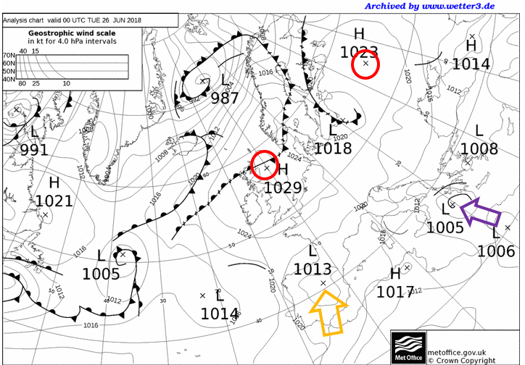
Synoptic Analysis
Fig.2: Surface map in Europe from U.K. Meteorological Service on 26/6/2018 00 UTC.

Slide 11
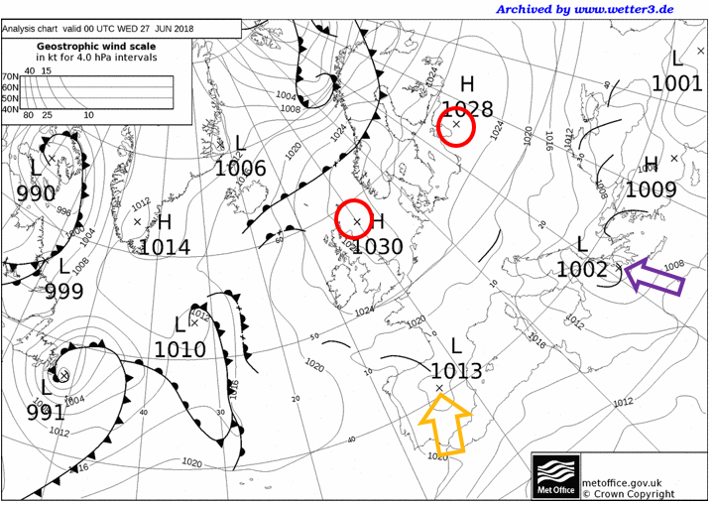
Synoptic Analysis
Fig.3: Surface map in Europe from U.K. Meteorological Service on 27/6/2018 00 UTC.

Slide 12
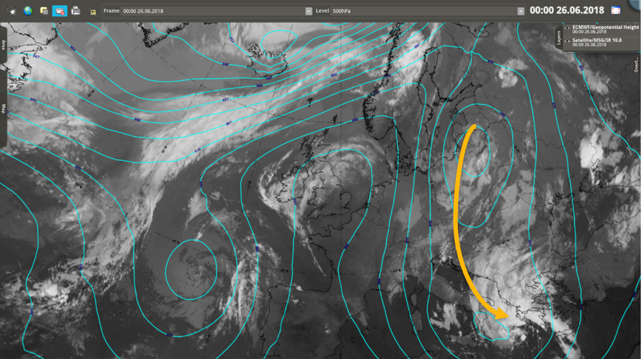
Synoptic Analysis
Fig.4: IR 10.8 channel image and geopotential height at 500hpa in Europe on 26/6/2018 00 UTC.

Slide 13
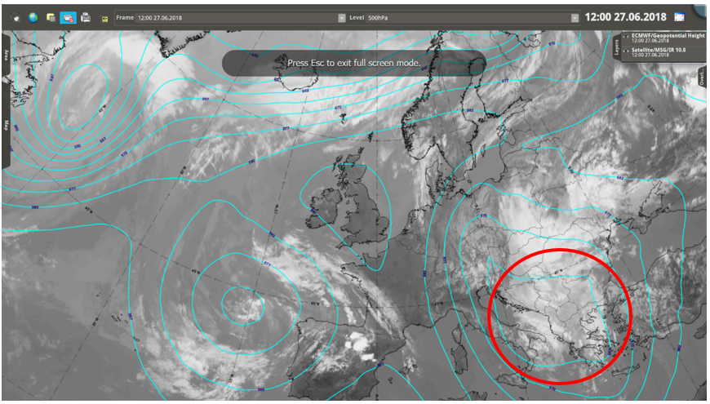
Synoptic Analysis
Fig.5: IR 10.8 channel image and geopotential height at 500hpa in Europe on 27/6/2018 12 UTC.

Slide 14
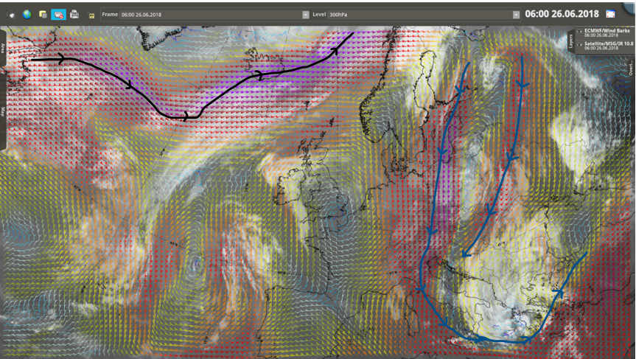
Synoptic Analysis
Fig.6: IR 10.8 channel image and wind Barbs at 300hpa in Europe on 26/6/2018 06 UTC.

Slide 15
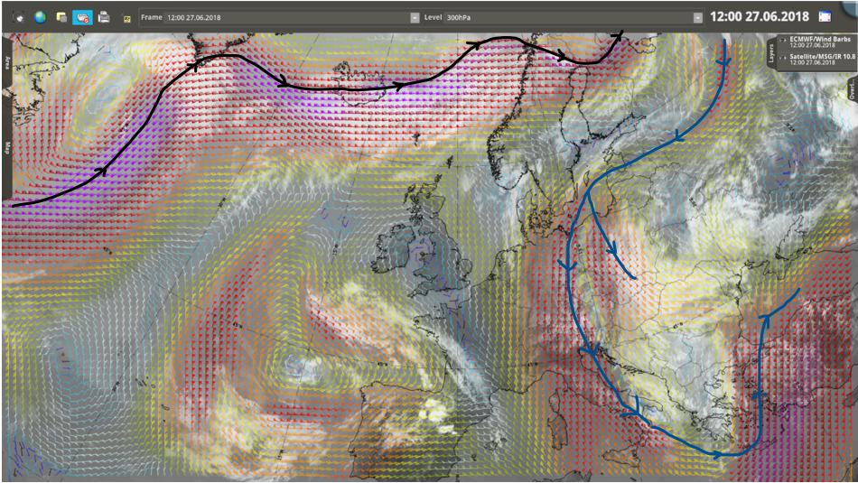
Synoptic Analysis
Fig.7: IR 10.8 channel image and wind Barbs at 300hpa in Europe on 27/6/2018 12 UTC.

Slide 16
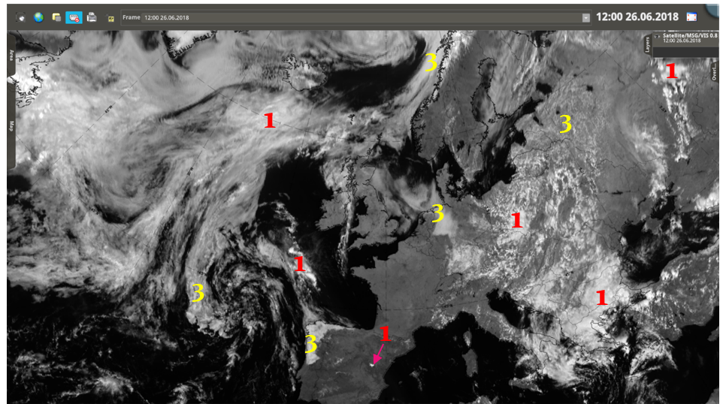
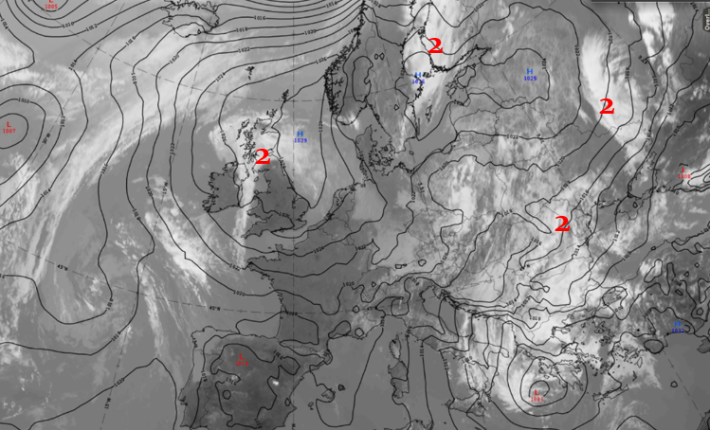
Fig.8: VIS 0.8 channel image in Europe on 26/6/2018 12 UTC.
High clouds with high optical thickness (Cb, thick Cirrus and As)
High clouds with low optical thickness (thin Cirrus)
Low clouds (St, Sc, Ns, Cu)
Fig.9: IR 10.8 channel image in Europe on 26/6/2018 12 UTC.

Slide 17
Fig.10: WV 6.2 channel image and isotachs in Europe on 26/6/2018 12 UTC.

Slide 18
Fig.11: Airmass RGB in Europe on 26/6/2018 12 UTC.

Slide 19
Fig.12: Day Natural Colours RGB in Europe on 26/6/2018 12 UTC.
Water
2. Ice

Slide 20
Fig.13: Dust RGB in Europe on 26/6/2018 12 UTC.
Thick ice clouds 2. Cirrus
3. Thick middle clouds

Slide 21
Fig.14: Day Microphysics RGB in Europe on 26/6/2018 12 UTC.
Thick big ice particles clouds.
Thin big ice particles Cirrus.
Semi-transparent ice clouds over the sea.
Snow cover.
Middle clouds with big droplets.
Thick small ice crystals clouds.

Slide 22
Fig.15: HRV image in Europe on 27/6/2018 12 UTC.

Slide 23
Fig.16: Severe Storms RGB in Europe on 26/6/2018 12 UTC.
Big ice particles clouds
2. Small ice particles clouds

Slide 24
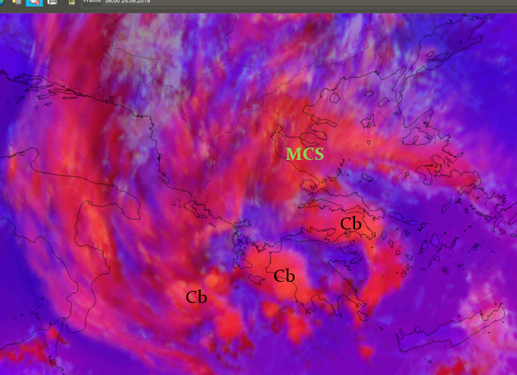
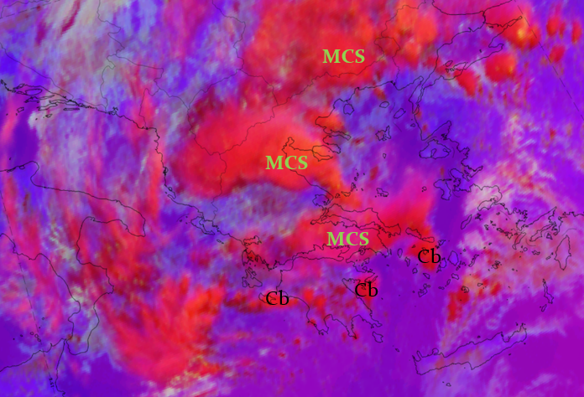
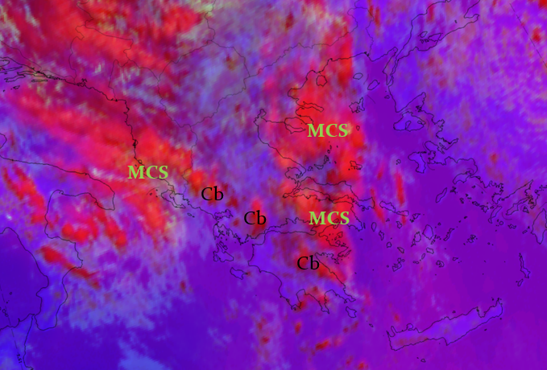
Fig.17: Severe Storms RGB in Greece: a)25/6 12 UTC, b)26/6 06 UTC, c)26/6 12UTC and d) 27/6 12 UTC.
a
b
c
d

Slide 25
Fig.18: Total precipitation (mm) in Greece between 25 to 28/6/2018 (over 250 weather stations by Ν.Ο.Α.)

Slide 26
Conclusions
Dynamical cause: upper atmosphere (East Europe)
Meridian jet stream (central Europe)
Transport cold and wet air mass (Balkans)
Stationery low pressure center without fronts (Ionian Sea)
Thermodynamic cause (continental Greece)

Slide 27
Thank you

