Slide 1
A case study of a simple thunderstorm over the Balkans?

Slide 2
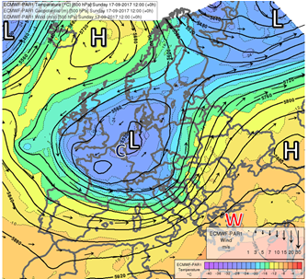
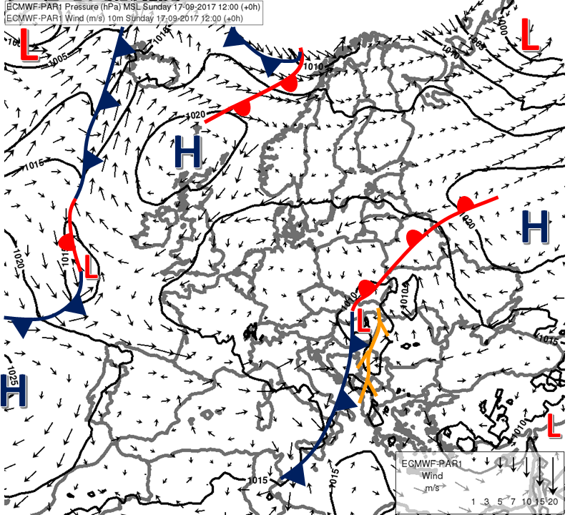
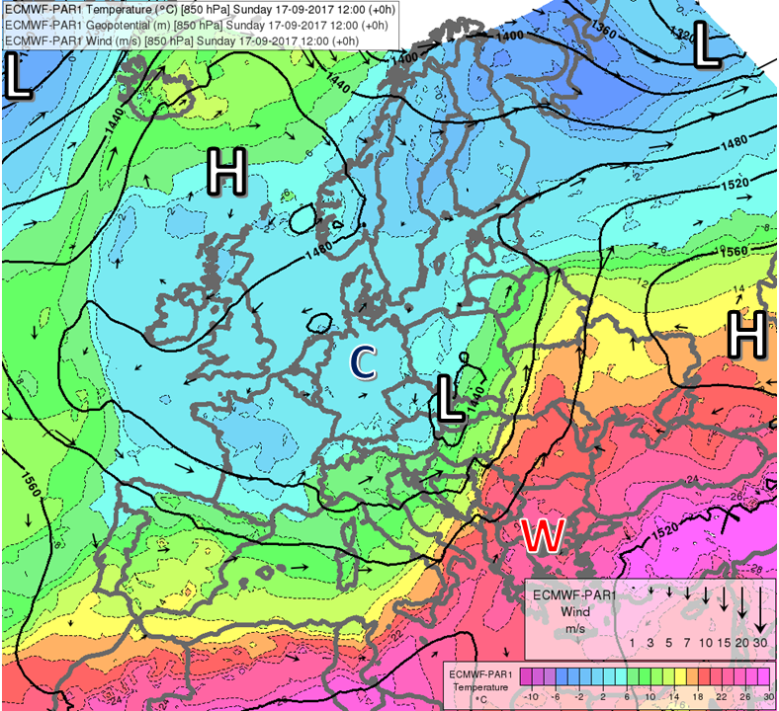
Synoptic situation on...
Fig. 3. Surface fronts and ECMWF analysis of mean sea-level pressure (solid lines, hPa) and 10 m wind (arrows, m/s) valid for 17 September 2017 1200 UTC. Tree-shaped symbols indicate convergence lines. Labels L and H are used for lows and highs.
Fig.4, 5. ECMWF analysis of 850/500 hPa geopotential (thick solid lines, gpm), temperature (shades and thin dashed lines, °C) and wind (arrows, m/s) valid for 17 September 2017 1200 UTC. Labels L and H are used for lows and highs, W and C for local temperature maxima and minima.

Slide 3
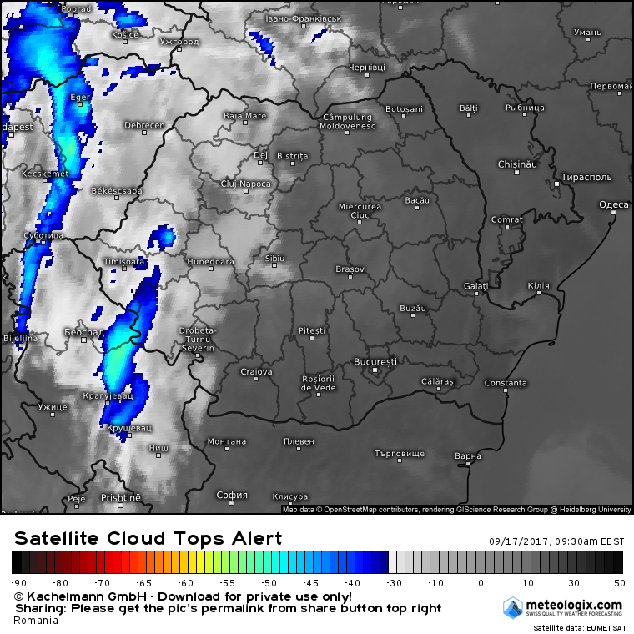

Slide 4
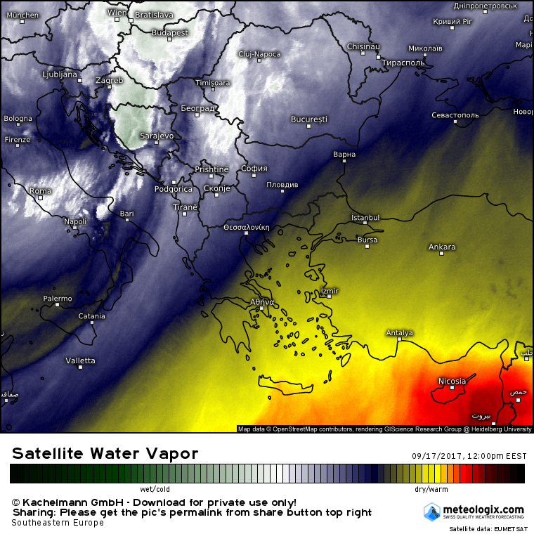

Slide 5
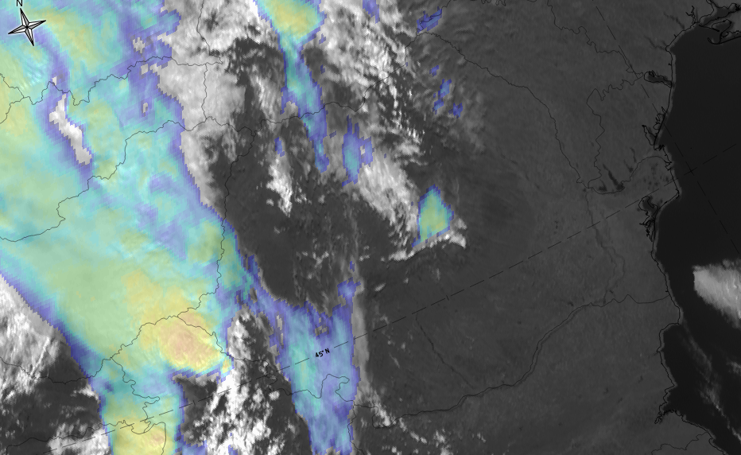

Slide 6
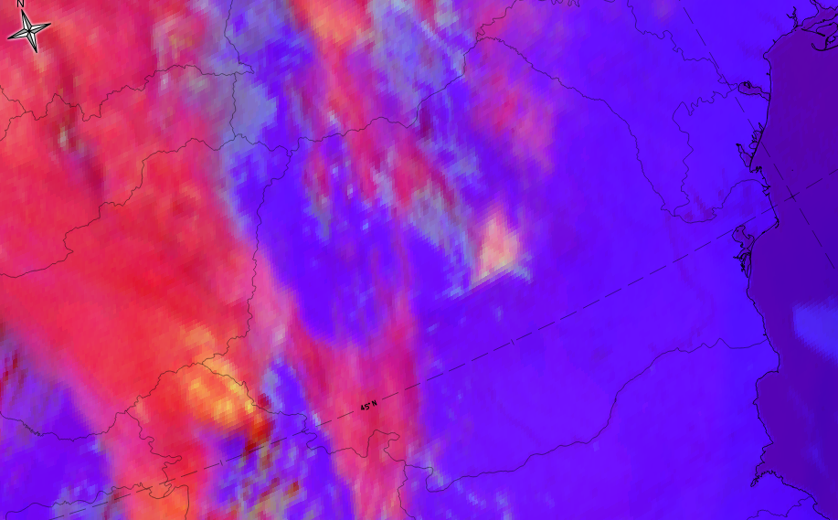

Slide 7
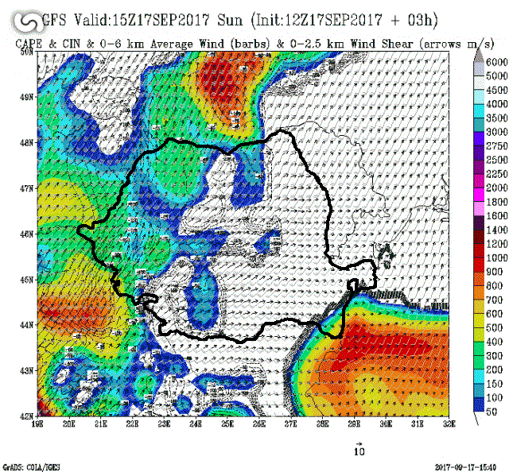

Slide 8
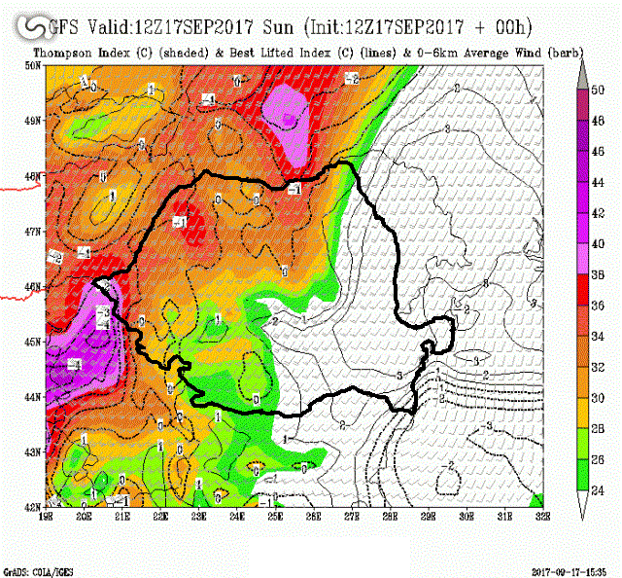

Slide 9
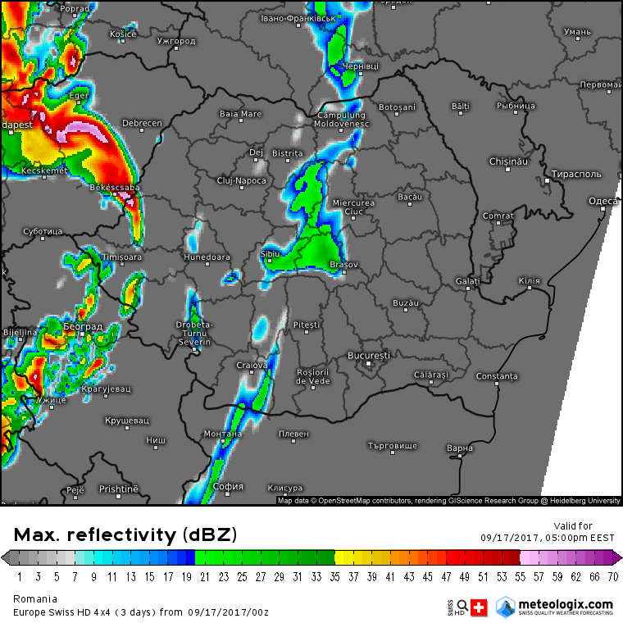
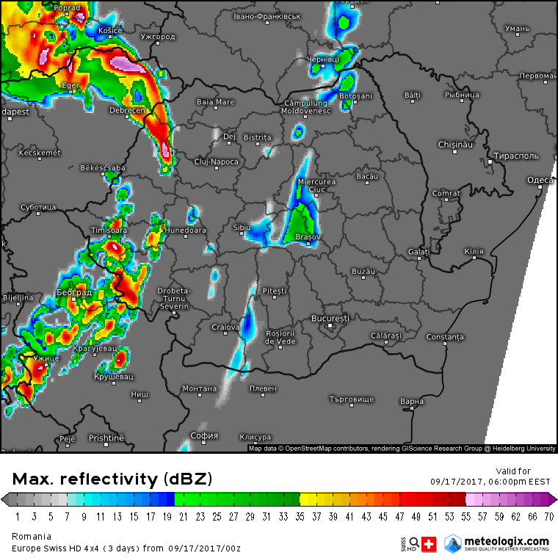
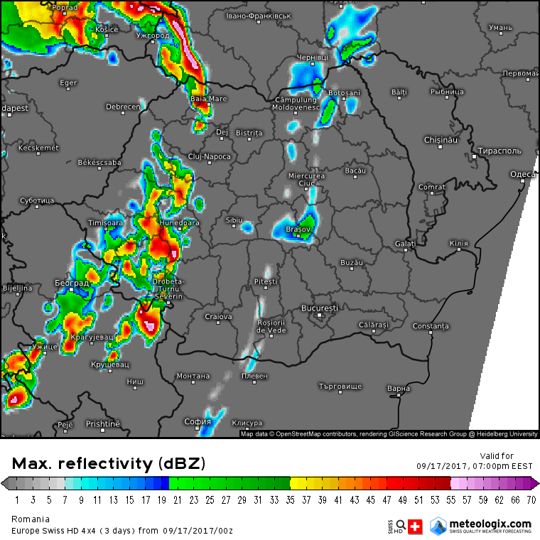
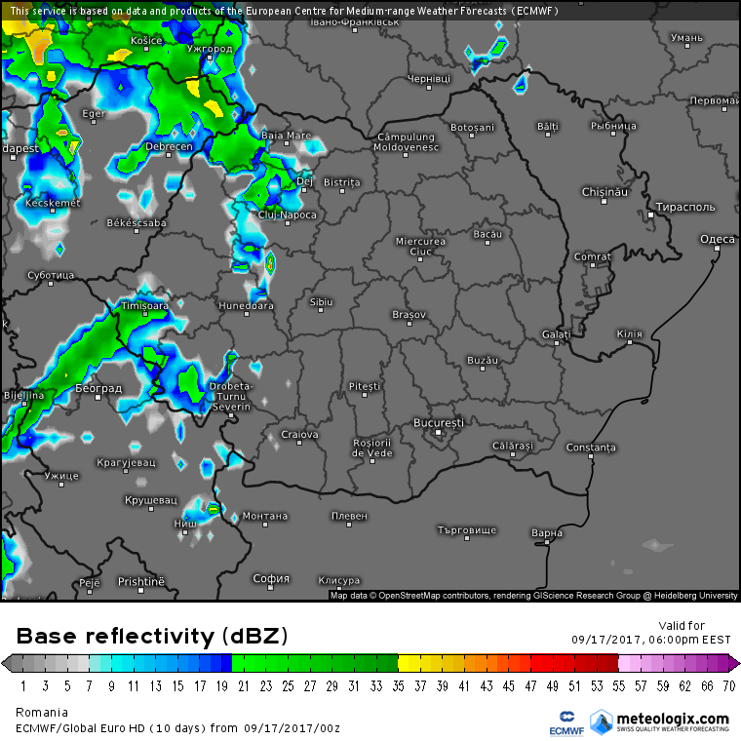
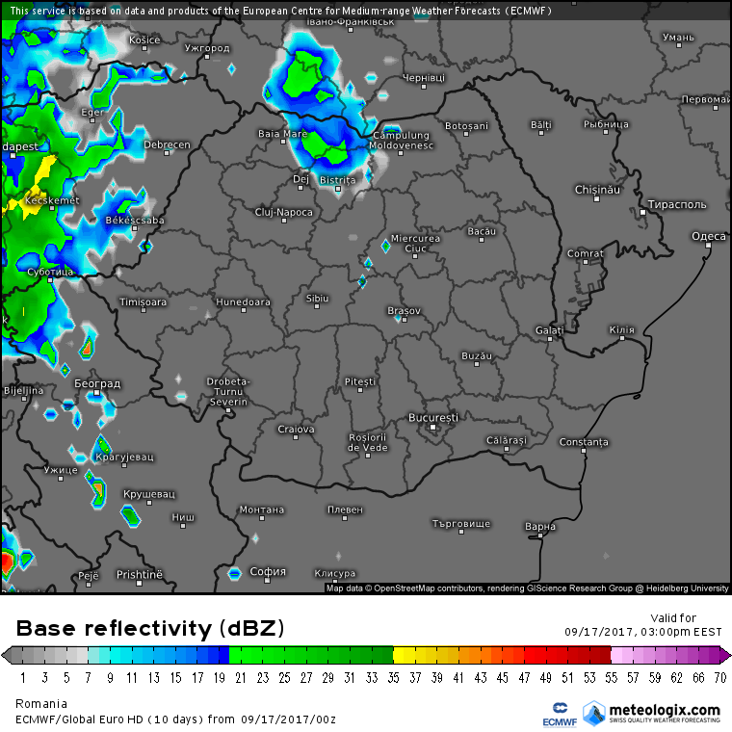
12 UTC
13 UTC
14 UTC
12 UTC
15 UTC

Slide 11
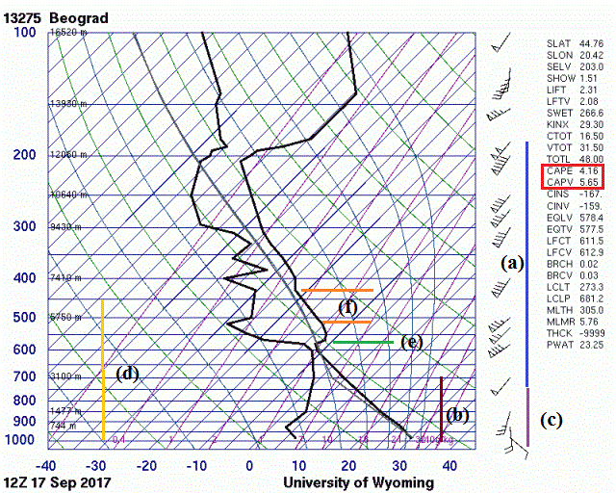

Slide 13
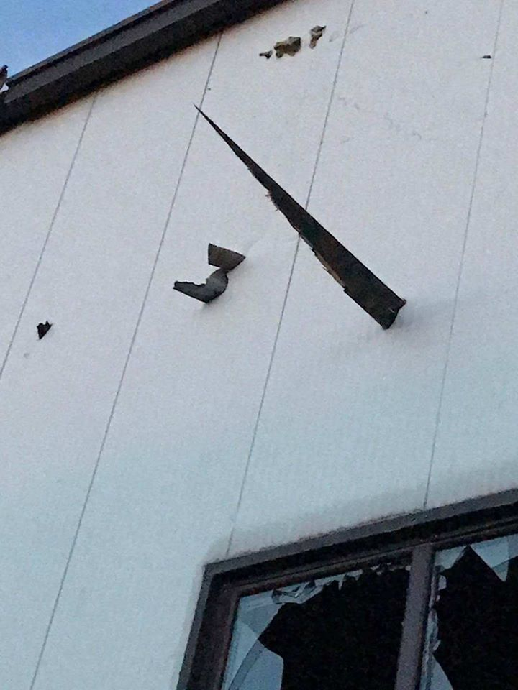
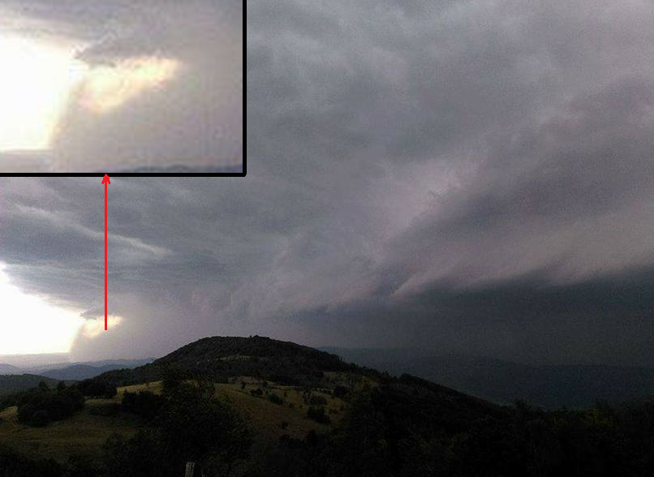
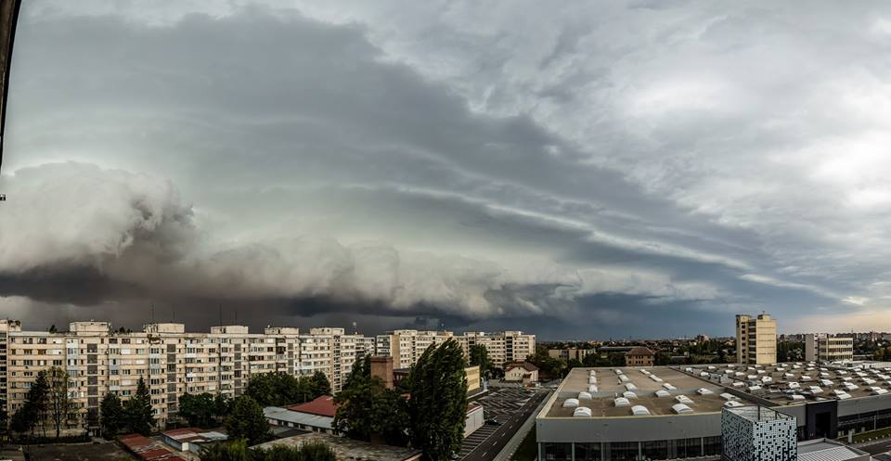
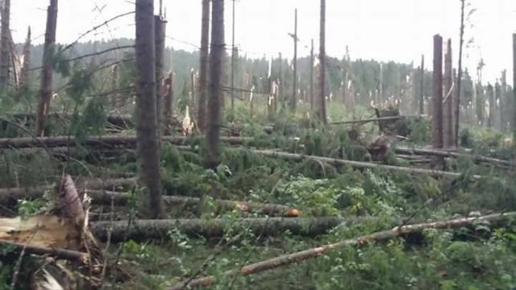

Slide 14
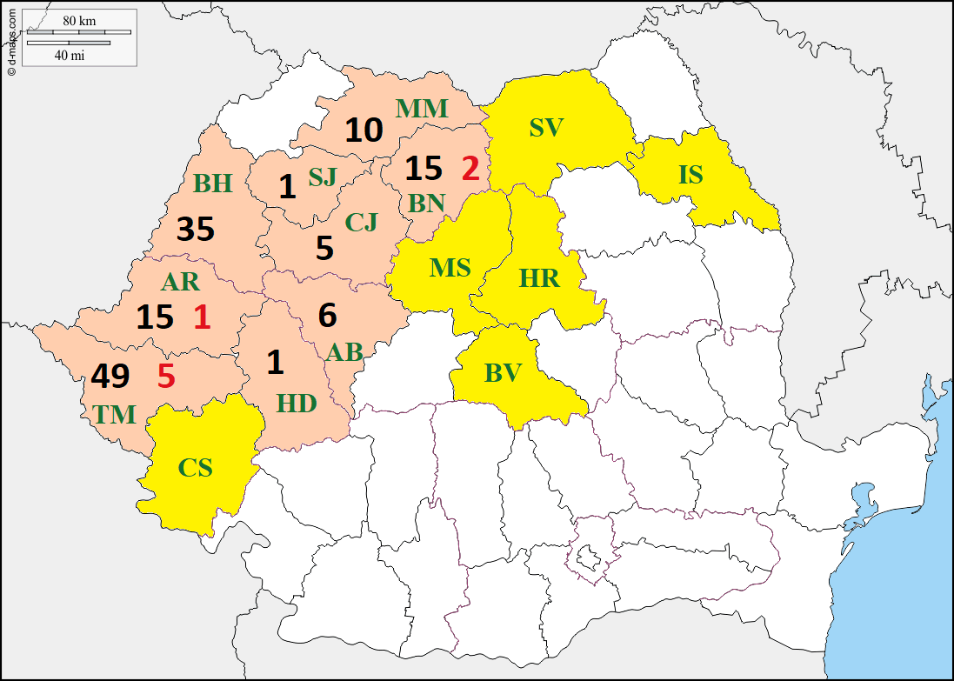
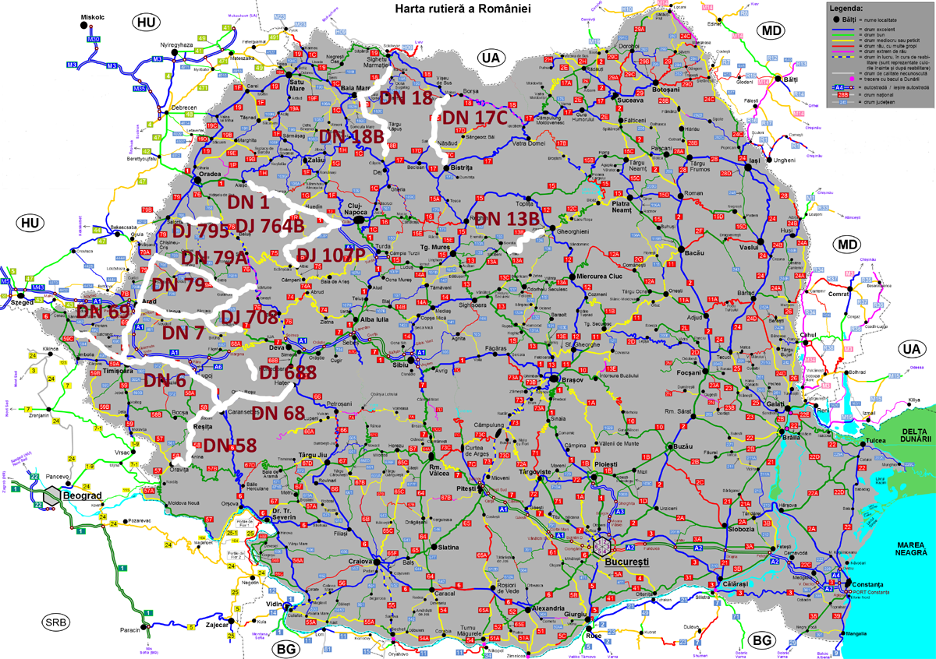
Impact of the storm
Fig. 11a. Impact of the 17 September 2017 windstorm in Romania. Yellow shade show counties, where only material damage was reported, in orange-shaded counties there were also injured people (black numbers) or casualties (red numbers).
The forestery reported 460000 m3 of fallen trees, from this 246000 m3 occurred on compact area (Regia Nationala a Padurilor, Romsilva, personal communication
Fig. 11b. Closed roads (thick white lines) in Romania due to 17 September 2017 windstorm consequences. The number of these roads is also emphasized. Source: forum.construim-romania.ro

Slide 15
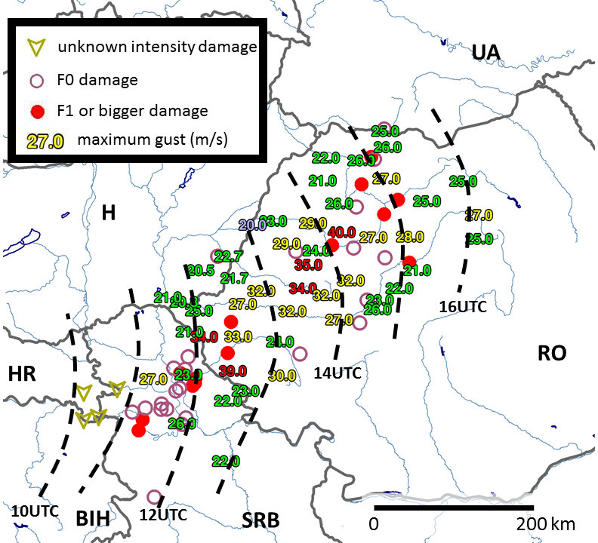
Evolution of the derecho on 17th of September 2017
Small number of known cases, little is known about climatology of derechos and similar windstorms in Europe
More information about the environment and macrosynoptic conditions for long-lived convective windstorms is available from the USA (Evans and Doswell, 2001, hereafter ED01, Coniglio et al., 2004)
Fig.1. Maximum wind gusts measured during the 17 September 2017 windstorm

Slide 16
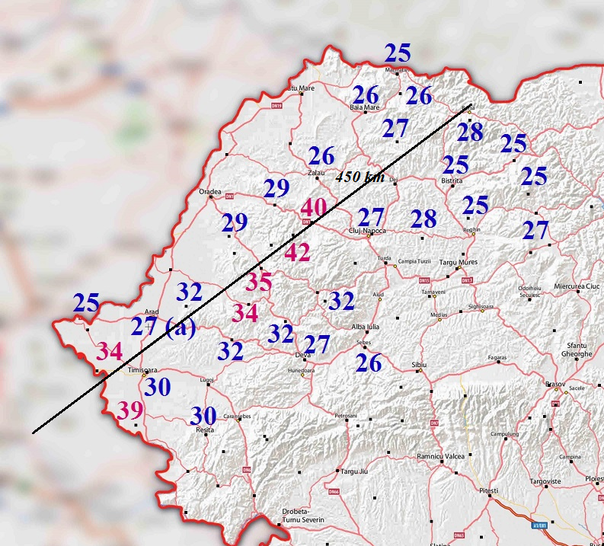

Slide 17
Introduction
The presented study examines the origin and environmental conditions of the 17 September 2017 severe convective windstorm, which affected several countries in the central and southeastern Europe, above all Serbia and Romania
The large area of the damage swath (at least 500 km long) and high wind gusts (up to 40 m/s) would classify this event as a derecho or at least as a storm very similar to derechos (with respect to newer definition proposals). Small-scale bow echoes were found in areas with highest reported wind gusts and some thunderstorms within the storm-producing convective system were probably supercells.

Slide 18
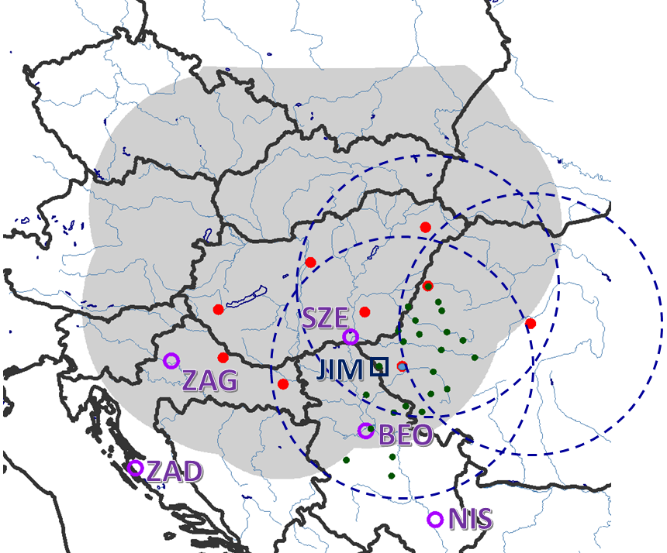
Methodology
The presented study was done using information from several types of observations (aerological, radar, satellite, surface measurements) and outputs (analyses and forecasts) of the ECMWF numerical model.
At the Hungarian Meteorological Service (OMSZ), an operational, mosaic radar imagery of Hungarian, Croatian and Slovak radars was used throughout the study (depicted in Fig. 2).
We also examined available products of Romanian radars (Table 1). We used data of synoptic stations with hourly frequency (those, which were subject to international data exchange).
Fig. 2. Positions of radars (full circles) and area of coverage of the mosaic radar imagery of Hungarian, Croatian and Slovak radars used in the study (shaded). The range of the Romanian radars in the eastern and central part of the country is indicated by dashed circles. Empty circles show the positions of soundings on 17 September 2017 at 00 and 12 UTC. Letters ZAD, ZAG, SZE, BEO, NIS denote Zadar, Zagreb, Szeged, Beograd, Nis. Letter JIM and rectangle shows the position of IASI L2 profile over Jimbolia (Romania). The smaller full dots show the positions of pseudo-soundings from the ECMWF used for the calculation of convective parameters and characterization of the pre-storm environment valid for the 17 September 2017 12 UTC.
Station | Pogányvár | Budapest | Szentes | Nyíregyháza-Napkor | Bilogora | Osijek | Timisoara | Oradea | Tarnaveni/Bobohalma
Type | DWSR-2501C | DWSR-2500C | DWSR-5001C | DWSR-2501C | WSR-88D | DWSR 74 S | WSR 98D | WSR 98D | WSR 98D
Band | C-band | C-band | C-band | C-band | S-band | S-band | S-band | S-band | S-band
range (km) | 240 | 240 | 240 | 240 | 240 | 240 | 230 | 230 | 230
beam width | 0.9° | 0.94° | 0.95° | 0.96° | 2.1° | 2.1° | 0.99° | 0.99° | 0.99°

Slide 19
Sounding | Position/stage of the storm development | MUCAPE (MUCIN) (J/kg) | MLCAPE (MLCIN) (J/kg) | 0-6 km shear (m/s) | DCAPE (J/kg) | MLMR (g/kg) | 0-3km RH (%) | DCP
Beograd (13275) 12 UTC | forward flank of the system, mature | 22.5 (69.5) | 6.2 (131) | 39.5 | 632.3 | 5.8 | 42.4 | 0.074
Nis* (13388) 12 UTC | southeast of the system, mature | 958.1 (50.8) | 129.6 (187) | 22.9 | 704.5 | NA | 42.8 | 1.28
Szeged (12982) 12UTC | northern flank of the system, mature | 65.7 (0) | 2.2 (0) | 42.5 | 55.6 | 9.4 | 75.1 | 0.014
Zagreb (14240) 12UTC | behind the system, mature | 842.8 (0) | 423.8 (0) | 35 | 360 | 10.2 | 89.7 | 1.24
Zadar (14430) 00 UTC | early development | 1069.9 (0.8) | 895.2 (13.2) | 31.9 | 599.7 | 13.3 | 87.2 | 2.5
Comparison of parameters derived from soundings in the area of the studied storm on 17 September 2017.

Slide 20
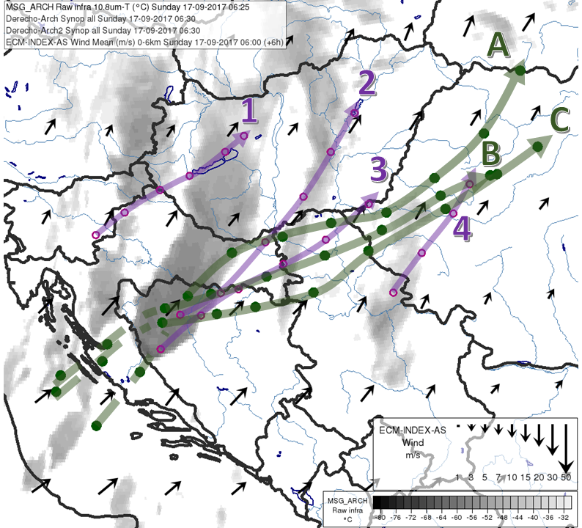
Development of the storm from radar and satellite observations
Intense development of deep convection could be observed over Croatia and Bosnia-Hercegovina already in the morning hours of 17 September 2017 (Fig. 8a).
Fig. 8a. Tracks of certain significant storms and segments of the 17 September 2017 convective system (long thick annotated curves with arrowheads). Circles show the positions of the storms (usually the maximum radar reflectivity) with hourly intervals, starting from 0630 UTC

Slide 21
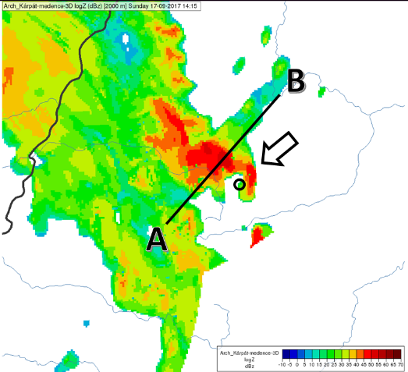
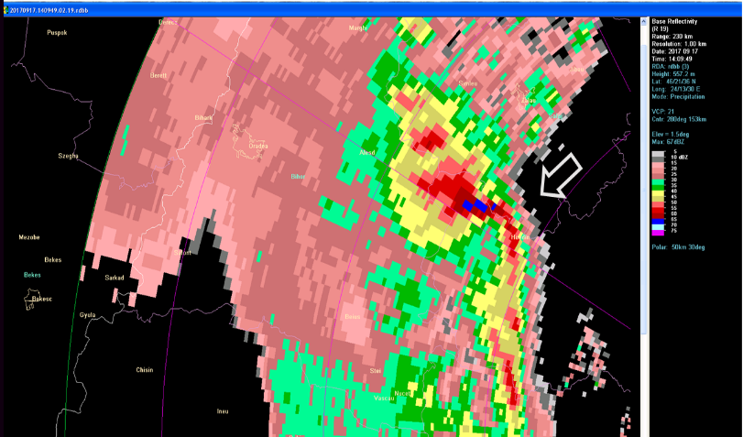
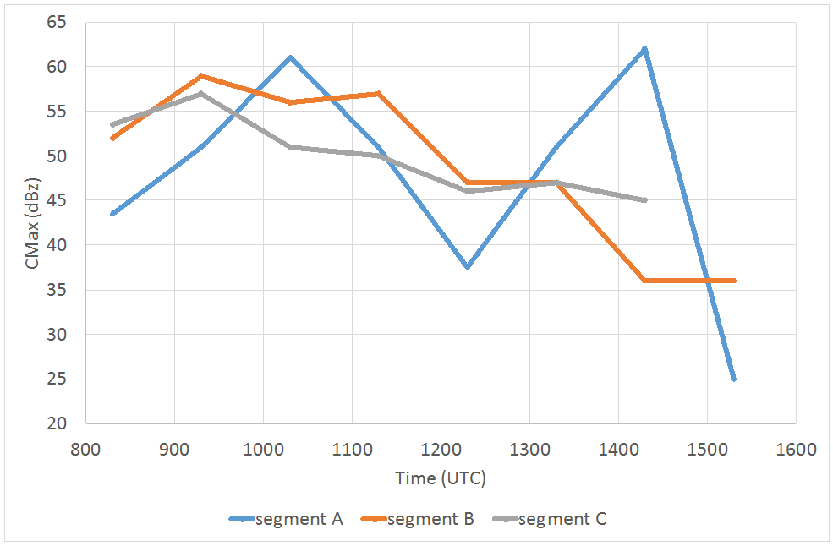
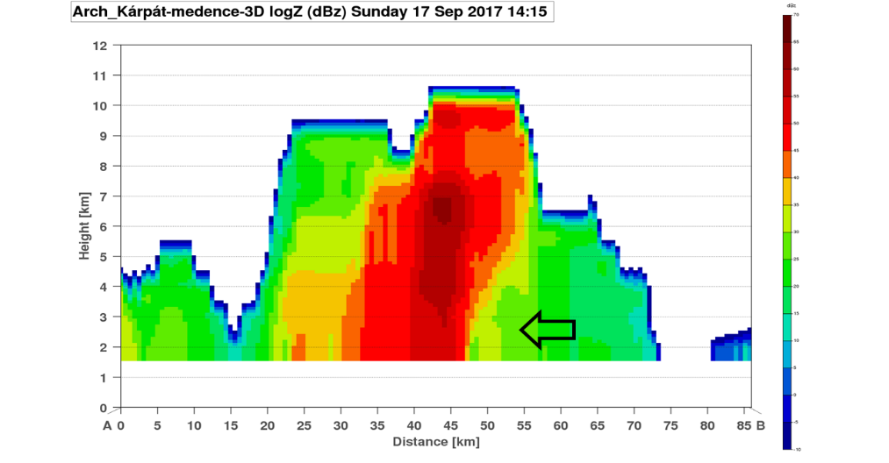
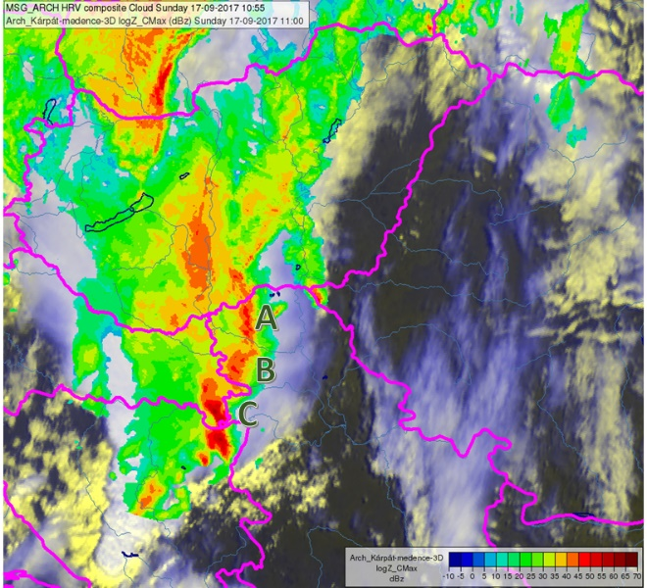
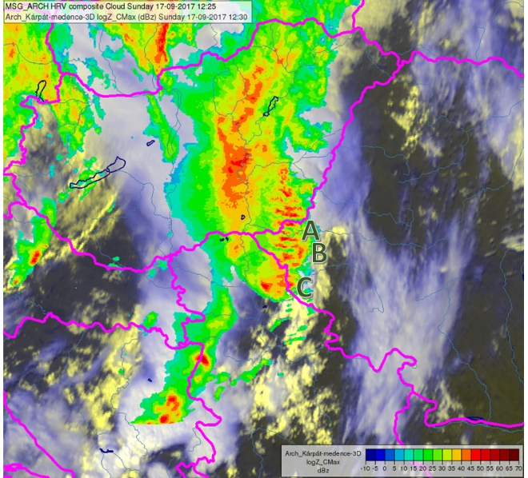
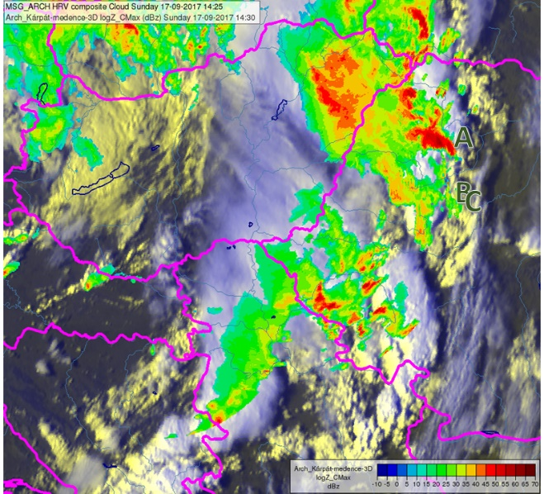
Development of the storm from radar and satellite observations

Slide 22
Conclusions
The case of the 17 September 2017 windstorm showed several characteristics, which were typical for a derecho event.
The intensity of the studied storm was determined mainly by deep convection and to a less extent by large-scale pressure distribution. This can be demonstrated by the fact that the maximum wind gust forecast of the hydrostatic ECMWF model (including parameterisation of convection) was 22 m/s for plain territory of Romania and 24 m/s for mountain regions, although the maximum observed gusts reached 40 m/s.
It is possible that the presence of unsaturated dry air close to the surface (and not only at mid-levels) could have influenced the intensity of the gusts via stronger evaporation of precipitation and intensification of downdrafts.
The convective system did not exhibit a large-scale, long-lived bow echo, which is often observed during derecho events and provides an important hint on presence of severe wind. On radar imagery, we could see only smaller-scale bow echoes, over Romania or in the border region of Romania and Serbia. The system also showed a tendency to split into several segments and cells, which maximum radar reflectivity was sometimes rather low, mainly on the southern and southeastern flank of the system (probably due to inflow of drier environmental air).
In our case, the compactness of the area of high wind gusts and associated damages indicate that these cells developed on the leading edge of one large, propagating cold pool. Due to high wind shear and possible presence of a rear-inflow jet, it is likely that the system was not cold pool-dominated and an equilibrium could develop between the cold pool-generated horizontal vorticity and environmental shear
Use of non-hydrostatic models capable to predict that kind of storm and other parameters that could help the forecaster
A lot of other conclusions and unanswered things...

Slide 23
A case study of a derecho storm in a high shear and dry environment – 17th of September 2017
Autumn Summer School on Sattelites – EUMETSAT - Thessaloniki
Zoltán Sipos, André Simon, Kálmán Csirmaz, Tünde Lemler, Robert-Daniel Manta, Mirela Polifronie, Zsófia Kocsis

