Slide 1
“Medusa” storm: An unusual and very intense storm on the 16th of July, 2017 in Greece
Eumetsat ,September 2019
Aggelidou Eleni
1
Notes:
Good morning Ladies and Gentleman ! Let me introduce myself! My name is Eleni Aggelidou,ι am from Greece and I am a postgraduate student of the department of Meteorology , Climatology and Atmospheric Environment in the Aristotle University of Thessaloniki. The theme of my work is “Medusa….. that happened on July 16th ….

Slide 2
Introduction
This intense storm, in the heart of the summer, which started from northern mainland Greece and then passed to the rest of the country, has significantly affected the weather in Greece with:
heavy and lasting showers
thunderstorms
hailstorms
gusty winds
Eumetsat ,September 2019
1

Slide 3
Characteristics of the storm
Two different types of weather:
North-Central Greece:
Extensive ana-frontal cloud shield
Long-lasting moderate-heavy rainfall, with amounts summing up to ~ 70 mm at places
Scattered thunderstorms, embedded in the above cloud shield
South-Central Greece:
Kata-frontal like structure along the leading edge of a stratospheric dry air intrusion / upper level front
Severe thunderstorms
Flash floods
Gusty winds
hailstorms
Eumetsat ,September 2019
1

Slide 4
Weather episode description
Main Purpose: The evolution of the major trough, associated with the storm on the 16th of July 2017 in Greece.
Method: The simulation was made by the online weather-map viewer applet. This system, which was accompanied with the rainfall, was due to both convective activity-instability and synoptic causes.
In the pictures below, the storm is analyzed from a synoptic and satellite imaging perspective.
Eumetsat ,September 2019
1
Notes:
This study monitors the evolution of a major trough on the 16th of July 2017 in Greece, in order to record the track of the depression. The simulation was made by the online weather-map viewer applet. This system, which was accompanied with the rainfall, was due to both convective activity-instability and synoptic causes.
In the pictures below, the barometric low is analyzed from a synoptic and satellite imaging perspective.

Slide 5
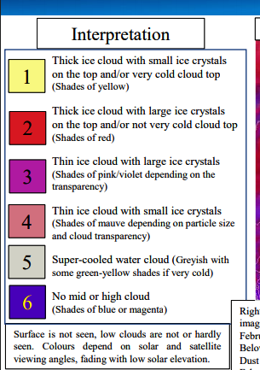
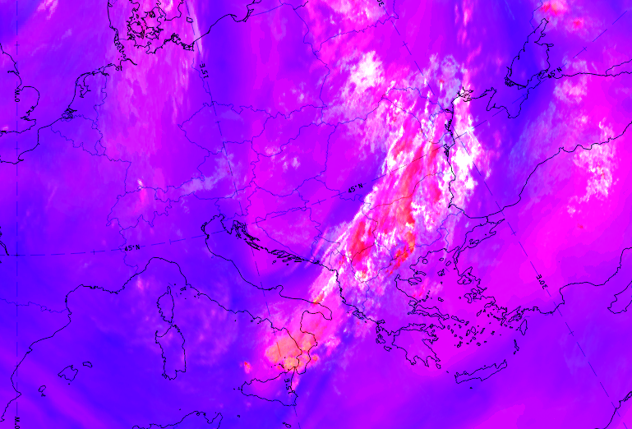
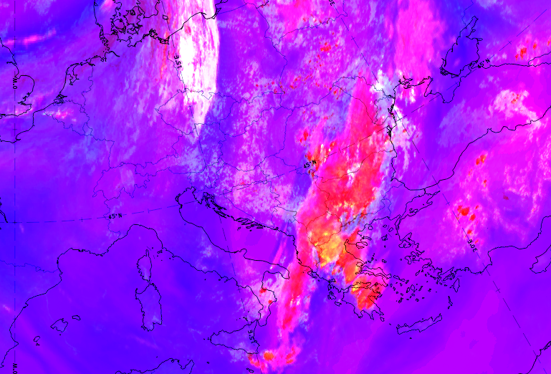
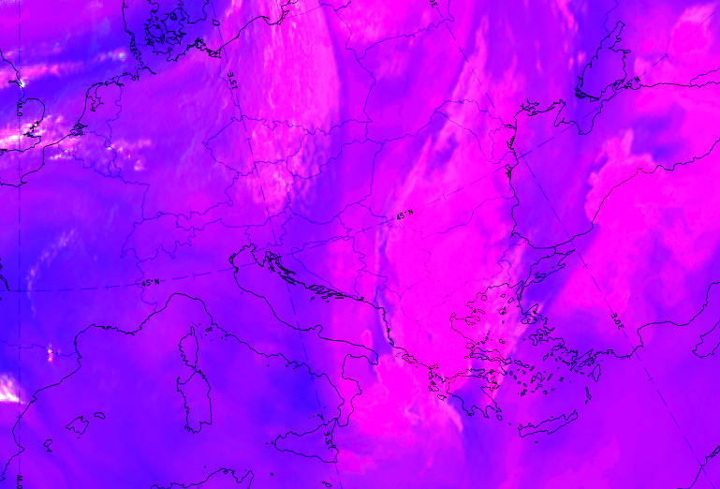
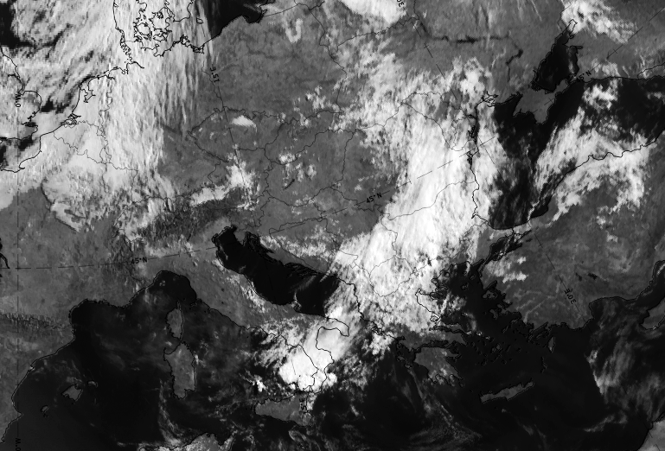
Interpretation of satellite images
Severe Storms RGB and Visual images
Intense storms
MSG-Severe Storms RGB, 16 July 2017, 06:00 UTC
MSG-Severe Storms RGB, 16 July 2017, 12:00 UTC
MSG-Severe Storms RGB, 16 July 2017, 18:00 UTC
Huge cloud’s thickness
Big cloud’s content in water
As, Anvil Cs, Cu Congestus, Cb
Cloud’s thickness
Cu , As
Eumetsat ,September 2019
MSG-VIS0.8, 16 July 2017, 06:00 UTC
MSG-VIS0.8, 16 July 2017, 12:00 UTC
1
Notes:
In the next section we are going to give the Interpretation…. The satellite images that were collected are worth commenting and depicting, where the storm has created and developed in Greece. First of all the 3 images below represent the SEVERE STORMS with RGB analysis where the red and yellow shades represent thick ice clouds with large/ small ice crystals on the top and-or not very/very cold cloud top . for 06-12-18 UTC ……and the 2 beneath of them show the VIS0.8 analysis ,where the white colouring depicts the intense albedo and the cloud’s thickness, which mean bad weather conditions.
For 06:00 Clouds…. And for 12:00 MAINLY--→
Background
The table shows which channel differences are used in this RGB type, and lists some of the land and cloud features which typically make a low or high contribution to the colour beams in this RGB. WV6.2–WV7.3 is used to highlight high-level clouds. NIR1.6–VIS0.6 is used to separate ice from water clouds. IR3.9–IR10.8 is used to highlight those cloud tops which are covered with small ice crystals and/or which are very cold
Colour Channel [µm] Physically relates to Smaller contribution to the signal of Larger contribution to the signal of
Red WV6.2–WV7.3 Cloud top height No mid or high clouds High-level clouds
Green IR3.9–IR10.8 Cloud top particle size and temperature Opaque ice cloud with large cloud top particles and/or not very cold cloud top temperature Opaque ice cloud with small crystals and/or very cold cloud top temperature
Blue NIR1.6–VIS0.6 Cloud top phase Thick ice clouds Water clouds Land, sea surface

Slide 6
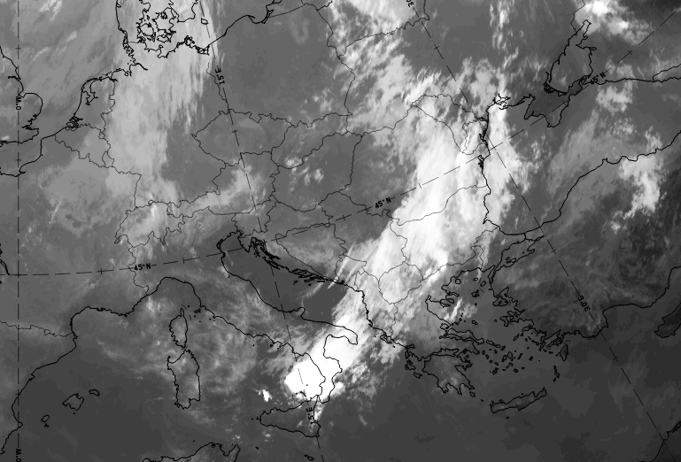
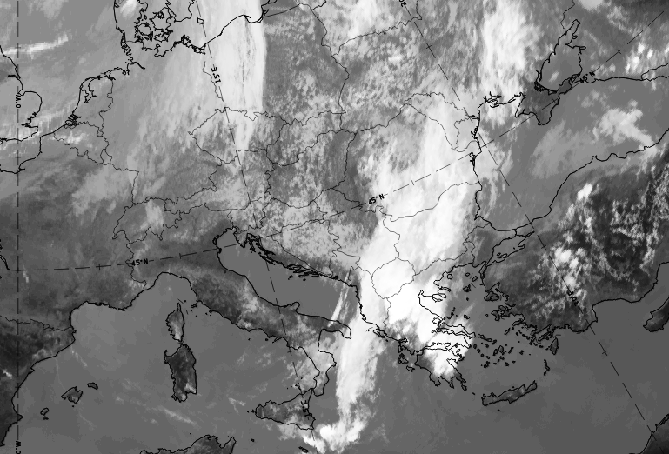
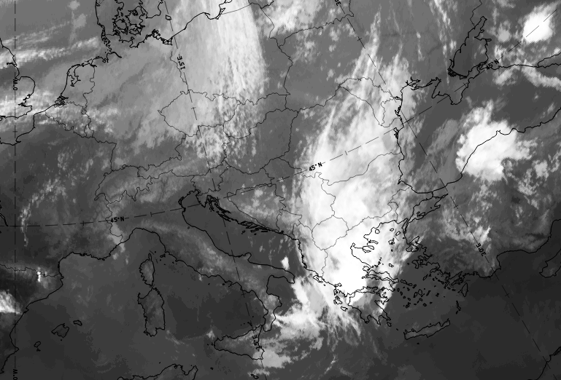
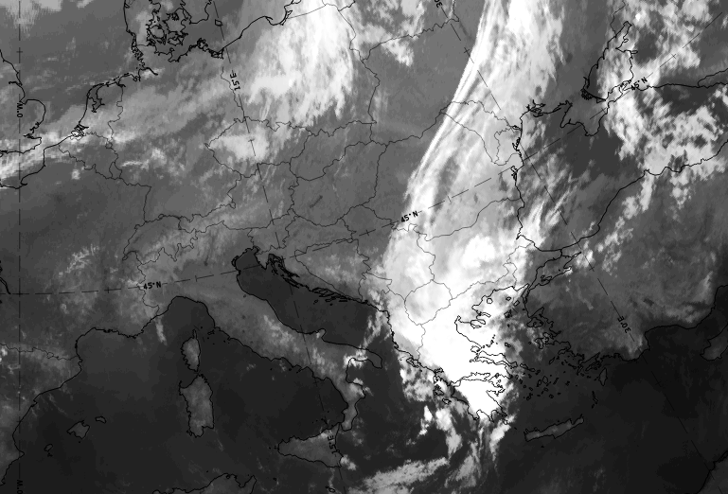
Satellite images in infrared
White shades → Cold regions → High clοuds
Cu Congestus, Cb,
Anvil Cs
Cs
Cs
As
MSG-IR10.8, 16 July 2017, 00:00 UTC
MSG-IR10.8, 16 July 2017, 06:00 UTC
MSG-IR10.8, 16 July 2017, 12:00 UTC
Upper level front:
Anvil Cs, Cb
Anvil Cs, Cb
MSG-IR10.8, 16 July 2017, 18:00 UTC
MSG-IR10.8, 17 July 2017, 00:00 UTC
Eumetsat ,September 2019
1
Notes:
White shades are cold regions which mean High clouds (mainly) Cs combined with the satellite images in VIS0.8 ,result in (low thick) convective clouds(Cb+Cumulus Congestus) Εκταση νεφων=

Slide 7
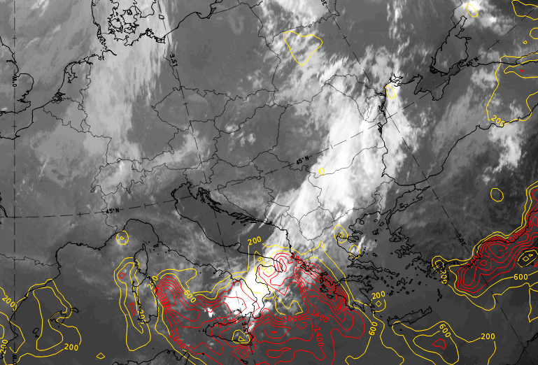
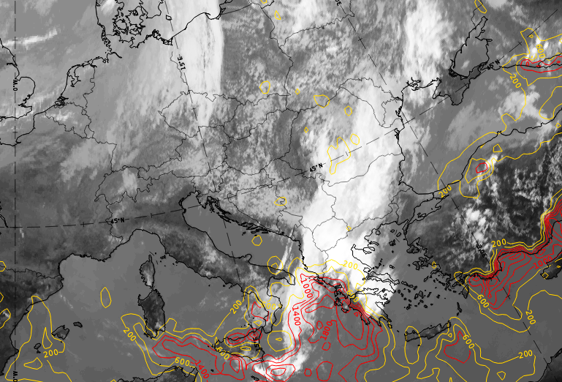
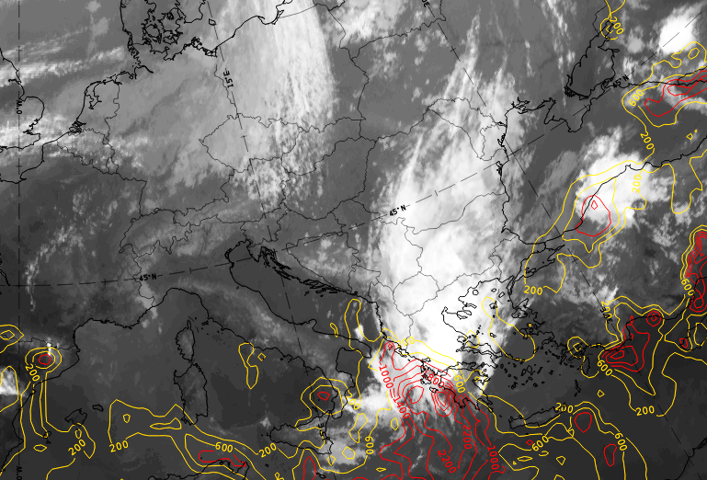
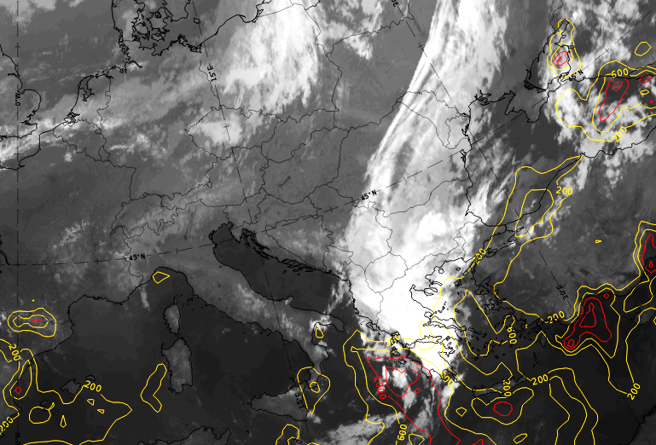
Connection between
satellite images in infrared and CAPE
MSG-IR10.8 & CAPE, 16 July 2017, 00:00 UTC
MSG-IR10.8 & CAPE, 16 July 2017, 06:00 UTC
MSG-IR10.8 & CAPE, 16 July 2017, 12:00 UTC
CAPE ranges between the values:
CAPE < 0 Stable
0 ≤ CAPE ≤ 1000 Marginally unstable YELLOW
1000 < CAPE ≤ 2500 Moderately unstable RED
2500 < CAPE ≤ 3500 Very unstable RED
CAPE > 3500-4000 Extremely unstable RED
MSG-IR10.8 & CAPE, 16 July 2017, 18:00 UTC
MSG-IR10.8 & CAPE, 17 July 2017, 00:00 UTC
Eumetsat ,September 2019
1
Notes:
Continuing in the next slides we can observe/notice/look/ the Connection….
Where the model gives us mainly marginally unstable atmosphere CAPE ranges between the values ….
CAPE < 0 Stable
0 ≤ CAPE ≤ 1000 Marginally unstable YELLOW
1000 < CAPE ≤ 2500 Moderately unstable RED
2500 < CAPE ≤ 3500 Very unstable RED
CAPE > 3500-4000 Extremely unstable RED

Slide 8
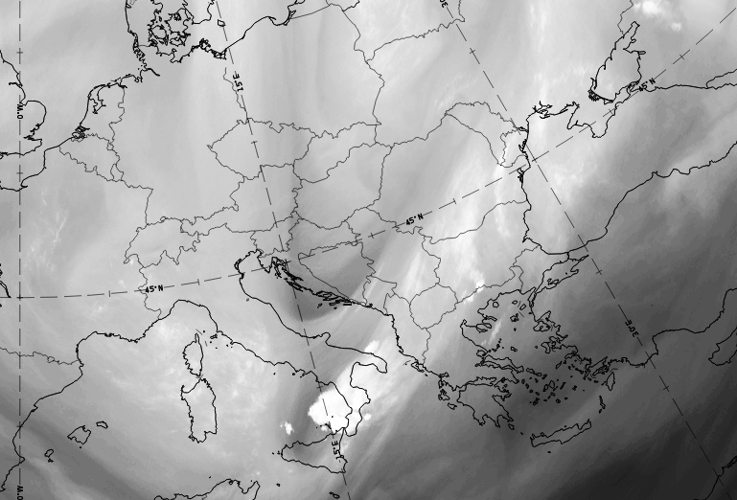
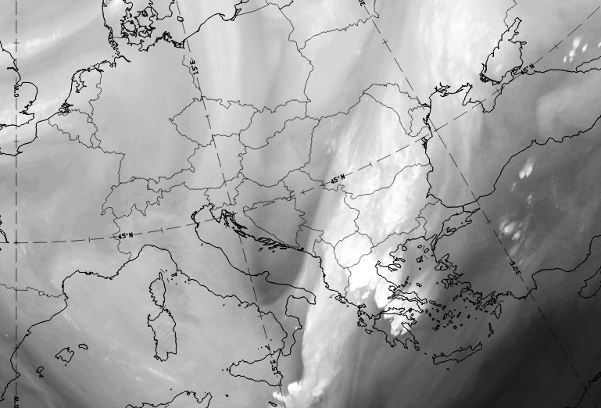
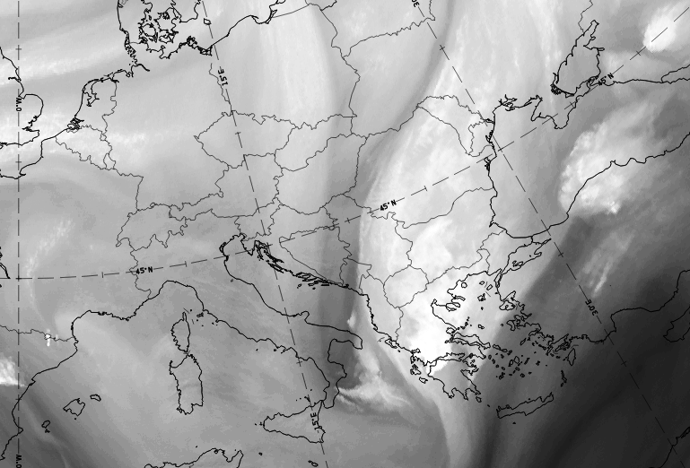
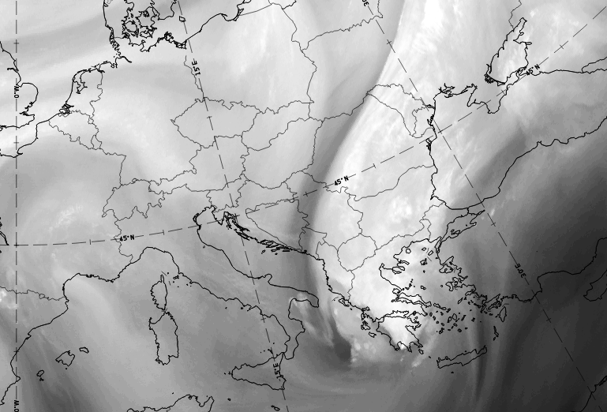
Satellite WV images
A
A
B
C
A
A
D
E
E
A
C
E
D
B
E
C
E
D
B
E
C
MSG-WV6.2, 16 July 2017, 00:00 UTC
MSG-WV6.2, 16 July 2017, 06:00 UTC
MSG-W6.2, 16 July 2017, 12:00 UTC
A
A
C
A
E
A
E
A
B
E
D
D
B
E
MSG-WV6.2, 16 July 2017, 18:00 UTC
MSG-WV6.2, 17 July 2017, 00:00 UTC
A: area of high humidity, B: dry stratospheric intrusion, C:clouds, D:jet stream, E:area of low humidity
Eumetsat ,September 2019
1
Notes:
High humidity in the middle and upper troposphere, is depicted /illustrated with open shades of gray-------→ low temperature
Low humidity -------------------//---------------------------------- dark shades of gray-------→high temperature
Very white shades of gray-------→High Clouds

Slide 9
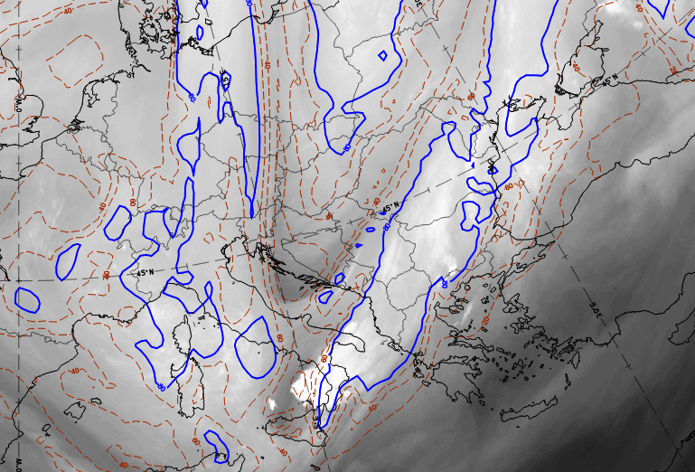
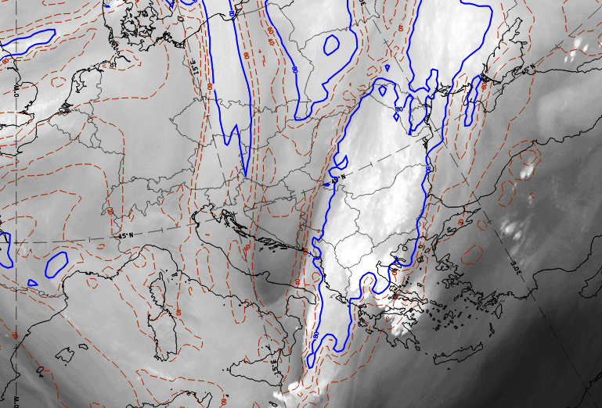
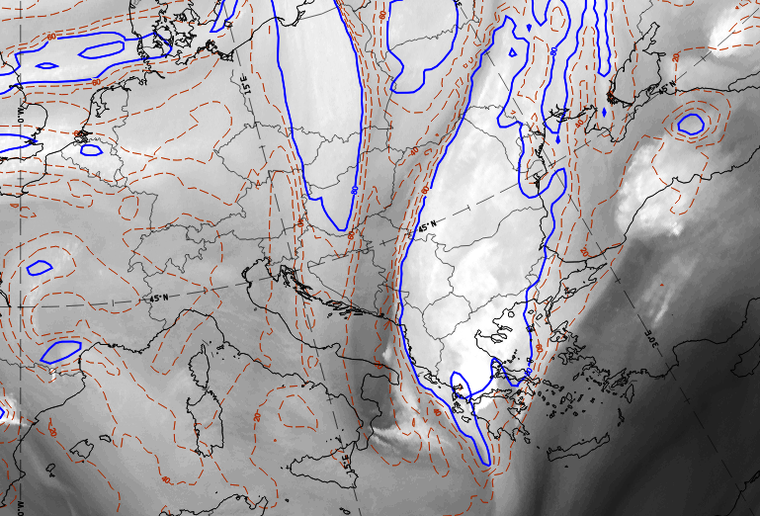
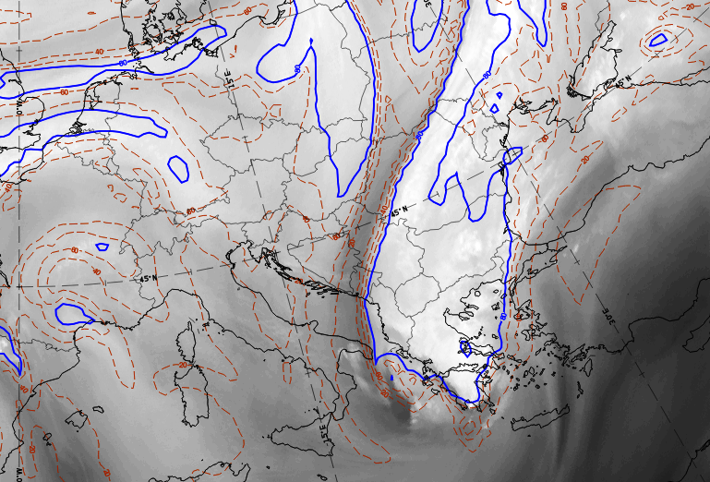
Connection between satellite WV images and Relative Humidity in 300hpa
80%
20-40%
60-80%
20-40%
MSG-WV6.2 & Relative Humidity, 16 July 2017
00:00 UTC
MSG-WV6.2 & Relative Humidity, 16 July 2017
06:00 UTC
MSG-WV6.2 & Relative Humidity, 16 July 2017
12:00 UTC
80%
80%
MSG-WV6.2 & Relative Humidity, 16 July 2017
18:00 UTC
MSG-WV6.2 & Relative Humidity, 17 July 2017
00:00 UTC
Eumetsat ,September 2019
1
Notes:
RH ranges between: 1) firstly in northern Greece between 20%-40% RH
2) At 06:00 UTC in northern Greece between 60%-80% and in central Greece about 20-40% RH
3)At 12:00 UTC the wet air masses with 80%RH passes through the central Greece
4)Then at 18:00 and 00:00 UTC these air masses continue its way to the south

Slide 10
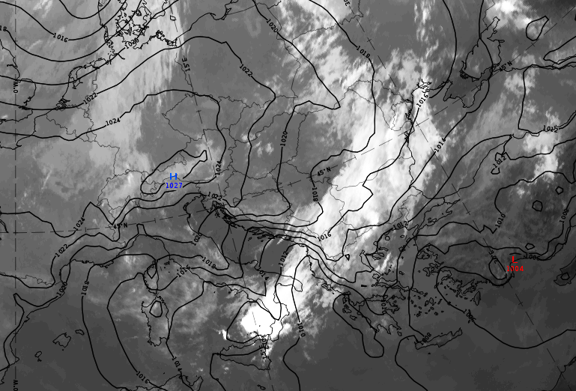
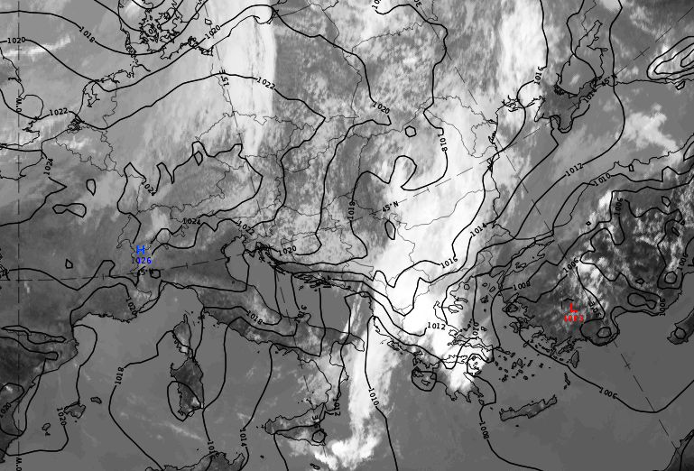
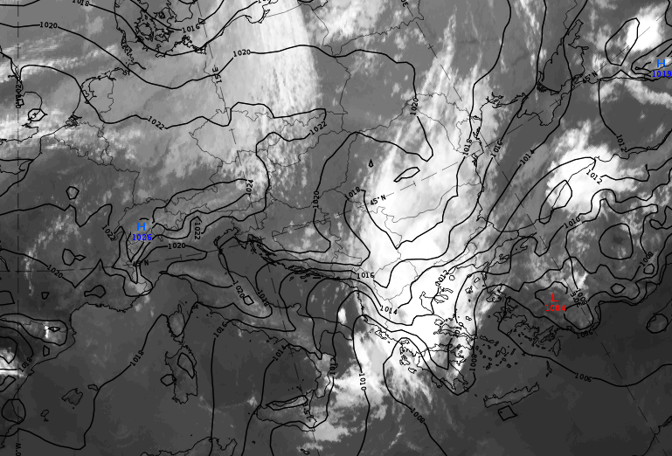
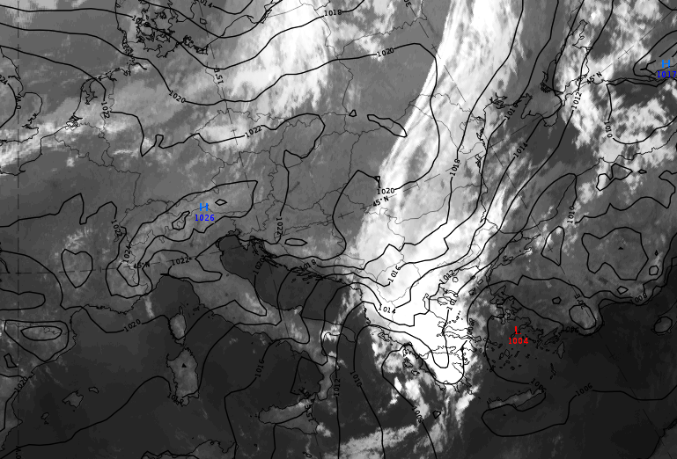
Connection between satellite images in infrared and MSL Pressure
Cold
Cold
Cold
L
L
L
MSG-IR10.8 & MSL Pressure, 16 July 2017
00:00 UTC
MSG-IR10.8 & MSL Pressure, 16 July 2017
06:00 UTC
MSG-IR10.8 & MSL Pressure, 16 July 2017
12:00 UTC
Low level front:
The low center was moved from Cyprus->Turkey->Aegean sea
Cold
Cold
L
Eumetsat ,September 2019
MSG-IR10.8 & MSL Pressure, 16 July 2017
18:00 UTC
MSG-IR10.8 & MSL Pressure, 17July 2017
00:00 UTC
1
Notes:
Intensive trough + isobar fractures
And the low center which is moving from Cyprus,passes to Turkey and ends in the Aegean sea with 1008hPa

Slide 11
As far as the two different types of weather are concerned:
In the north, ana-frontal type of rainfall is associated with the arrival of a quite cold, for the time of the year, air mass, at low levels (snowfall was reported on Mount Olympus).
In the south, severe convection was triggered along the leading edge (upper level front) of a deep cold air mass (T_{500 hPa} < -12ºC) and a stratospheric dry air intrusion.
Eumetsat ,September 2019
1

Slide 12
Effects and Consequences
The fierce wave of bad weather that afflicted Greece, caused dozens of problems and damage to crops in several parts of the Territory. The tragic account of the entire phenomenon was the death of a 49-year-old shepherd that was caused by lightning. Some indicative measurements that have been made:
81 mm, Larissa/ 59 mm, Amfilochia / 31 mm, Romanos Patras / 101.6 mm (35 mm at 1 h), Chalkidiki Neos Marmaras /67 mm, Kiato / 66 mm, Limnos
Eumetsat ,September 2019
1
Notes:
….the most significant are …in Chalkidiki

Slide 13
Effects and Consequences
Furthermore, other extensive damages which were caused by this synoptic system were:
Floods in Sithonia-Chalkidiki, Limnos, Larisa, Agrinio, Kozani, Trikala-Central Greece and Patra-Southern Greece
Crops damages and landslides from the hailstorms in Metsovo, Kalavrita-Central Greece
Problems in transportation due to landslides caused by rainstorms in Patra-Northern Greece
Eumetsat ,September 2019
1

Slide 14
THANK YOU FOR YOUR ATTENTION!! ANY QUESTIONS??

