Slide 1
22/08/2019 Croatia
Matea Martinković
DHMZ
www.meteo.hr

Slide 2
Airmass+ AT300, 22/08/19, 06 UTC
www.meteo.hr

Slide 3
Surface pressure chart, 22/08/19, 06UTC
www.meteo.hr

Slide 4
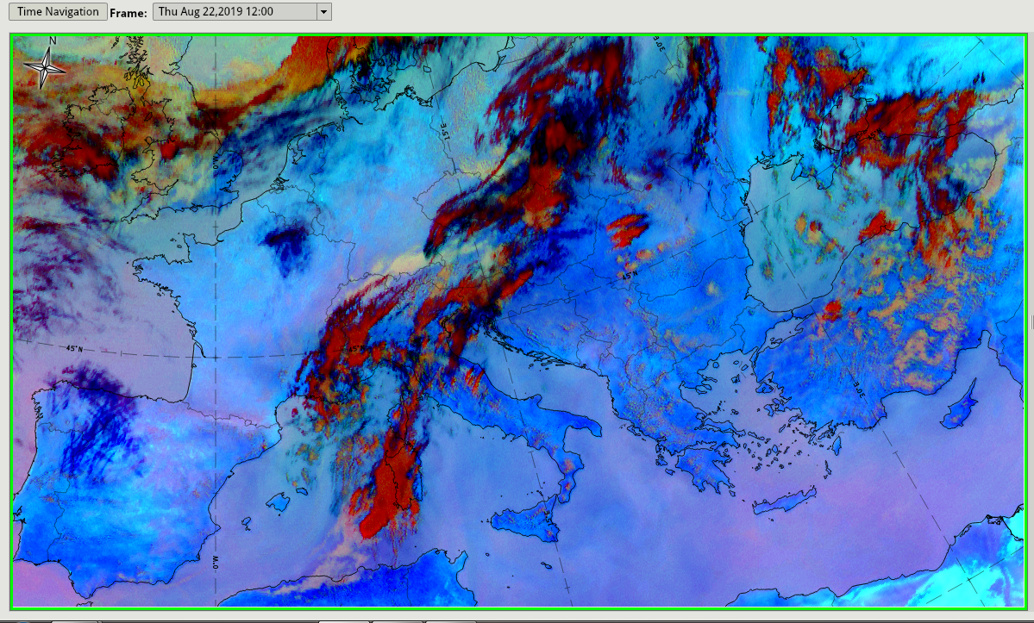
24h Microphysics, 22/08/19, 12 UTC
www.meteo.hr

Slide 5
HRV clouds + Convective rainfall rate
Thank you!
www.meteo.hr

