Slide 1
Active Red Sea Trough(ARST)
6.2.2019

Slide 2
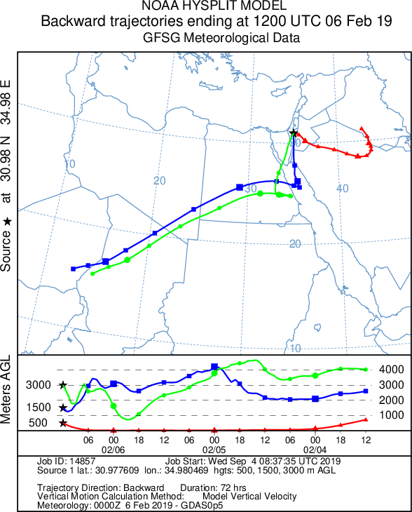
intro
Scattered showers and flash floods in the eastern and southern regions of Israel(16 [mm] average at the desert stations)
Started as an passive red sea trough and got initiated to be active because penetration of atmospheric river.
The air parcel movement-

Slide 3
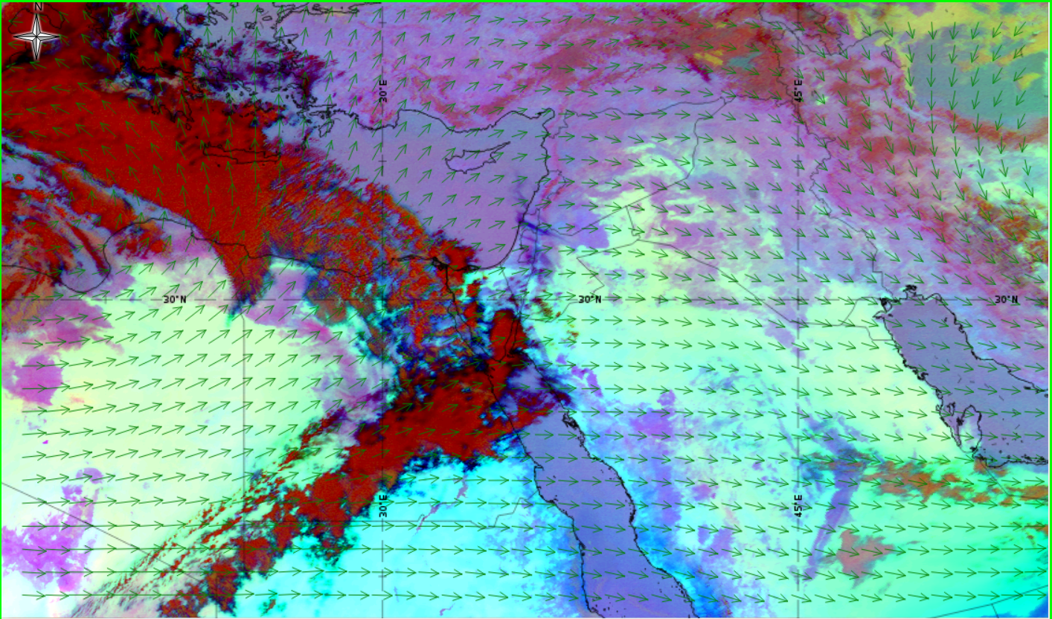
Before – 5.2.2019 12:00Z
Warm Front
Atmospheric river

Slide 4
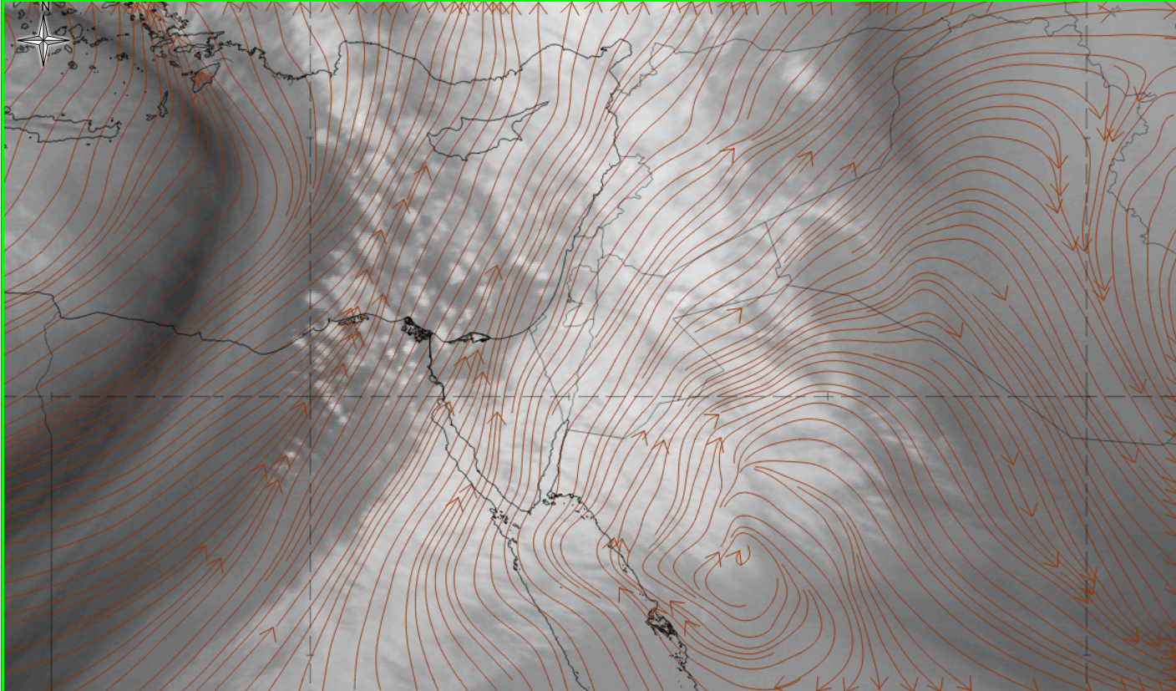
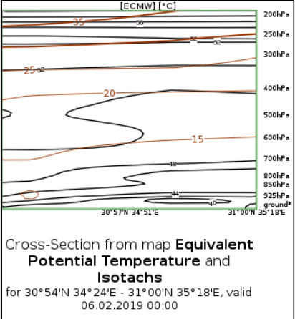
The start of the event – 6.2.2019(00:00z) 6.2WV
Dry intrusion
Atmospheric river

Slide 5
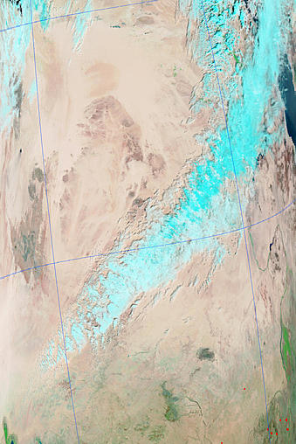
beginning of the event – 6.2.2019(08:00z)
RGB(7-2-1)

Slide 6
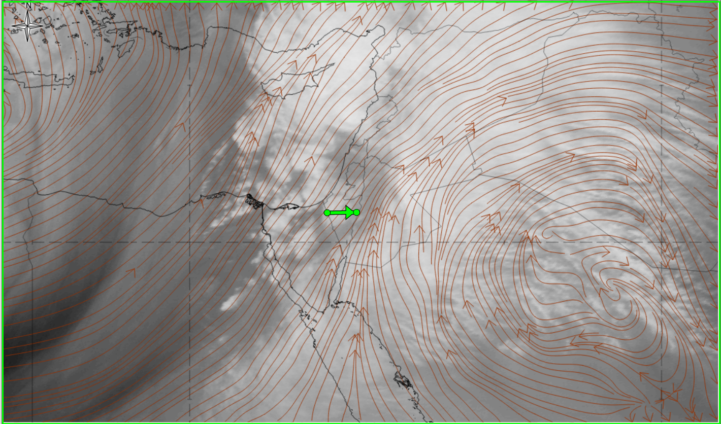
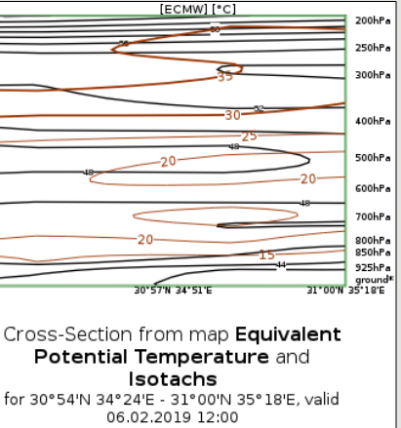
middle of the event – 6.2.2019(12:00z) 6.2WV
Dry intrusion
Atmospheric river

Slide 7
conclusions
Even trough the dry lower-mid layer of the RST the atmospheric river from the tropical ITCZ(TP) managed to cause strong rain in the dry regions of Israel.
Only when the jet penetrated in the southern regions the convections has been started.
After the enters of the dry intrusion the convections has been stopped.

Slide 8
Reference
EumatRain –Eport Pro
Global Imagery Browse Services -https://lance.modaps.eosdis.nasa.gov/cgi-bin/imagery/realtime.cgi
Ims(Israeli mereological service)- rain strations database

