Slide 1
MSG & MODIS observations of
land surface temperature and its interaction with atmospheric circulation in different scales
Itamar M. Lensky, Shilo Shiff
and
Uri Dayan
itamar.lensky@biu.ac.il
5th SALGEE Workshop 2017, 18 ‐ 20 September 2017

Slide 2
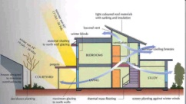
Atmospheric scales
Scale | Example |  | temporal | spatial
Micro | building |  | min | meters

Slide 3
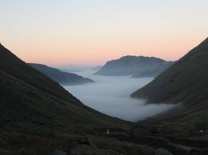
Atmospheric scales
Scale | Example |  | temporal | spatial
Micro | building |  | min | meters
Topo | valley |  | hours | Few km

Slide 4
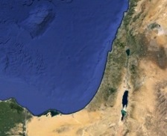
Atmospheric scales
Scale | Example |  | temporal | spatial
Micro | building |  | min | meters
Topo | valley |  | hours | Few km
Meso | country |  | < 1 day | 10-100 km

Slide 5
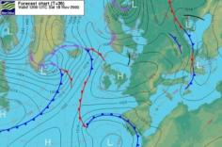
Atmospheric scales
Scale | Example |  | temporal | spatial
Micro | building |  | min | meters
Topo | valley |  | hours | Few km
Meso | country |  | < 1 day | 10-100 km
Synoptic | continent |  | Few days | 500-5000 km

Slide 6
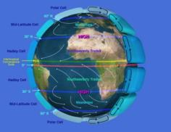
Atmospheric scales
Scale | Example |  | temporal | spatial
Micro | building |  | min | meters
Topo | valley |  | hours | Few km
Meso | country |  | < 1 day | 10-100 km
Synoptic | continent |  | Few days | 500-5000 km
Global | planet |  | > weeks

Slide 7
Atmospheric scales
Scale | Example |  | temporal | spatial
Micro | building |  | min | meters
Topo | valley |  | hours | Few km
Meso | country |  | < 1 day | 10-100 km
Synoptic | continent |  | Few days | 500-5000 km
Global | planet |  | > weeks

Slide 8
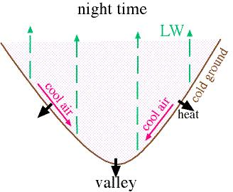
Cold air pool formation
Radiative cooling at clear winter nights causes stable stratification.
Topographic depressions are filled with cold air.
Notes:
This climate phenomenon is called The Cold Air Pool. Drainage flow from the mountain. The cold and dense air sinks to the bottom of the valley.
We will see further on that it has some important agricultural implications.

Slide 9
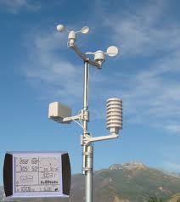
Detecting Finescale Climatic Features
Met stations

Slide 10
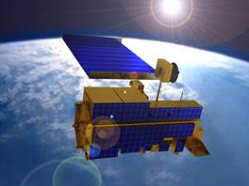
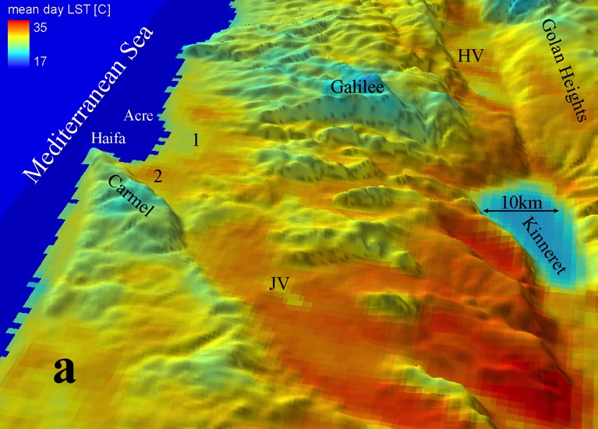
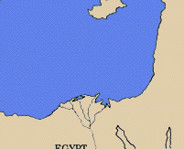
Detecting Finescale Climatic Features
MODIS
Met stations
705 km, 10:30 AM/PM
Lensky and Dayan, BAMS 2011

Slide 11
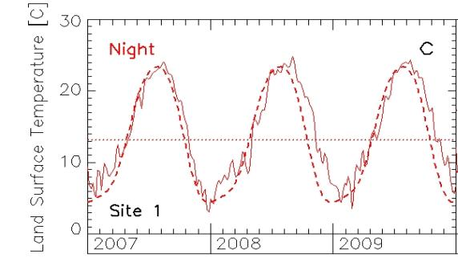
Summer Nights - LST controlled by altitude
+1000 m
- 200 m
JJA
JJA
JJA
Warm lowlands
Cold mountains
Notes:
The spatial distribution LST based on these 10.000 pixels indicates that the mean summer night LST is largely controlled by the altitude as displayed by warmer lowlands and cold mountains.

Slide 12
Winter Nights - Detecting cold patches
Longer winter clear-sky nights.
Stable atmosphere suppresses turbulence.
Drainage flow from the mountains.
DJF
DJF
Notes:
The winter nights exhibit a different picture showing that some low terrains where cold air drained from the mountains is accumulated results in colder temperature than the nearby mountains.

Slide 13
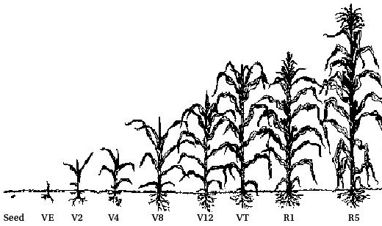
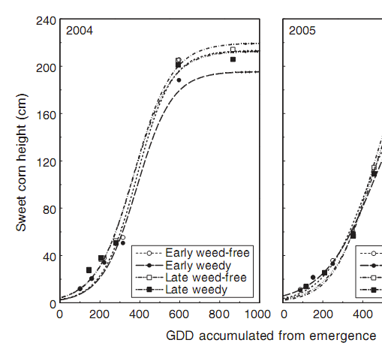
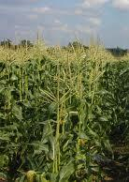
Implications for Agricultural Planning:
Simulation of corn growth
Slow growth
Fast growth
GDD accumulated
Growing Day Degree
Notes:
The thermal heterogeneity resulting from topography has strong impacts on agriculture. Here I’ll show an example of its impact on crop production.
Plant development depends on the amount of heat they accumulate (temperature units above a base temperature defined as Growing Day Degree).
Consequently warm regions reach the heat requested for corn growth earlier than colder regions leading to their fastest growth.
Farmers can use this knowledge for planning their planting.

Slide 14
Implication for pest management:
Predicting timing of pest population expansion
Pupae
Moth
A 3-week delay in pest population expansion is expected in cold pools
Notes:
2nd example, this time for pest management in which we can notice as much as a 3 weeks delay on the timing of the emergence of adult Heliothis moth from its pupal stage in 2 very closed sites.
Again, based on this knowledge farmers can optimize the spraying of insecticides.

Slide 15
Radiative cooling @ winter nights in valleys
amplitude difference between winter & summer LST
Notes:
For a clearer demonstration of the radiative cooling phenomena I show here the amplitude between summer and winter nights.
The largest amplitude of the winter/summer night LST of about 11 deg. can be seen in the 3 valleys while the smallest ones (6.5 deg.) are seen over the mountains
Note the high amplitude in the valleys colored blue caused by the cold drainage flow.

Slide 16
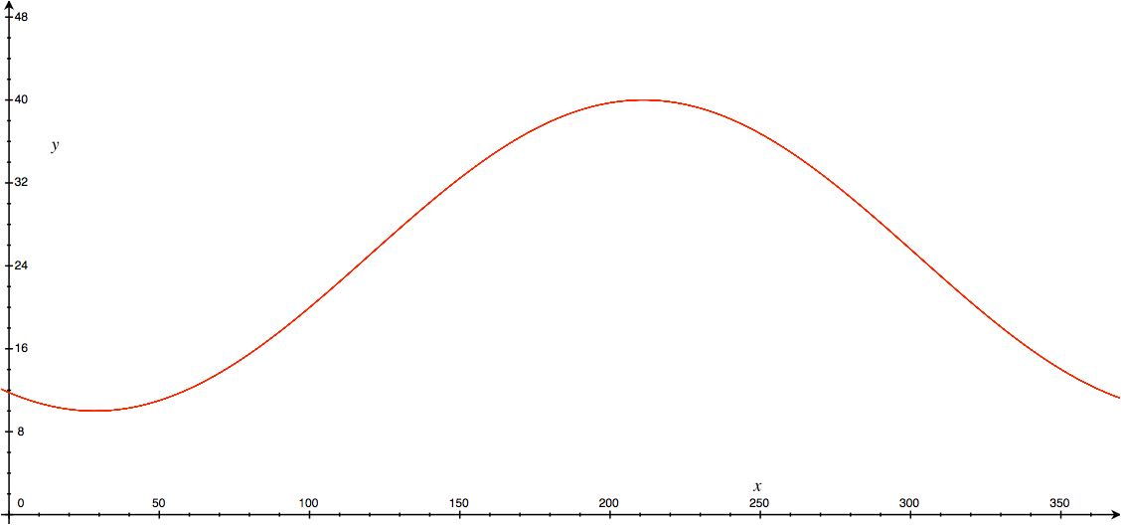
Temporal Fourier Analysis (TFA)
LST(t) = LST_{mean} + Acos(ωt+φ)
R – LST_{mean}
G – φ
B – A
φ
LST_{mean}
A

Slide 17
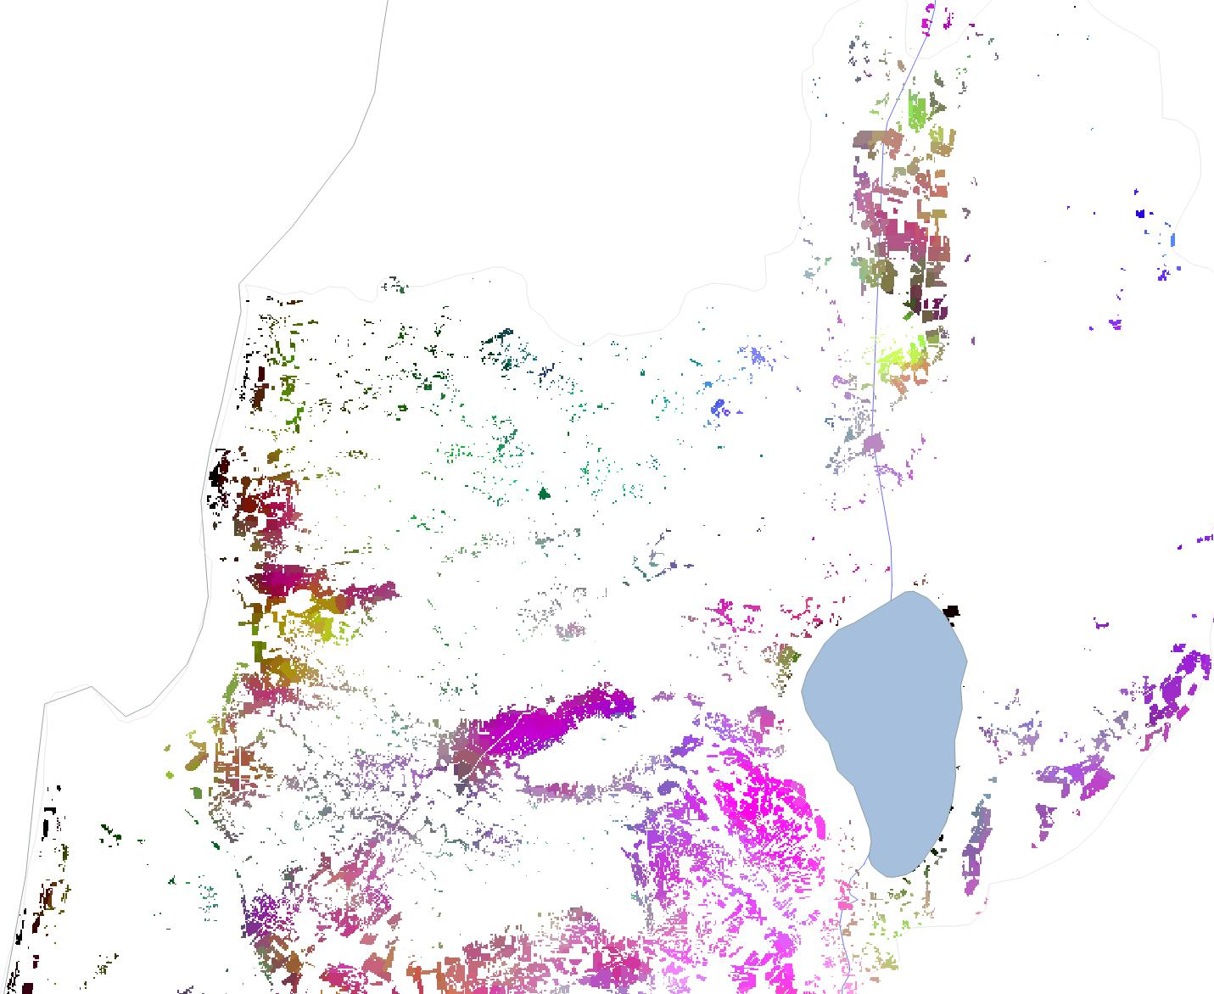
Temporal Fourier Analysis (TFA)
LST(t) = LST_{mean} + Acos(ωt+φ)
R – LST_{mean}
G – φ
B – A
φ
LST_{mean}
A

Slide 18
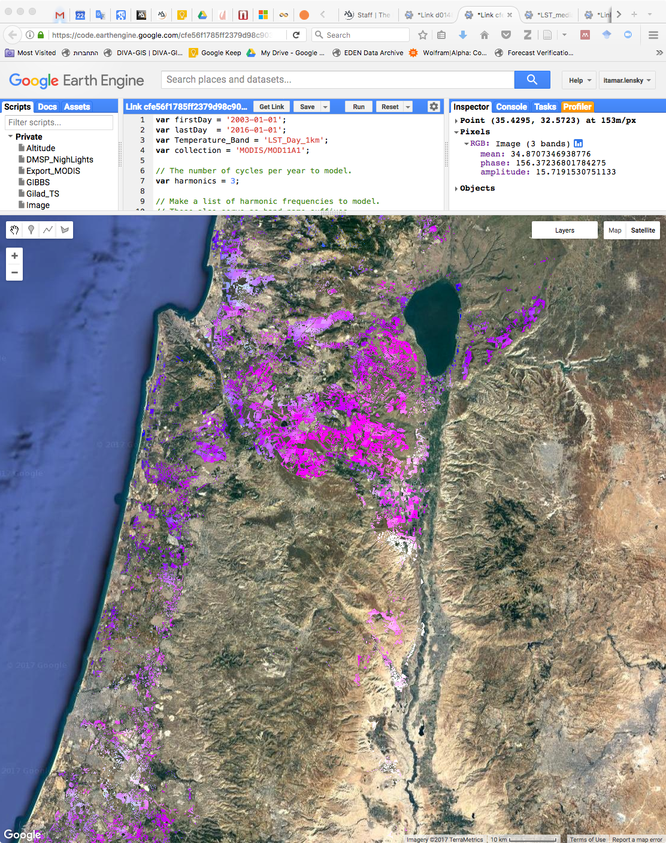
Google Earth Engine

Slide 19
Atmospheric scales
Scale | Example |  | temporal | spatial
Micro | building |  | min | meters
Topo | valley |  | hours | Few km
Meso | country |  | < 1 day | 10-100 km
Synoptic | continent |  | Few days | 500-5000 km
Global | planet |  | > weeks

Slide 20
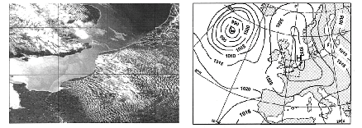
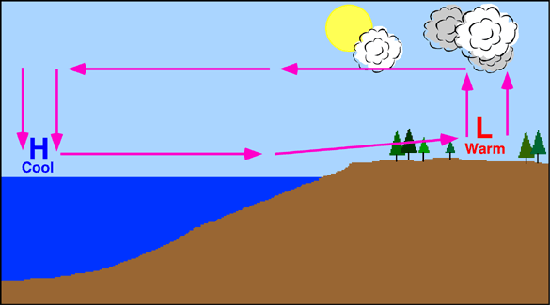
Sea Breeze: summer mesoscale system
Mesoscale
Synoptic scale
Notes:
Sea Breeze is probably the most analyzed summer mesoscale system and is caused by the daytime differential surface heating between the sea and the land
SB penetrates inland during the day. Its onshore penetration can be seen by the line of clouds parallel to the coast.
Most SB studies monitor SB front progression by such cloud lines as compared to our method where for the first time SBF is detected in clear sky conditions (when SB is stronger)
Other are detecting the SBF along the cloud formed in the convergence line associated with the SBF.

Slide 21
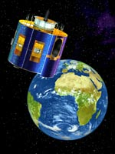
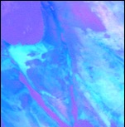
Resolution: 15 min; 4 km
MSG
9:00
July 31
2005
SB detection is based on the contrast between
cool marine-air and underlying warm terrain
Notes:
Now I’ll show you the daily progression of the SB inland in a 30 min time step.

Slide 22
9:30
July 31
2005

Slide 23
10:00
July 31
2005

Slide 24
10:30
July 31
2005

Slide 25
11:00
July 31
2005

Slide 26
11:30
July 31
2005

Slide 27
12:00
July 31
2005

Slide 28
12:30
July 31
2005

Slide 29
13:00
July 31
2005

Slide 30
13:30
July 31
2005

Slide 31
14:00
July 31
2005

Slide 32
14:30
July 31
2005

Slide 33
15:00
July 31
2005

Slide 34
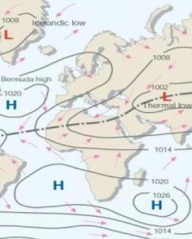
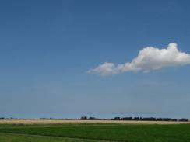
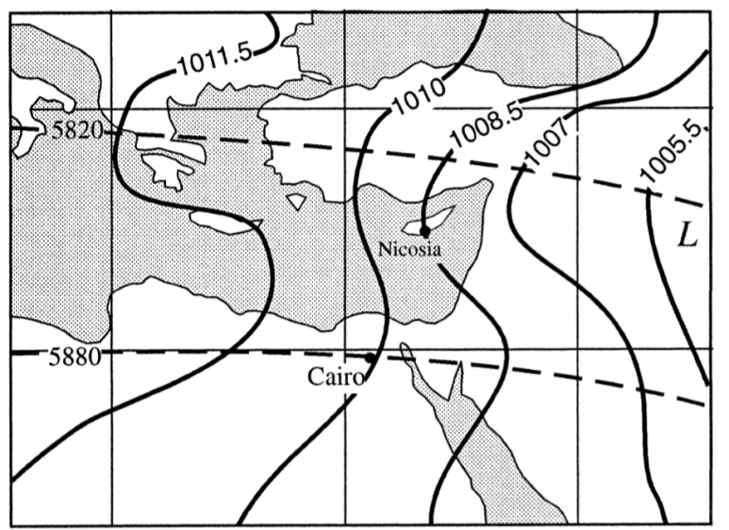
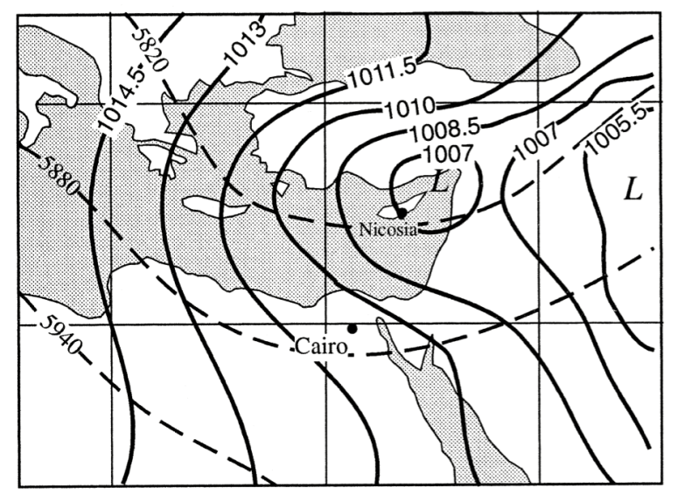
Persian Trough prevails at Summer over the EM
an extension of the Indian monsoon
Weak
Deep
SB best observed when synoptics is weak
Notes:
Such mesoscale phenomenon are imbedded in the synoptic scale. However, since this mesoscale phenomenon is clearly observed when the large forcing is weak, I’ll show its detection for Weak Synoptic conditions as compared to Deep Synop conditions.
For this sake I’ll use both modes of the PT synoptic system which is an extension of the Indian summer Monsoon affecting the EM.
The PT has 2 modes: the Deep Mode generating strong winds and the Weak Mode generating weak winds.

Slide 35
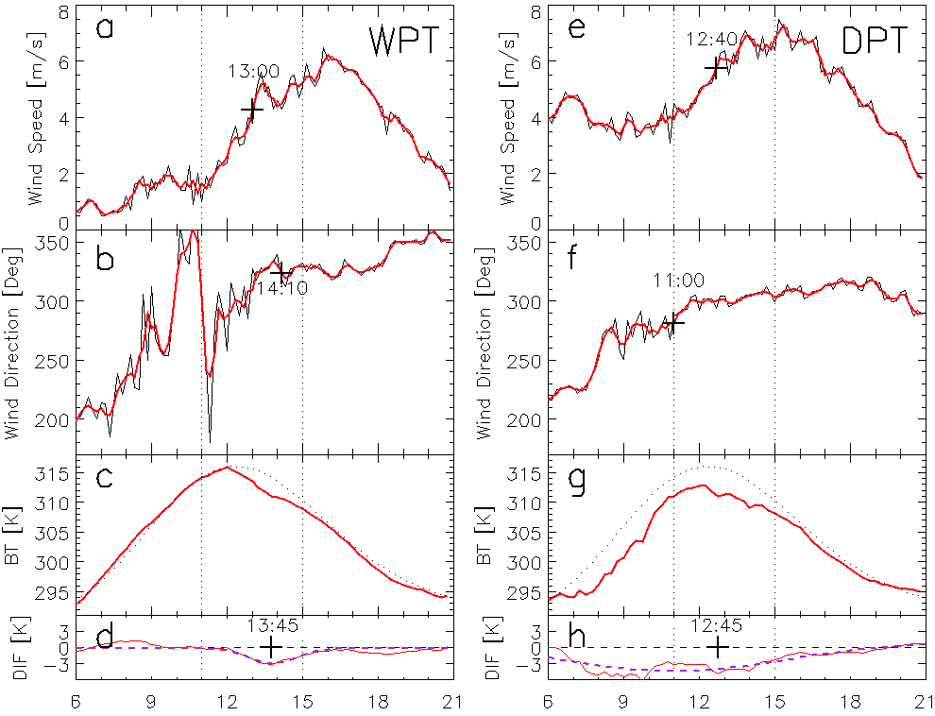
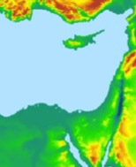
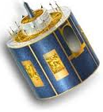
July 7 2010
July 21 2010
Weak
Deep
SB
strong winds
weak winds
steady direction
variable direction
clim
actual
Meso signal
Synoptic signal
Notes:
Here we compare 2 days: one identified as weak and the second as deep. The upper panel shows the wind speed from a meteorological station.
In the weak mode the wind intensify only at the arrival of the SB, while for the deep mode, strong winds blow from the morning indicating the large scale forcing.
The lower panel shows the surface temperature detected by the satellite for one pixel collocated with the met station.
In the weak mode the SB cools the surface temperature from noon for ~3 hours as seen by the temperature deviation from climatology.
In the deep mode the longer deviation is attributed to large-scale cold air advection.
We performed the same treatment for all the pixels in the domain which enabled to display the spatial / temporal SB penetration.

Slide 36
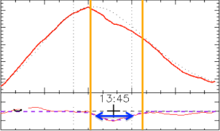
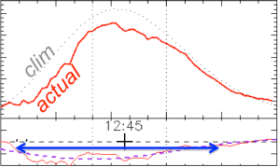
Timing of the Sea Breeze
July 7 2010
July 21 2010
Weak
Deep
SB
Synoptic
רוחות חלשות
Lensky and Dayan, ACP 2012
Timing of the SB: 11:00, 13:00, 15:00.
Notes:
By just using LST and its deviation from its climatological value SB is detectable.
July 7 is characterized by weak winds and the SB pixels are quite clear.
In July 21, the EM is affected by strong winds advecting cool air onshore which are the synoptic pixels. The white color indicates the region after removing these pixels leaving the region with the SB pixels only.

Slide 37
Atmospheric scales
Scale | Example |  | temporal | spatial
Micro | building |  | min | meters
Topo | valley |  | hours | Few km
Meso | country |  | < 1 day | 10-100 km
Synoptic | continent |  | Few days | 500-5000 km
Global | planet |  | > weeks

Slide 38
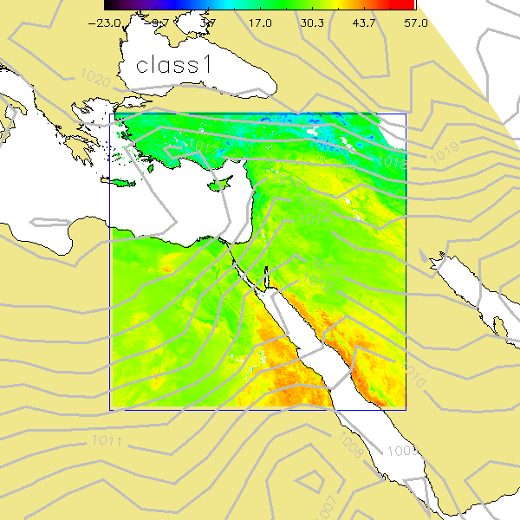
surface temperature patterns induced by synoptic circulation over the Eastern Mediterranean

Slide 39
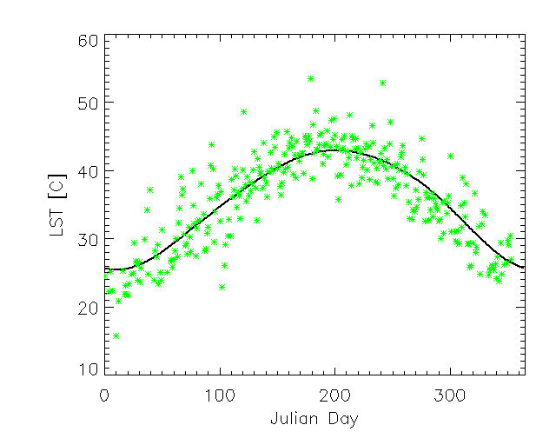
the seasonal & diurnal cycles,
LST is controlled by:
10:30 LT
seasonality
2400 X 2400 1km pixels
MODIS 10:30 LT LST product

Slide 40
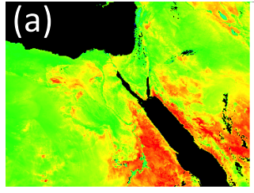
the seasonal & diurnal cycles,
topography, land cover, mineralogy
LST is controlled by:
LST
Oct 10
2000
2400 X 2400 1km pixels
MODIS 10:30 LT LST product

Slide 41
the seasonal & diurnal cycles,
topography, land cover, mineralogy and
circulation
Seasonality masks the effect of circulation on LST
LST is controlled by:
10:30 LT
circulation
positive anomaly
seasonality
circulation
negative anomaly
2400 X 2400 1km pixels
MODIS 10:30 LT LST product

Slide 42
The anomaly removes the effects of:
seasonality, topography, land cover, and mineralogy
a
b
c=a-b
Actual
Oct 10
2000
Climatological
Oct. 10
2000-12
anomaly
Oct. 10
2000

Slide 43
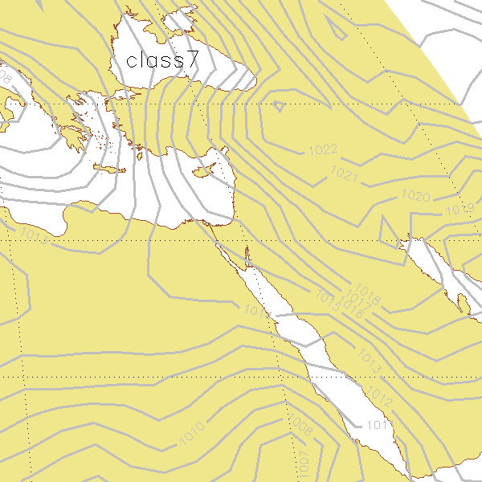
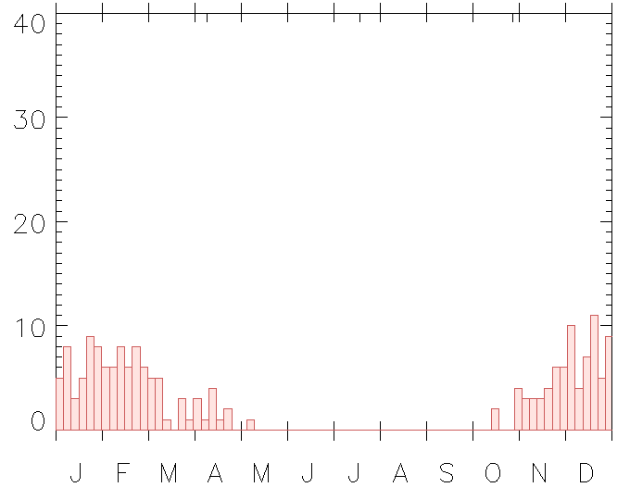
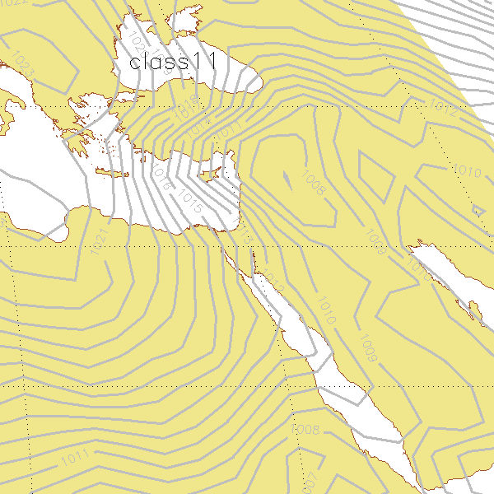
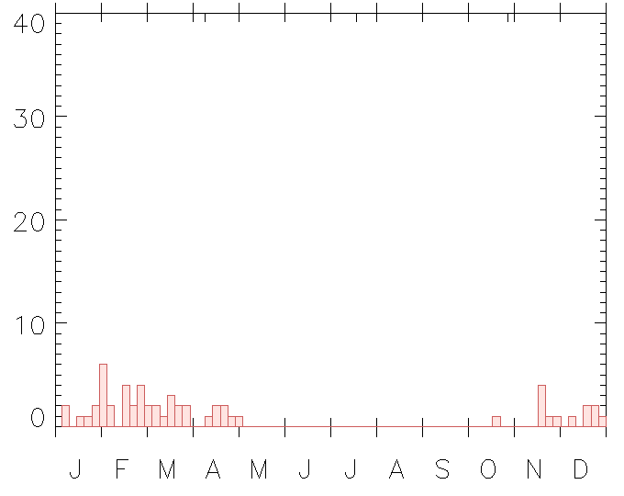
Synoptic effect on LST in the same season (winter)
Synoptic category | days
Red Sea Trough with eastern axis | 558
Red Sea trough with western axis | 56
Red Sea trough with central axis | 263
Weak Persian trough | 674
Median Persian trough | 379
Deep Persian trough | 163
high to the east | 184
high to the west | 627
high to the north | 372
high over Israel | 298
deep low to the east | 56
deep Cyprus low to the south | 4
shallow Cyprus low to the south | 15
deep Cyprus low to the north | 35
shallow Cyprus low to the north | 148
cold low to the west | 29
shallow low to the east | 232
sharav low to the west | 35
sharav low over Israel | 23
H
184
Winter
56
L
SLP 12 UTC (2000-2012)

Slide 44
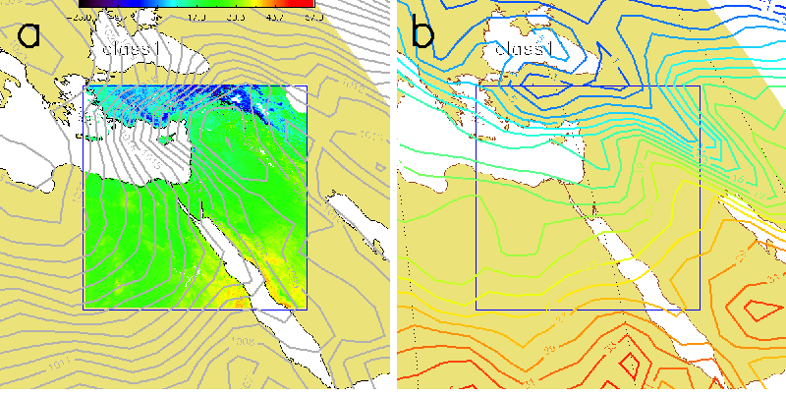
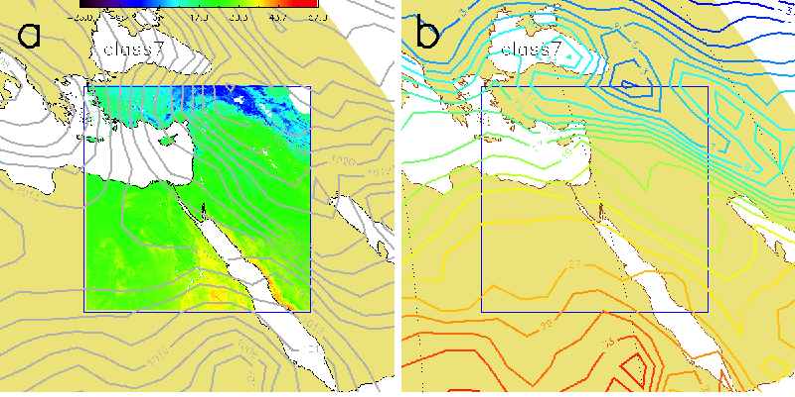
Winter – The effect of seasonality
LST (MODIS)
T₉₉₅ (NCEP/NCAR)
Deep Low to the east
Mean
High to the east
Lensky and Dayan, IJoC 2014

Slide 45
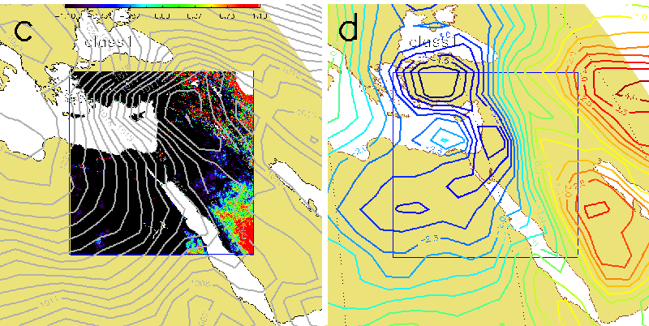
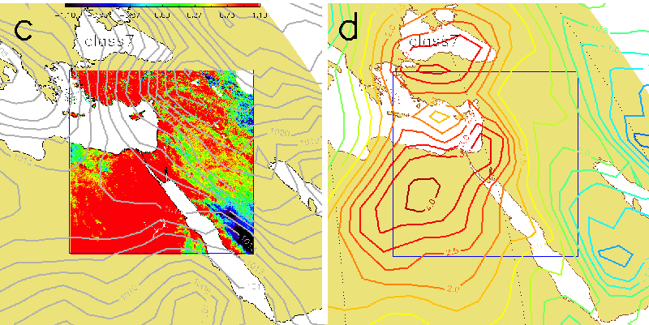
Winter – The effect of synoptics
LST (MODIS)
T₉₉₅ (NCEP/NCAR)
Deep Low to the east
Anomaly
High to the east
Lensky and Dayan, IJoC 2014

Slide 46
Atmospheric scales
Scale | Example |  | temporal | spatial
Micro | building |  | min | meters
Topo | valley |  | hours | Few km
Meso | country |  | < 1 day | 10-100 km
Synoptic | continent |  | Few days | 500-5000 km
Global | planet |  | > weeks

Slide 47
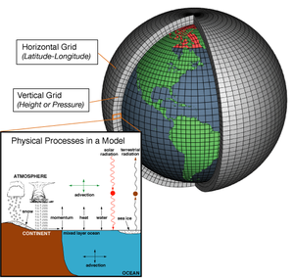
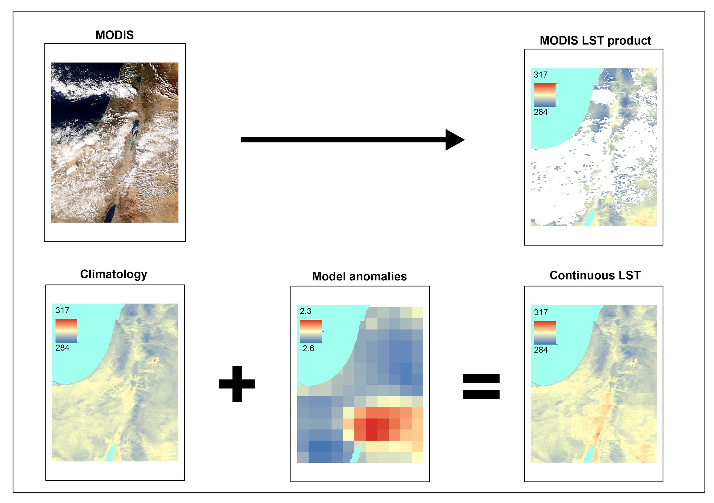
combining MODIS & CFSv2 data
combining 1 km resolution MODIS Land Surface Temperature with
25 km Climate Forecast System Version 2 (CFSv2) modeled surface temperature
to provide continuous LST at a spatial resolution of 1 km in cloudy pixels
MODIS
CFSv2

Slide 48
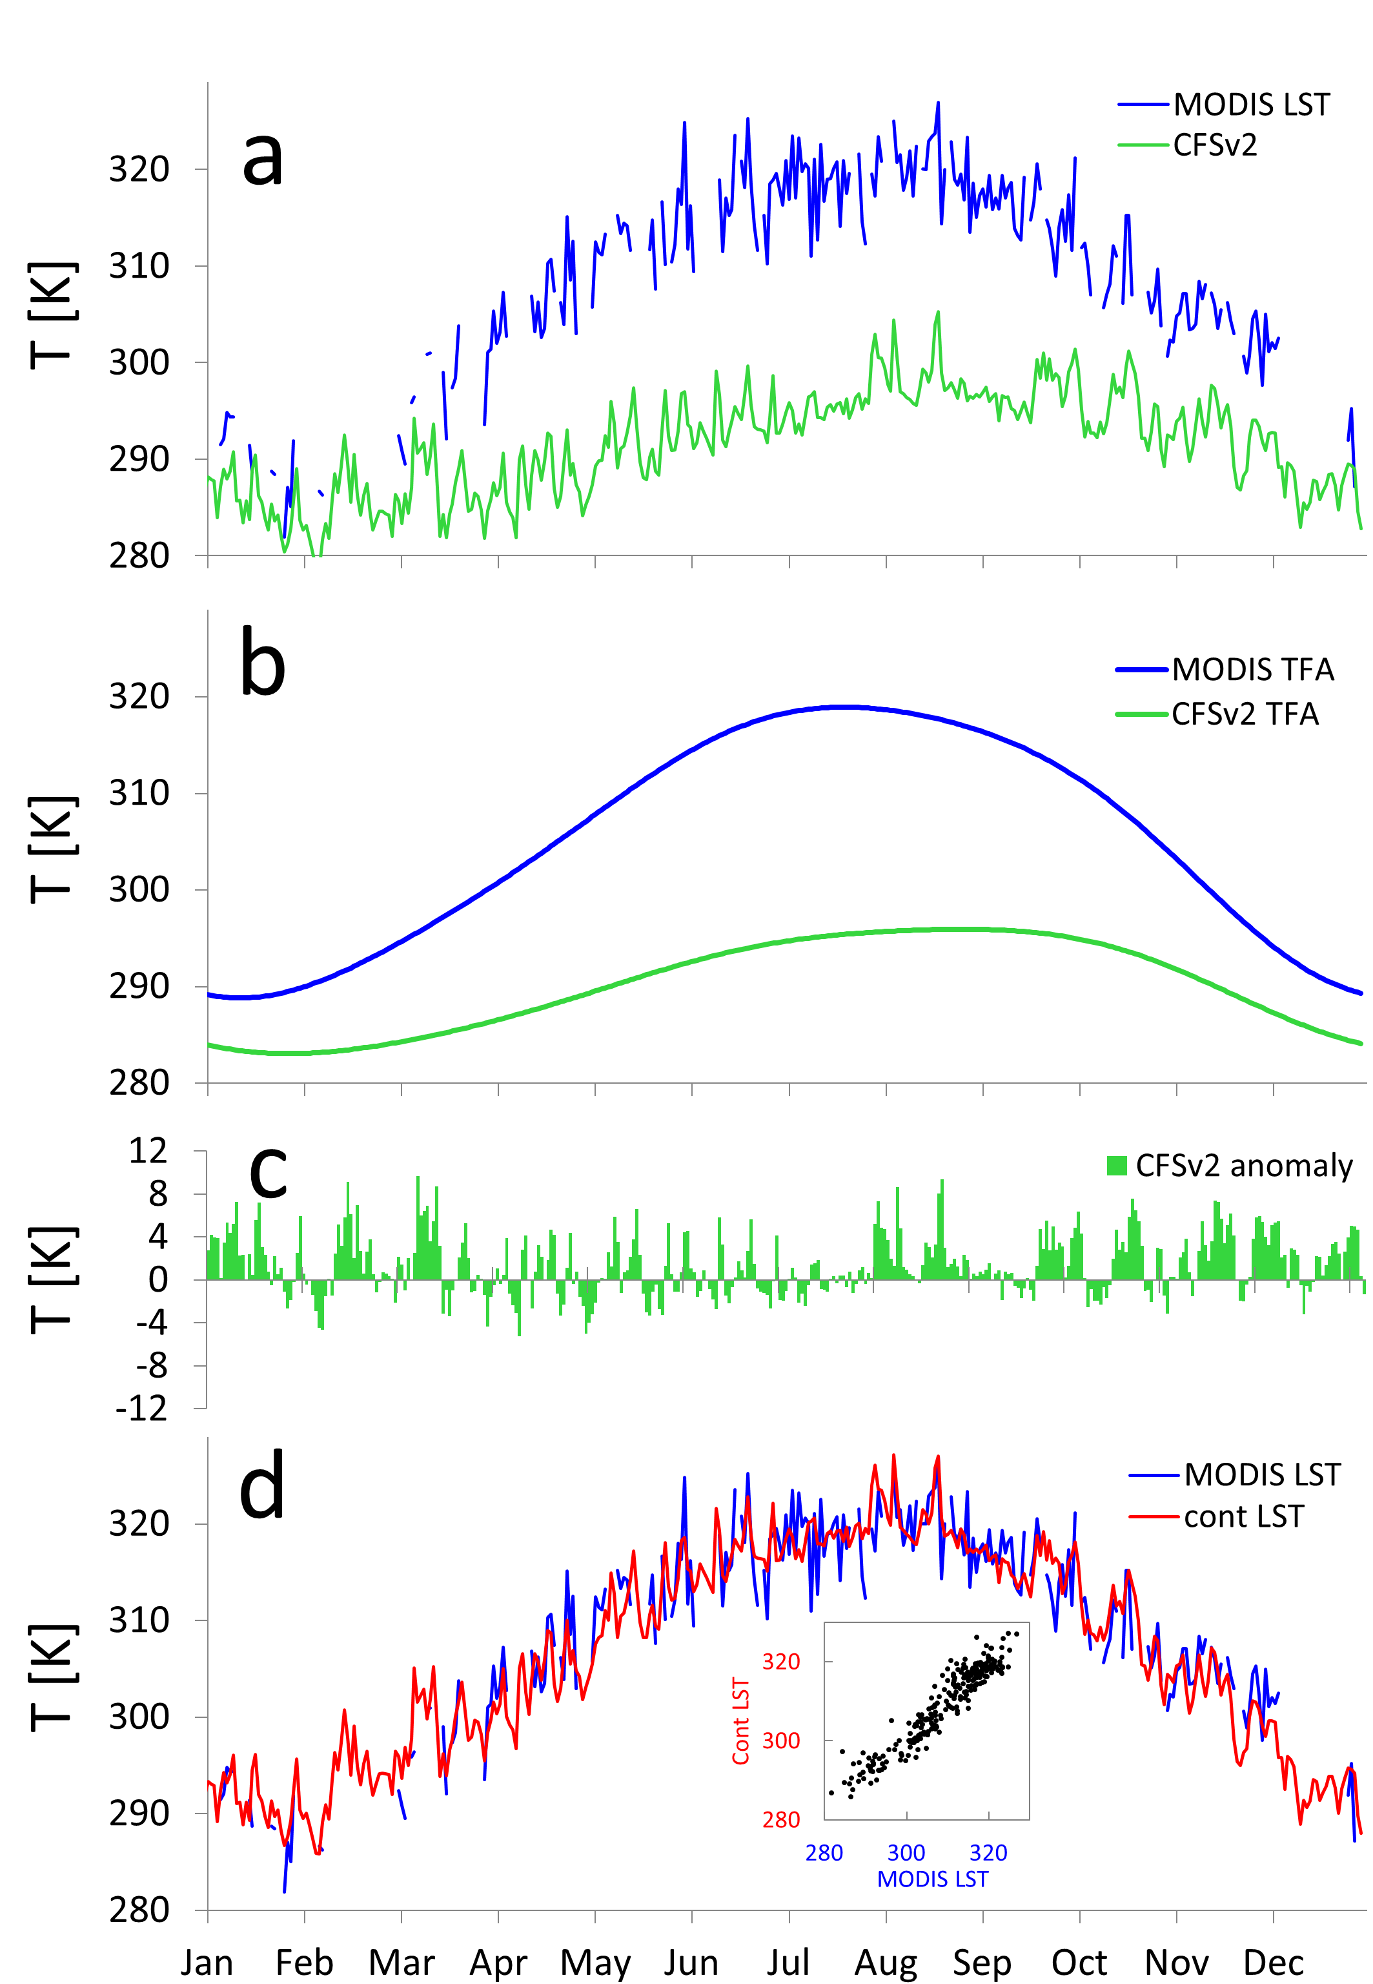
MODIS
CFSV2

Slide 49
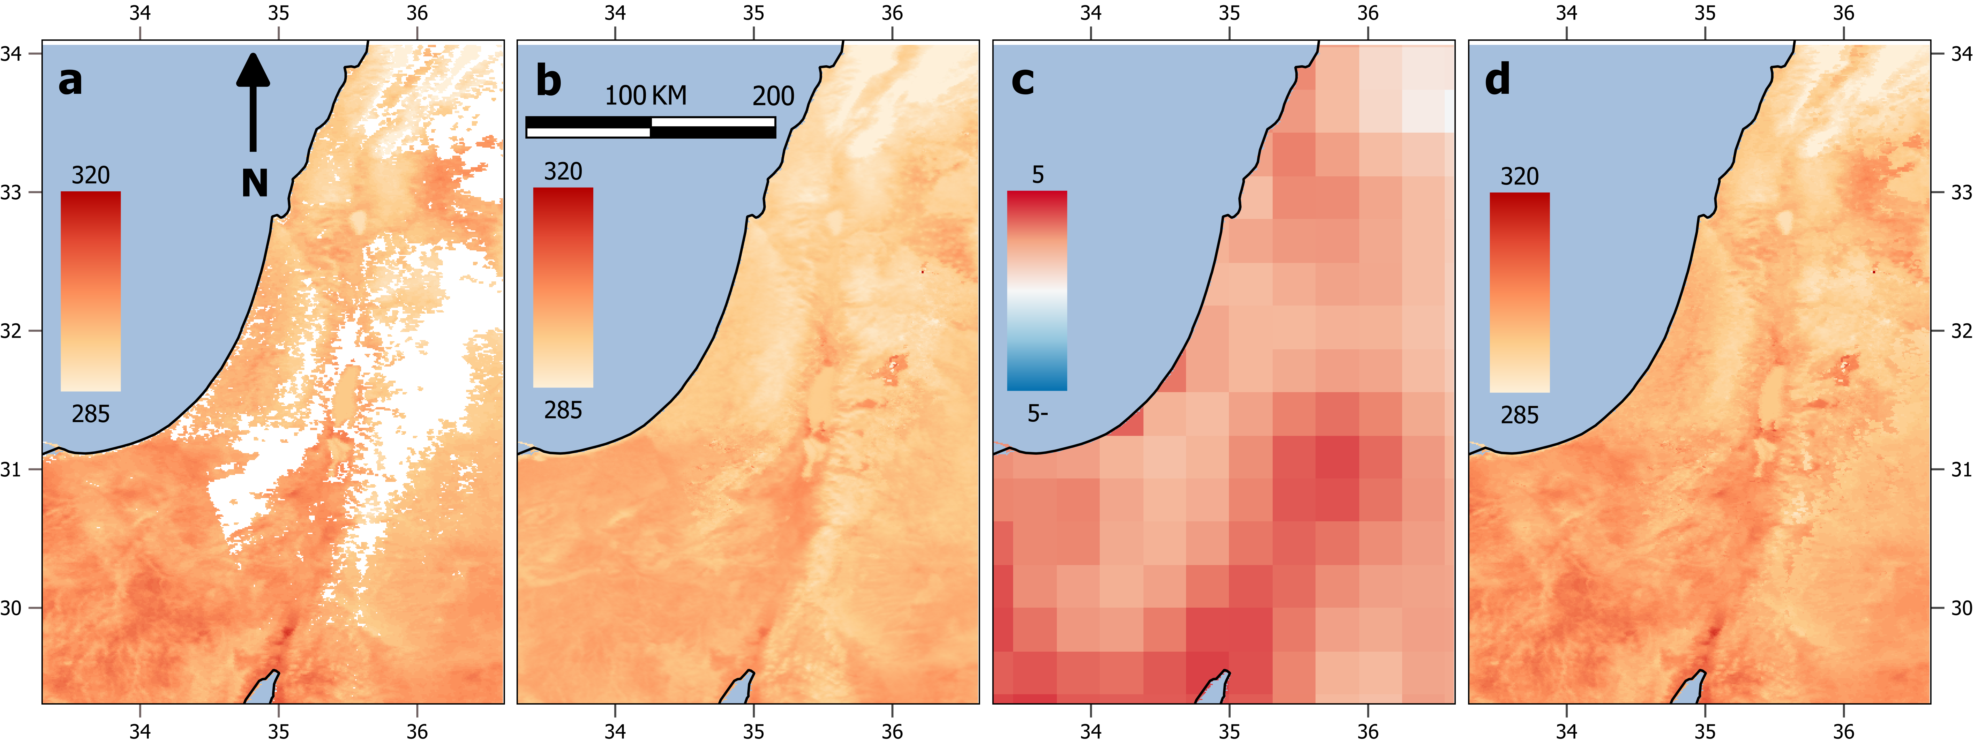
High to the east
Observation
MODIS LST
Climatology
MODIS TFA LST
Model anomaly
CFSv2
Continuous LST
MODIS + CFSv2

Slide 50
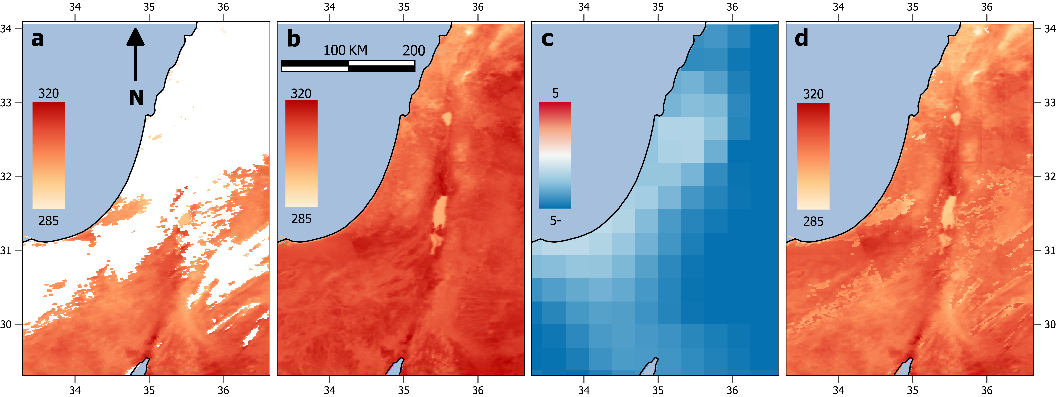
Deep Low to the east
Observation
MODIS LST
Climatology
MODIS TFA LST
Model anomaly
CFSv2
Continuous LST
MODIS + CFSv2

Slide 51
Summary and conclusions
The effect of different atmospheric scales on land surface temperature can be detected from satellite
This together with model data was used to achieve a continuous LST dataset at 1 km resolution
Useful for agricultural planning and management
THANK YOU!

