Slide 1
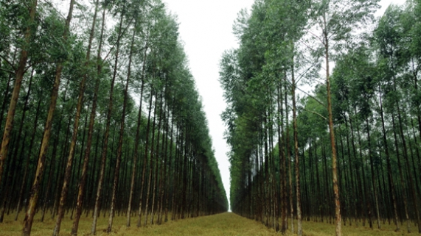
UNIVERSITY OF LISBON
An operational system of fire danger rating over Mediterranean Europe based on fire radiative power derived from Meteosat
Carlos C. DaCamara
with contributions from Miguel M. Pinto, Sílvia A. Nunes and Ricardo M. Trigo
5th SALGEE Workshop 2017, Yerevan (Armenia), Ani Plaza Hotel, 18 – 20 September 2017

Slide 2
Introduction
Wildfires have been identified as the most important threat to forests in Mediterranean Europe that is regularly affected by large and destructive events.
These weather-related hazards represent a serious problem to modern societies, with great negative impacts at social, economic and ecological levels and causing significant human casualties.
A striking illustration of the magnitude of the problem is provided by the recent tragic episode of June 17, 2017, that took place in central Portugal at Pedrógão Grande-Góis; with an official death toll of 64 people, the fire involved more than 1 000 fire fighters, destroyed almost 500 buildings and burned a continuous patch of more than 42 000 ha in one week.

Slide 3
Fires in Mediterranean Europe
According to the last report issued in 2016 by the European Commission, during the period 1980-2015 the five Southern Member States (Portugal, Spain, France, Italy and Greece) were affected by a total of 1 751 067 fires that burned 16 121 036 ha, corresponding to an yearly average of 48 641 fires and a burned area average of 447 807 ha per year.

Slide 4
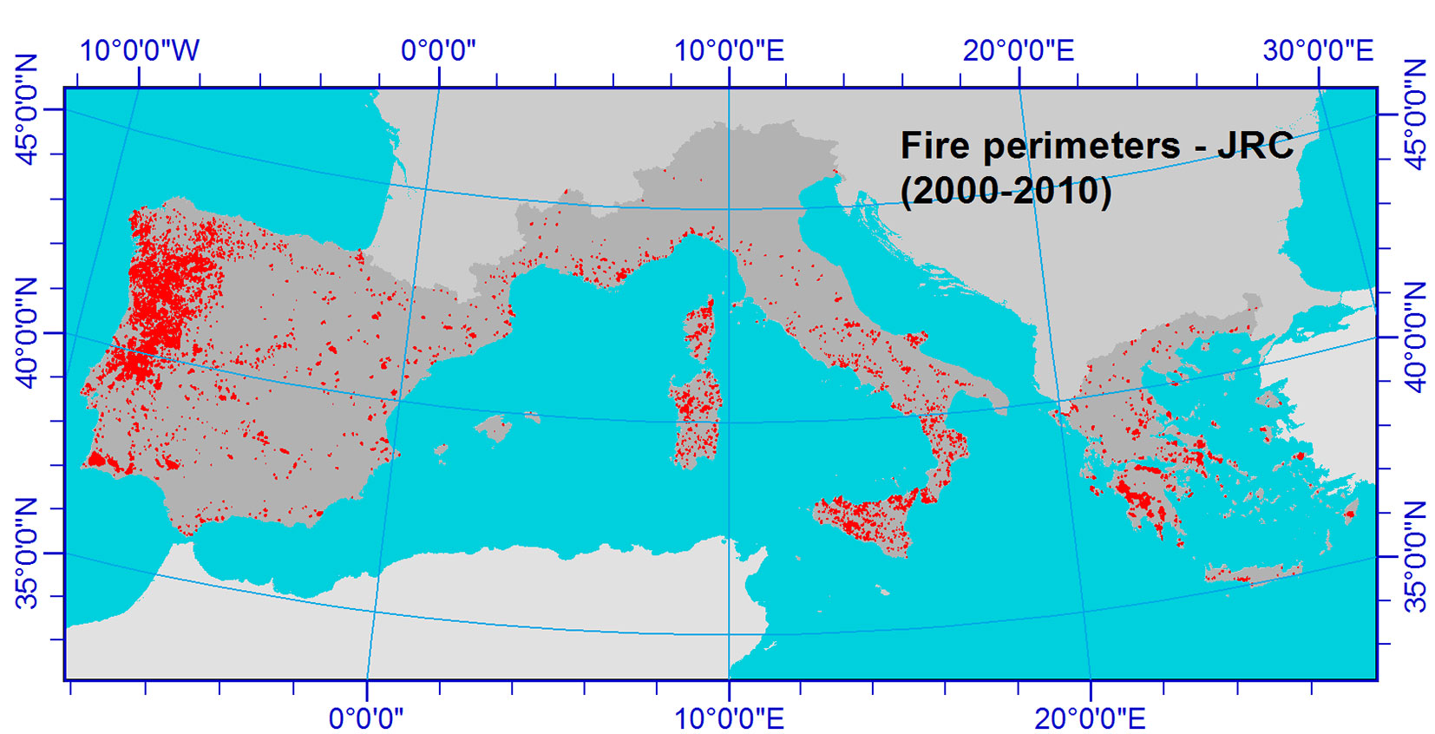
Fire Perimeters (2000-2010) – JRC
(Koutsias et al. 2015)

Slide 5
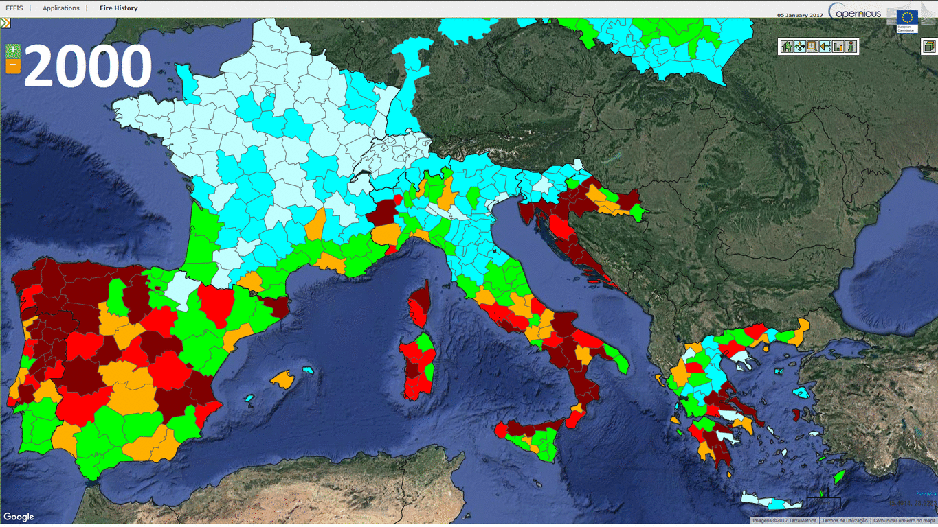
Burned areas (2000-2013) – EFFIS

Slide 6
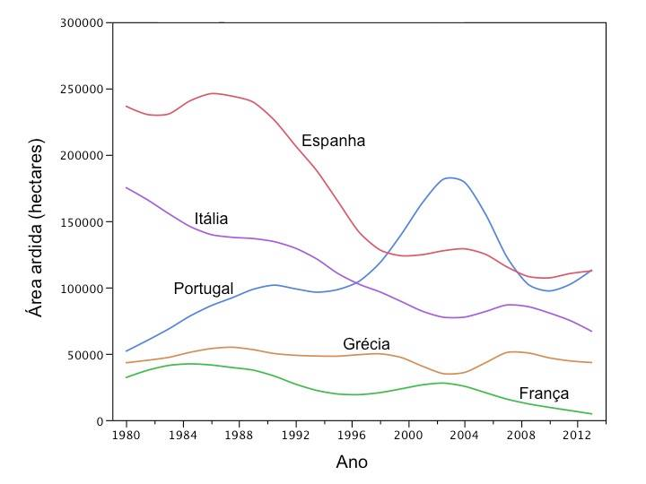
Burned areas (1980-2013) – EFFIS
Burned area (ha)

Slide 7
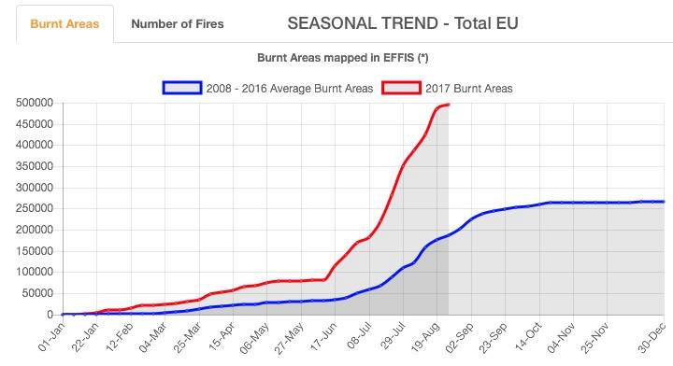
Burned areas (2008-2016) – EFFIS
The burned area in 2017 is about half a million hectares (a typical amount in the 1980’s.
Portugal has contributed with 200 thousand hectares, which represent 40 % of the total.

Slide 8
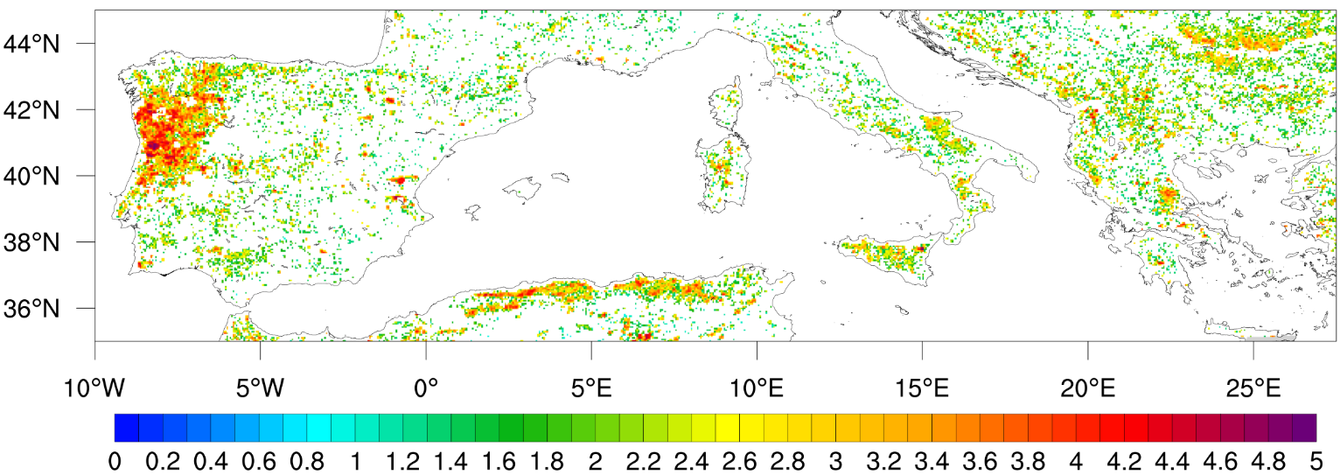
Fire Radiative Energy 2010-2016 – FRP product, LSA SAF
decimal logarithm of energy (in GJ)

Slide 9
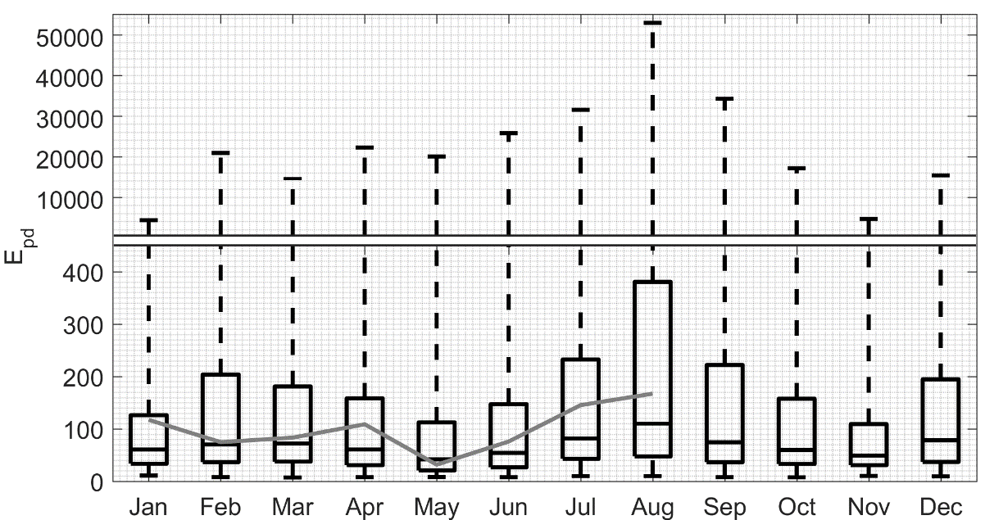
Daily Fire Radiative Energy per MSG pixel 2010-2016 – FRP product, LSA SAF
2017

Slide 10
The role of meteorology
This proneness of Mediterranean Europe to be affected by fire is linked to its climate characterized by rainy and mild winters followed by warm and dry summers.
A severe fire season is often triggered by a wetter-than usual winter that increases the amount of fuel, followed by a warmer and drier than average spring that leads to higher levels of vegetation stress.
Extreme weather conditions in summer (high temperature, strong wind, low fuel moisture and low relative humidity) are a key factor in the ignition and spread of large wildfires.

Slide 11
Meteorological Fire Danger
The role played by meteorological factors in the occurrence of severe fire episodes is conveniently assessed by means of indices of meteorological fire danger that rate the likelihood of a fire event.
The Fire Weather Index (FWI) that is part of the Canadian Forest Fire Weather Index System (CFFWIS) provides a numeric rating of fire intensity and is particularly suitable as a general index of meteorological fire danger, in particular for the ecosystems of Mediterranean Europe.

Slide 12
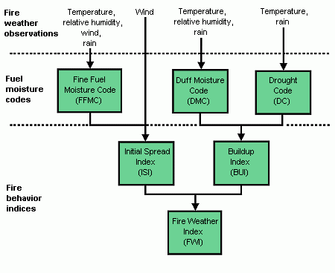
The Canadian Forest Fire Weather Index System (CFFWIS)

Slide 13
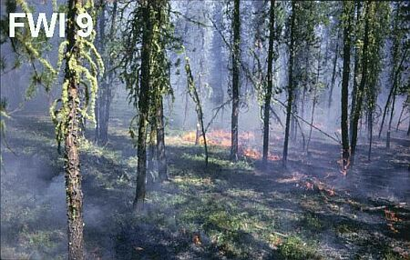
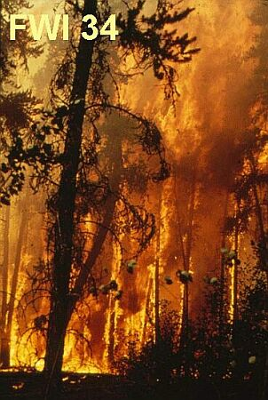
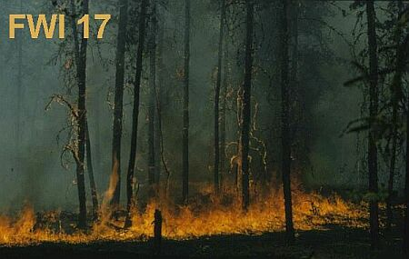
Frontline intensity of fire, (kW/m)
R w
FWI
I_{B} =
2
Speed of propagation, m/h
Fuel consumption, t/ha
Example:
R = 360 m/h
w = 25 t/ha
I_{B} = 4500 kW/m
ISI
BUI

Slide 14
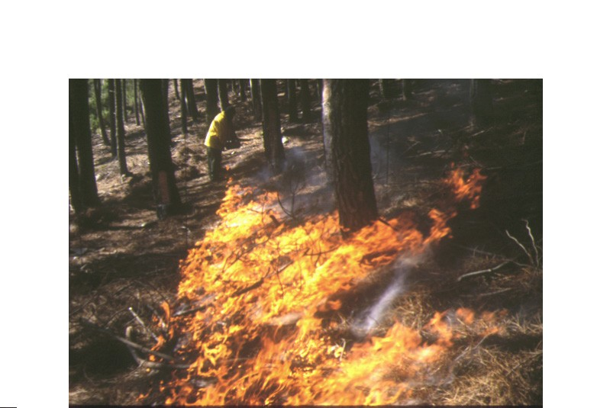
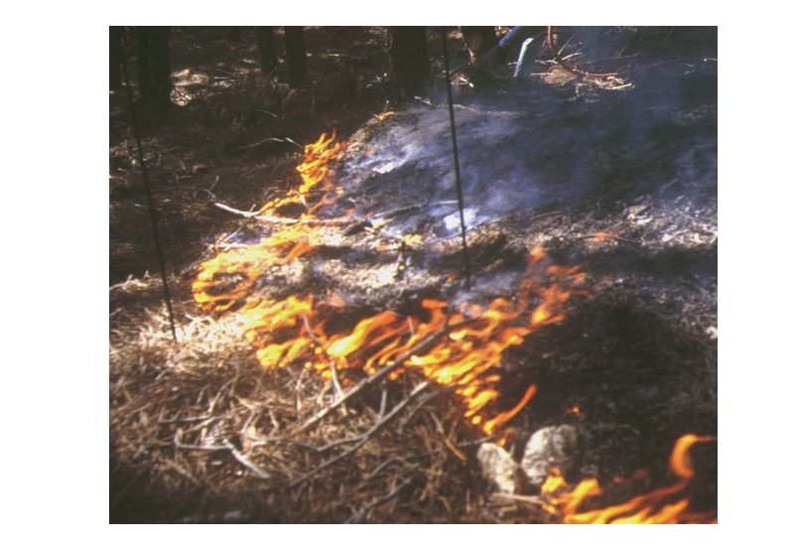
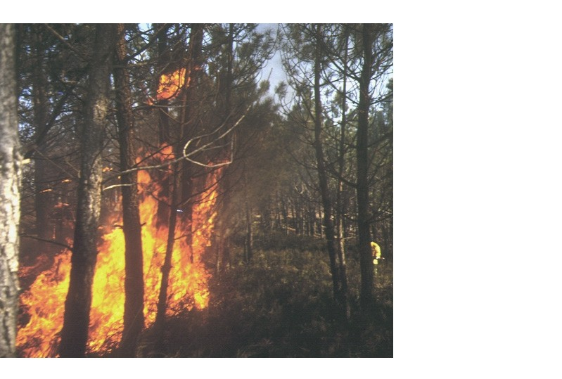
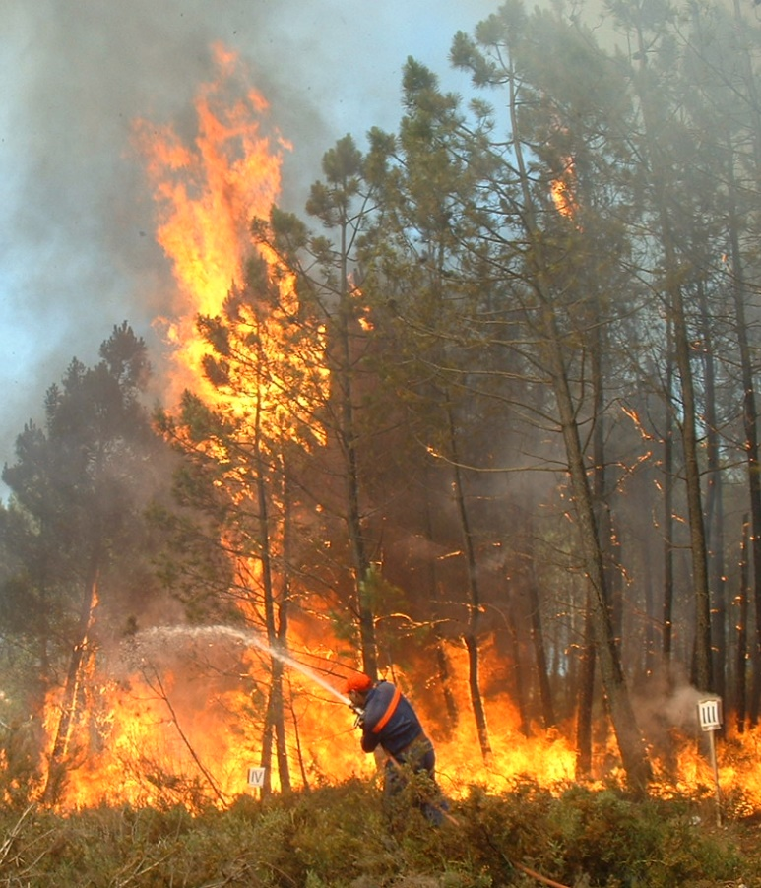
I_{B} =17 kW/m
I_{B} =243 kW/m
I_{B} =1250 kW/m
I_{B} = 11 040 kW/m
I_{B} = 67 500 kW/m
I_{B} = 3675 kW/m
Notes:
14

Slide 15
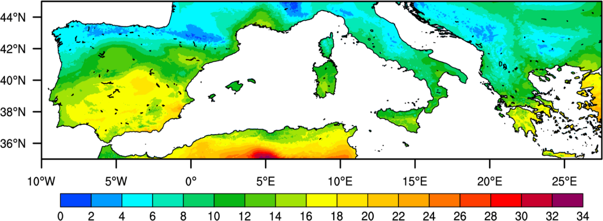
FWI 1979-2014 – ERA Interim, ECMWF

Slide 16
Aim of the work
FWI was specifically designed for the Canadian forest and therefore should be calibrated to the vegetation cover and meteorological conditions over the Mediterranean region.
We present a methodology to assess fire danger based on the estimation of the probability of exceedance of predefined thresholds of daily released energy by active fires as derived from satellite observations of fire radiative power.

Slide 17
Rationale
The procedure involves estimating static and daily probabilities of exceedance of daily energy released by fires occurring at the pixel level. Static probability at a given pixel is estimated by the ratio of the number of daily fire occurrences releasing energy above a given threshold to the total number of occurrences inside a cell centered at the point. Daily probability takes into account meteorological factors by means of the Canadian Fire Weather Index (FWI) and is estimated using a Daily Model based on a Generalized Pareto distribution with static probability and FWI as covariates of the scale parameter. Five classes of fire danger are then associated to daily probability estimated by the Daily Model.

Slide 18
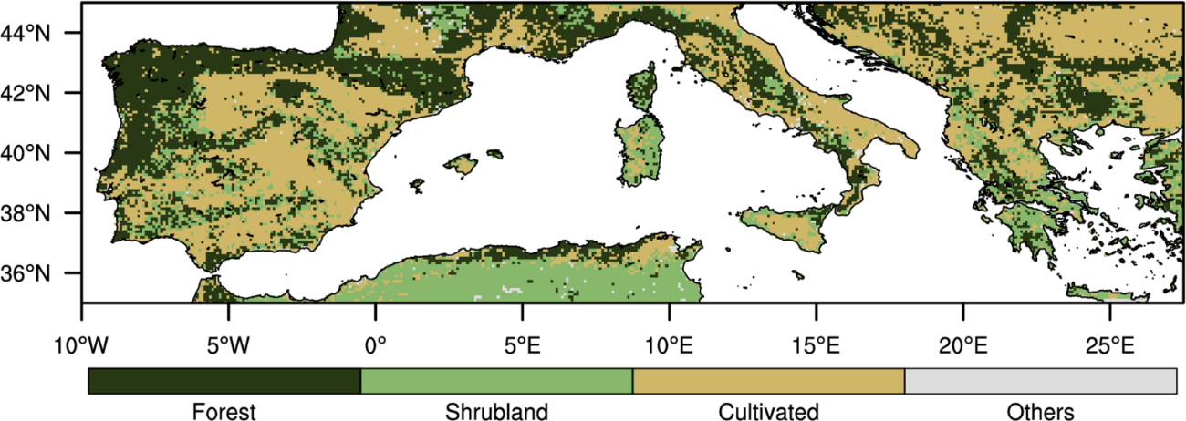
Types of vegetation cover/land use – GLC2000

Slide 19
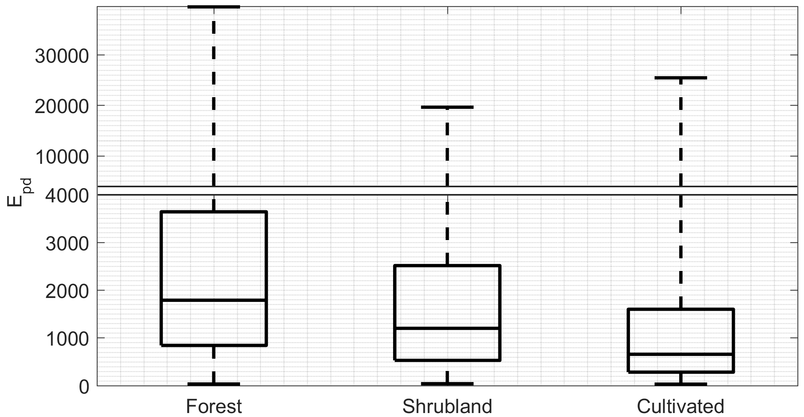
Daily Fire Radiative Energy per MSG pixel (2010-2016) – according to types of Types of vegetation cover/land use

Slide 20
How to estimate probability of exceedance?
Forest
Shrubland
Cultivated
Daily Energy
FWI*
Static Probability
P(2000 GJ | 0 GJ)
Daily Probability
P(2000 GJ | 200 GJ)
Notes:
0->The follow-up question is how to estimate the probability of exceedance?
1-> The first step is to define the static probability which will use information from vegetation and energy.
2-> The second step is to define the daily probability which uses information from energy, FWI* and also the static probability.
3-> We shall notice that whereas the static probability is fixed for all the years, the daily probability varies each day provided the meteorological conditions. Also, daily probability keeps indirectly information about the vegetation by means of the static probability.
4-> Now let’s have a look at the methodology used to compute these two variables.

Slide 21
Forest
Static Probability
P(2000 GJ | 0 GJ)
Shrubland
Cultivated
i
j
Notes:
1-> Starting with static probability: The grid represents a set of pixels coloured acoording to the vegetation category they belong. For each pixel i j a window of initial size delta is considered.

Slide 22
Forest
Static Probability
P(2000 GJ | 0 GJ)
Shrubland
Cultivated
i
Pixels used in the computation are restricted to those matching the vegetation class of pixel (i, j).
j
$$δ=0.7°$$
Notes:
1-> Next we will only consider the pixels belonging to the same vegetation category of the central pixel.

Slide 23
Forest
Static Probability
P(2000 GJ | 0 GJ)
Shrubland
Cultivated
i
Daily Energy
$S_{p}\left(0.7°,0\right)>100$ (?)
j
$$δ=0.7°$$
$$P_{p}\left(2000 | 0\right)=\frac{S_{p}\left(0.7°,2000\right)}{S_{p}\left(0.7°,0\right)}$$
Notes:
1-> Finally we consider the fires observed in those pixels for the period 2010-2016.
2-> The static probability is then given, in this case, by the ratio between number of fires exceeding 2000 GJ by the total number of fires.
3-> There’s only an additional condition: If the total number of fires is less than a hundred, the window size is increased until the condition is met. This process is repeated for all i j pixels.
4-> The result is represented by the following map which shows

Slide 24
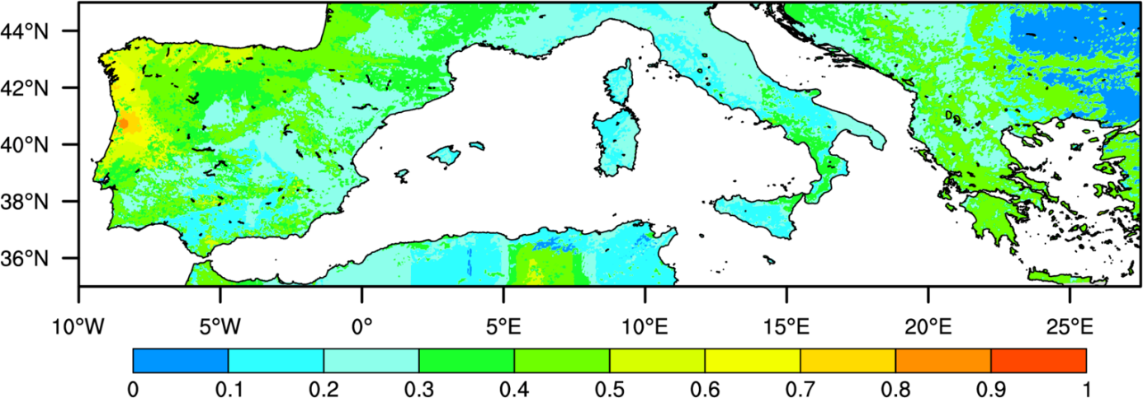
Static probability of exceedance of 2000 GJ

Slide 25
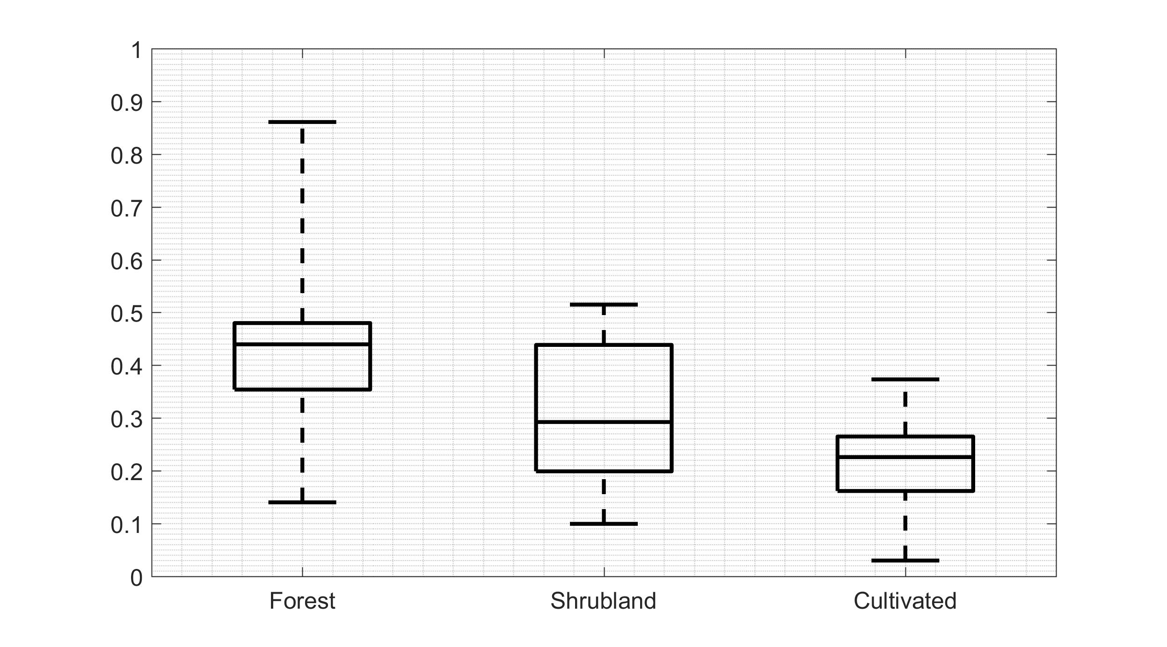
Static probability of exceedance of 2000 GJ – according to types of Types of vegetation cover/land use

Slide 26
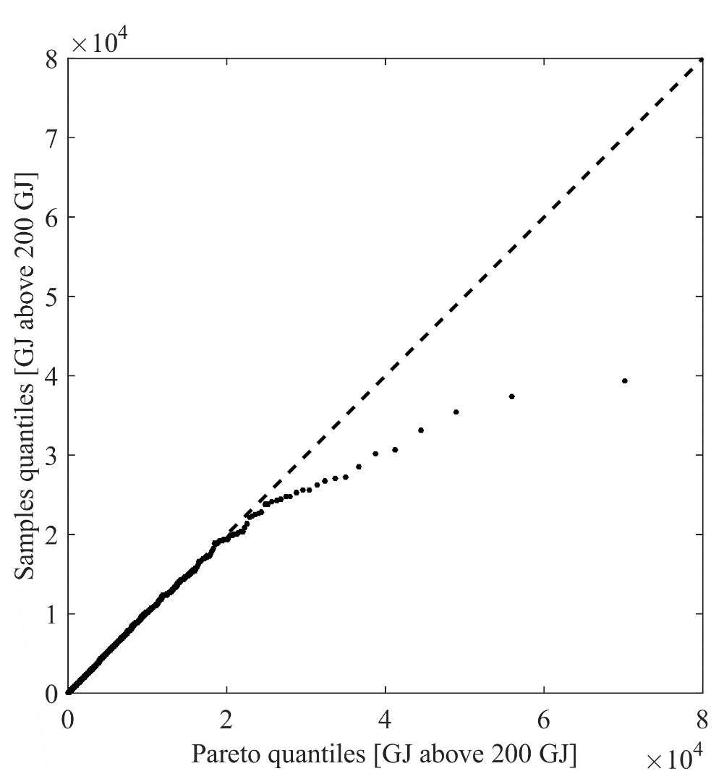
Null model
P(2000 GJ | 200 GJ)
Sample Size [%] | $α$ [95% CI] | $σ$ [95% CI] | CL
$$5630 [93\%]$$ | $$0.30 [0.26, 0.33]$$ | $$1719 [1647, 1794]$$ | $$58\%$$
shape
$$G\left(ΔE | α,σ\right)=1−{\left(1+\frac{α}{σ}ΔE\right)}^{−\frac{1}{α}}$$
Sample quantiles [GJ above 200 GJ]
scale
Exceedances above 200 GJ follow a GP distribution.
Pareto quantiles [GJ above 200 GJ]
Notes:
1-> Regarding the daily probability, to start with, it’s observed that released energy observations follow a generalized pareto distribution.
2-> The GP distribution has a shape parameter alfa and a scale parameter sigma.
3-> The quantile-quantile plot allows to evaluate visually the goodness of fit that has been also evaluated robustly with Anderson-Darling test.
4-> It was then observed that both FWI* and static probability show a linear dependence with scale parameter sigma.

Slide 27
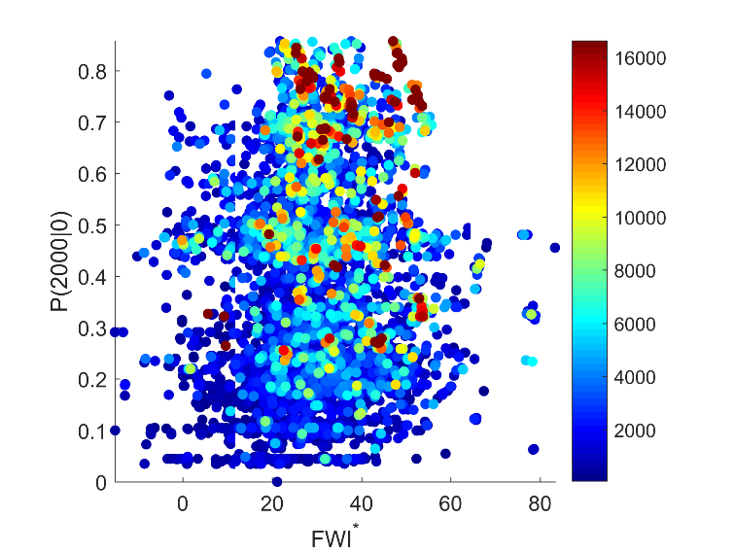
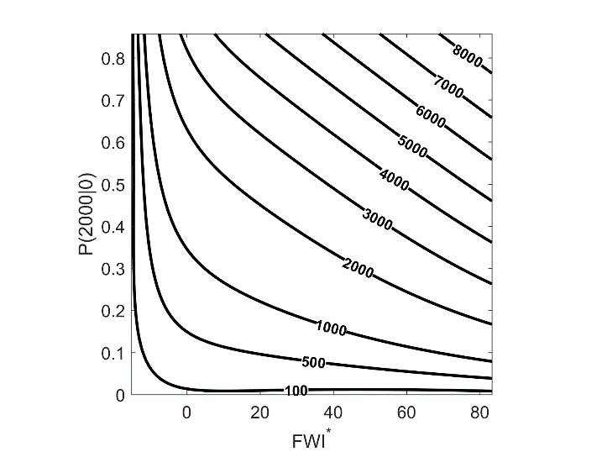
Daily model
P(2000 GJ | 200 GJ; P(2000|0), FWI*)

Slide 28
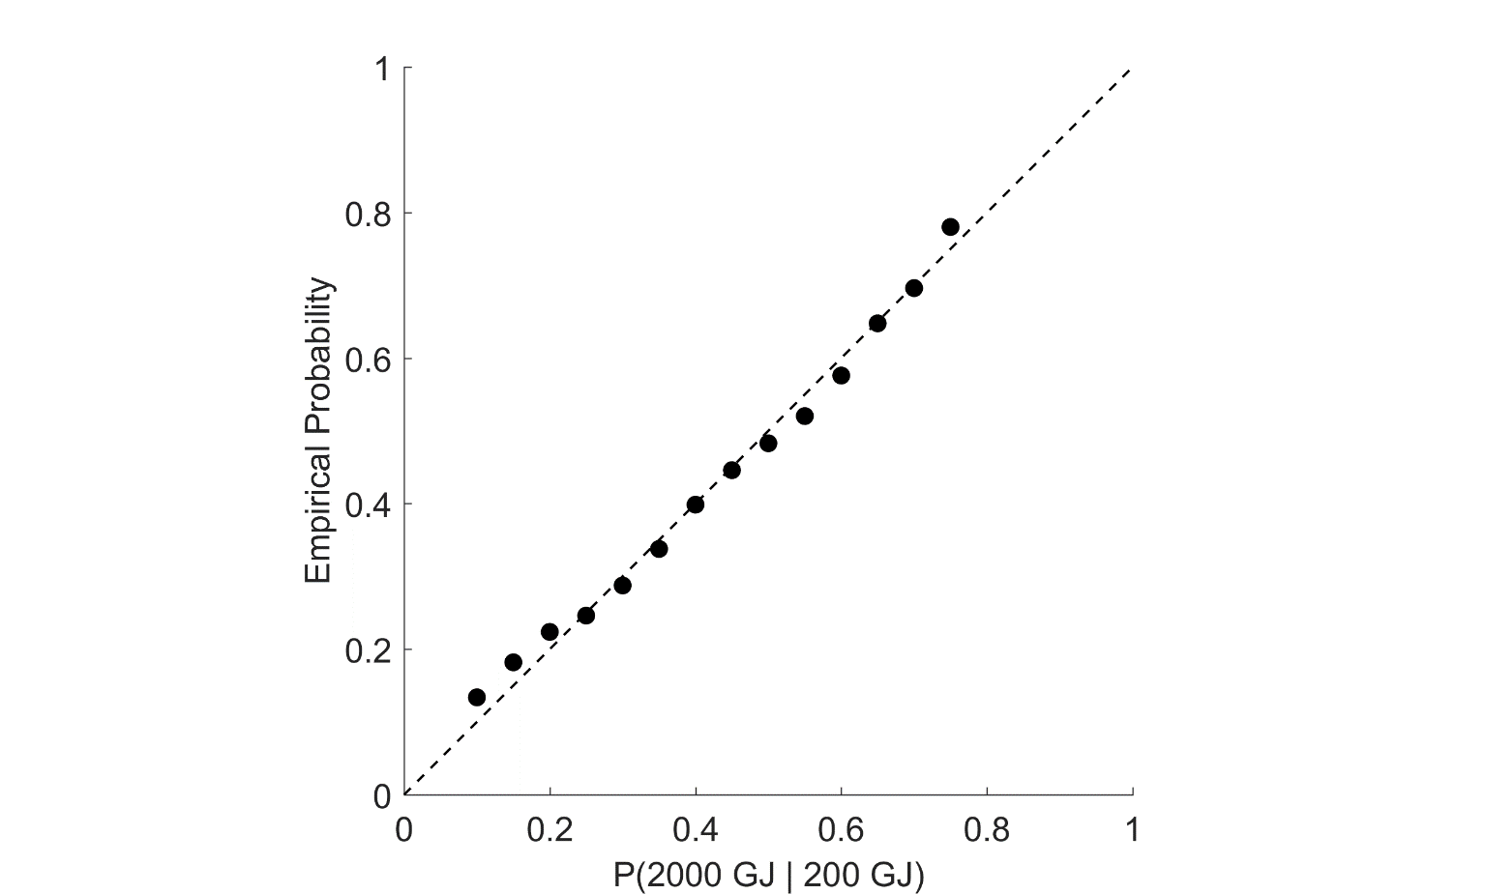
Daily model
P(2000 GJ | 200 GJ; P(2000|0), FWI*)

Slide 29
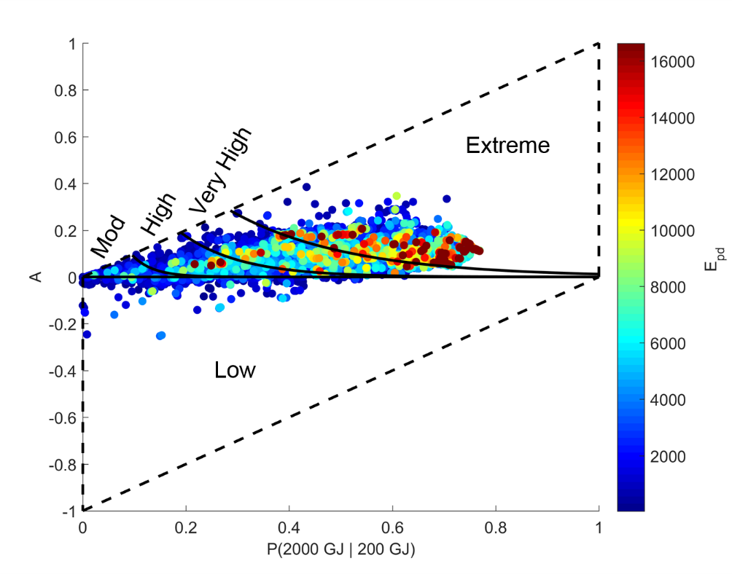
Classes of Fire Danger

Slide 30
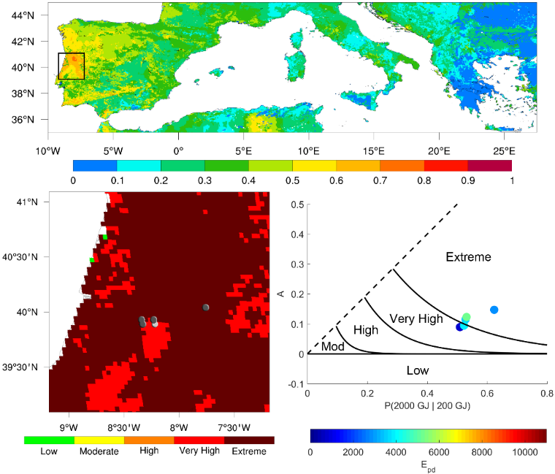
June 18, 2017

Slide 31
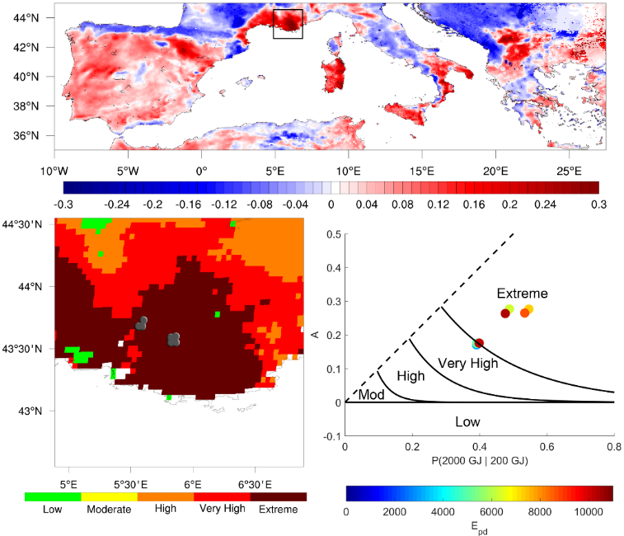
July 25, 2017

Slide 32
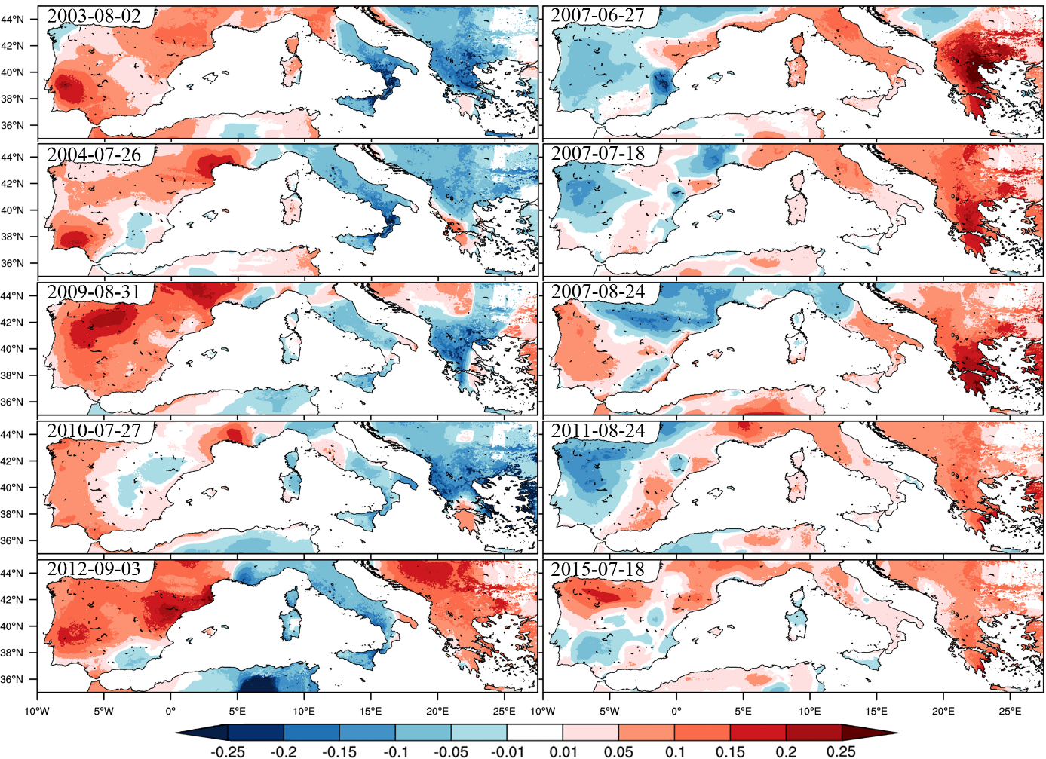
Notes:
1-> These maps show the anomaly of daily probabilty for 10 different cases. Here we can see the days when Portugal requested assistance to Europe to fight the wildfires, on the left, and when Greece requested assistance on the right.
2-> Indeed the anomalies of probability are particularly higher in the affected regions. For example, in the top right pannel, valid for 27 june 2007, the anomalies have exceeded the 25% in some regions of Greece.

Slide 33
Performance assessment & validation
Performance of the Daily Model is assessed by comparing during the calibration period (2010–2016) the distributions of events among the classes of fire danger for the three ranges of energy with those obtained when using the LSA SAF and the EFFIS products.
Validation involves applying the Daily Model to the validation period (January–August 2017).

Slide 34
 | Energy [GJ] | Low | Moderate | High | Very High | Extreme | Total
Daily Model | < 2000 | 367 [10] | 531 [14] | 1102 [29] | 1070 [28] | 714 [19] | 3784 [100]
 | 2000–10000 | 69 [3] | 52 [3] | 315 [15] | 669 [33] | 948 [46] | 2053 [100]
 | > 10000 | 0 [0] | 0 [0] | 7 [3] | 41 [19] | 168 [78] | 216 [100]
LSA-SAF | < 2000 | 98 [3] | 219 [6] | 1417 [37] | 1513 [40] | 537 [14] | 3784 [100]
 | 2000–10000 | 19 [1] | 53 [3] | 475 [23] | 1080 [52] | 426 [21] | 2053 [100]
 | > 10000 | 0 [0] | 0 [0] | 17 [8] | 119 [55] | 80 [37] | 216 [100]
EFFIS | < 2000 | 101 [3] | 181 [5] | 1248 [33] | 1419 [37] | 835 [22] | 3784 [100]
 | 2000–10000 | 32 [2] | 66 [3] | 720 [35] | 708 [34] | 527 [26] | 2053 [100]
 | > 10000 | 1 [1] | 5 [2] | 58 [27] | 70 [32] | 82 [38] | 216 [100]
Conditional probability of having a large release of energy (> 10 000 GJ) given Extreme danger:
Daily model: 168/1830 = 9.1 %
LSA SAF: 80/1043= 7.7 %
EFFIS: 82/1444 = 5.7 %
Conditional probability of having a small release of energy (< 2 000 GJ) given Low danger:
Daily model: 367/436 = 84.2 %
LSA SAF: 98/117 = 83.8 %
EFFIS: 101/134 = 75.4%

Slide 35
Validation (Jan–Aug 2017)
 | Energy [GJ] | Low | Moderate | High | Very High | Extreme | Total
Daily Model | < 2000 | 1 [0] | 54 [6] | 239 [25] | 460 [49] | 183 [20] | 937 [100]
 | 2000–10000 | 3 [0] | 5 [1] | 103 [13] | 374 [49] | 283 [37] | 768 [100]
 | > 10000 | 0 [0] | 0 [0] | 1 [1] | 48 [33] | 97 [66] | 146 [100]

Slide 36
Performance for Portugal (2010–2016)
 | Energy [GJ] | Low | Moderate | High | Very High | Extreme | Total
Daily Model | < 2000 | 32 [4] | 0 [0] | 36 [4] | 336 [41] | 411 [51] | 815 [100]
 | 2000–10000 | 3 [0] | 0 [0] | 14 [2] | 291 [31] | 629 [67] | 937 [100]
 | > 10000 | 0 [0] | 0 [0] | 0 [0] | 23 [15] | 132 [85] | 155 [100]
LSA-SAF | < 2000 | 6 [1] | 40 [5] | 189 [23] | 472 [58] | 108 [13] | 815 [100]
 | 2000–10000 | 0 [0] | 14 [1] | 129 [14] | 619 [66] | 175 [19] | 937 [100]
 | > 10000 | 0 [0] | 0 [0] | 6 [4] | 99 [64] | 50 [32] | 155 [100]
EFFIS | < 2000 | 16 [2] | 42 [5] | 387 [48] | 281 [34] | 89 [11] | 815 [100]
 | 2000–10000 | 3 [0] | 22 [2] | 420 [45] | 347 [37] | 145 [16] | 937 [100]
 | > 10000 | 0 [0] | 0 [0] | 49 [32] | 58 [37] | 48 [31] | 155 [100]

Slide 37
Performance for Spain (2010–2016)
 | Energy [GJ] | Low | Moderate | High | Very High | Extreme | Total
Daily Model | < 2000 | 19 [4] | 22 [4] | 97 [19] | 226 [44] | 150 [29] | 514 [100]
 | 2000–10000 | 4 [1] | 0 [0] | 23 [7] | 148 [45] | 155 [47] | 330 [100]
 | > 10000 | 0 [0] | 0 [0] | 3 [10] | 11 [35] | 17 [55] | 31 [100]
LSA-SAF | < 2000 | 2 [0] | 20 [4] | 163 [32] | 227 [44] | 102 [20] | 514 [100]
 | 2000–10000 | 0 [0] | 3 [1] | 73 [22] | 165 [50] | 89 [27] | 330 [100]
 | > 10000 | 0 [0] | 0 [0] | 5 [16] | 13 [42] | 13 [42] | 31 [100]
EFFIS | < 2000 | 40 [8] | 30 [6] | 154 [30] | 157 [30] | 133 [26] | 514 [100]
 | 2000–10000 | 21 [6] | 35 [11] | 116 [35] | 83 [25] | 75 [23] | 330 [100]
 | > 10000 | 1 [3] | 2 [6] | 7 [23] | 8 [26] | 13 [42] | 31 [100]

Slide 38
Eastern Europe (17.5°–27.5°E)

Slide 39
Performance for Eastern Europe (2010–2016)
 | Energy [GJ] | Low | Moderate | High | Very High | Extreme | Total
Daily Model | < 2000 | 39 [9] | 180 [41] | 60 [14] | 117 [27] | 42 [9] | 438 [100]
 | 2000–6000 | 11 [9] | 10 [8] | 19 [15] | 52 [41] | 35 [27] | 127 [100]
 | > 6000 | 0 [0] | 1 [3] | 2 [6] | 20 [61] | 10 [30] | 33 [100]
LSA-SAF | < 2000 | 22 [5] | 16 [4] | 154 [35] | 149 [34] | 97 [22] | 438 [100]
 | 2000–6000 | 8 [6] | 2 [2] | 38 [30] | 51 [40] | 28 [22] | 127 [100]
 | > 6000 | 0 [0] | 0 [0] | 8 [24] | 14 [43] | 11 [33] | 33 [100]
EFFIS | < 2000 | 30 [7] | 33 [8] | 223 [51] | 115 [26] | 37 [8] | 438 [100]
 | 2000–6000 | 8 [6] | 4 [3] | 58 [46] | 32 [25] | 25 [20] | 127 [100]
 | > 6000 | 0 [0] | 0 [0] | 15 [46] | 8 [24] | 10 [30] | 33 [100]

Slide 40
Conclusions
A product is proposed that consists of forecasts of fire danger over Mediterranean Europe based on a statistical procedure that combines information about fire history derived from the Fire Radiative Power (FRP) product by the Satellite Application Facility for Land Surface Analysis (LSA SAF) with daily meteorological forecasts provided by the European Centre for Medium-Range Weather Forecasts (ECMWF).

Slide 41
Conclusions
The product derived from the proposed Daily Model mainly differs from LSA SAF and EFFIS products in that the indices of meteorological fire danger are calibrated based on seven years of information about fire radiative power, with a temporal resolution of 15 minutes as derived from the SEVIRI instrument on-board MSG satellites.
Besides providing a solid physical meaning to the approach since energy is a measurable physical property, fire radiative power is also directly related to the amount of fuel burned and smoke production.
Fire radiative power is also useful in fire management and firefighting because it can be used as a proxy of fire line intensity.

Slide 42
Conclusions
Insofar as fire radiative power is derived from remote-sensed information by the same instrument, observations are consistently performed in space and time, an advantage over the traditional approaches where the calibration procedures are performed by means of analyses of fire weather history based on ground observations of amount of burned area or on the number of fire occurrences that are affected by the policy of individual countries and by changes in criteria along time.
A prototype of the proposed procedure is running since April 2017 at Instituto Dom Luiz, Faculty of Sciences, University of Lisbon (http://idlcc.fc.ul.pt/CeaseFire/).

Slide 43
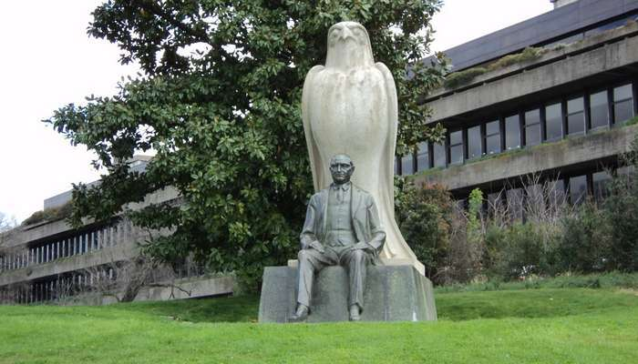
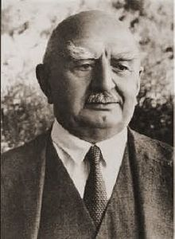
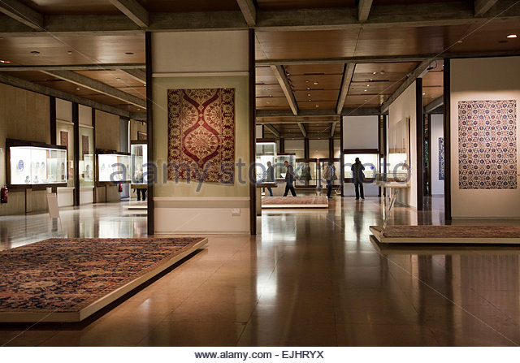
Thank you!
Calouste Gulbenkian (Գալուստ Կիւլպէնկեան)
23 March 1869 – 20 July 1955

