Slide 1
On the study of a heat wave event in Athens, Greece, with synoptic and satellite data
Aristotle University of Thessaloniki, AUTh, Greece
Faculty of Sciences, School of Geology
Department of Meteorology and Climatology
Krystallia Dimitriadou
Physicist BSc
MSc in Meteorology, Climatology and Atmospheric Environment

Slide 2
Overview
Introduction
Definition
Heat waves in Greece
Description of the event
Synoptic Situation and Satellite Data
Consequences
Further Study and Improvements

Slide 3
Introduction: Heat Waves
Heat waves of different intensities and durations occur in the Mediterranean area during summertime. (Prezerakos, 1989; Karakostas and Gawith, 1994)
Impacts in:
ecosystems
human society & human health,
agriculture,
water resources,
energy demand,
regional economies
(Meehl et al., 2000; WHO, 2004)
Extended period of excessively hot weather condition
High levels of humidity.
Linked to the synoptic-scale circulation of the atmosphere.

Slide 4

Heat Waves: Definition
According to the World Meteorological Organization (WMO) a heat wave is defined as the phenomenon during which the daily maximum temperature for at least five consecutive days exceeds the average maximum temperature by 5ºC, considering the period between 1961 and 1990 as the normal measuring period.

Slide 5
Heat Waves in Greece
Criteria:
Tmax ≥ 37 ºC (National Observatory of Athens (NOA), Thission, Athens)
Average daily T ≥31ºC (Thission, Athens).
Tmax ≥ 38 ºC Larissa station (Central Greece)
The temperatures is at least 5º above normal in parts of this area for a period of at least two days or more.
Metaxas and Kallos (1980)

Slide 6
The event
On 26th of June 2007 →Tmax= 44.8 °C (Thission, Athens)
It was the absolute maximum temperature recorded at Thission since 1897 (previous record high of 44.1 °C of July 2000).
In the summer of 2007, the National Health’s Operational Center (NHOC) declared a state of national alert from June 22 to June 28 and from July 23 to 27.
All patients diagnosed with heat exhaustion and heatstroke in the emergency department units, as well as mortality data of heatstroke.

Slide 7
Synoptic Situation over Europe
Synoptic Charts – MSG satellite images
23-26 June 2007

Slide 8
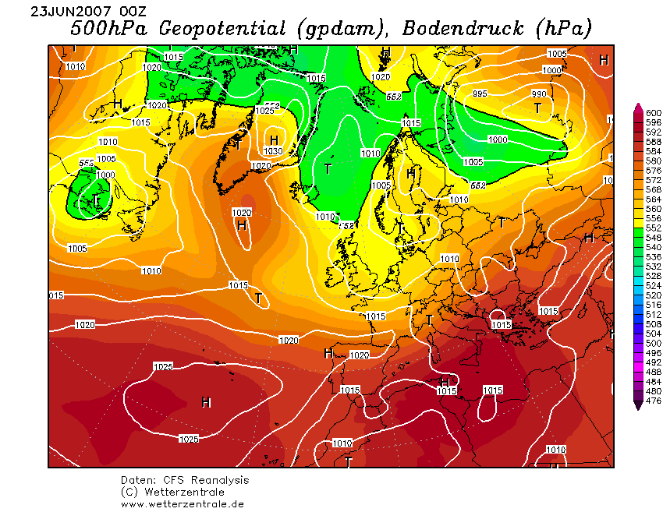
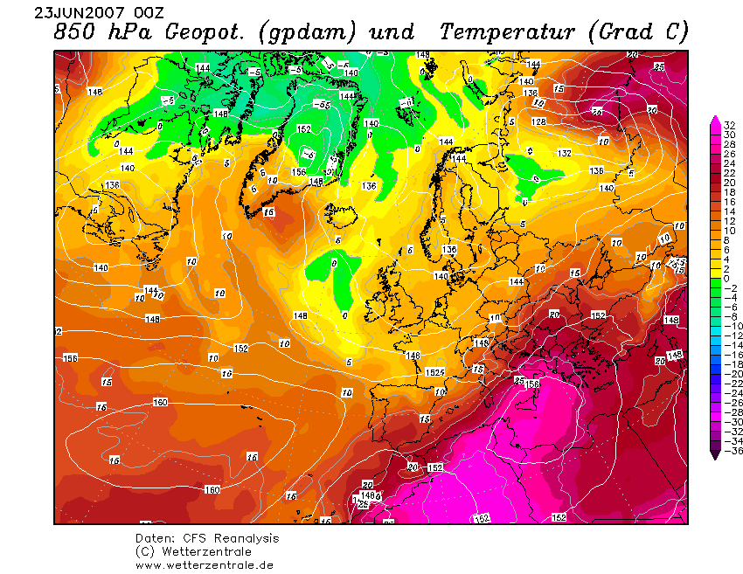
23 June 2007 0000UTC
Existence of a long wave ridge over Europe.
Belt of warm air masses intrud the Mediterranean from SE.
Saharan air masses advect towards Italy and Greece.
Notes:
1)the 500 hPa analysis from 0000 UTC 23 June 2007 shows the existence of a long wave ridge over Europe
2a)it is evident that at 850 hPa a belt of warm air masses had intruded the Mediterranean from the southwest, advecting warm Saharan air masses towards Italy and Greece
2b) The temperature at 850 hPa over Greece ranged between 22 and 26 °C which is almost 10° higher than the climatological values in the region.

Slide 9
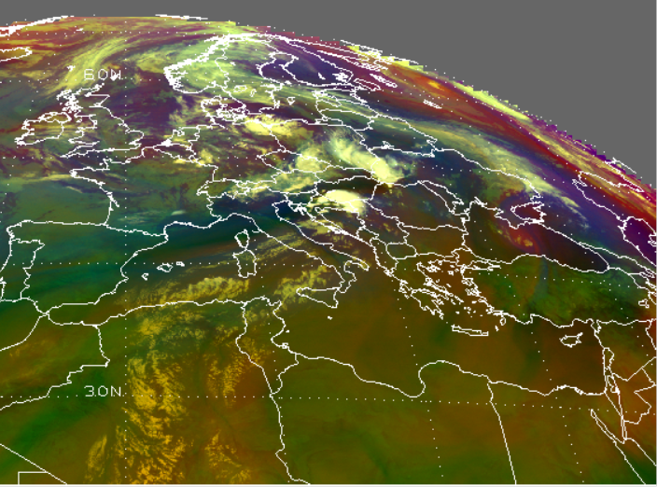
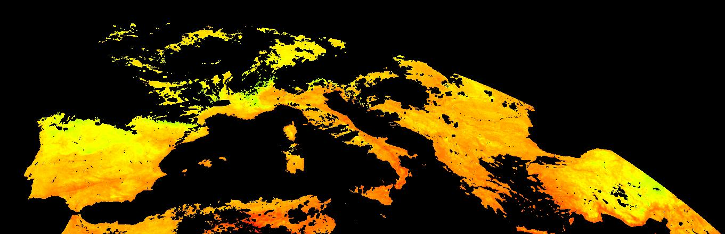
23 June 2007 0000UTC
Airmass RGB composite Image
WV Image (6.4μm)+500hPa Geopotential Height
LSA SAF LST product

Slide 10
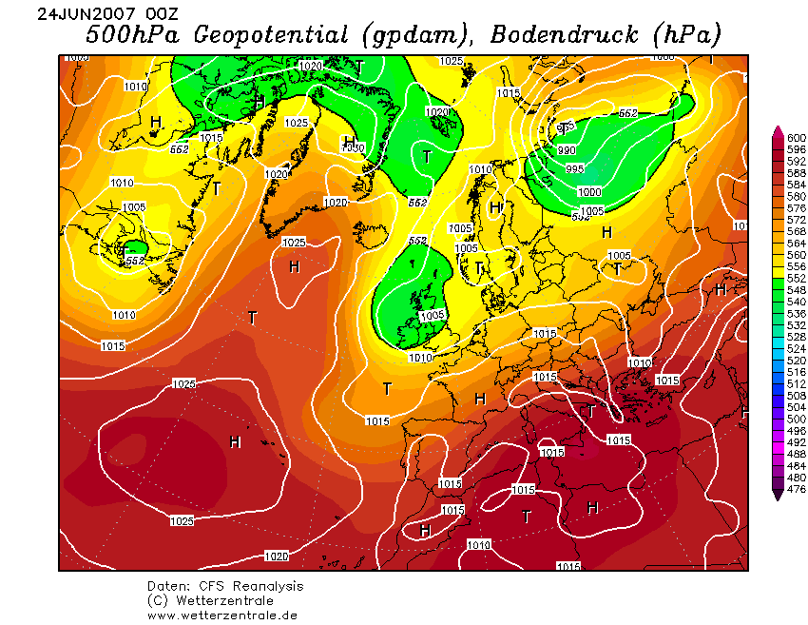
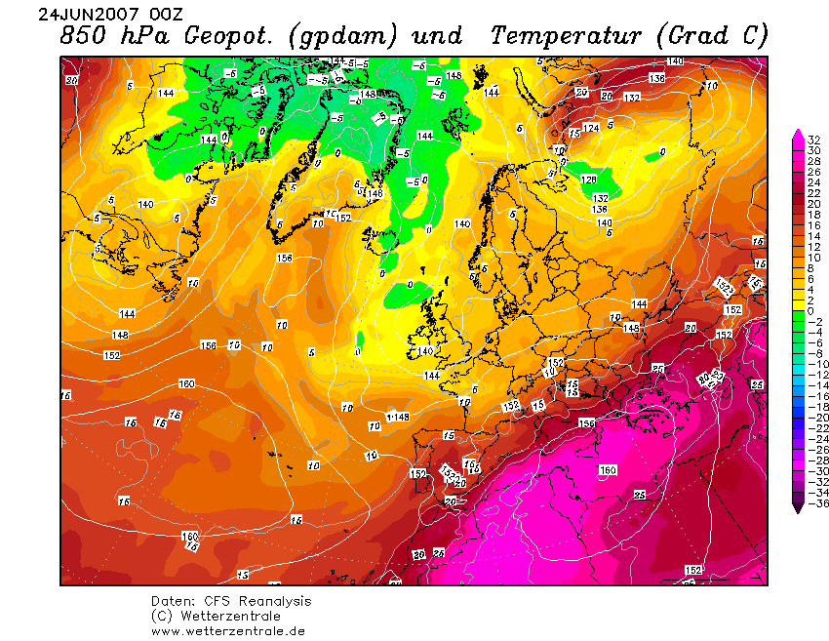
24 June 2007 0000UTC
The High still persists while two lows intensify at both sides of the ridge.
One over the British Isles on the west and the second over Russia on the east.
The warm advection persists also at the 850 hPa level.
At this level the temperature over Greece ranged from 26 to 28 °C.
Notes:
On 24 June, the High still persisted while two lows intensified at both sides of the ridge: one over the British Isles on the west and the second over Russia on the east
The warm advection persisted also at the 850 hPa level and at this level the temperature over Greece ranged from 26 to 28 °C from 24 June up to 26 June

Slide 11
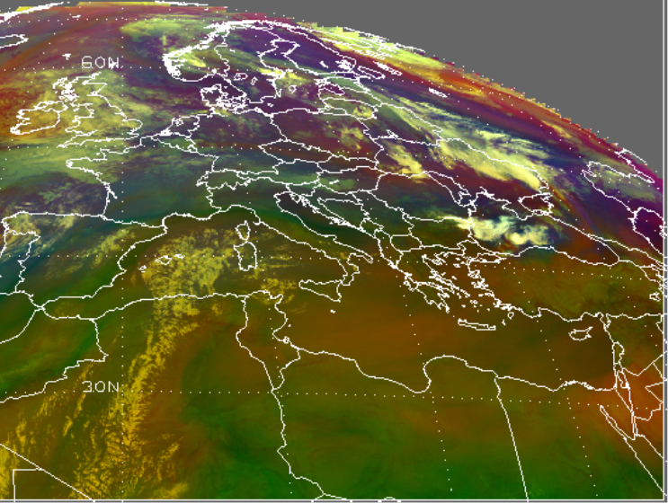
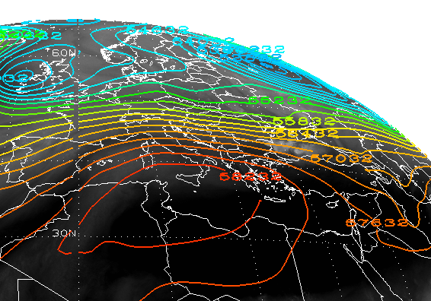
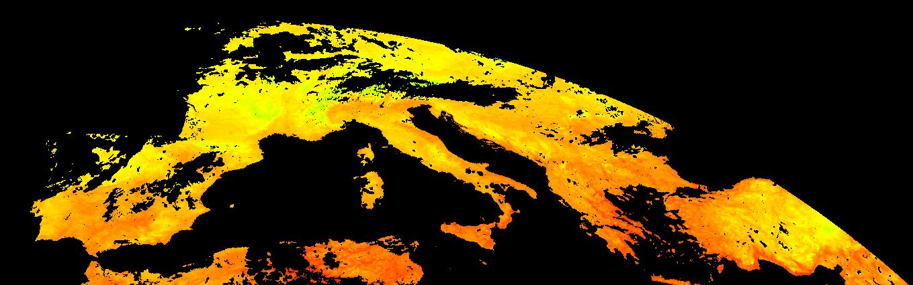
24 June 2007 0000UTC
Airmass RGB composite Image
WV Image (6.4μm)+500hPa Geopotential Height
LSA SAF LST product

Slide 12
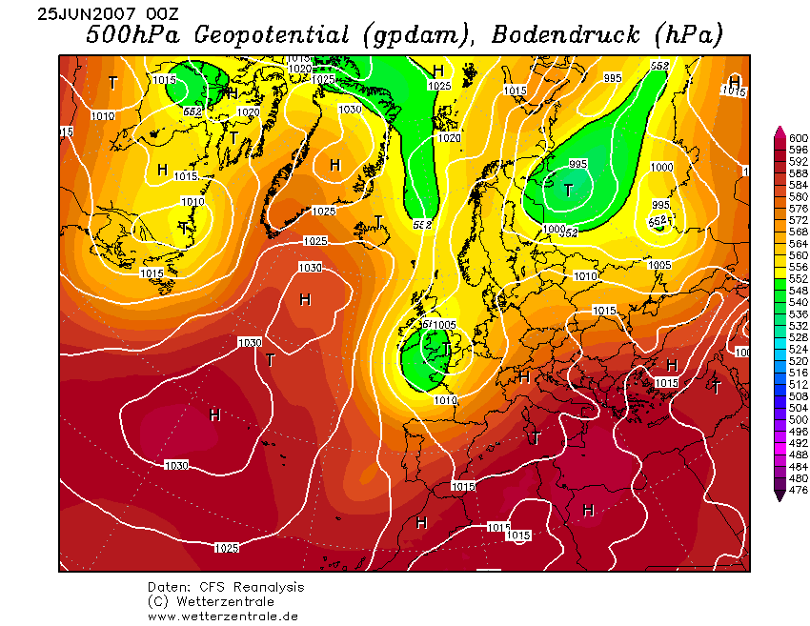
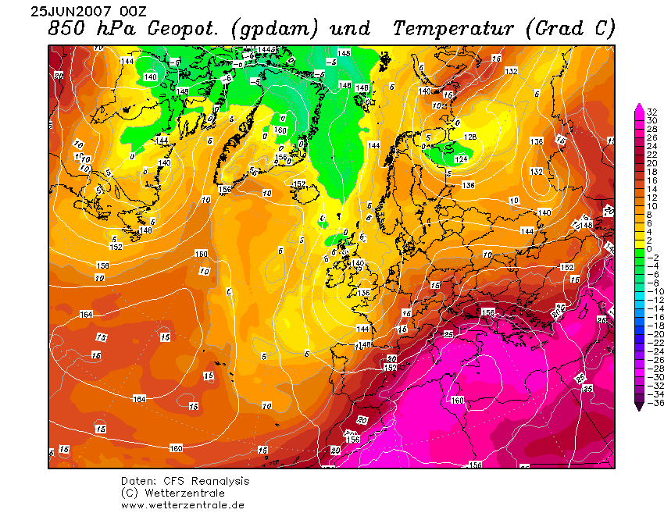
25 June 2007 0000UTC
The cyclonic circulation in both sides of the ridge intensifies further.
The warm advection persists also at the 850 hPa level.
Notes:
The cyclonic circulation in both sides of the ridge intensified further at 0000 UTC 25 June
The warm advection persisted also at the 850 hPa level and at this level the temperature over Greece ranged from 26 to 28 °C from 24 June up to 26 June

Slide 13
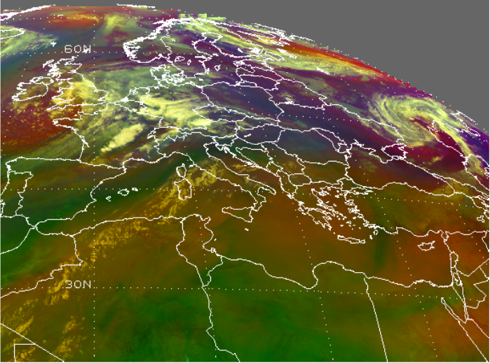
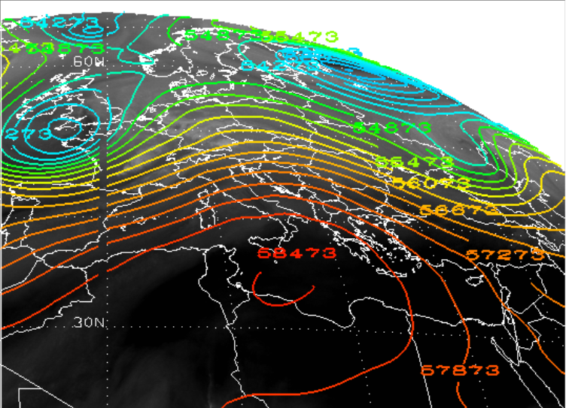
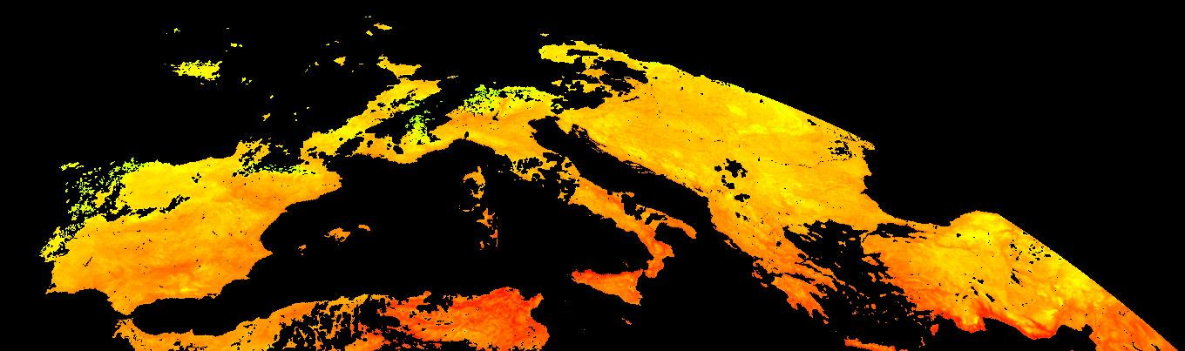
25 June 2007 0000UTC
Airmass RGB composite Image
WV Image (6.4μm)+500hPa Geopotential Height
LSA SAF LST product

Slide 14
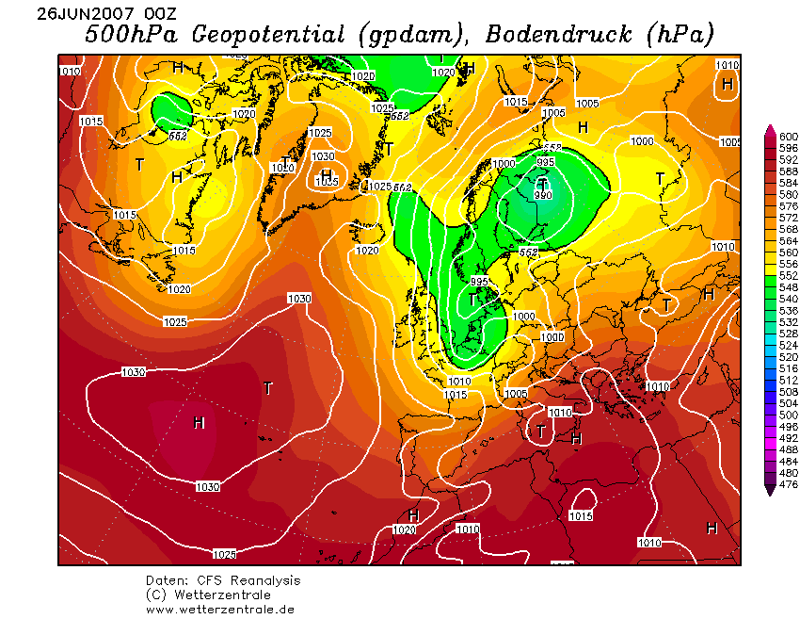
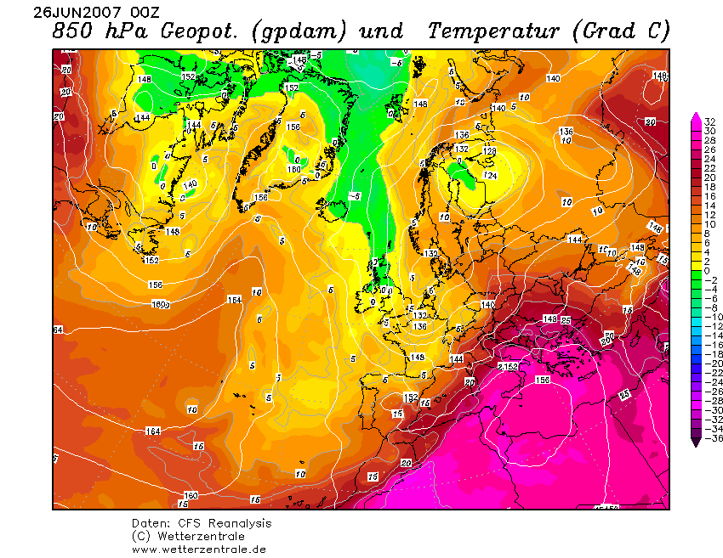
26 June 2007 0000UTC
The situation is similar to the previous day.
Notes:
The cyclonic circulation in both sides of the ridge intensified further at 0000 UTC 26 June
The warm advection persisted also at the 850 hPa level and at this level the temperature over Greece ranged from 26 to 28 °C from 24 June up to 26 June

Slide 15
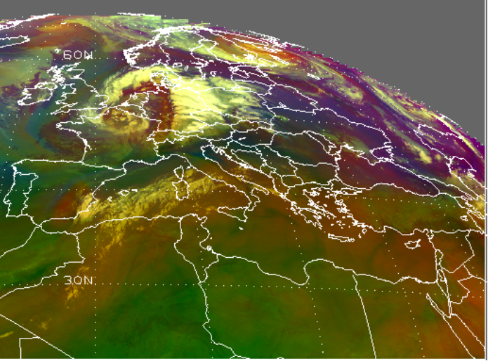
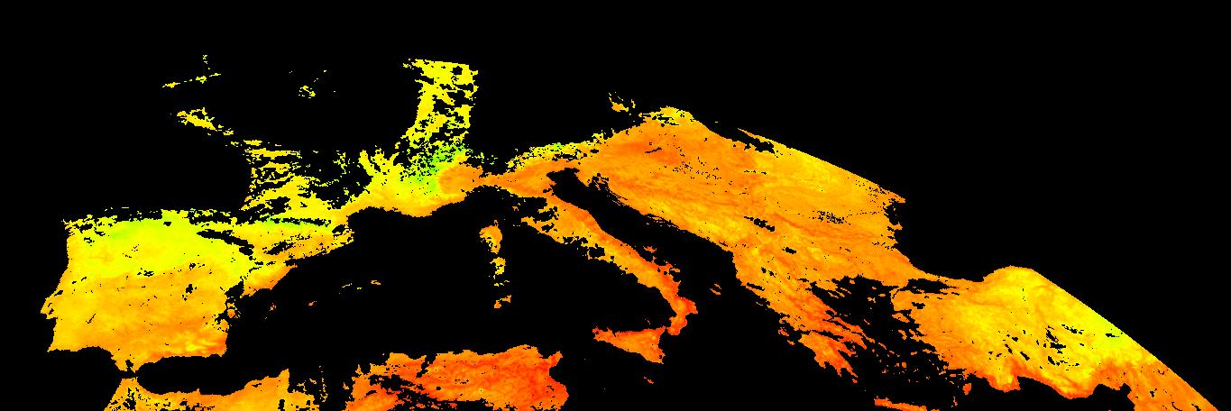
26 June 2007 0000UTC
Airmass RGB composite Image
WV Image (6.4μm)+500hPa Geopotential Height
LSA SAF LST product

Slide 16
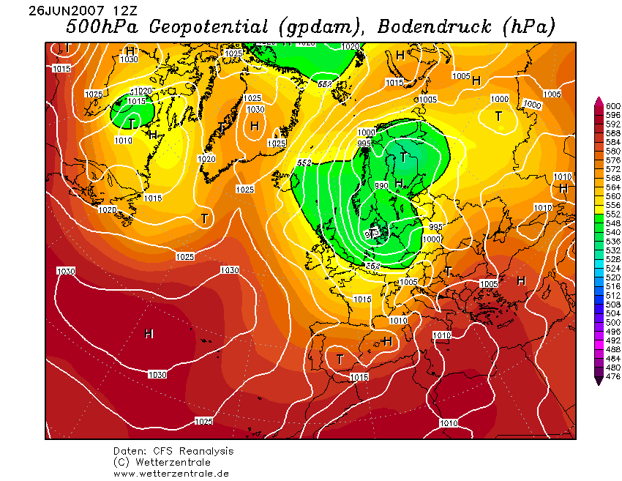
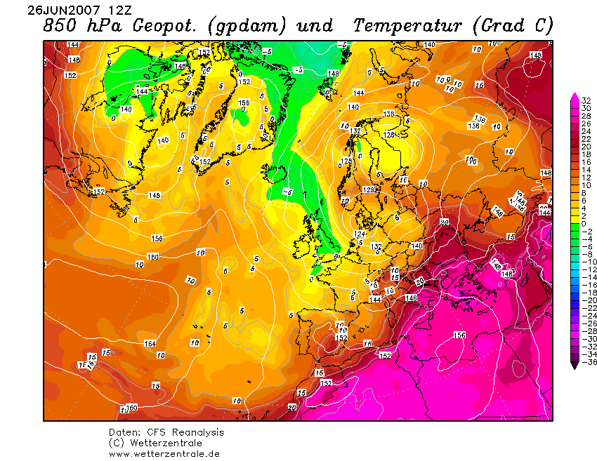
26 June 2007 1200UTC
The ridge intesnifies further over the Balkan area and Greece.
Notes:
1) The ridge intesnifies over the Balkan area

Slide 17
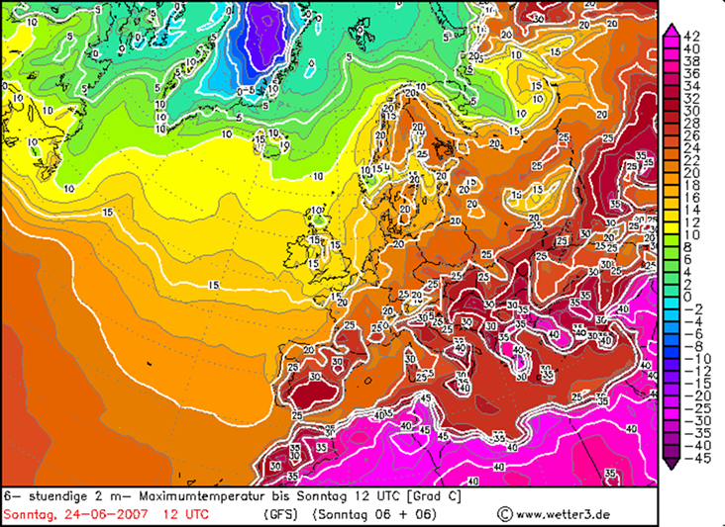
26 June 2007 1200UTC
2-m temperatures over Greece exceeded 40 °C in many places in Greece.
Focusing in the area of Athens, Thission station reached a daily maximum of 44.8 C, a record high since 1897
Notes:
1) 2-m temperatures over Greece exceeded 40 °C in many places in Greece. Focusing in the area of Athens, Thission station reached a daily maximum of 44.8 C, a record high since 1897

Slide 18
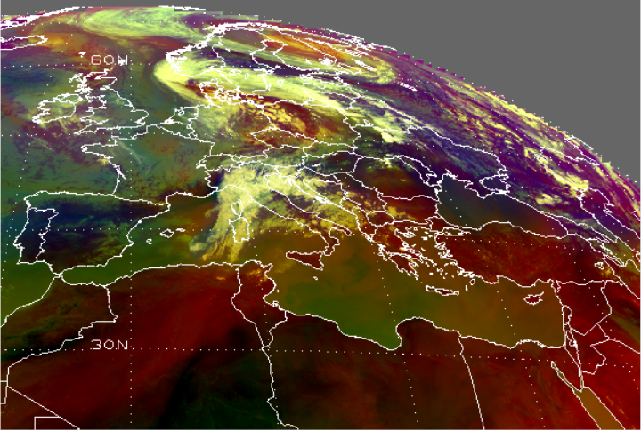
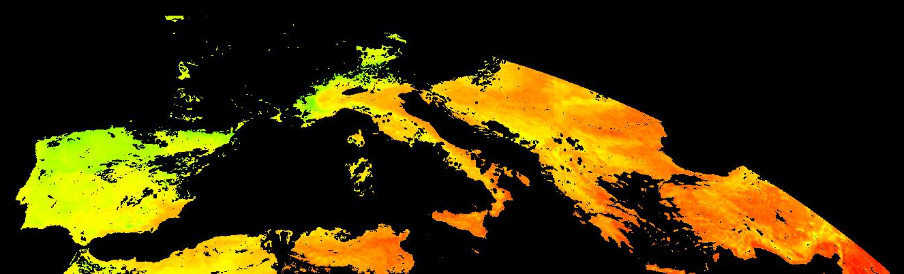
26 June 2007 1200UTC
Airmass RGB composite Image
WV Image (6.4μm)+500hPa Geopotential Height
LSA SAF LST product

Slide 19
Pytharoulis, Brikas et al., 2009
Latitude-pressure vertical section of potential temperature (K; thin contours), horizontal wind speed (m/s; bold contours) and vertical velocity, ω (Pa/s; color shading) at 23°E at 1200 UTC, 24 June 2007. The thick red line below the panel indicates the location of Greece.
During the episode, the Subtropical Jet stream (SJ) was located just north of Greece in higher latitudes than its climatological location. Previous studies have shown that the heat waves in Greece are associated with a poleward transport of the SJ (Brikas 2006), which is the northern limit of the Hadley circulation. In the beginning of the episode, Greece was located under the right flank of the SJ exit.
The indirect secondary circulation that arises in the exit of the jet streams was expected to induce subsidence in the area of interest and to contribute to the development of the heat wave.

Slide 20
Consequences
During the June heat wave:
NHOC reported 146 emergency department visits for heat exhaustion and heatstroke in Attica region. (62 were men and 84 women)
6 deaths (4 males and 2 females) reported from excessive heat exposure.
(Theoharatos et al.,2010)

Slide 21
Further Study and Improvements
In order to predict effectively such extreme phenomena, it is obvious that satellite imagery provides the ideal platform for monitoring a heat wave. (specific the LSA SAF products)
Furthermore, numerical simulations with higher horizontal resolution, can provide better understanding for these events, better estimate the synoptic situations as well the extreme temperature, and make further predictions much better.
Notes:
Simulations with numerical weather prediction models had been made, with higher horizontal resolution, to better estimate the synoptic situations as well the extreme temperatures.

Slide 22
Thank you!

