Slide 1
5th SALGEE Workshop 2017, MSG LAND SURFACE APPLICATIONS: HEAT WAVES, DROUGHT HAZARD AND FIRE MONITORING
Matheos Papadakis
Cyprus
Department of Meteorology

Slide 3
2 events over Cyprus
Fire in Solea, 19/06/2016
Dust storm, 08/09/2015

Slide 4
Fire in Solea, 19/06/2016
General info
Alert Date and Time: 19 June 2016 at 13:50 hrs local time
Location: Solea region (Troodos mountain range)
Total burnt area: 1886 hectares (18,8 square kilometres)
Type of vegetation burnt: Pine forest
Loss of human lives: Two forest fire fighters died when their fire engine overturned down a cliff.
Also, a number of fire-fighters were injured.
Other info: 10 nearby villages were affected, some of which were evacuated. Houses and structures
of historical value were threatened. Two fire engines were burned.
Meteorological conditions in the area at 14:00 hrs:
- Temperature: 36ºC
- Relative humidity: 22 %
- Wind speed and direction NNE: 12-16 kts
- Precipitation: 0 mm

Slide 5
Info about the fire fighting operation:
Total number of people involved in the fire fighting operations: About 1400 (including 600 volunteers)
Fire engines: 70
Air means – Rep. of Cyprus: 2 aeroplanes and 6 helicopters
Air means – Other countries:
- Greece: 2 aeroplanes and 2 helicopters
- France: 2 aeroplanes and 1 coordination aeroplane
- Italy: 1 aeroplane
- Israel: 4 aeroplanes
- RAF (UK): 2 helicopters

Slide 6
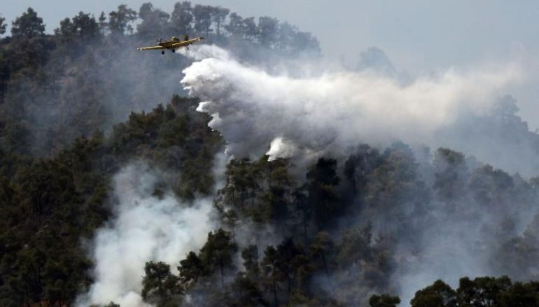

Slide 7
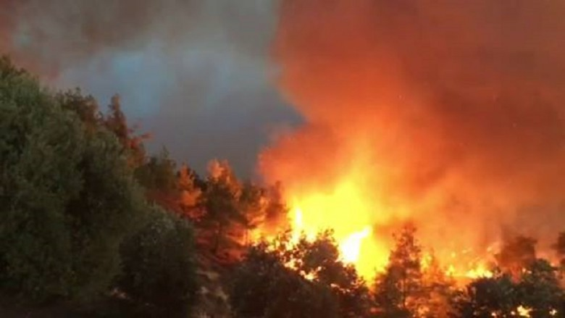

Slide 8
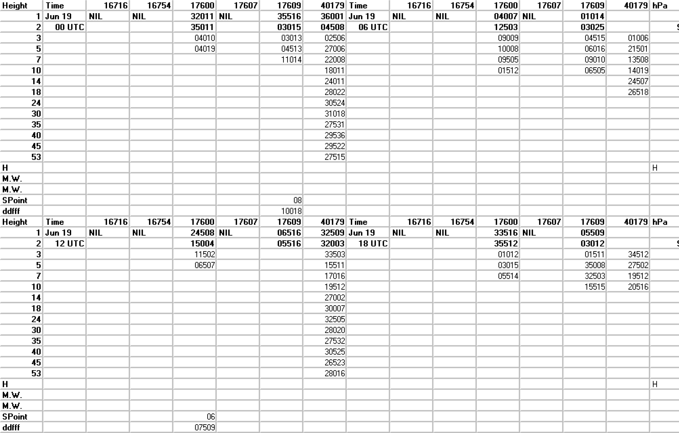
Larnaka wind sheet, 19/06/2016

Slide 9
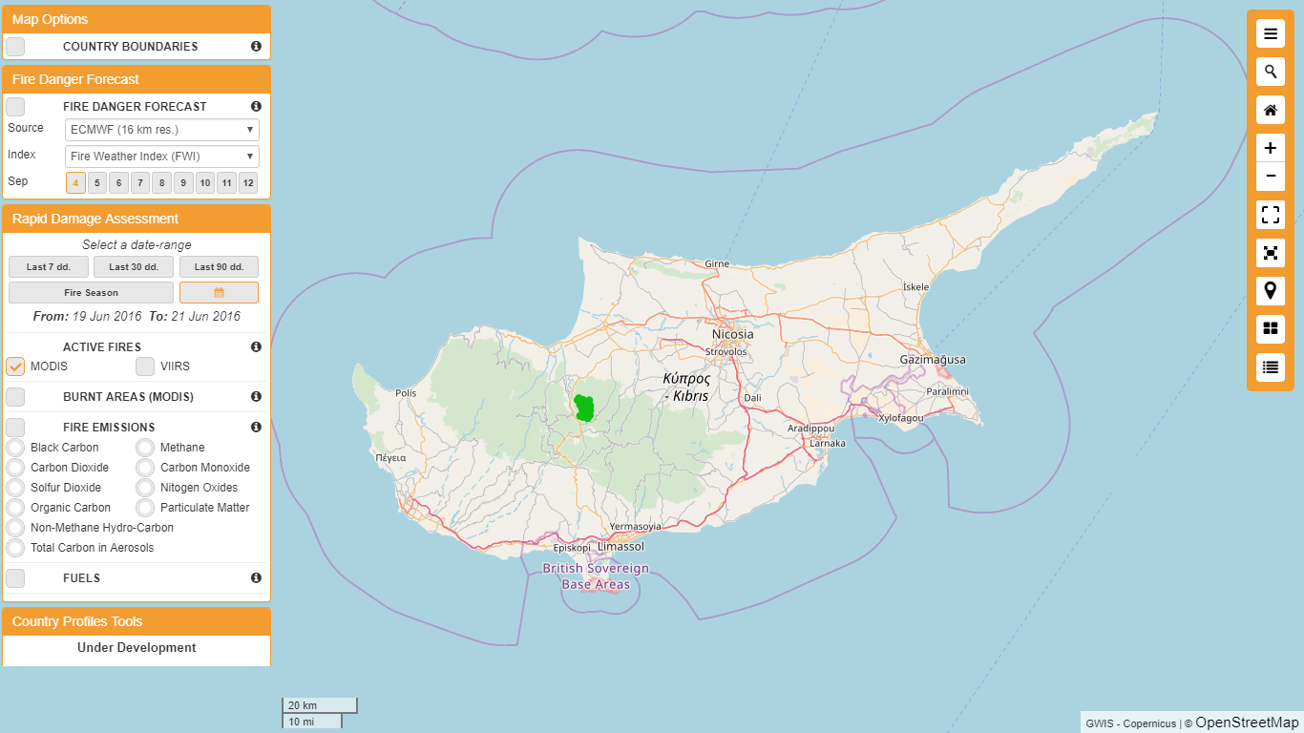

Slide 10
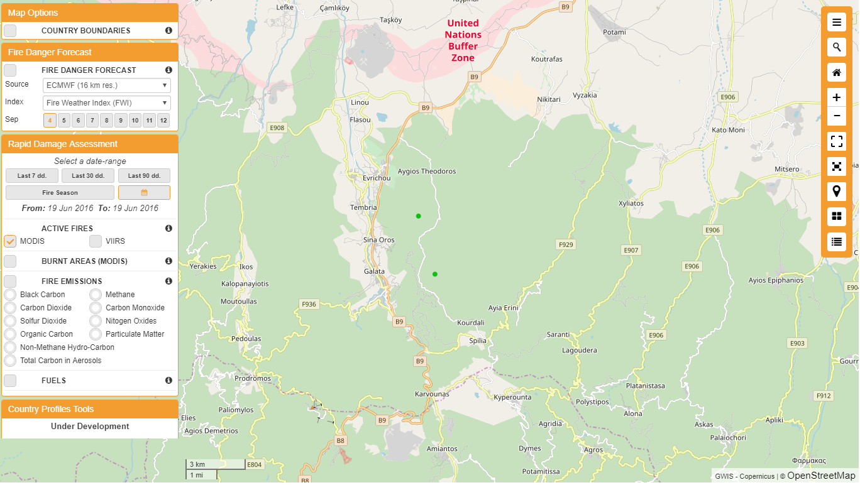

Slide 11
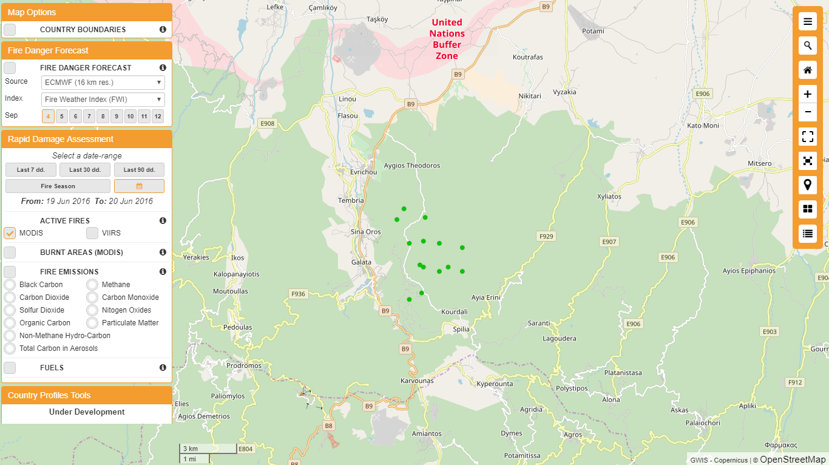

Slide 12
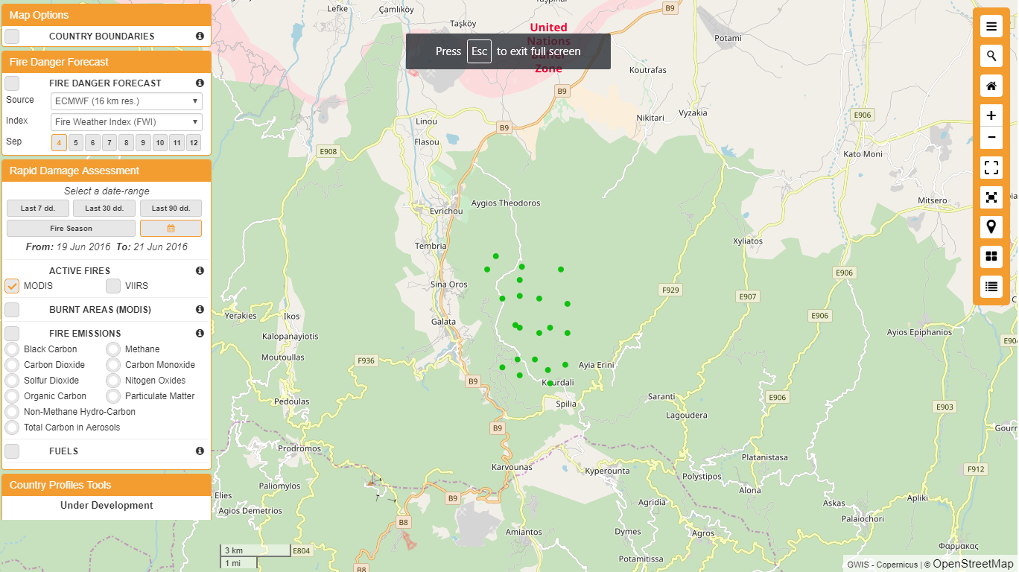

Slide 13
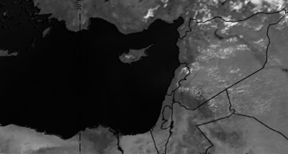
MSG-VIS 0.8, 1200 UTC-19/06/2016

Slide 14
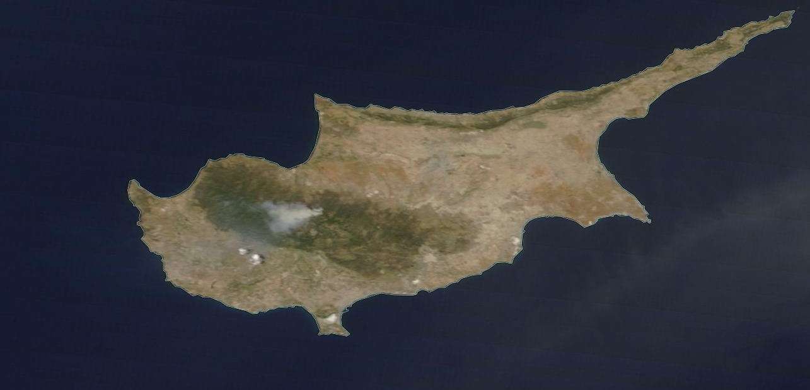
MODIS (Terra/Aqua) Corrected Reflectance (True Color)

Slide 15
Dust storm, 08/09/2015
General info
Extreme dust storm.
Health warnings were issued due to the dust in the atmosphere combined with the high temperatures (41ºC ).
More than 50 people were medically treated mostly due to respiratory problems.
Schools were closed and outdoor labor work was restricted to minimum.
Visibility was reduced significantly.
Flights were redirected from Larnaca airport to Paphos airport.
Dust transport models failed to predict this dust storm.
General atmospheric conditions favorite Sahara dust transport in the area. Unusual for dust storms originating
in northern Syria and Iraq to affect Cyprus.

Slide 16
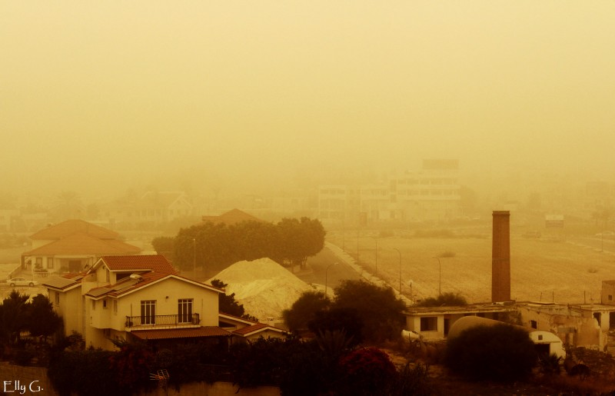
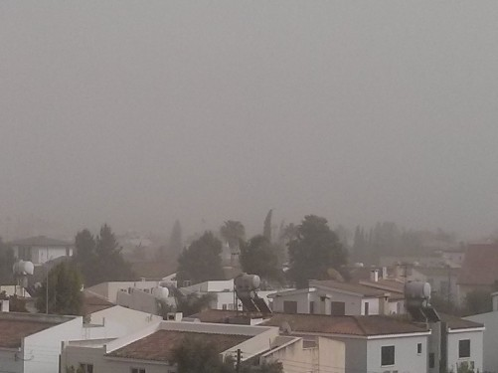

Slide 17
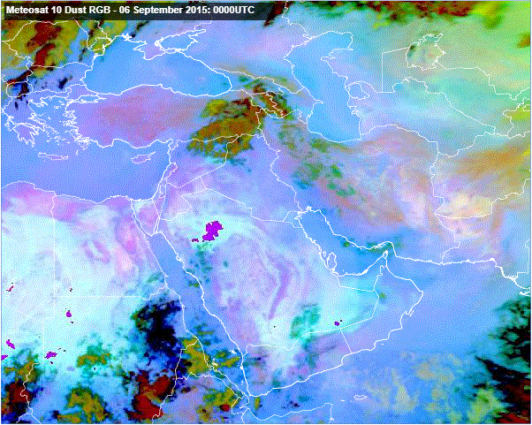

Slide 18
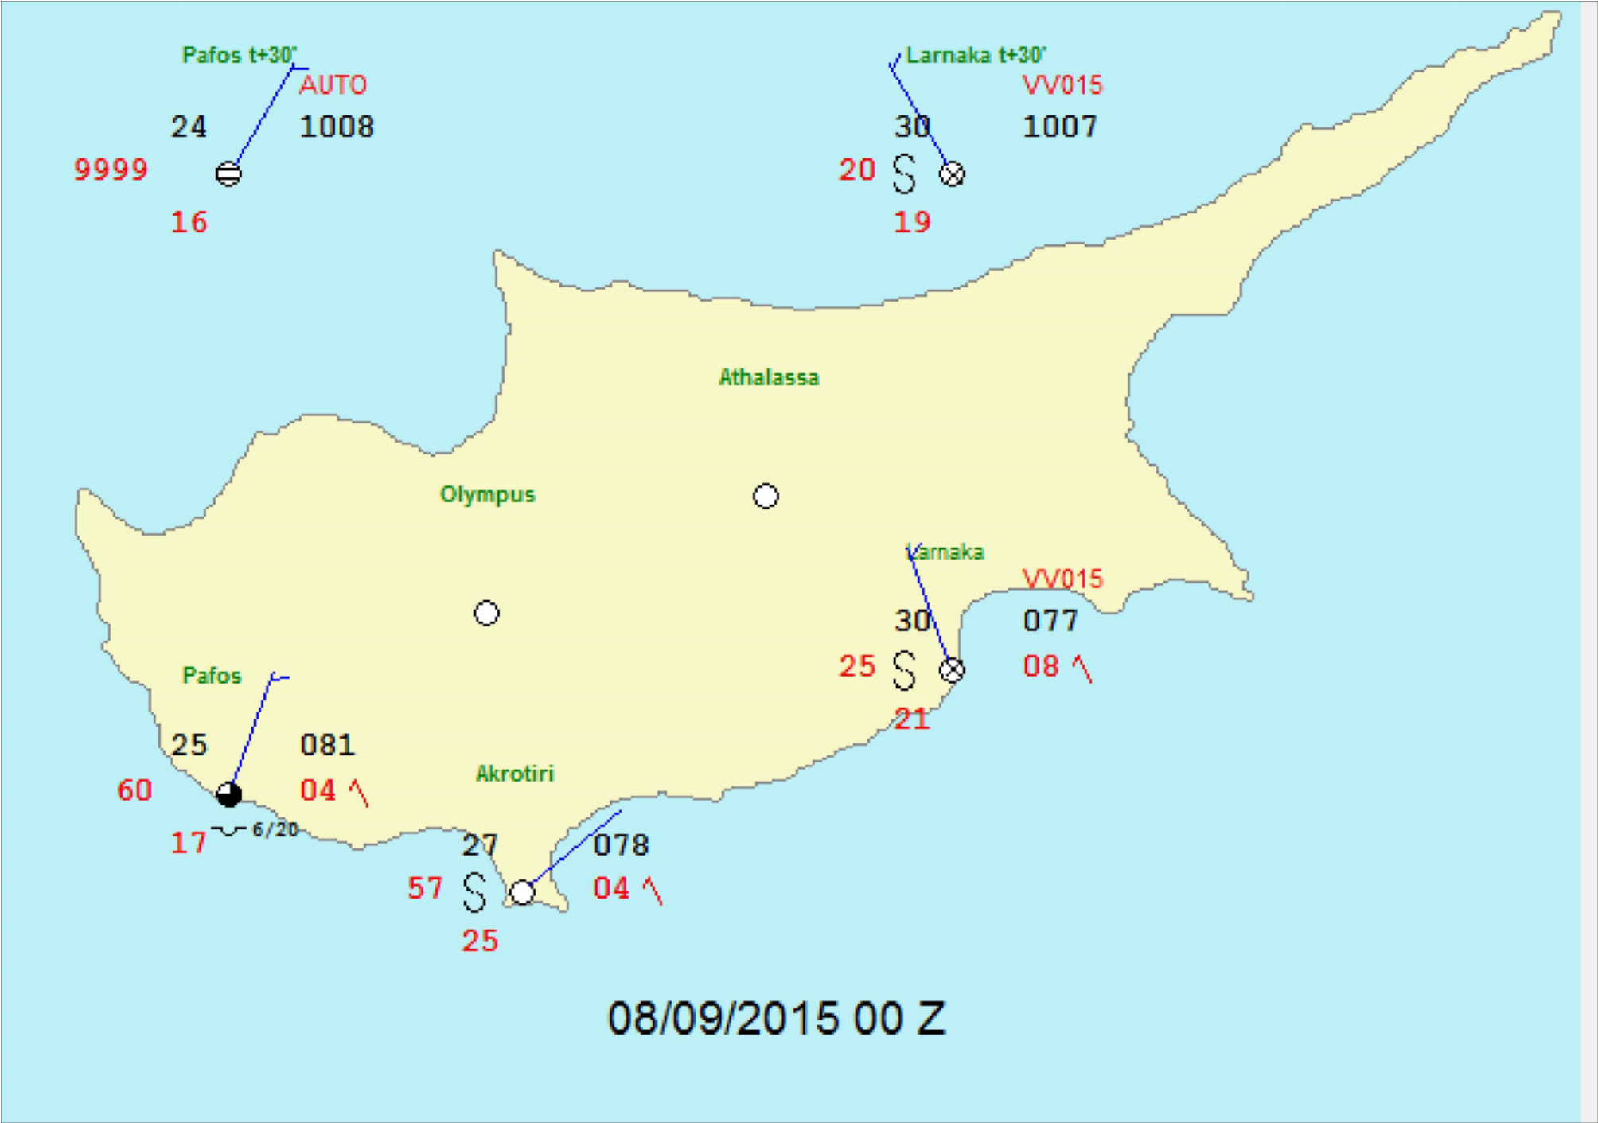
Latest data access at: 11:42:47

Slide 19
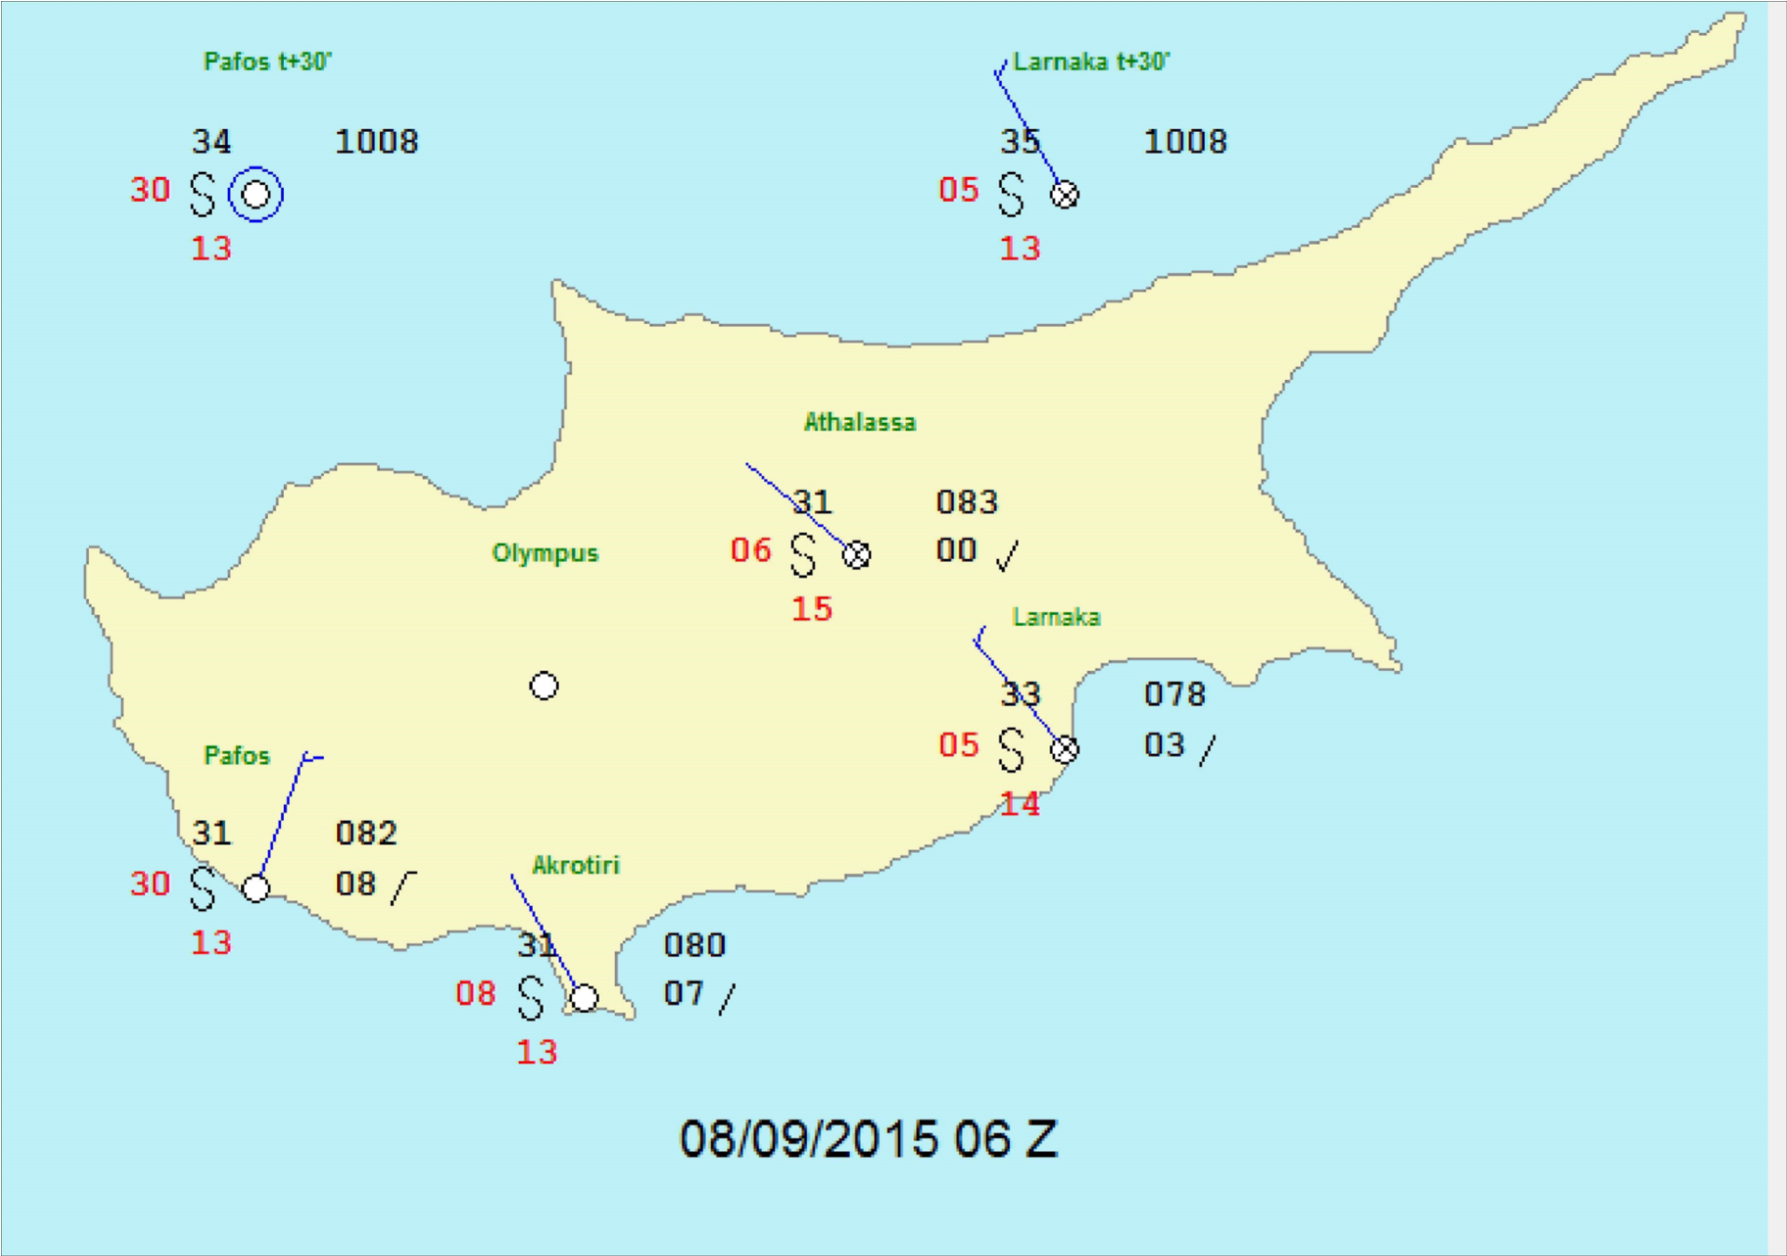
Latest data access at: 11:36:47

Slide 20
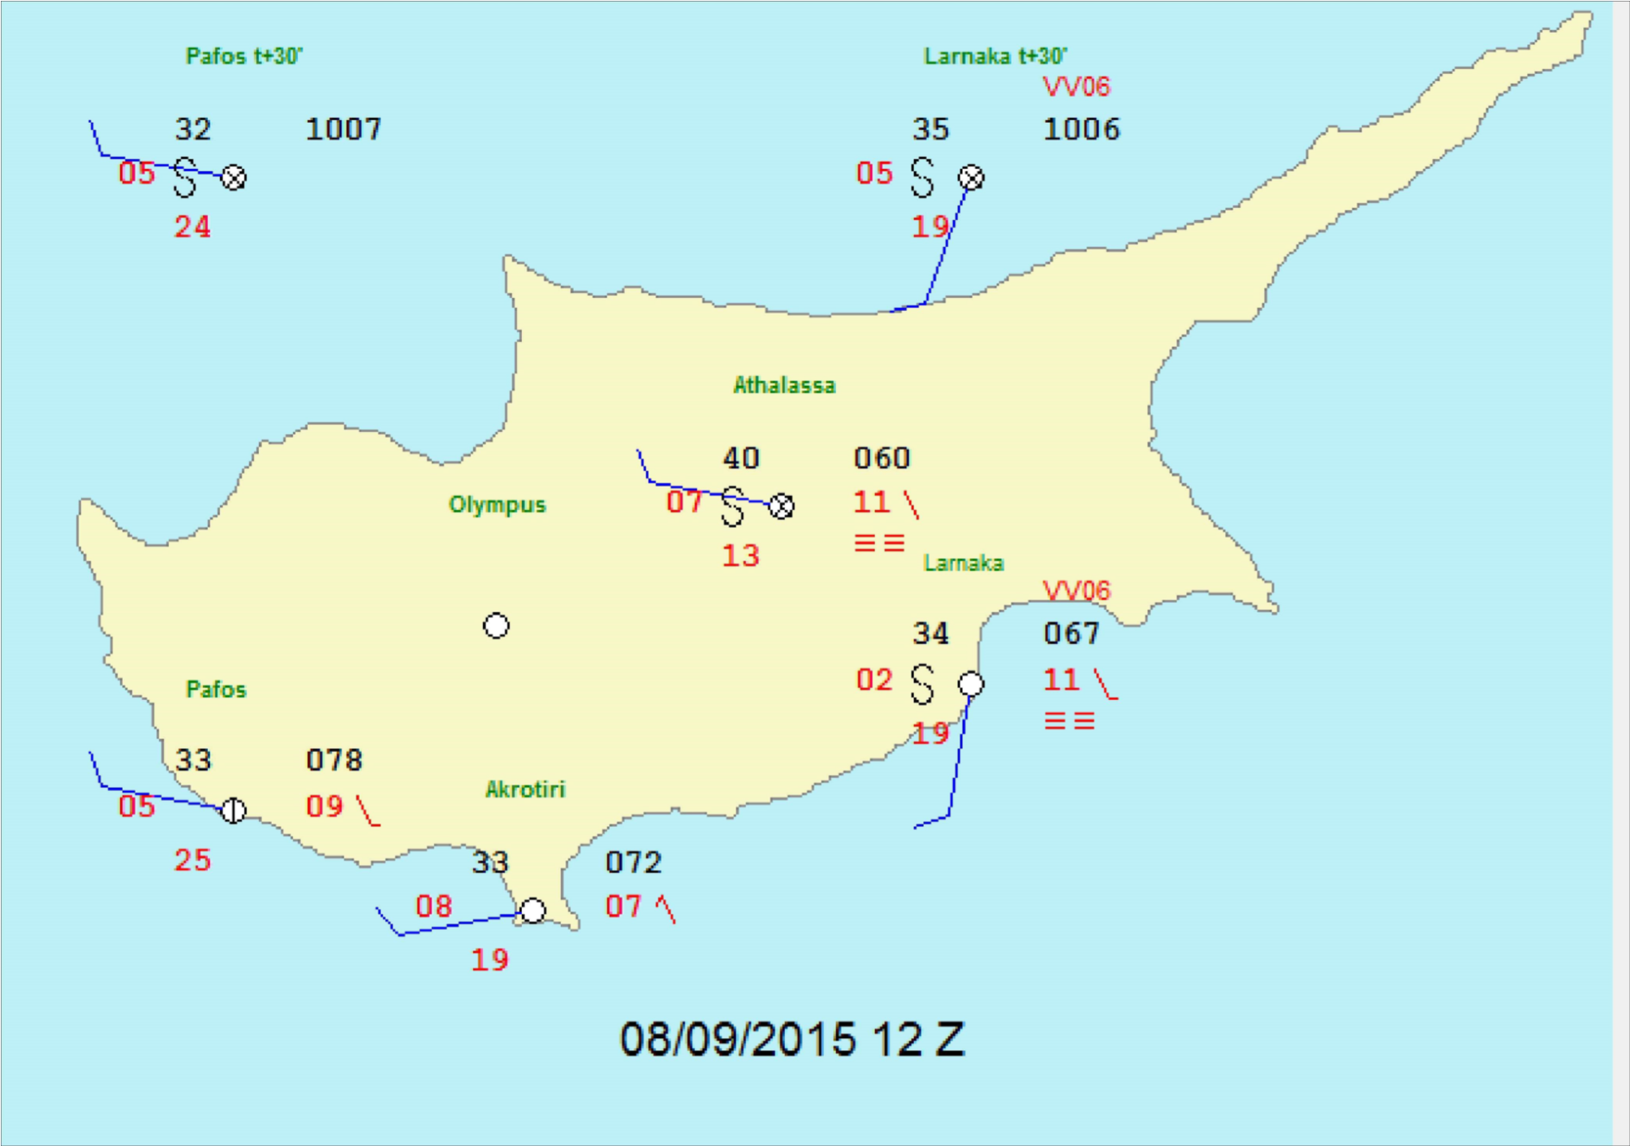
Latest data access at: 11:42:17

Slide 21
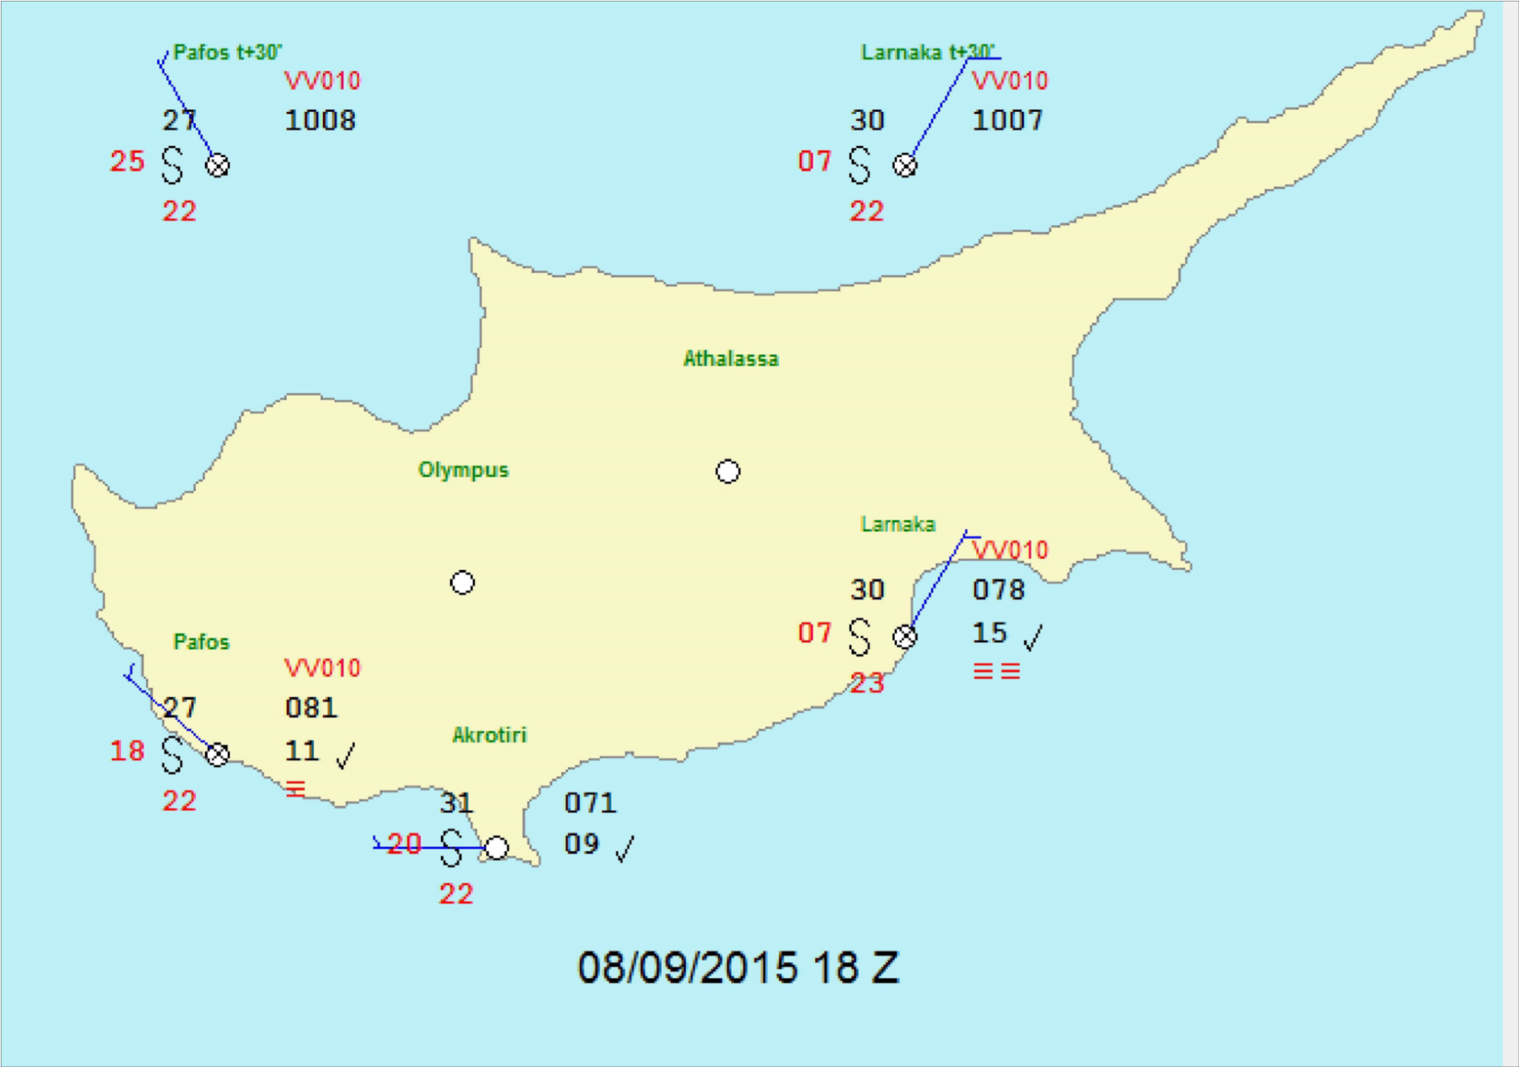
Latest data access at: 11:43:07

Slide 27
TAF LCLK 070530Z 0706/0806 12008KT FEW025 BECMG 0709/0712 22012KT BECMG 0718/0720 32006KT=
TAF LCPH 070530Z 0706/0806 20008KT FEW025 BECMG 0710/0713 28012KT BECMG 0719/0721 35007KT=
TAF LCLK 071130Z 0712/0812 18010KT 9999 FEW025 BECMG 0716/0719 33008KT PROB30 TEMPO 0715/0723 0800 DU PROB30 TEMPO 0723/0806 3000 BR HZ BKN007 BECMG 0807/0810 18010KT=
TAF LCPH 071130Z 0712/0812 28010KT 9999 FEW025 BECMG 0716/0719 03008KT BECMG 0808/0811 28010KT=

Slide 28
TAF LCLK 071730Z 0718/0818 28005KT 5000 DU SCT016 PROB40 0718/0808 3000 DU PROB30 TEMPO 0722/0807 0800 DU BKN005 BECMG 0810/0813 20010KT BECMG 0815/0817 26005KT=
TAF LCPH 071730Z 0718/0818 27008KT 8000 FEW015 PROB30 0720/0815 5000 DU PROB30 TEMPO 0723/0806 1000 DU BKN002=
TAF LCLK 072330Z 0800/0824 VRB03KT 5000 DU SCT016 PROB40 0800/0810 3000 DU PROB30 TEMPO 0800/0807 0800 DU BKN005 BECMG 0810/0813 20012KT BECMG 0815/0817 26005KT=
TAF LCPH 072330Z 0800/0824 27008KT 9999 BKN019 PROB30 0800/0812 5000 DU PROB30 TEMPO 0800/0806 1000 DU BKN002=

Slide 29
TAF LCLK 080530Z 0806/0906 VRB03KT 3000 DU FEW025 PROB40 0806/0814 1000 DU BECMG 0809/0812 19011KT BECMG 0815/0817 26005KT=
TAF LCPH 080530Z 0806/0906 27008KT 5000 DU FEW018 PROB30 0806/0814 2000 DU BECMG 0816/0818 02006KT=
TAF LCLK 081130Z 0812/0912 20011KT 0800 DU FEW015 PROB40 0812/0906 0200 DU BECMG 0817/0820 31006KT BECMG 0910/0912 20011KT=
TAF LCPH 081130Z 0812/0912 28010KT 1000 DU FEW015 PROB30 0812/0906 0600 DU BECMG 0817/0819 01006KT BECMG 0905/0908 13010KT BECMG 0911/0912 27010KT=

Slide 30
Phenomena | Yellow | Orange | Red
Wind mean speed | Inland 50-61 km/h (7BF) Coast 62-74 km/h (8BF) | Inland 62-74 km/h (8BF) Coast 75-88 km/h (9BF) | Inland >74km/h (8BF) Coast >88km/h (9BF)
Wind Gust | ≥95km/h (10BF) | ≥115km/h (11BF) | ≥125km/h (12BF)
Rain | ≥45mm/3h ≥50mm/6h ≥55mm/24h | ≥65mm/3h ≥70mm/6h ≥85mm/24h | ≥90mm/3h ≥95mm/6h ≥115mm/24h
Thunderstorms | ≥35mm/h gust≥70km/h (8BF) | ≥55mm/h gust≥80km/h (9BF) Hailstorm | ≥70mm/h gust≥90km/h (10BF) Severe hailstorm
Extreme Maximum Temperature(°C) | Inland 40 ≤Tmax ≤42 26≤ Tmin≤28 Mountains 31<Tmax≤33 Tmin≥24 West Coast Tmax≥37 Tmin≥25 South Coast Tmax≥39 26≤ Tmin≤28 | Inland 42< Tmax ≤44 28<Tmin≤30 Mountains 33<Tmax≤35 Tmin≥25 West Coast Tmax≥38 Tmin≥26 South Coast Tmax≥41 28<Tmin≤30 | Inland Tmax >44 Tmin>30 Mountains Tmax>35 Tmin≥26 West Coast Tmax≥39 Tmin≥27 South Coast Tmax≥42 Tmin>30
Extreme Minimum Temperature(°C) | Inland Tmin≤-2 Mountains Tmin≤-8 Coast Tmin≤0 | Inland Tmin≤-3 Mountains Tmin≤-10 Coast Tmin≤-1 | Inland Tmin≤-4 Mountains Tmin≤-12 Coast Tmin≤-3
Fog | 100m/6h | Not applicable | Not applicable

Slide 31
Thank you

