Slide 1
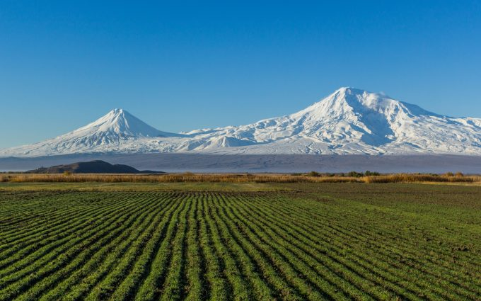
CROP YIELD FORECASTING ARMENIA

Slide 2
General methodology
Steps:
Identifying quantitative factors correlated with crop yield:
  Meteorological (Rain, T°,sunshine duration…)
  Agrometeorological (ETP, …)
  Remote sensed NDVI from satellite images
  Generating explanatory variables
  Correlation between historical yield data and generated explanatory variables
  Yield prediction using the most correlated parameters

Slide 3
Remote sensing part
1.
2.
5.
3.
4.
Downloading NDVI images from the web page http://www.vito-eodata.be/PDF/portal/Application.html#OrderFollowup
2. Customization of NDVI images with softwares VGT Extract, FWTools
Temporal smoothing of NDVI images and getting seasonality parameters with TIMESAT software
Computing statistics of variables per regions with WinDisp
statistical analysis in Excell

Slide 4
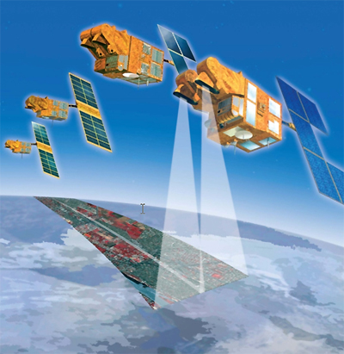
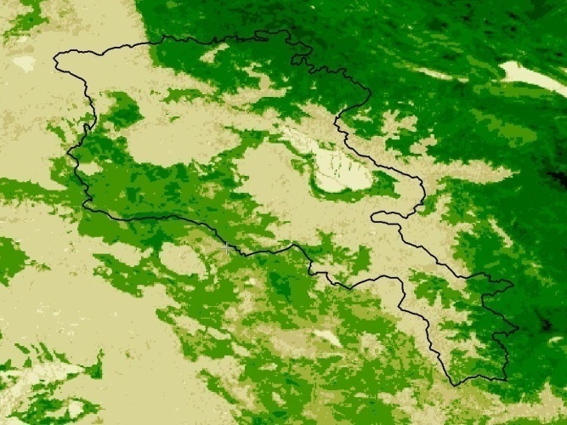
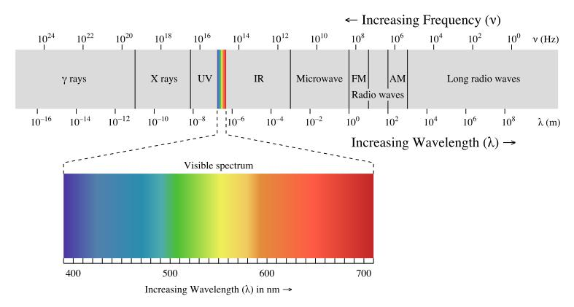
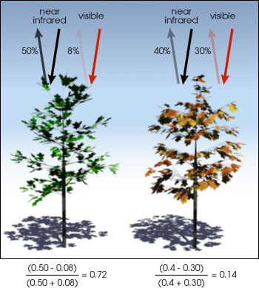
NDVI
SPOT VEGETATION NDVI image
NIR: Near Infra Red radiation (0,725 à 1 µm)
Red: Red radiation (0,58 à 0,68 µm)
Dense vegetation and good phytosanitary condition : → absorbtion peak for RED band → HIGH NDVI
Few vegetation and/ or bad phytosanitary condition : → no absorption peak in RED → LOW NDVI

Slide 5
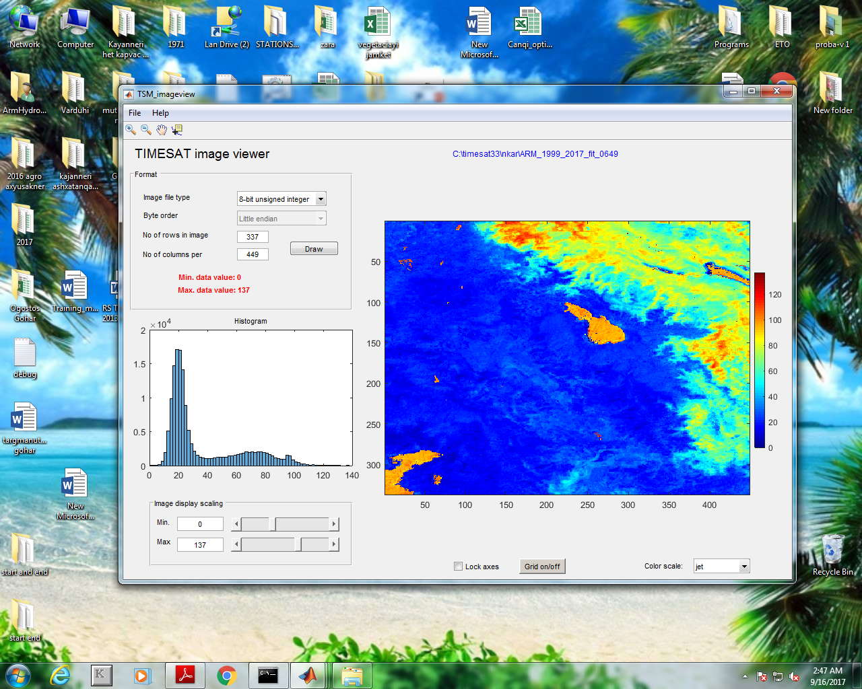
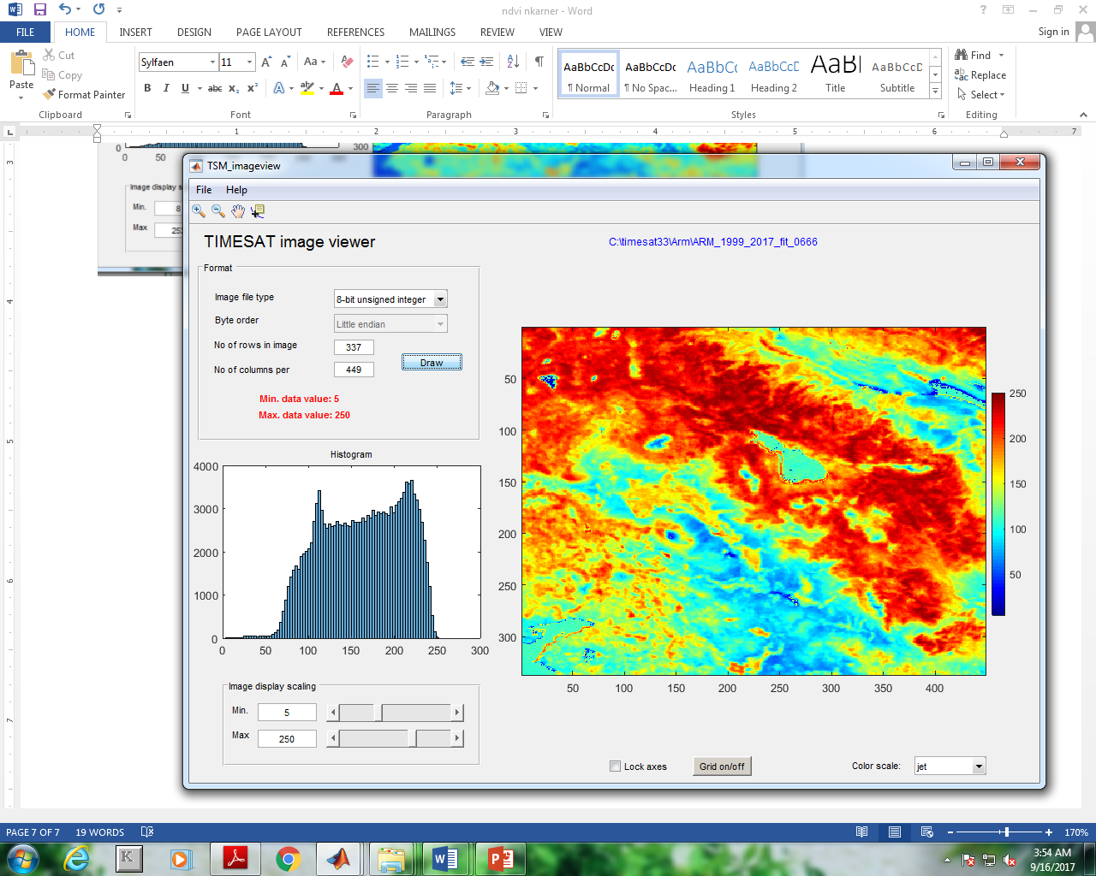

Slide 6
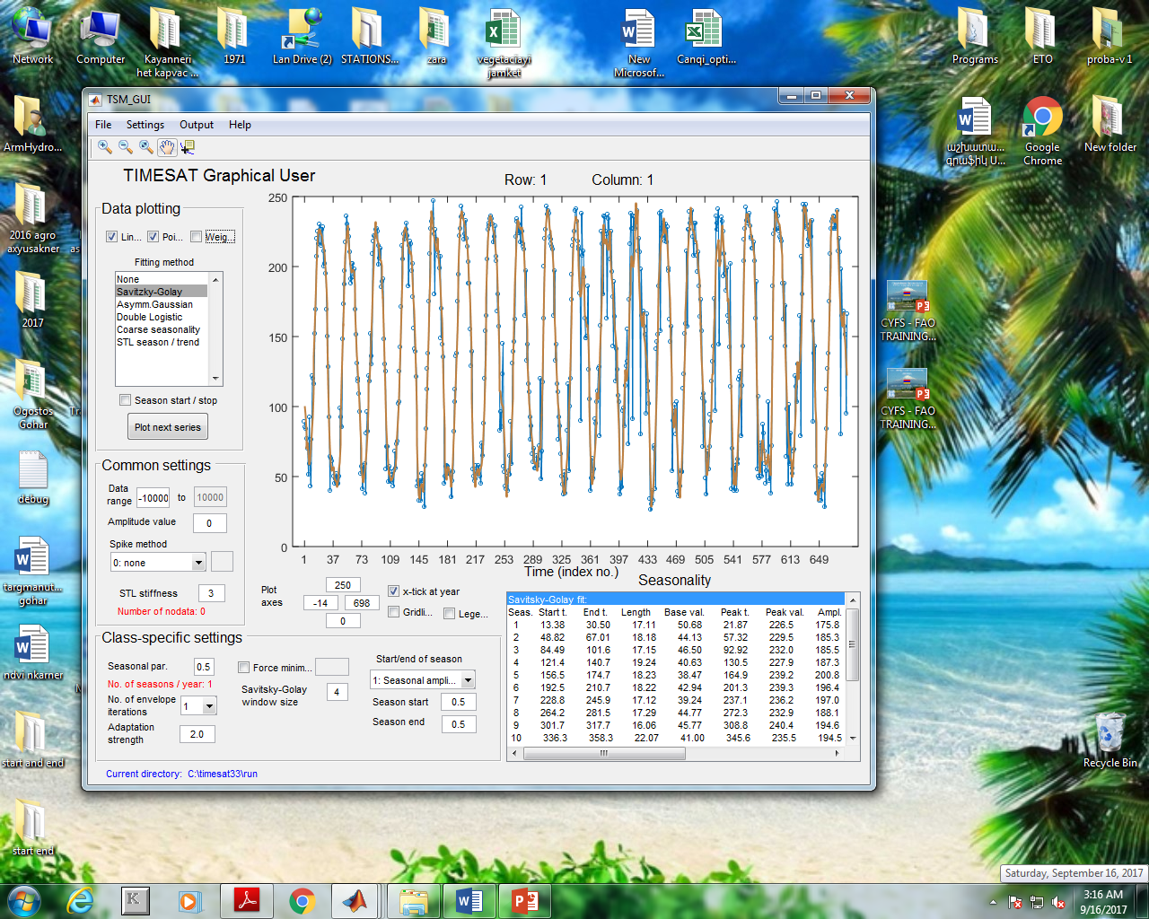
1999-2017 NDVI time-series

Slide 7
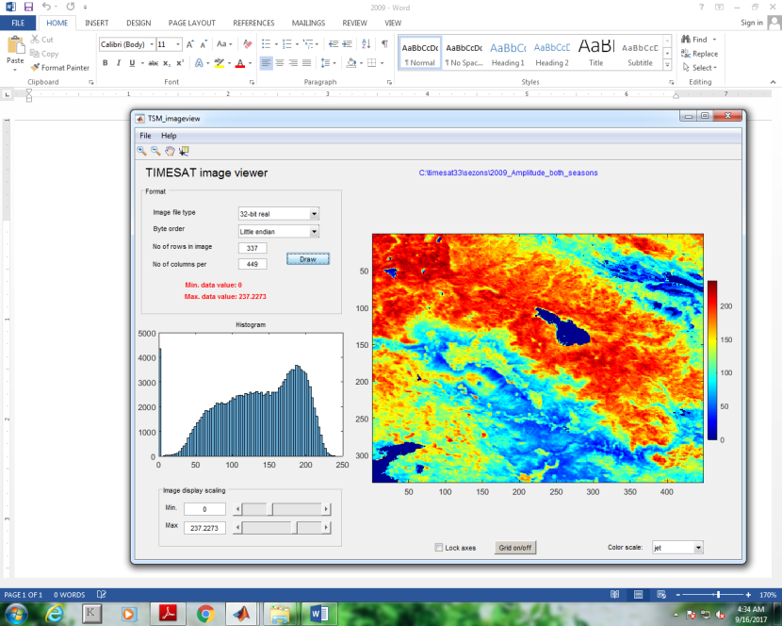
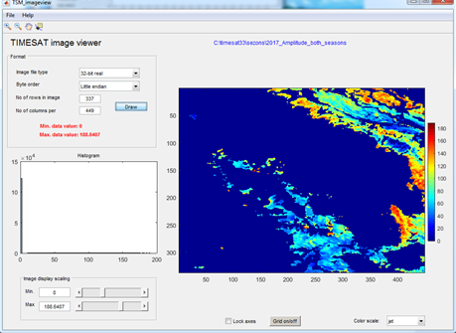
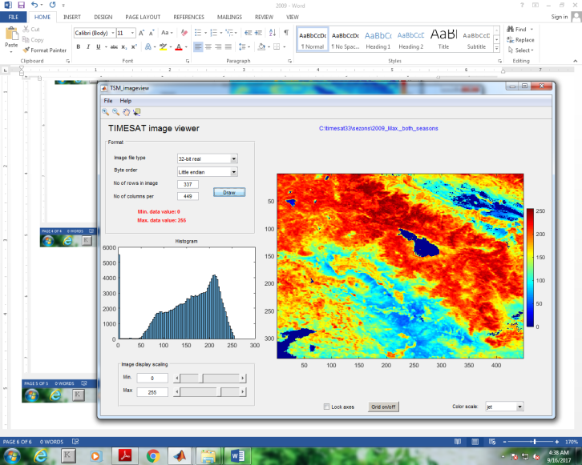
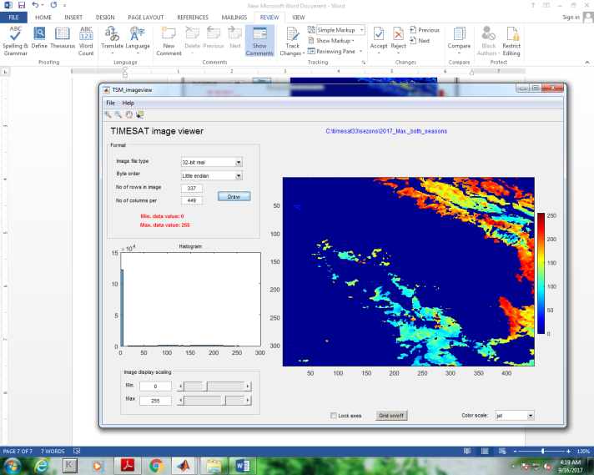
Amplitude and season max of NDVI for years 2009 and 2017

Slide 8
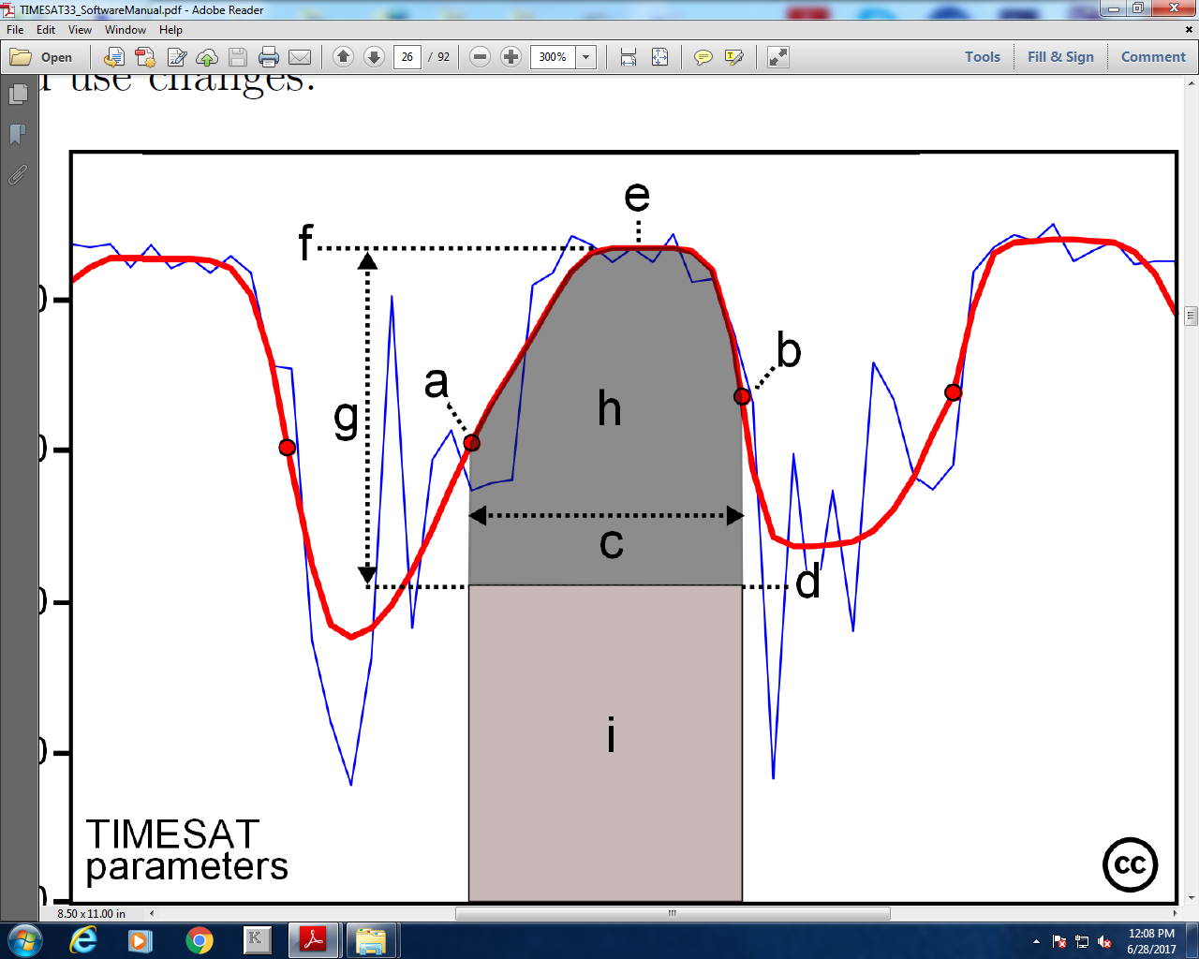
Start-of-season time
End-of-season time
Length of season
Base value
Time of middle of season
Maximum value value of fitted data
Amplitude
Left derivative
Right derivative
Large integral
Small integral
Start-of-season value
End-of-season value

Slide 9
Main indicators affecting the amount of Yield over years

Slide 10
Correlation among variables and Yield indicators
All variables of the model were correlated with the output variable: Yield

Slide 11
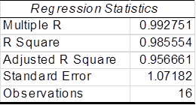
Results of a Regression analysis
All of the significant repressors are presented below. Model proved to have a high predicting power with a R squared value over 98%.

Slide 12
Prediction based on regression output and observed amount of yield during 2001-2017

Slide 13
Thank you

