Slide 1

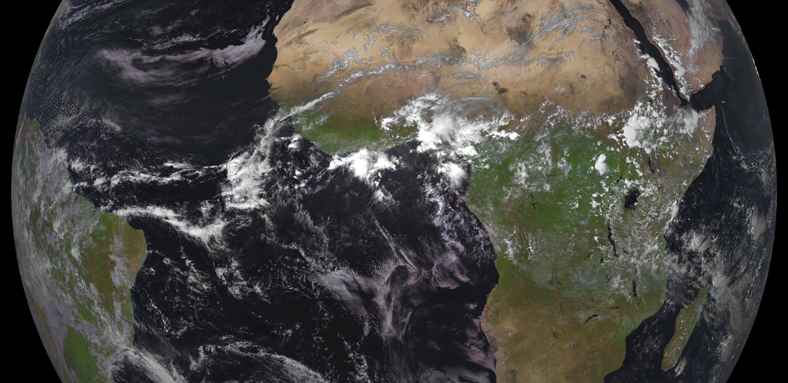
Use of Vegetation Indexes from EUMETSAT satellites for Drought Management: Validation and Applications
Boštjan Muri, Mateja Iršič Žibert, Gregor Gregorič
Slovenian Environment Agency

Slide 2
Contents
Slovenian Environment Agency (ARSO)
Drought Management Centre for Southeastern Europe
Drought Monitoring in Slovenia
Applications of Satellite Vegetation Indexes
Conclusions and Future Work

Slide 3
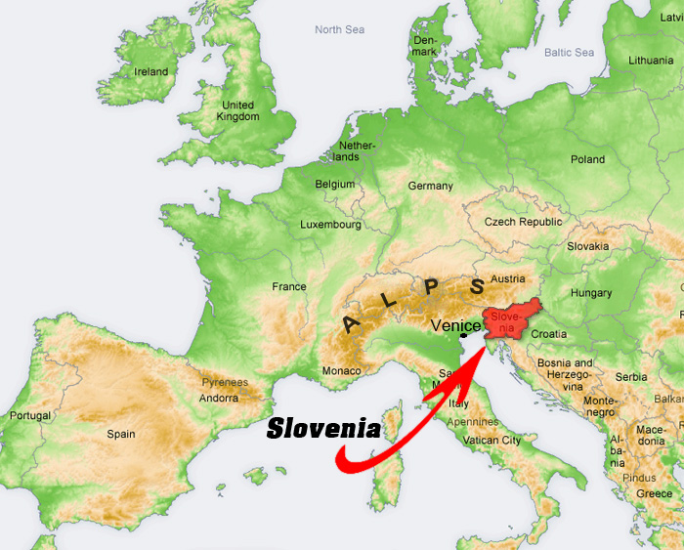
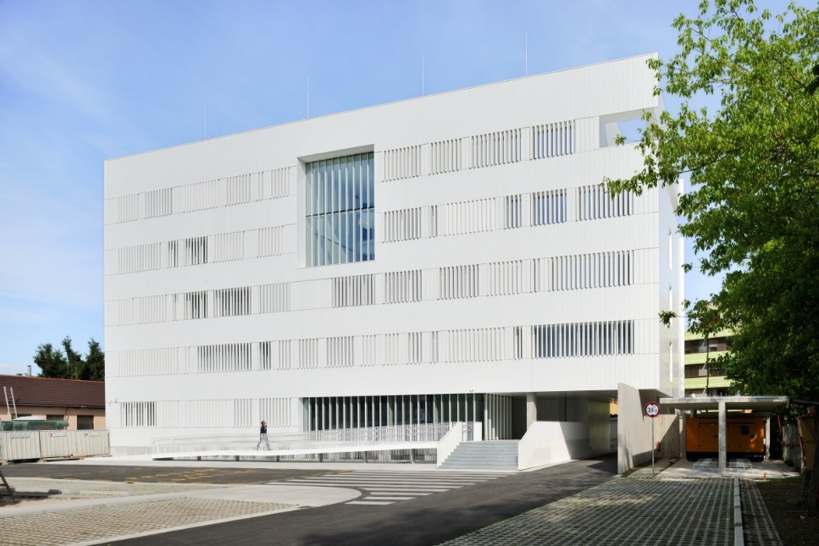
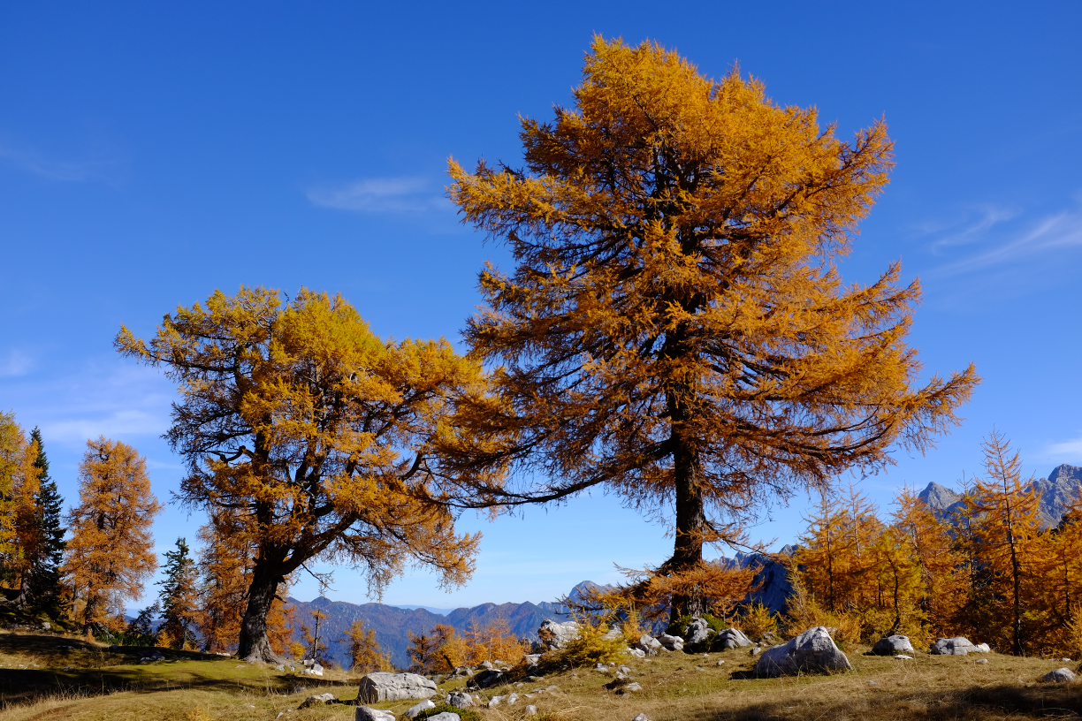
Overview
Overview of ARSO/Slovenia
  DMCSEE
  ESA project
ARSO role within CDOP-3 phase (DSSF, VEGA, ET, ET_ref)

Slide 4
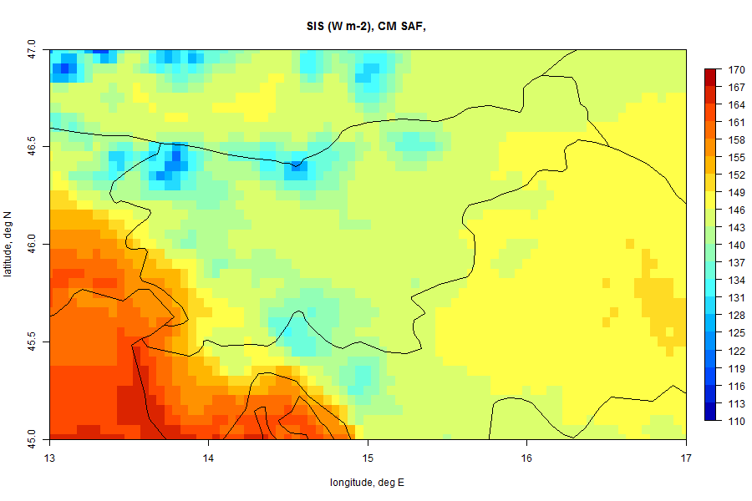
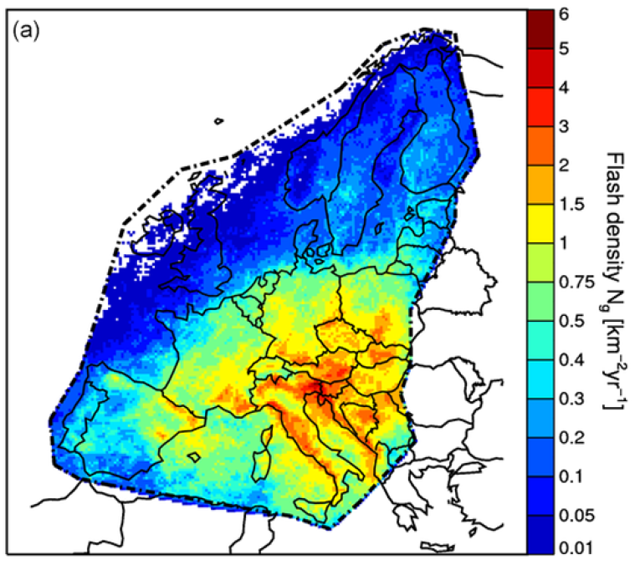
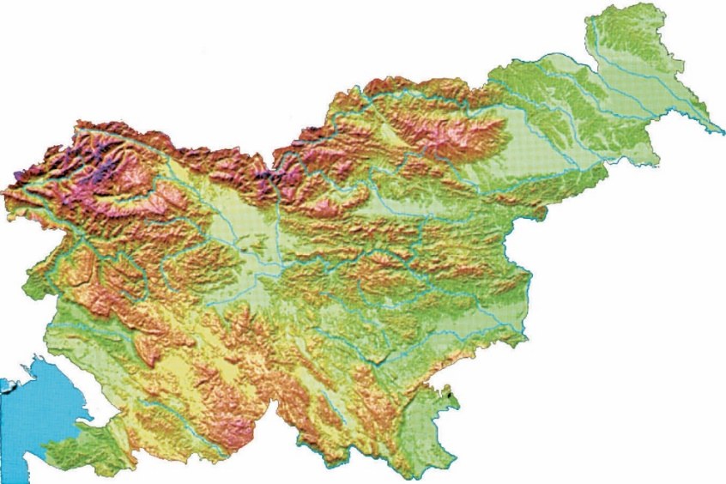

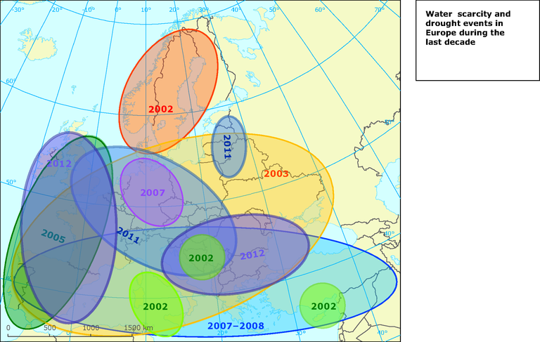
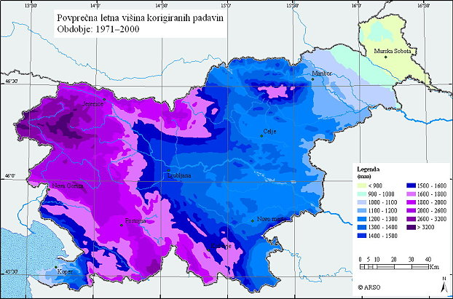
Overview
Mean Surface Incoming Solar radiation SIS (1983 – 2013)
Mean annual CG flash density [km-2 yr-1], based on 2006 - 2014 and 20 km x 20 km, Poelman et al., 2016.
Very severe drought in Slovenia in:
2003, 2006, 2007, 2012, 2013
High Precipitation gradient over Slovenia:
West > 3200mm/year, East < 900 mm/year
Alpine, Mediterranean
and Continental climate regions

Slide 5











International Cooperation
The Republic of Slovenia is a member of:
Slovenian Environment Agency is a member of:
Associate Member:
Hosting:
ECOnomic interest grouping of the National Meteorological Services
High Resolution Numerical
Weather Prediction Project

Slide 6
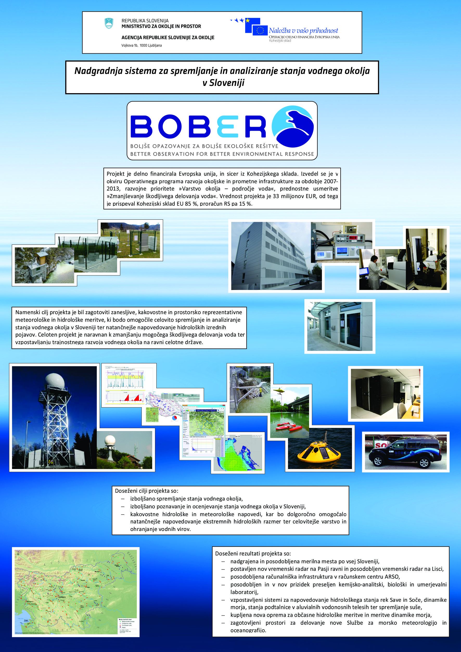
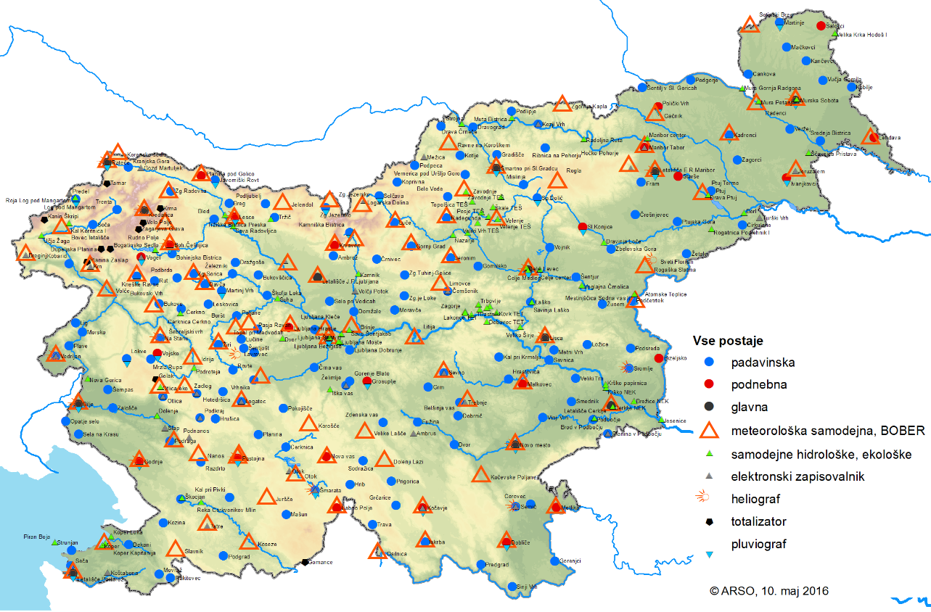

Recent Investments in Environmental Monitoring
  Upgrade of monitoring system and environment for water analyses (€33M)
  281 new/renovated hydro-meteo stations, weather radar, infrastructure, hardware, software, new tools to monitor agricultural drought …
More on http://www.arso.gov.si/

Slide 7
Contents
Slovenian Environment Agency (ARSO)
Drought Management Centre for Southeastern Europe
Drought Monitoring in Slovenia
Applications of Satellite Vegetation Indexes
Conclusions and Future Work

Slide 8
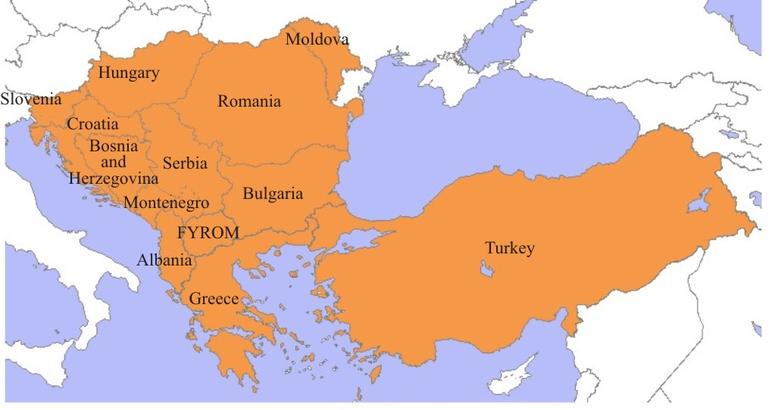
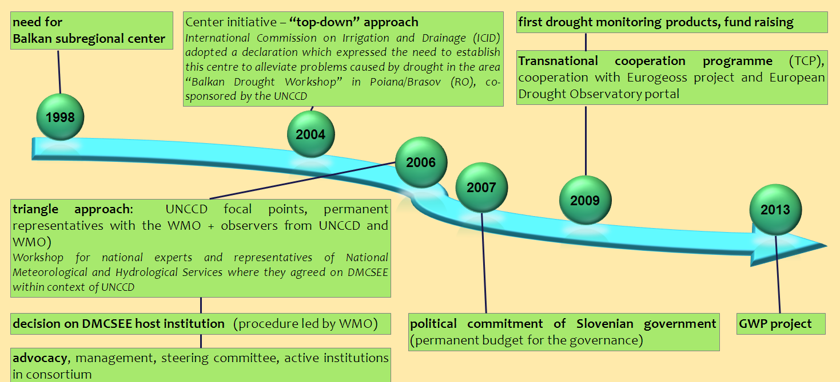
Drought Managament Centre for Southeastern Europe - DMCSEE
DMCSEE is lead by ARSO!
Global water partnership
Integrated drought management programme
DRI Danube – lead by ARSO
InterReg 2017-2019

Slide 9
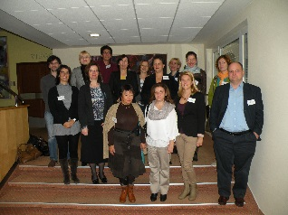
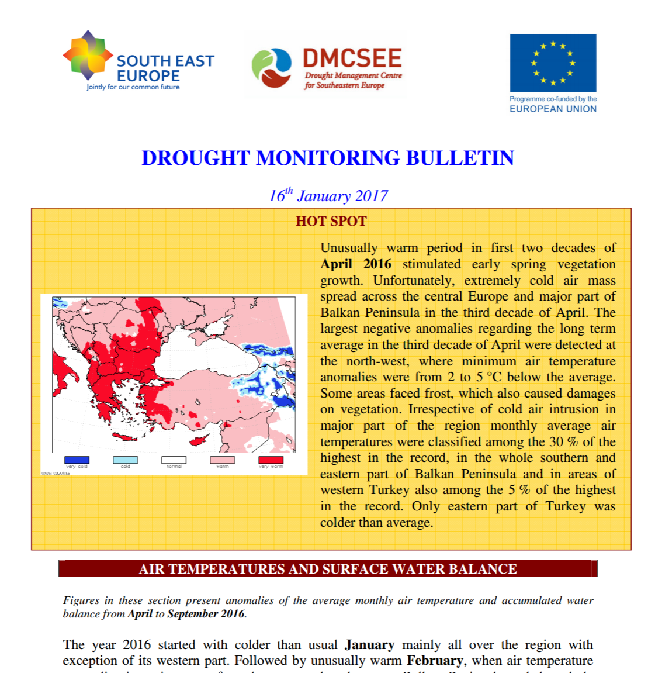
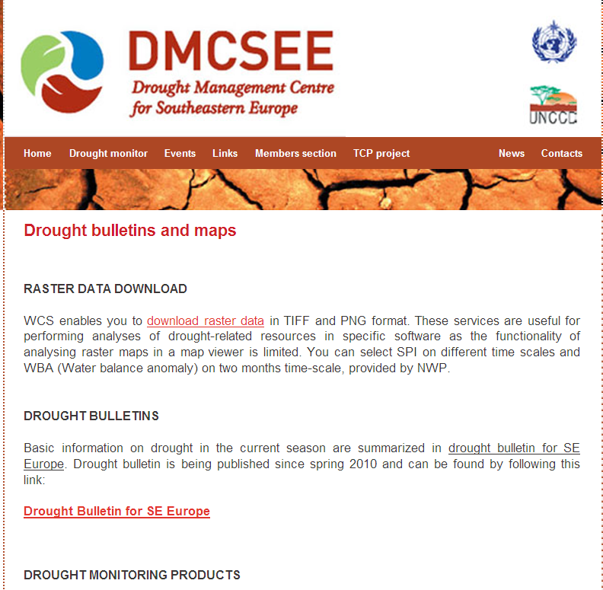
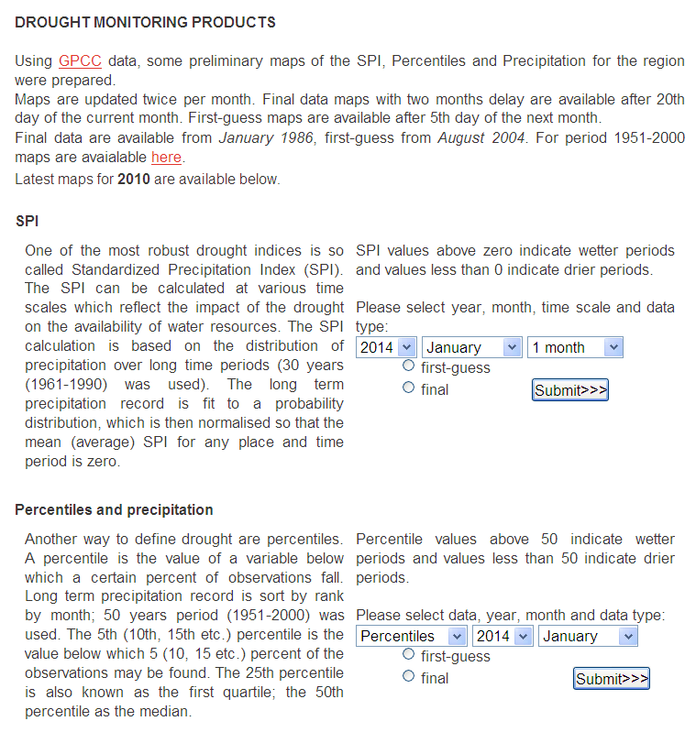


Drought Managament Centre
(www.dmcsee.org)
Implementation of standardized precipitation index (SPI)
SPI, percent. and precipitation (SEE)
Historical maps (1951-2000)
Data origin: GPCC data / update once per month

Slide 10
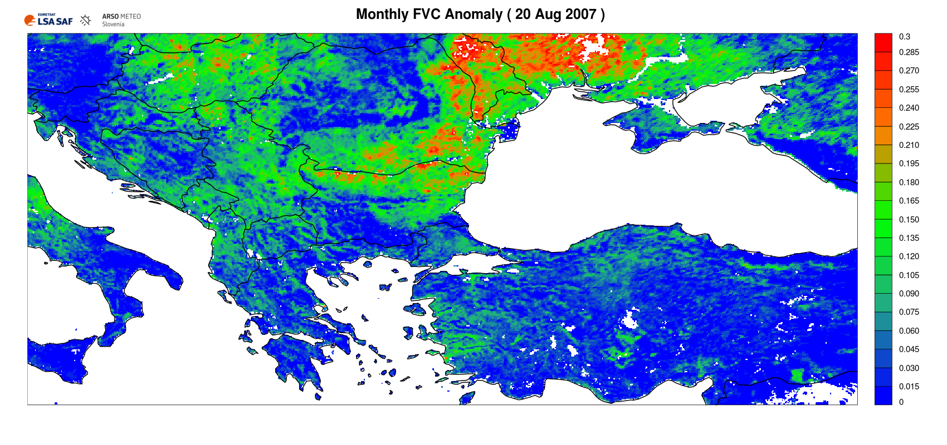
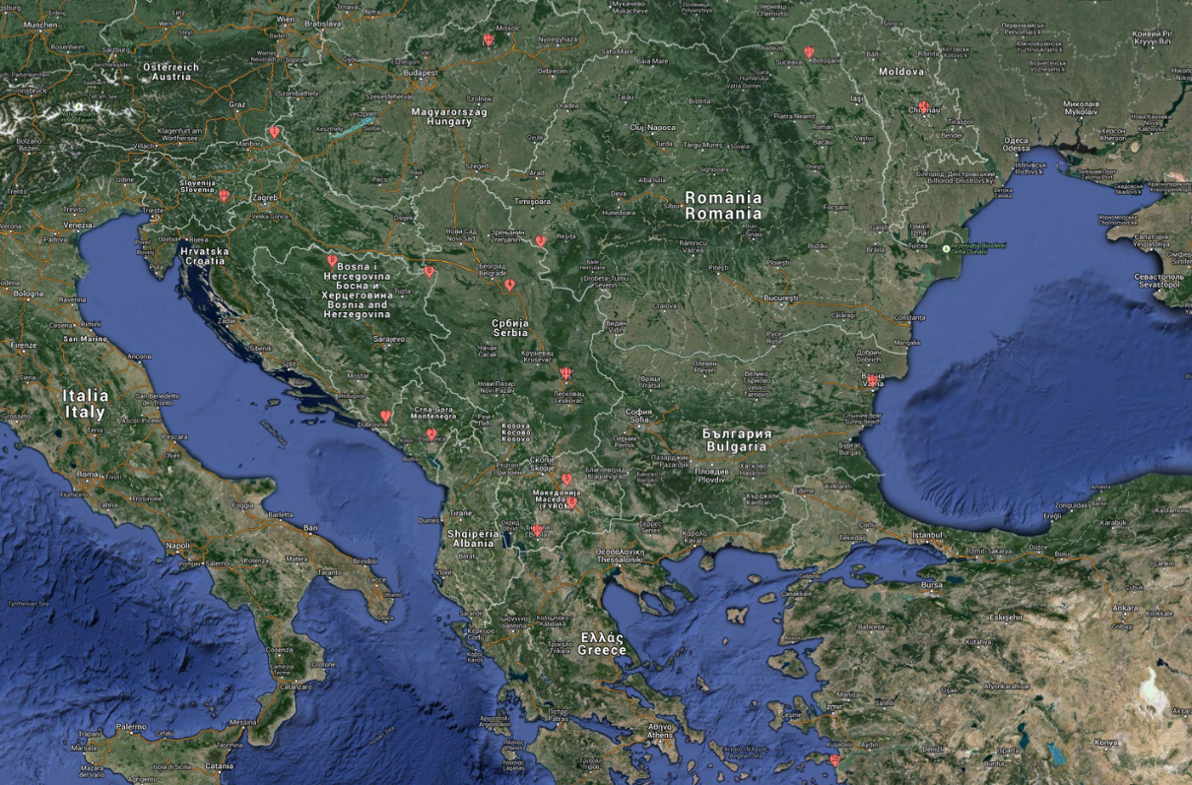
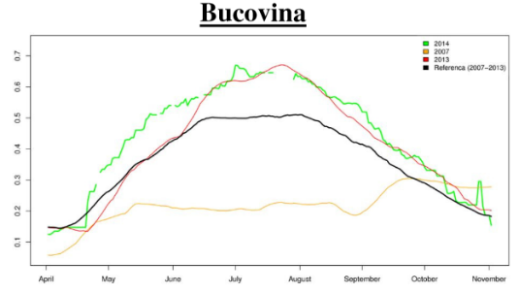
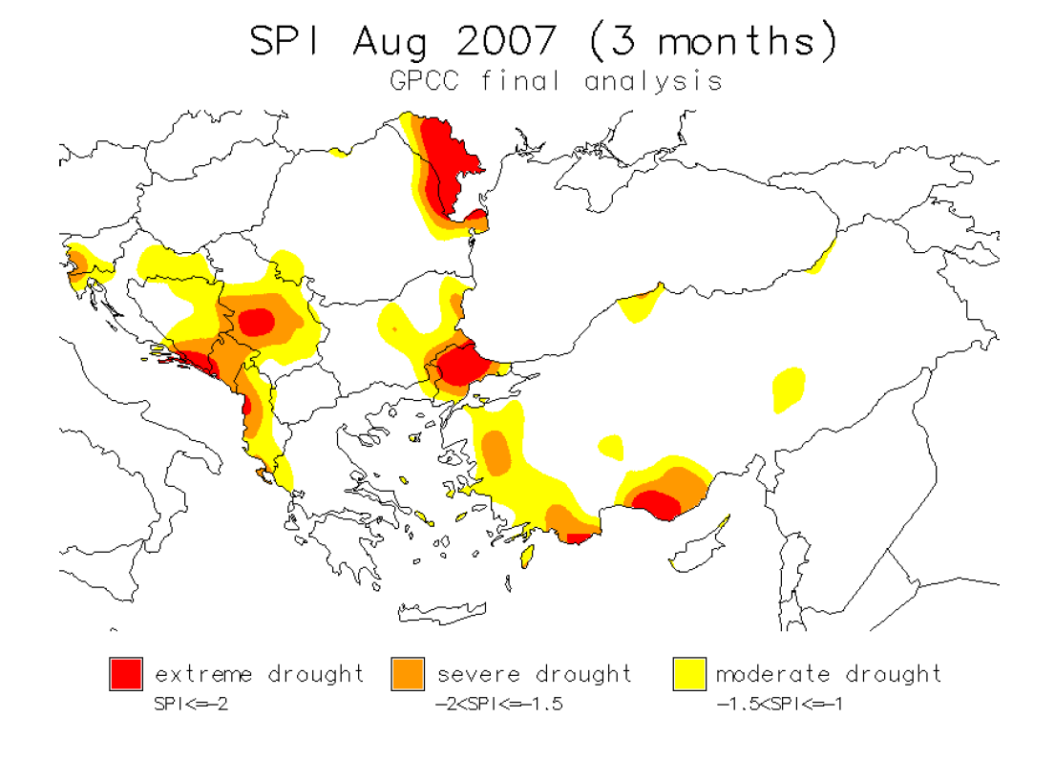
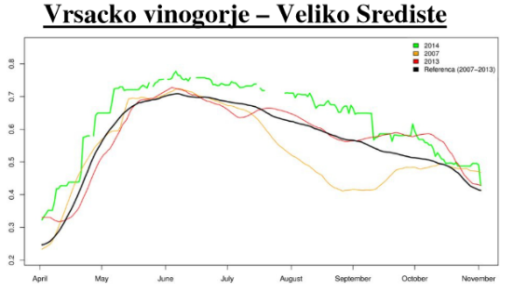
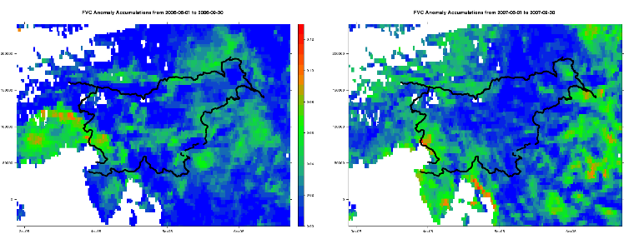
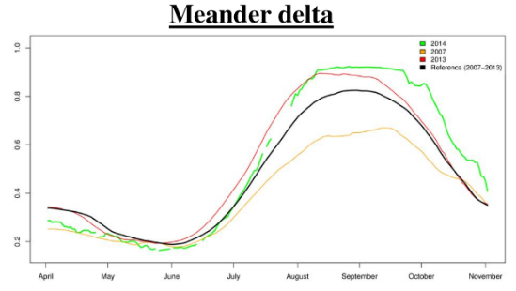
DMCSEE Monthly Bulletin
Integration of LSA SAF VEGA in DMCSEE Monthly Bulletin, selected locations covering 10 areas in SE Europe (SI, HU, RO, BH, MK, ME, RS, TR, BG, MD, GR)

Slide 11
Contents
Slovenian Environment Agency (ARSO)
Drought Management Centre for Southeastern Europe
Drought Monitoring in Slovenia
Applications of Satellite Vegetation Indexes
Conclusions and Future Work

Slide 12
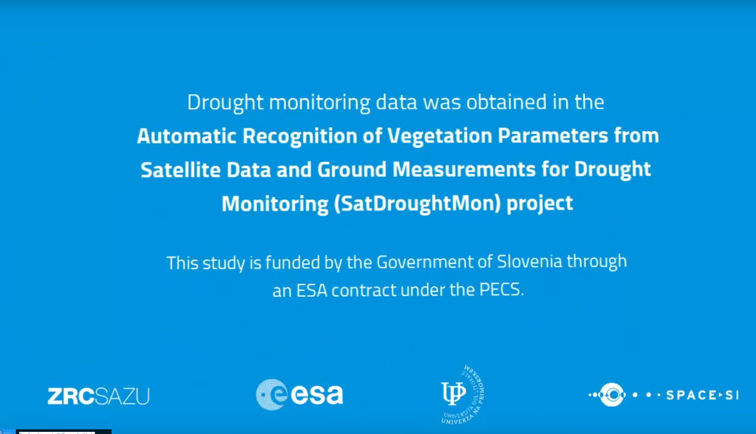
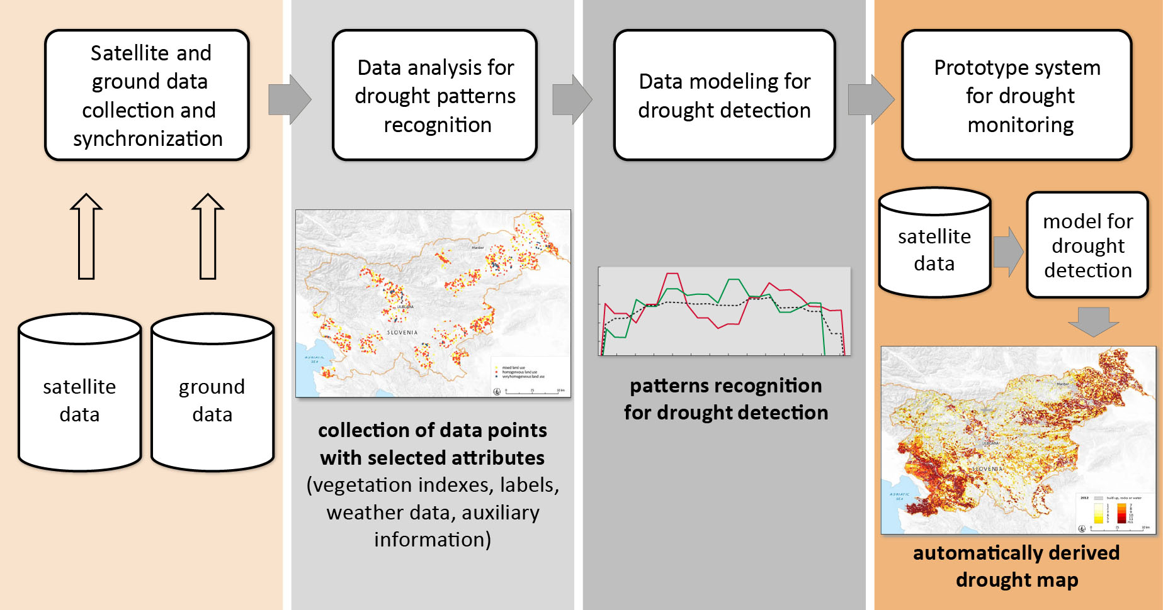
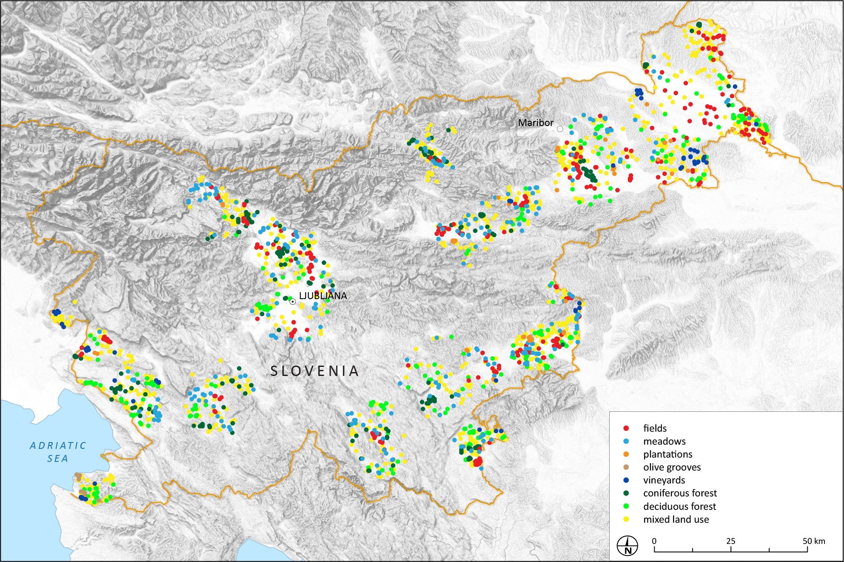
ESA SatDroughtMon Project (2013-2015)
Automatic drought detection flow chart
A set of 2000 training points (2006-2012) for drought detection.

Slide 13
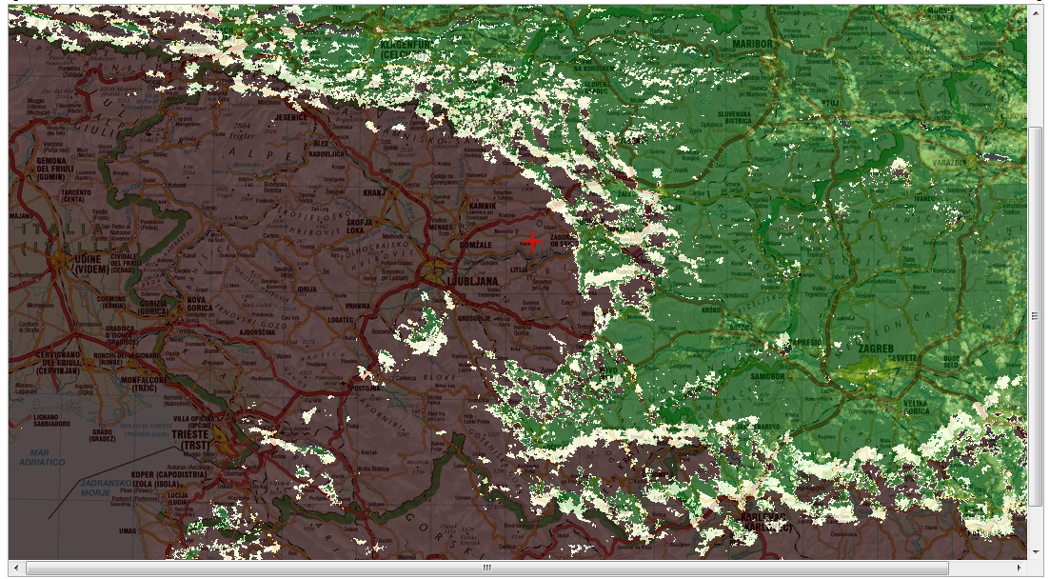
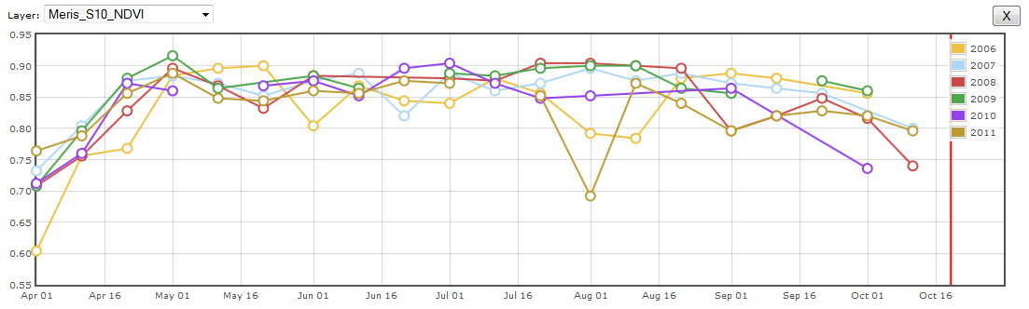
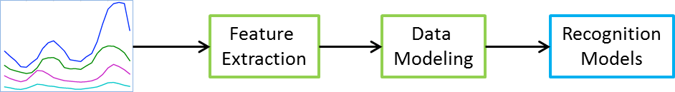
ESA SatDroughtMon: Drought Labelling
Manual drought labelling (field observations, drought impacts, meteo measurements, agro-meteo modelling, and satellite VEGA).
Drought labels: severe drought, drought, no drought, and no (reliable) data.
Machine learning for drought modelling (HMM).
Web application graphical interface
High res satellite data (ESA MERIS and NASA MODIS) for 2006-2012
VEGA products (NDVI, EVI, LAI and FAPAR)

Slide 14
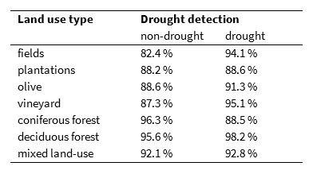
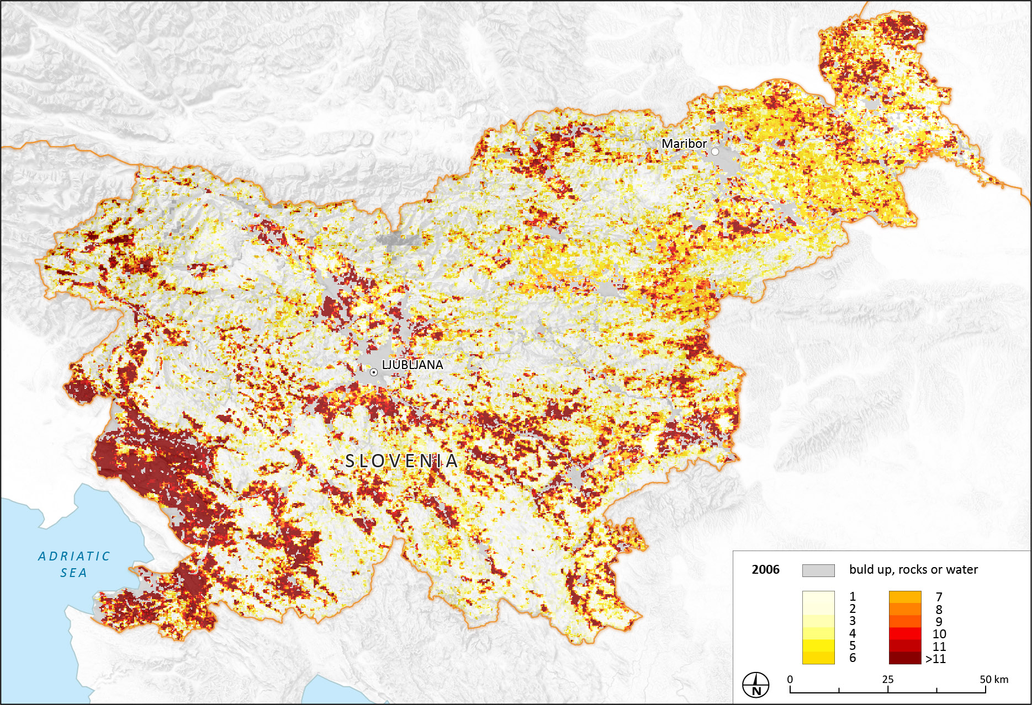
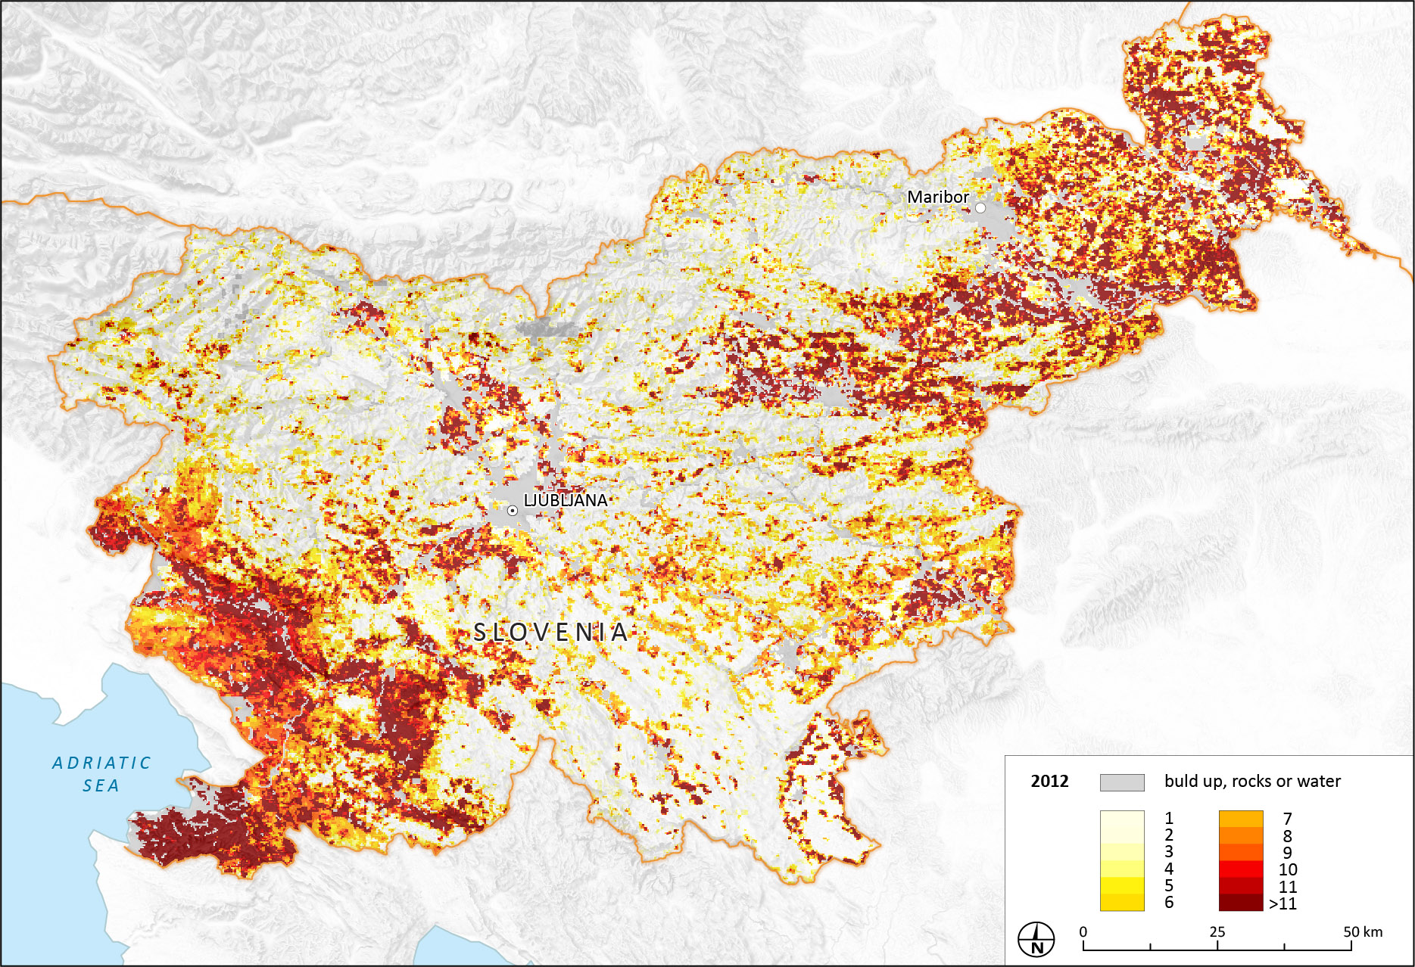
ESA SatDroughtMon: Drought Detection System
Drought maps for 2006-2012.
Drought and non-drought label streams were computed for each 250 m grid point for each growing season separately.
The recognition was performed in a time series every 5 days.
Cumulative yearly drought map show total number of drought events.
The results of drought detection system on test data based on different land use types.
2006 drought map
2012 drought map

Slide 15
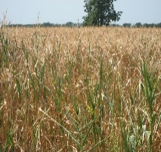
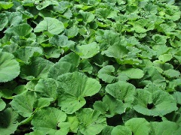
Land Surface Analysis Satellite Applications Facility
Comparison with in situ data, NWP
Assessment of Product Applications
ARSO participation at:
WP 2300: User Support
Presentation of product demonstration and verification cases:
Demonstration and Verification cases:
Product Verification and QM:
(DSSF, ET, ET0, FVC and LAI over Slovenia)
WP 2500: Demonstration, Training & Outreach
Organization of training events for target user communities:
ARSO (with contribution from other partners): European users
Production of product demonstration and verification cases:
ARSO will focus on:
DSSF (MSG and MTG);
daily MSG and MTG Evapotranspiration and Ref. Evapotran.;
daily and 10-daily FVC, LAI as examples of drought signals, and showing benefits of geostationary data when compared with low orbital data (including vegetation indexes from Copernicus Global Land Service);
daily and 10-DAILY NDVI.
  Solar Energy:
  Electric Power Transmission System -operational access of DSSF from 2014
  Forest & Agriculture Applications:
  Drought Monitoring (VEGA, ET, ET_ref), Forest Sleet Damage (VEGA)
  ARSO & DMCSEE (13 countries)
  Hydrological Modeling- regional or EU:
  ET, ET_ref
  ARSO & WMO Regional (SEEFGG) or ECMWF (EFAS)

Slide 16
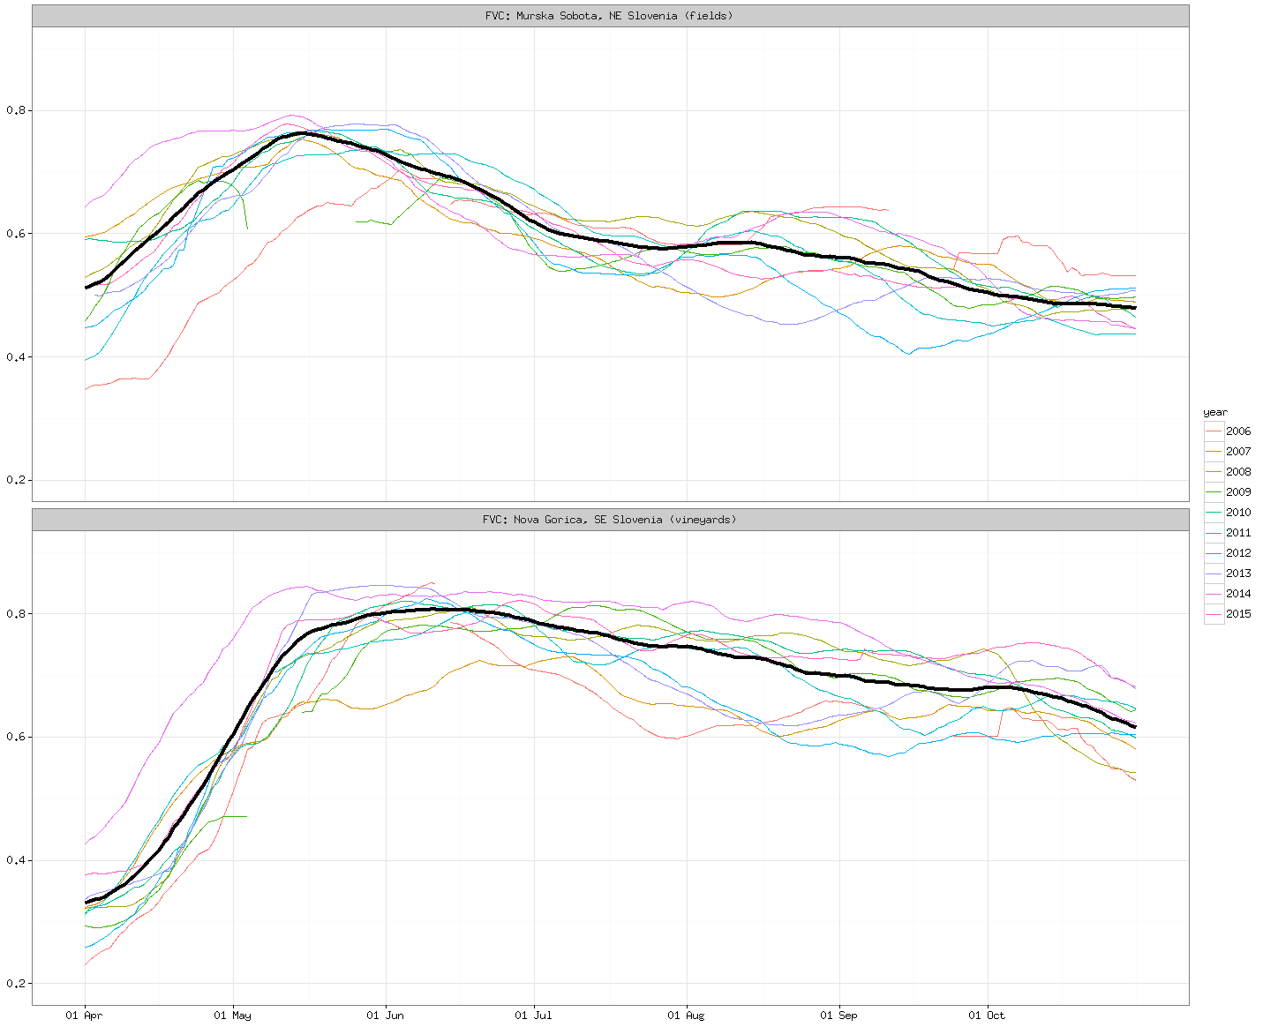
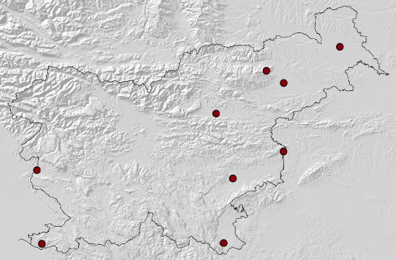
LSA SAF Vegetation Indices – Seasonal Variation
LSA SAF FVC index
Reference based on 2008-2015 average (vegetation season with no drought).
Murska Sobota (NE Slovenia, fields)
Very dry years: 2007, 2012 and 2013 (summer values below reference)
Nova Goria (SW Slovenia, vineyards)
Very dry years: 2006, 2007, 2012 and 2013
A very moist year with high precipitation: 2014 (values well above reference)
Fields
Vineyards

Slide 17
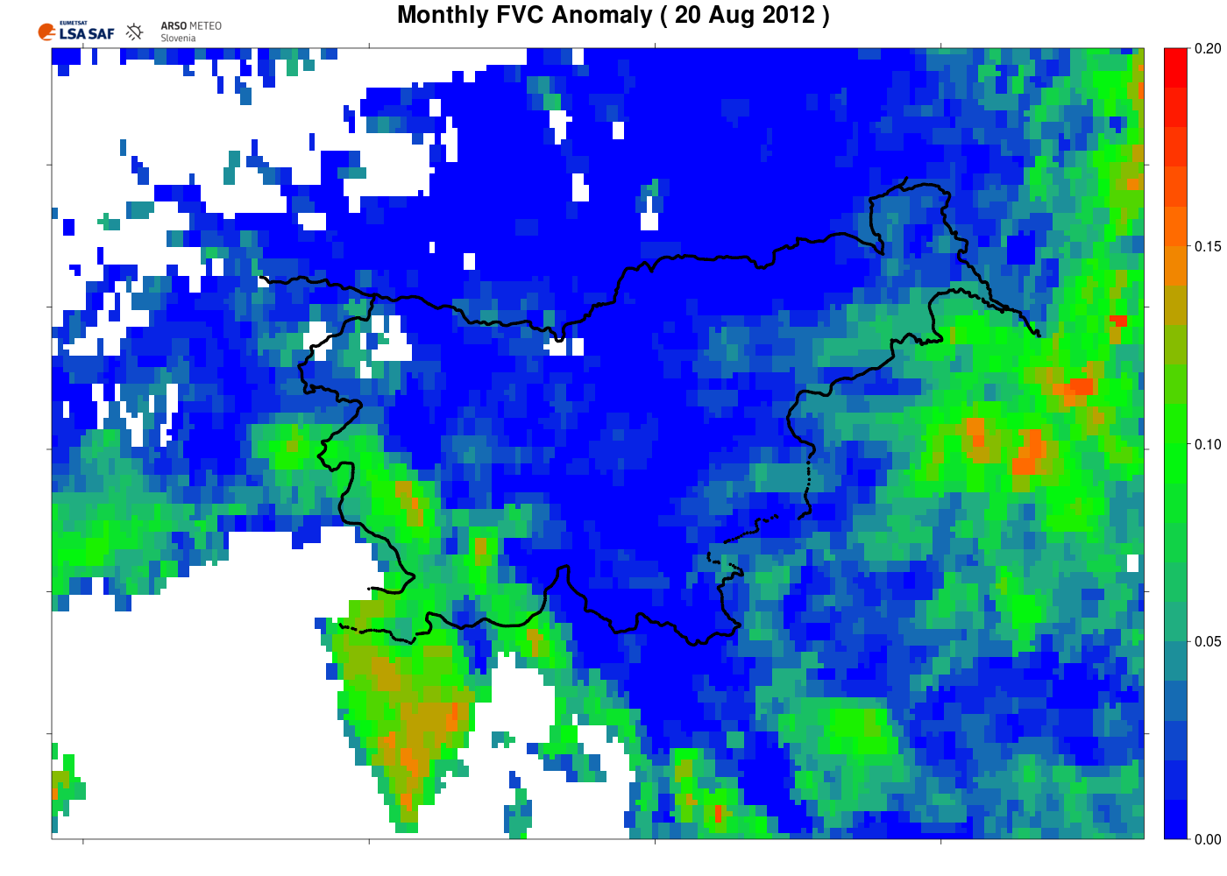
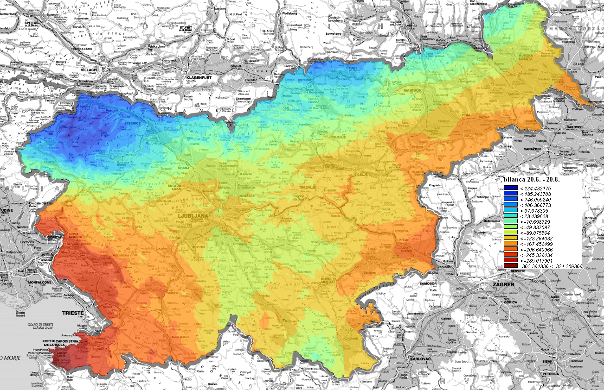
2012 Drought Episode (Slovenia)
Water Balance (WB) in mm for 20 Jun 2012 – 20 Aug 2012
WB = RR – ETP (ground measurements)
Drought in SW and parts of E Slovenia
LSA SAF FVC monthly anomaly on 20 Aug 2012
Average monthly departure from the reference vegetation curve.
A pretty good spatial agreement between drought signal from calculated water balance and satellite vegetation data!
WB (20 Jun 2012 – 20 Aug 2012)

Slide 18
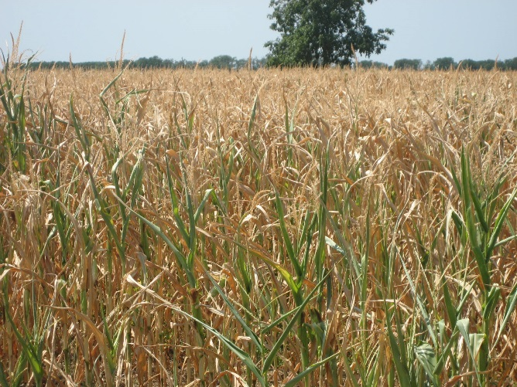
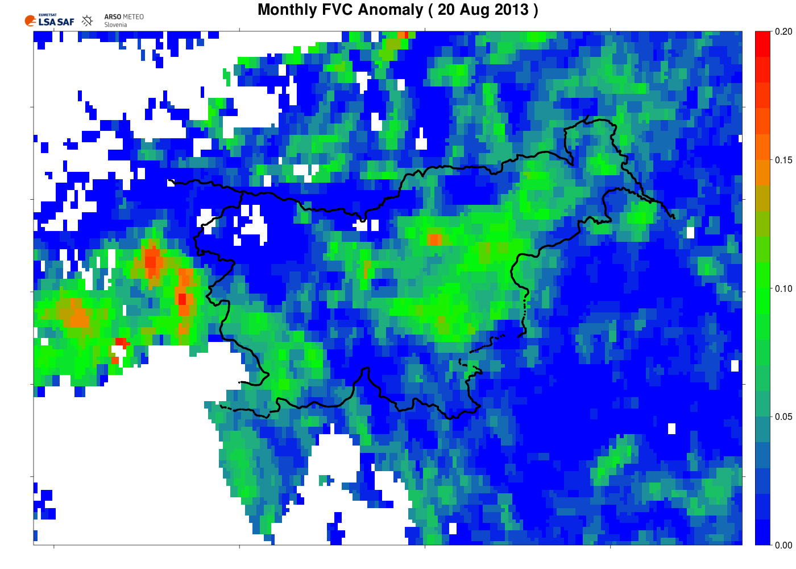
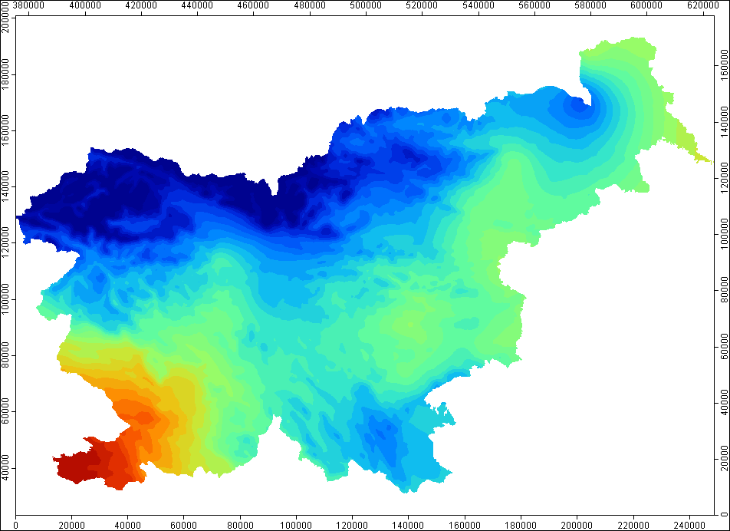

2013 Drought Episode (Slovenia)
Water Balance (WB) in mm for 11 Jun 2013 – 10 Aug 2013
WB = RR – ETP (ground measured data)
Drought in SW and parts of E Slovenia
LSA SAF FVC average monthly anomaly on 20 Aug 2013
Average monthly departure from the reference vegetaton curve.
Again a fairly good spatial agreement between drought signal from calculated water balance and satellite vegetation data!
WB (11 Jun 2012 – 10 Aug 2013)

Slide 19
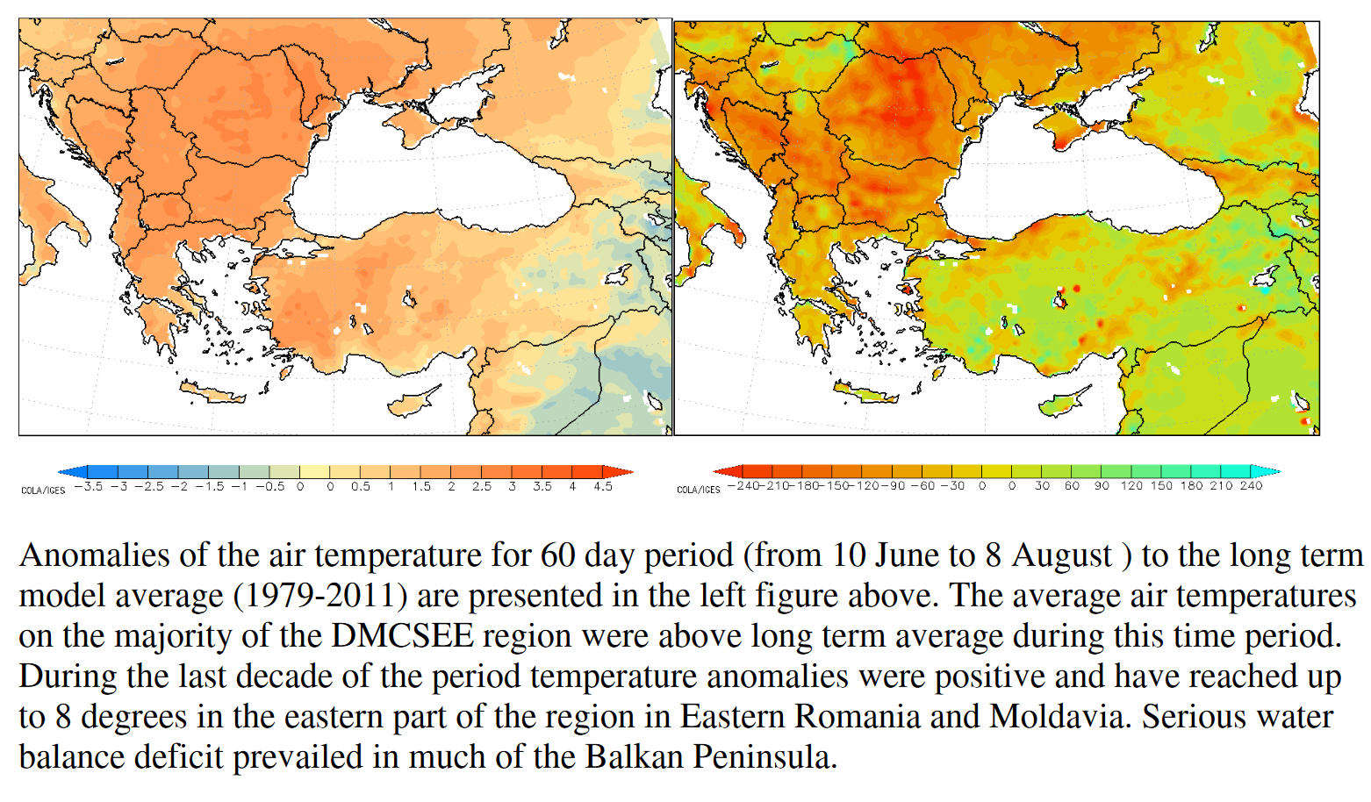
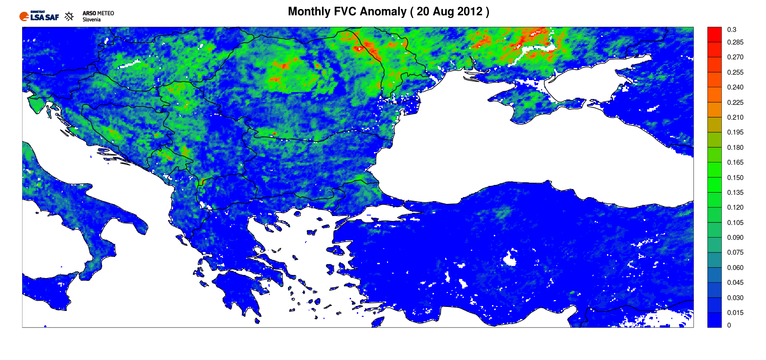
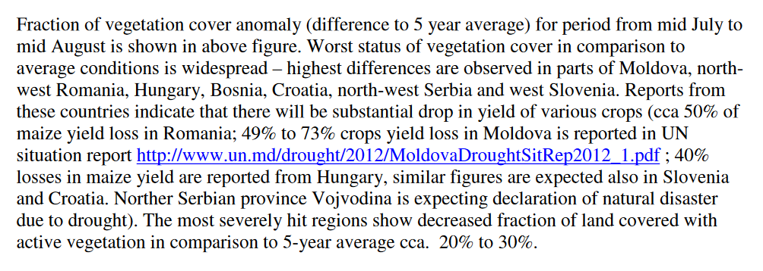
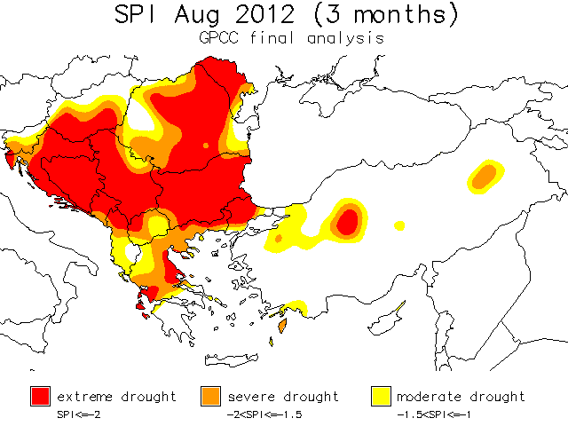
2012 Drought Episode (SE Europe)

Slide 20
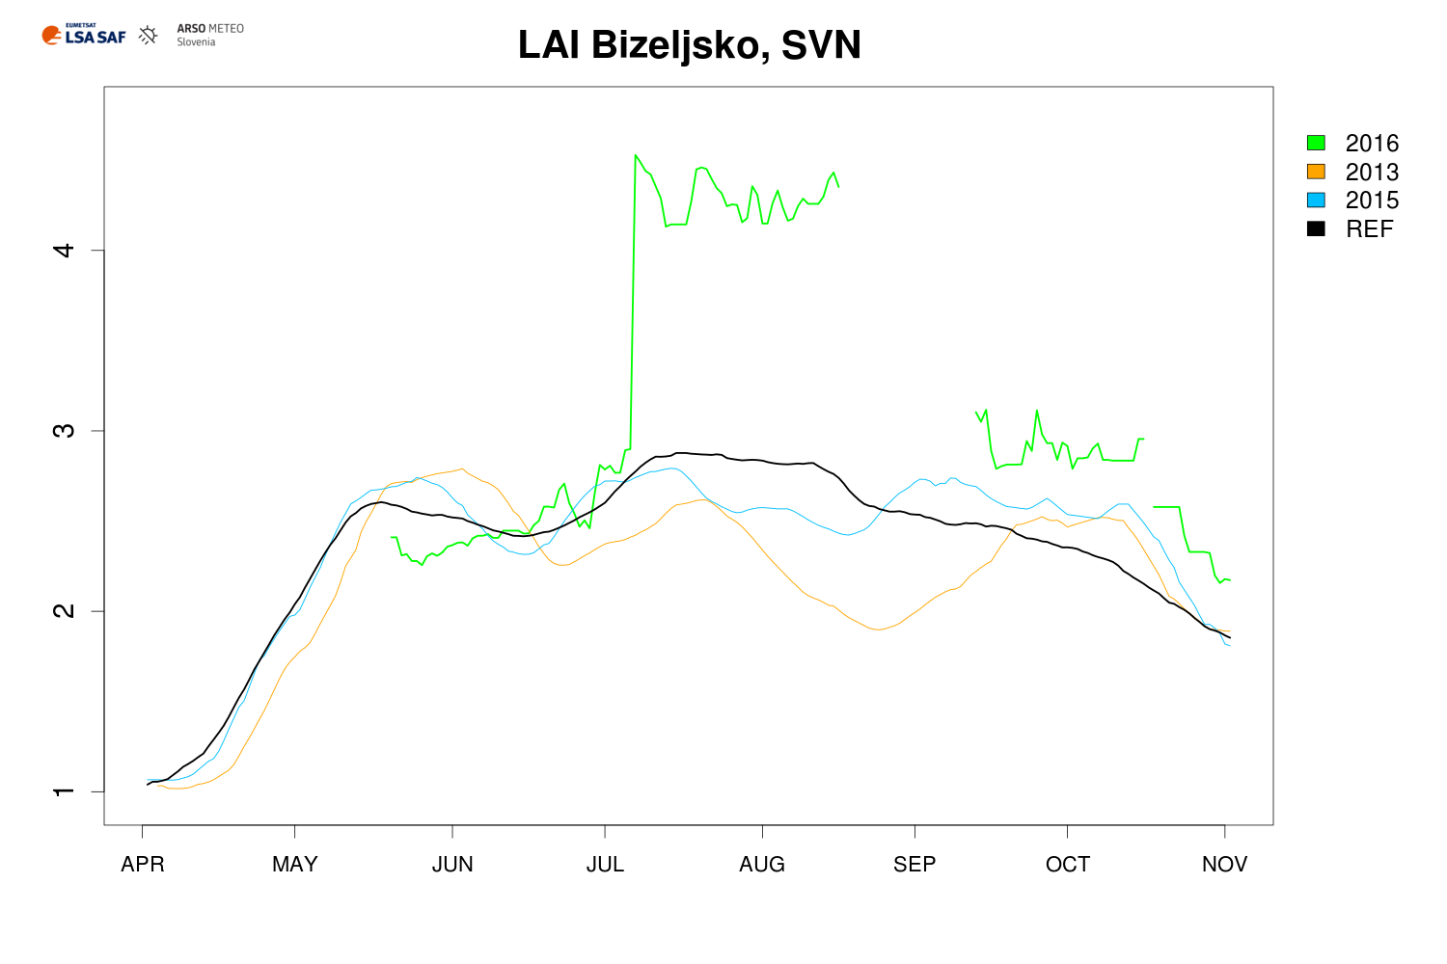
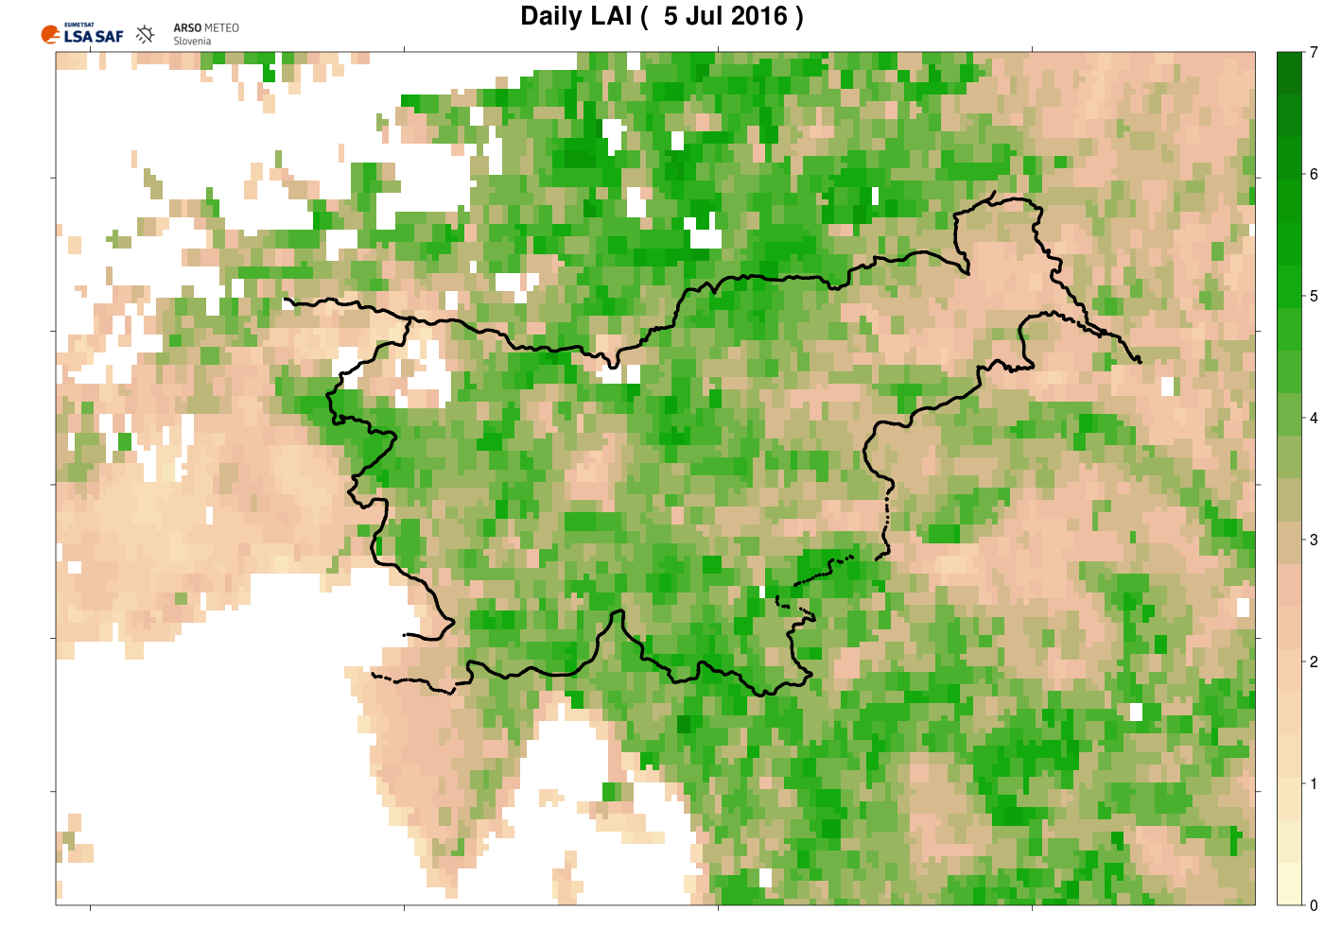
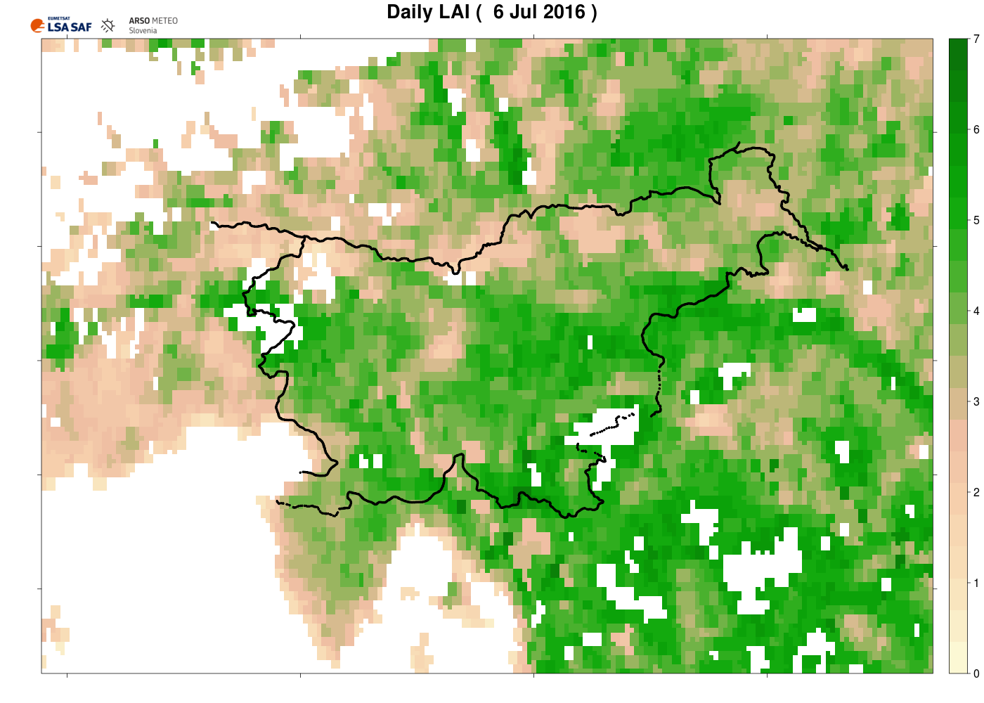
Version 3 Vegetation Algorithm (Slovenia)
6 Jul 2016: a switch to a new LSA SAF VEGA algorithms!
Provide a more accurate identification of the vegetation and soil components, which reduces a positive bias of FVC and LAI values for South America and South Africa regions, and also improves the consistency with other satellite based products. A new condition is added to better identify pixels with residual snow over Europe (LSA SAF web site).
Over Slovenia the difference between older and newer algorithm can be quite significant, particularly in the forests!

Slide 21
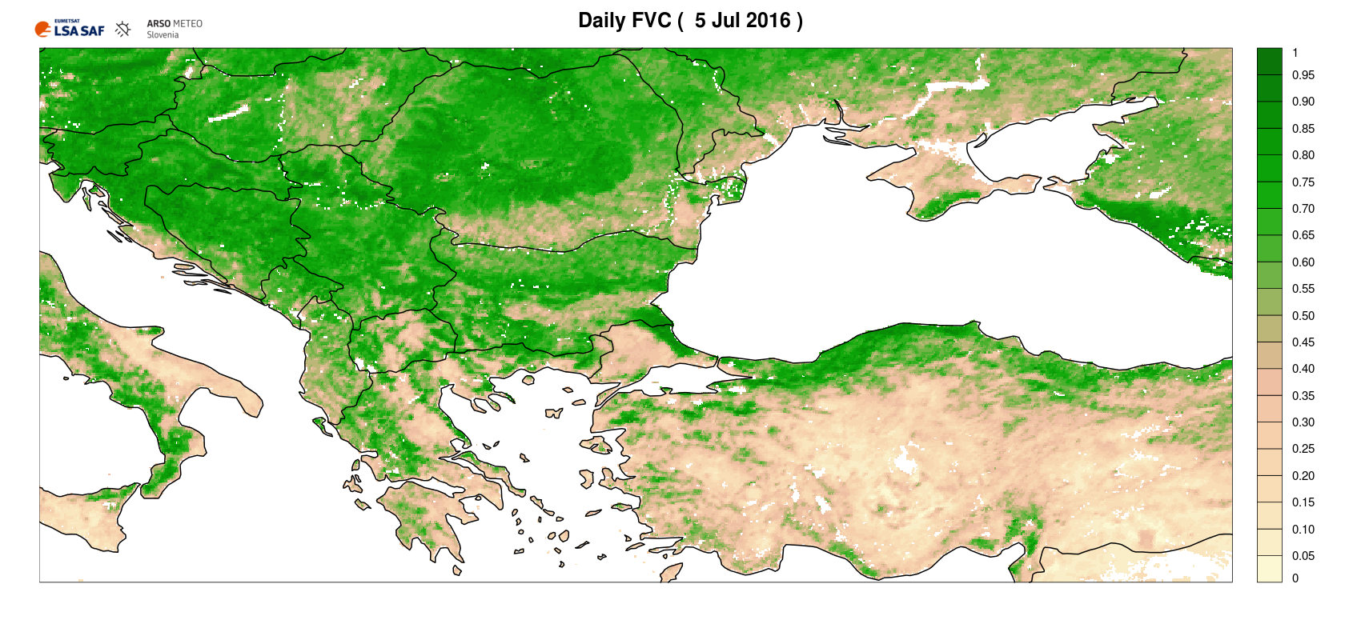



Version 3 Vegetation Algorithm (SE Europe)

Slide 22
V3 Vegetation Algorithm
In some areas a significant difference between VEGA data (FVC and LAI) processed by V2 and V3 algorithms whereas some other locations display no significant impact due to algorithm change.
Reprocessing of V3 VEGA for 2004-2012 already done and according to LSA SAF available for end-users.
Reprocessing of V3 VEGA needed also for 2013-2016 (according to LSA SAF planned and will be done ASAP).

Slide 23


High Spatial Resolution Satellite Data
LSA SAF‘s FVC
Copernicus LAND

Slide 24

Evapotranspiration
Comparison of LSA SAF ET in blue with ET0 calculated from ground measurements in red for Maribor, Slovenia (Apr – Nov).
Scatter plot
2013 – red circle – deviation between satellite ET and potential ET0
2011 – correlation is excellent

Slide 25
Contents
Slovenian Environment Agency (ARSO)
Drought Management Centre for Southeastern Europe
Drought Monitoring in Slovenia
Applications of Satellite Vegetation Indexes
Conclusions and Future Work

Slide 26
Vegetation Damage not Associated with Drought
Occasionally departure of vegetation signal from normal is not associated with droughts. Some notable examples:
Glaze ice
Hail

Slide 27



Glaze Ice (SW Slovenia), Jan/Feb 2014
Anticyclone over EE, cyclone over SE
Colder and moist air mass in the valleys (E wind)
Warmer and moist air mass at around 1000 m (SW wind)
Around 5 cm of sleet in the worst hit areas
Causing > €400M damage
Ground measured precipitation (29 Jan – 6 Feb)
UK Met Office synoptic chart, 1 Feb 2014.
Vertical temperature sounding, 31 Jan 2014, Ljubljana, central Slovenia.
Precipitation type and amount, Postojna, 30 Jan – 6 Feb. Colour chart: snow, freezing rain, rain with snow, rain and ice pellets.

Slide 28




Glaze Ice (SW Slovenia), Jan/Feb 2014
And below aftermath of the event a few months later …
(all pictures extracted from Slovenian news sources, e.g., Delo)

Slide 29


Glaze Ice (SW Slovenia), Jan/Feb 2014
2014 summer season was extremely wet. Vegetation was well above normal during the summer.
Glaze ice damage map based on ground measured TEMP and RR + vertical TEMP profile.
There is a fairly good spatial agreement between the glaze ice damage map and FVC, particularly in SW Slovenia suffering the worst of glaze ice!
The glaze ice signal is still present in 2015. The sleet also partly contributed to bark beetle outbreak on coniferous trees in 2016/2017.
Glaze ice damage

Slide 30





Hail in Bizeljsko, E Slovenia (11 Jul 2011)
Pictures above obtained from Slovenian local news (http://www.bizeljsko.si).

Slide 31
Contents
Slovenian Environment Agency (ARSO)
Drought Management Centre for Southeastern Europe
Drought Monitoring in Slovenia
Applications of Satellite Vegetation Indexes
Conclusions and Future Work

Slide 32
Conclusions
Drought frequency and intensity necessitates a focus on drought monitoring!
Satellite data is very helpful for drought monitoring.
LSA SAF VEGA products are very important for ARSO (daily temporal resolution is ideal for drought monitoring).
High spatial resolution satellite measurements require a more detailed land use type knowledge (e.g. what crops are grown on the fields).
In combination with ground based drought data …

Slide 33
Future Work
EPS VEGA from AVHRR/METOP
LSA SAF ET (hydrological modelling)

Slide 34

Thank you for your attention!

