Slide 1



SALGEE towards the biogeophysical and biogeochemical connection of climate and biosphere
SALGEE
Julia Stoyanova
National Institute of Meteorology and Hydrology, Bulgaria
6th SALGEE Workshop, 14 – 17 October, Darmstadt, EUMETSAT HQ, Germany
‘MSG Land Surface Applications: Connection of climate and biosphere’

Slide 2
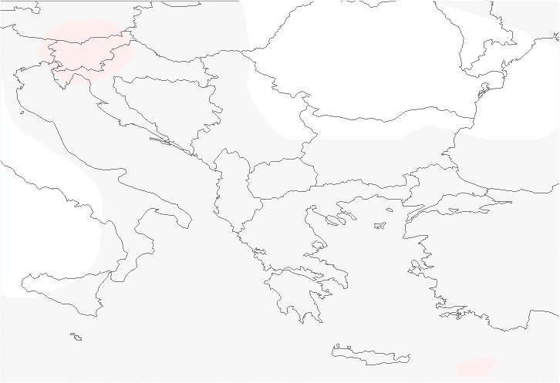


SALGEE, The Satellite Applications in Land surface analyses Group for Eastern Europe has been established in 2009 for gathering experts in the field of satellite meteorology to complement the activities of EUMETSAT Land Surface SAF for progression of using satellite Land Surface Analyses techniques and training in Eastern Europe and other regions of interest where their application might be beneficial in conjunction with other source of information (CGMS-38, 2010), http://www.eumetsat.int/Home/Main/AboutEUMETSAT/InternationalRelations/CGMS/CGMSPublications/index.htm
EUMETSAT
SALGEE Project /2009-2019/
in support to LSA SAF
The Land Surface Analyses Satellite Application Facility, LSA SAF has been especially designed to serve the needs of the meteorological community, particularly Numerical Weather Prediction (NWP). Nowadays, the LSA SAF program addresses a much broader community and operational applications.
The EUMETSAT Satellite Application Facility on Land Surface Analysis (Land-SAF) aims to be a leading centre for retrieval of information on land surfaces from remote sensing data, with emphasis on EUMETSAT satellites.

Slide 3
SALGEE User Group in support to EUMETSAT LSA SAF
Satellite Applications in Land surface analyses Group for Eastern Europe
inciated 2009 - established 2010
Objectives of the SALGEE initiative
To support to LSA SAF activities in user services & training in south-eastern and eastern Europe and other regions of interest to take full advantage of remotely sensed data (MSG and EPS) on:
  land
  land-atmosphere interactions and
  biosphere applications.
To foster an integrated approach for research and operational activates in meteorology and climatology in support to the:
  quantification of biogeophysical cycle,
  biochemical cycle, and
  related land surface processes,
in combination with information from in situ data, model outputs and satellite observations (accounting for the active role of vegetation).

Slide 4
SALGEE User Group in support to LSA SAF
SALGEE Role
Promotion of LSA SAF products
  Develop training materials to support:
    the use of new land surface analysis methods, and
    operationally generated geophysical products, and
    their application in operational meteorology and climatology.
Facilitate the product use
  Assist EUMETSAT in responding to the needs of NMHSs in Eastern Europe and other target user regions for access to satellite data and training.
  Assist the LSA SAF in communicating with National Meteorological and Hydrological Services (NMHSs) on the use of satellite data and products for the purpose of land surface analysis.
  Validation activities towards applicability of LSASAF satellite products for the target region.
Gathering experts & Exchange of knowledge
  Facilitate the exchange of knowledge and information between leading scientists and experts at an international level on the use of satellite land surface analysis techniques.
  Establish mechanisms and environment where scientists and user community provide feedback to product developers at EUMETSAT, LSA SAF, NOAA/NASA.
  Organise biennial international workshops to review and discuss progress in using satellite products for land surface applications.

Slide 5
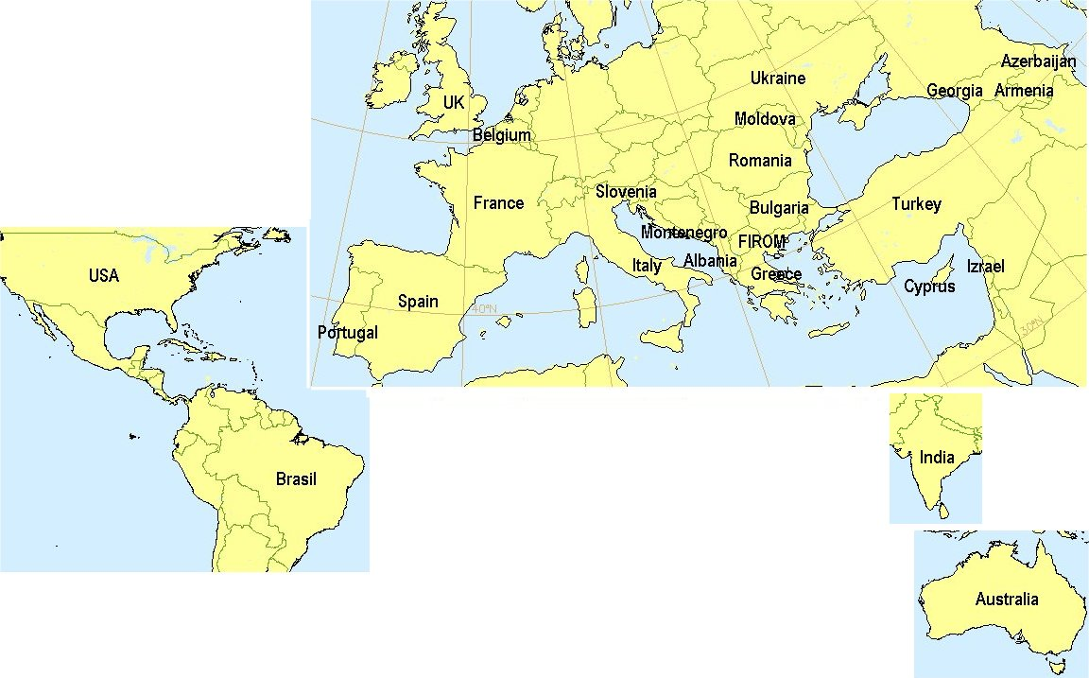
EUMETSAT SALGEE (Satellite Applications for Land surface analyses Group for south Eastern-eastern Europe) Project
Countries, which have been involved in the activities of SALGEE and/or participated in the workshops.
North Macedonia
New comers 2019:
Austria, Poland, Switzerland,
Iran, Jordan, Palestine
SALGEE Activities
Gathering experts & Exchange of contemporary knowledge.
Maintain a close cooperation with the LSA SAF Consortium Members, NOAA/NESDIS and NASA.
Work in coordination with the LSASAF CDOP-3 (2017-2022) priorities.
Maintain a web site for the efficient exchange of information and the provision of documentation.
Thematic Biannual Workshops.

Slide 6
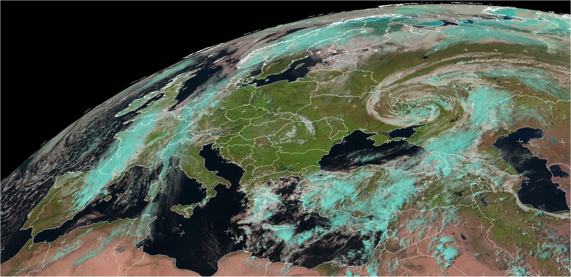
SALGEE Activities on MSG Land Surface Applications
Drought and related environmental response
Fire hazards, risk diagnoses and forecast
Climate –vegetatation relations
6th SALGEE
Connection of climate and biosphere, 14-17 Oct 2019
EUMETSAT, Darmsatadt
1st SALGEE
5th SALGEE
4th SALGEE
Drought and Fires
7-10 Sep 2009
Sofia, Bulgaria
Drought and Environmental response
1-3 Sep 2015
Matera, Italy
Heat waves,
Drought Hazard and Fire Monitoring
18-20 September
Yerevan, Armenia
2nd SALGEE
3rd SALGEE
Drought and Fire Emissions
20 - 21 March 2013
Ericeira/Lisbon, Portugal
Drought and Fires
4 - 7 April 2011 Antalya, Turkey
1st Workshop, Sofia, 7-10 September 2009, Bulgaria, “MSG Land Surface Applications: Drought & Fires”, http://info.meteo.bg/conferences/EUMETSAT07092009
http://gofc-fire.umd.edu/implementation/Events/meetings/past.asp
2nd Workshop, Antalya, 4-7 April 2011, Turkey, “MSG Land Surface Applications: Drought & Fires” http://www.eumetsat.int/Home/Main/DataProducts/HowtoUseOurProducts/WorkshopsAndCourses/SP_
3rd Workshop, Lisabon/Ericeira, 20 - 21 March 2013, Portugal, “MSG Land Surface Applications: Drought & Fire emissions”
4th Workshop, Matera, Italy 1 - 3 September 2015, “MSG Land Surface Applications: Drought and Environmental response” https://www.cnr.it/it/evento/14133
5th Workshop, Yerevan, Armenia 18 - 20 September 2017, “MSG Land Surface Applications: Heat waves, drought hazard and fire monitoring” https://www.cnr.it/it/evento/14133
Notes:
6
6

Slide 7
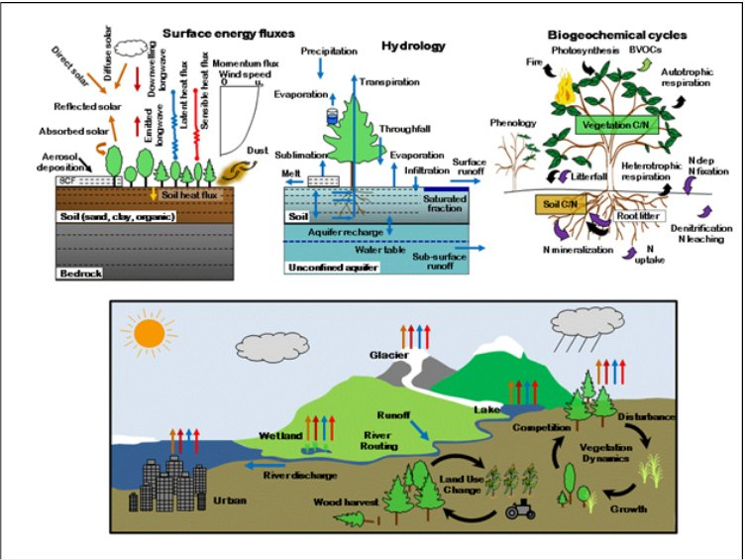
SALGEE approach: Scientific background and priorities
The 6th SALGEE Workshop 2019
“MSG Land Surface Applications: Connection of climate and biosphere”
Schematic diagram depicting processes represented in the Community Land Model (CLM)
Earth system science and modeling
Biogeophysical cycling
  http://www.cesm.ucar.edu/models/clm/
Biogeochemical cycling
.

Slide 8
SALGEE approach:
- Land surface state & anomalies assessment
- Interdisciplinary framework and science
Earth system science and modeling - two central themes (e.g. in CLM) :
1) terrestrial ecosystems, through their cycling of energy, water, chemical elements, and trace gases, are important determinants of weather and climate,
2) the land surface is a critical interface through which climate change influences humans and ecosystems, and through which humans and ecosystems can affect global environmental change.
To quantify the role of terrestrial processes in diurnal to interannual weather
and climate variability including influence on droughts, floods, temperature extremes and their effects.
References:
http://www.cesm.ucar.edu/models/clm/
Lawrence, D. and Fisher, R., National Center for Atmospheric Research (NCAR), Boulder, Colorado, USA. The Community Land Model Philosophy: model development and science applications, https://pdfs.semanticscholar.org/26eb/cbc1b7998d2144e83ed73e3d791a3c46cc2f.pdf

Slide 9

Role of land in the climate system ?
There are strong evidences that the land surface influences weather and climate at a range of time scales from seconds to millions of years.
Atmosphere
Biogeophysical processes regulate fluxes of:
  momentum
  heat
  water
  gaseous components.
energy
water
СО2
energy
water
СО2
Land
Ocean
Land-Atmosphere coupling is based on ecosystems functioning, which are at the bottom of atmosphere.
Coupling of energy-water-carbon cycles is :
  from one side the bases of ecosystem functioning (referring to all processes related to biosphere, e.g. distribution, productivity, etc.)
  that from other side is resulting in transformation of solar energy into the energetic fluxes of latent heat, LE and sensible heat, H towards atmosphere, and in the soil, G, as well as chemical compounds.
Short term effects
Long-term effects

Slide 10
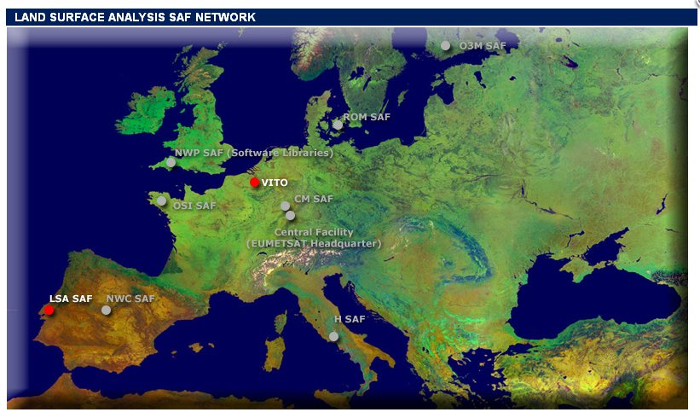

Objectives of the 6th SALGEE Workshop
“MSG Land Surface Applications: Connection of climate and biosphere”
EUMETSAT LSA SAF Program
The Land Surface Analyses Satellite Application Facility, LSA SAF has been especially designed to serve the needs of the meteorological community, particularly Numerical Weather Prediction (NWP). Nowadays, the LSA SAF program addresses a much broader community and operational applications.
https://landsaf.ipma.pt/en/
Land surface bio-physical parameters from large scale optical sensors in an operational way
To continue the traditions from preceding Workshops in:
    Widespread interdisciplinary approach in
    application of LSASAF products in the context of biogeophysical & biogeochemical cycling.

Slide 11
SALGEE
Objectives of the 6th SALGEE Workshop
“MSG Land Surface Applications: Connection of climate and biosphere”
2. To support studies on the connection Climate-Biosphere by using satellite data and products in conjunction with meteorological models, NWP models and ground observations so to reflect:
  Main aspects of biogeophysical cycle and related meteorological extremes - drought, fire risk, heat waves;
  Main aspects of biogeochemical cycle related processes of NPP, GPP, crops yield, biomass burning and fire emissions;
  Main problems in Agrometeorology;
  The problem of forest sustainability and disturbances.

Slide 12
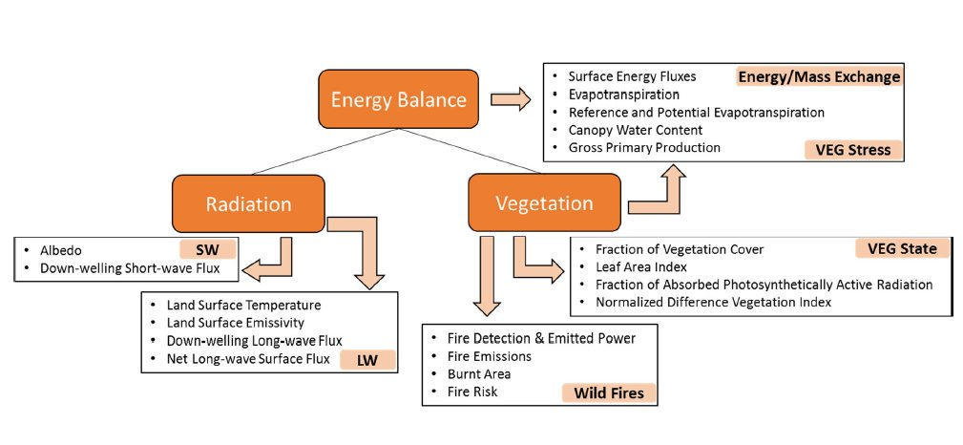
Accent will be given on LSASAF products directly connected to biogeophysical and biogeochemical cycles.
The scope of Land Surface Analysis Satellite Applications Facility (LSA SAF) is to increase benefit from EUMETSAT Satellites (MSG and EPS) data related to:

Slide 13
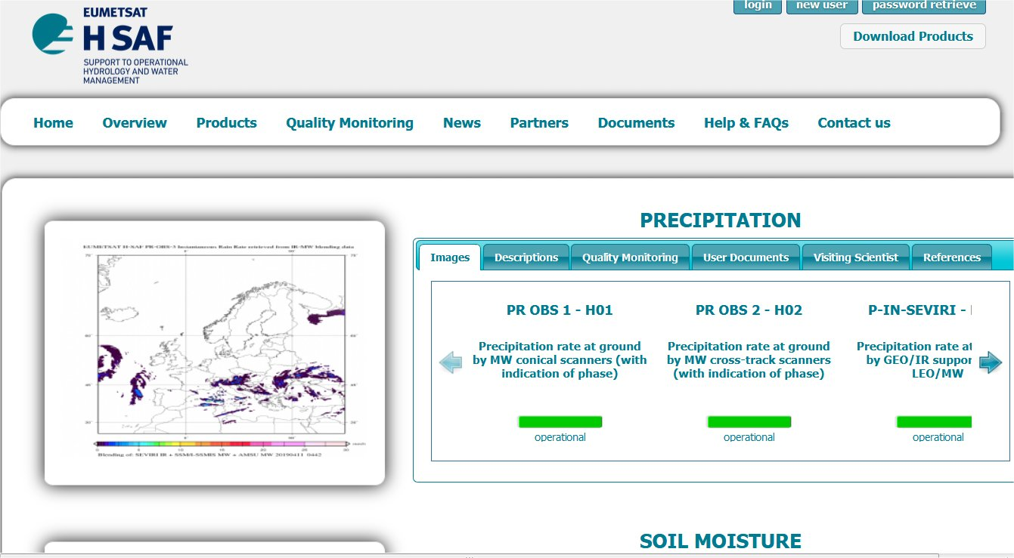
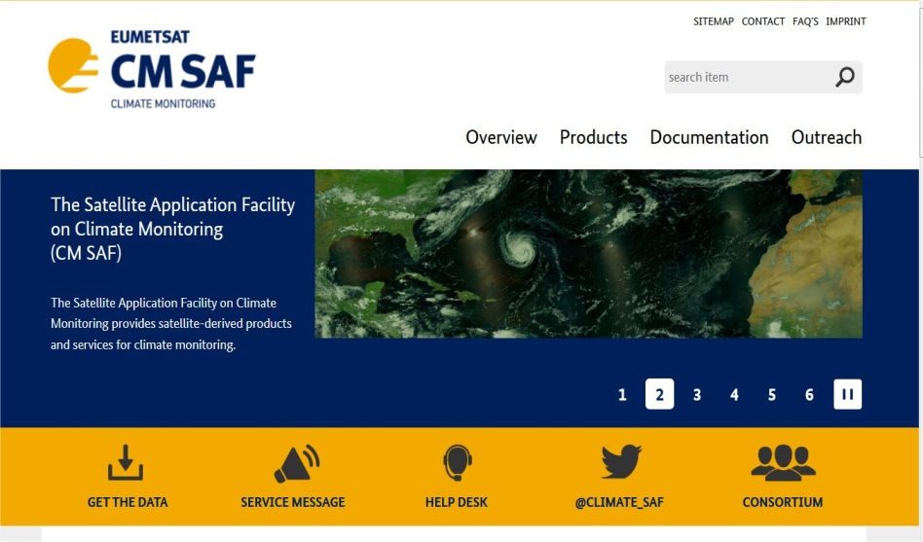
SALGEE
Objectives of the 6th SALGEE Workshop
“MSG Land Surface Applications: Connection of climate and biosphere”
EUMETSAT LSA SAF Program
3. To make a bridge with
  Climate Monitoring SAF
  Hydrological SAF
https://landsaf.ipma.pt/en/
EUMETSAT CM SAF Program
EUMETSAT CM SAF Program
https://www.cmsaf.eu/EN/Home/home_node.html
http://hsaf.meteoam.it/

Slide 14

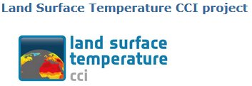

SALGEE
Objectives of the 6th SALGEE Workshop
“MSG Land Surface Applications: Connection of climate and biosphere”
4. To make a bridge with related institutions & projects
  EC- Joint Research Center
  Deutsche Wetterdienst, DWD
  University of Sheffield experienced in Carbon cycle and climate relations
  ESA LST CCI
  DISARM INTERREG Project
5. To rise new problems for the SALGEE community on using satellites in the field of:
  Agrometeorology in its physical context
  Climate and Forest relations
    Forest sustainability
    Vegetation and Carbon cycle
6. To inform the user community about current knowledge, methods, and available satellite information related to climate-biospere connection.
7. To promote the LSA approach beyond the SALGEE areas of interest inviting participants from Middle East.

