Slide 1
The Role of Satellite in Climate Monitoring
Christine Träger-Chatterjee
SALGEE Meeting
October 2019

Slide 2
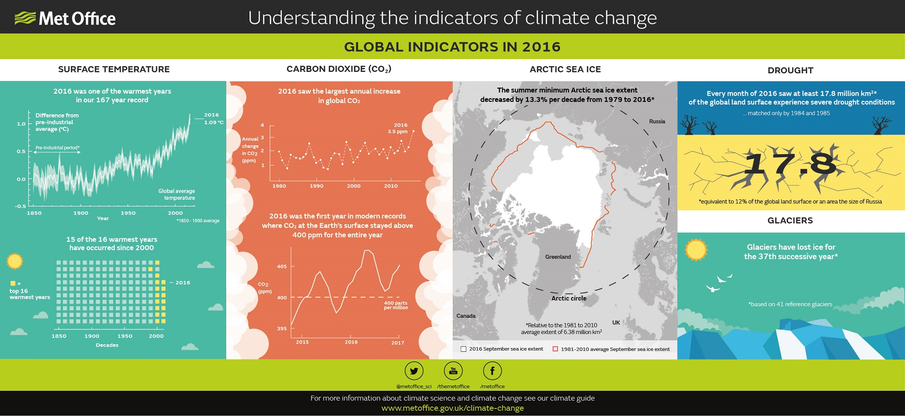
Climate Change - Facts
UK-MetOffice, 2017
Courtesy: Joerg Schulz

Slide 3

Climate Monitoring – Why?
Mitigation
Adaptation
Observation
Forecast / scenarios
Understanding
Modelling
Courtesy: CM SAF, adjusted

Slide 4
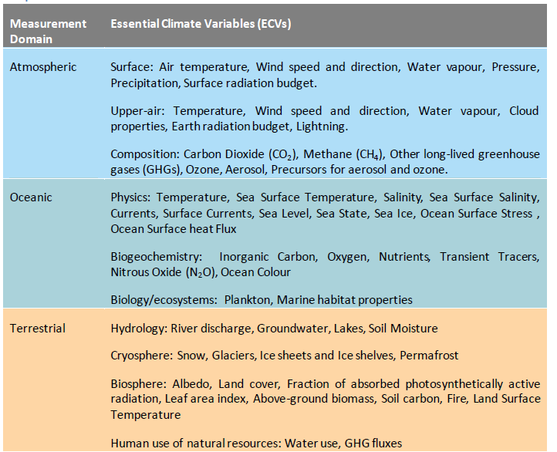
Climate Monitoring - Variables
“An ECV is a physical, chemical or biological variable or a group of linked variables that critically contributes to the characterization of Earth’ s climate.” (WMO)
EUMETSAT + SAF‘s produce 26% of Climate Data Records on ECV‘s observable from space
ECV inventory: climatemonitoring.info
Notes:
EUMETSAT + SAF‘s produce 26% p of CDR‘s on ECV‘s observable from space

Slide 5

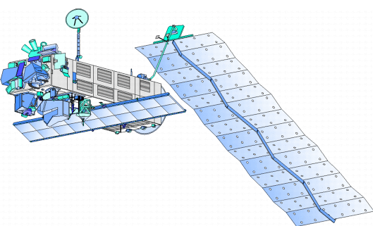

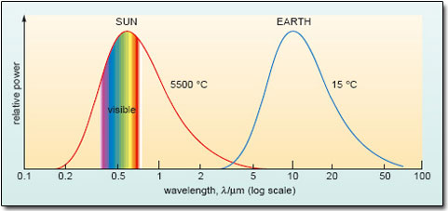
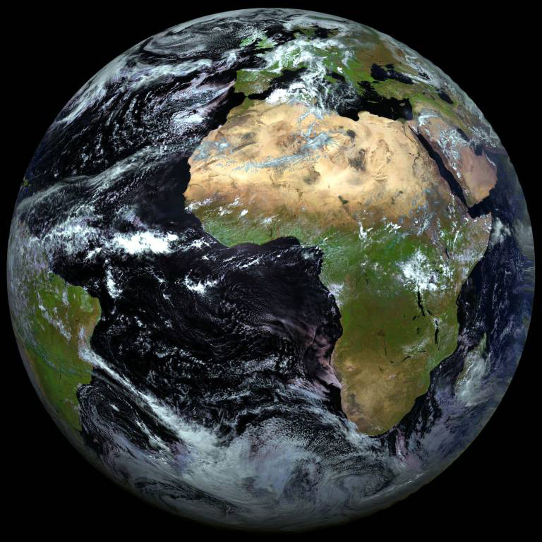
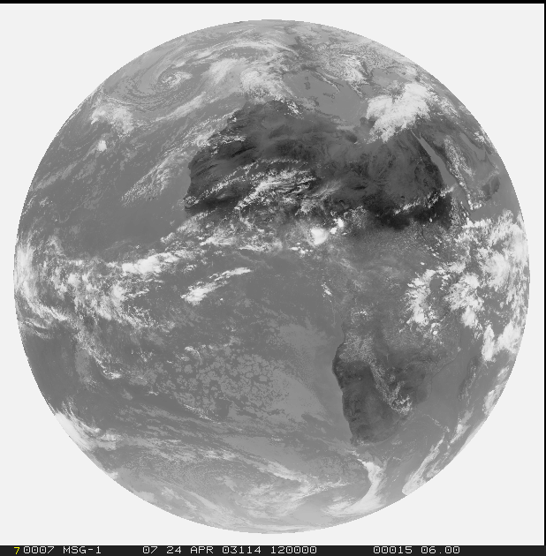
What does a satellite measure?

Slide 6
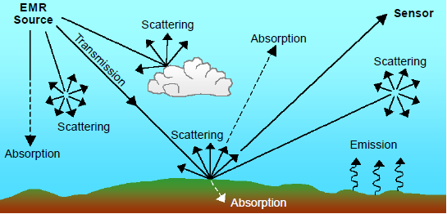
What does a satellite measure?

Slide 7
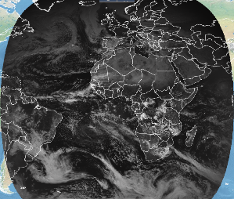
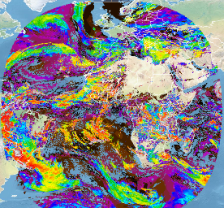
Space based Climate Monitoring - Challenges
Satellite
Data
Retrieval Algorithm
Environmental Data Record
generated on a monthly basis
First-order satellite calibration
Most recent algorithm and input data (i.e. not homogeneous over time)
Resulting time series not applicable
for all climate monitoring purposes, e.g. trend estimation
Operational
Climate
monitoring
Schulz (2009), adapted & updated
Notes:
Environmental Data Record (EDR): Satellite Data are collected, a first order calibration and retrieval algorithms to derive geophysical variables are applied (operational satellite data). The retrieval algorithms develop over time and the sources for auxiliary input data might change. I.e. the value of month X might be retrieved with a (slightly) different retrieval than month Y.
Fundamental Climate Data Record (FCDR): Homogenized time series (of satellite data). The sensors used the during the entire time series are carefully calibrated and intercalibrated. I.e. it is ensured (as far as possible) that no articical jumps and no artifical trends are in the time series. An FCDR is updated irregularly, i.e. every few years with no fixed update cylce.
Thematic Climate Data Record (TCDR): A stable retrieval algorithm with the same source of auxiliary input data is applied to the a Fundamental Climate Data Record. It is ensured (as far as possible) that trends and varibalities are due to actual changes in the environment and not due to changes in sensor characteristics nor due to changes in the retrieval. A TCDR is updated irregularly, i.e. every few years with no fixed update cylce.
Interim Climate Data Record (ICDR): The same stable retrieval algorithm and the same sources of auxiliary input data data as applied to derive the most recent TCDR are applies to operational satellite data. The result is „attached“ to the TCDR. An ICDR can be used beyond operational climate montoring, but care needs to be taken to use it for long term climate analysis, as the longterm stability of the satellite sensor used can not be guaranteed.

Slide 8
Space based Climate Monitoring - Challenges
Short and Intermediate Term
Longterm
Satellite
Data
Archived
Satellite
Data Records
Observing system
performance monitoring
& automated corrections
Retrieval Algorithm
Environmental Data Record
generated on a monthly basis
First-order satellite calibration
Most recent algorithm and input data (i.e. not homogeneous over time)
Resulting time series not applicable
for all climate monitoring purposes, e.g. trend estimation
Operational
Climate
monitoring
Schulz (2009), adapted & updated
Notes:
Environmental Data Record (EDR): Satellite Data are collected, a first order calibration and retrieval algorithms to derive geophysical variables are applied (operational satellite data). The retrieval algorithms develop over time and the sources for auxiliary input data might change. I.e. the value of month X might be retrieved with a (slightly) different retrieval than month Y.
Fundamental Climate Data Record (FCDR): Homogenized time series (of satellite data). The sensors used the during the entire time series are carefully calibrated and intercalibrated. I.e. it is ensured (as far as possible) that no articical jumps and no artifical trends are in the time series. An FCDR is updated irregularly, i.e. every few years with no fixed update cylce.
Thematic Climate Data Record (TCDR): A stable retrieval algorithm with the same source of auxiliary input data is applied to the a Fundamental Climate Data Record. It is ensured (as far as possible) that trends and varibalities are due to actual changes in the environment and not due to changes in sensor characteristics nor due to changes in the retrieval. A TCDR is updated irregularly, i.e. every few years with no fixed update cylce.
Interim Climate Data Record (ICDR): The same stable retrieval algorithm and the same sources of auxiliary input data data as applied to derive the most recent TCDR are applies to operational satellite data. The result is „attached“ to the TCDR. An ICDR can be used beyond operational climate montoring, but care needs to be taken to use it for long term climate analysis, as the longterm stability of the satellite sensor used can not be guaranteed.

Slide 9
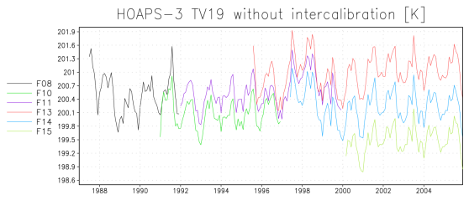
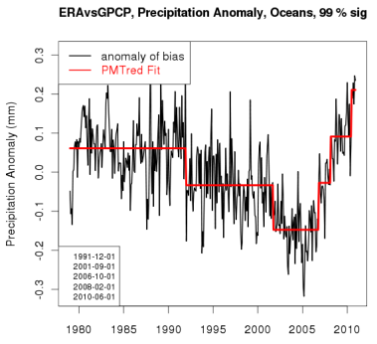
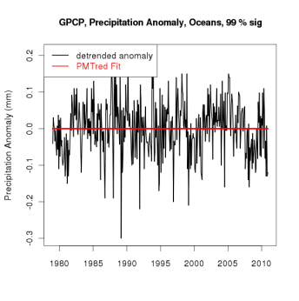
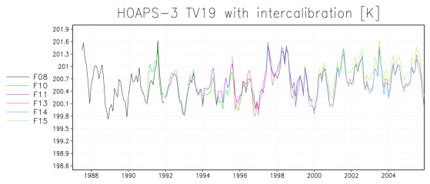
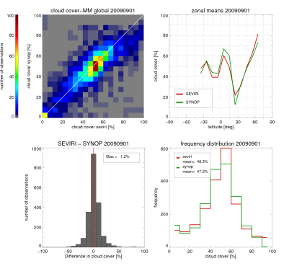
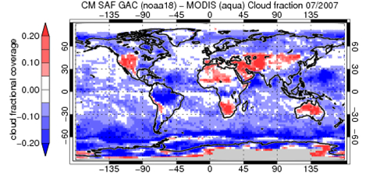
Climate Monitoring - Requirements to Climate Data
x
x
Value
Time
Sufficiently long time series
(> 30 years)
(Inter)Calibrated:
Carefully calibrated instruments
Carefully intercalibrated of all instruments used over the time series
Homogeneous:
make sure that no artificial jumps are in the timeseries (e.g. due to sensor changes)
Point of measurement
x
Representative:
Measurements need to represent the charachteristics of the area it is measured in
Quality controlled:
ensure the measurements fulfills the defined qualitiy criteria (e.g. accuracy, completenes and correctness of meta data)
Notes:
Sufficiently long time series: for climate monitoring the time series should cover several decades of observations.
Homogenisation
Calibrated instruments: the sensitivity of measuring instrumenst changes over time. This needs to be accounted for when creating a climate data record, to avoid trends introduced by the instrument (artificial trend versus natural trend).
Intercalibrated instruments: when collecting observations over several decades it usually means that one has to deal with changing instruments (instruments being replaces by new ones). Different instruments always behave slightly different. This needs to be accounted for when creating a climate data record, to avoid jumps in the time series that are due to the change of instruments (artificial jumps)
Representative: Looking at one and the same situation, the same instruments need to measure the same values. I.e. the data need to be representative for the area/region they are measured in.
Quality controlle: the measurements need to fulfill defined accuracy requirements and come with a complete set of metadata.

Slide 10
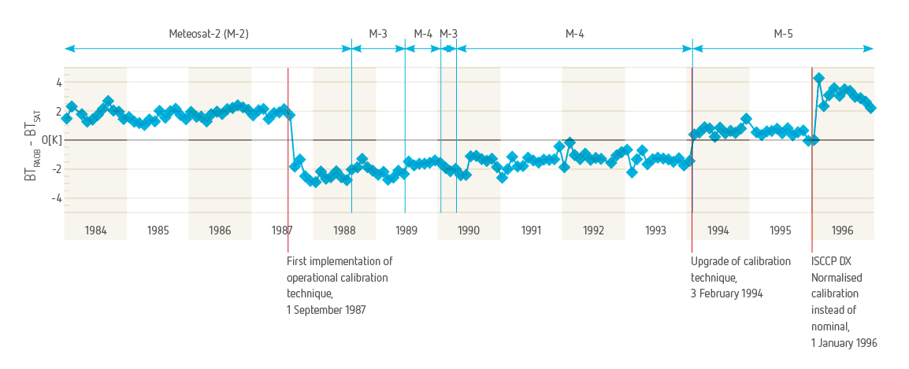
Space based Climate Monitoring - Challenges
Calibration changes
Instrument changes
Courtesy: Rob Roebeling

Slide 11

Space based Climate Monitoring - Challenges
Brilliant Scientists
and Engineers
(with very good ideas)!
Courtesy: Joerg Schulz

Slide 12
Space based Climate Monitoring - Challenges
Short and Intermediate Term
Longterm
Satellite
Data
Archived
Satellite
Data Records
Fundamental
Climate
Data Records
Observing system
performance monitoring
& automated corrections
Re-calibration &
Inter-calibration,
Retrieval Algorithm
Environmental Data Record
generated on a monthly basis
First-order satellite calibration
Most recent algorithm and input data (i.e. not homogeneous over time)
Resulting time series not applicable
for all climate monitoring purposes, e.g. trend estimation
Operational
Climate
monitoring
Schulz (2009), adapted & updated
Notes:
Environmental Data Record (EDR): Satellite Data are collected, a first order calibration and retrieval algorithms to derive geophysical variables are applied (operational satellite data). The retrieval algorithms develop over time and the sources for auxiliary input data might change. I.e. the value of month X might be retrieved with a (slightly) different retrieval than month Y.
Fundamental Climate Data Record (FCDR): Homogenized time series (of satellite data). The sensors used the during the entire time series are carefully calibrated and intercalibrated. I.e. it is ensured (as far as possible) that no articical jumps and no artifical trends are in the time series. An FCDR is updated irregularly, i.e. every few years with no fixed update cylce.
Thematic Climate Data Record (TCDR): A stable retrieval algorithm with the same source of auxiliary input data is applied to the a Fundamental Climate Data Record. It is ensured (as far as possible) that trends and varibalities are due to actual changes in the environment and not due to changes in sensor characteristics nor due to changes in the retrieval. A TCDR is updated irregularly, i.e. every few years with no fixed update cylce.
Interim Climate Data Record (ICDR): The same stable retrieval algorithm and the same sources of auxiliary input data data as applied to derive the most recent TCDR are applies to operational satellite data. The result is „attached“ to the TCDR. An ICDR can be used beyond operational climate montoring, but care needs to be taken to use it for long term climate analysis, as the longterm stability of the satellite sensor used can not be guaranteed.

Slide 13
Space based Climate Monitoring - Challenges
Short and Intermediate Term
Longterm
Archived
Satellite
Data Records
Fundamental
Climate
Data Records
Satellite
Data
Observing system
performance monitoring
& automated corrections
Re-calibration &
Inter-calibration,
Retrieval Algorithm
Reprocessing
Retrieval Algorithm
Environmental Data Record
Thematic Climate Data Record
generated on a monthly basis
First-order satellite calibration
Most recent algorithm and input data (i.e. not homogeneous over time)
Resulting time series not applicable
for all climate monitoring purposes, e.g. trend estimation
Generated on an irregular basis, e.g. every 2 years
Calibrated and homogenized satellite data
Algorithm and auxiliary input data homogeneous over time
Resulting time series fully applicable for climate monitoring purposes, including trend estimation
Operational
Climate
monitoring
Longer term climate variability & climate change analysis
Schulz (2009), adapted & updated
Notes:
Environmental Data Record (EDR): Satellite Data are collected, a first order calibration and retrieval algorithms to derive geophysical variables are applied (operational satellite data). The retrieval algorithms develop over time and the sources for auxiliary input data might change. I.e. the value of month X might be retrieved with a (slightly) different retrieval than month Y.
Fundamental Climate Data Record (FCDR): Homogenized time series (of satellite data). The sensors used the during the entire time series are carefully calibrated and intercalibrated. I.e. it is ensured (as far as possible) that no articical jumps and no artifical trends are in the time series. An FCDR is updated irregularly, i.e. every few years with no fixed update cylce.
Thematic Climate Data Record (TCDR): A stable retrieval algorithm with the same source of auxiliary input data is applied to the a Fundamental Climate Data Record. It is ensured (as far as possible) that trends and varibalities are due to actual changes in the environment and not due to changes in sensor characteristics nor due to changes in the retrieval. A TCDR is updated irregularly, i.e. every few years with no fixed update cylce.
Interim Climate Data Record (ICDR): The same stable retrieval algorithm and the same sources of auxiliary input data data as applied to derive the most recent TCDR are applies to operational satellite data. The result is „attached“ to the TCDR. An ICDR can be used beyond operational climate montoring, but care needs to be taken to use it for long term climate analysis, as the longterm stability of the satellite sensor used can not be guaranteed.

Slide 14
Space based Climate Monitoring - Challenges
Short and Intermediate Term
Longterm
Archived
Satellite
Data Records
Fundamental
Climate
Data Records
Satellite
Data
Observing system
performance monitoring
& automated corrections
Re-calibration &
Inter-calibration,
Retrieval Algorithm
Reprocessing
Retrieval Algorithm
Environmental Data Record
Thematic Climate Data Record
generated on a monthly basis
First-order satellite calibration
Most recent algorithm and input data (i.e. not homogeneous over time)
Resulting time series not applicable
for all climate monitoring purposes, e.g. trend estimation
Generated on an irregular basis, e.g. every 2 years
Calibrated and homogenized satellite data
Algorithm and auxiliary input data homogeneous over time
Resulting time series fully applicable for climate monitoring purposes, including trend estimation
Interim Climate Data Record
Generated on a monthly basis
First-order satellite calibration
Same algorithm and auxiliary input data as for current TCDR (i.e. homogeneous over time)
Improvement to quickly elongate TCDR‘s.
Attached to TCDR
Operational
Climate
monitoring
Usage beyond operational monitoring possible.
Careful for longer term variability trend analysis etc. → no guarantee for longterm stability of sensor
Longer term climate variability & climate change analysis
Schulz (2009), adapted & updated
Notes:
Environmental Data Record (EDR): Satellite Data are collected, a first order calibration and retrieval algorithms to derive geophysical variables are applied (operational satellite data). The retrieval algorithms develop over time and the sources for auxiliary input data might change. I.e. the value of month X might be retrieved with a (slightly) different retrieval than month Y.
Fundamental Climate Data Record (FCDR): Homogenized time series (of satellite data). The sensors used the during the entire time series are carefully calibrated and intercalibrated. I.e. it is ensured (as far as possible) that no articical jumps and no artifical trends are in the time series. An FCDR is updated irregularly, i.e. every few years with no fixed update cylce.
Thematic Climate Data Record (TCDR): A stable retrieval algorithm with the same source of auxiliary input data is applied to the a Fundamental Climate Data Record. It is ensured (as far as possible) that trends and varibalities are due to actual changes in the environment and not due to changes in sensor characteristics nor due to changes in the retrieval. A TCDR is updated irregularly, i.e. every few years with no fixed update cylce.
Interim Climate Data Record (ICDR): The same stable retrieval algorithm and the same sources of auxiliary input data data as applied to derive the most recent TCDR are applies to operational satellite data. The result is „attached“ to the TCDR. An ICDR can be used beyond operational climate montoring, but care needs to be taken to use it for long term climate analysis, as the longterm stability of the satellite sensor used can not be guaranteed.

Slide 15
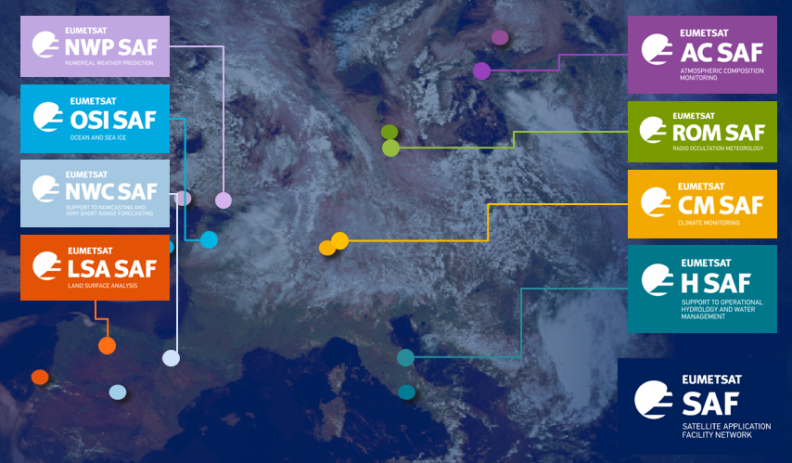
Satellite Application Facilities
EUMETSAT has a network of different Satellite Application Facilities (SAFs)
SAFs are dedicated centres of excellence for processing satellite data
  research, development and operational activities
  each SAF focusses on specific user communities or application areas
Each SAF is a consortium of entities from EUMETSAT member states

Slide 16
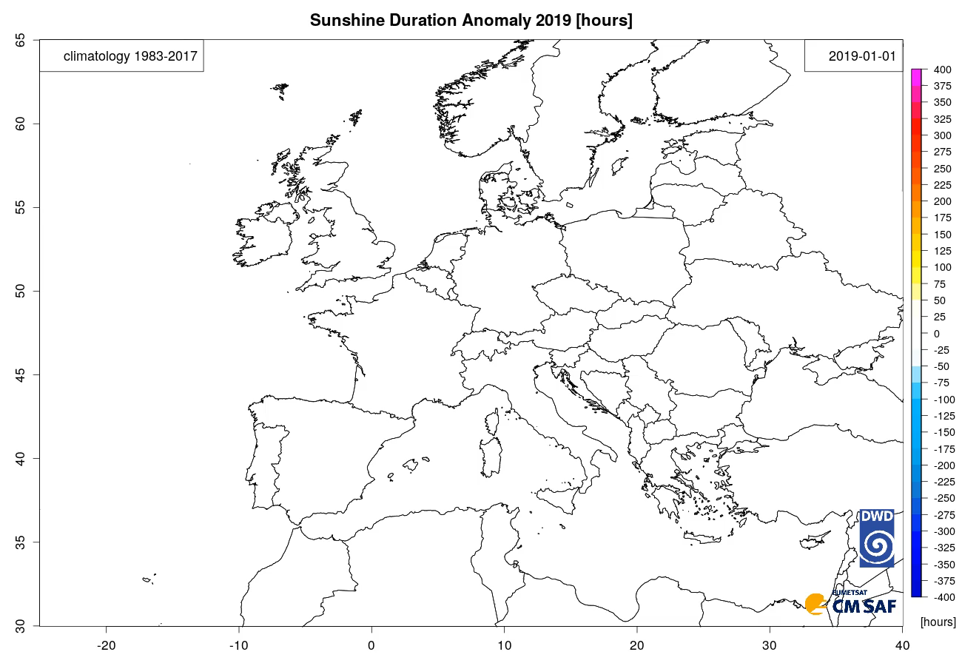
Climatology of Sunshine Duration

Slide 17
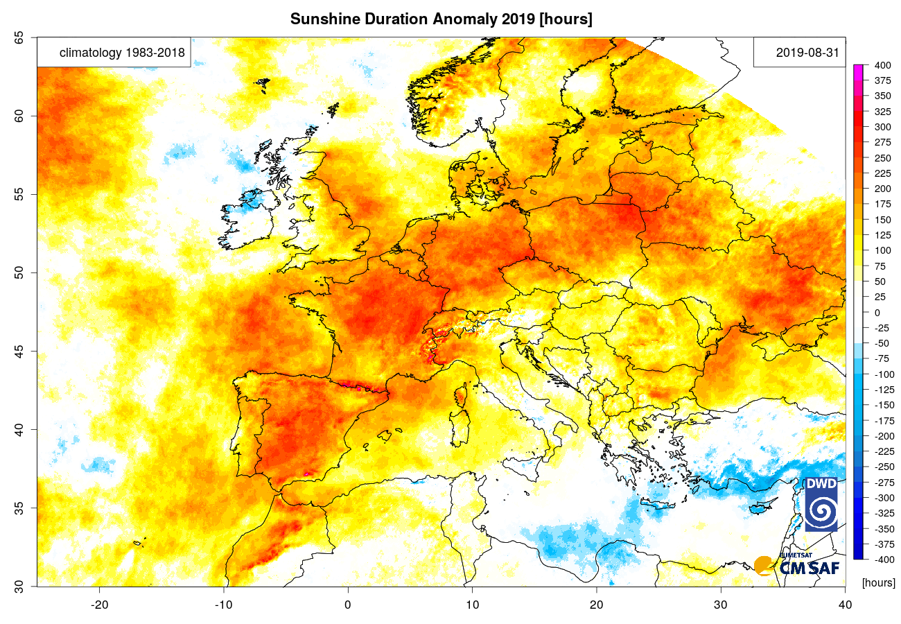
Anomaly of Sunshine Duration in 2019 until 31 Aug.

Slide 18
Questions?
Thank you!

Slide 19
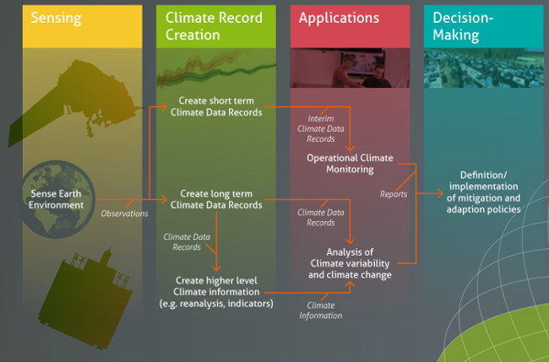
Space based Climate Monitoring
Training
Satellite Data Providers,
e.g. EUMETSAT
http://climatemonitoring.info

Slide 20
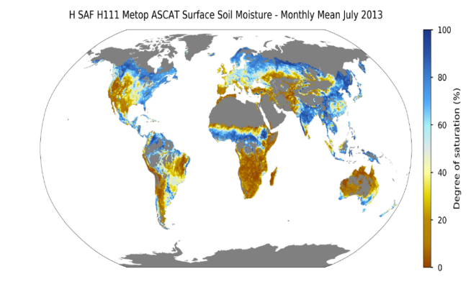
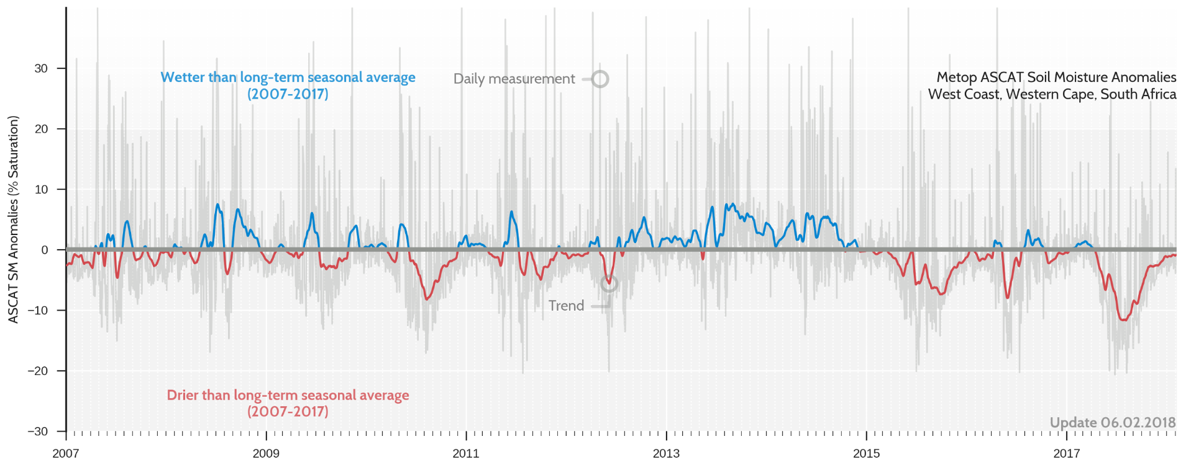

Drought 2017/2018 Western Cape, South Africa
Deviations of soil moisture from longterm average (2007- 2016), observed from ASCAT onboard Metop
Mariette Vreugdenhil/TU Wien, EUMETSAT H SAF
http://h-saf.eumetsat.int

Slide 21
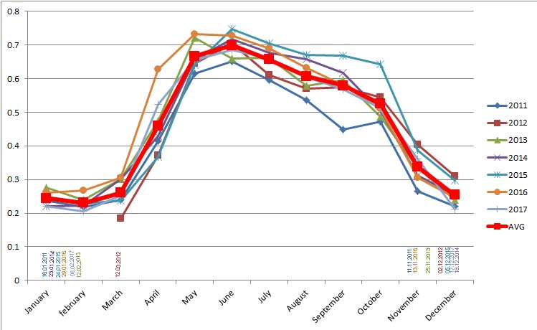
Fraction of Absorbed Photosynthetic Active Radiation
monthly average data for 2011-2017 for station Strumica
Courtesy of: Goran Basovski, AFFILIATION!! Training Participant, Krakow 2019

Slide 22
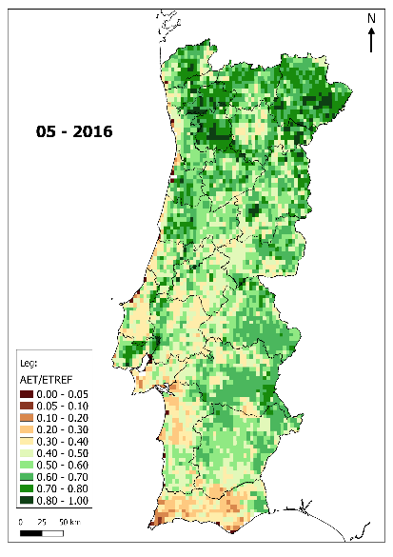
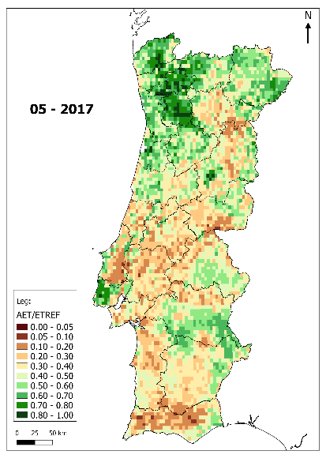
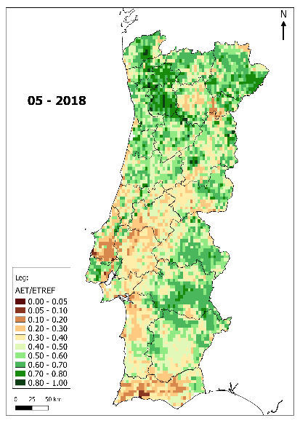
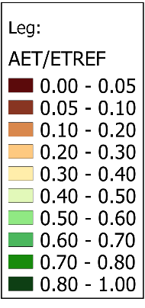
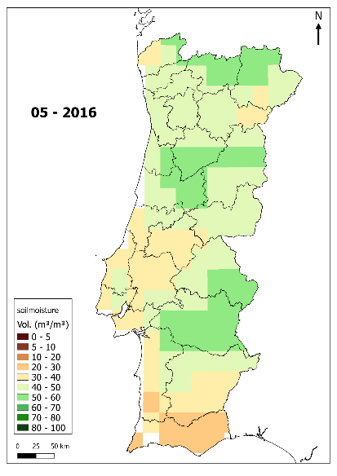
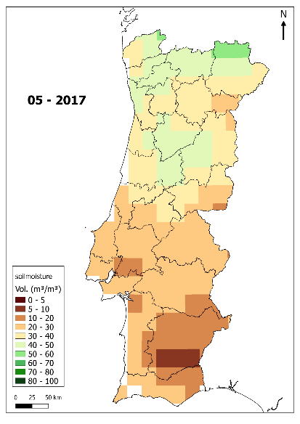
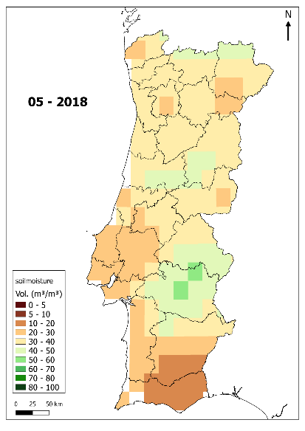
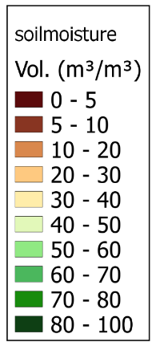
May (End of Spring MAM)
ET ratio
%
Soil moisture
Courtesy of: Jose Alvaro Silva, IPMA, Portugal Training Participant, Krakow 2019

Slide 23
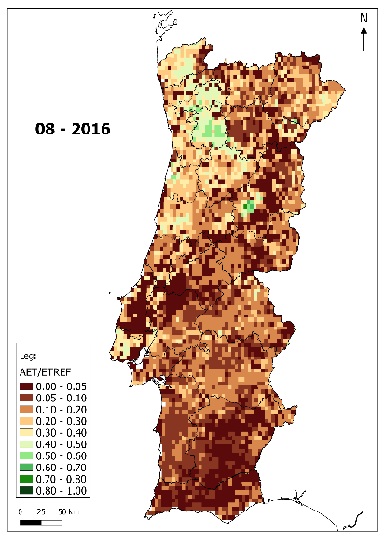
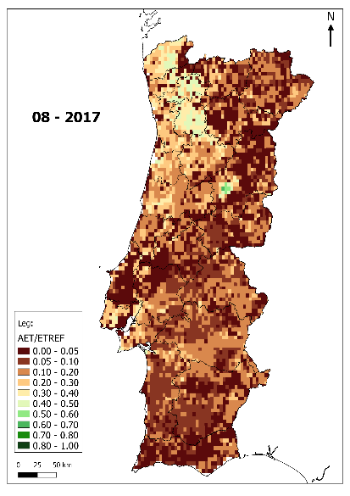
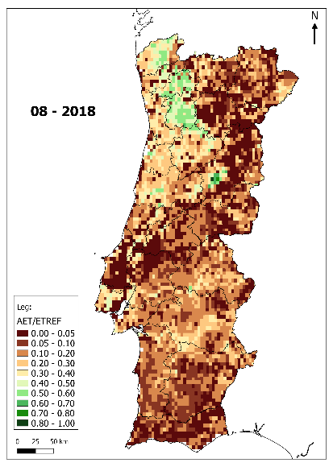
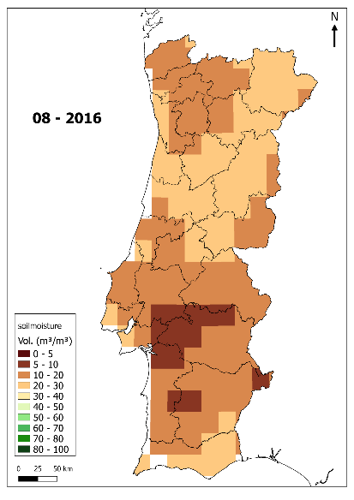
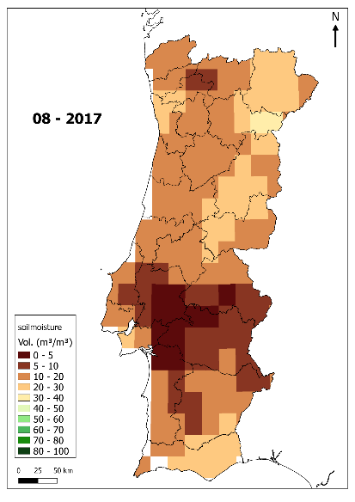
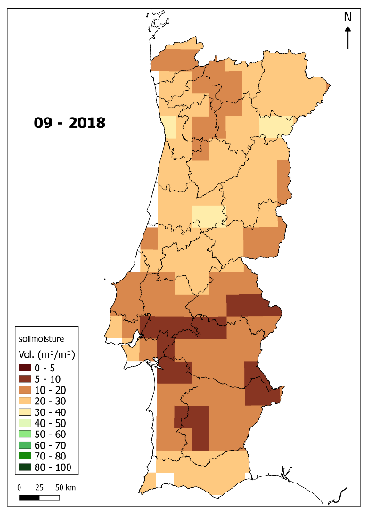
August (End of Summer JJA)
ET ratio
%
Soil moisture
Courtesy of: Jose Alvaro Silva, IPMA, Portugal Training Participant, Krakow 2019

Slide 24
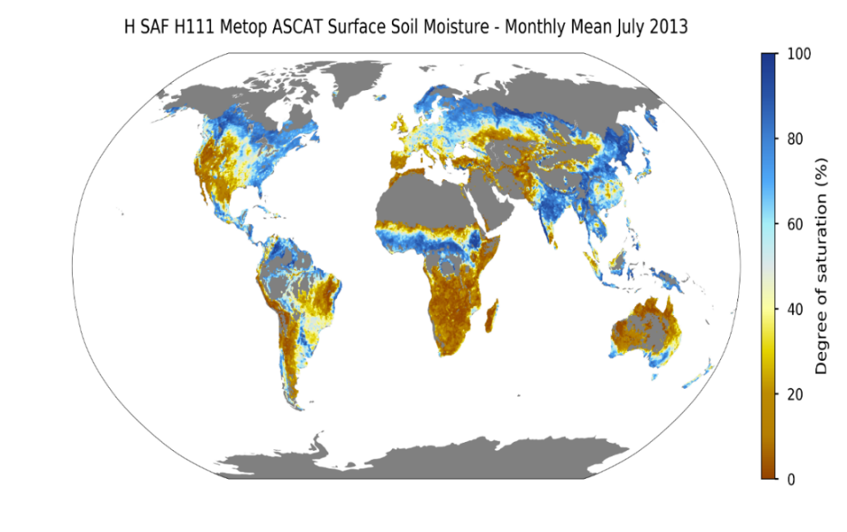
Product Example – Soil Moisture
Data source: H SAF
Mariette Vreugdenhil

Slide 25
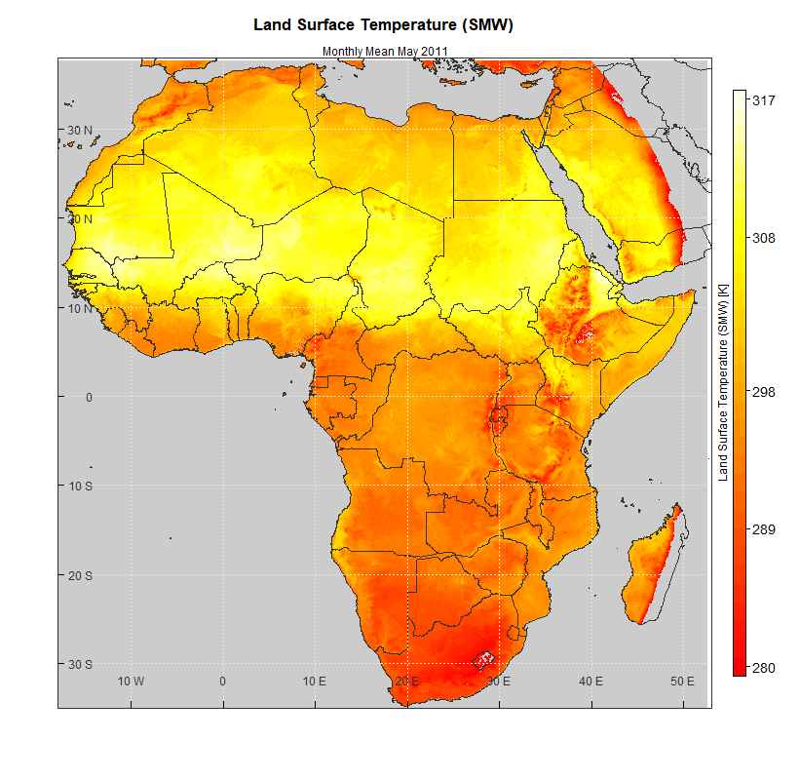
Product Example – Land Surface Temperature
Land Surface Temperature [K]
Monthly Mean May 2011
Replace with example for Europe!!!
Data source: CM SAF

Slide 26
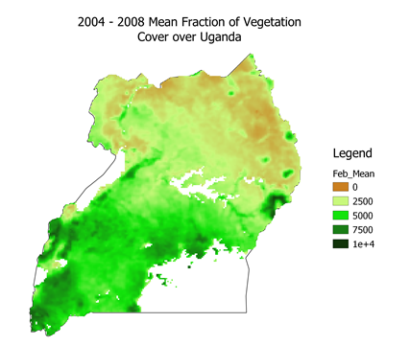
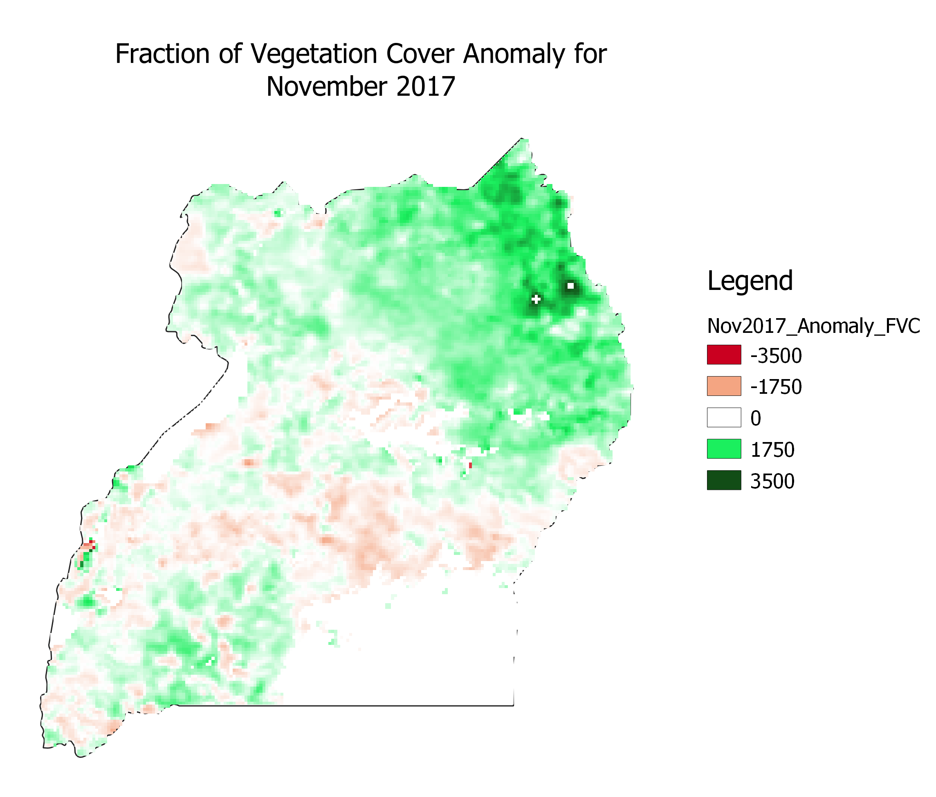

Vegetation Cover Uganda – Anomaly Study
Simon Ageet, Uganda National Meteorological Authority
http://lsa-saf.eumetsat.int

Slide 27
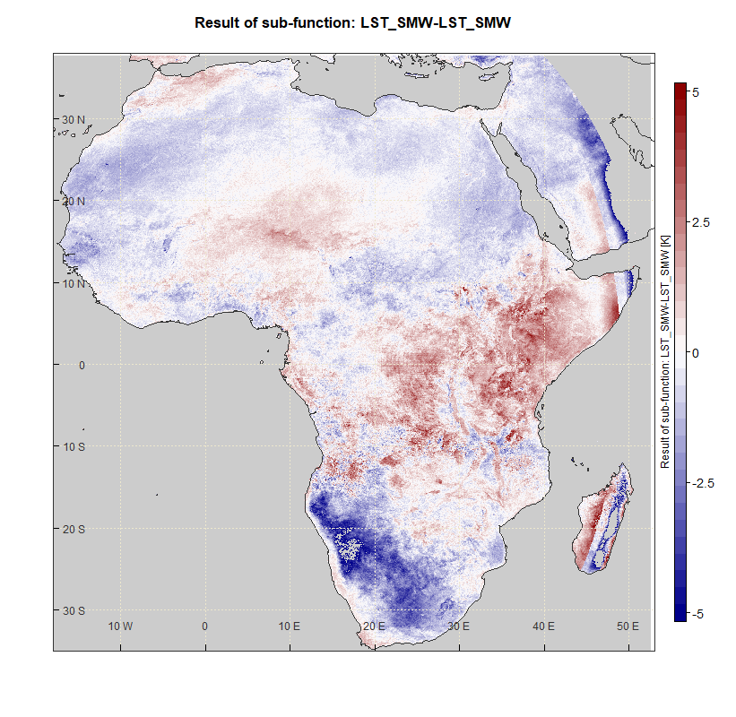

Climate Data Records - Examples
Anomaly LST Feb – Apr 2011 [K]
Mean LST of the period Feb to Apr 2011
longterm mean LST of the period Feb to Apr between 1991 and 2015
http://cm-saf.eumetsat.int

