Slide 1

Applications of H SAF Soil Moisture Data
Wolfgang Wagner
Department of Geodesy and Geoinformation (GEO)
Vienna University of Technology (TU Wien)
http://www.geo.tuwien.ac.at/

Slide 2
Information Content

Slide 3
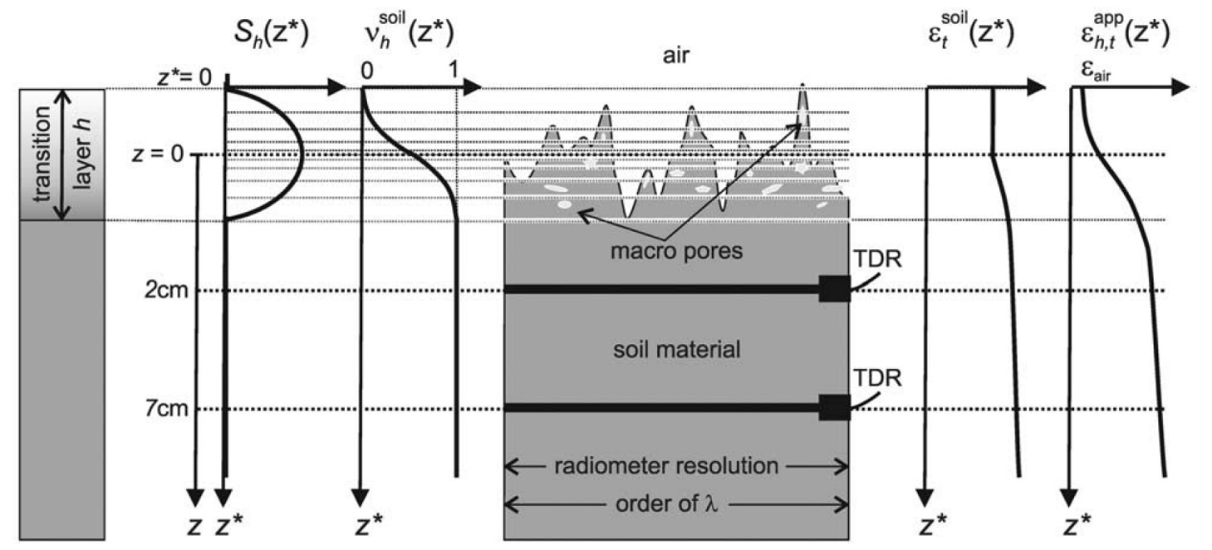
Information Content of Soil Moisture Retrievals
Microwave sensors can provide information about spatio-temporal soil moisture trends
  Information about absolute values comes from external data sets
Absolute values in soil moisture retrievals driven strongly by
  Available soil property maps
    Soil porosity, texture, etc.
  Surface roughness parameterization
    Not a geometric concept - use of “effective roughness” values - roughness depend on soil moisture
Air-to-Soil Transition Model
Schneeberger et al. (2004) Topsoil structure influencing soil water retrieval by microwave radiometry, Vadose Zone Journal, 3(4), 1169-1179.

Slide 4
Signal versus Noise
The information content of soil moisture is best characterised by the signal-to-noise ratio (SNR)
  Key criterion in data assimilation
Signal is tied to a certain scale, hence
  noise refers not only to random instrument noise and retrieval errors but also to representativity errors
  SNR is scale dependent
Soil moisture scaling approaches
  Highly non-linear hydrological processes are assumed to linearize at coarse satellite scales
  Standard error model

Slide 5
Triple Collocation
Originally proposed to estimate random error variances
  Covariance-formulation
Assumptions:
Error variances:
Scaling coefficients:
  Stoffelen, A. (1998). Toward the true near‐surface wind speed: Error modeling and calibration using triple collocation. Journal of Geophysical Research: Oceans (1978–2012), 103(C4), 7755-7766.

Slide 6
Signal to Noise Ration (SNR)
Recently extended to estimate the signal-to-noise ratio
More easy interpretabilty when expressed in decibel units
0 dB: signal variance = noise variance
+/- 3 dB: signal variance = double / half noise variance
  Draper, C., Reichle, R., de Jeu, R., Naeimi, V., Parinussa, R., & Wagner, W. (2013). Estimating root mean square errors in remotely sensed soil moisture over continental scale domains. Remote Sensing of Environment, 137, 288-298.
  Gruber, A., C. H. Su, S. Zwieback, W. Crow, W. Dorigo, W. Wagner (2016) Recent advances in (soil moisture) triple collocation analysis, International Journal of Applied Earth Observation and Geoinformation, 45, 200-211.

Slide 7
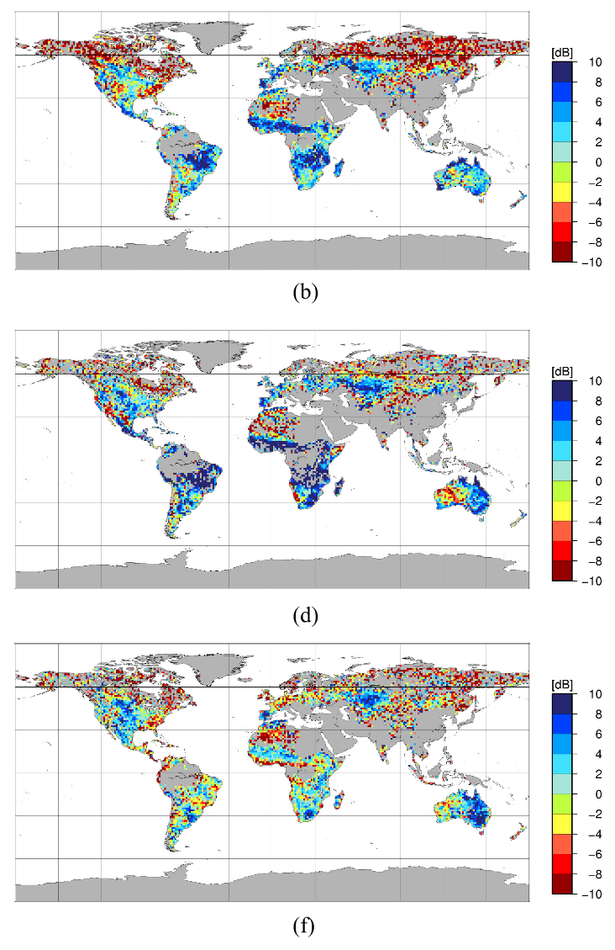
SNR of ASCAT & SMOS
ERA-Interim
Global triple collocation study using two different data triplets
  JRA-55 – ASCAT – SMOS
  ERA-Interim – ASCAT – SMOS
SNR varies strongly depending on land cover
  Spatial patterns of SNR of ASCAT and SMOS similar
SNR shows where satellites may add value to models
ASCAT
SMOS
Miyaoka et al (2017) Triple collocation analysis of soil moisture from Metop-A ASCAT and SMOS against JRA-55 and ERA-Interim, IEEE Journal of Selected Topics in Applied Earth Observation and Remote Sensing, 10(5), 2274-2284.

Slide 8
Capturing Rainfall

Slide 9
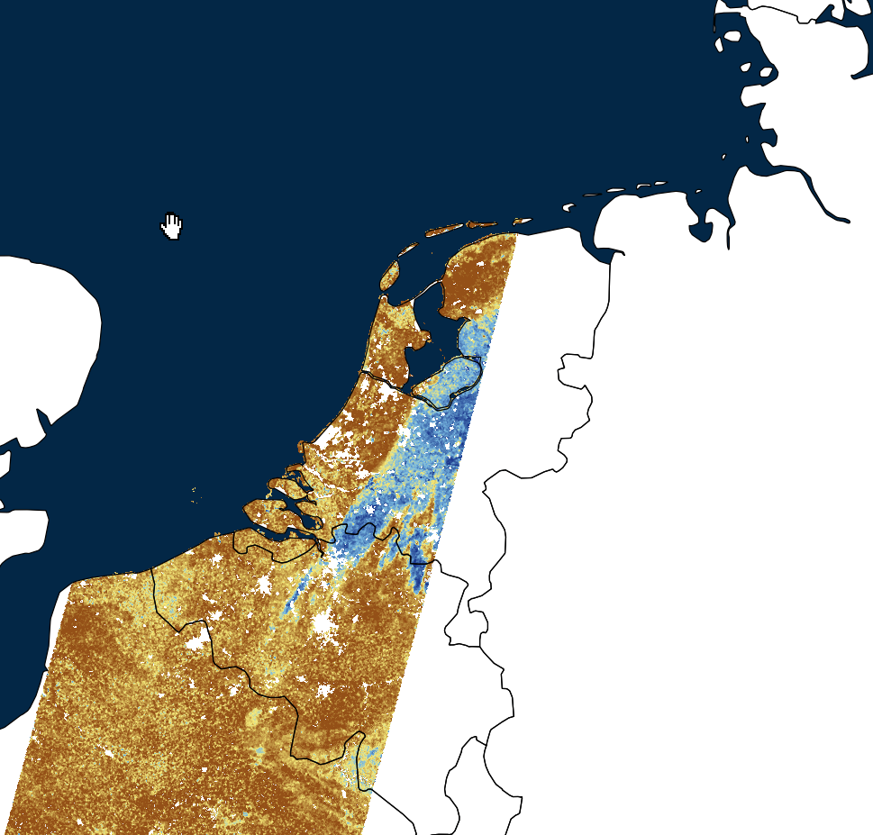
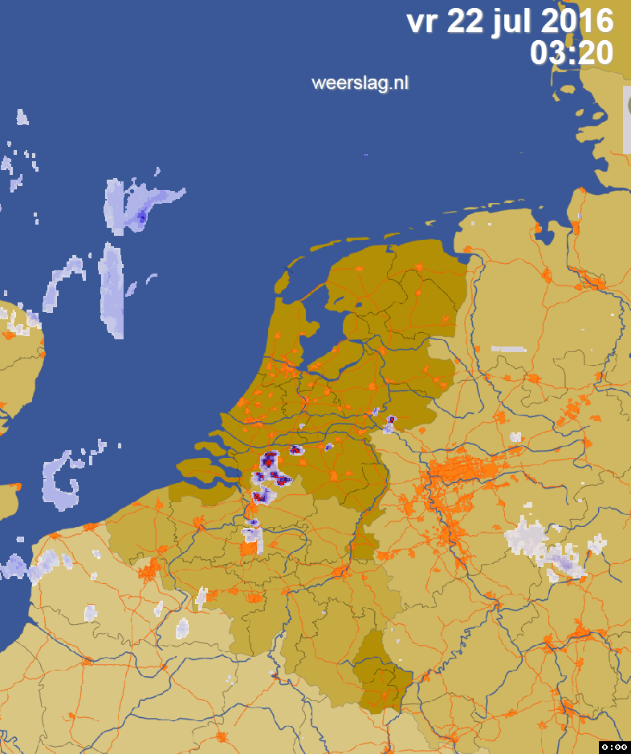
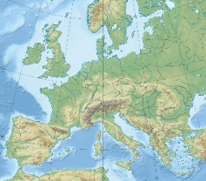
Sentinel-1 Soil Moisture vs Rainfall-Radar
2016-07-22 05:57:13

Slide 10
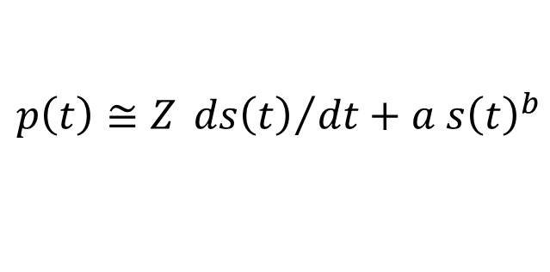
Rainfall derived from satellite soil moisture: SM2Rain
Water balance model:
Inverting for p(t):
$$p\left(t\right)≅Z{ ds\left(t\right)}/{dt}+a{ s\left(t\right)}^{b}$$
Assuming during rainfall:
+
+
  Brocca et al. (2014) Soil as a natural rain gauge: Estimating global rainfall from satellite soil moisture data. Journal of Geophysical Research: Atmospheres, 119(9), 5128-5141.

Slide 11
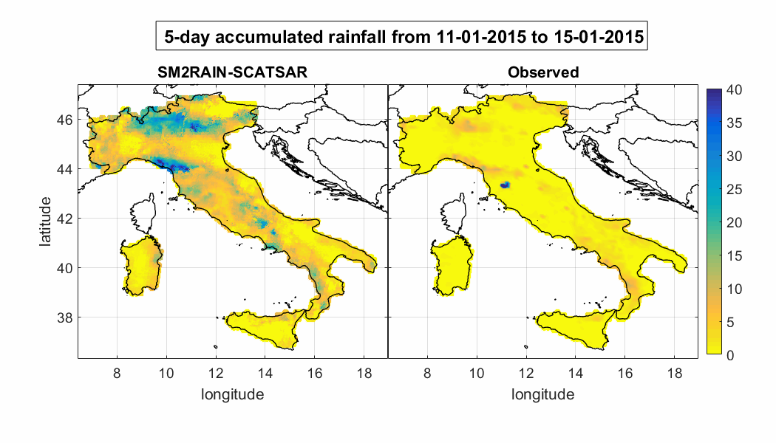

SM2Rain Results for Italy

Slide 12
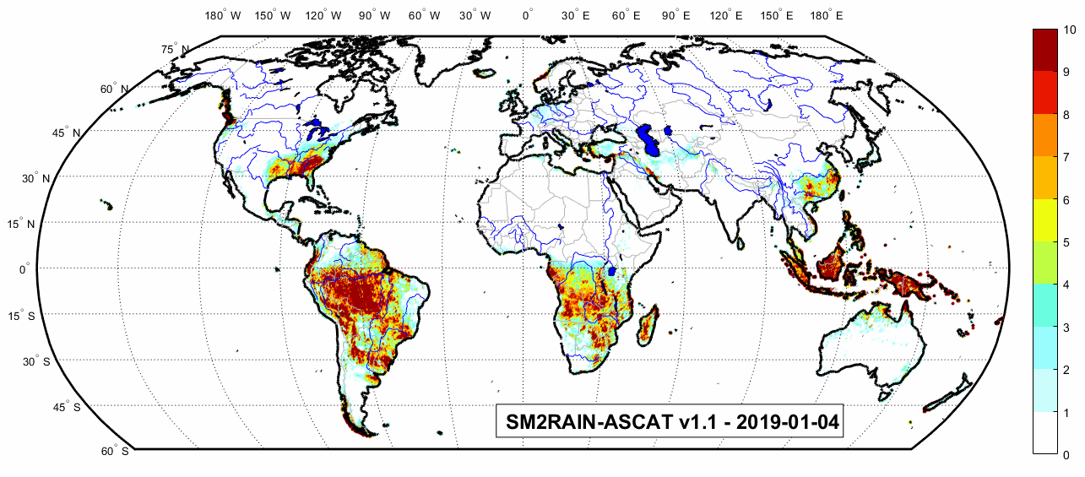
SM2Rain ASCAT Daily Rainfall Data
Freely available @ Zenodo
https://zenodo.org/record/2591215
Brocca et al. (2019) SM2RAIN-ASCAT (2007–2018): global daily satellite rainfall from ASCAT soil moisture, Earth Syst. Sci. Data, in press.

Slide 13
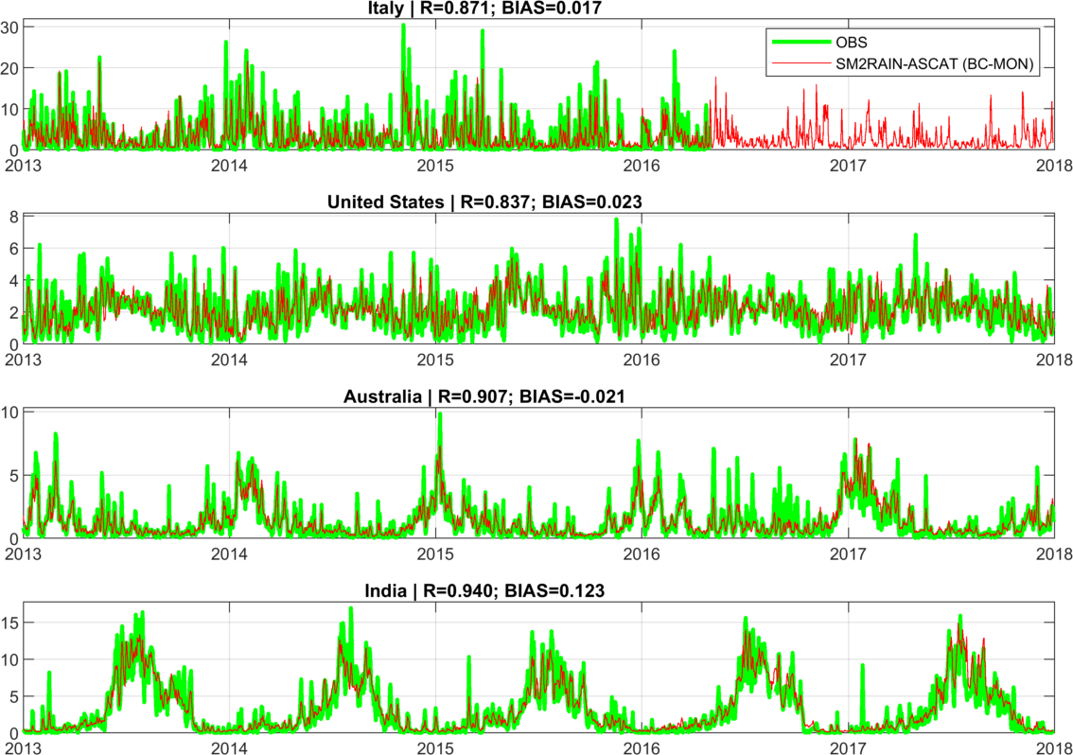
SM2Rain ASCAT Rainfall Time Series
Time series of mean areal rainfall for the four regions for observed data, OBS, and SM2RAIN-ASCAT data record. From Brocca et al. (2019).

Slide 14
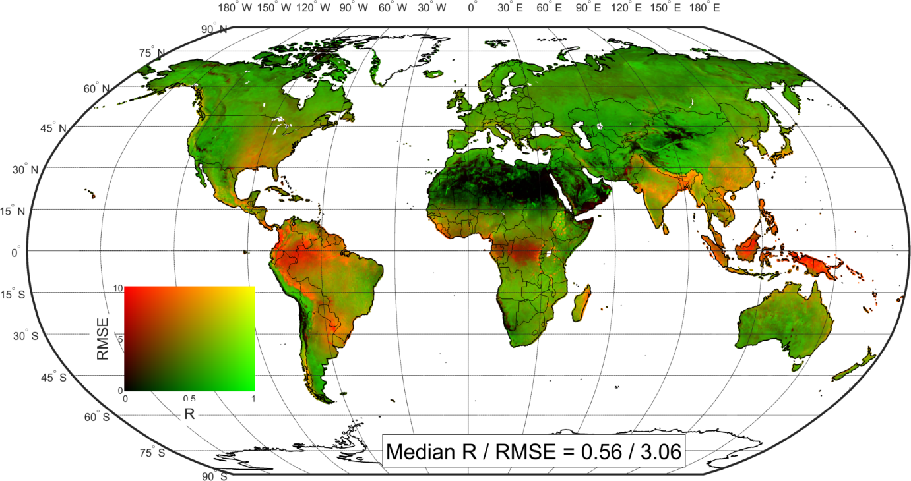
SM2Rain ASCAT Rainfall versus ERA5 Rainfall
Pearson’s correlation, R, and root mean square error, RMSE, map of SM2RAIN-ASCAT data record compared with ERA5 reanalysis dataset used as benchmark (period 2007-2018). From Brocca et al. (2019).

Slide 15
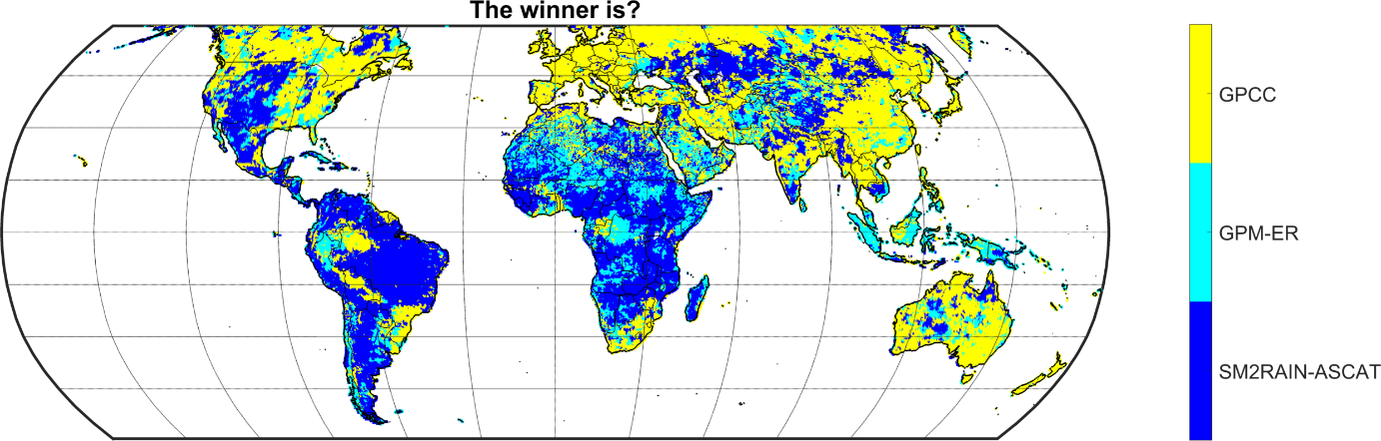
AM2Rain ASCAT vs GPM vs GPCC
Best performing rainfall product based on the results of a triple collocation analysis according to Brocca et al. (2019).
GPCC = gauge-based Global Precipitation Climatology Centre data set
GPM = Integrated Multi-Satellite Retrievals for Global Precipitation Measurement

Slide 16
Comparison with in situ and model data

Slide 17
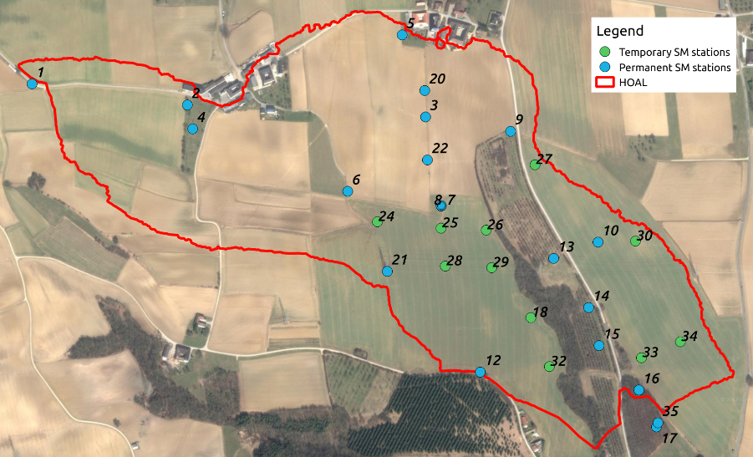
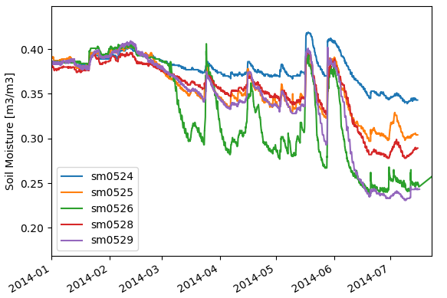

Representativeness of In Situ Data?
Soil moisture can vary within one field with the same land cover
Temporal stability concept
HOAL Soil Moisture Network, Petzenkirchen, Austria

Slide 18
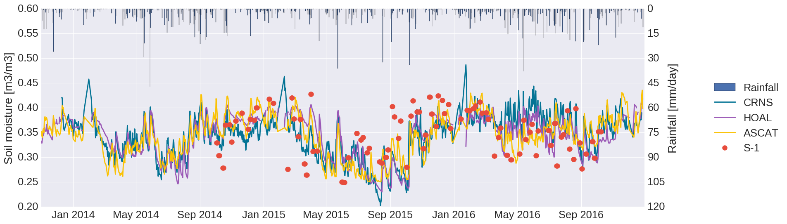


Satellite versus In Situ Soil Moisture Data over HOAL
CRNS: Cosmic Ray Neutron Sensor
HOAL: Catchment average of 31 TDT measurements
ASCAT: 25 km ASCAT soil moisture retrievals
S-1: 1 km Sentinel-1 soil moisture retrievals
Hydrological Open Air Laboratory (HOAL) in Petzenkirchen, Austria

Slide 19
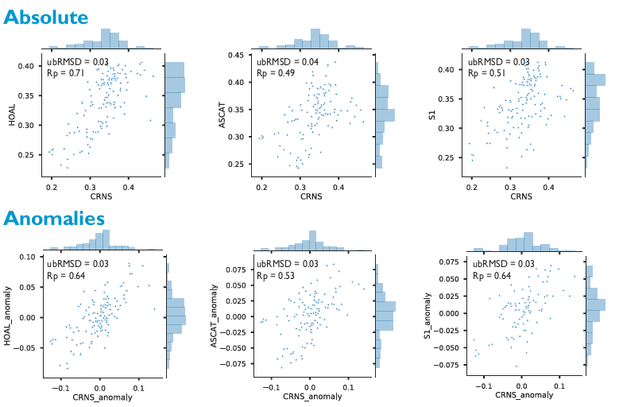
CRNS versus In Situ, ASCAT and S-1 over HOAL

Slide 20
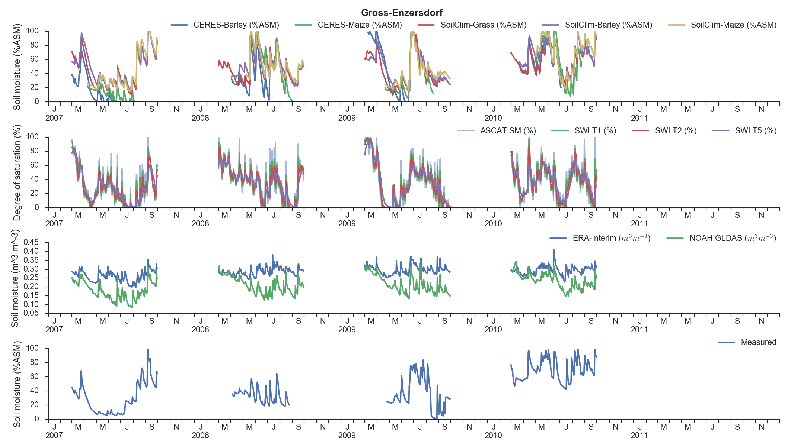
Soil Moisture from Models, In Situ and Satellites
Field-Scale Model
Global Satellite
(ASCAT Test Product)
Global Models
Local In Situ
Thaler et al. (2018) The performance of Metop Advanced SCATterometer soil moisture data as a complementary source for the estimation of crop-soil water balance in Central Europe, The Journal of Agricultural Science, 156, 577-598.

Slide 21
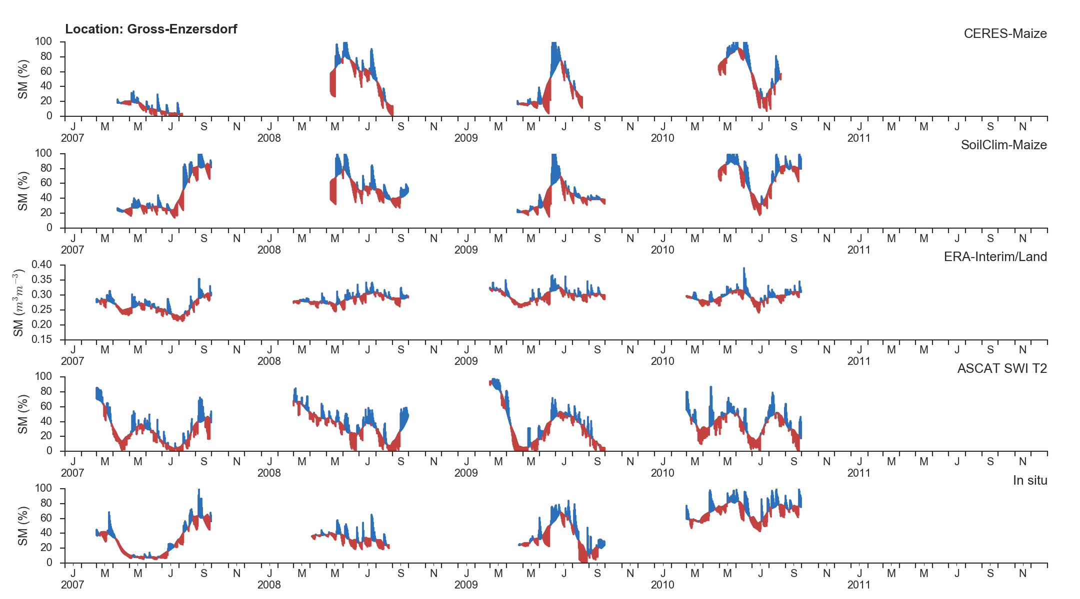
Comparison of Short-Term Anomalies
Field-Scale Model
Field-Scale Model
Global Model
Global Satellite
(ASCAT Test Product)
Local In Situ
Based upon Thaler at al. (2018)

Slide 22
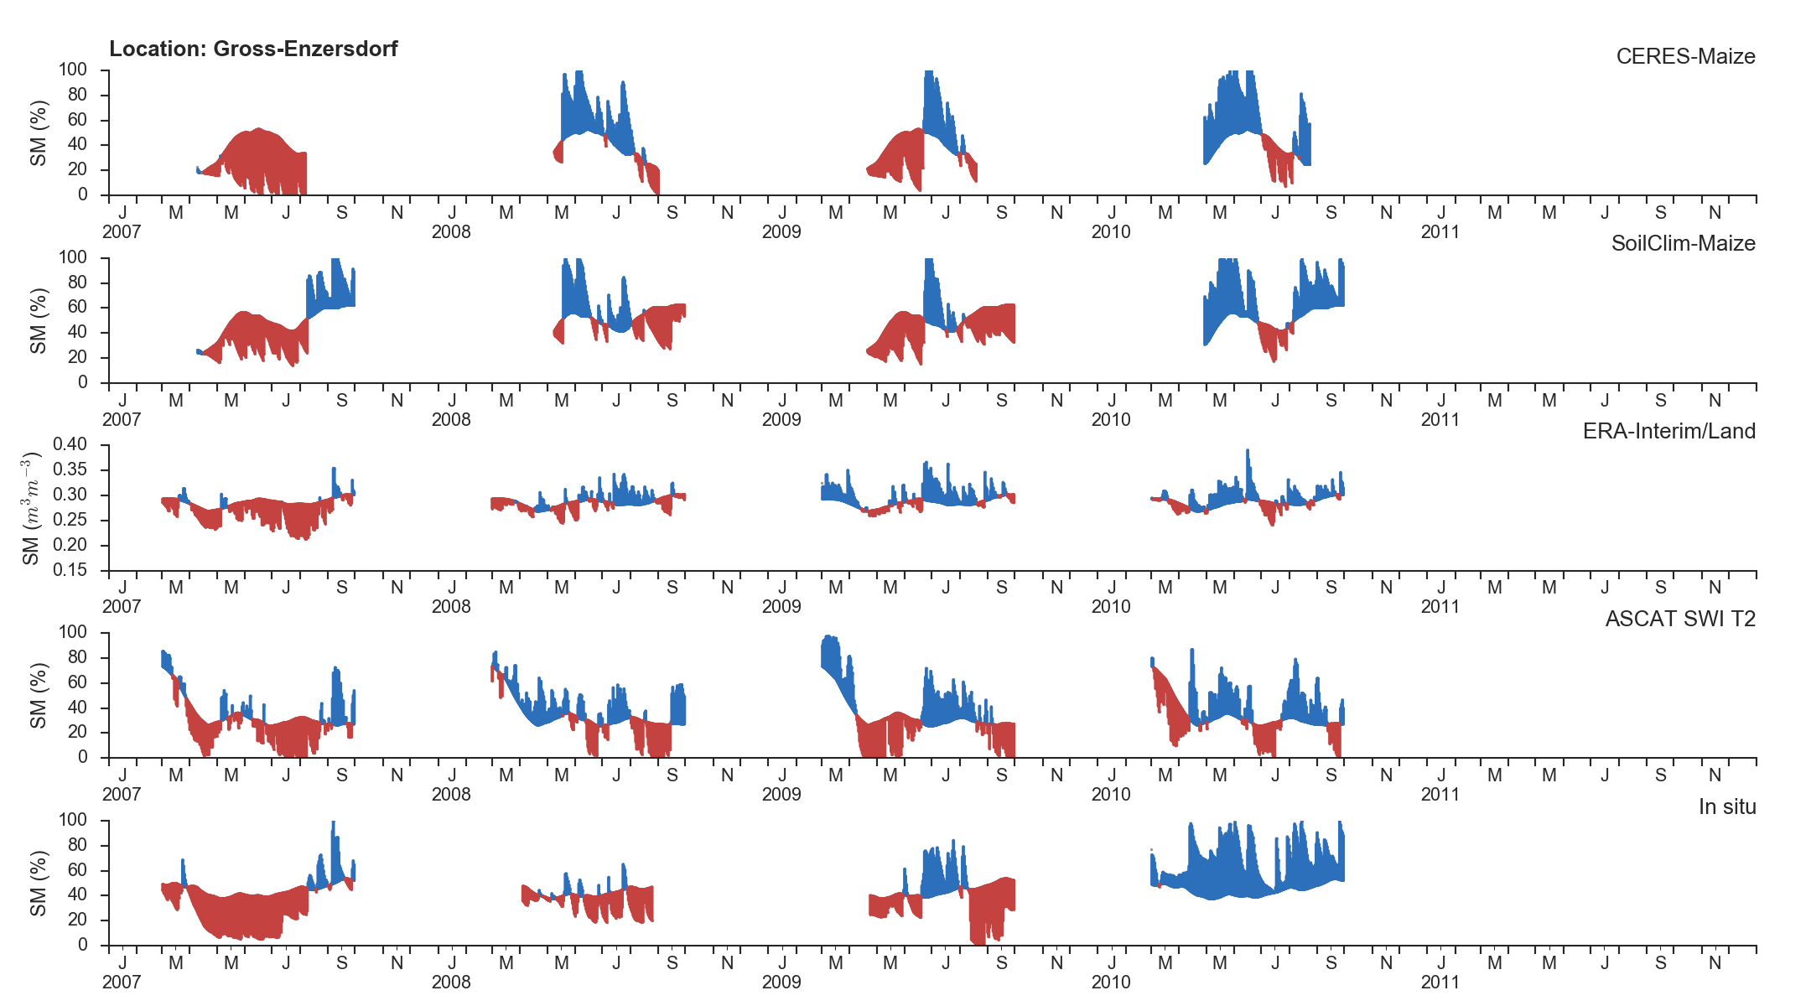
Comparison Against Mean Seasonal Signals
Based upon Thaler at al. (2018)

Slide 23
Soil Water Index

Slide 24
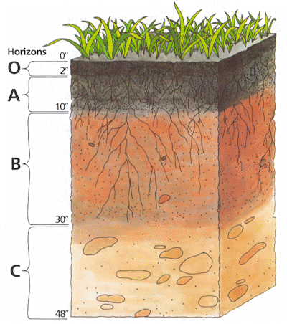
Soil Water Index
The SWI is an indicator of the profile soil moisture content
The method rests upon simple differential model for describing the exchange of soil moisture between surface layer (Θ_{s}) and the “reservoir” (Θ)
  T … characteristic time
Thin, remotely sensed soil layer with Θ_{s}
Root zone with Θ : layer of interest for most applications
Soil profile
Wagner, W., G. Lemoine, H. Rott (1999) A Method for Estimating Soil Moisture from ERS Scatterometer and Soil Data, Remote Sensing of Environment, 70, 191-207.

Slide 25
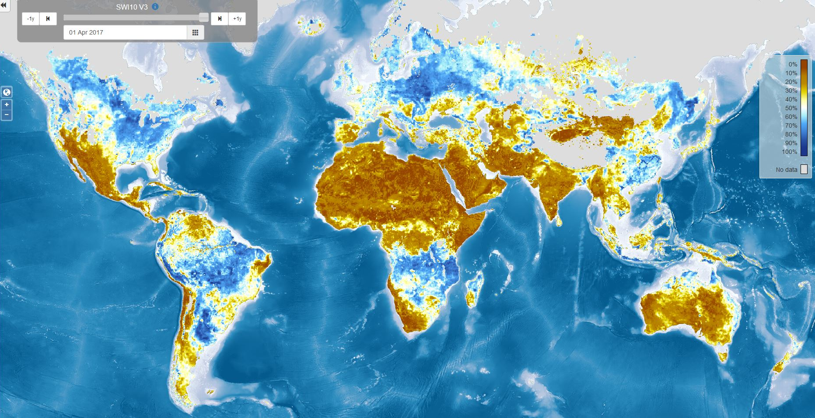

ASCAT Soil Water Index

Slide 26
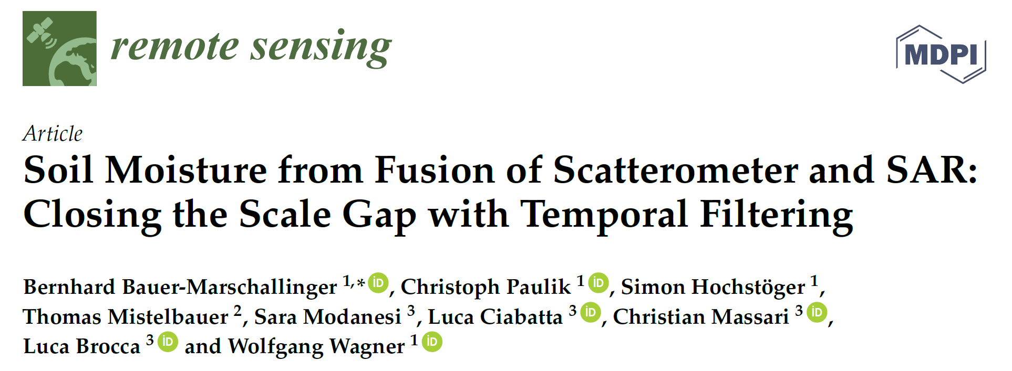
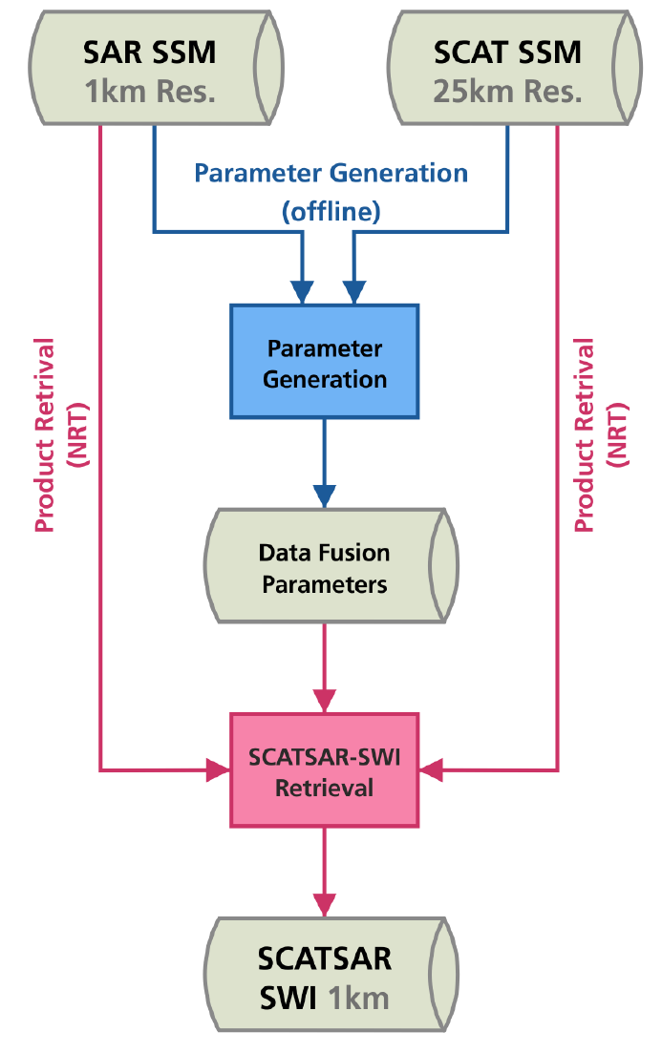
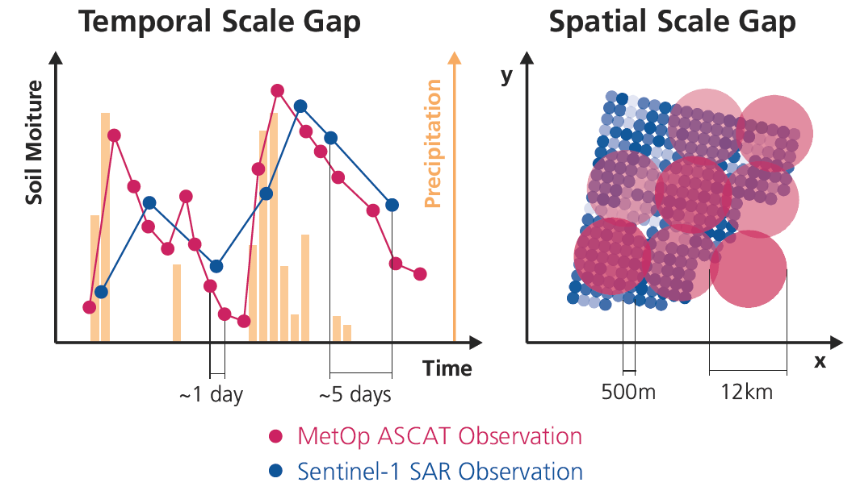

Slide 27
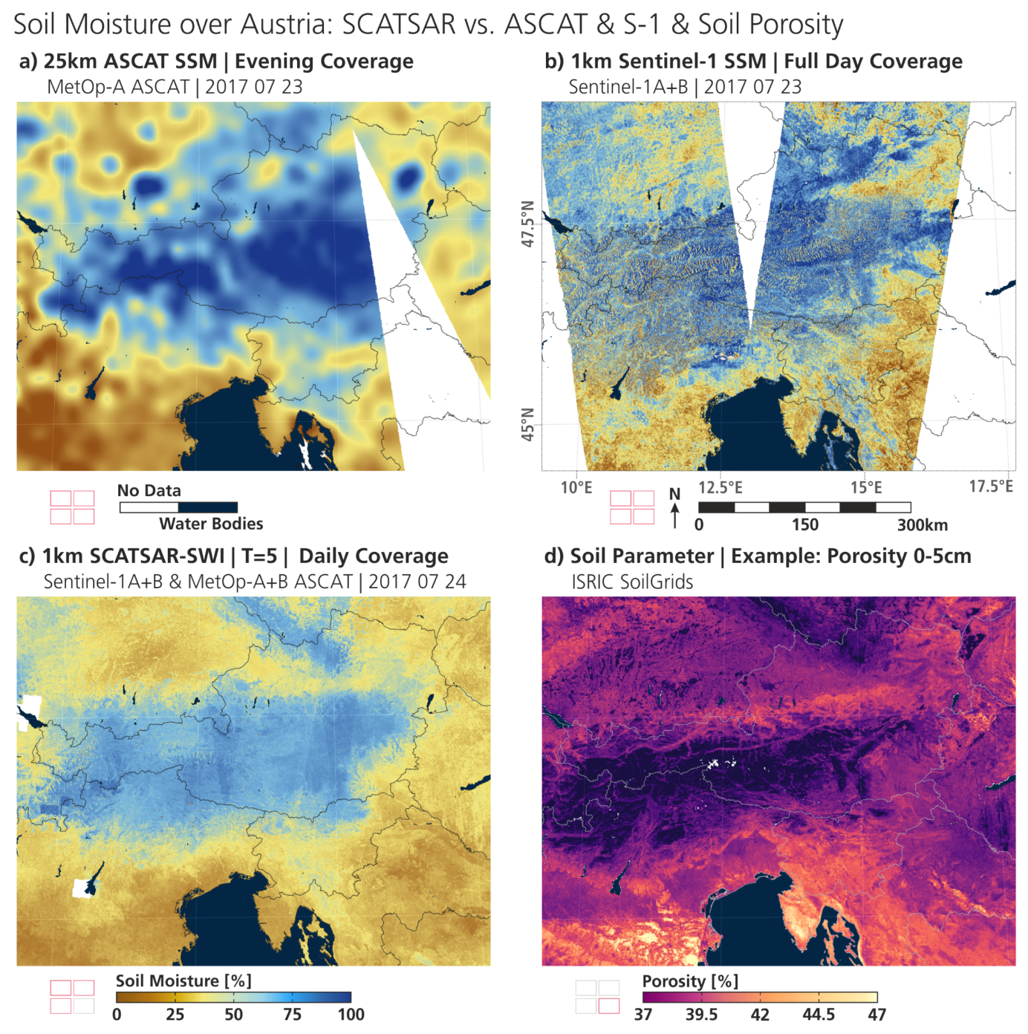
Bauer-Marschallinger et al. (2018) Soil moisture from fusion of scatterometer and SAR: Closing the scale gap with temporal filtering, Remote Sensing, 10(7), 1030, 26 p.

Slide 28
Applications

Slide 29
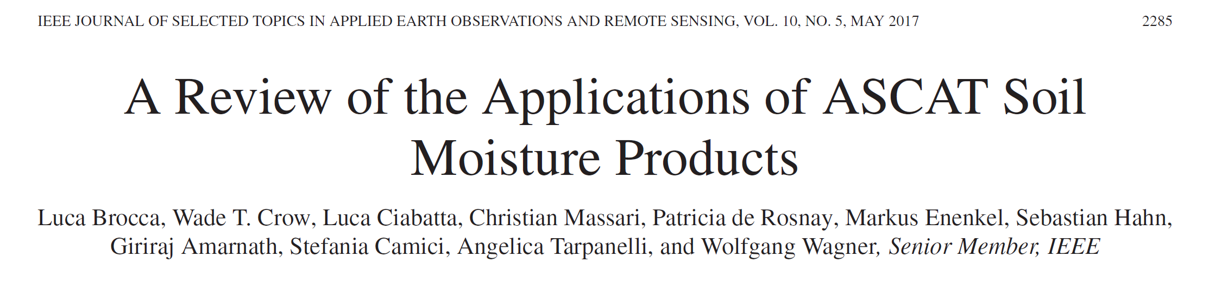
Users of first Climate Change Initiative (CCI) soil moisture data set release (2012)

Slide 30
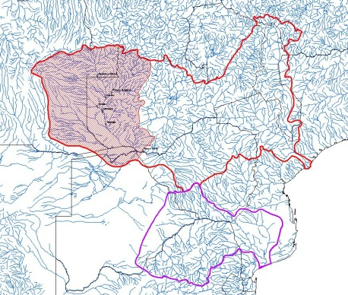
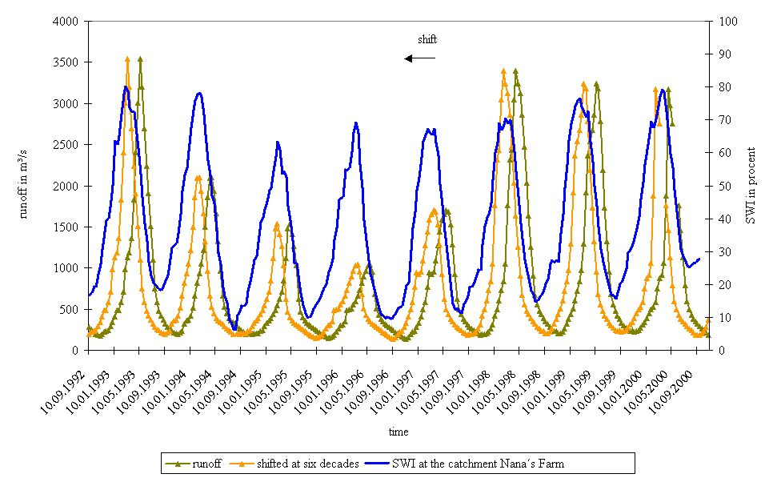
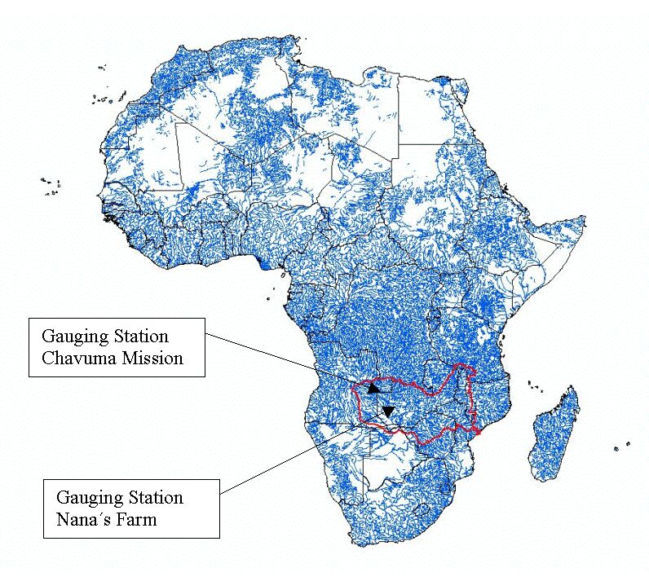
SCAT Soil Moisture versus River Runoff
Sambesi – Nana‘s Farm
60 days shift
Runoff
Soil Moisture (Blue Line)
Time
Shifted Runoff
Runoff
Scipal et al. (2005) Soil moisture-runoff relation at the catchment scale as observed with coarse resolution microwave remote sensing, Hydrology and Earth System Sciences, 9(3), 173-183.

Slide 31
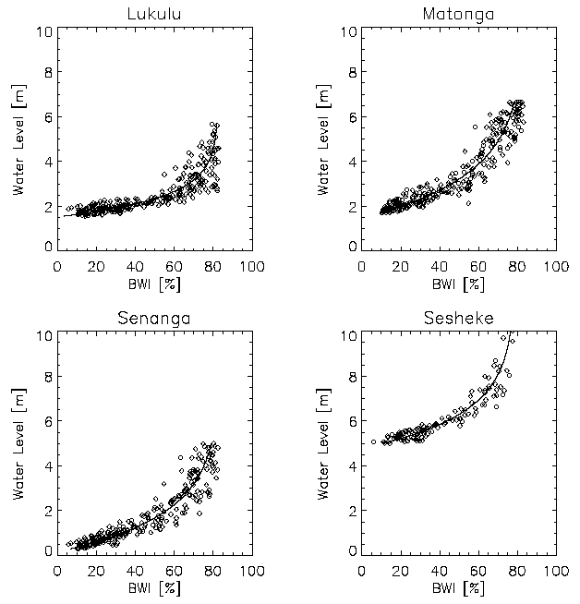
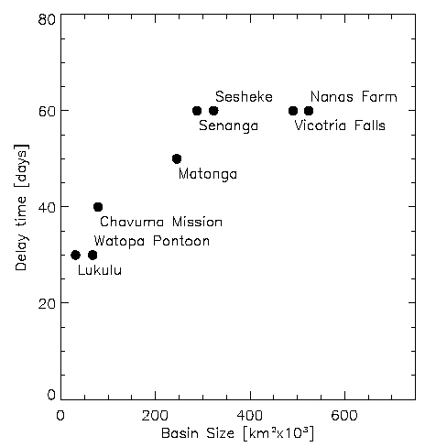
Time Shift and
Catchment Size

Slide 32
Event-based Rainfall-Runoff Modelling
"Curve Number Method"
Q … runoff
P … precipitation
S … retention
SWI … Soil Water Index
Brocca et al. (2009) Antecedent wetness conditions based on ERS scatterometer data, Journal of Hydrology, 364(1-2), 73-87.

Slide 33
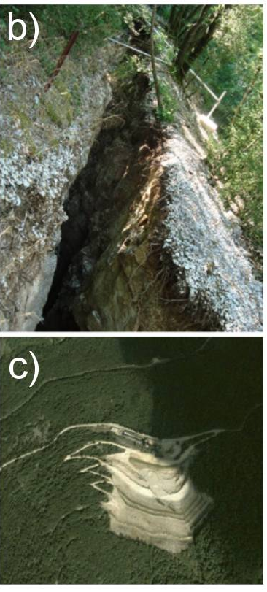
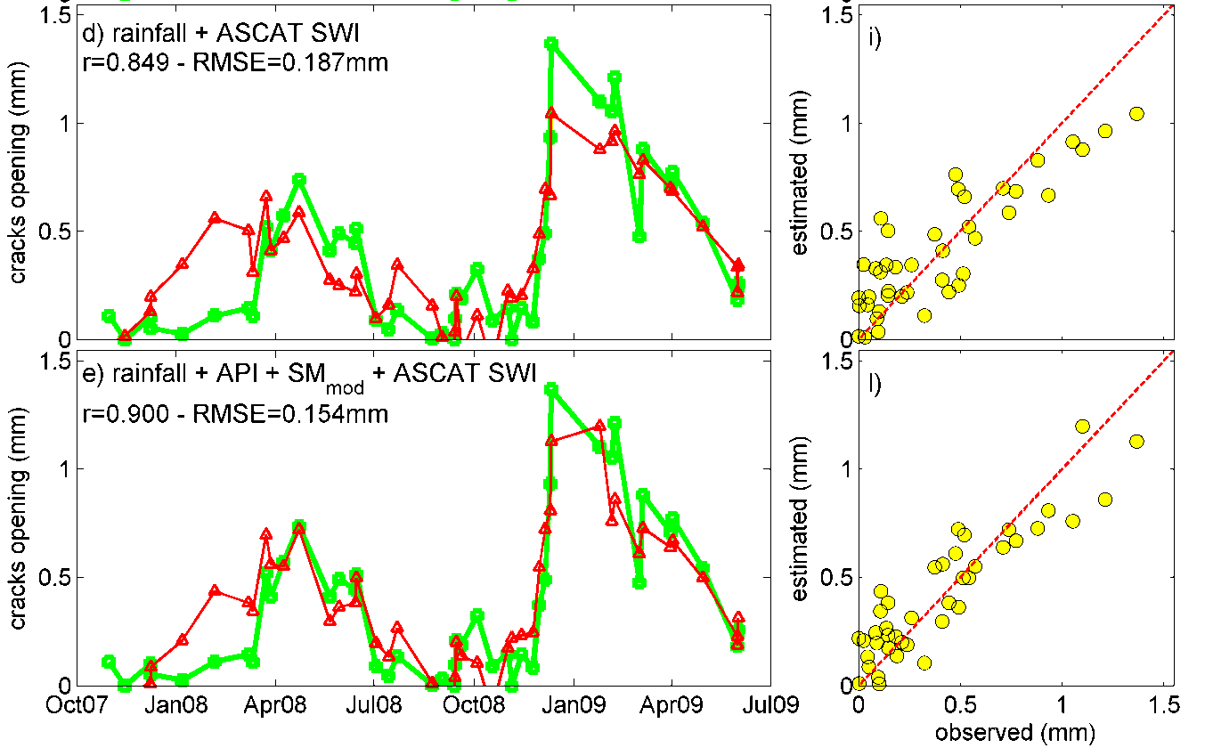
Landslide Monitoring
Comparison between observed (circles) and estimated (triangles) crack aperture of the Torgiovannetto Landslide
in Central Italy from the beginning to the end of the selected rainfall events.
Brocca et al. (2012) Improving Landslide Forecasting Using ASCAT-Derived Soil Moisture Data: A Case Study of the Torgiovannetto Landslide in Central Italy, Remote Sensing, 4(5), 1232-1244.

Slide 34
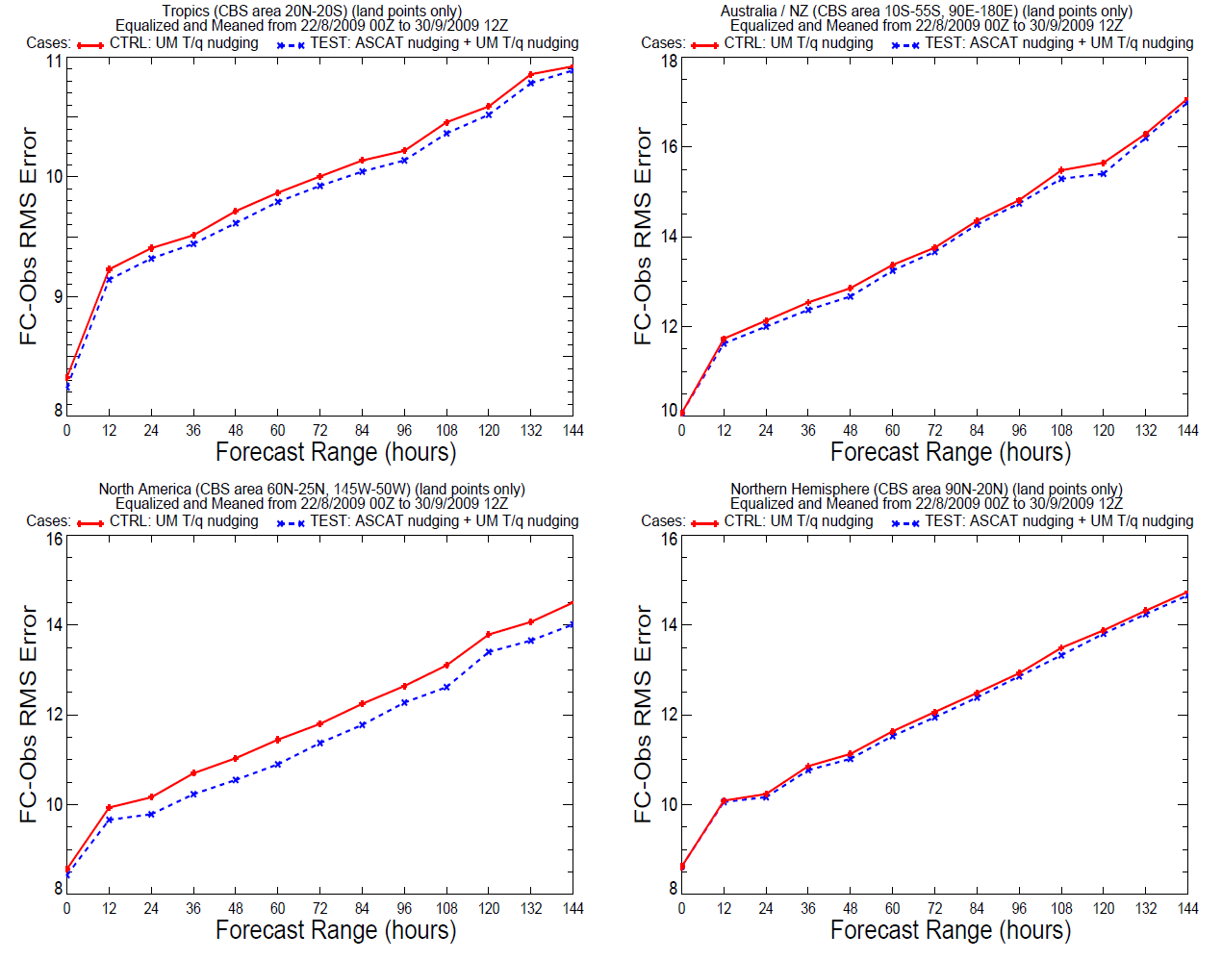
ASCAT Assimilation at NWP Centres
Impact on temperature and humidity
Centres
  ECMWF
  Mete Office
  Meteo France
  ZAMG
Tropics
Australia
Skill of relative humidity forecasts
Dharssi, I., Bovis, K.J., Macpherson, B., & Jones, C.P. (2011). Operational assimilation of ASCAT surface soil wetness at the Met Office. Hydrology and Earth System Sciences, 15, 2729-2746
North America
Northern
Hemisphere

Slide 35
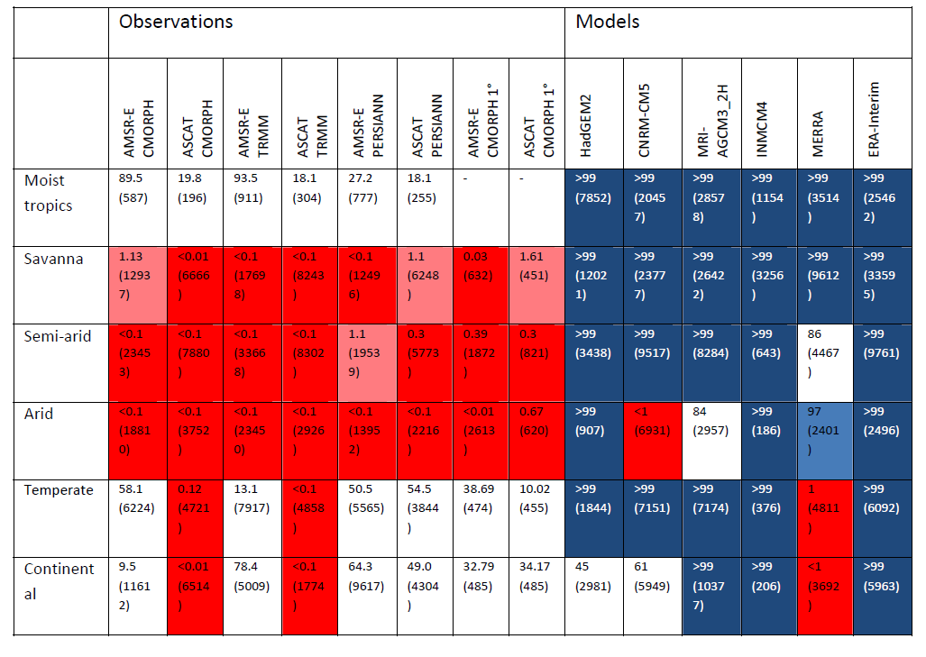
Afternoon rain more likely over drier soils
Dark red = rain falls most likely over drier soils
Pink = rain falls likely over drier soils
Blue = rain falls likely over wetter soils
Dark blue = rain most falls likely over wetter soils
Taylor et al. (2012) Afternoon rain more likely over drier soils. Nature, 489, 423-426.

Slide 36
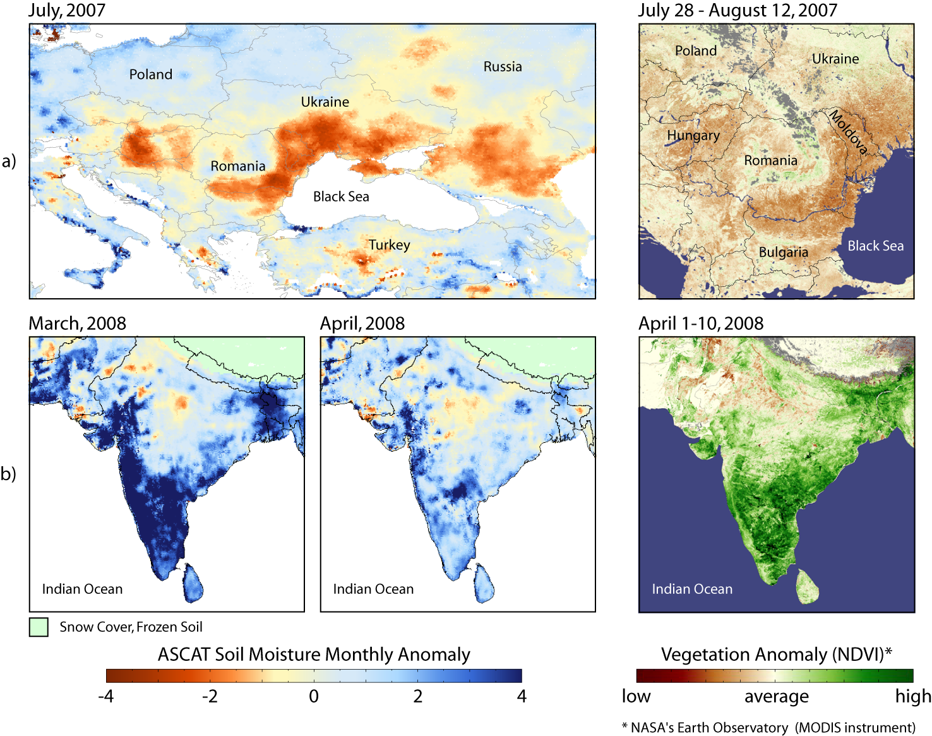
Soil Moisture and Vegetation
Naeimi, V., W. Wagner (2010). C-band Scatterometers and their Applications, Chapter 13 of "Geoscience and Remote Sensing New Achievements", P. Imperatore and D. Riccio (Ed.), INTECH, Vukovar, Croatia, 230-246.

Slide 37
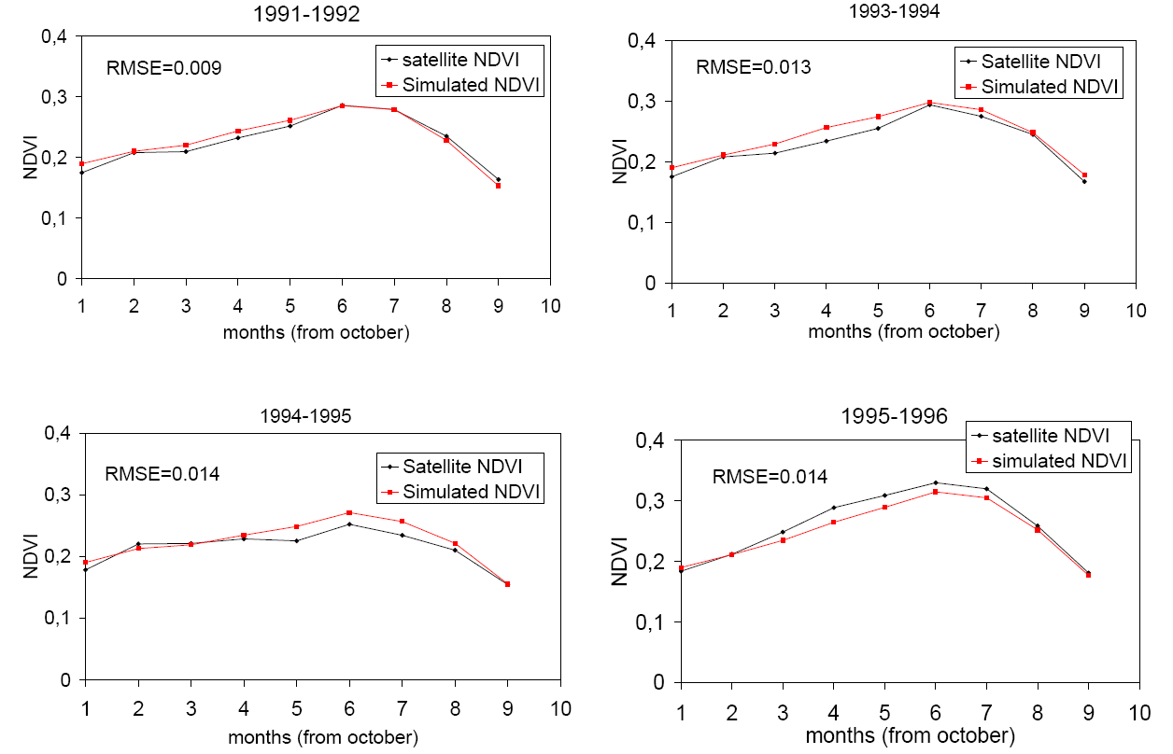
Prediction of NDVI using SWI
Modelling next month's NDVI using SWI
Zribi et al. (2010) Relationship between soil moisture and vegetation in the Kairouan plain region of Tunisia using low spatial resolution satellite data, Water Resources Research, 46, W06508, 13 p.

Slide 38
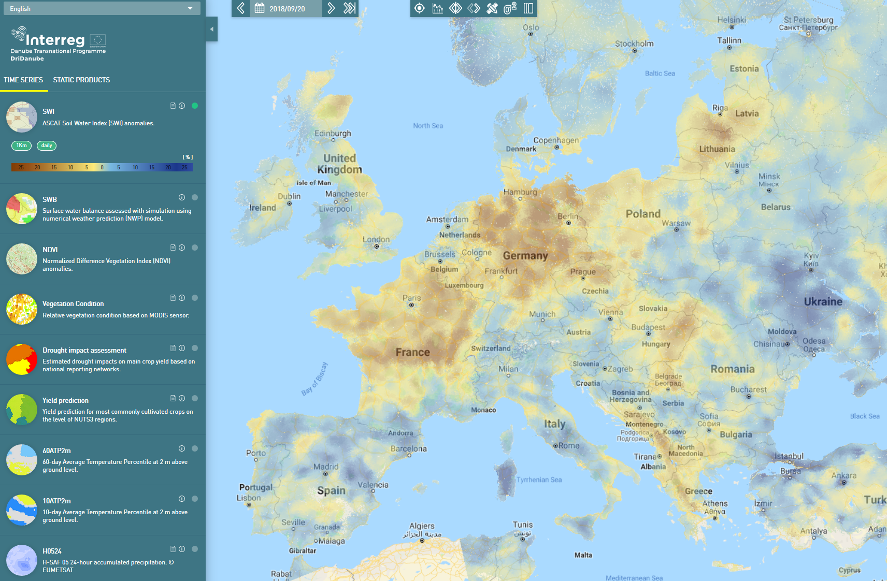
Drought Monitoring
ASCAT based drought index for 20 September 2018. https://droughtwatch.eu/

Slide 39
Final Thoughts
Steadily increasing uptake by users despite ASCAT soil moisture data are not “plug and play”
    Soil moisture is often not a direct input variable but a state variable
    Many land surface models do not have a topsoil layer
    Dealing with spatially and temporally varying uncertainties is challenging
    Long time series needed for model calibration
    Data are complex
Increasing number of downstream data services
  Value-added soil moisture data
  Rainfall estimates
  Drought indices
  Etc.
Acknowledgements
EUMETSAT: H-SAF CDOP2
European Commission JRC: Copernicus Global Land
Interreg Danube Translational Programme: DriDanube
FFG Austrian Space Applications Programme: BMon

