Slide 1
Using Satellite data for Crop Monitoring in Armenia
Hasmik Panyan
Service of the Hydrometeorology and Active Influence on
Atmosphere Phenomena, Armenia
Head of Satellite information analysis and application division
SALGEE Workshop, 14.10.2019-17.10.2019

Slide 2
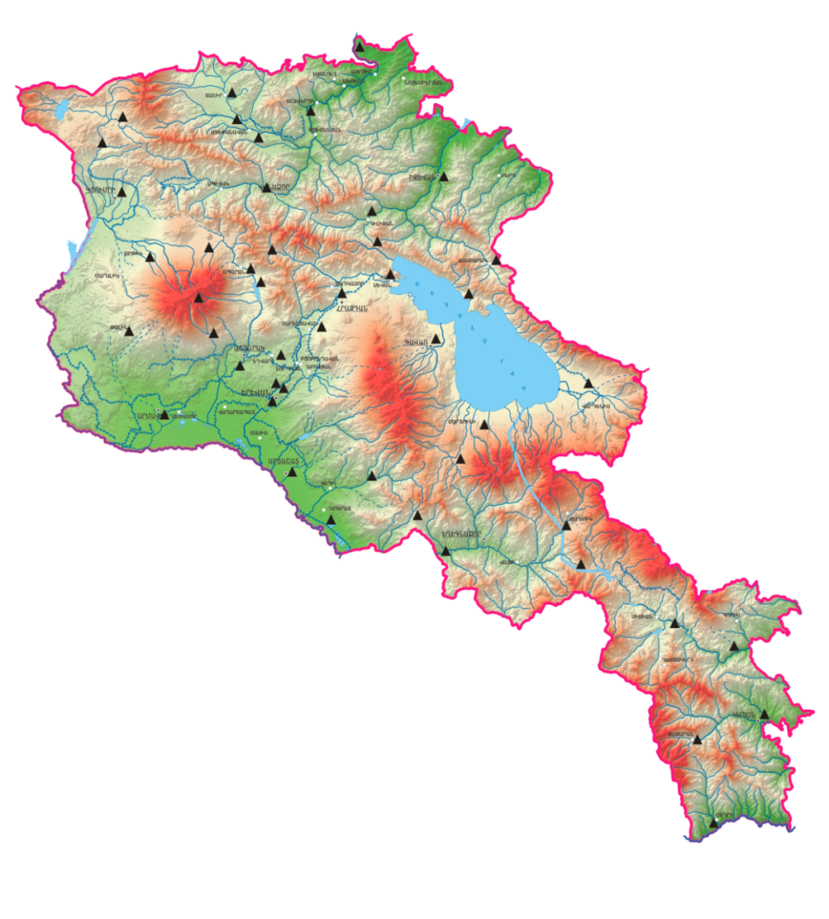
Observation Network
47 meteorological station, including
40 agrometeorological
7 actinometric
1 aerological
2 Radar
Atmospheric Ozone
Gamma phone
Radioactive dust (Yerevan)
Meteorological stations of Armenia
Agrometeorological observations
Sunshine duration
Soil temperatures
Soil moisture of 10, 20, 50 cm
Temperature on the depth of winter crops tillering node (3cm)
Snow height
Direct solar radiation
Global and reflected solar radiation
Notes:
This is the distribution of meteorological stations in Armenia:
we have 47 meteorological stations, of which 40 are also doing agrometeorological observations, 7 actinometric observations, 1 is aerological station, we have 2 radar, and as well as atmospheric ozone, gamma phone and radioactive dust observations․
Agrometeorological observations
Includes
Sunshine duration
Soil temperatures
Soil moisture of 10, 20, 50 cm
Temperature on the depth of winter crops tillering node (3cm)
Snow height
Direct solar radiation
Global and reflected solar radiation

Slide 3
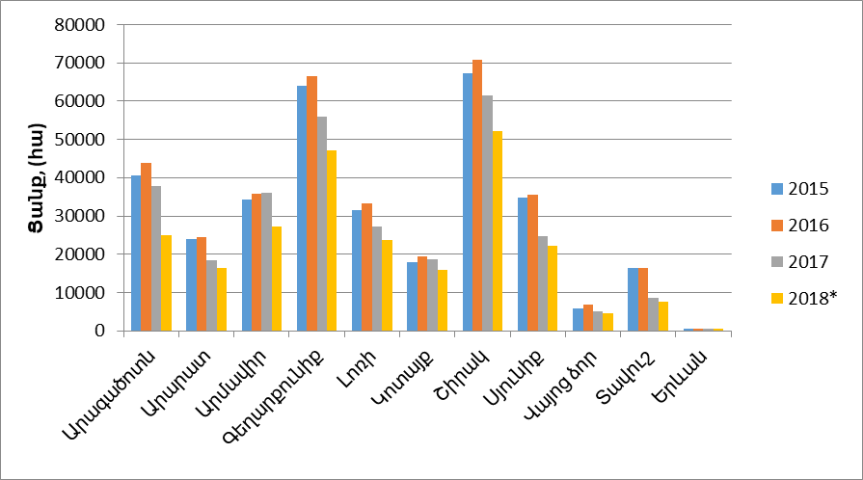
Crop cultivation areas of the Republic of Armenia by regions 2015-2018 /ha/
Aragatsotn | Ararat | Armavir | Gegharquniq | Lori | Kotayq | Shirak | Syuniq | Vayots Dzor | Tavush | Yerevan

Slide 4
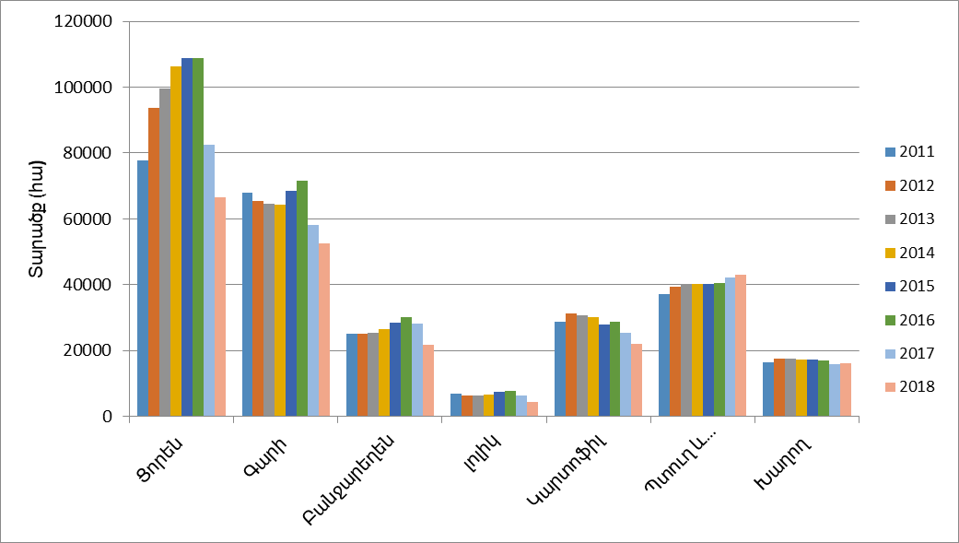
Sowing areas of agricultural crops 2011-2018 /ha/
Wheat | Barley | Vegetables | Tomatoes | Potatoes | Fruit | Grapes

Slide 5
Agricultural lands of RA
Almost 30 percent of the area is unfit for agriculture. According to the 2011 land balance, the total agricultural land is 2077.0 thousand hectares, including arable lands 449.2 (21.6%), perennial plantations - 33.0 (1.6%), grassland - 128.3 (6.2%), pastures 1067.2 (51.4%) and other land types - 399.3 (19.2%) thousand hectares (excluding perennial plantations and arable land)

Slide 6
Satellite data in use
EUMETSAT data reception system via EUMETCast (DAWBEE)
PLANET Hydromet Service of Russia (http://sputnik.infospace.ru)
EUMETSAT official website (www.eumetsat.org)
COPERNICUS land (https://www.copernicus.eu/)
VITO (http://www.vito-eodata.be/)
ASAP - ANOMALY HOTSPOTS OF AGRICULTURAL PRODUCTION (https://mars.jrc.ec.europa.eu/asap/)
Notes:
es

Slide 7
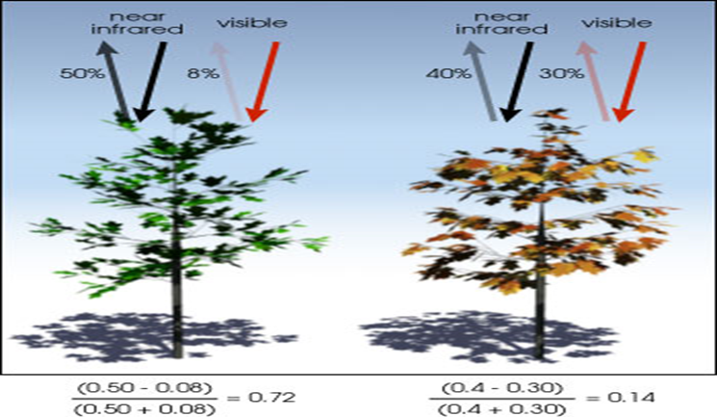
Remote Sensing indexes for crop condition monitoring and yield forecast
(NDVI, CHV, TCI, VCI….) The NDVI is the most well known and often used vegetation index. It is simple, but effective for quantifying green vegetation. The NDVI normalizes green leaf scattering in the near-infrared wavelength and chlorophyll absorption in the red wavelength. NDVI = (NIR – RED) / (NIR + RED) Dense vegetation in good phytosanitary condition absorbs a lot the electromagnetic spectrum in the RED spectral region: HIGH NDVI value. Sparse vegetation and/or in bad phytosanitary condition will not absorb a lot the electromagnetic spectrum in the RED spectral region: LOW NDVI
Notes:
Remote Sensing indexes for crop condition monitoring and yield forecast. (NDVI, CHV, TCI ....)
The NDVI is the most well-known and frequently used vegetation index. It's simple, but effective for quantifying green vegetation. The NDVI normalizes green leaf scattering in the near-infrared wavelength and chlorophyll absorption in the red wavelength.
NDVI = (NIR - RED) / (NIR + RED)
Dense vegetation in good phytosanitary condition absorbs a spectrum of the electromagnetic spectrum in the RED spectral region: HIGH NDVI value.
Sparse vegetation and / or bad phytosanitary condition will not absorb a lot of electromagnetic spectrum in the RED spectral region: LOW NDVI value

Slide 8
Satellite data for vegetation monitoring
 | SPOT_VGT | METOP | PROBA-V | SENTINEL-2
Spatial resolution | 1 km | 1 km | 1 km | 1km
N° images per year | 36 | 36 | 36 | 36
Years available | 1999-2013 | 2008-2022 | 2013- | 2014-

Slide 9
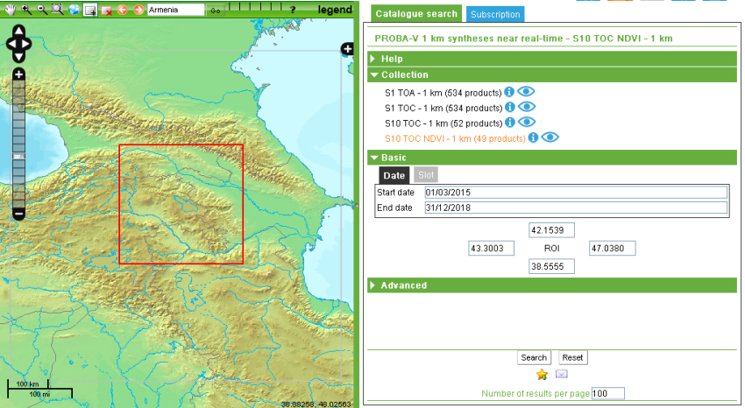
Getting Data PROBA-V http://www.vito-eodata.be
Notes:
The NDVI 1km data of the Proba-V satellite we are downloaded from the site:
http://www.vito-eodata.be

Slide 10
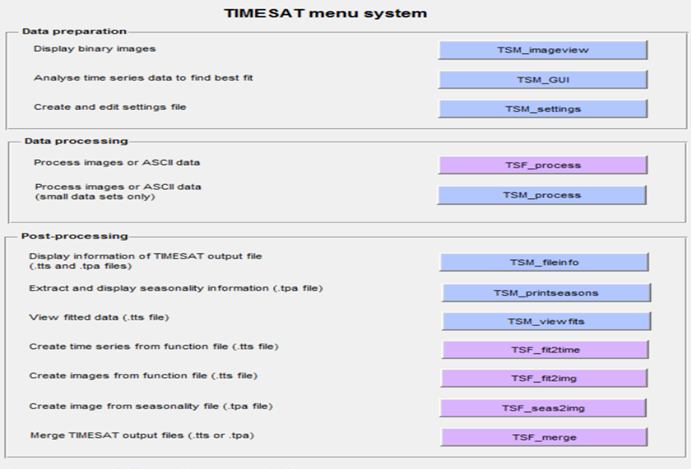
Software in use
VGT Extract 1.4.1
VAST 3.0
WinDisp 5.1
PPT
TIMESAT
R, R-STUDIO
GIS
Notes:
For the analising the software are used

Slide 11
Viewing temporal NDVI evolution in a graph 1998-2011

Slide 12
12 crop phenological parameters
SDAT is the starting decade of the growing season
PEAK is the decade at which NDVI peaks
HORZ = PEAK - SDAT
SVAL is the value of NDVI at SDAT
PVAL is, similarly, the value of NDVI at time PEAK
VERT = PVAL - SVAL
EVAL is the NDVI at time PEAK + 4
DROP = PVAL - EVAL
SLOP is the slope of the line joining (SDAT,SVAL) to (PEAK,PVAL)
CUMM is the sum of NDVI values from SDAT to PEAK
SKEW is the ratio between the sum of the three NDVI values after PEAK (peak+1 to peak+3) and the sum of the seven values from Peak-3 to peak+3....
Notes:
12

Slide 13
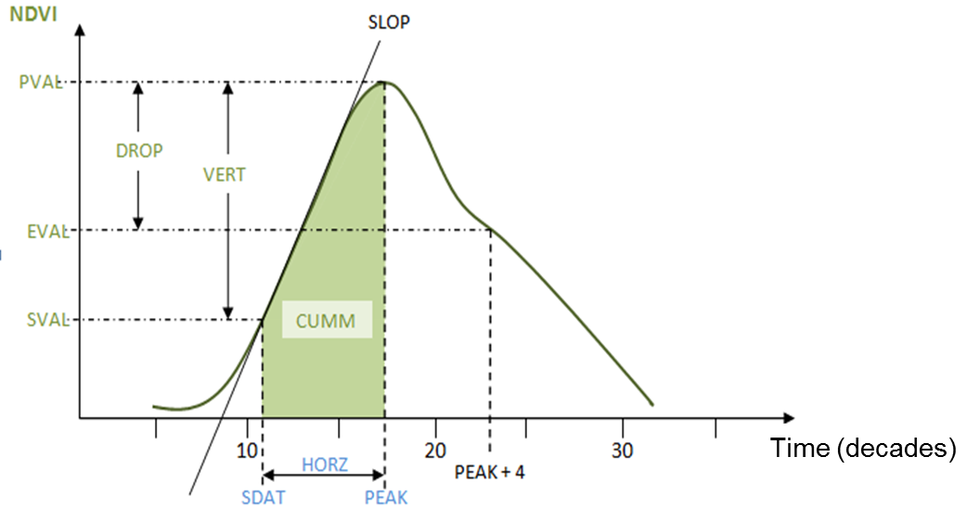
Vegetation Analysis in Space and Time
NDVI time serie
(36 images/year)
12 Phenological parameters IDA images
12 Phenological parameters computation
Notes:
13

Slide 14
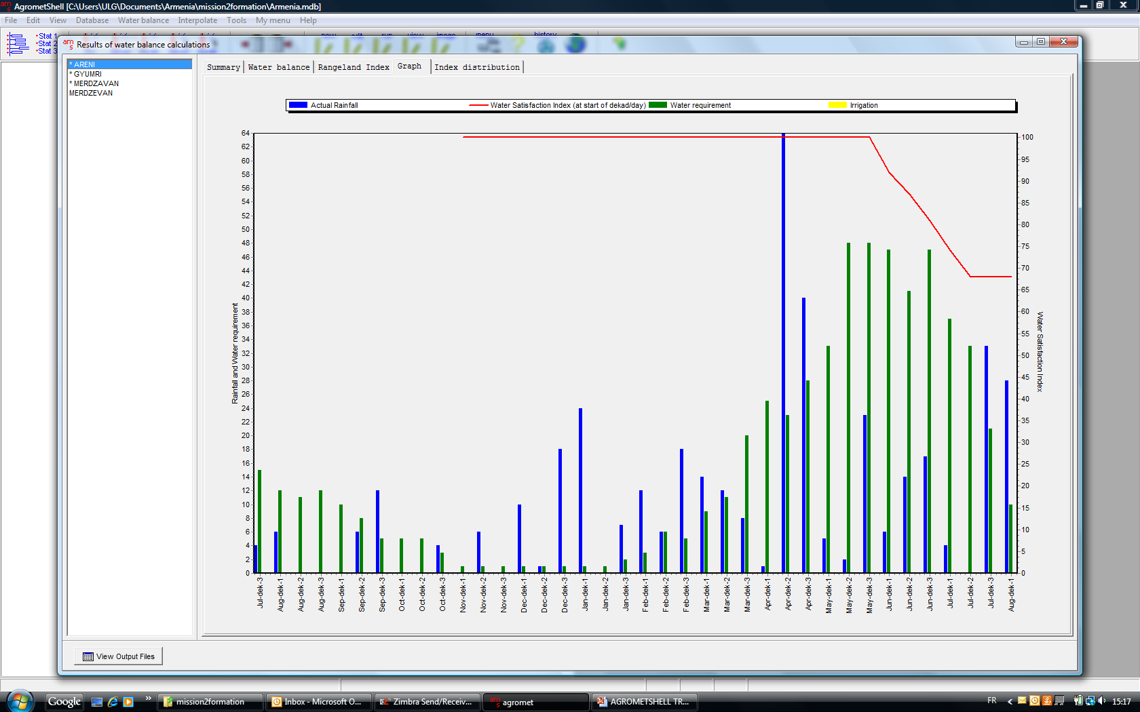
Water Balance
Notes:
Making Assessment of the water balance every decade , compering the value for different years, taking in to account T,P it becom possible to make disition regarding Vegetation stress on T, P

Slide 15
Changes in Vegetation Activity
Changes in vegetation photosynthetic activity can be characterized by
changes in growing season
changes in NDVI magnitude
Increases in growing season
Increases in NDVI magnitude
earlier spring
delayed fall
Increase
Jan
Jul Aug
Dec
Jan
Jul Aug
Dec
NDVI
NDVI

Slide 16
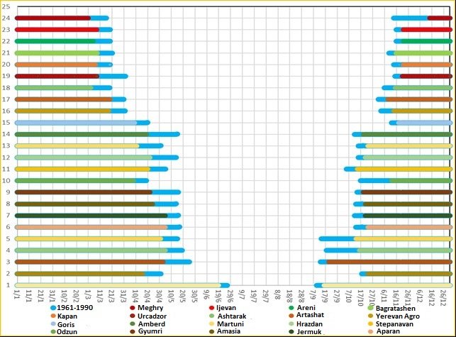
Changes of the in growing season

Slide 17
3 decade, 2018 July, NDVI TimeSat

Slide 18
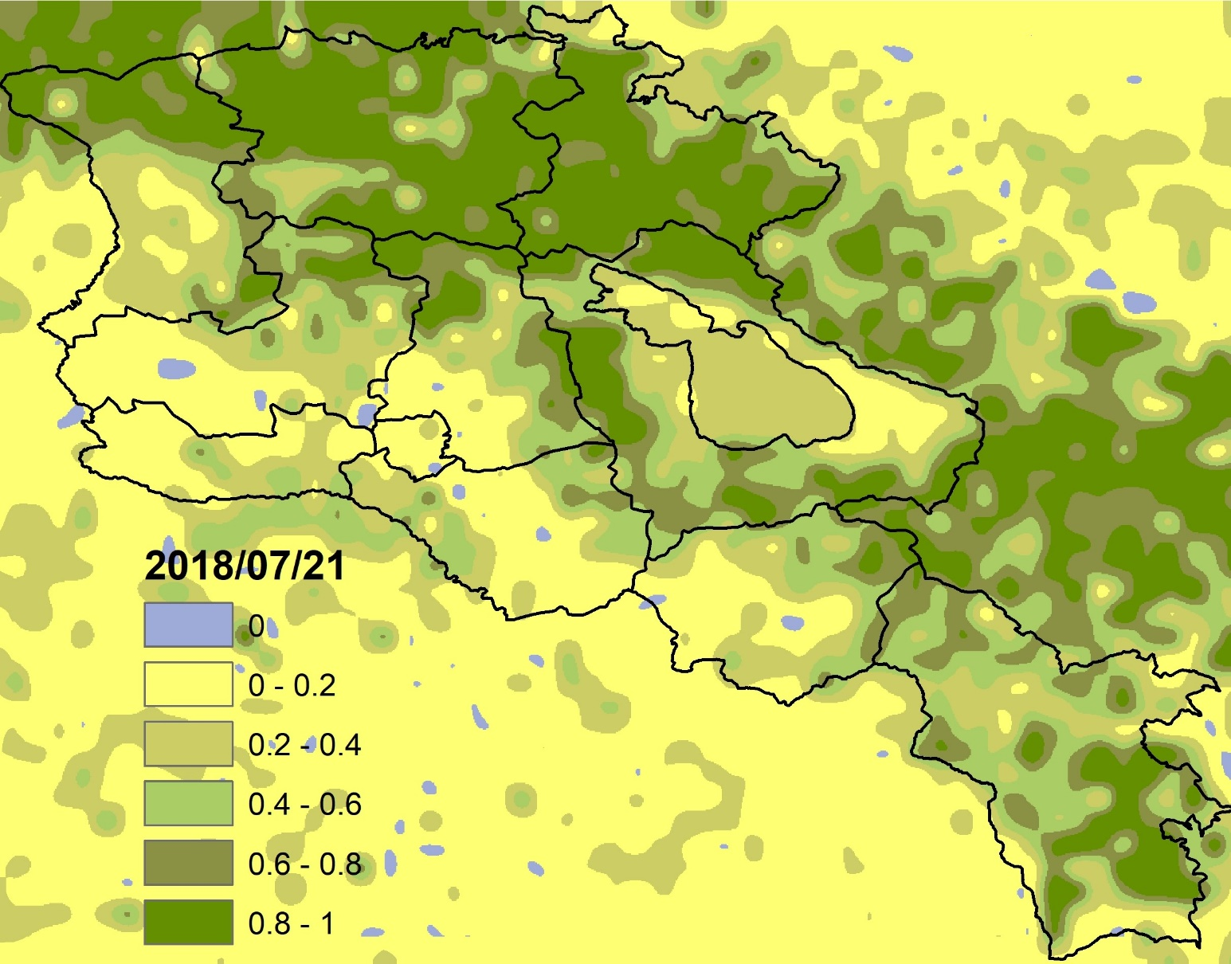
3 decade, 2018 July, NDVI 300m GIS

Slide 19
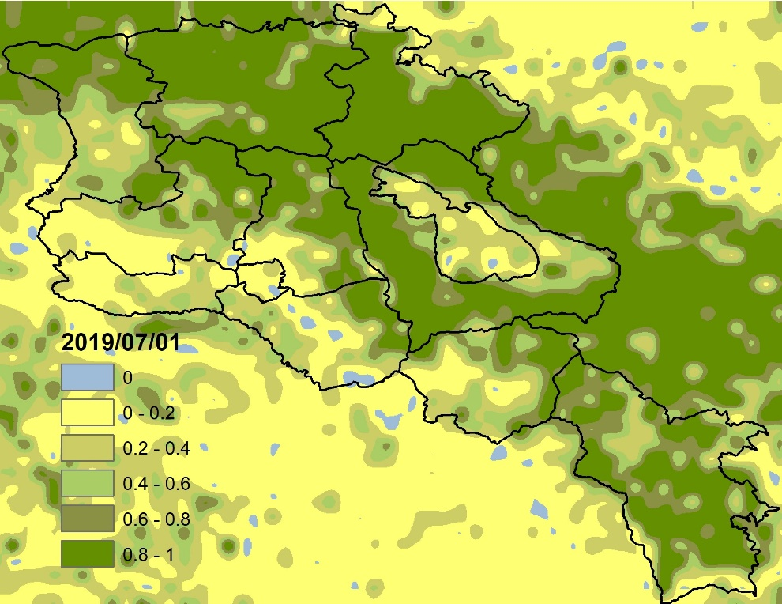
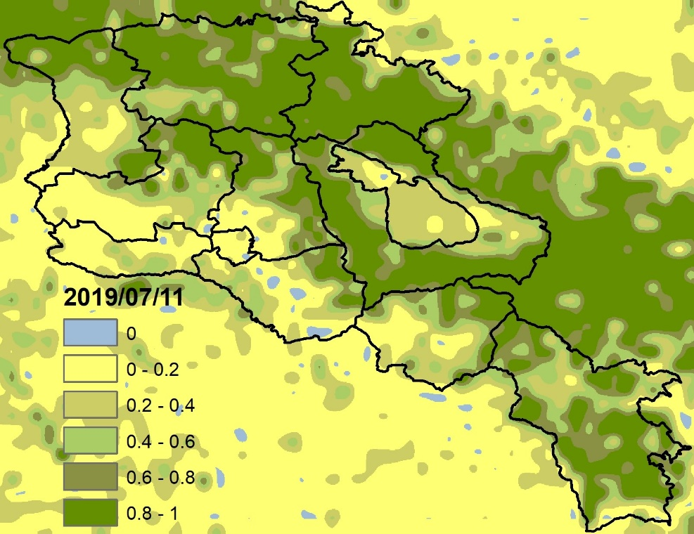
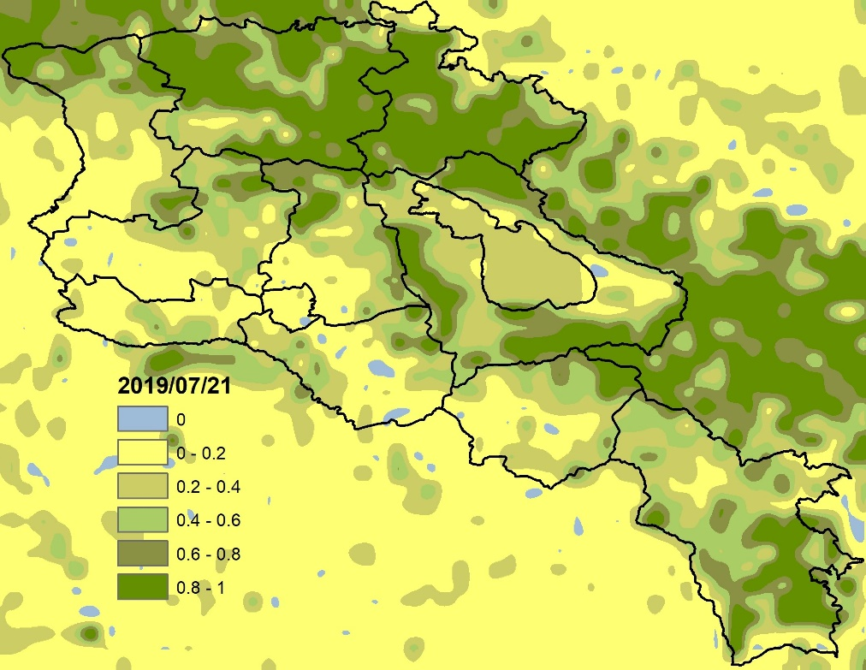

Slide 21
Needs Identification
Methodology
Processing tools
Knowledge transfer
FORUM

Slide 22
THANK YOU
ՇՆՈՐՀԱԿԱԼՈւԹՅՈւՆ

