Slide 1
Assessing Agricultural Droughts by Combined Vegetation and Evapotranspiration Signal from LSA SAF
Boštjan Muri, Mateja Iršič Žibert, Gregor Gregorič, Jana Čampa and Andreja Sušnik
Slovenian Environment Agency (ARSO)

Slide 2
Contents
Overview
Vegetation Monitoring
Combined Drought Index
Conclusions

Slide 3
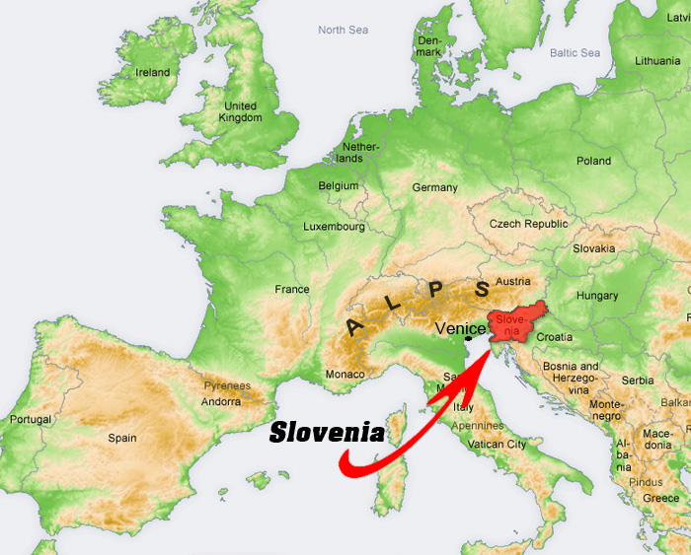
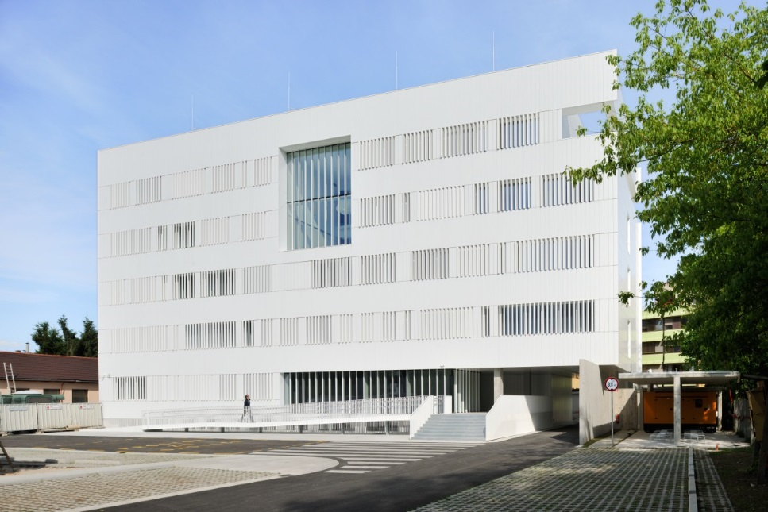
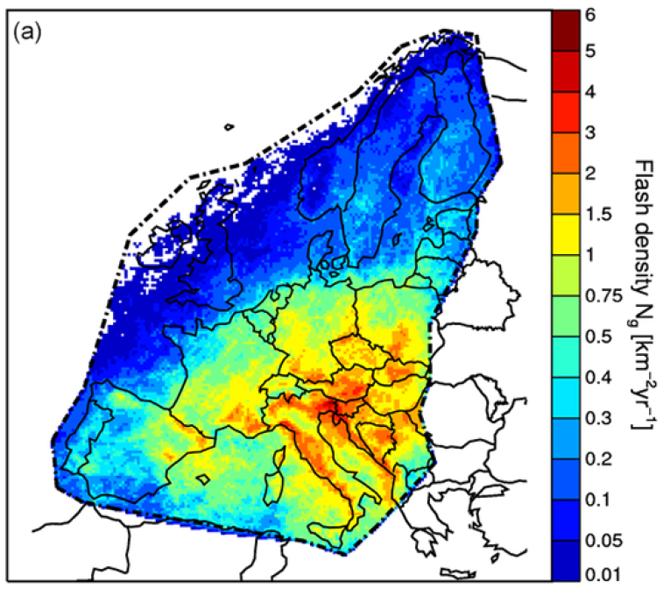
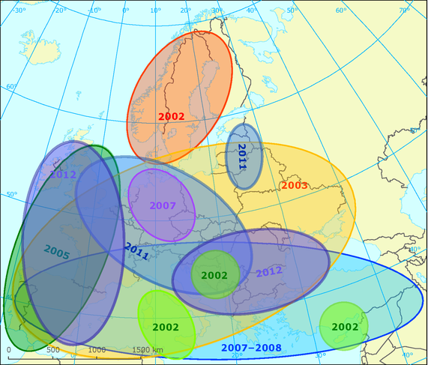
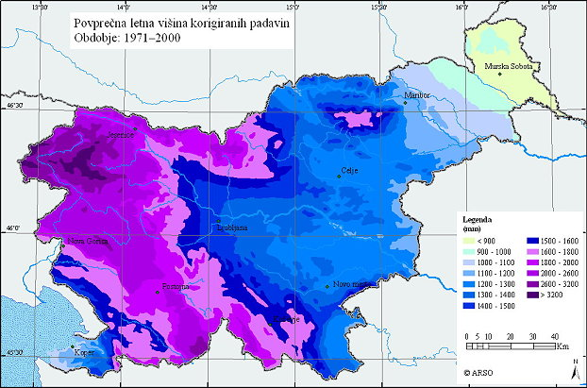
Slovenian Environment Agency (ARSO)
Environmental Measurement Office
Meteorological Measurements
Hydrometrics
Network Maint. Development
Laboratories
State of the Environment Office
Air Quality
Ecolo. Status of Waters
Chem. Status of Waters
Environmental Information
Meteorology and Hydrology Office
Data Control, Flow & Archive
Analysis
Models
Forecasts
ARSO role within EUMETSAT‘s LSA SAF CDOP-3 phase: shortwave radiation, vegetation, evapotranspiration
Slovenia: Alpine, Mediterranean and Continental climate
Products & Services
Mean annual CG flash density [km-2 yr-1], Poelman et al., 2016.
Severe droughts in:
2003, 2006, 2007, 2012, 2013
West > 3200mm/year, East < 900 mm/year

Slide 4
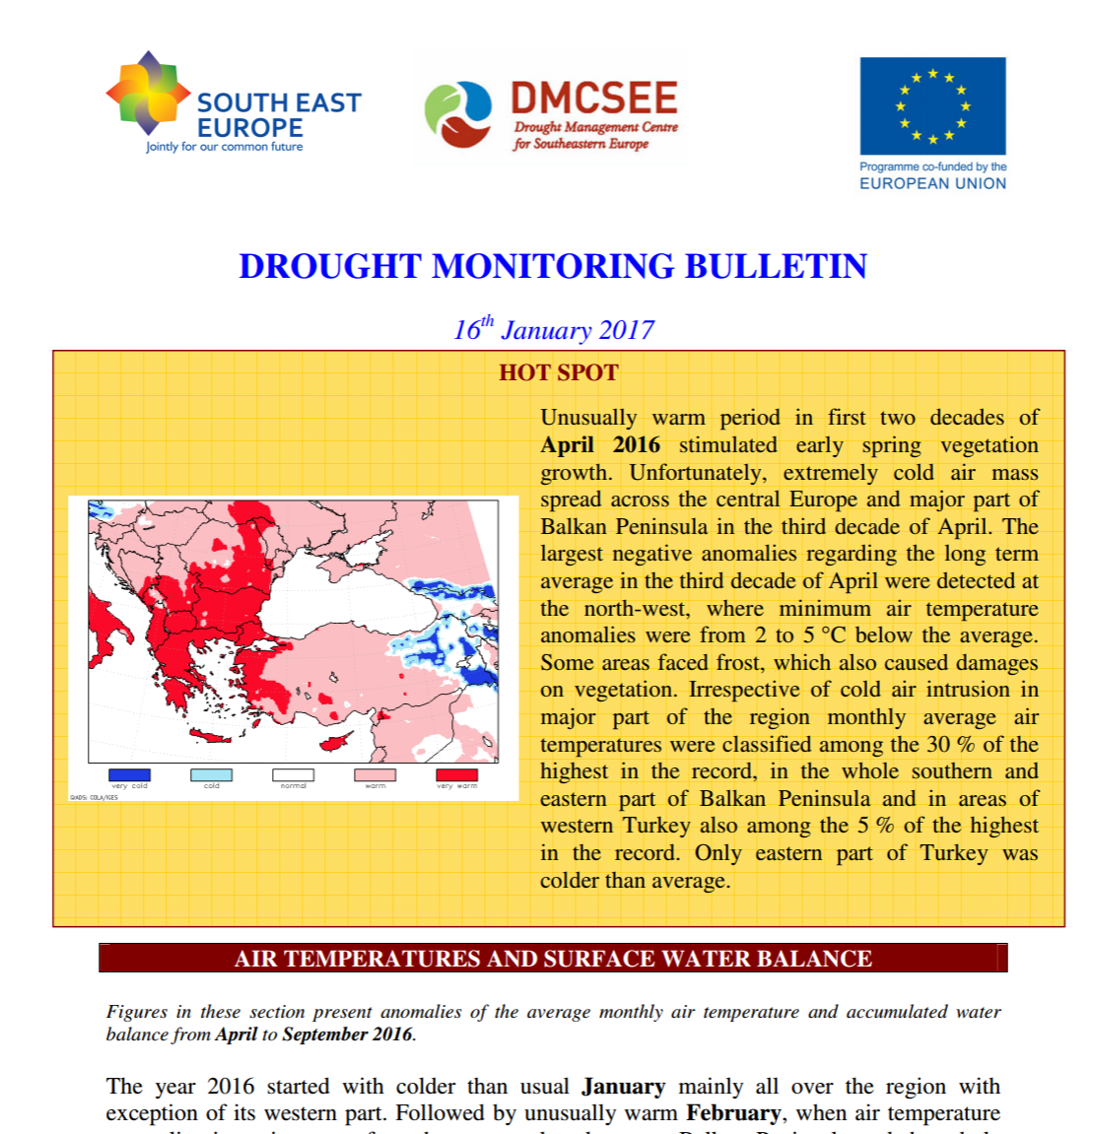
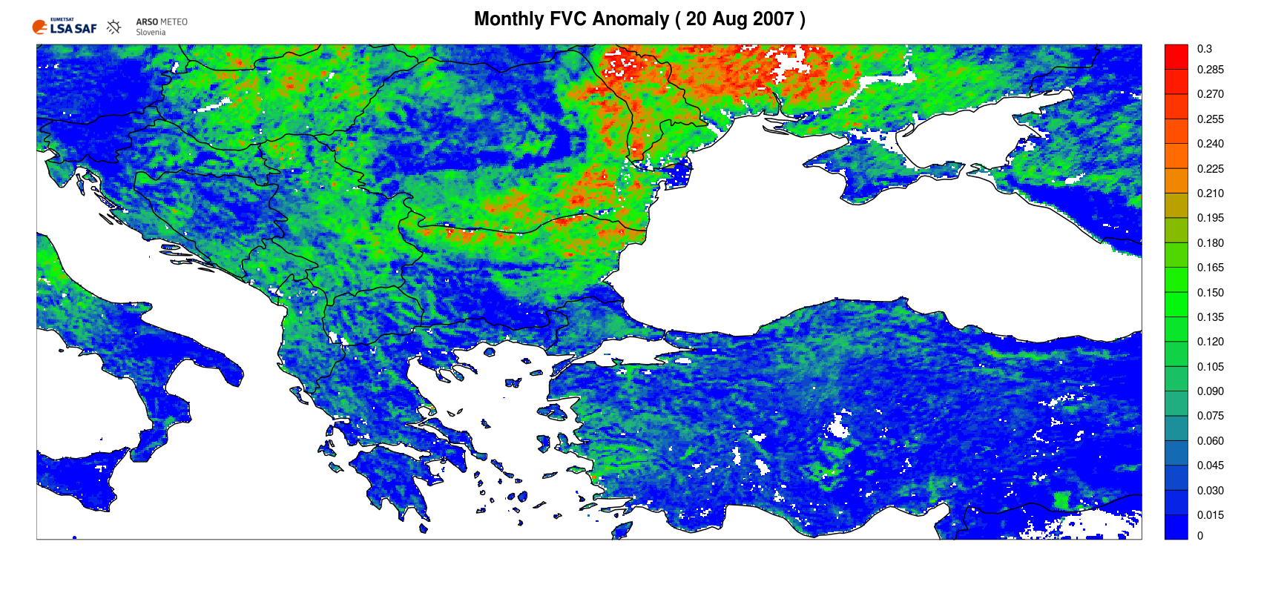
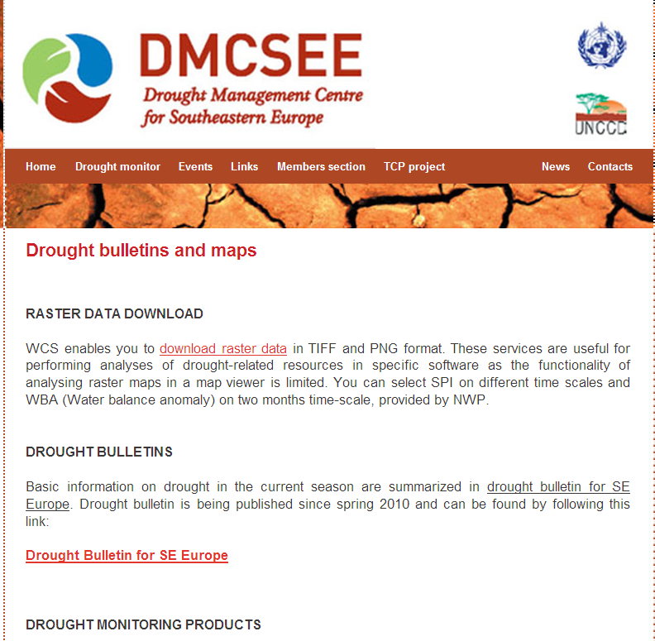
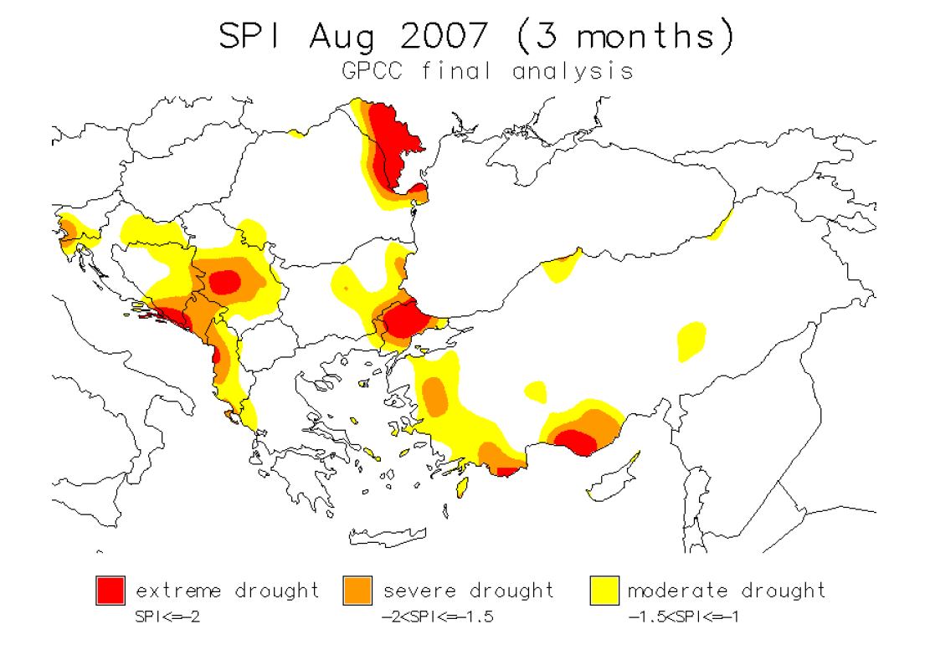
Drought Management Centre for SE Europe (DMCSEE)
Implementation of standardised precipitation index (SPI)
SPI, percentiles and precipitation
LSA SAF VEGA products
Historical maps (1951-2000)
Data origin: GPCC data / update once per month
DMCSEE Monthly Bulletin
www.dmcsee.org

Slide 5
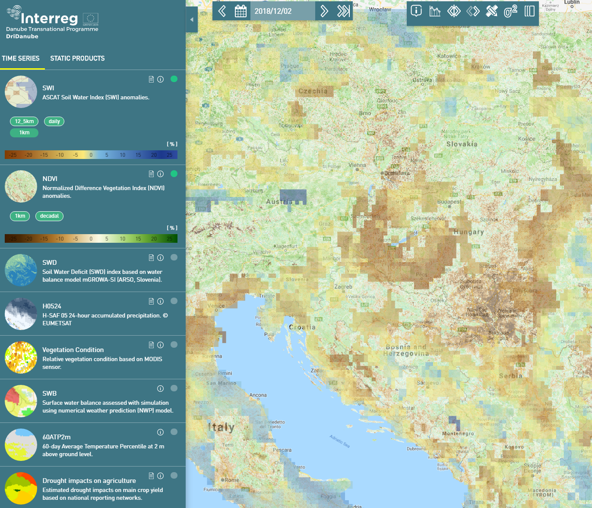
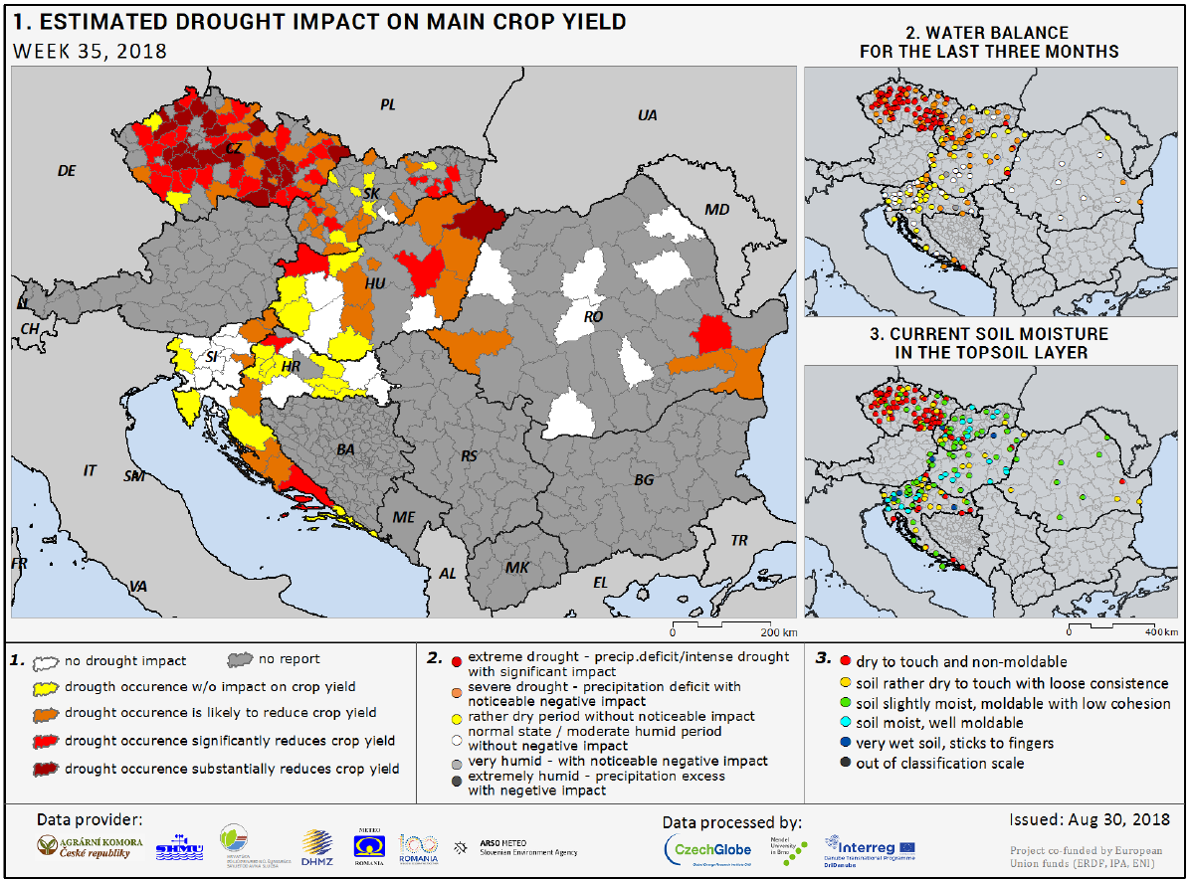
DriDanube Project
Improved drought emergency response and better cooperation among operational services and decision making authorities in the Danube region.
GENERAL OBJECTIVE
Project aims to increase the capacity of the Danube region to adapt to climatic variability by enhancing resilience to drought with recently developed tools and data sets.
New drought monitoring services
Unified drought risk protocol
Improve drought emergency
response in the Danube region.
Soil Water Index (SWI)
NDVI
Soil Water Deficit (SWD)
Relative Vegetation Condition (VegCon):
Soil Water Balance (SWB)
Drought impacts on agriculture: ground conditions as reported by human observers
SPECIFIC OBJECTIVES
the Drought Watch tool
www.interreg-danube.eu

Slide 6
Contents
Overview
Vegetation Monitoring
Combined Drought Index
Conclusions

Slide 7
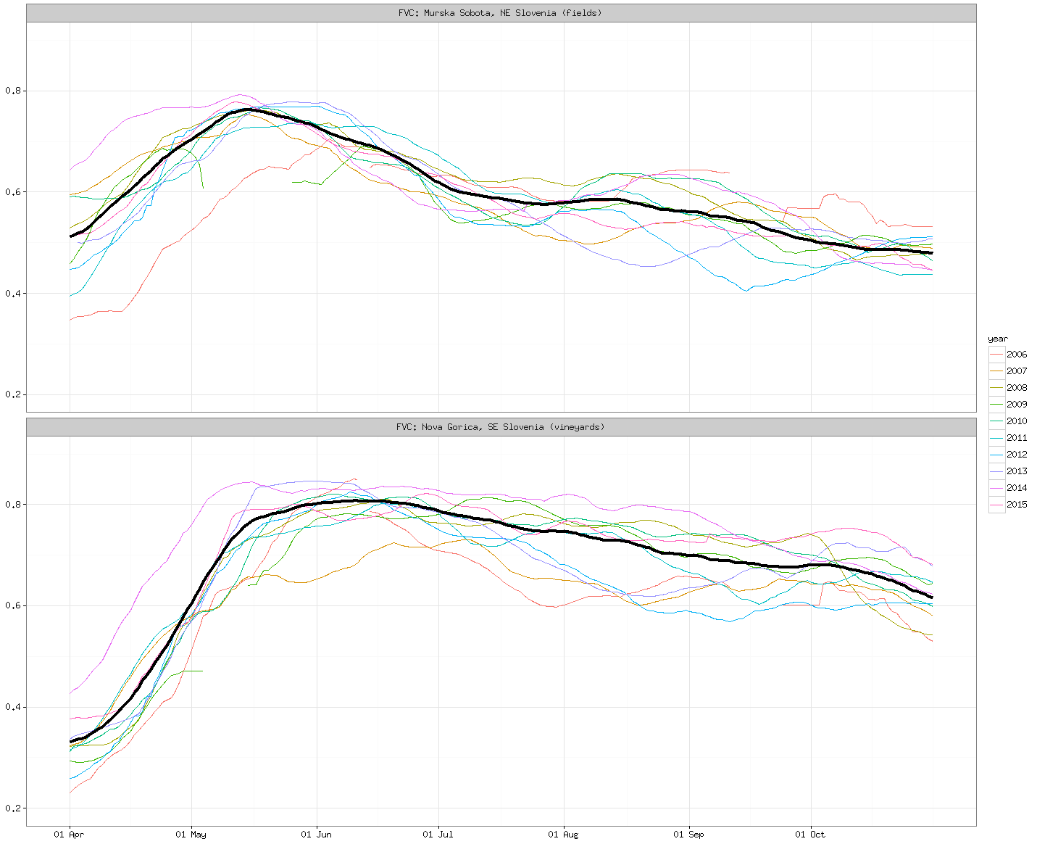
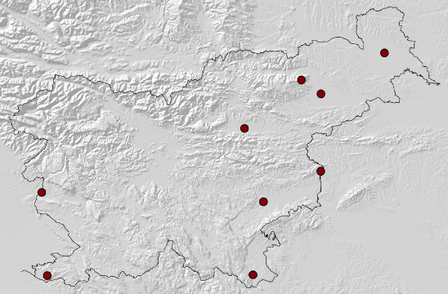
LSA SAF Vegetation Products
We rely on LSA SAF satellite products (products related to land surface & land-atmosphere interactions) for drought and vegetation monitoring. LSA SAF products focus on the use of EUMETSAT satellites.
MSG/METOP VEGETATION INDICES (daily / multi-day temporal frequency):
Fraction of vegetation cover (FVC)
Leaf Area Index (LAI)
Fraction of Photosynthetically Active Radiation (fAPAR)
LSA SAF FVC index
Reference based on long-term
average vegetation (2004–2018).
Murska Sobota (NE Slovenia, fields)
Very dry years: 2007, 2012 and 2013 (summer values below reference)
Nova Goria (SW Slovenia, vineyards)
Very dry years: 2006, 2007, 2012 and 2013
A very moist year with high precipitation: 2014 (values well above reference)
Fields
Vineyards

Slide 8
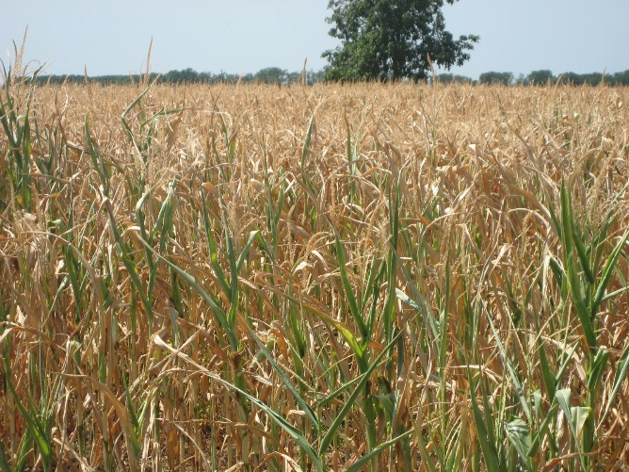
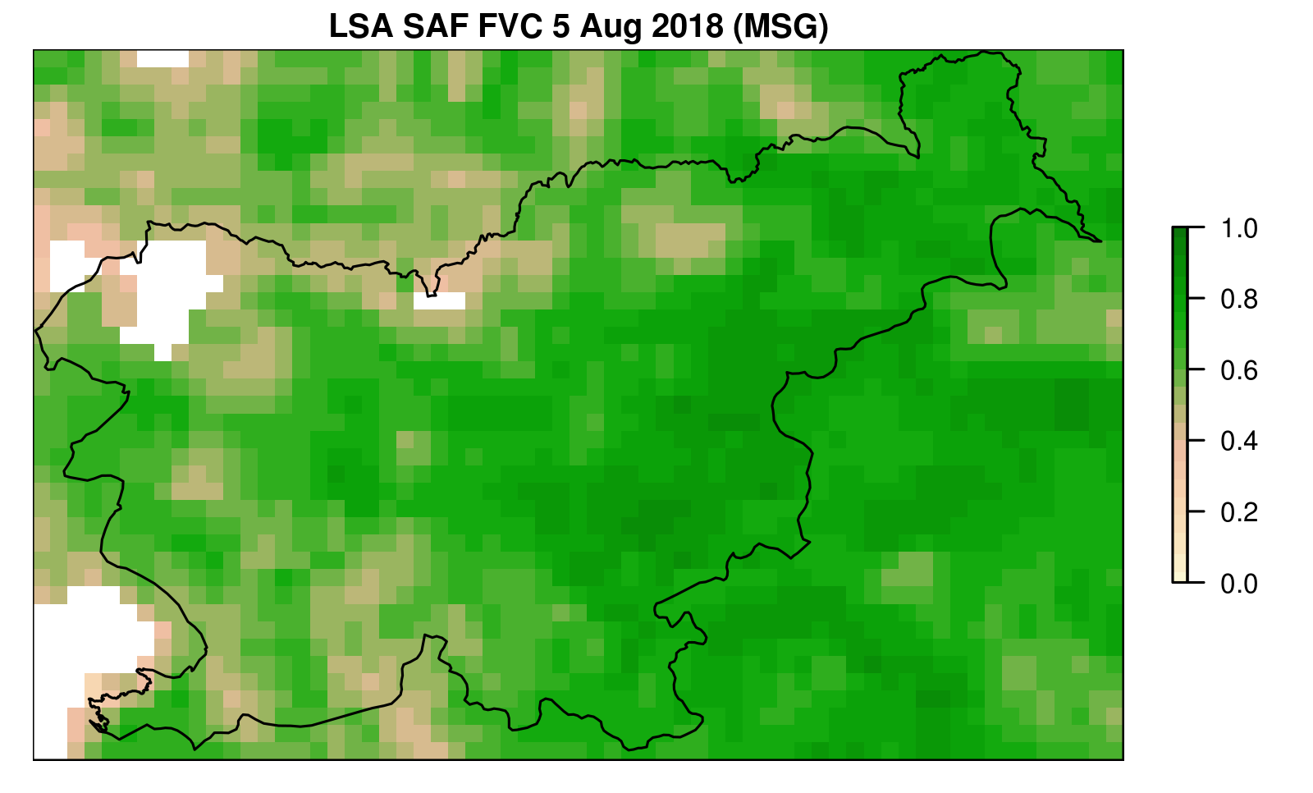
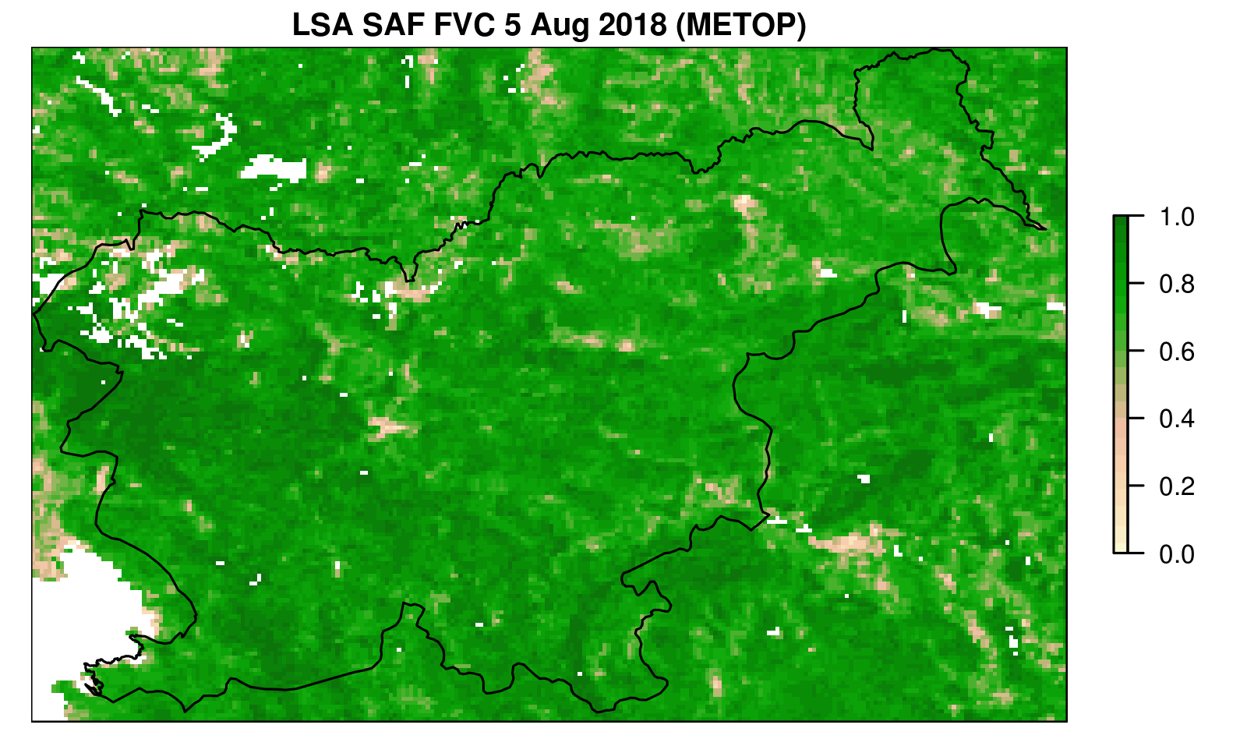
High Spatial Resolution Satellite Data
Frequency: daily
Spatial resolution: ~ 4km
Frequency: 10 days
Spatial resolution: ~ 1km
LSA SAF Fraction of vegetation cover (MSG)
LSA SAF Fraction of vegetation cover (METOP)

Slide 9
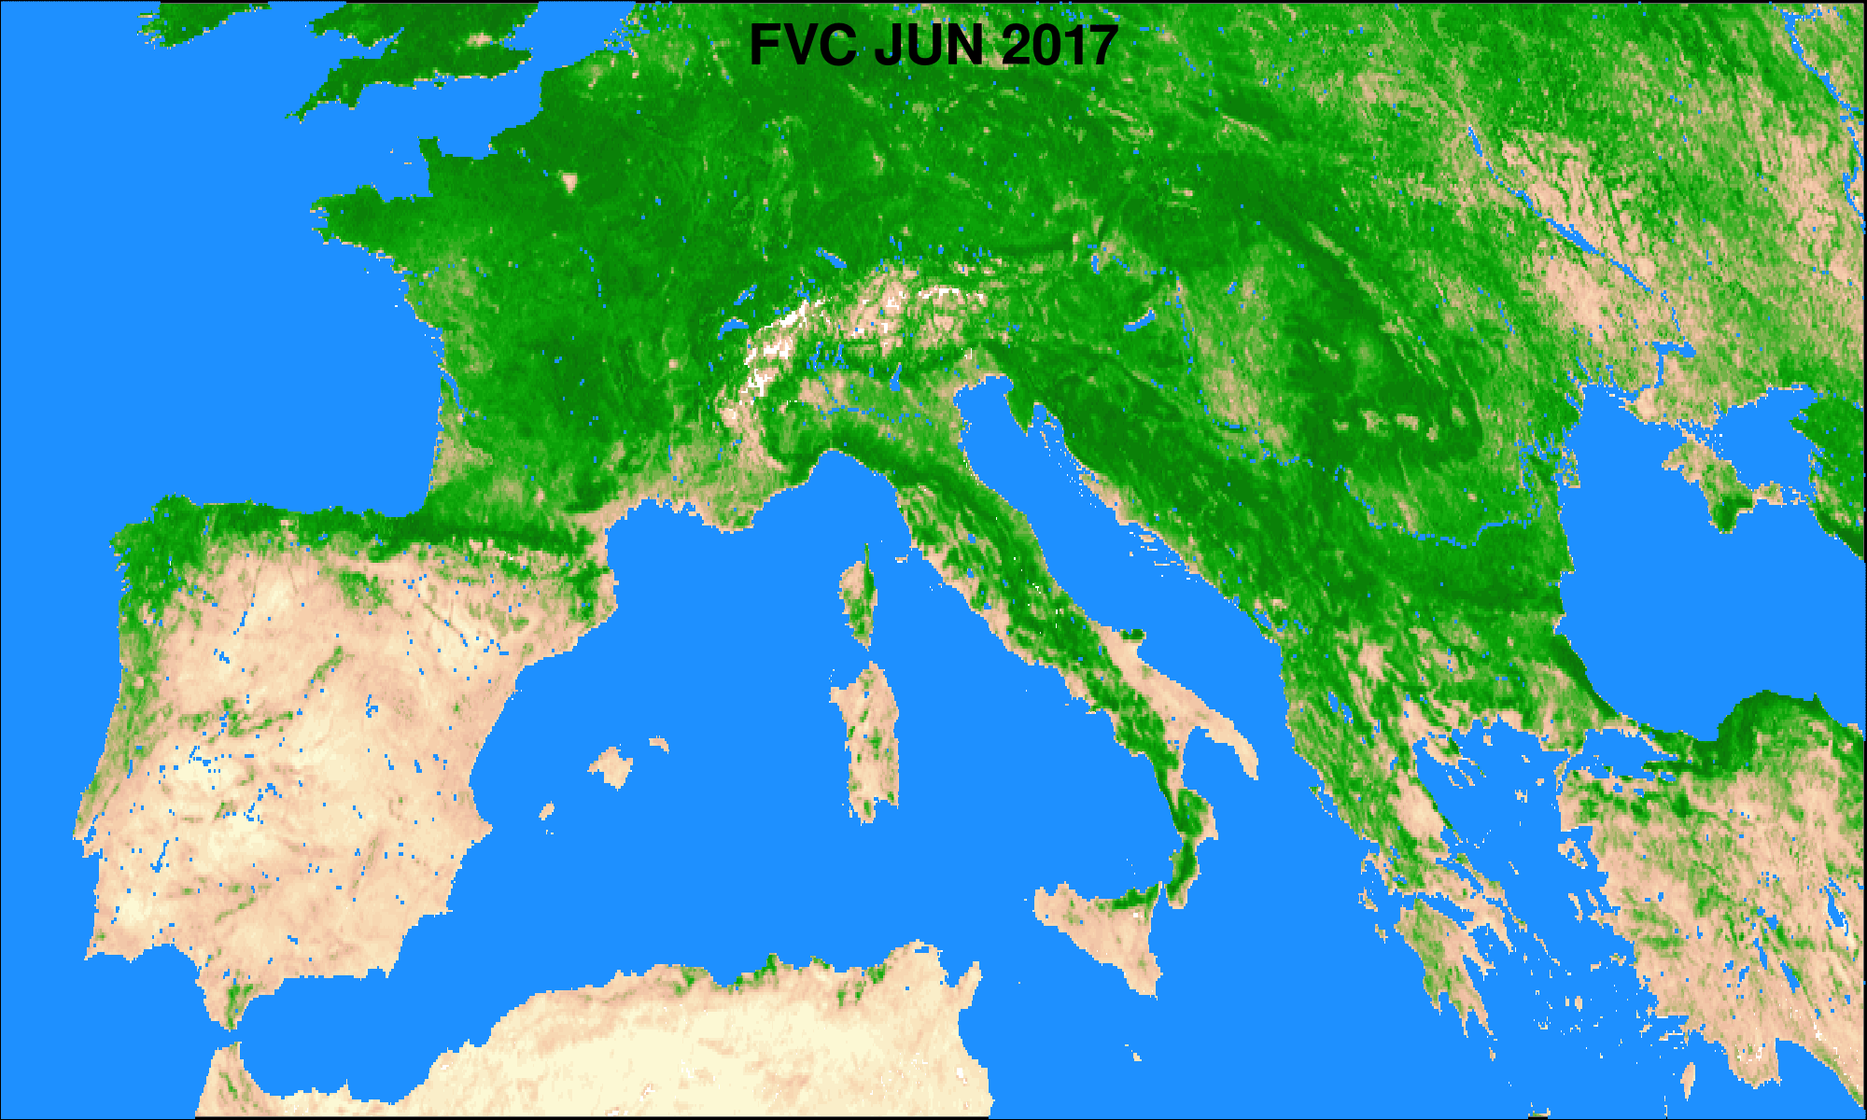
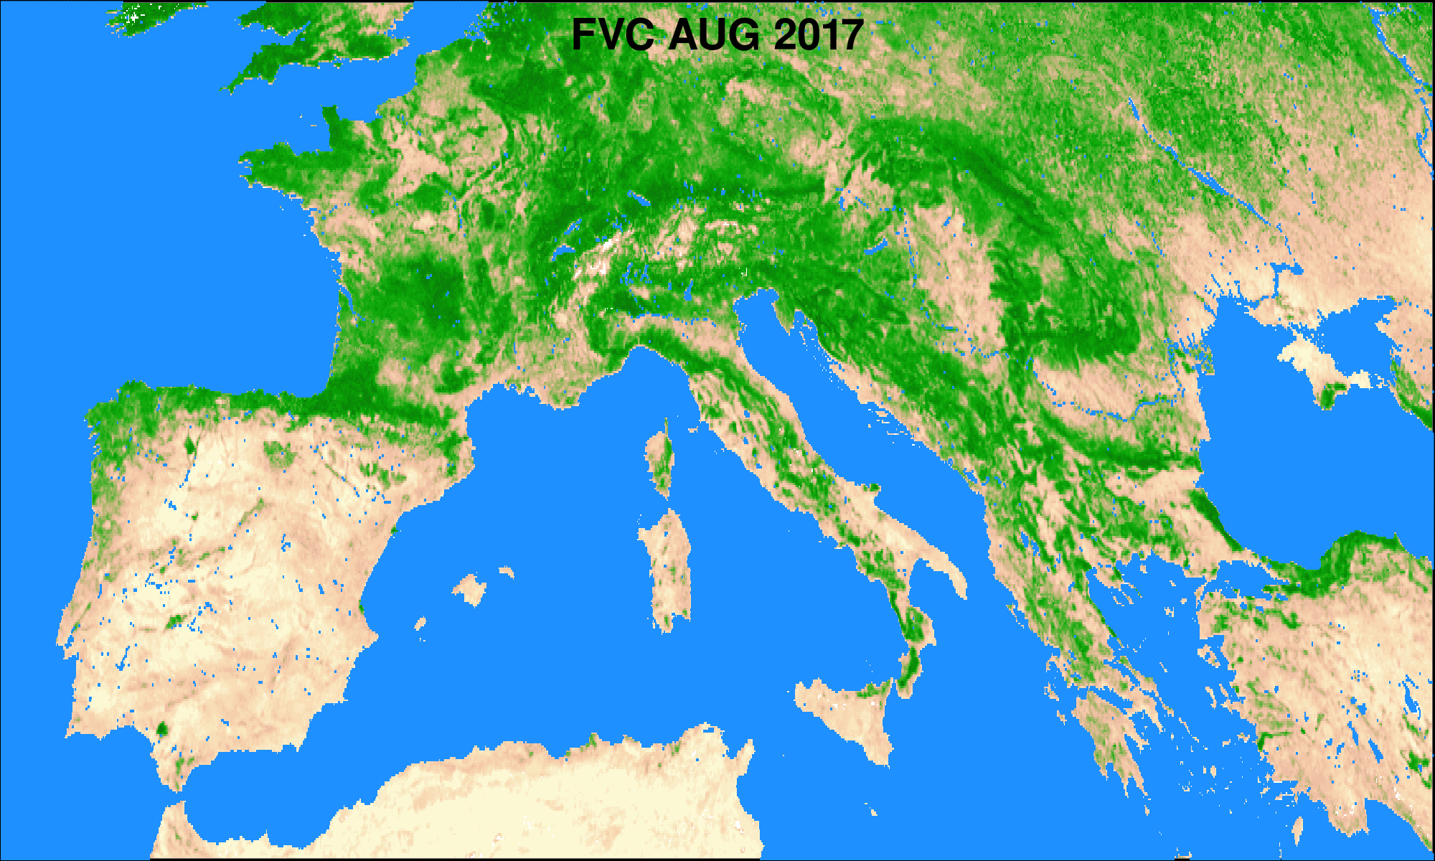
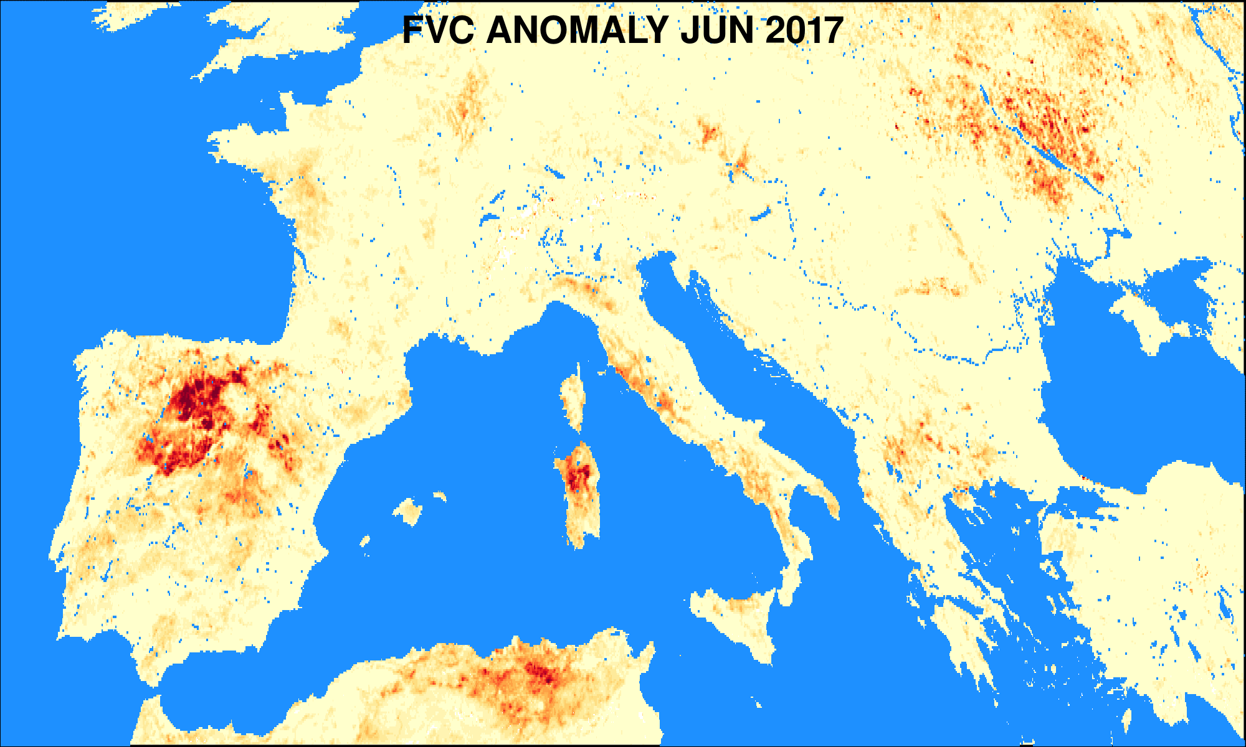
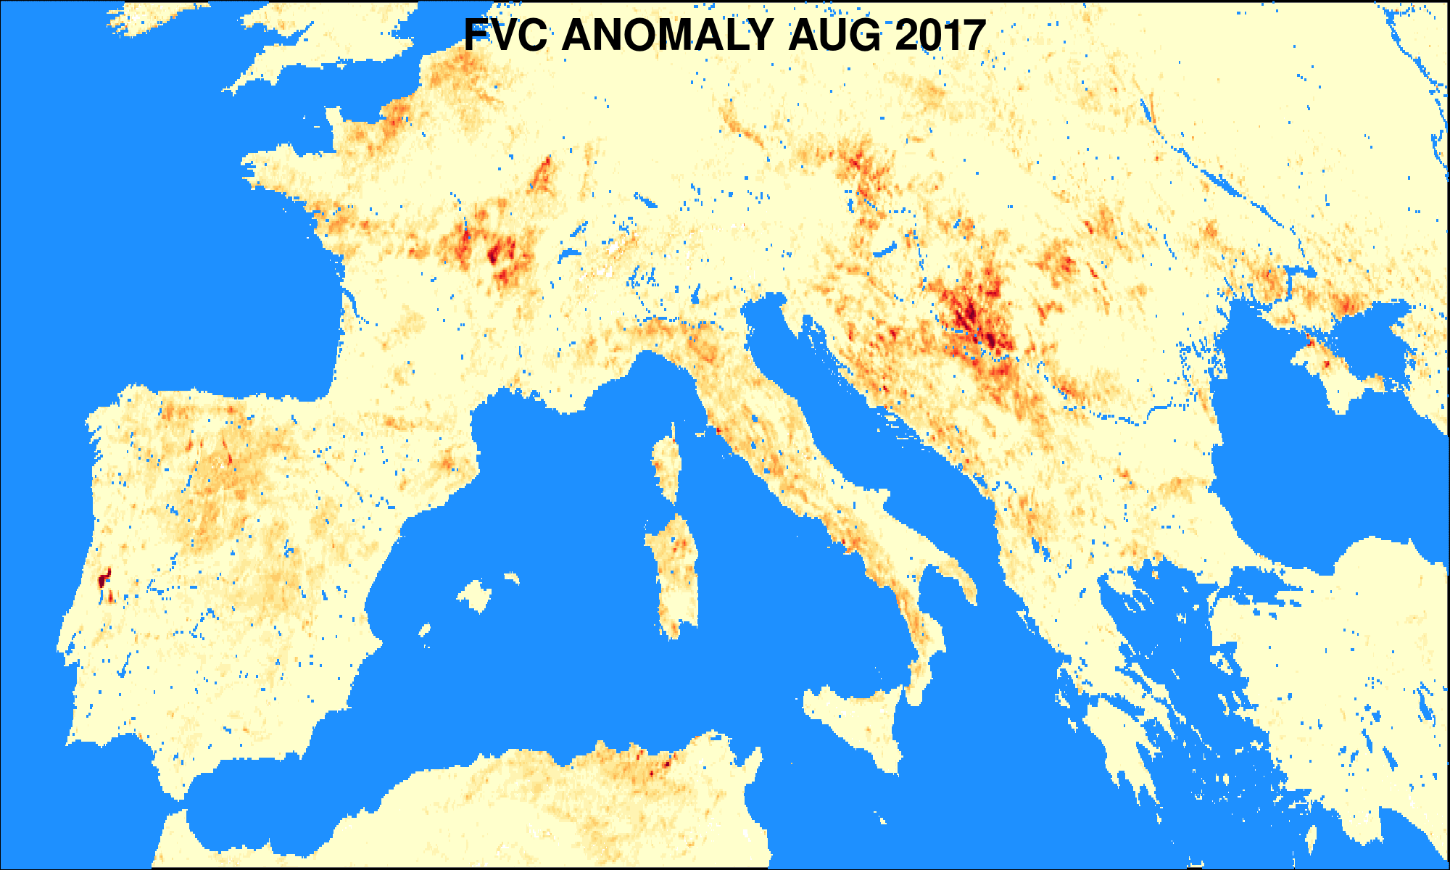
Fraction of Vegetation Cover: Locating Drought Impacted Areas
FVC and its negative anomaly (difference from average value) are displayed on the left.
Droughts: Iberia, Italy, France (middle/late summer) and the Balkans (late summer).
Areas of burnt forest in Portugal caused by massive forest wildfires encircled in black.

Slide 10
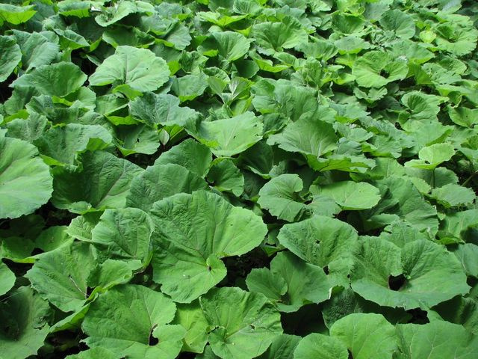
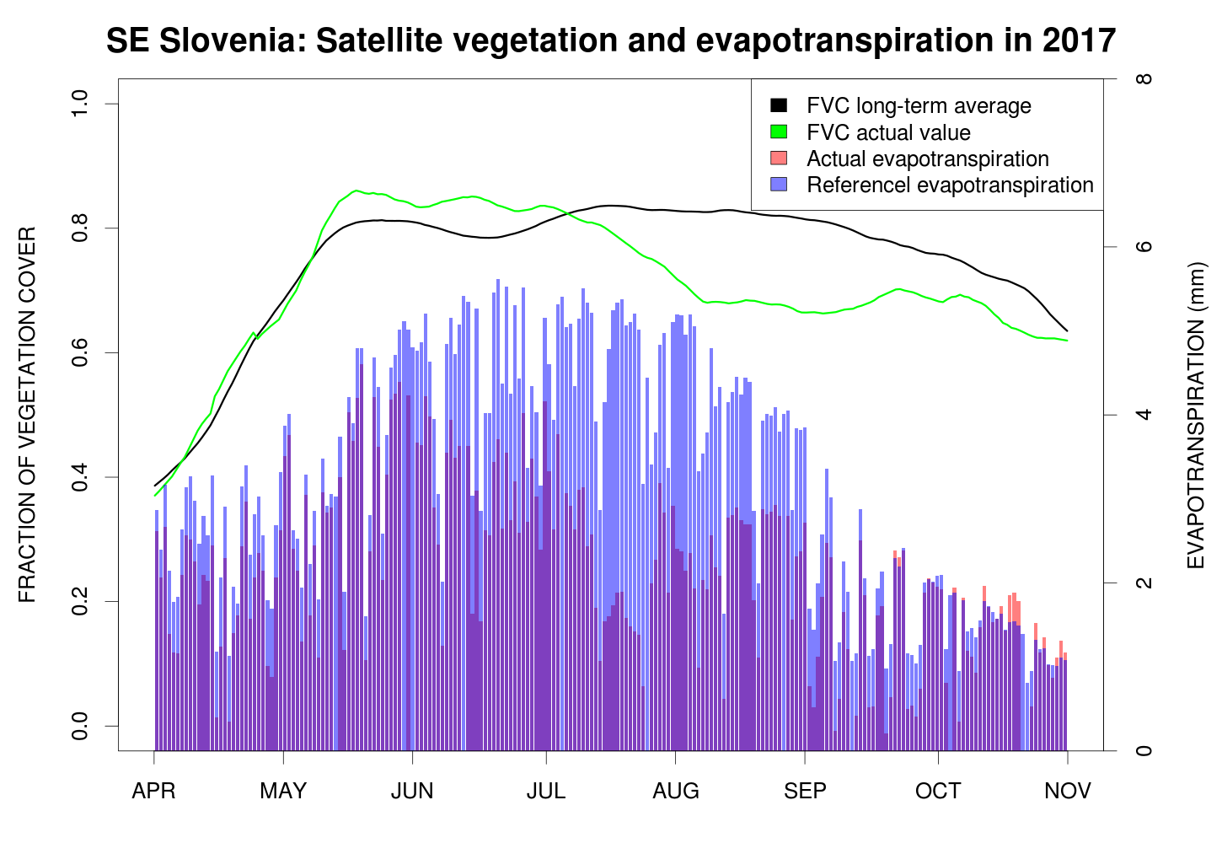
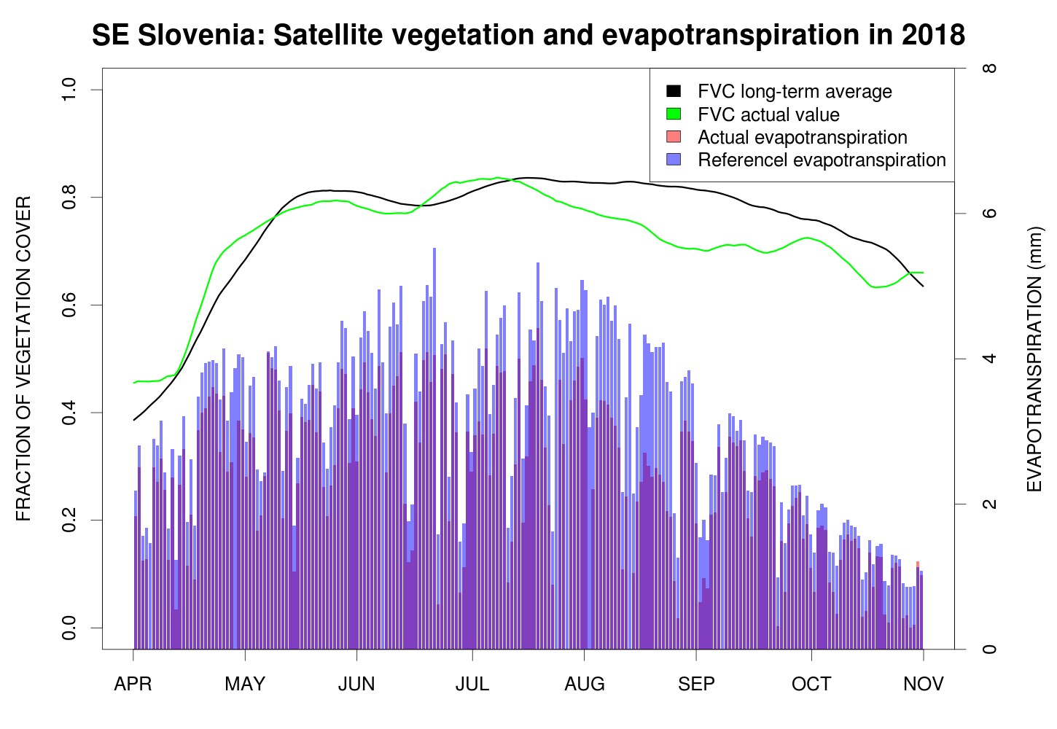
Actual and Reference Evapotranspiration
SEVIRI/MSG:
30 min / 3 km sub-satellite point
Daily composites
Actual ET: Energy Balance by cover type within each pixel using SEVIRI down-welling radiation, Albedo, Vegetation, LST, ….
Reference ET: Evapotranspiration of reference non-stressed surface driven by DSSF.
Large difference between actual and reference evapotranspiration signals drought.

Slide 11
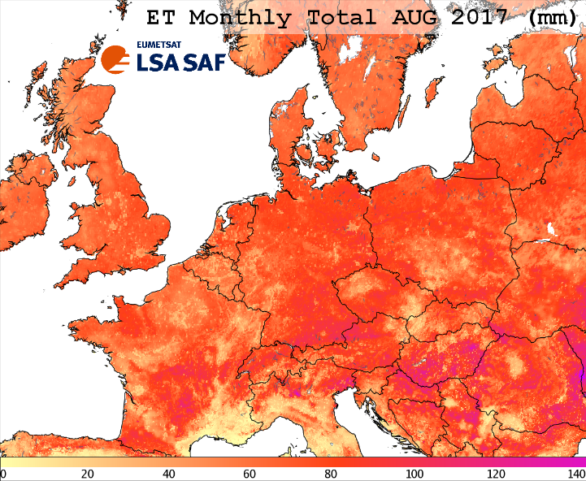
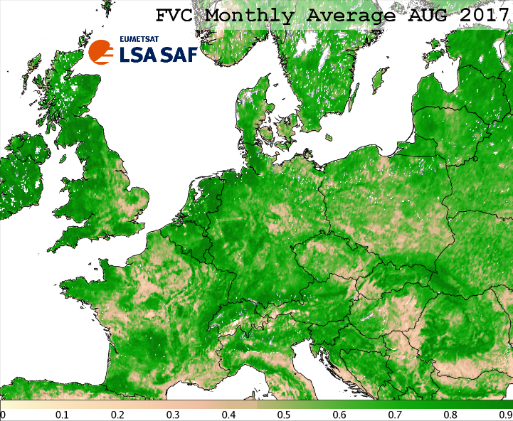
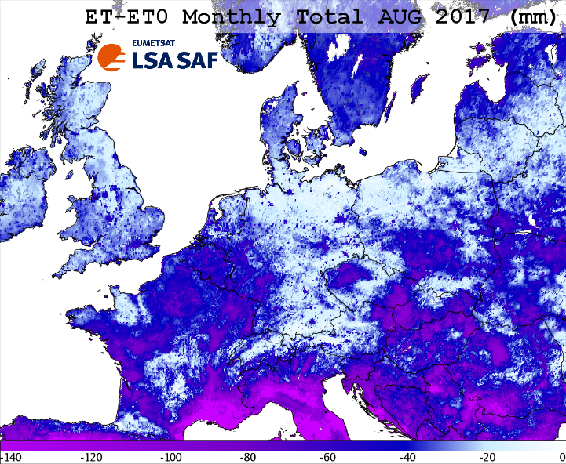
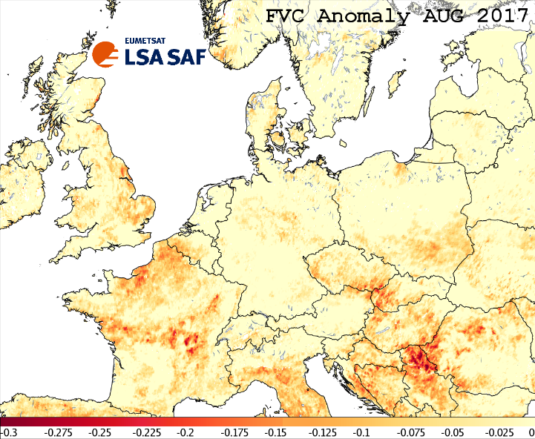
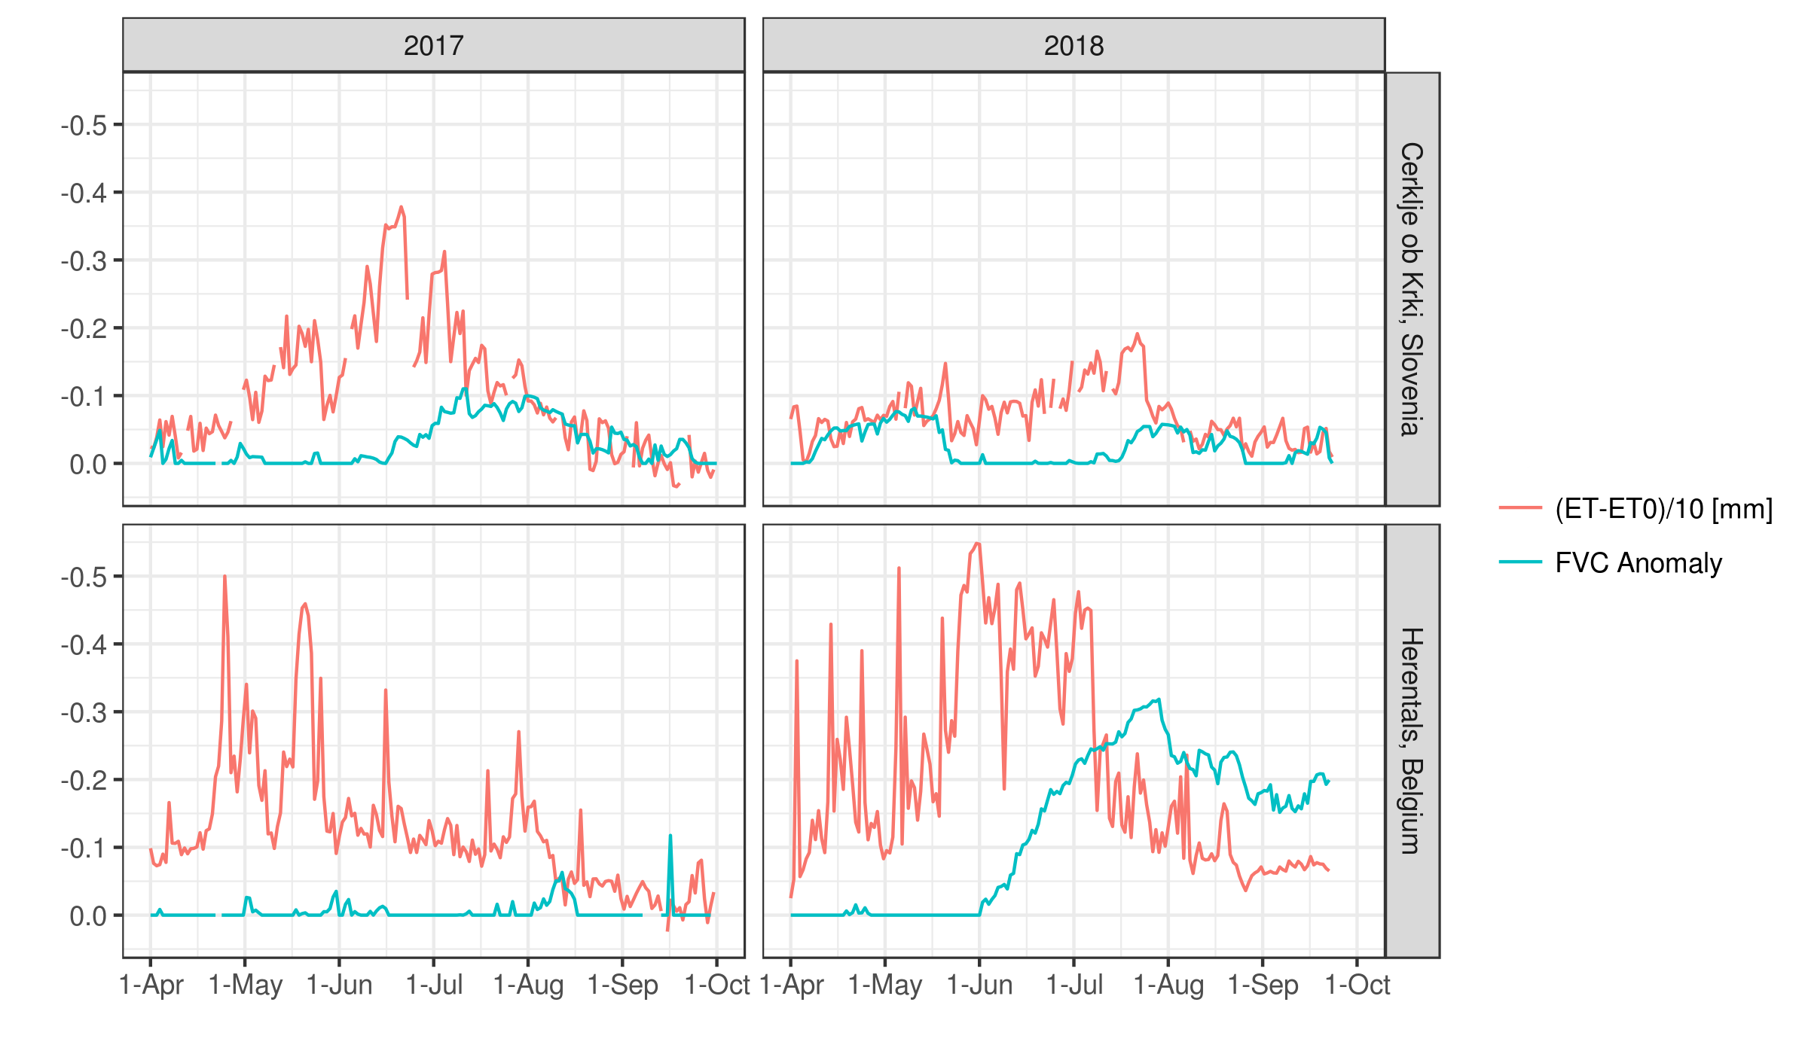
Combined Vegetation and Evapotranspiration Signal (2017)
A combination of satellite ET and vegetation signal improves locating droughts.
ET drought signal often occurs before vegetation drought signal.
ET difference (ET – ET₀) and FVC anomaly both highlight that mostly areas of S and SE Europe experienced strongest drought in Aug 2017.

Slide 12
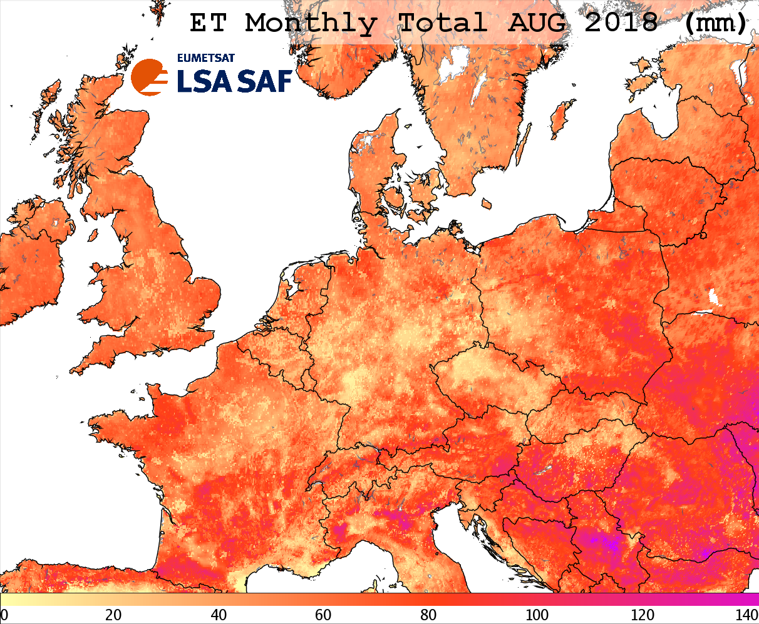
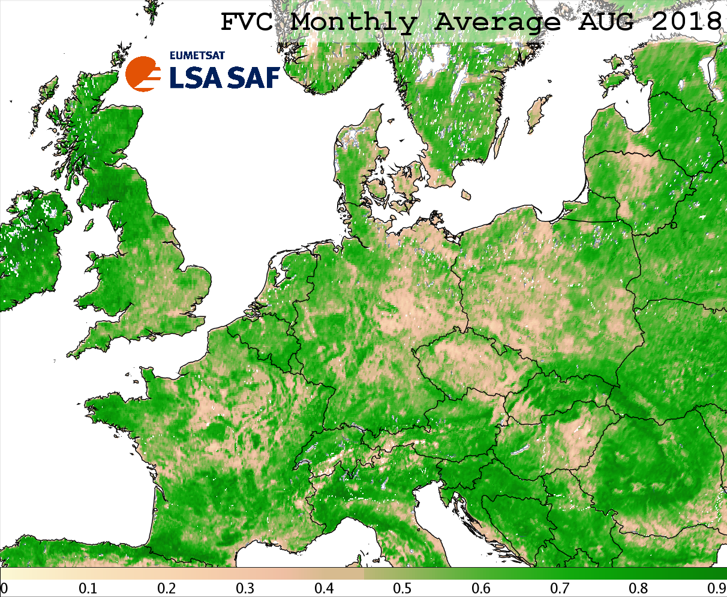
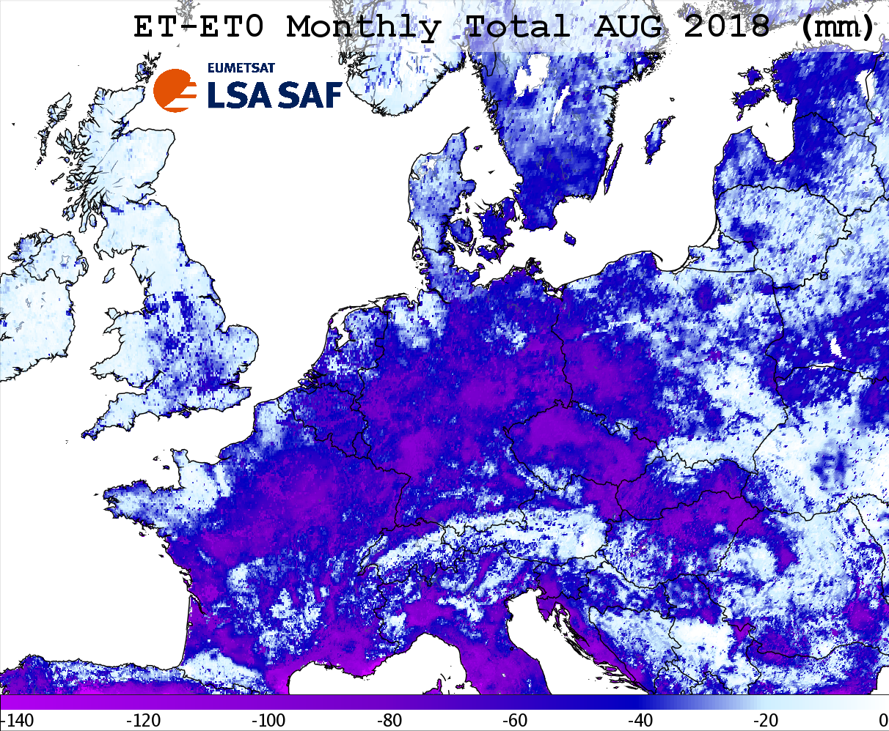
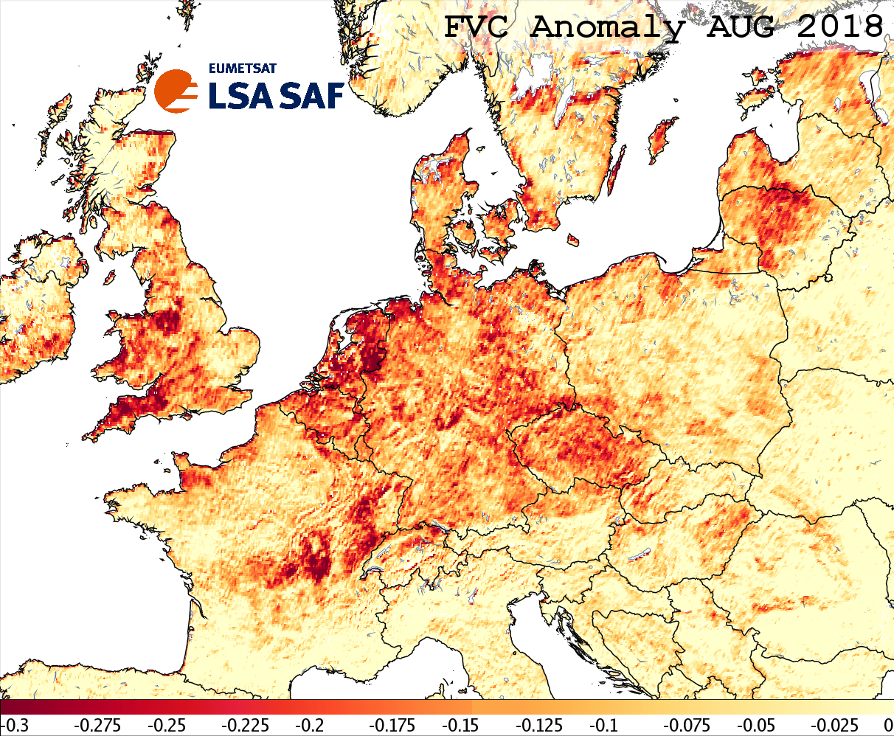
Combined Vegetation and Evapotranspiration Signal (2018)
A combination of satellite ET and vegetation signal improves locating droughts.
ET drought signal often occurs before vegetation drought signal.
In Aug 2018 vegetation and evapotranspiration drought signal is present in N, W and Central Europe.

Slide 13
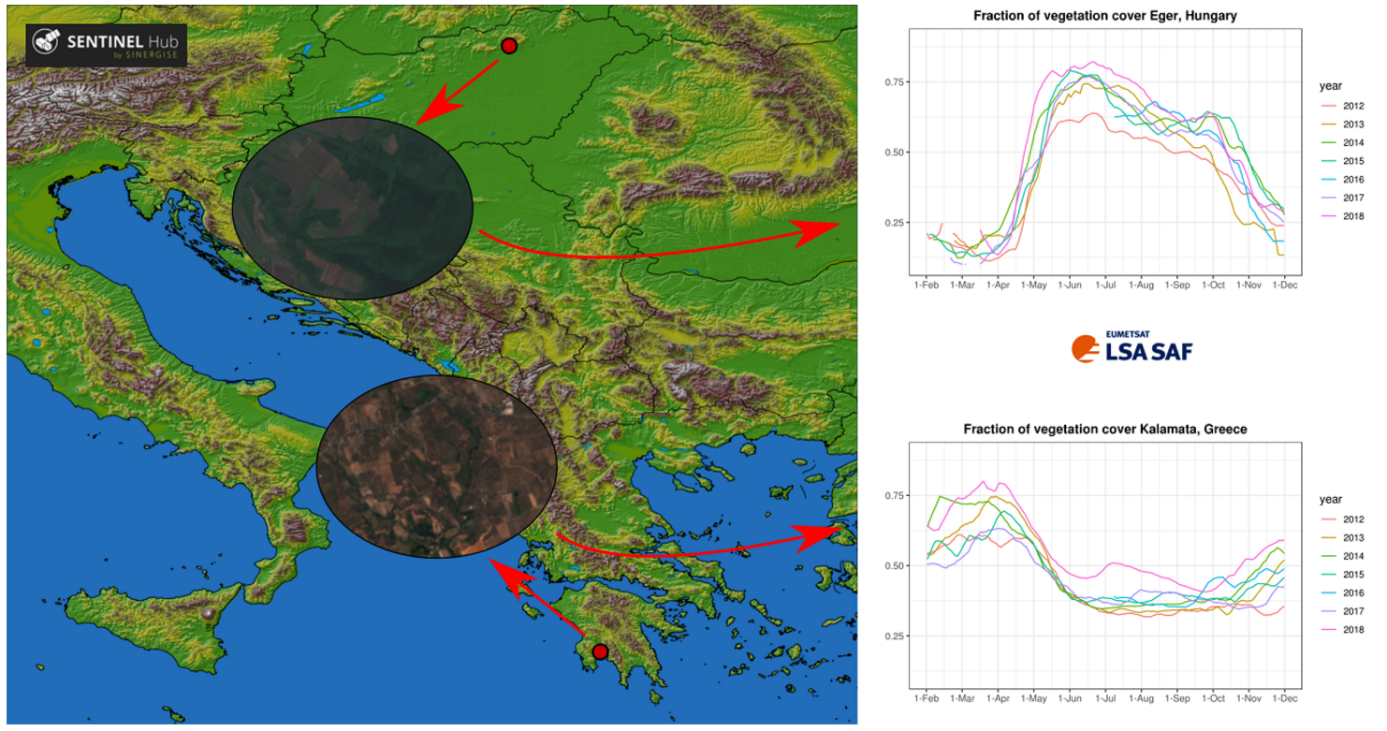
Vegetation Response Variability
Vegetation signal from space (LSA SAF FVC from MSG) depends on various factors, such as growing season, water availability and vegetation type.
Vegetation is at its greenest in late spring and early summer in Eger, Hungary (mixed vegetation types; continental climate).
Kalamata, Greece (olive groves; Mediterranean climate): vegetation is green in spring and brown in summer.
The two locations are located in different climate regions, which results in a large difference between vegetative season in Hungary and Greece.

Slide 14
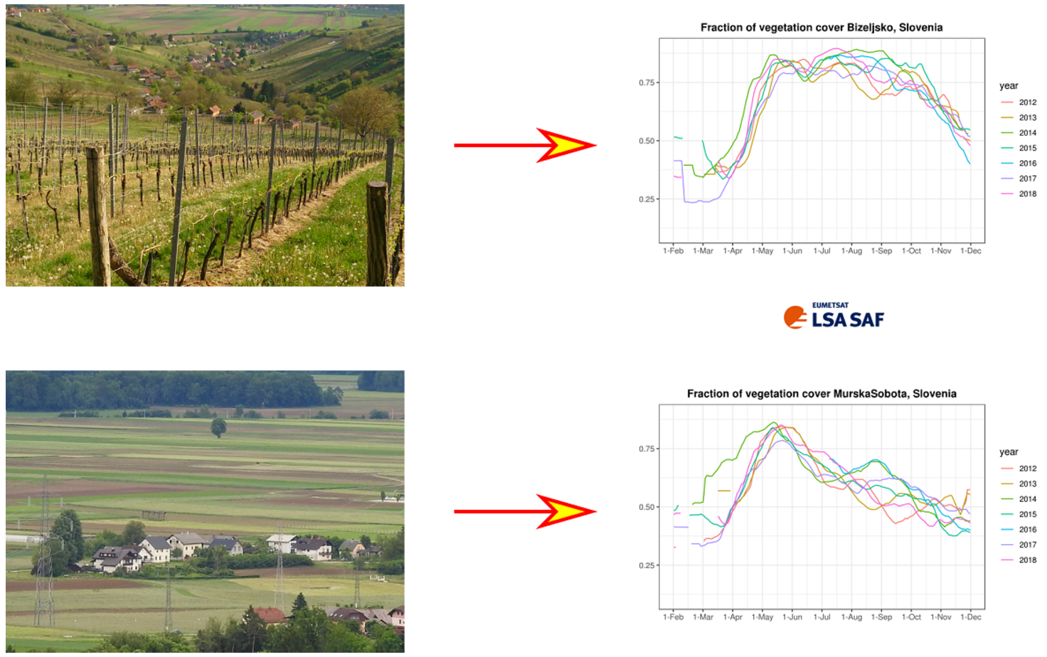
How do land and climate type affect vegetation signal from space?
LSA SAF FVC (from MSG) yearly evolution at two locations in Slovenia close to each other with a similar climate: Bizeljsko (mostly vineyards and forests) and Murska Sobota (crops).
Vegetation stays very green from late spring until the end of summer in Bizeljsko, whereas there is a peak of FVC in the late spring with decreased values of FVC later in the season in Murska Sobota.
Additionally, one can spot year-to-year FVC variability, which is a function of available water in the growing season and the types of crops that are grown on the cultivated land.
Different land types cause differences in their respective satellite signals.

Slide 15
Contents
Overview
Vegetation Monitoring
Combined Drought Index
Conclusions

Slide 16
AIM: operational drought monitoring tool for Slovenia and SE Europe.
A New Drought Monitoring Tool
Ratio between actual and reference evapotranspiration (ET RATIO) can provide an accurate overview of drought conditions. A large difference between actual and reference evapotranspiration indicates a shortage of water, which could lead into drought.
The goal is to create a combined drought index taking into account satellite vegetation (FVC), precipitation and evapotranspiration. Following a similar methodology as JRC European Drought Observatory (see Sepulcre G, Horion S, Singleton A., Carrão H., Vogt J.V. (2012): Development of a Combined Drought Indicator to detect agricultural drought in Europe. Natural Hazards and Earth System Sciences, vol. 12, pp 3519- 3531, European Geosciences Union).
Combined drought index combines ratio between actual and reference evapotranspiration (ET RATIO), 3-monthly SPI anomaly (SPI) and FVC monthly anomaly (FVC ANOMALY).
Meteorological drought: a period with an abnormal precipitation deficit (SPI, SPEI)
Agrometeorological drought: a soil moisture deficit that limits water availability for natural vegetation and crops (soil moisture)
Hydrological drought: surface or sub-surface water deficit due to prolonged precipitation shortages

Slide 17
AIM: operational drought monitoring tool for Slovenia and SE Europe.
A New Drought Monitoring Tool
Ratio between actual and reference evapotranspiration (ET RATIO) can provide an accurate overview of drought conditions. A large difference between actual and reference evapotranspiration indicates a shortage of water, which could lead into drought.
The goal is to create a combined drought index taking into account satellite vegetation (FVC), precipitation and evapotranspiration. Following a similar methodology as JRC European Drought Observatory (see Sepulcre G, Horion S, Singleton A., Carrão H., Vogt J.V. (2012): Development of a Combined Drought Indicator to detect agricultural drought in Europe. Natural Hazards and Earth System Sciences, vol. 12, pp 3519- 3531, European Geosciences Union).
Combined drought index combines ratio between actual and reference evapotranspiration (ET RATIO), 3-monthly SPI anomaly (SPI) and FVC monthly anomaly (FVC ANOMALY).
WATCH
WARNING
ALERT
ET RATIO < Threshold_{ET}
OR SPI < Threshold_{SPI}
ET RATIO < Threshold_{ET}
OR SPI < Threshold_{SPI}
FVC < Threshold_{FVC MSG}
OR FVC < Threshold_{FVC METOP}
ET RATIO < Threshold_{ET}
OR SPI < Threshold_{SPI}
FVC < Threshold_{FVC MSG}
AND FVC < Threshold_{FVC METOP}
OR
FVC < 2 * Threshold_{FVC MSG}
OR FVC < 2 * Threshold_{FVC METOP}

Slide 18
EUMETSAT’s Land Surface Analysis Satellite Application Facility (LSA SAF, lsa-saf.eumetsat.int) products have been operationally used since 2011 for drought monitoring at Slovenian Environment Agency.
Combined Drought Index: Data Sources
SATELLITE DATA (LSA SAF)
FVC from MSG and METOP; data in 2015-2019
Actual evapotranspiration from MSG (from 2004) and reference evapotranspiration (from 2016)
near real-time data
GROUND DATA
precipitation
reference evapotranspiration
standardised precipitation index
many years of archive data

Slide 19
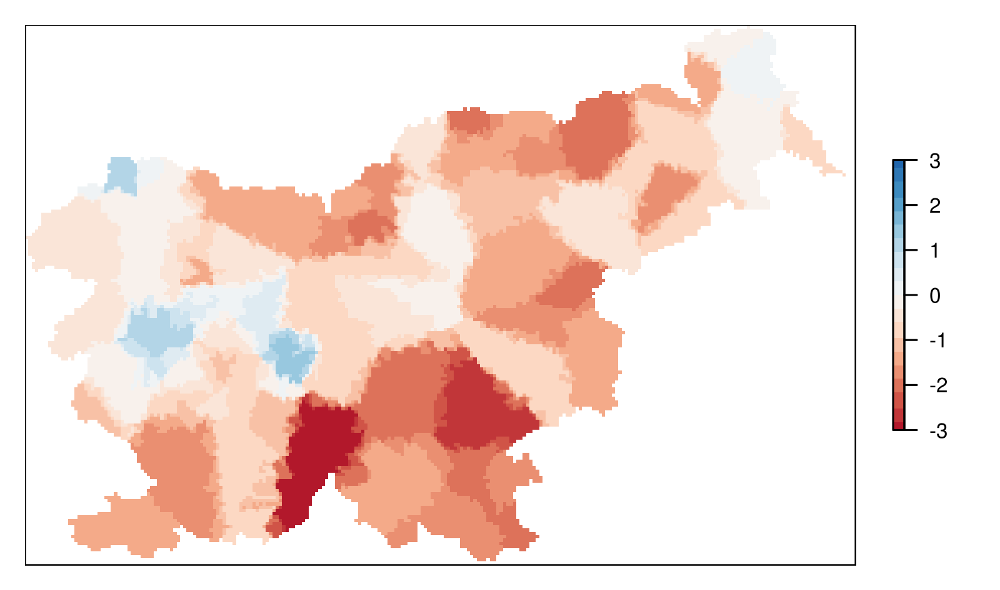
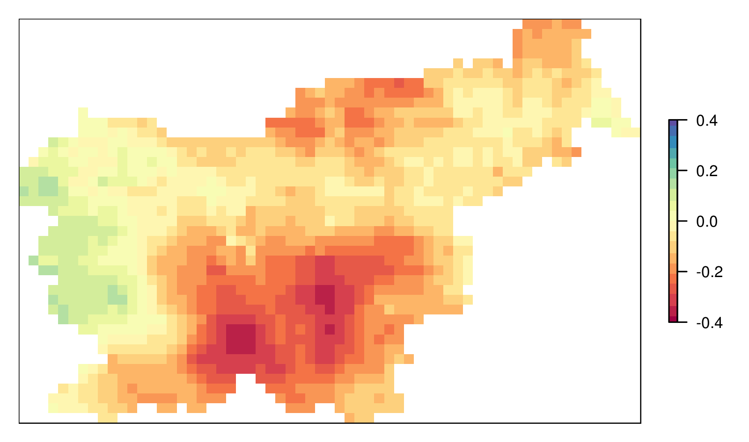
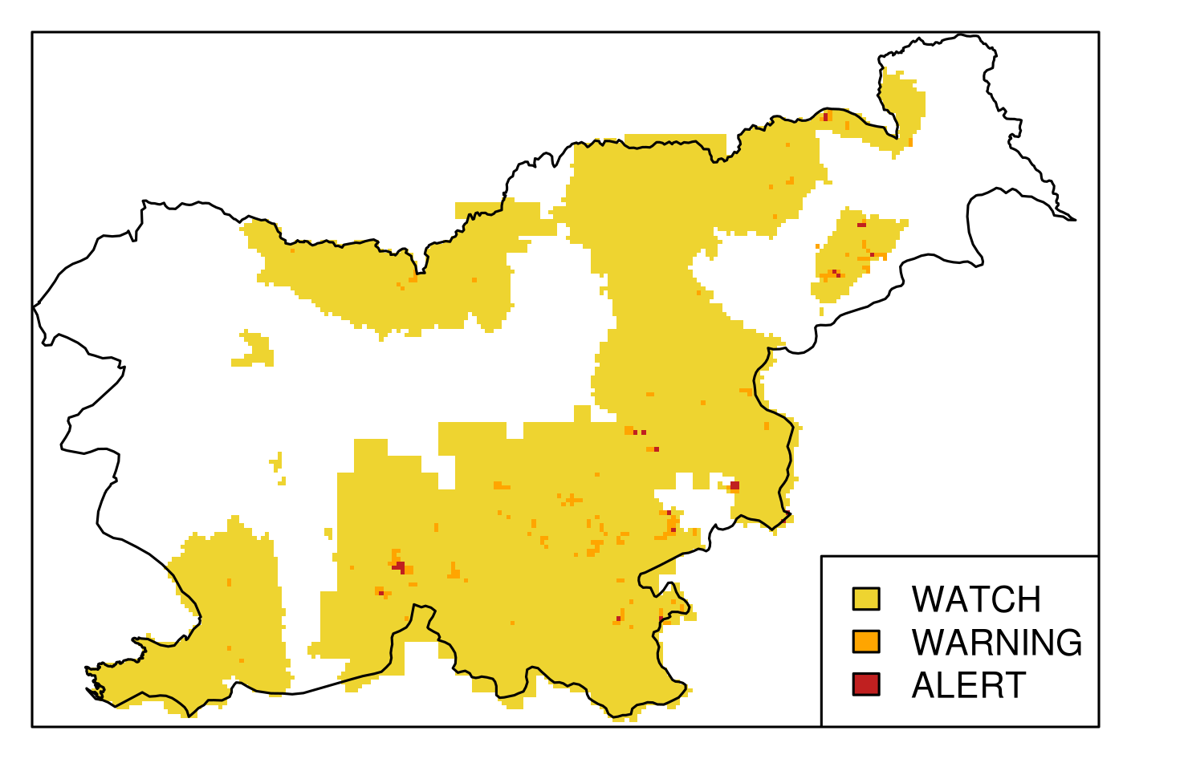
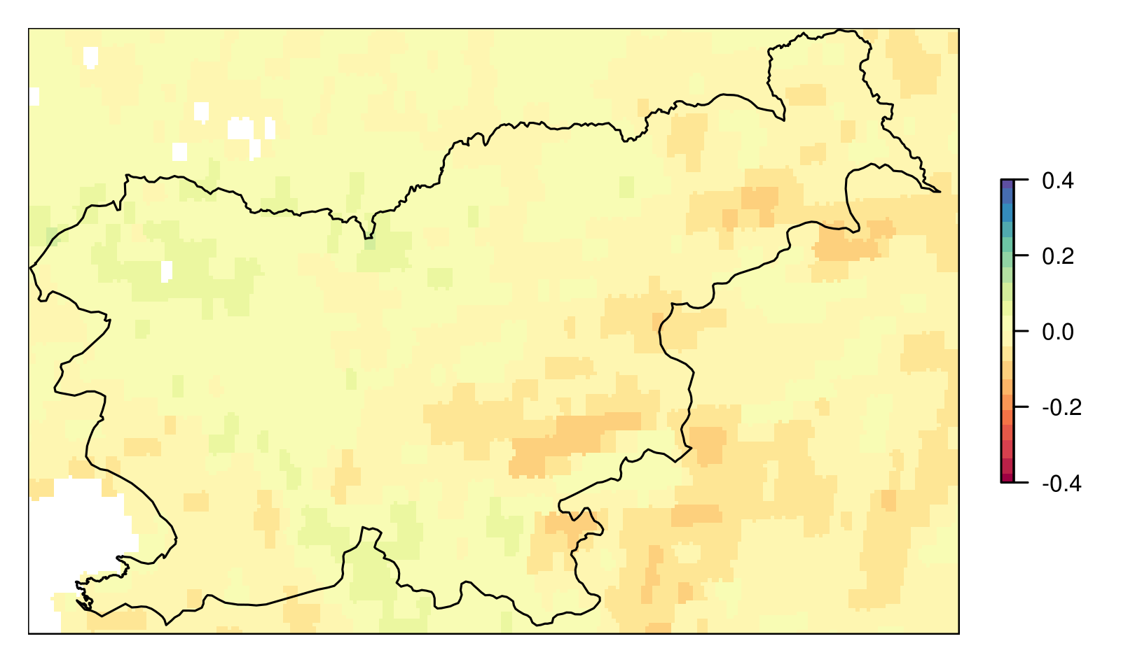
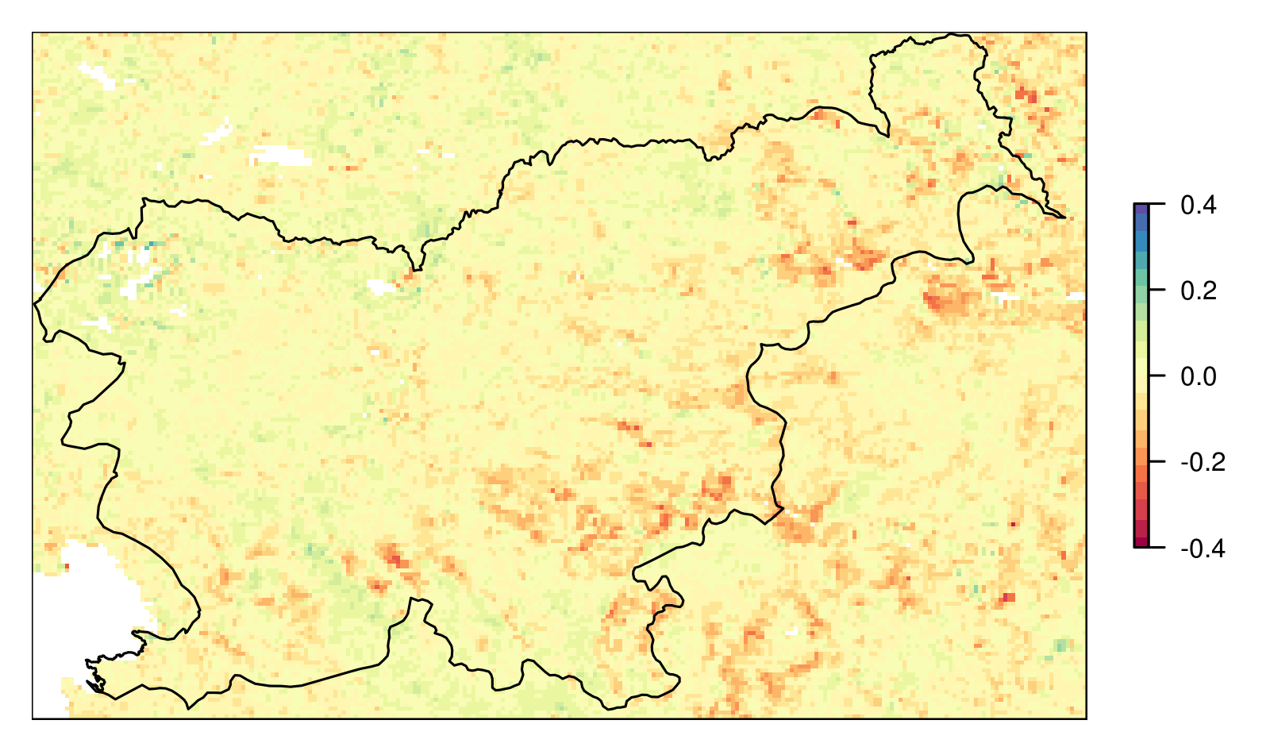
First Results over Slovenia (August 2017)
SPI (3-monthly)
ET RATIO monthly anomaly
(MSG and ground data)
Combined Drought Index (CDI)
monthly FVC ANOMALY (MSG)
monthly FVC ANOMALY (METOP)

Slide 20
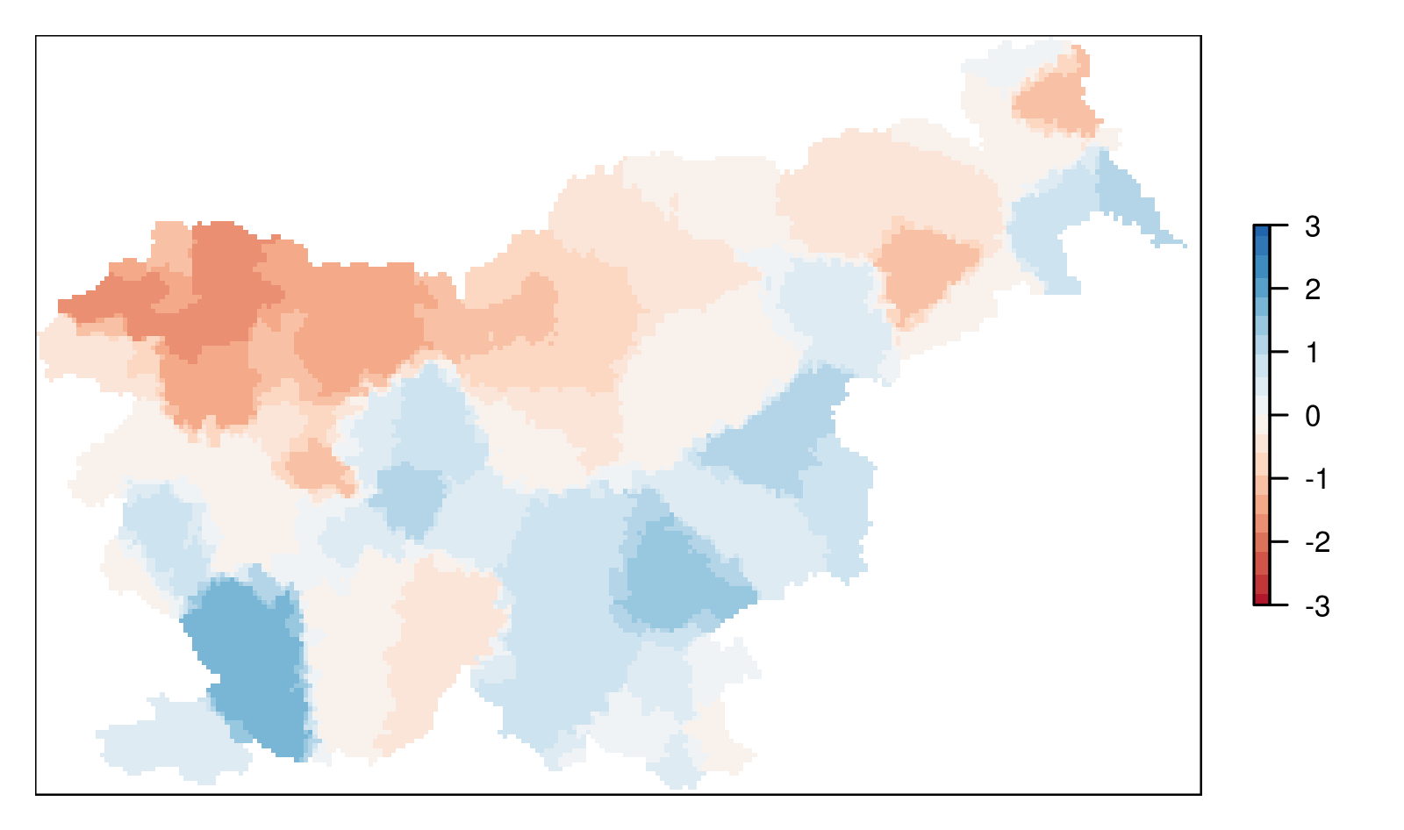
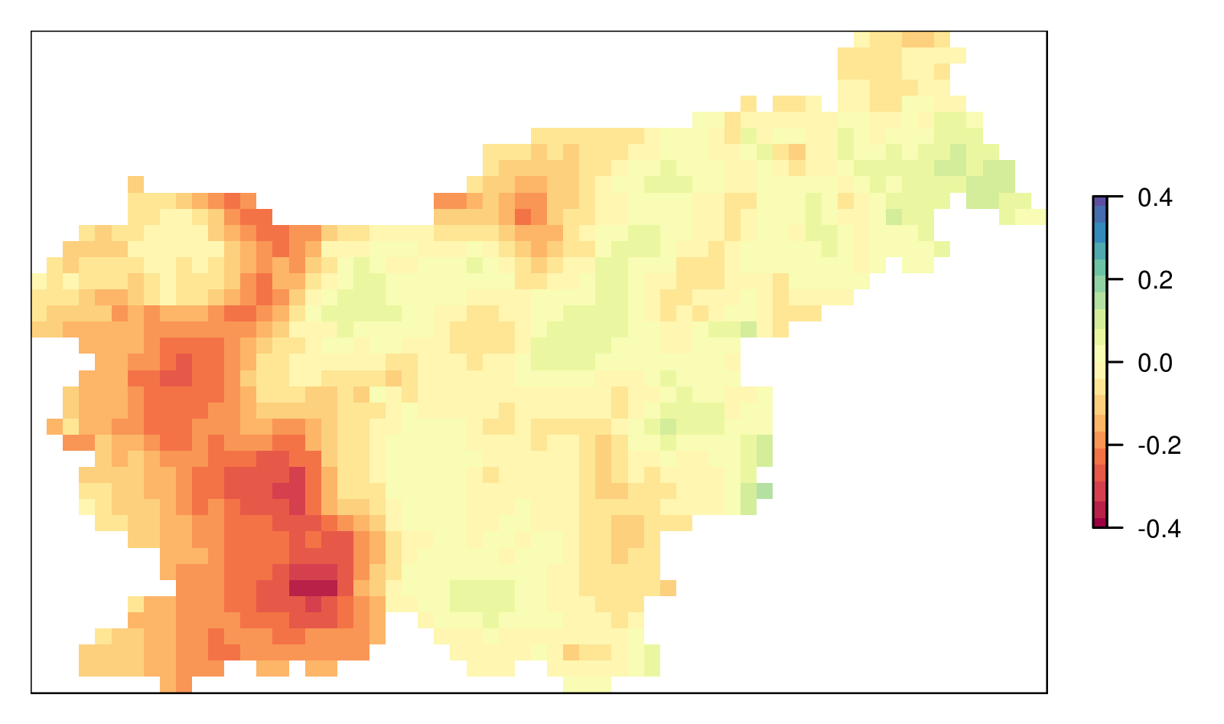
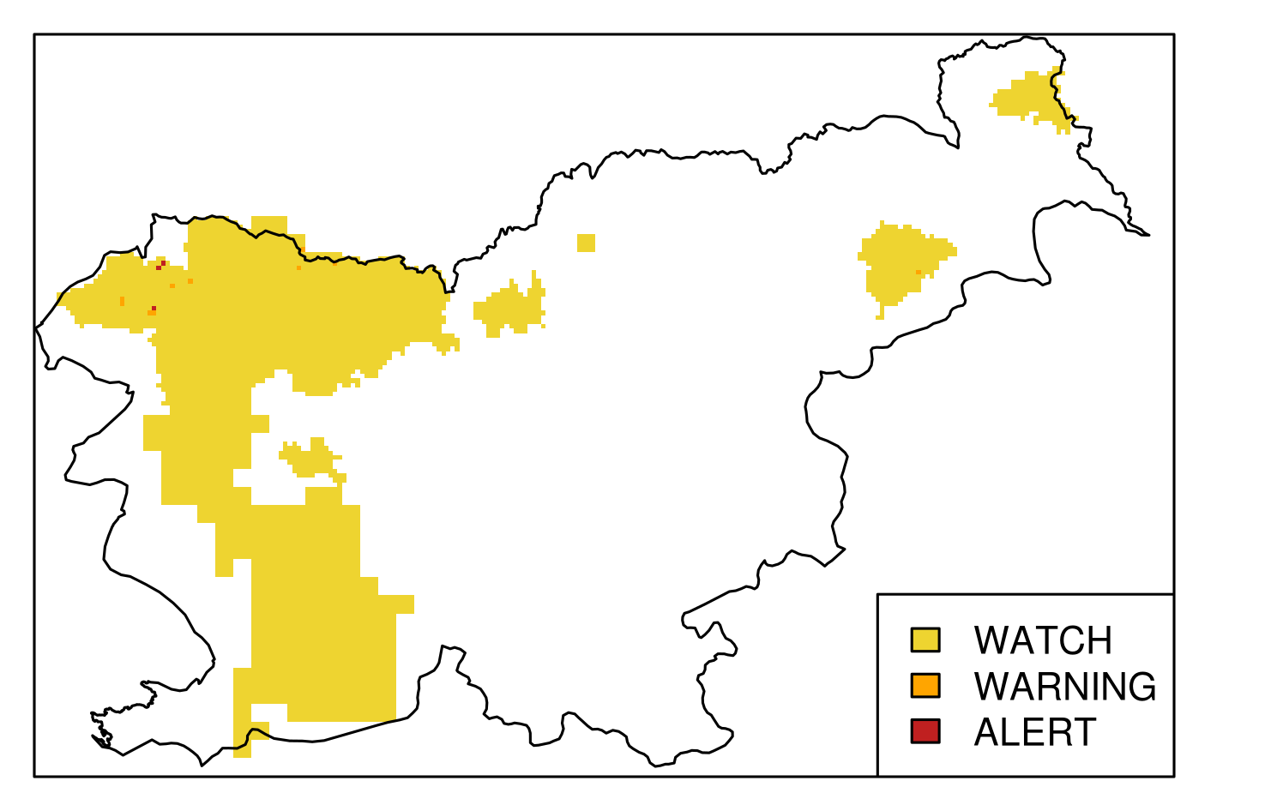
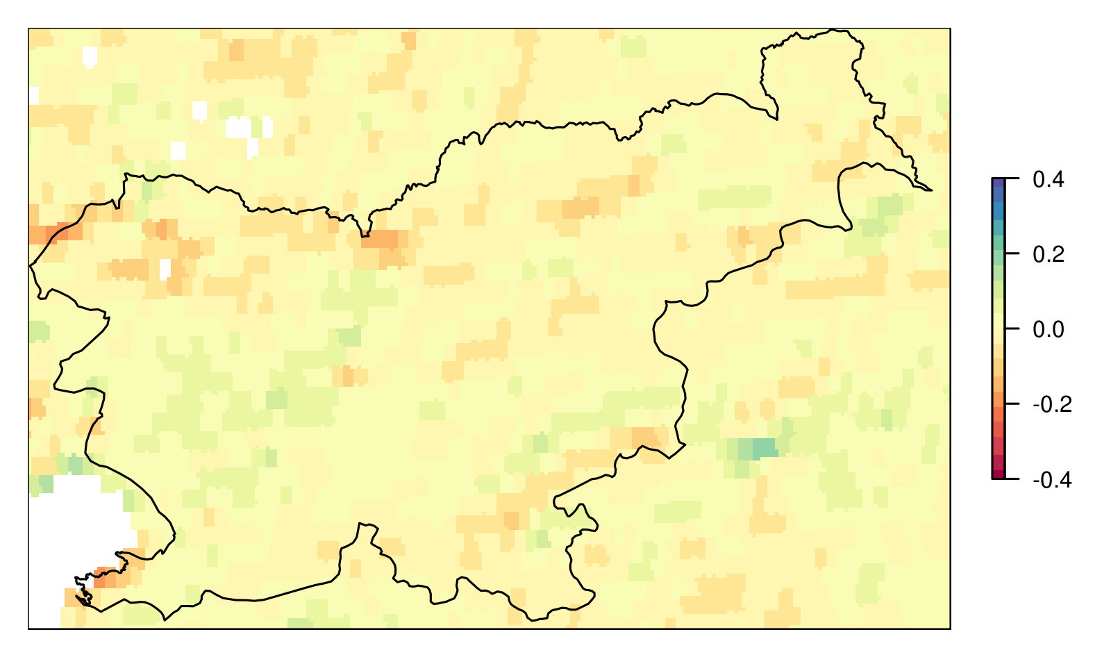
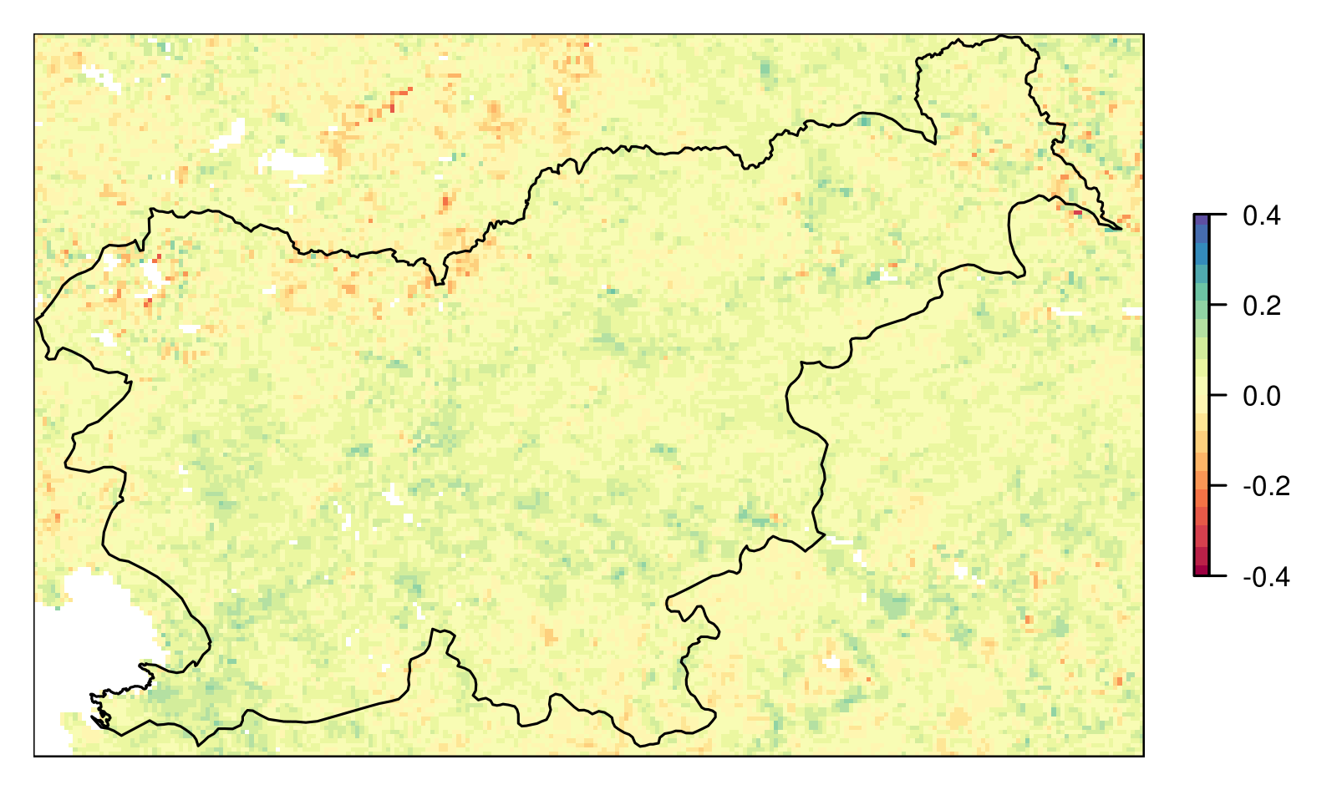
First Results over Slovenia (August 2018)
SPI (3-monthly)
ET RATIO monthly anomaly
(MSG and ground data)
Combined Drought Index (CDI)
monthly FVC ANOMALY (MSG)
monthly FVC ANOMALY (METOP)

Slide 21
First Results over Slovenia
Actual drought situation on the ground
2017: drought occured over arable land in SE, E (in line with what CDI indicates) and NE part of the country (not indicated by CDI)
2018: only a moderate drought; limited drought reports from SW and NE Slovenia
In future: satellite based reference evapotranspiration (LSA SAF METREF)
CDI August 2017
CDI August 2018

Slide 22
Contents
Overview
Vegetation Monitoring
Combined Drought Index
Conclusions

Slide 23
Conclusion
CURRENT STATUS: in testing phase, monthly data, non-operational,
reference evapotranspiration calculated from ground data.
First results over Slovenia at combining satellite evapotranspiration and vegetation for drought detection are promising. These are the things that still need to be addressed:
focus on arable land
mask out damaged vegetation unrelated to droughts (e.g., fires, hail, ...)
thresholds for CDI are still being tuned
concept looks to be promising so far, still work to do
Plans
create an operational tool drought monitoring tool
rely on satellite data sources
possible extension of the drought monitoring domain over S/SE Europe (thresholds will need to be defined regionally)
perform calculations every 10 days (ET RATIO has a faster drought response than SPI)
additional sources of satellite data may be considered in future (e.g., Coperncius PROBA-V)

Slide 24
Thank you!
bostjan.muri@gov.si

