Slide 1
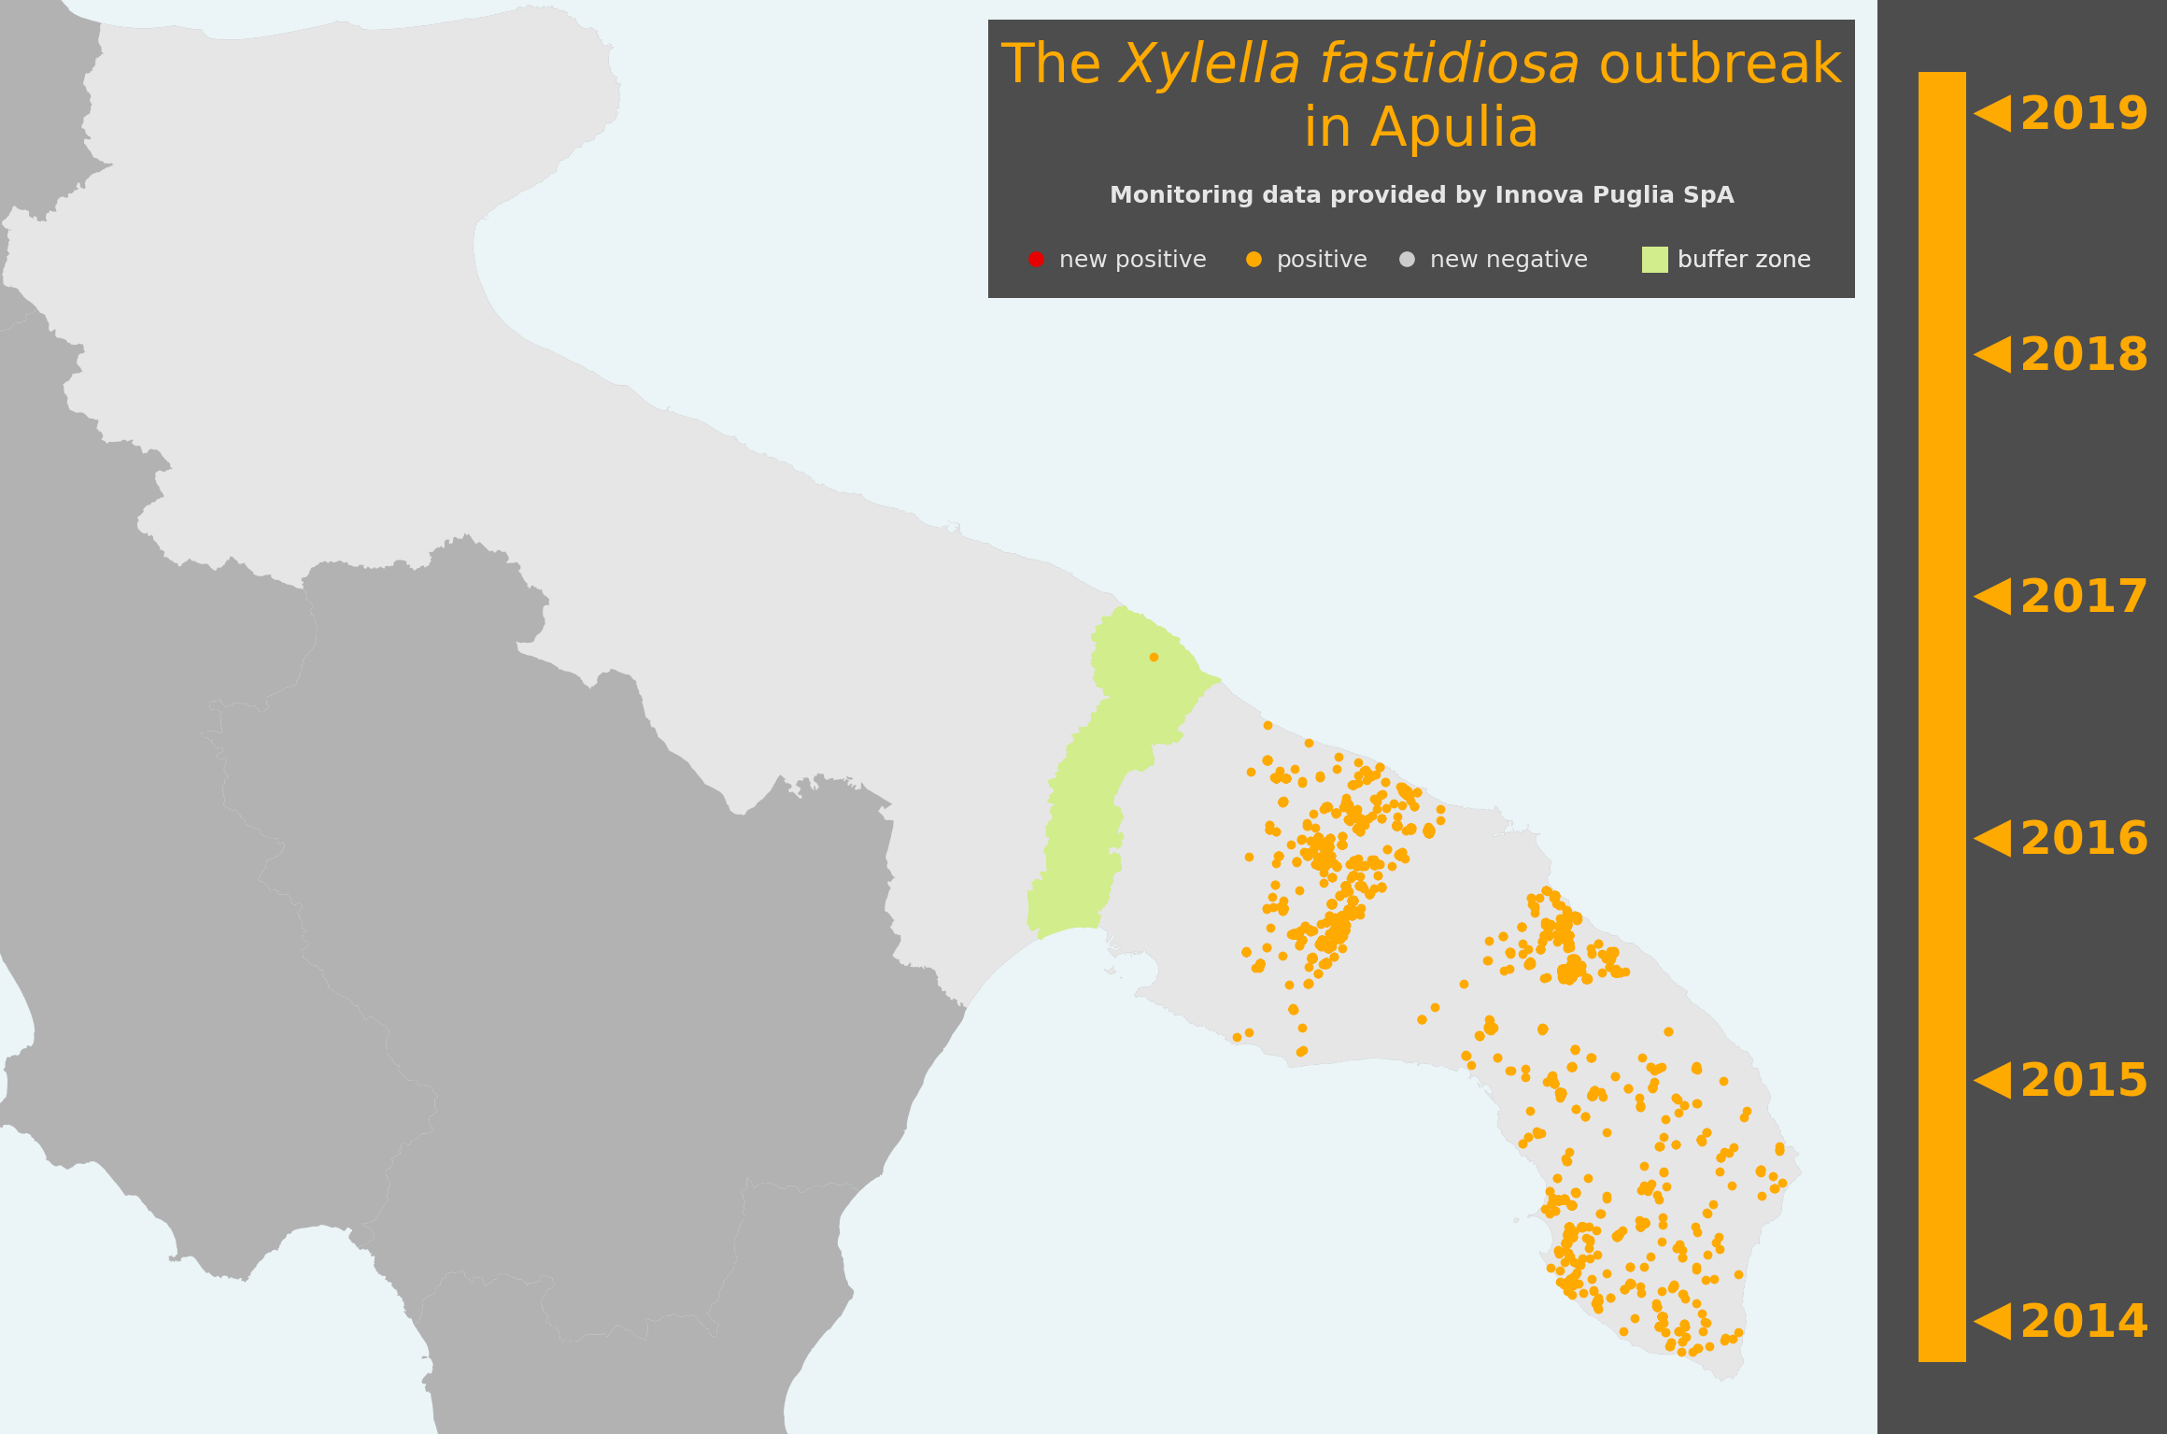
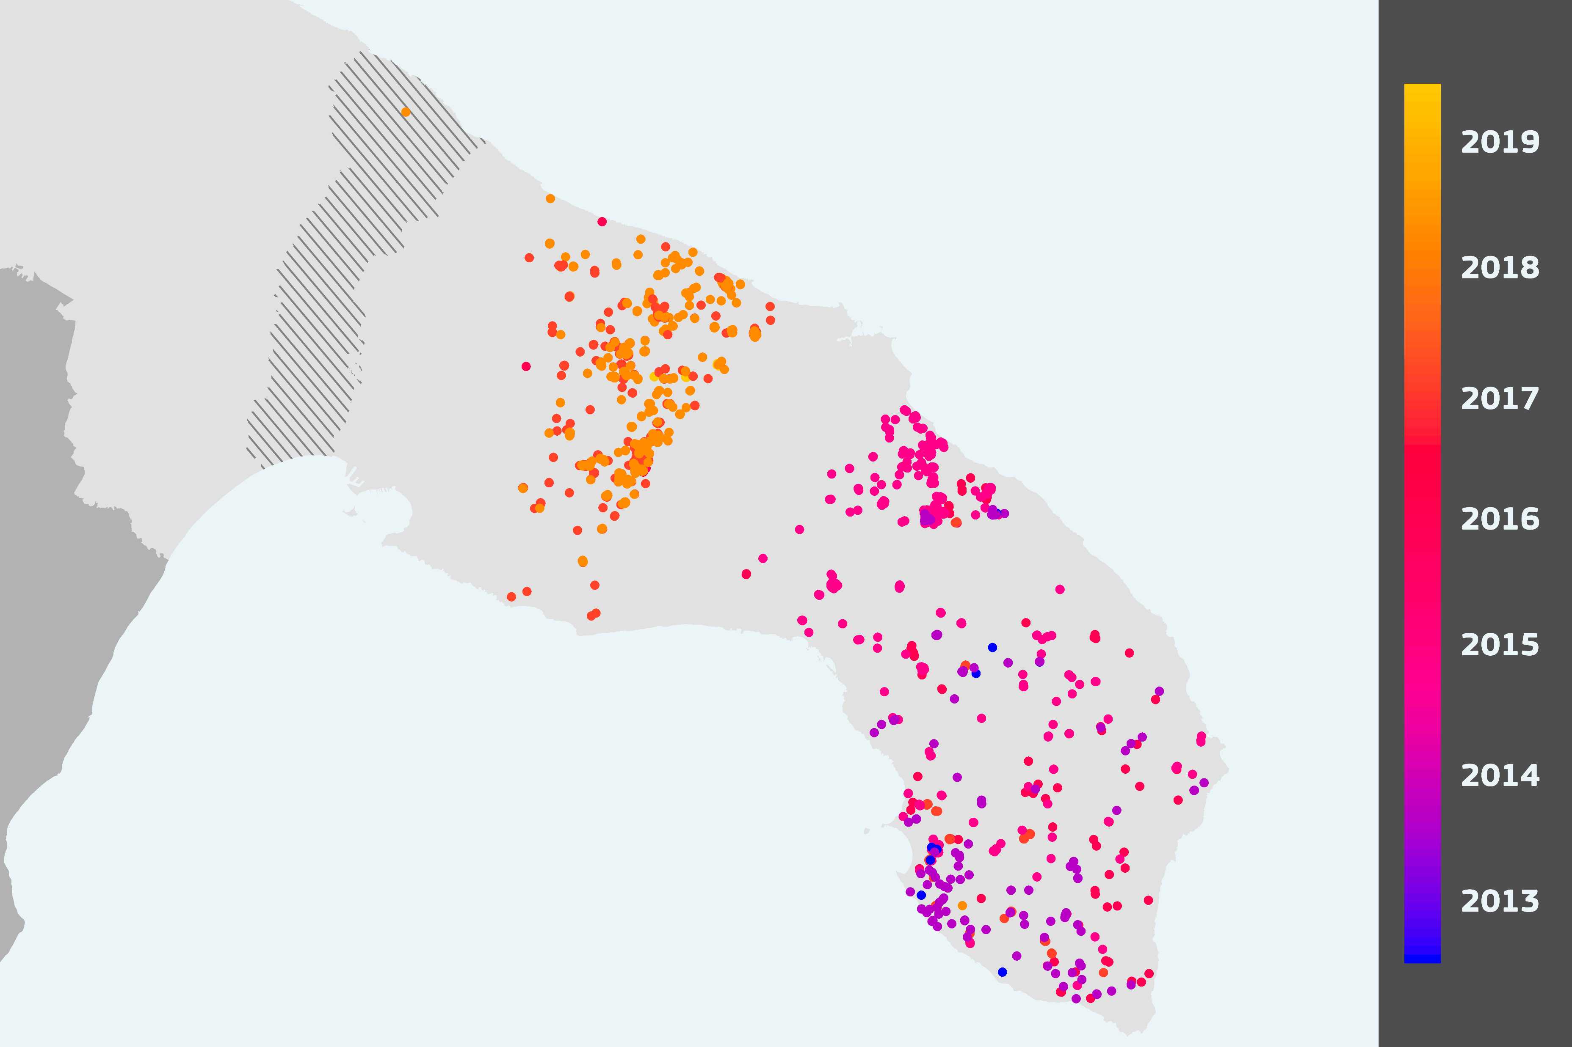

Slide 2
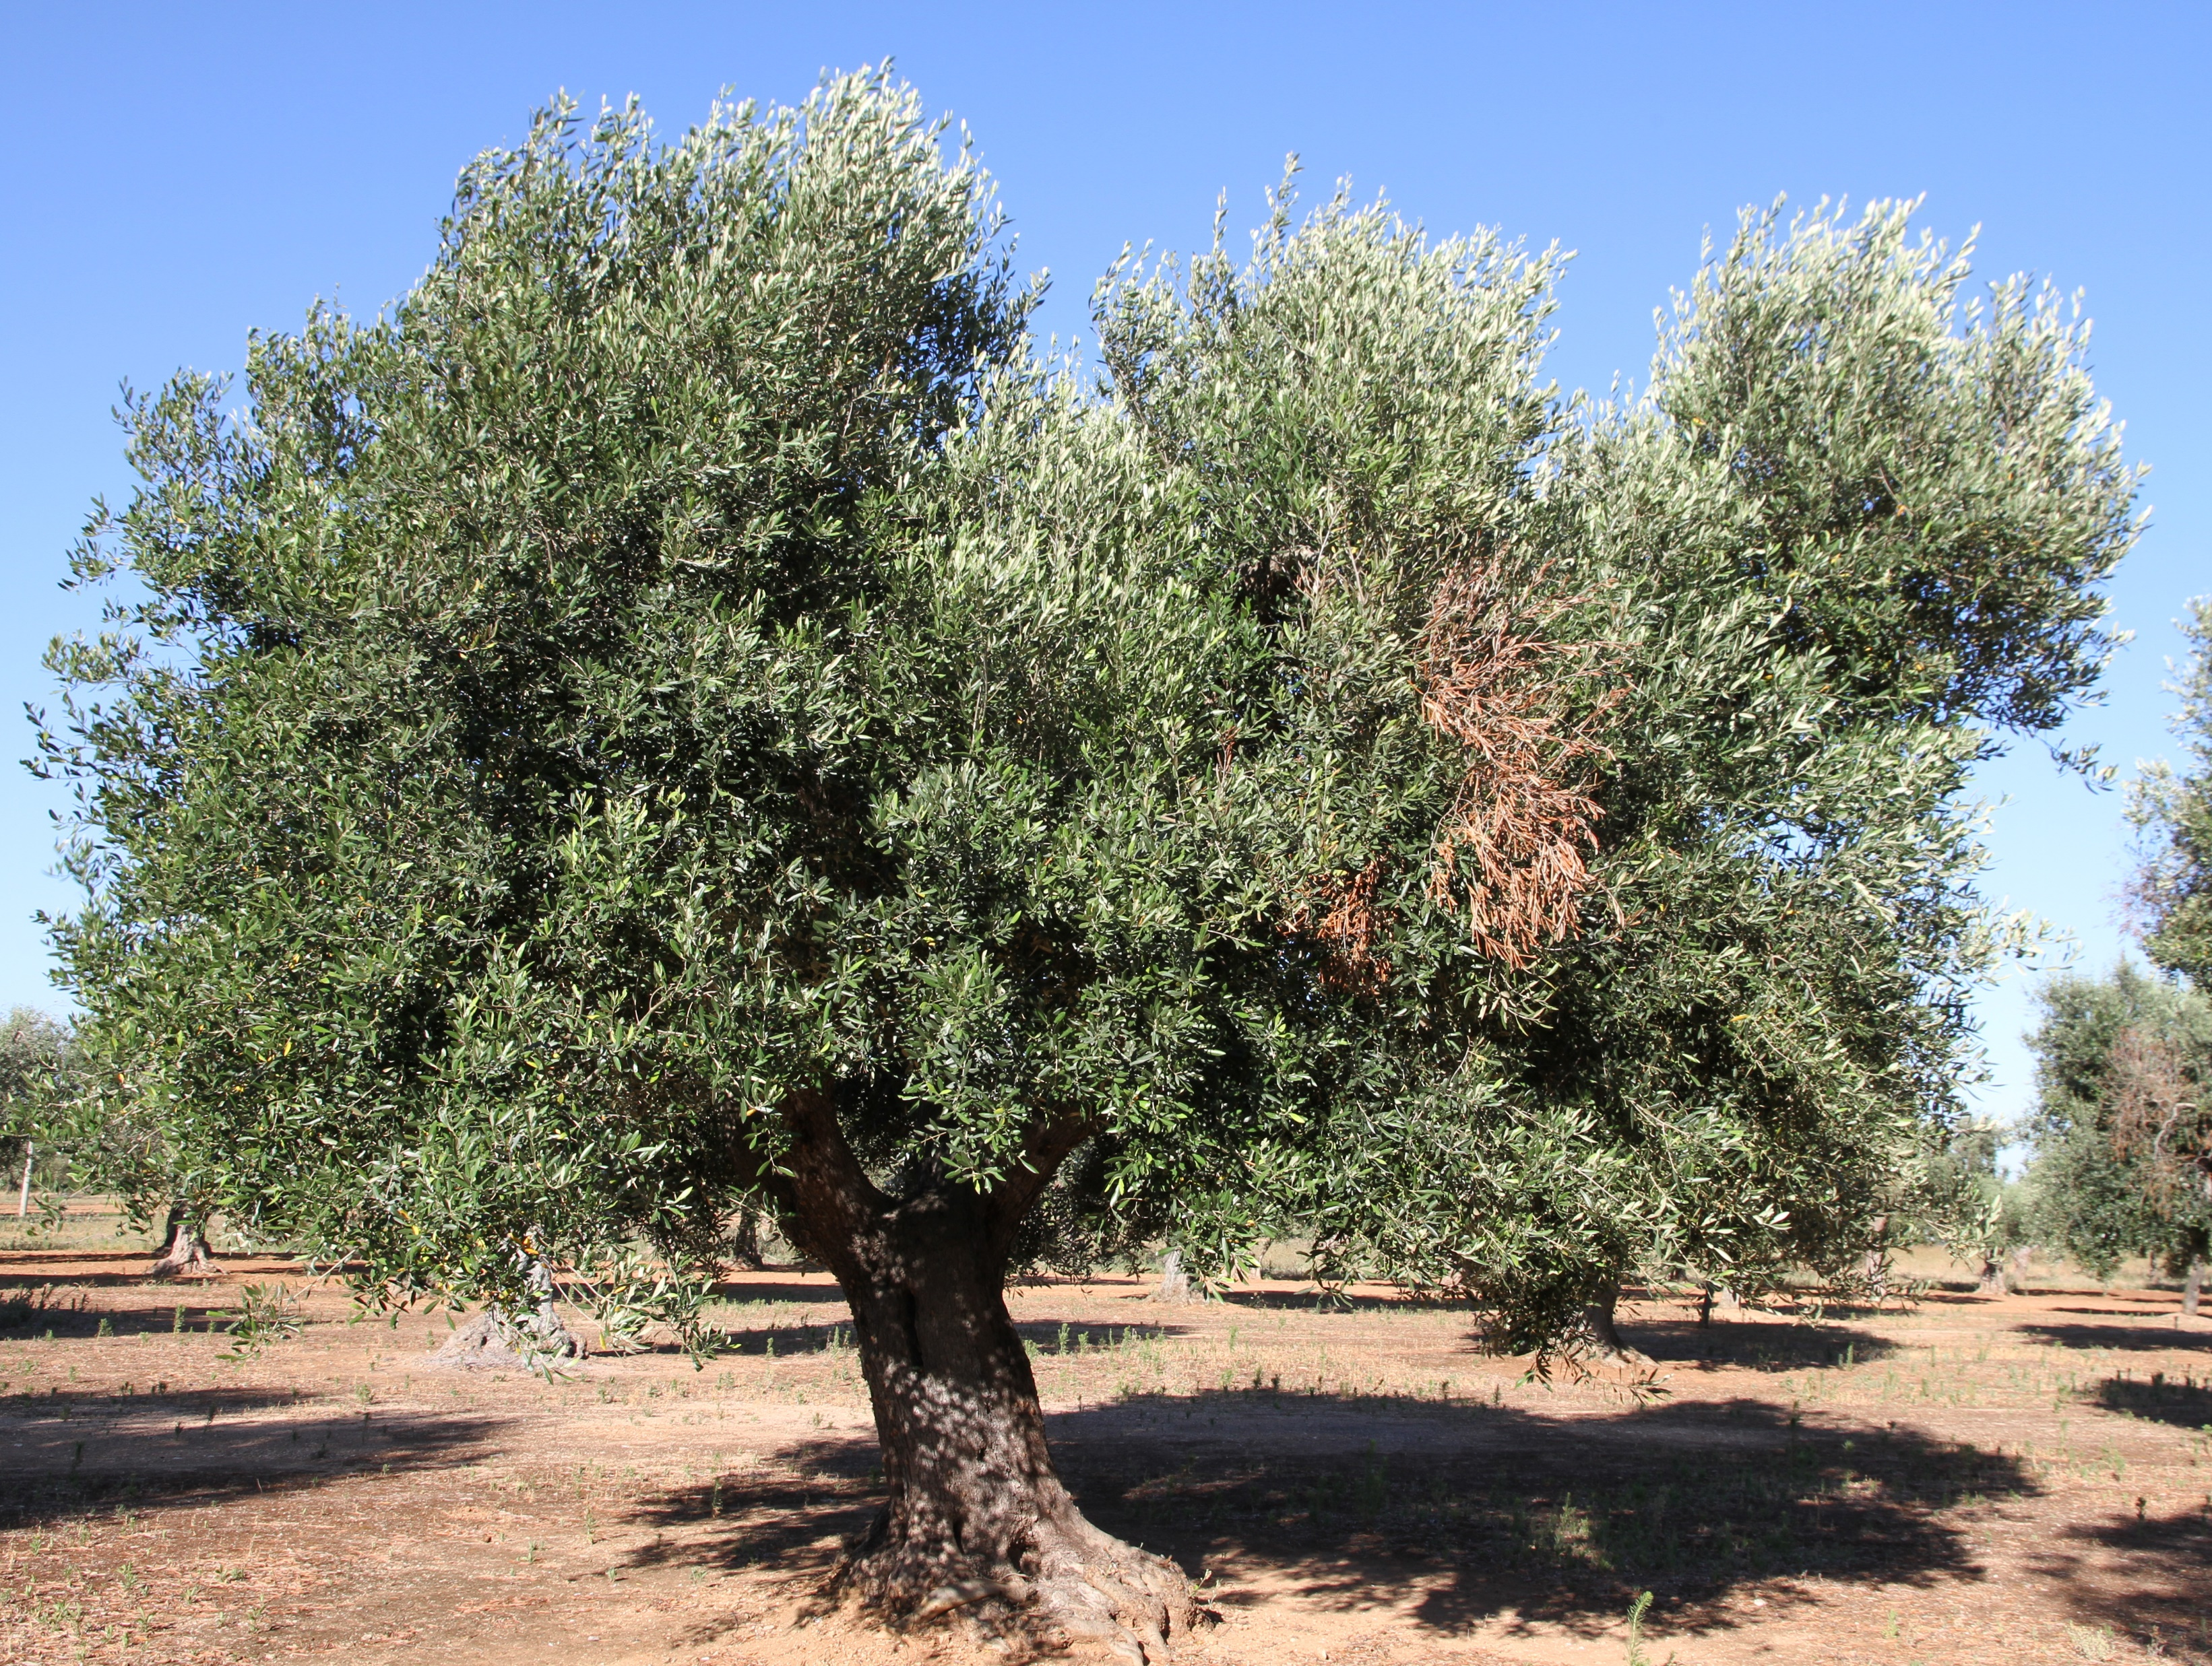
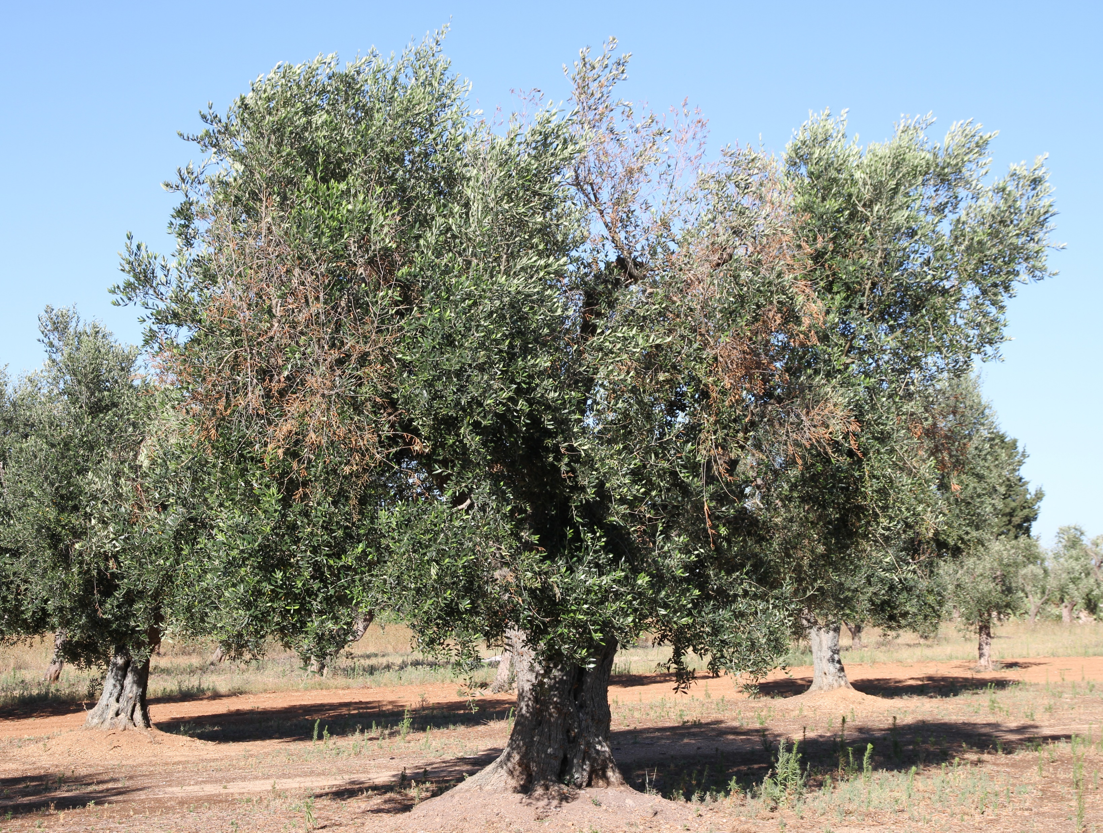
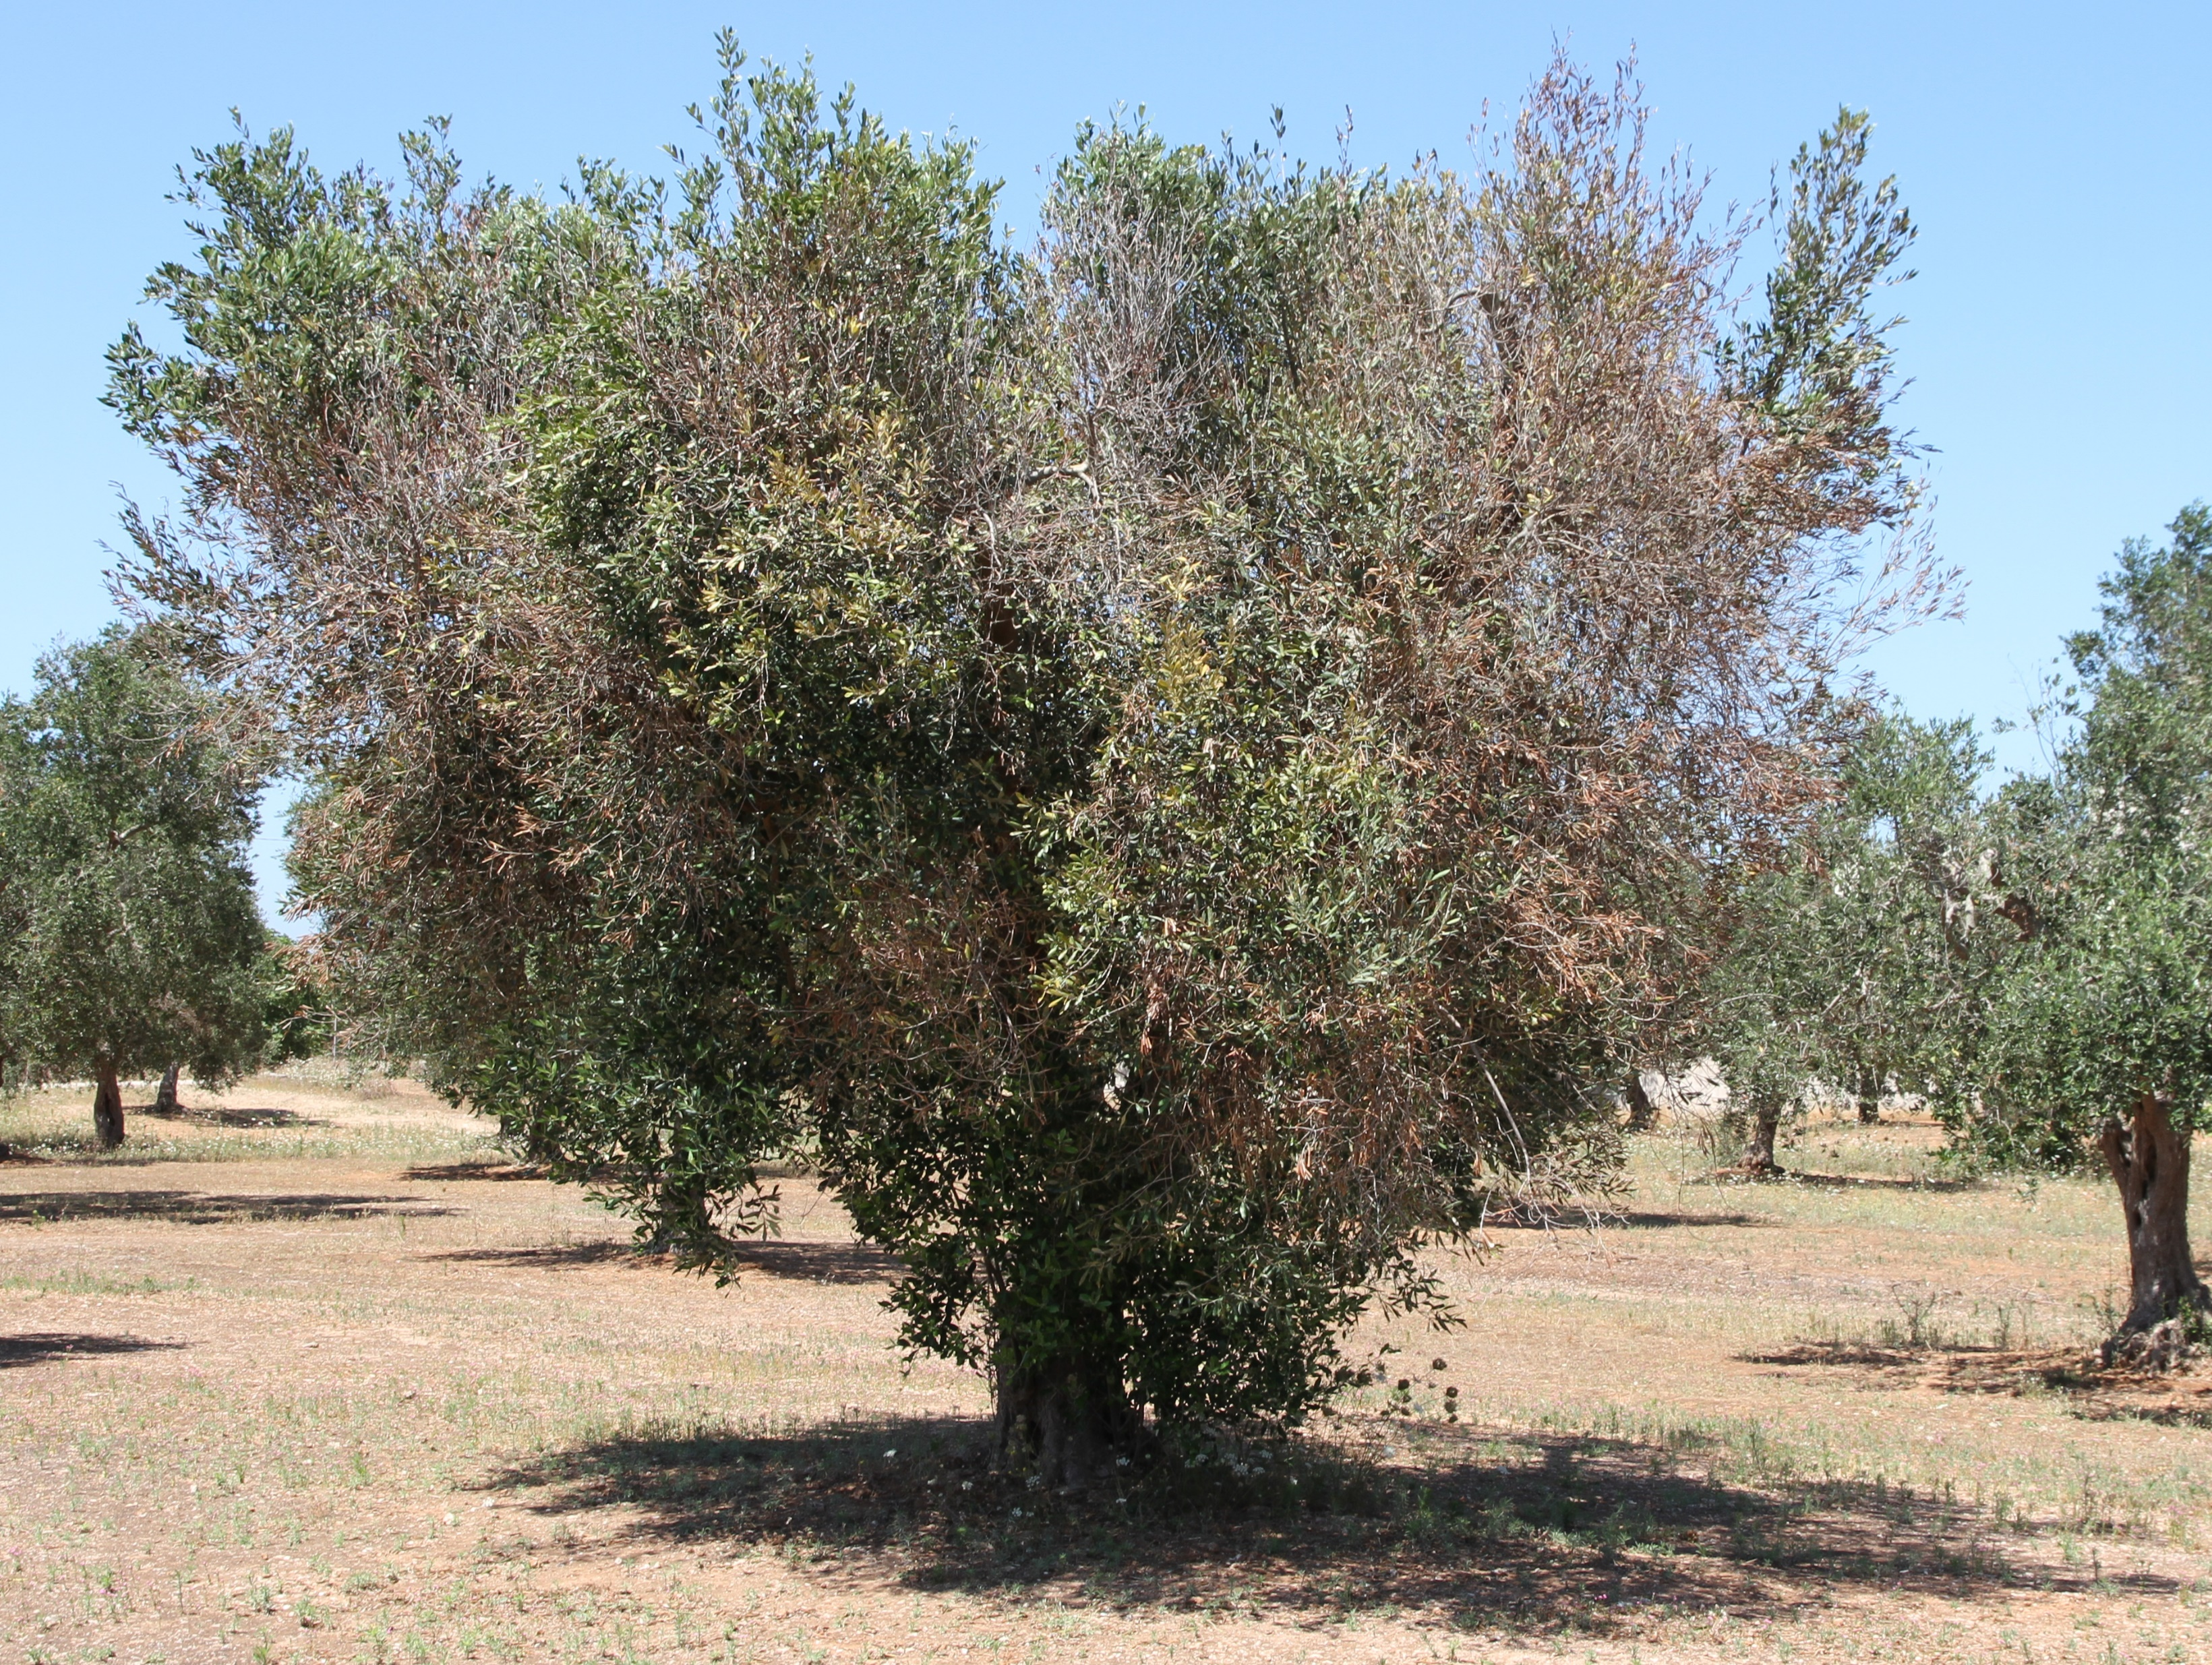
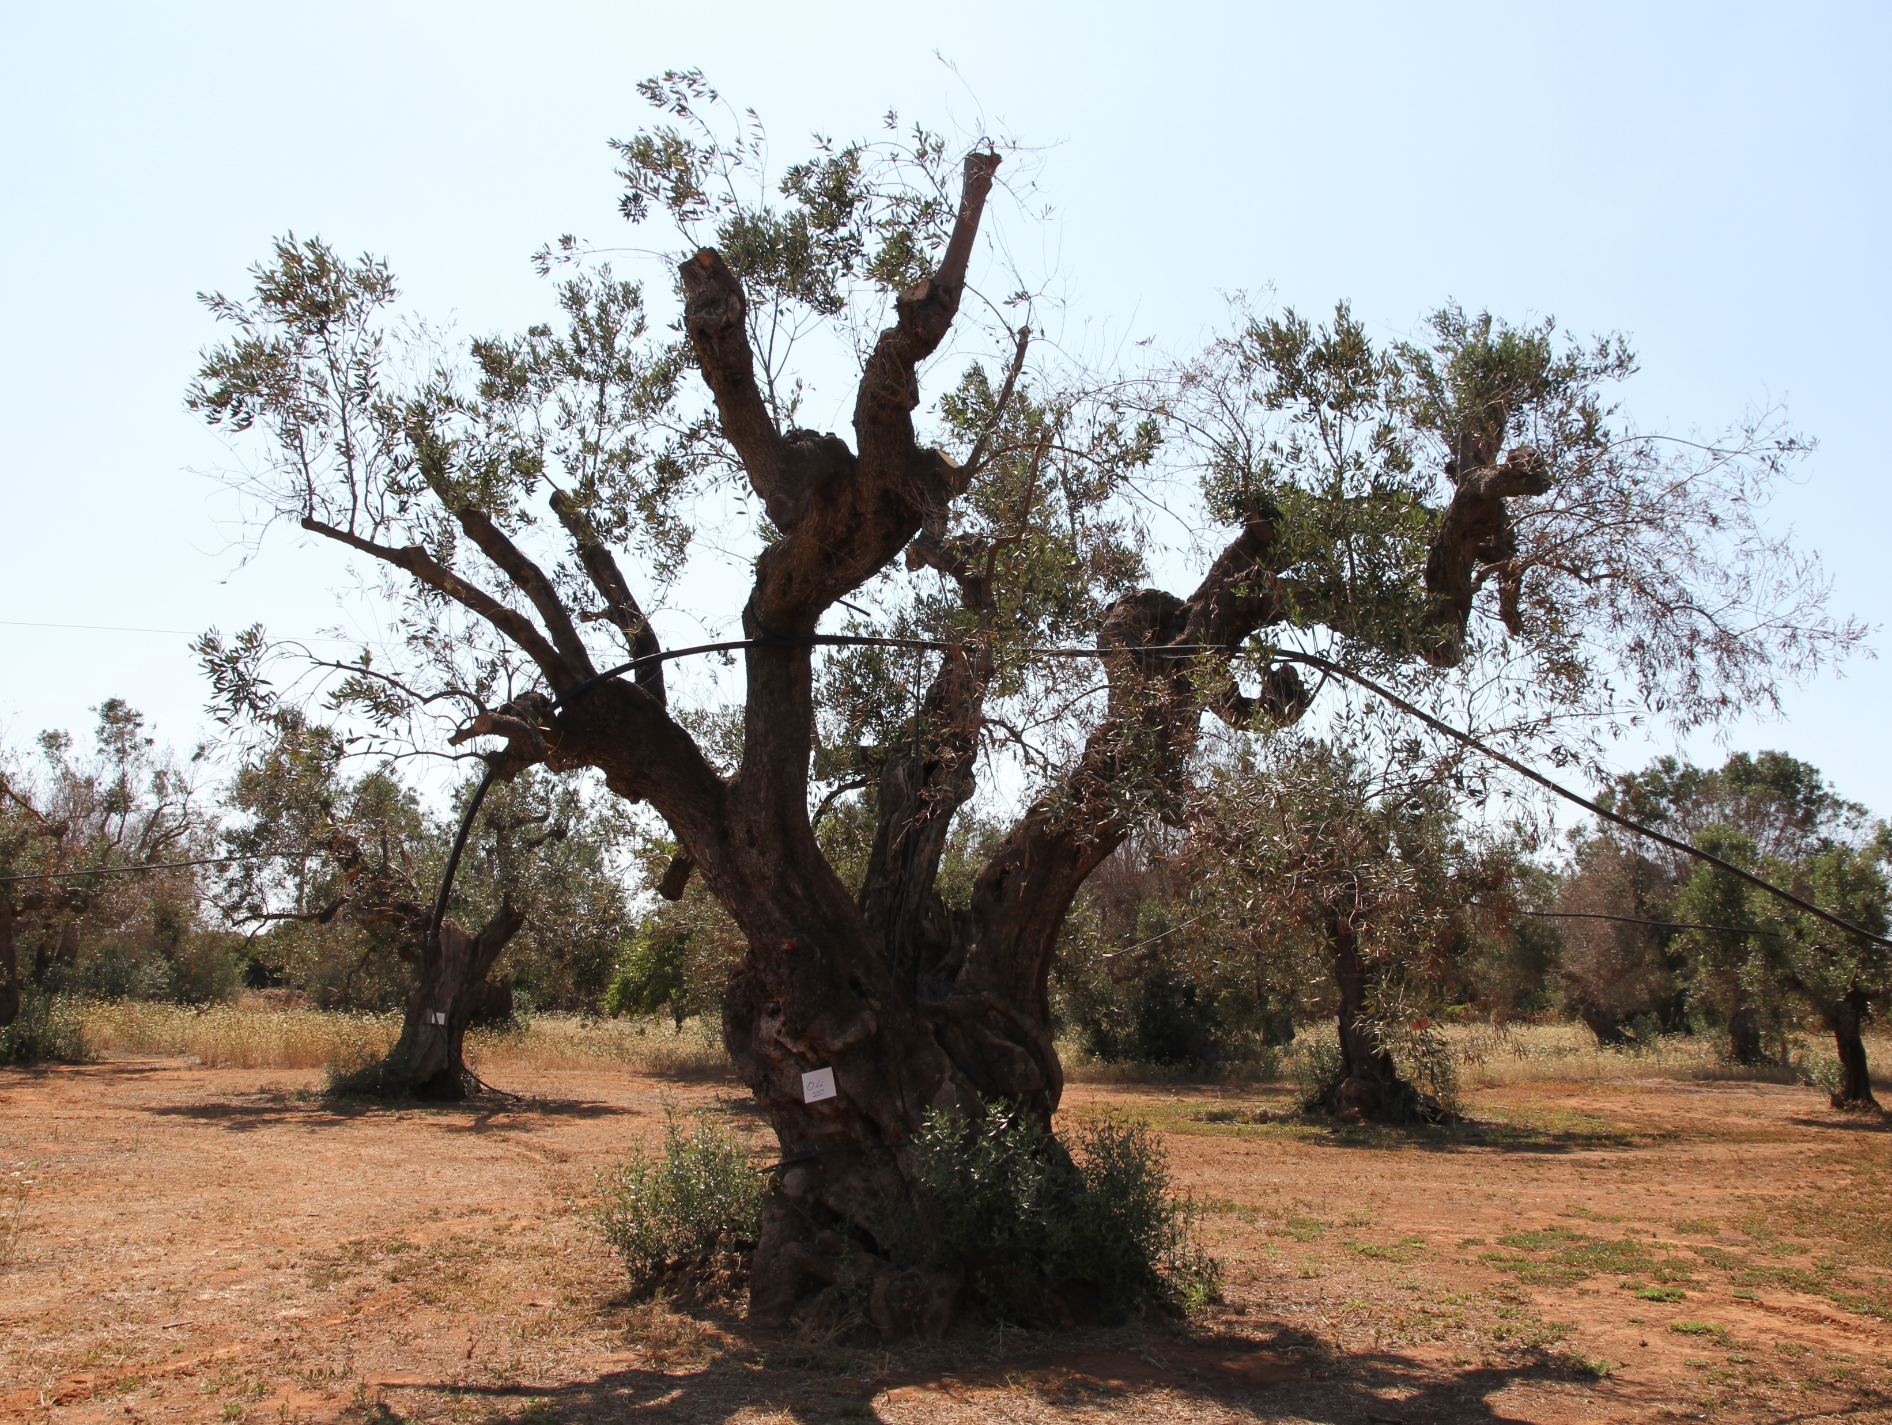
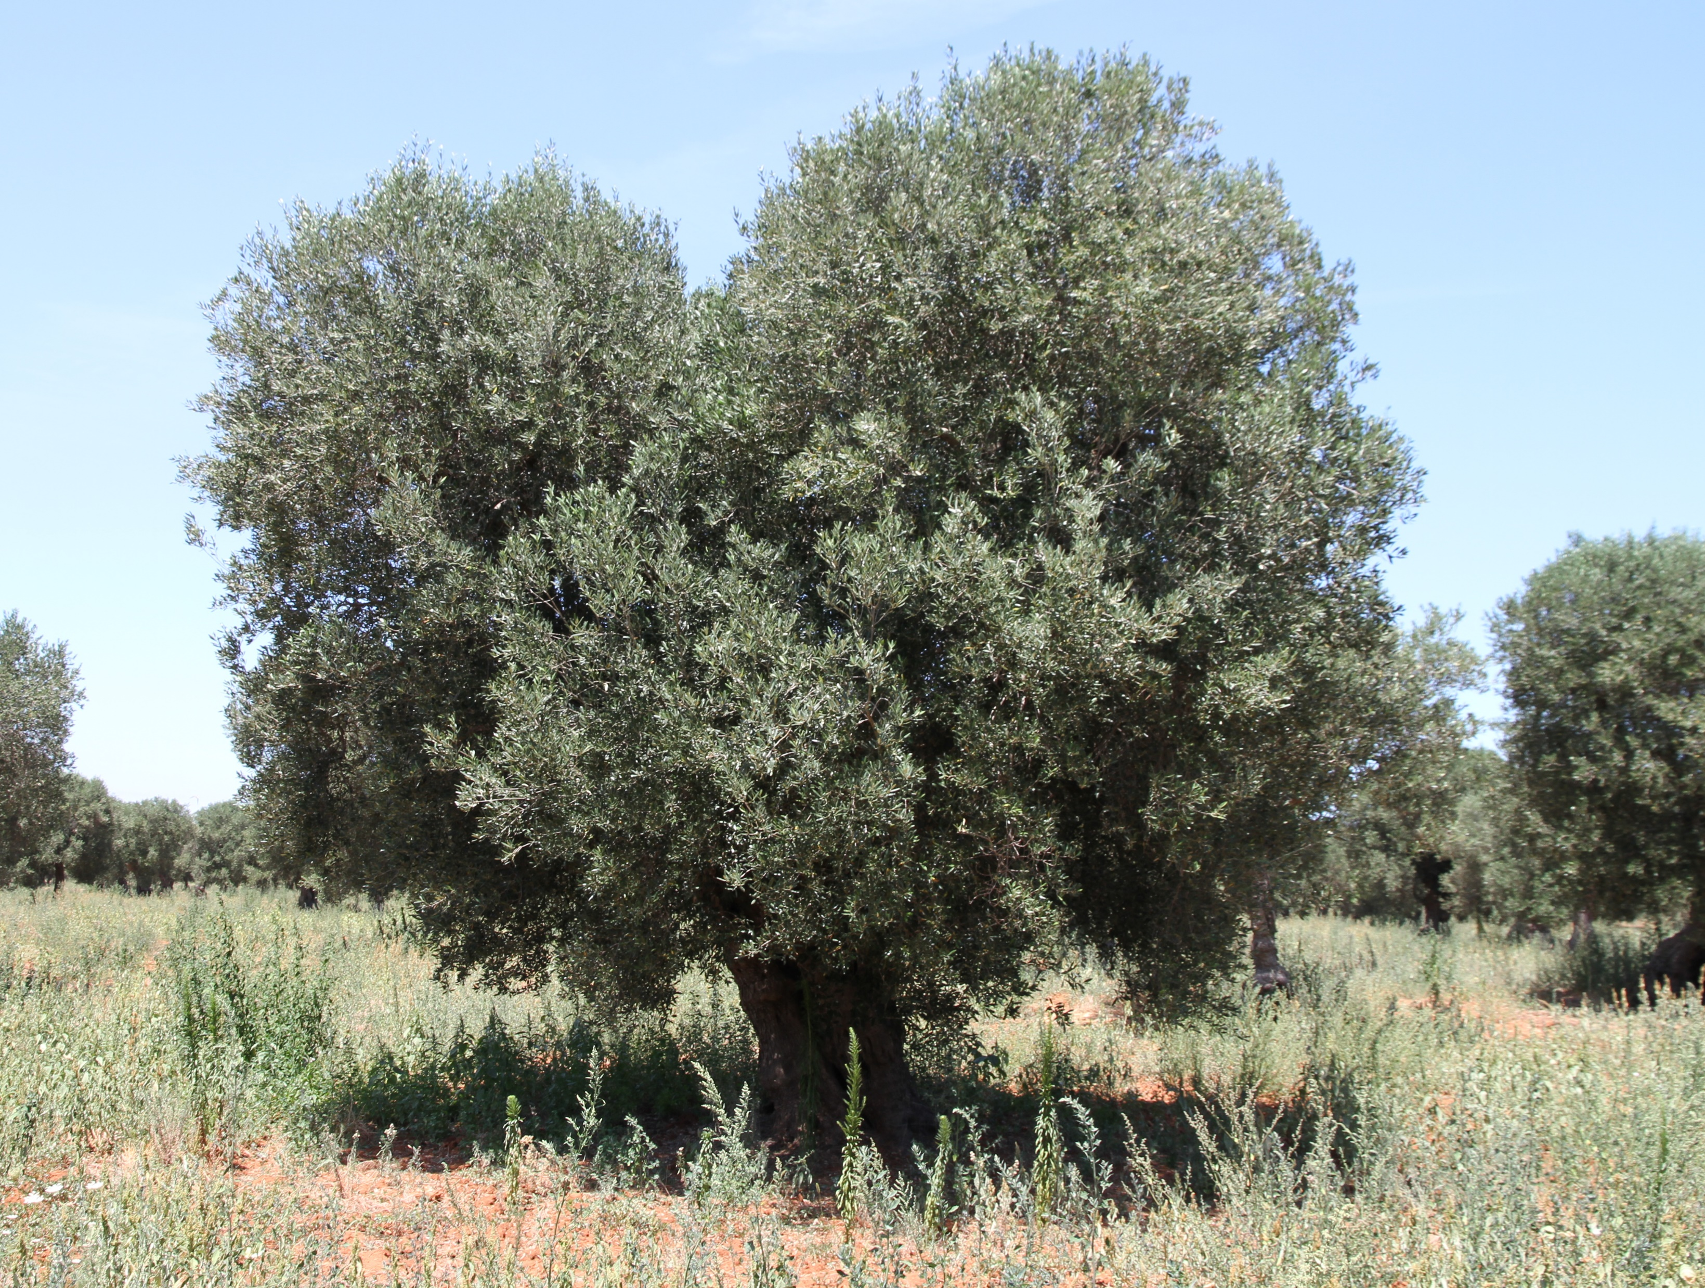

Slide 3
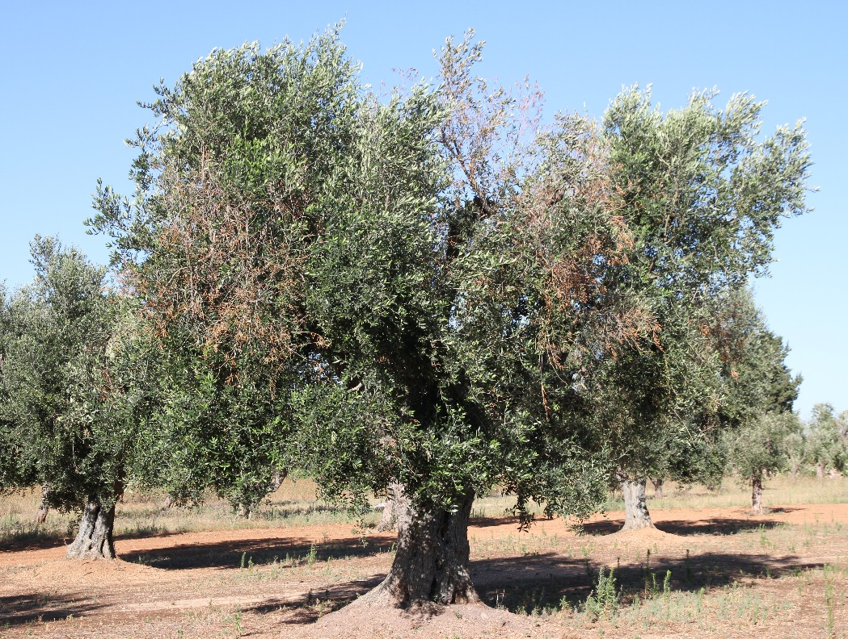

Slide 4
Spread Monitoring

Slide 5
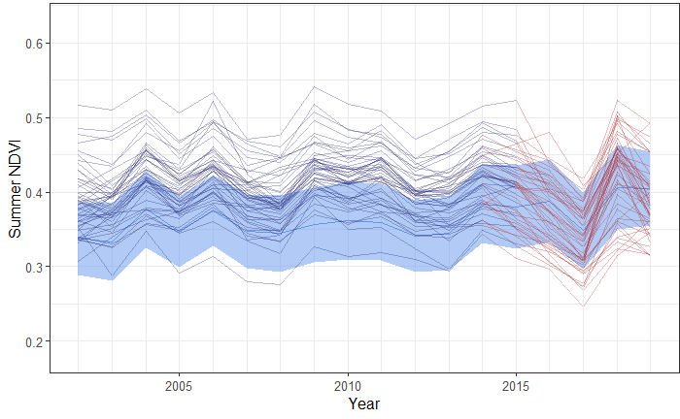
Monitoring pest damage - Xylella

Slide 6
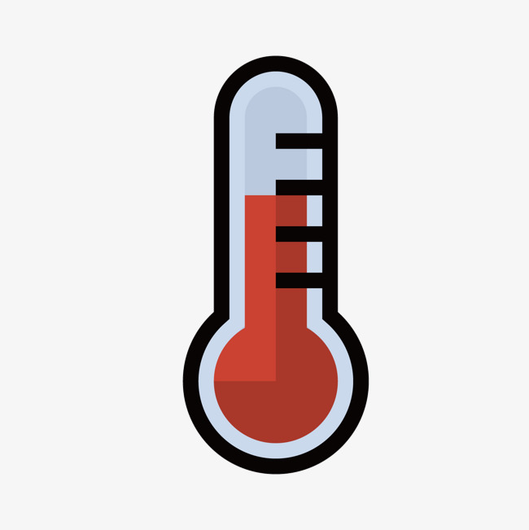
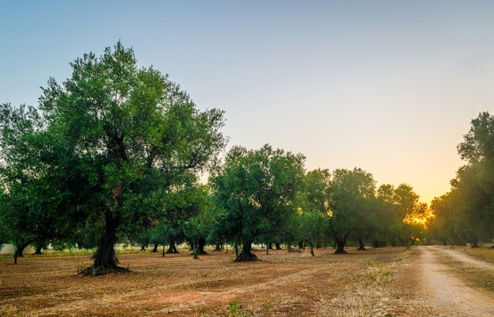
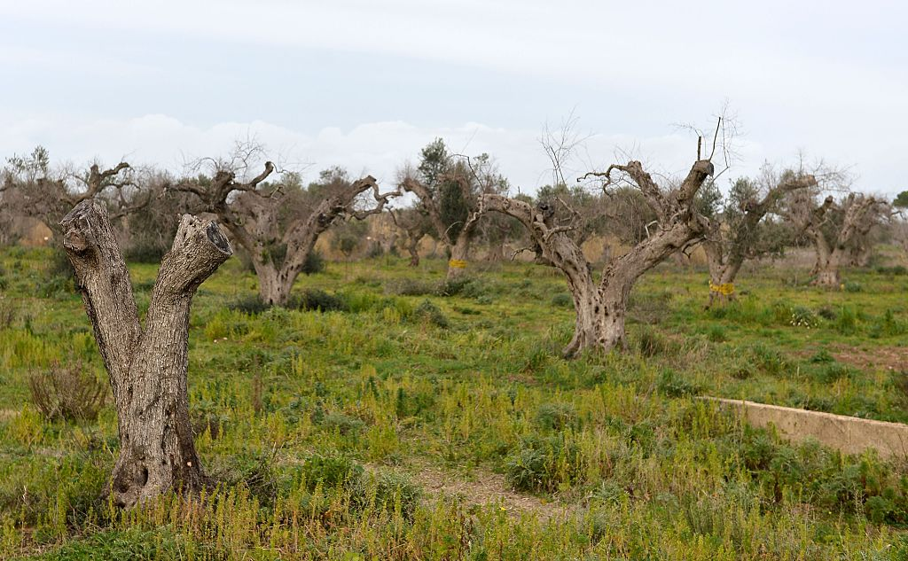
Pre-Xylella
Xylella

Slide 7
MODIS NDVI
2000 - 2018
Pre-Xylella
2000 - 2012
Xylella
2013 - 2018
Model
Summer residuals
(obs - pred)
Neutral/
positive
Negative
SPEI-3

Slide 8
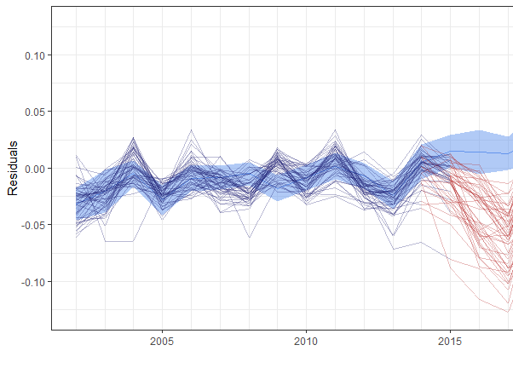
Monitoring pest damage - Xylella

Slide 9
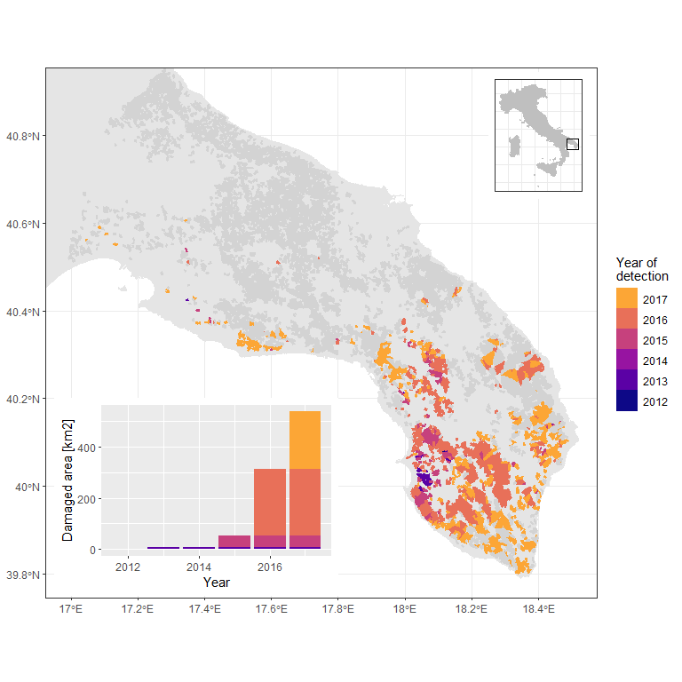
Monitoring pest damage - Xylella
Preliminary results !

Slide 10
Early Detection

Slide 11
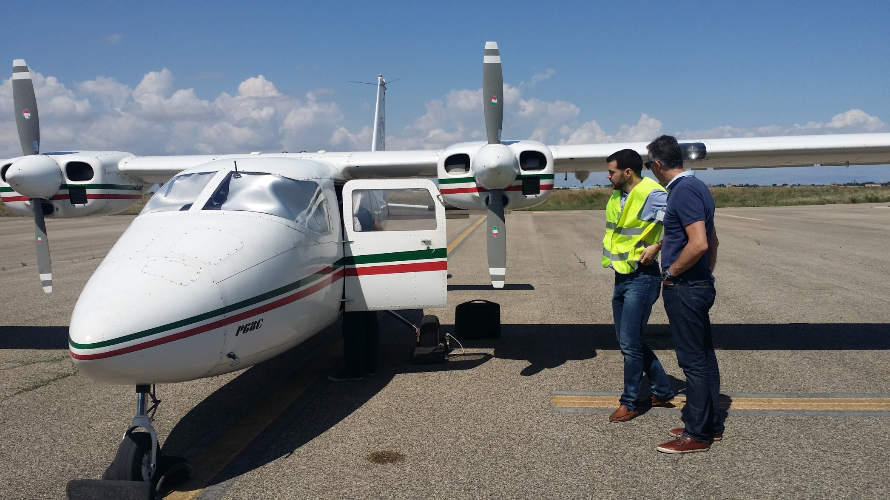
Very high resolution imaging for early detection
Dedicated flights in July 2016 and 2017

Slide 12
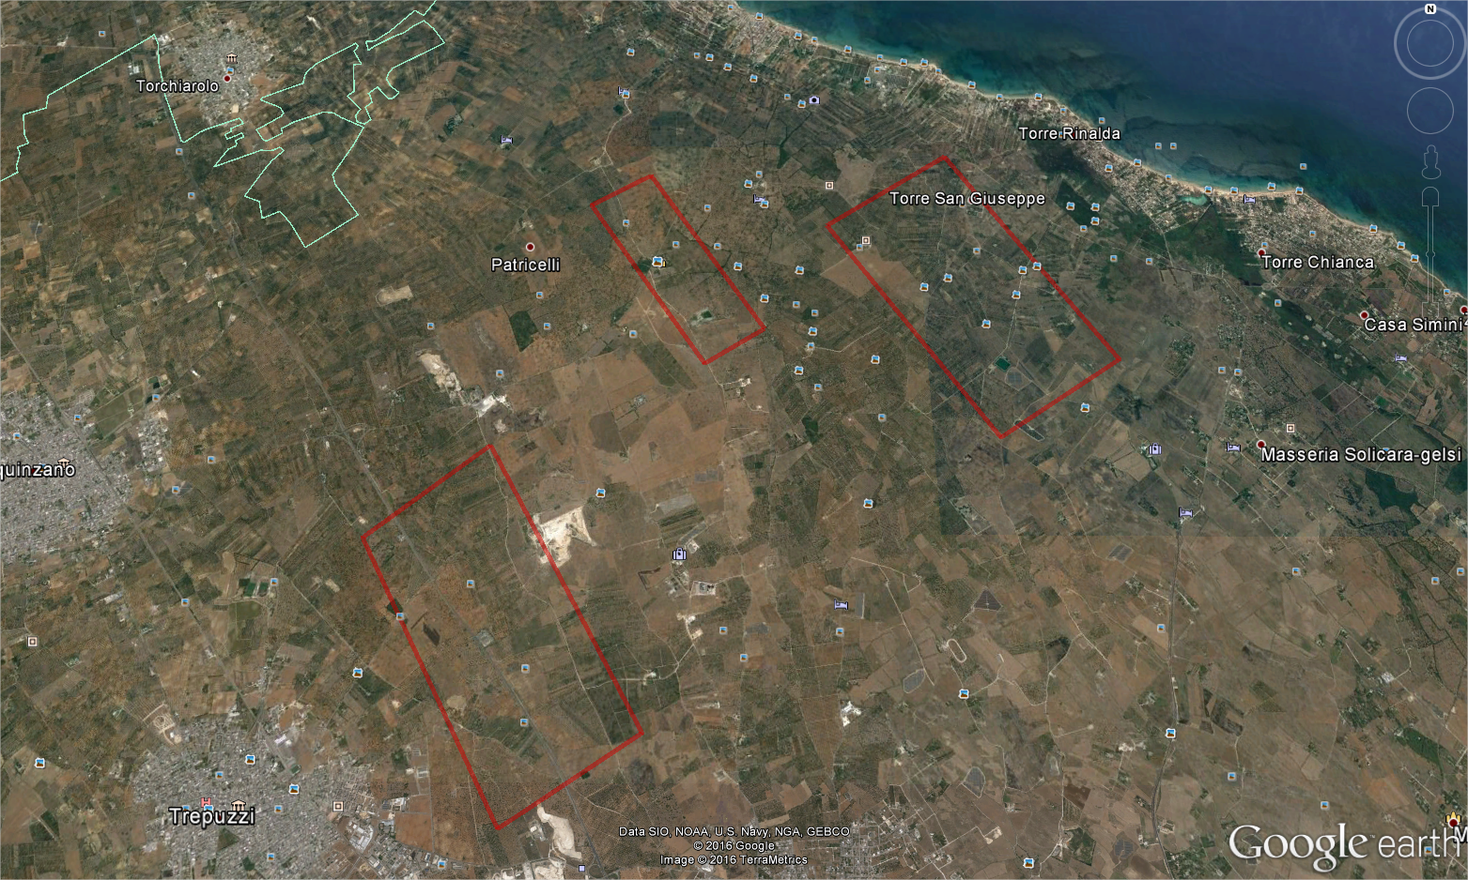
Airborne campaigns 2016 in 2017
200,000 trees scanned
Resolution ranging 7-60 cm
Hyperspectral + Thermal + RGB
3 areas, 1200 ha total
5 matching field campaigns
4000 trees / year

Slide 13
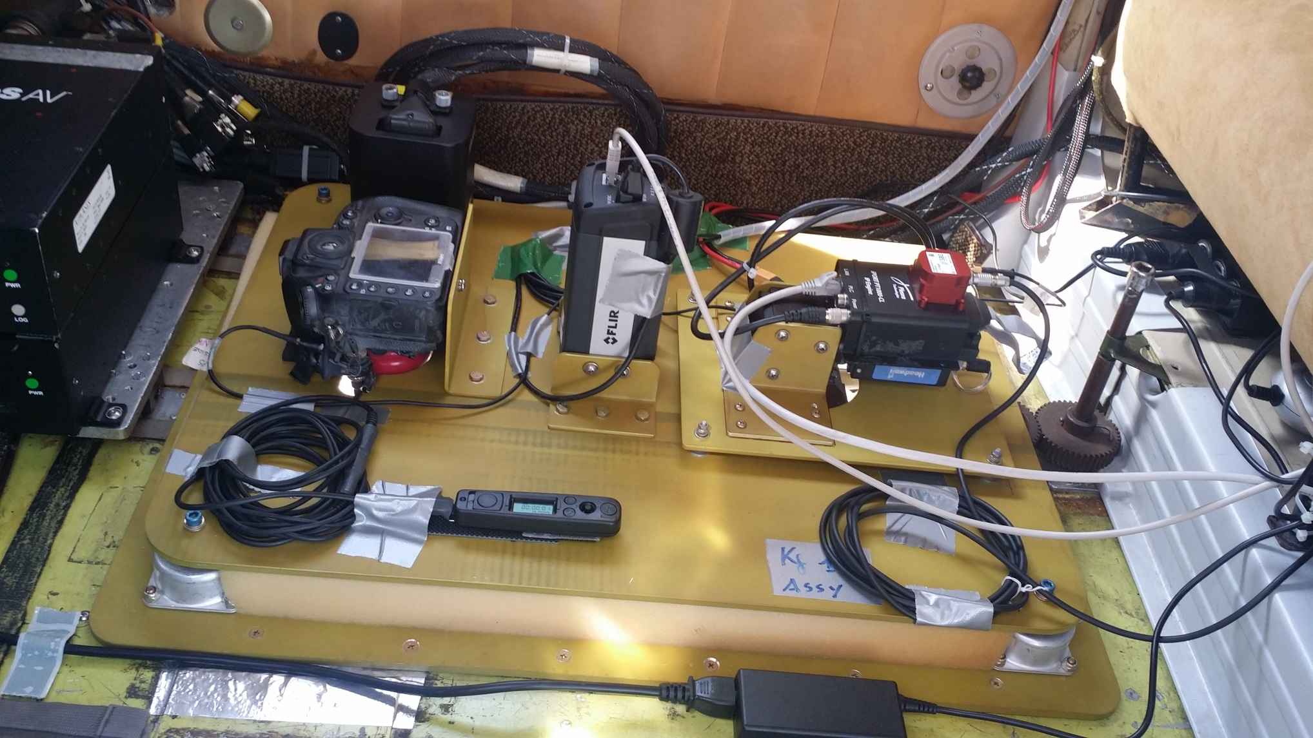
Customized camera set-up
Deployed in July 2016 and 2017

Slide 14
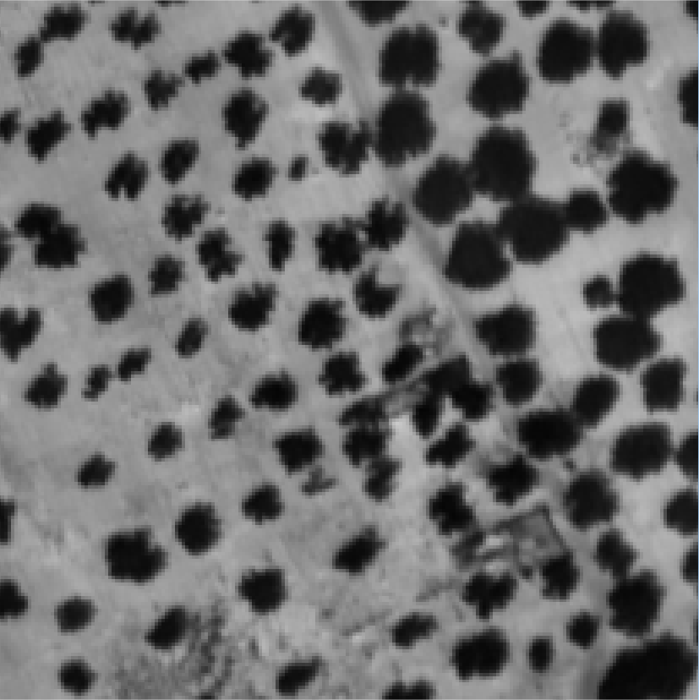
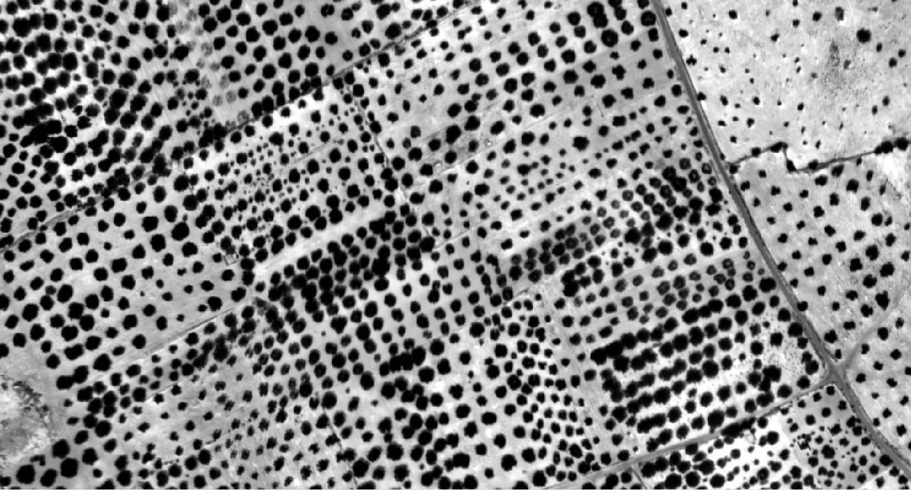
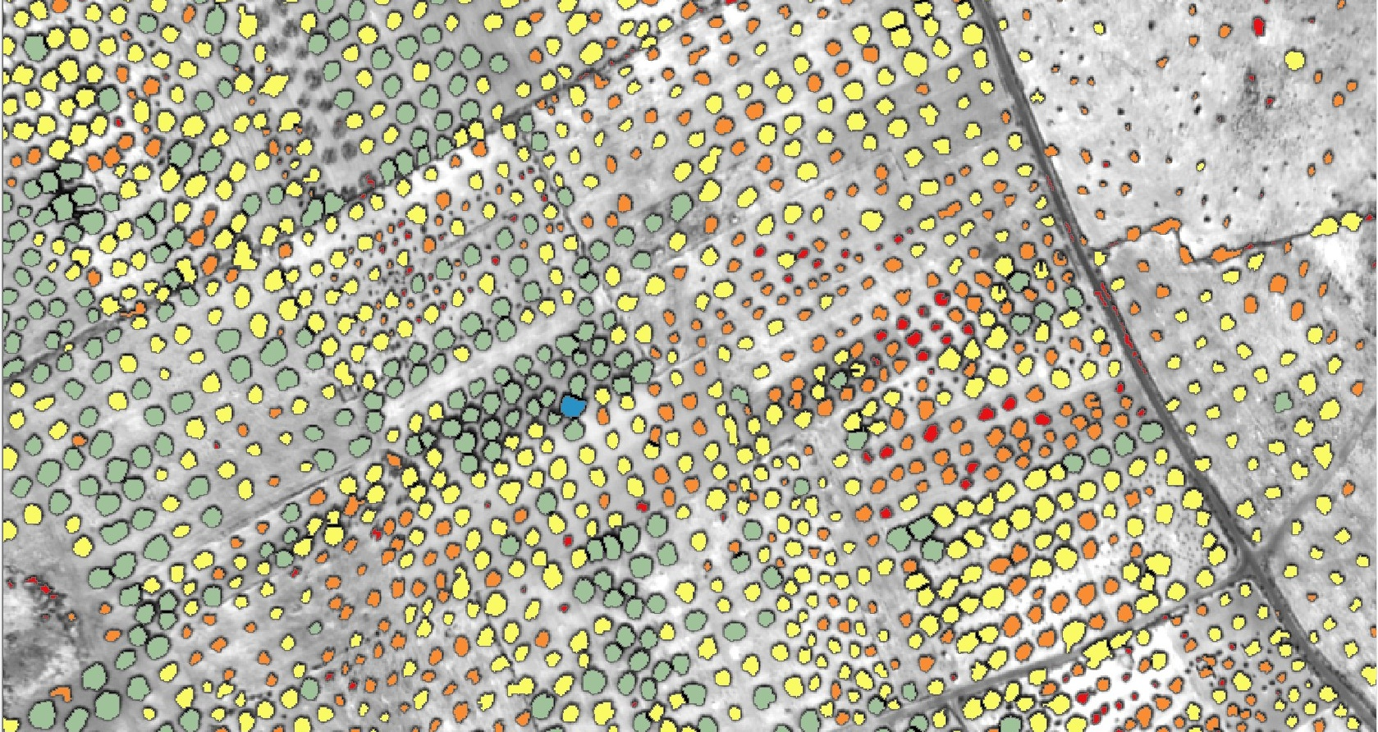
Thermal images
60 cm resolution
Notes:
Thermal 60 cm
the 8-14 micron

Slide 15
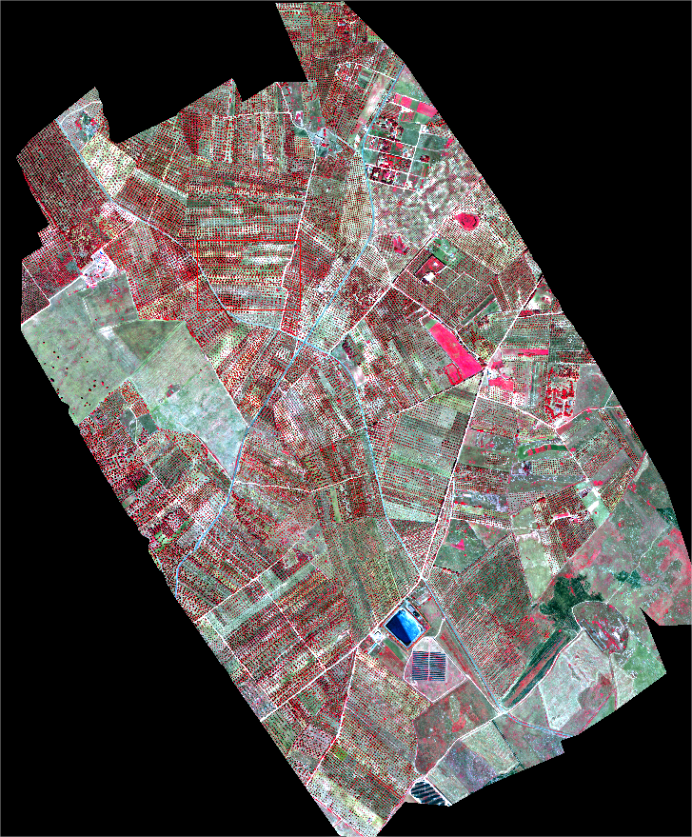
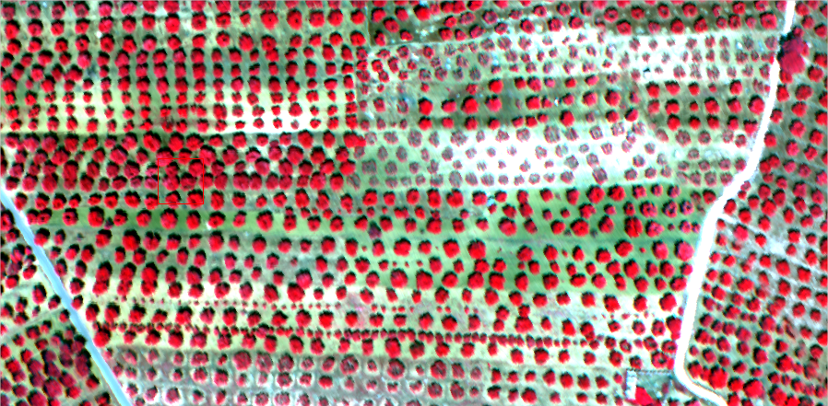
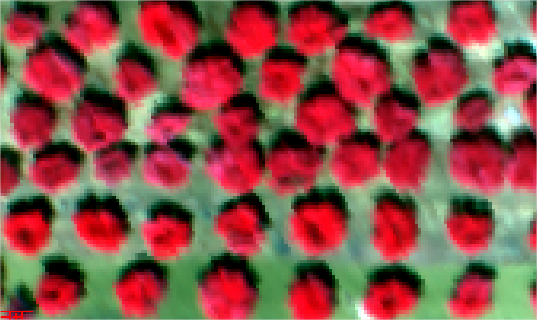
Hyperspectral images
45 cm resolution
Notes:
Hyperspectral 45 cm
150-300 spectral bands @ FWHM~5-7 nm

Slide 16
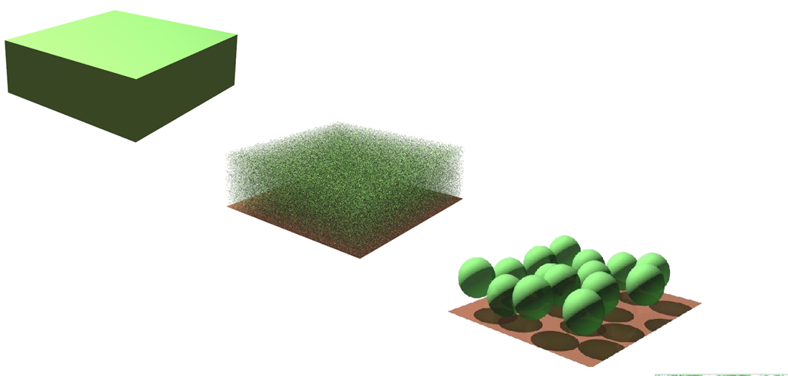
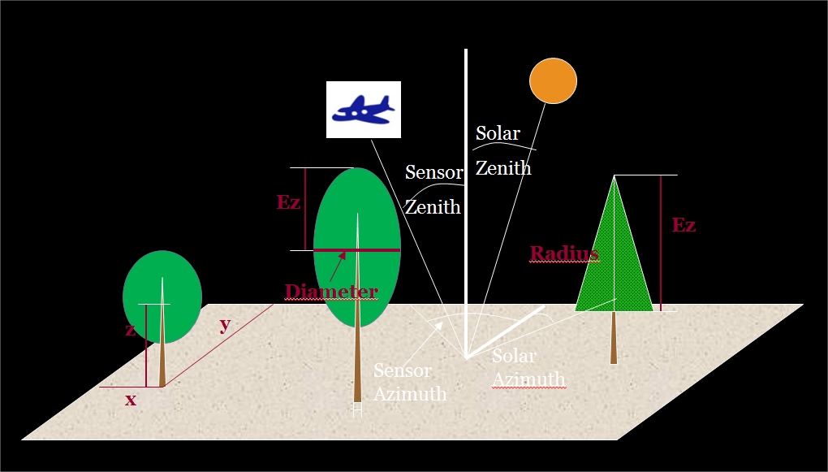
Estimating plant structural and physiological traits (relating to pigment and structure) from the images using spectral indices and models combining radiative transfer and canopy simulation

Slide 17
Zarco et al. 2018 Nature Plants
Notes:
NPQI indicator of chlorophyll degradation (based on phaeophytinization)

Slide 18
Detection accuracy for symptomatic trees (κ) > 80%
Zarco et al. 2018 Nature Plants

Slide 19
Concluding thougths
Annual forest disturbance mapping from satellite is now operational
Disturbance regimes are rapidly changing
Research is increasingly targeting forest disturbance attribution and early detection
New programmes (incl Copernicus), sensors and platforms development (RPAS, HAPS, smallsats), and analytical techniques (Google Earth Engine, deep learning) are accelerating developments
Zarco et al. 2017 Phot Eng & RS

