Slide 1



Monitoring of forest cover disturbances during natural hazards by meteorological satellites
SALGEE
Julia Stoyanova
With contribution of: Christo Georgiev, Andrey Kulishev
National Institute of Meteorology and Hydrology, Bulgaria
6th SALGEE Workshop, 14 – 17 October, Darmstadt, EUMETSAT HQ, Germany
‘MSG Land Surface Applications: Connection of climate and biosphere’

Slide 2
Outline
Ecosystem functioning is mainly characterized by fluxes and budgets of energy, water and carbon, where vegetation and soil properties regulate the exchange processes.
Natural hazards that result of natural events but also from human activity can prevent sustainability of ecosystems. Monitoring forest cover state and capacity for sustainable functioning before – during – after natural hazards is performed using capabilities of MSG geostationary and MetOp polar orbiting satellites.
The spatial and temporal evolution of functional and structural characteristics of forest canopy before and after the hazard is monitored:
  Land Surface Temperature, LST as a key surface variable links the processes of energy and water exchange between the forest and the atmosphere, and characterizes energetic aspects of forest functioning.
  Evapotranspiration, ET as a water balance component indicates the disturbances of stand-scale water balance
  Fraction of Vegetation Cover, FVC reflects the disorder in forest structure after forest fire and disease.
  EDLST from MetOp are used as indicators of natural hazards effects.

Slide 3
Outline
Two real situations of natural hazards are analyzed to illustrate the capacity of MSG LSA SAF /EPS products to monitor in near real-time forest state and anomalies:
The effects of a large forest fire lasting from 24-28 August 2017 in Kresna Gorge, SW Bulgaria is explored. Classified as an environmental catastrophe it has influenced canopy state characteristics ( as seen by MetOp).
A real problem in silvicultural practice in Bulgarian with conifer forests in the lower forest belt after the injuries by heavy snow conditions in 2015. Broken trees become affected by a corolla disease and subsequent desiccation. A selected region with progressive mass wilting of conifers is tested by space/time evolution of LST, ET, FVC deviations from their means before the storm (e.g. 2013, 2014 years) and after the storm and disease (e.g. 2016, 2017).

Slide 4
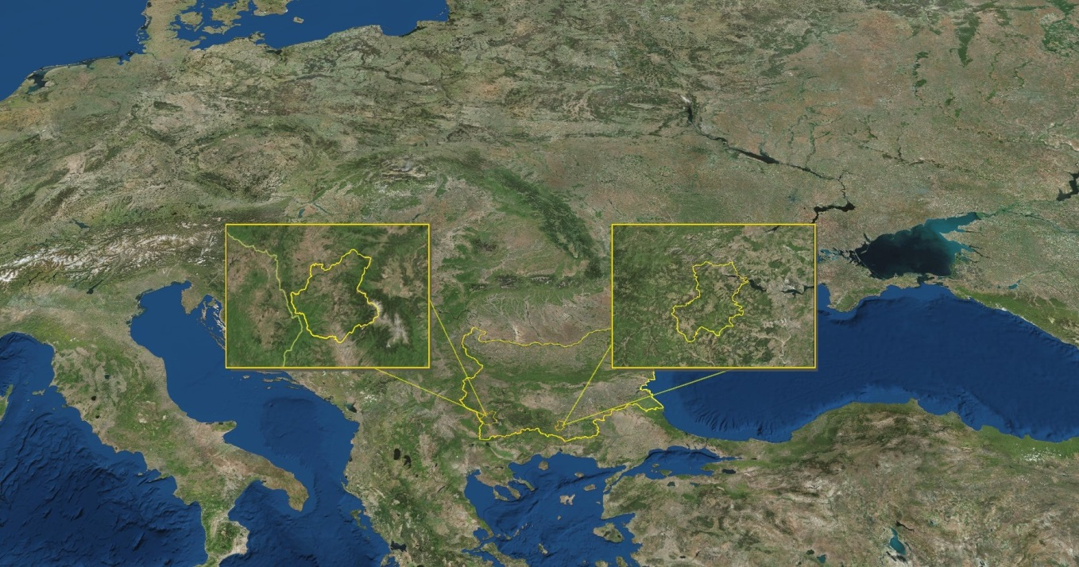
Regions of the two types of disturbances in forest sustainability
First type of forest disturbances
Second type of forest disturbances
Kresna & Simitly
forest estates
Ardino
forest estate
Forest fire
disturbances
Bulgaria
Forest decease and
desiccation

Slide 5
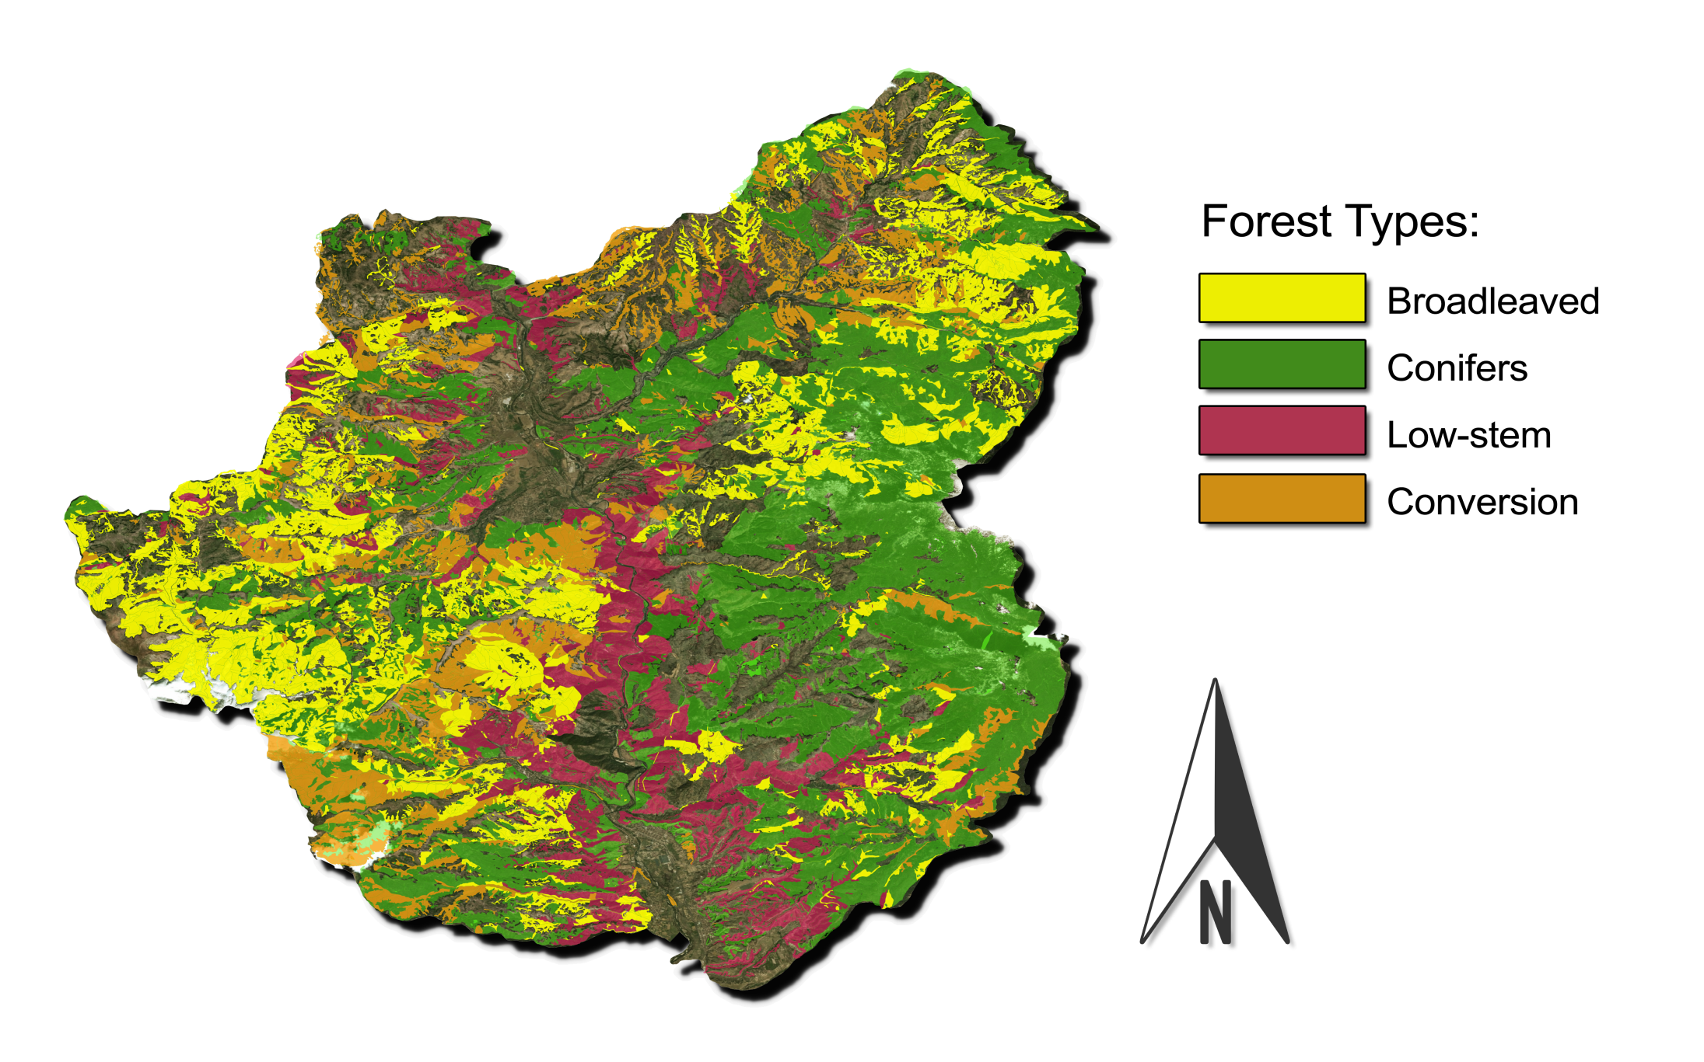
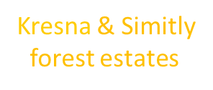
A. Forest fires & Forest cover disturbances
http://www.procurement.iag.bg:8080/cgi-bin/lup.cgi .

Slide 6
A. Forest fires & Forest cover disturbances
Outline
1. Fire event
24-29 August 2017
2. The aim: First attempt for applications of the land surface temperature (EDLST) from MetOp to identify fire prone areas in short-term time scale.
The day- and night-time behavior of EDLST dataset before, during and after a large fire in SW Bulgaria in Aug 2017 is evaluated.
EDLST data source: LSA SAF Help Desk, archive information.
Some problems in using EDLST
EDLST application & Main results
http://www.procurement.iag.bg:8080/cgi-bin/lup.cgi .

Slide 7
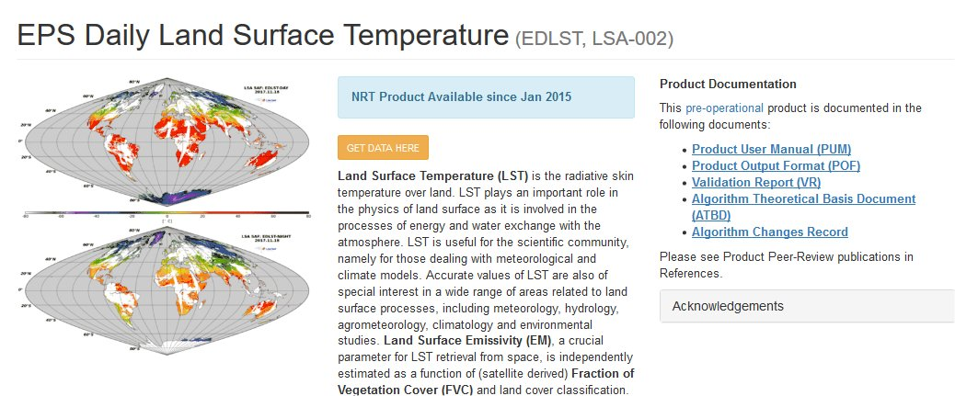
EPS Daily Land Surface Temperature (EDLST, LSA-002)

Slide 8
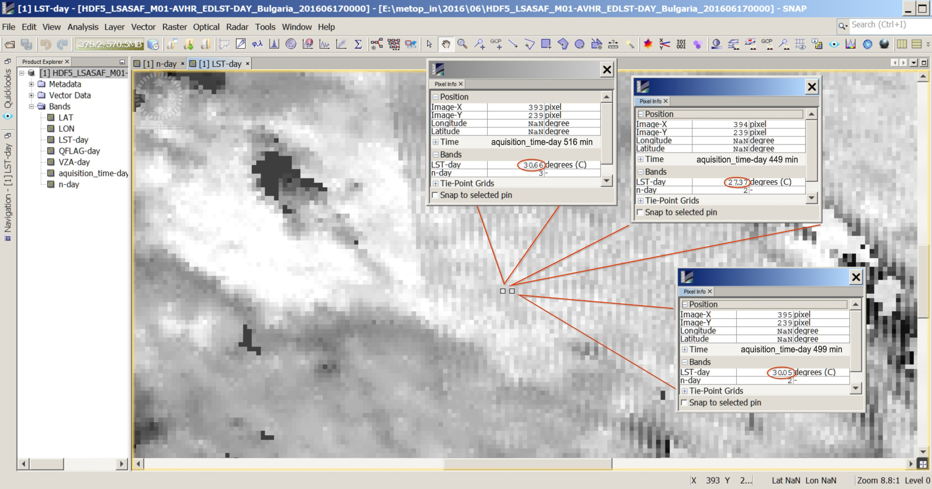
Some problems in using EDLST
NIMH Bulgaria are the first users of EDLST
EDLST dataset was provided by LSA-SAF Help Desk. Some problems that arise in using these archive data are discussed with Help Desk and need further clarification to facilitate the use of the archive data
As an example: There are many HDF files for the region that obviously consist of measurements from two overpasses with 100 min differences in the acquisition time. In the area of overlapping of these two overpasses there is a mixture of the data.
The problem is reported to LSASAF Help Desk.

Slide 9
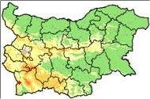
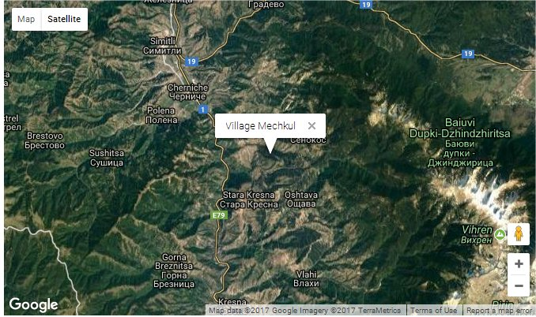
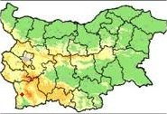
Case study example: 24-29 August 2017
Large Crown Forest Fires estimated as “ecological disaster”
Kresna
Vlahi
Start:41.825; 23.194.
Large forest fire in Kresna Gorge, 24 – 29 Aug 2017
Location: southwestern Bulgaria, Kresna gorge, at the bottom of National Reserve Pirin mountain
Fire start: about 13:30 LT, village Mechkul (41.825; 23.195)
Although lasting six-days, no danger for local settlements village
The fire has caused "an environmental catastrophe"
It will take between 13 million and 15 million leva to finance the planting of new trees and
At least 50 years to restore the forests which have been brought to ashes.

Slide 10
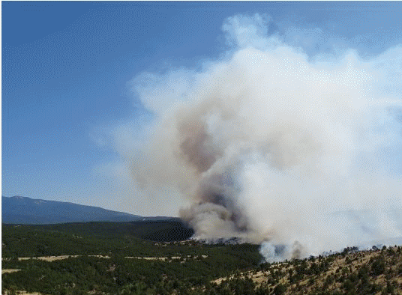
Case study example: 24-29 August 2017
Large Crown Forest Fires estimated as ecological disaster
On 29th of August, the fire was brought under control.
For sixth consecutive days, 3 helicopters, firefighters, volunteers, and military men have been battling the wildfire, which destroyed more that 17 thousands of decares of mixed forests, planted forest, and shrubs in the area of Kresna Gorge in Western Bulgaria; Terrainis steep, difficult to access.
Very dry land surface conditions.
Although lasting six-days, no danger for local settlements Village and victims

Slide 11
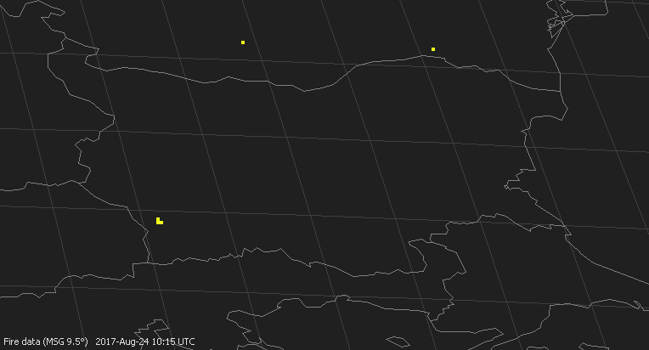
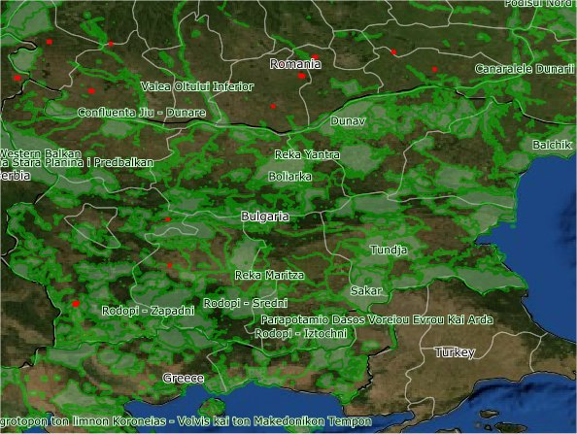
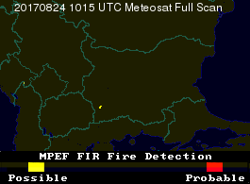
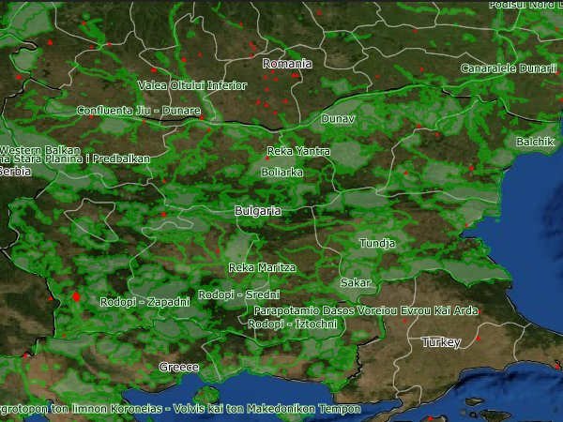
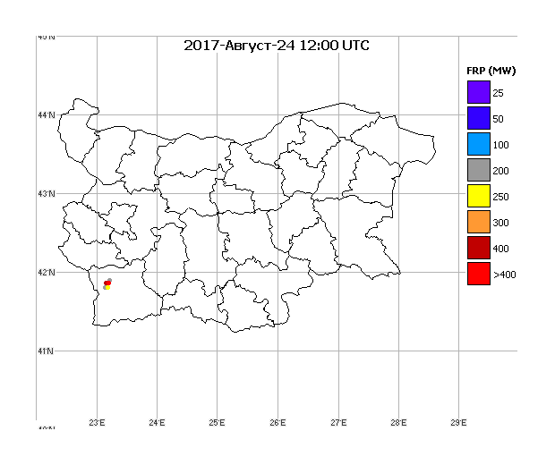
Case study example: 24-29 August 2017
Large Forest Fires estimated as “ecological disaster”
Polar orbiting satellites
MPEF FIR Rss, 24 Aug 2017, 1015 UTC
24/08/2017 MOD-6
SEVIRY detections
MPEF FIR Fss, 24/08/2017 1015UTC
All satellite algorithms
Detect the fire with first detection at 10:15 UTC (for geostationary) and during corresponding overpass of environmental
satellites.
24/08/2017 VIIRS 750 m
LSA SAF FRP, 24 Aug 2017, 1200 UTC

Slide 12
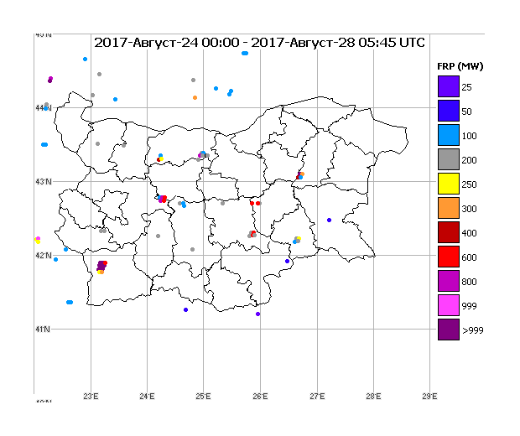
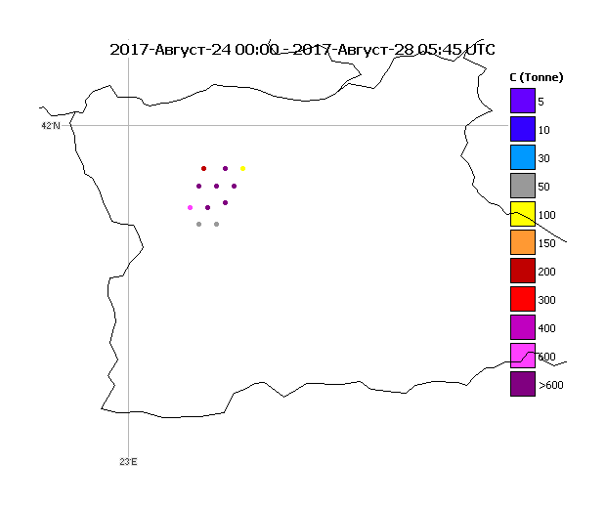
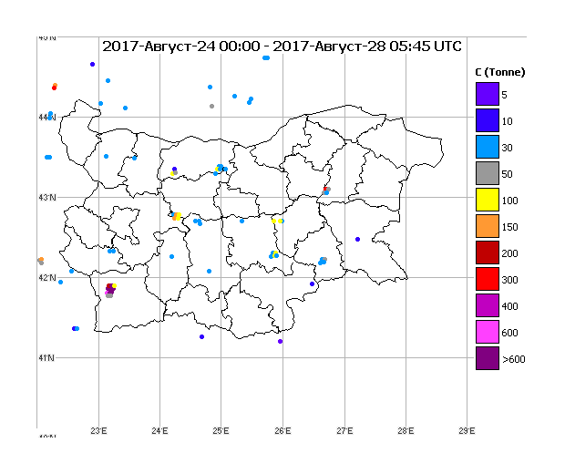
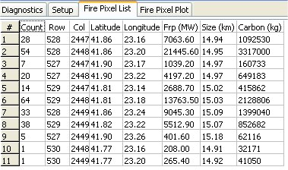
Case study example: 24-29 August 2017
Large Forest Fires estimated as ‘ecological disaster’
LSA SAF FRP-PIXEL, Accumulated effects from biomass burning, 24–28 Aug 2017
Biomass burning affected area, more that 17 000 dk (forest, shrubs, grass)
with a large amount of energy released and CO2Eq emitted.
All these determines fire as an “ecological disater”.

Slide 13
Case study description: Kresna Gorge fire, SW Bulgaria
Figure 1. Satellite detection and monitoring of crown forest fire over Bulgaria on 24-28 August 2017 by available satellite algorithms

Slide 14
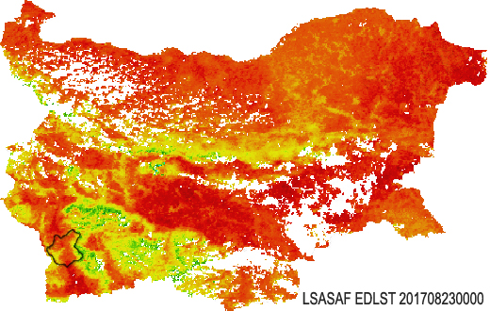
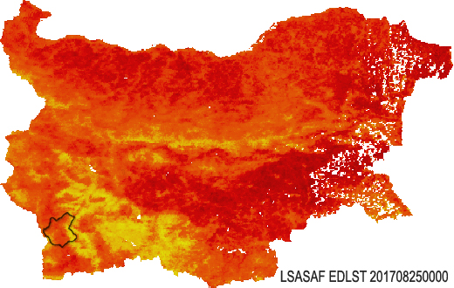
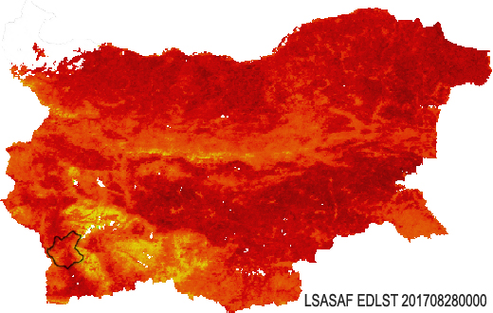

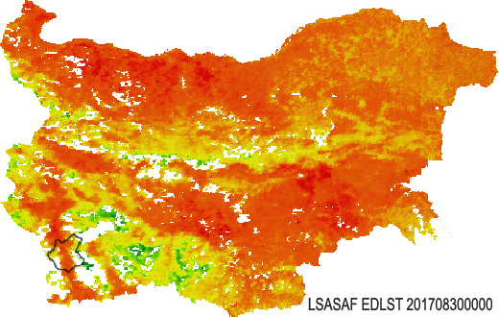
Land surface state: EDLST from MetOp
day before fire
second day with fire
detections
LST is a key surface variable that links the processes of energy and water exchange between the forest and the atmosphere, and characterizes energetic aspects of forest functioning.
23 Aug 2017
25 Aug 2017
last day with fire
detections
third day
with fire detections
26 Aug 2017
28 Aug 2017
Figure 2. Land surface temperature characterized by EDLST MetOp observations before-during-after fire.
day after fire
Region of Forest estates Kresna & Simitly are characterised with high values of land surface temperature (due to specific microclimate, land cover).
30 Aug 2017

Slide 15
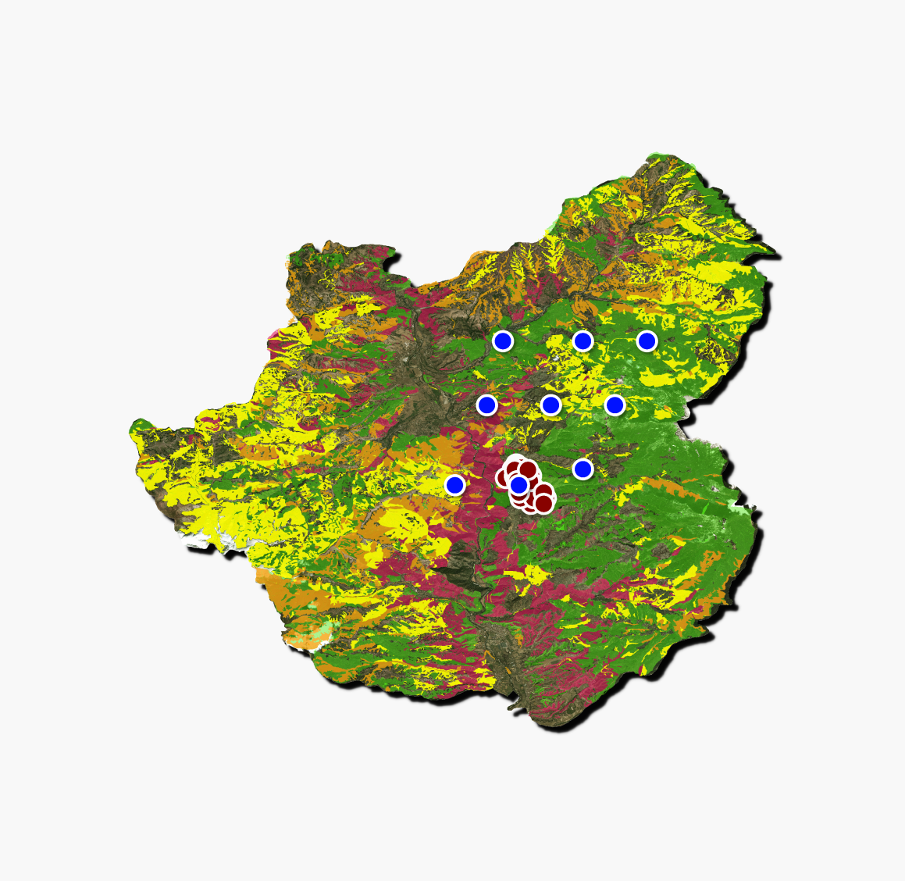
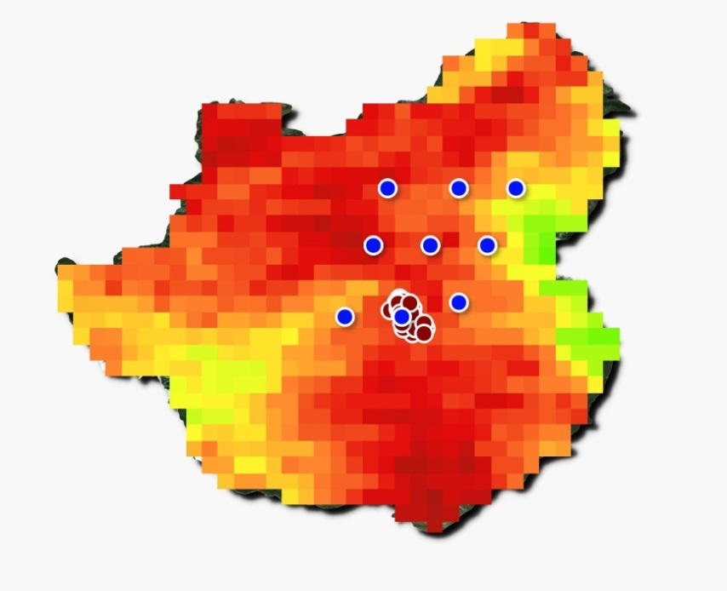
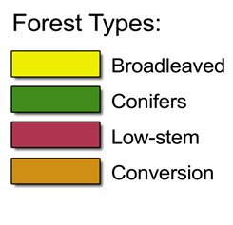
Results
Thermal anomalies in the field of day-time EDLST from MetOp
a)
24 August 2017
First day with fire detections
b)
Figure 3. Satellite detected thermal anomalies superimposed over:
a) Map of forest cover types; b) Day-time EDLST from MetOp.
LSA SAF FRP-Pixel product
NPP Suomi VIIRS 350 m

Slide 16
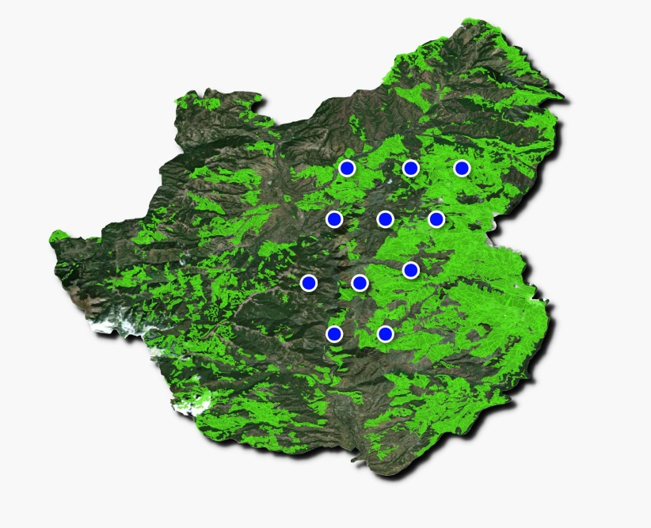
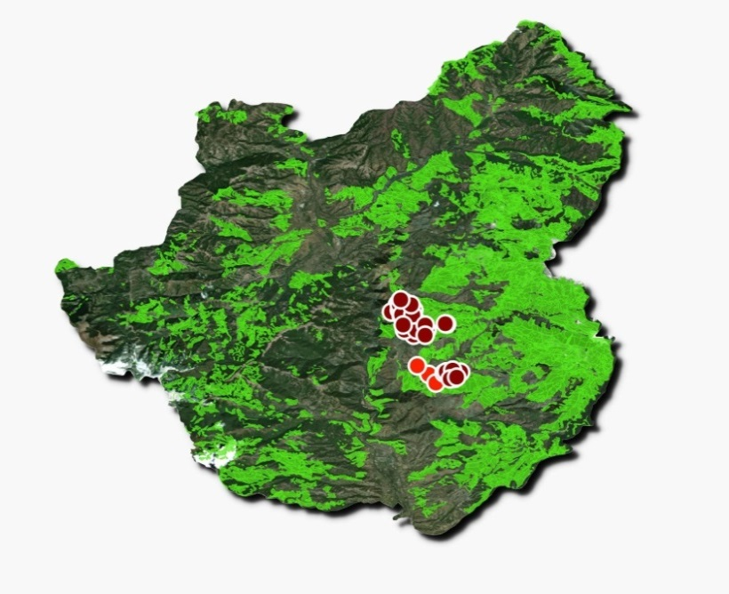
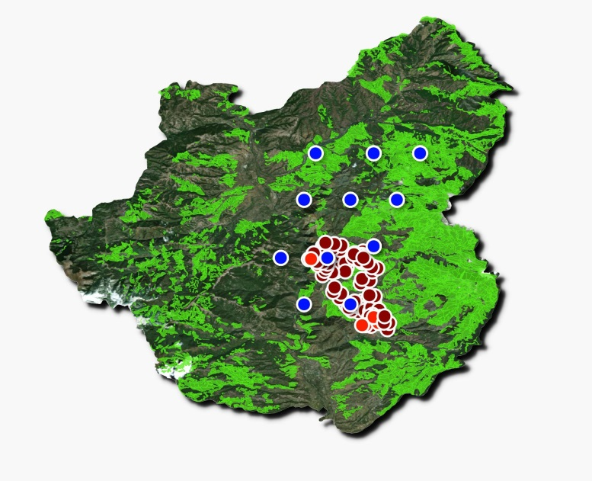
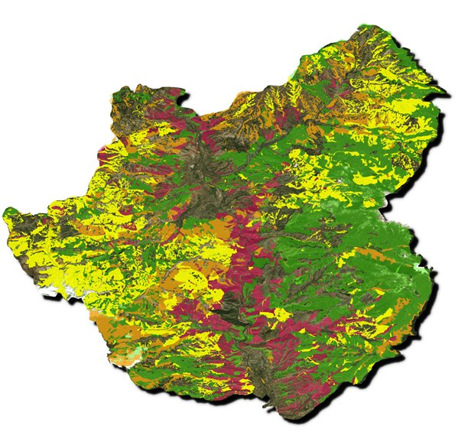
Results
Natural Land Cover, fire detection & monitoring by: a) LSA SAF FRP–Pixel product;
b) Aqua/Terra MODIS sensor & NPP Suomi VIIRS 350 m; c) fire seen by all sensors.
24-25 August 2017
fire occurrence
26-28 August 2017
fire occurrence
Summary of 24-28 August 2017
fire occurrence
Figure 4. Region of forest estates affected by the fire 24-28 August 2017:
  thermal anomalies detected by LSA SAF FRP-Pixel product (blue);
  fire detections by MODIS (red dots); VIIRS (dark red);
  all detections from all satellite sensors for the whole fire period;
  Most of the fire detections coincide.
Maps from State Forest Agency (SFA) of Bulgaria; conifer forest are depicted because most of fires occurred there. http://www.procurement.iag.bg:8080/cgi-bin/lup.cgi

Slide 17
Results
Natural Land Cover, fire detection & monitoring by: a) LSA SAF FRP–Pixel product;
b) Aqua/Terra MODIS sensor & NPP Suomi VIIRS 350 m; c) fire seen by all sensors.
24-25 August 2017
fire occurrence
26-28 August 2017
fire occurrence
Summary of 24-28 August 2017
fire occurrence
Figure 4. Region of forest estates affected by the fire 24-28 August 2017:
  thermal anomalies detected by LSA SAF FRP-Pixel product (blue);
  fire detections by MODIS (red dots); VIIRS (dark red);
  all detections from all satellite sensors for the whole fire period;
  Most of the fire detections coincide.
Considering MODIS and VIIRS fire detections as a reference it seems that
FRP-Pixel product exhibits false alarms 1 or 2 pixels to the north of fire location.
Studies are needed to check on the validity of MSG FRP pixels not confirmed by the reference.

Slide 18
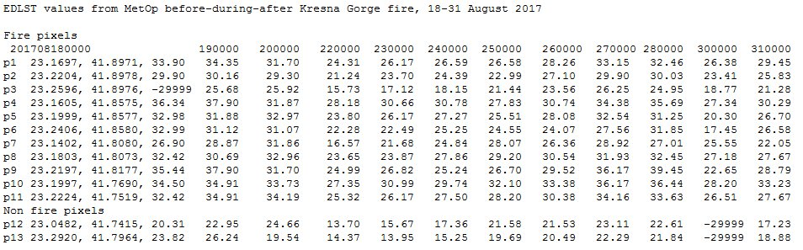
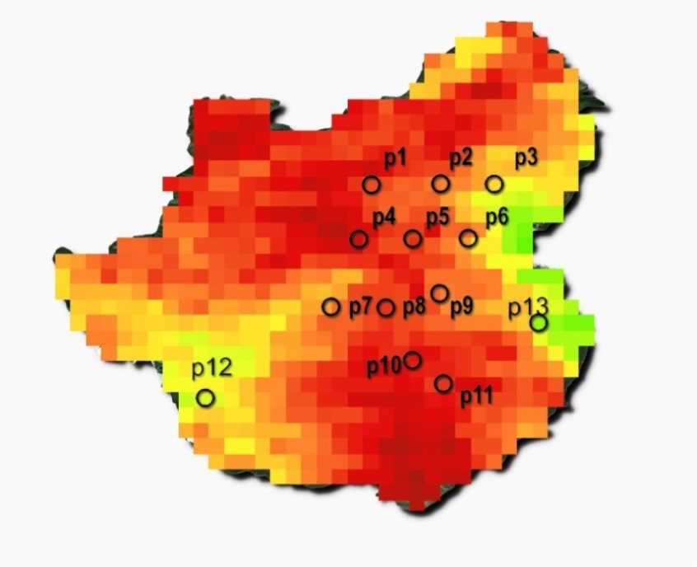
Day-time EDLST from MetOp dynamics before – during – after Kresna fire (24-28 Aug 2017)
18-23 Aug, before
24-28 Aug, during
30-31 Aug, after
For evaluation of EDLST dynamics during fire event
pixels with detected fires and pixels without fires are selected.
Non fire pixel
Non fire pixel

Slide 19
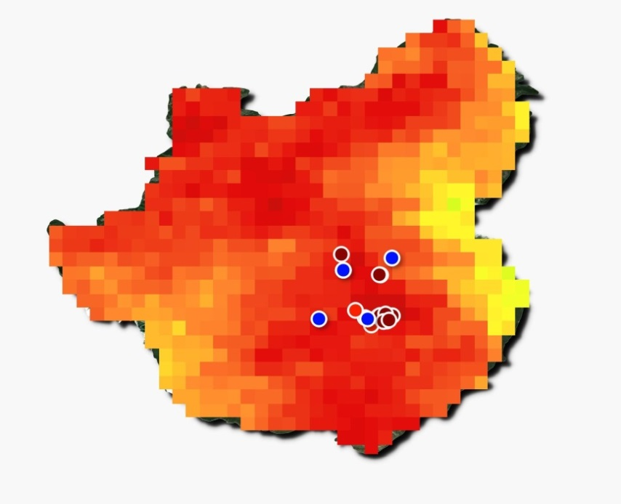
Fire detections in the field of day-time EDLST from MetOp
24 Aug 2017 (first day)
25 Aug 2017 (second day)
Figure 5. Day-time Land Surface Temperature (EDLST from MetOp) with superimposed fire occurrence detected by all sensors
  LSA SAF FRP-Pixel product (blue); fire detections by MODIS (red dots); VIIRS (dark red)

Slide 20

Fire detections in the field of day-time EDLST from MetOp
a)
b)
Figure 6 a) Location of fire (p1 – p11) and non fire (reference) pixels (p12, p13).
b) 18-31 Aug 2017 ED LST course of fire – reference pixels.
Fire pixels exhibit higher EDLST values compared to non fire pixels nevertheless of forest cover type, conifer (p.13) or broadleaved (p12) forests.

Slide 21
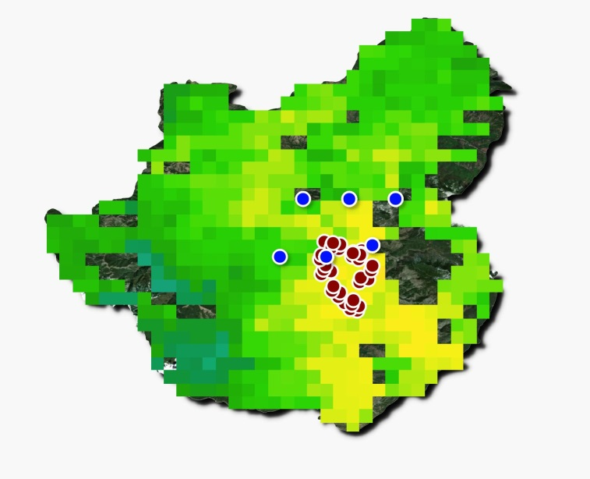
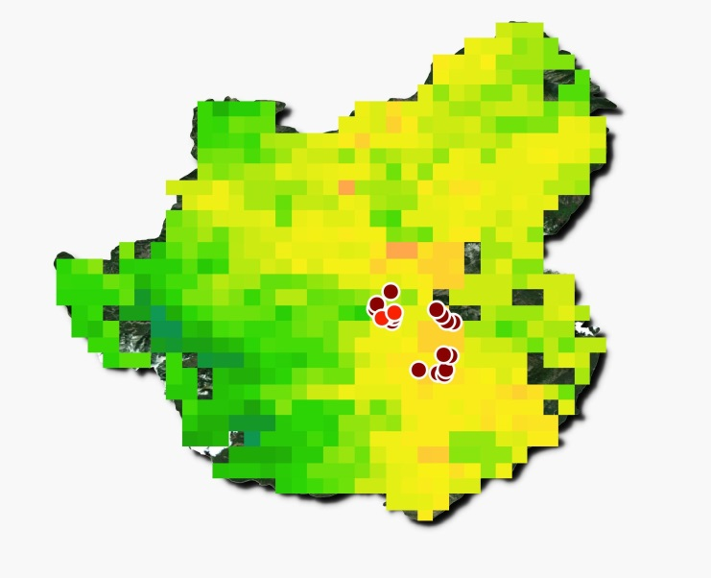
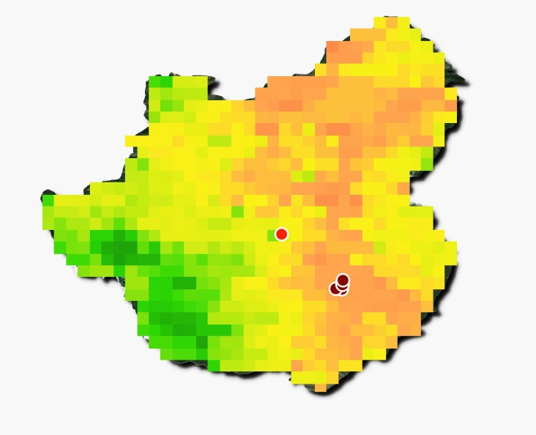
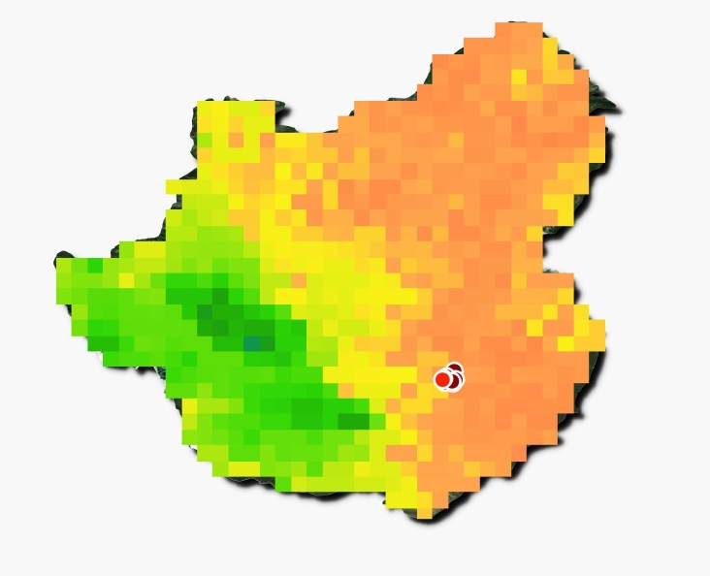
Night-time EDLST from MetOp dynamics before – during – after Kresna fire (24-28 Aug 2017)
24 Aug 2017
25 Aug 2017
EDLST night-time:
Lower values
Less fire pixels detected
During night-time, vegetation fires occur at locations with the highest EDLST values,
  at conifer forests.
26 Aug 2017
27 Aug 2017
Figure 7. Night-time Land Surface Temperature (EDLST from MetOp) with superimposed thermal anomalies detected by all satellite sensors.

Slide 22
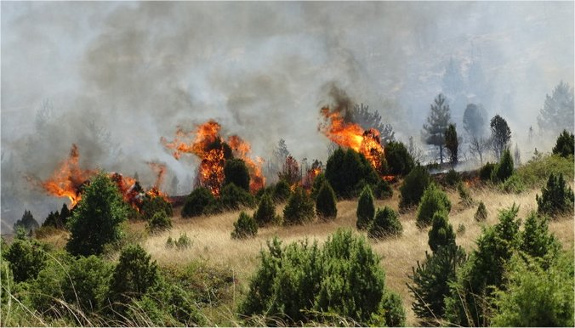
Concluding remarks
In this case the spatial distribution of Land Surface Temperature is indicative for regions most vulnerable to fire occurrence and spread:
  these are regions with persistent high Land Surface Temperature or higher than the mean for the region
    Knowledge about the LST climate are necessary to identify fire prone regions.
  MetOp EDLST provides reliable estimates for location of high fire risk regions (first results);
  Studies are needed to check on the validity of MSG FRP pixels not confirmed by the reference MODIS and VIIRS fire detections.

Slide 23
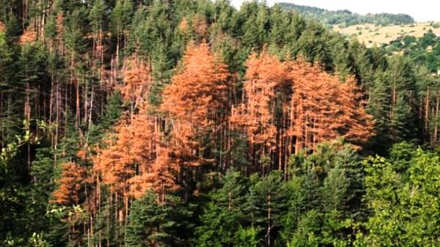
B. Forest disease and desiccation
Photo of affected by disease forest is provided by State Forest Agency, Bulgaria

Slide 24
Regions of the two types of disturbances in forest sustainability
Second type of forest disturbances
Kresna & Simitly
forest estates
Ardino
forest estate
Forest fire
disturbances
Bulgaria
Forest decease and
desiccation

Slide 25
Case study description:
Conifer forest disease, SE Bulgaria
Conifer forests in Forest Estate Ardino are influenced by heavy snow conditions in 2015, causing damages of trees;
Broken trees are affected by disease and start to become dry (Corolla infections);
It was requested by State Forest Agency of Bulgaria, NIMH to identify the area affected by diseased coniferous forest (December 2018).

Slide 26
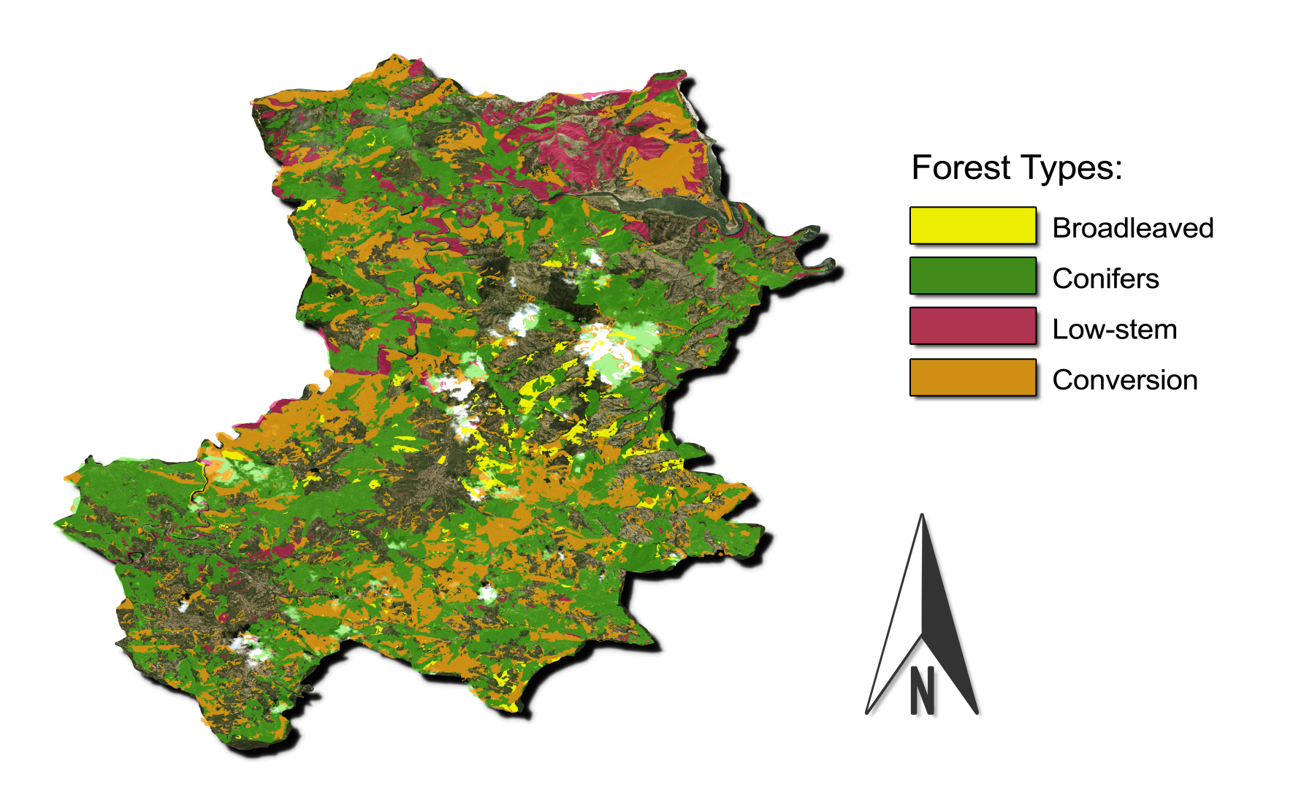
Approach
Test region
Meteosat data are used to infer signatures of coniferous forest functioning, implying differences between health and ill/dry forest.
Functional/structural parameters linking energy and water balance are used:
  Evapotranspiration after LSA SAF ET product
  Land Surface Temperature after LSA SAF LST product.
  Fraction of Vegetation Cover, LSASAF FVC product.
Mass wilting observed after 2015, i.e. in 2016 and 2017 is evaluated in terms of:
  Definition of mean for 2013 and 2014 ET /LST ‘norms’, constructed by differences between health-dry forest.
  Deviation of ET/LST differences between health-dry forest towards norms.
Analyses is performed on a pixel bases.
Forest Estate Ardino, SE Bulgaria
Figure 8. Map of forests types distribution in Ardino Forest Estate, http://www.procurement.iag.bg:8080/cgi-bin/lup.cgi

Slide 27

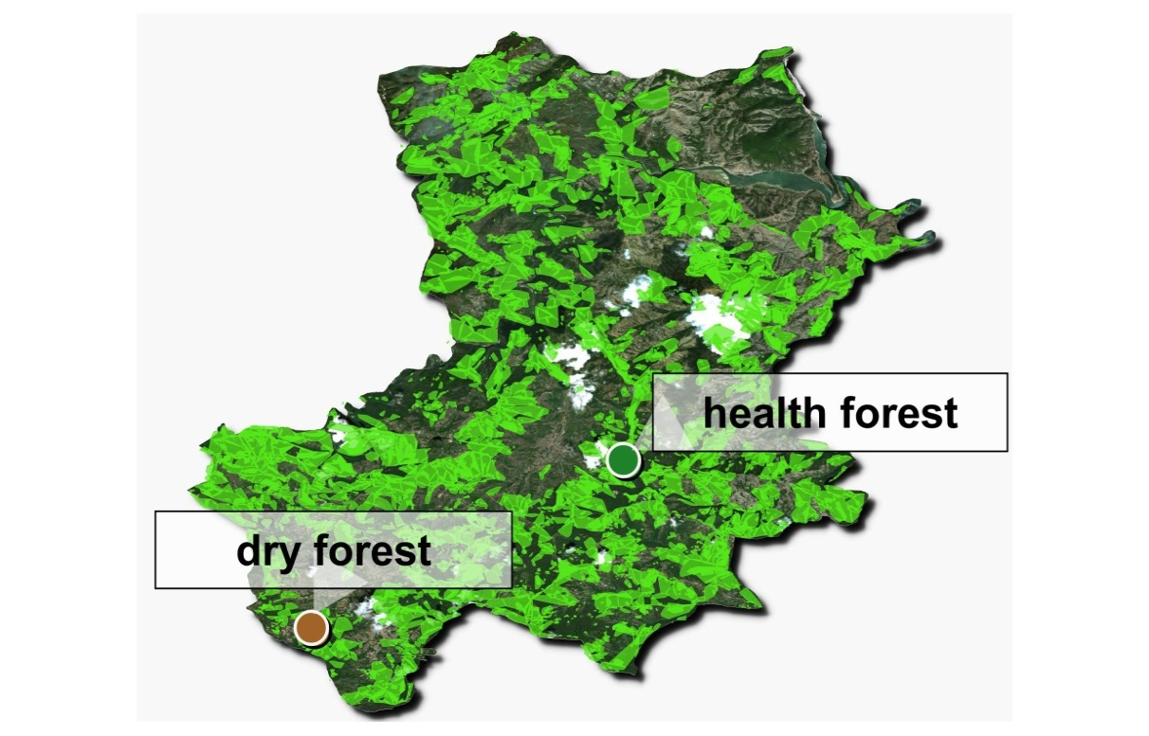
Approach
Forest Estate Ardino, SE Bulgaria
Experimental sites with health & ill forests
Locations with (provided by State Forest Agency, Bulgaria):
health conifer forest and
Dry conifer forests are selected.
Forest affected by disease and consequently becoming dry is indicated as ‘dry’ forest.
Figure 9. Map of conifer forests distribution in Ardino Forest Estate, http://www.procurement.iag.bg:8080/cgi-bin/lup.cgi

Slide 28
Approach
Dataset
LSA SAF LST at 0900 UTC +/-30 min averaged values for May-September 2007-2018.
LSA SAF ET at 0900 UTC +/-30 min averaged for May-September 2010-2018.
LSA SAF FVC for May-September 2007-2018.
Soil Moisture Availability, SMA for the region of SYNOP station in the region (based on SVAT model output).
Forest Estate Ardino, SE Bulgaria
Experimental design
The region is characterized by mean ET, LST, FVC values to check for natural differences between health-dry forest stands.
Evaluation for anomalies in behavior before and after the forest disease.
Figure 10. Areas of conifer forests distribution in Ardino, http://www.procurement.iag.bg:8080/cgi-bin/lup.cgi

Slide 29
Results
a)
1) Mean seasonal course of LSASAF ET evapotranspiration of studied health and ill forest stands
b)
d)
Years, 2010-2018
Years, 2010-2018
c)
e)
Years, 2010-2018
Years, 2010-2018
Figure 11. Seasonal course of monthly mean (May-September) Evapotranspiration (LSA SAF ET) at the specific fraction of vegetation cover (LSA SAF FVC) for dry and health forest stands, (2010-2018).

Slide 30
1) Mean seasonal course of LSASAF ET evapotranspiration of studied health and ill forest stands
Forest affected by disease and consequently becoming dry is indicated as ‘dry’ forest;
‘Dry’ site exhibits lower evapotranspiration from May to September;
This course is valid for each year, 2010-2018 due to local reasons;
The largest ET difference appears in July 2015, 2016, 2017, after ‘dry’ forest was affected by disease.
Years, 2010-2018
Figure 11c. Seasonal course of monthly mean (July) Evapotranspiration (LSA SAF ET) at the specific fraction of vegetation cover (LSA SAF FVC) for the dry and health forest stands.

Slide 31
1) Mean seasonal course of land surface temperature, LSASAF LST of studied health and ill forest stands
a)
d)
Years, 2010-2018
b)
e)
Years, 2010-2018
Years, 2010-2018
c)
Figure 12. Seasonal course of monthly mean (May-September) Land Surface Temperature LSA SAF LST for the dry and health forest stands, (2010-2018).
Years, 2010-2018

Slide 32
1) Mean seasonal course of land surface temperature, LSASAF LST of studied health and ill forest stands
c)
LST is higher at ‘dry’ forest site (Fig. 12);
This trend is preserved for the whole May-September period of 2010-2018;
This implies that ‘dry’ sites might be more susceptible to environmental constrains;
The largest difference becomes in July 2015, 2016, 2017.
Years, 2010-2018
Figure 12c. Seasonal course of monthly mean Land Surface Temperature LSA SAF LST in July, for the dry and health forest stands, (2010-2018).

Slide 33
Comparison: Dry and health forest functioning seen by Meteosat
a)
b)
dry health
Years, 2010-2018
Years, 2010-2018
Figure 13. Characterizing conifer ecosystem functioning of health and ill conifer forest stands in July (2010-2018) by Meteosat:
  a) Evapotranspiration, LSA SAF (ETxFVC) 0900 UTC;
  b) Land Surface Temperature LSA SAF LST 0900 UTC.
Dry forest shows a disturbed functioning (lower evapotranspiration and higher skin temperature) compared to the health forest.
The maxima occurs in July 2015, 2016, 2017 after it is affected by disease and consequently desiccates.

Slide 34
2) Deviation of coniferous forest functioning as characteristics of disease
Mean value of deviation of ET/LST between health and “dry” forest is introduces as a NORM (constructed on the bases of 2013, 2014).
a)
b)
2016
2017
2017
2018
2018
2015
2015
2013
2016
2013
2014
years
years
Figure 14. Characterizing deviation of conifer ecosystems functioning from ‘norms’ (2013-2014) after disease attack in 2015 by mean ET in a) June; b) July; c) August.
c)
Deviation of forest functioning due to decease starts to increase from June 2015, 2016, 2017, and becomes maxima in July.
From 2015 starts an increased deviation in ET from the NORM, being maximum in July (Fig. 14b).
This implies that evapotranspiration in health forest increases, while in 2015, 2016, 2017 it decreases in dry forest (although the soil moisture availability is positive, Fig. 14d).
2018
2014
2015
2013
2016
2017

Slide 35
Mean value of deviation of ET/LST between health and “dry” forest is introduces as a NORM (constructed on the bases of 2013, 2014).
d)
e)
2018
2013
2015
2014
2016
2017
years
Figure 14. Characterizing deviation of conifer ecosystems functioning from ‘norms’ (2013-2014) after disease attack in 2015 for:
  d) Soil Moisture Availability for years affected by disease
  e) mean LSASAF LST in July.
During 2015, 2016, 2017 due to disease forest functioning is disturbed and LST increases;
Thus the deviation of LST from the NORM in “ill” years becomes even negative because the surface temperature of ‘dry’ forest increases;
These trend is better revealed in July, when SMA is still positive, being not a disturbing factor.
In August soil moisture is limited and becomes additional forest functioning disturbing factor for all tested years; this reduce evapotranspiration in both health/dry forests;
2018 is a wet year, SMA does not become negative; no disease is practically observed

Slide 36
Concluding remarks
Both parameters (LSASAF ET/LST) exhibit sensitivity to forest drying after corolla attacks in 2015, 2016, 2017; thus the deviations from the normal state and actual functioning is recommended to be used as a quantitative index for identification of affected conifer forests.
July is the most sensitive month for detection of the affected areas.
It is planned these findings to be applied for the whole forest estate Ardino to identify the total area of drying forest.
Areas with lower SMA are more susceptible to decease.
Dry forest spots are more susceptible to fire burning; this is another reason for the need of their identification.
Satellite information with a higher spatial resolution is recommended to be used.

Slide 37

Acknowledgements:
This study is funded by EUMETSAT, the European Organisation for the Exploitation of Meteorological Satellites in the frame of SALGEE Project 2019.
LSA SAF is acknowledged for providing archive data for EDLST.
The Forest Agency of Bulgaria has requested to define the corolla affected conifer forest for the selected Forest Estate and provided information for the location of health and ill forest sites for the selected Forest estate Ardino.
Agrolesproject Ltd., Bulgaria is acknowledged for decoded and providing files of the land cover for the forest estates used in current study.

