Slide 1
Monitoring vegetation conditions and disturbances using satellite derived Climate Data Records
Contributions
Carlos da Camara
Ricardo Trigo
Ana Bastos
Isabel Trigo
Virgílio Bento
David Barriopedro
Sergio Vicente-Serrano
….
Célia M. Gouveia
celia.gouveia@ipma.pt
Instituto Português do Mar e da Atmosfera (IPMA), Lisbon, Portugal.
Instituto Dom Luiz (IDL), Faculdade de Ciências, Universidade de Lisboa, Lisbon, Portugal.
SALGEE 2019, Darmstadt, 14-17 October2019

Slide 2
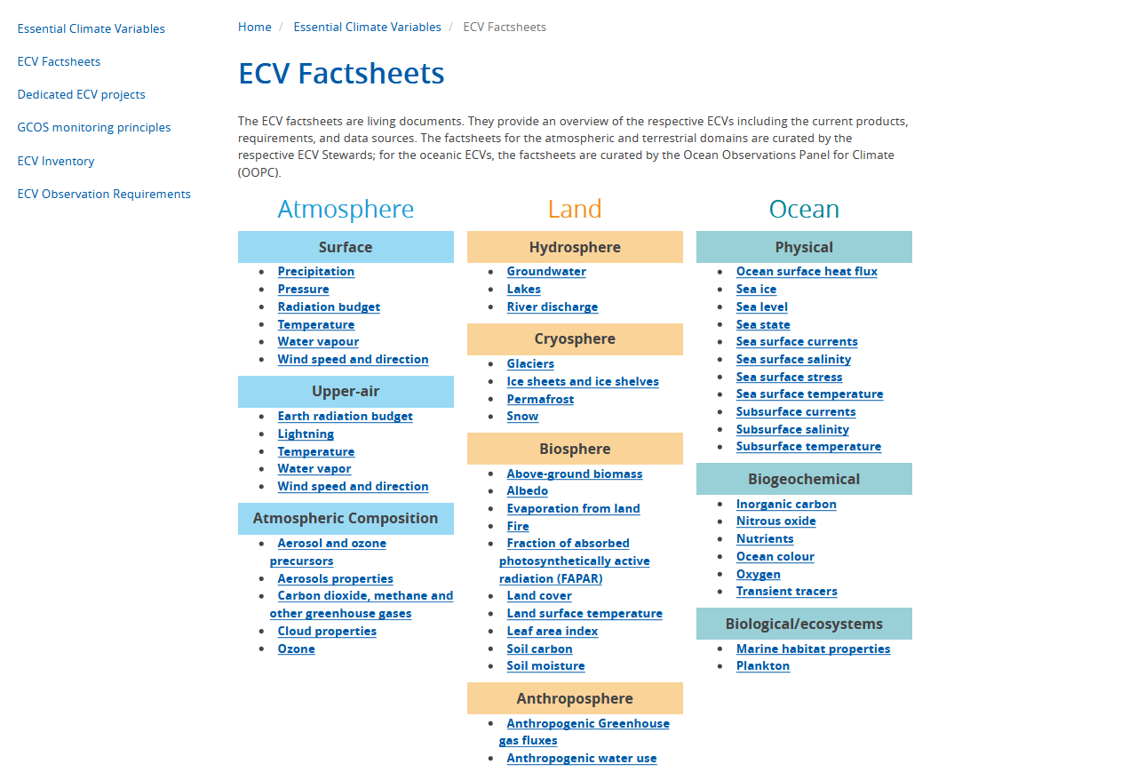
New Essential Climate Variables
from https://gcos.wmo.int/en/essential-climate-variables/ecv-factsheets, 2016)
SALGEE 2019, Darmstadt, 14-17 October2019

Slide 3
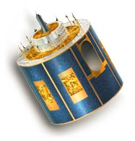




CDOP-2 MSG Produced
Data Records
Surface Radiation Budget
Vegetation State
DSSF
↓Surface Short-wave Flux
DSLF
↓Surface Long-wave Flux
Fraction Vegetation Cover
Period:
2004 - 2015
LST
Land Surface Temperature
ALBEDO
fAPAR
LAI
10-day
10-day
15-min
daily
daily
LSE
Land Surface Emissivity
Wild Fires
Water Stress
Fire Detection
Fire Risk Map
Evapotranspiration
Fire Radiative Power
Pixel
Reference Evapotranspiration
15-min
hourly
Fire Radiative Power
Gridded
SALGEE 2019, Darmstadt, 14-17 October 2019

Slide 4
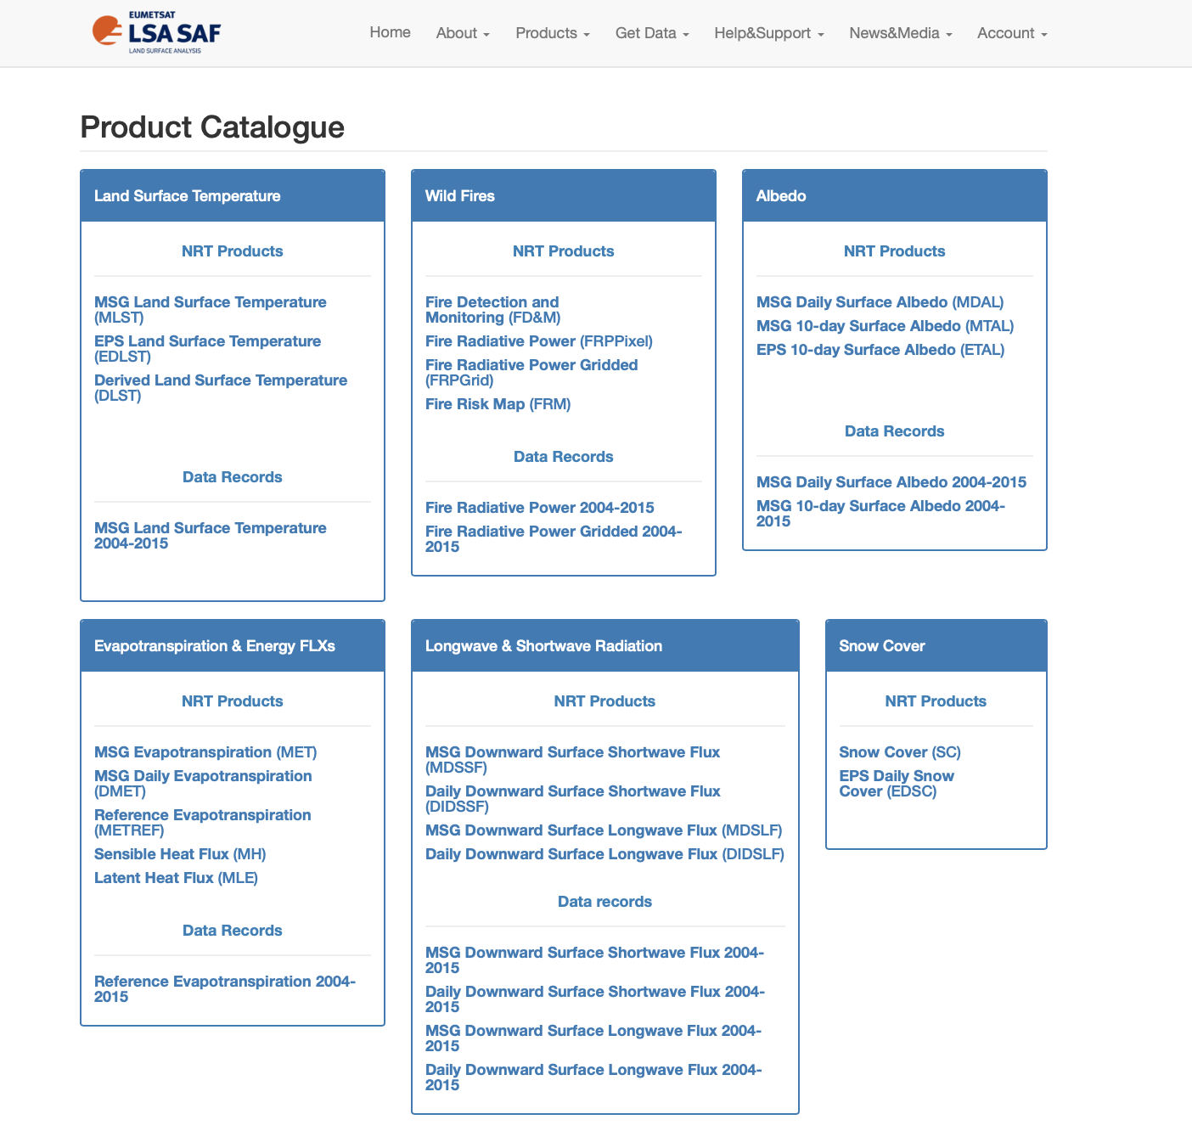
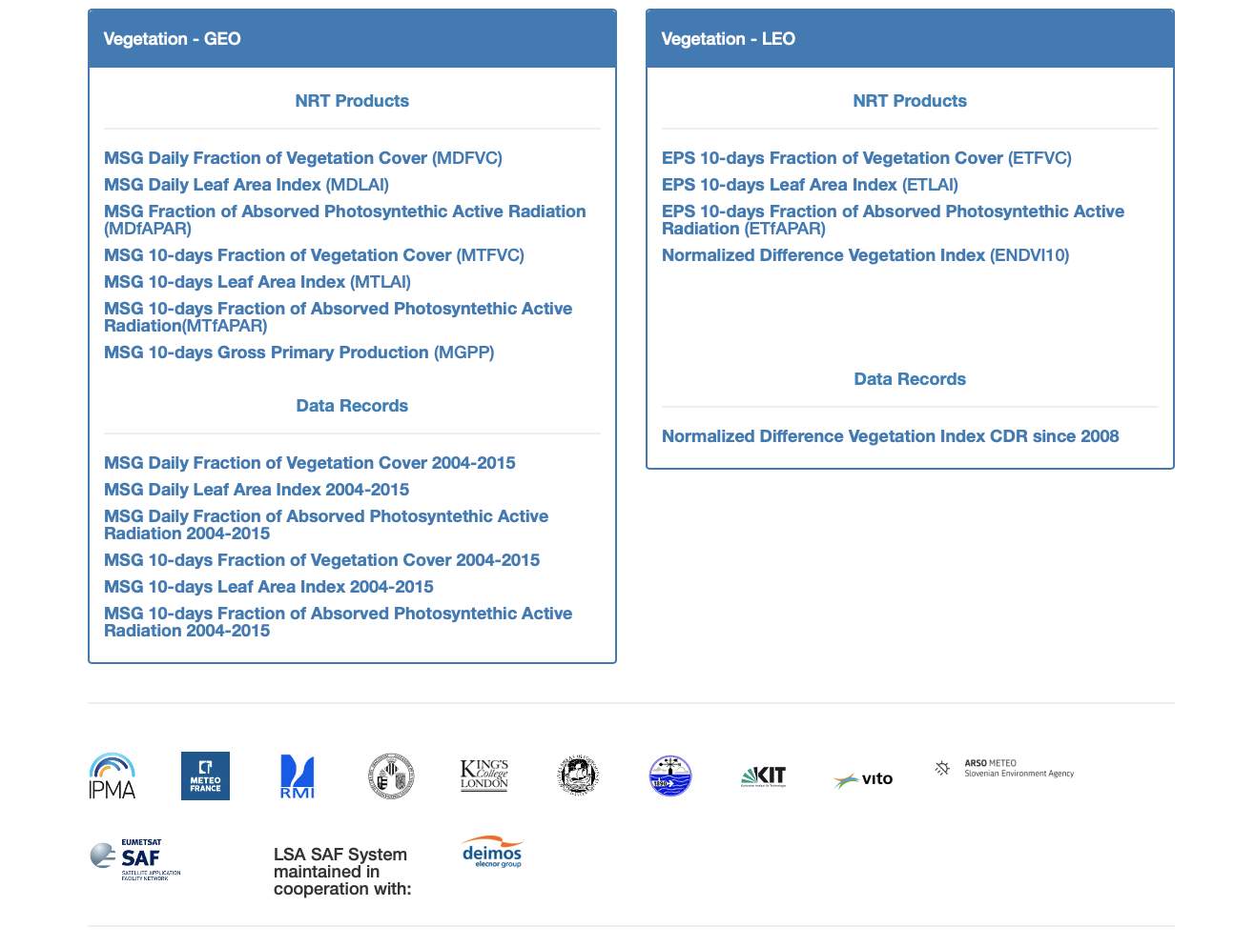
CDR –Climate Data Records
SALGEE 2019, Darmstadt, 14-17 October 2019

Slide 5
CDOP-3 MSG Data Records V2
Surface Radiation Budget
Vegetation State
Period:
2004
|
2020
DSSF
↓Surface Short-wave Flux
DSLF
↓Surface Long-wave Flux
FVC
Fraction Vegetation Cover
LST
Land Surface Temperature
ALBEDO
fAPAR
LAI
GPP
Gross Primary Production
LSE
Land Surface Emissivity
Wild Fires
Surface Energy Fluxes
FD&M
Fire Detection
FRM
Fire Risk Map
ET0
Reference Evapotranspiration
FRE
Fire Radiative Energy
FRP
Fire Radiative Power
LE&H
Latent and Sensible Heat Fluxes
ET
Evapotranspiration
SALGEE 2019, Darmstadt, 14-17 October 2019

Slide 6
CDOP-3 MSG Data Records V2
Surface Radiation Budget
Vegetation State
Period:
2004
|
2020
DSSF
↓Surface Short-wave Flux
DSLF
↓Surface Long-wave Flux
FVC
Fraction Vegetation Cover
LST
Land Surface Temperature
ALBEDO
fAPAR
LAI
GPP
Gross Primary Production
LSE
Land Surface Emissivity
Wild Fires
Surface Energy Fluxes
FD&M
Fire Detection
FRM
Fire Risk Map
ET0
Reference Evapotranspiration
FRE
Fire Radiative Energy
FRP
Fire Radiative Power
LE&H
Latent and Sensible Heat Fluxes
ET
Evapotranspiration
SALGEE 2019, Darmstadt, 14-17 October 2019

Slide 7
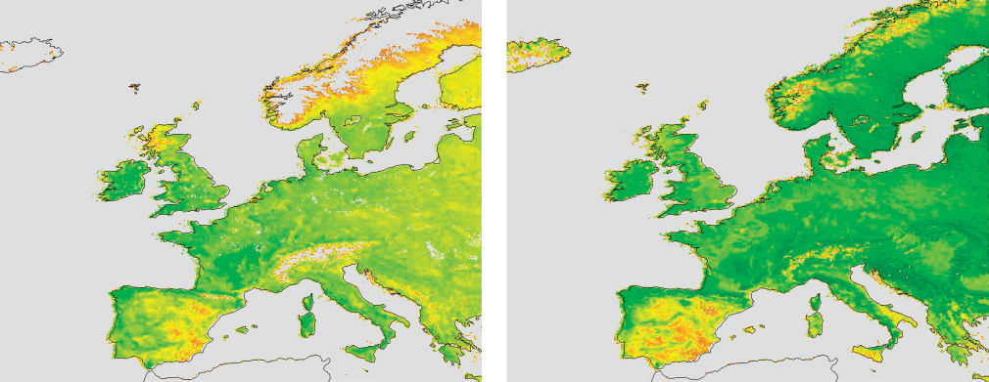

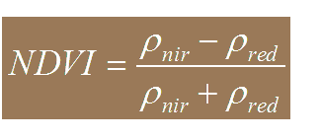
Monitoring Vegetation Conditions
  Vegetation Indices
  NDVI was successfully tested (e.g., in regions characterized by Mediterranean climates) to monitor vegetation dynamics
SPRING
SUMMER
GIMMS NDVI from 1982-2002
Gouveia et al. (2008)
SALGEE 2019, Darmstadt, 14-17 October 2019

Slide 8
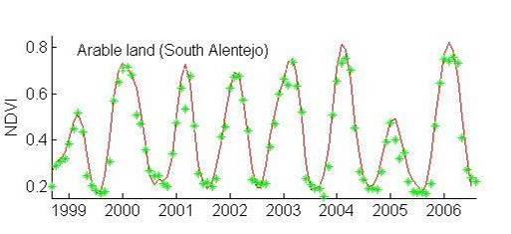
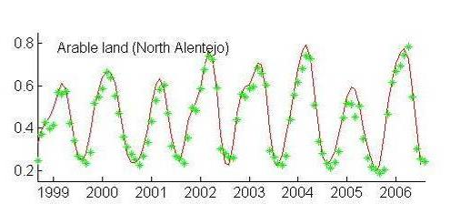
Monitoring Vegetation Conditions
  Vegetation Indices
  Monthly time-series of NDVI (1999–2006) for different land cover types
SPOT VEGETATION NDVI from 1999-2006
  During 2004/05 Iberian Peninsula was hit by one of the two worst drought episodes in the last 60 years.
SALGEE 2019, Darmstadt, 14-17 October 2019

Slide 9
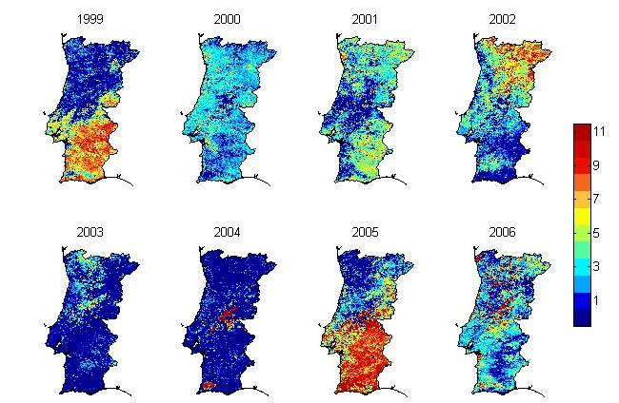
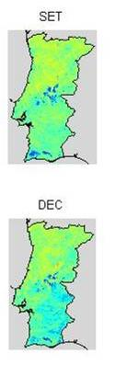
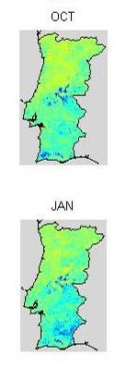
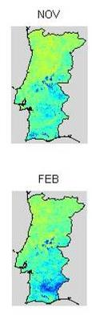
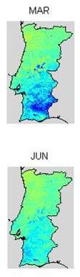
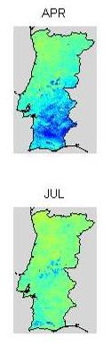
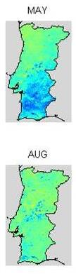

Monitoring Vegetation Conditions
  Vegetation Indices
  Drought persistence obtained by adding up (for each pixel) the number of months with NDVI anomalies < -0.025).
  NDVI anomalies from September to August of the year 2004/2005
Gouveia et al. (2009)
SALGEE 2019, Darmstadt, 14-17 October 2019

Slide 10
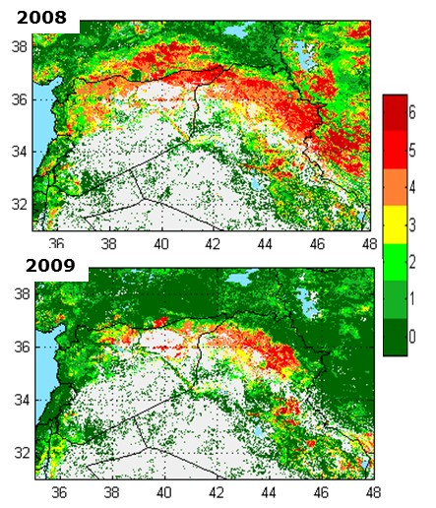
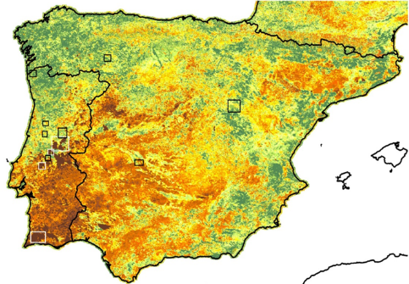
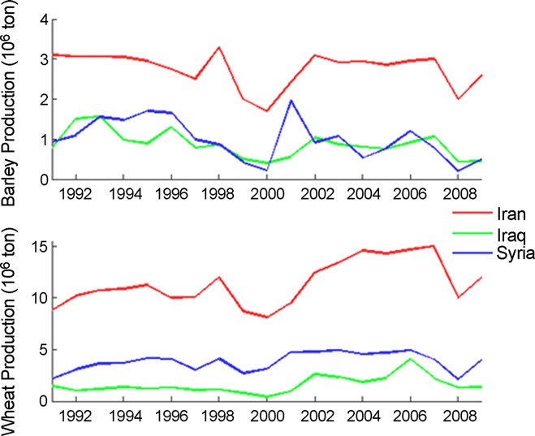
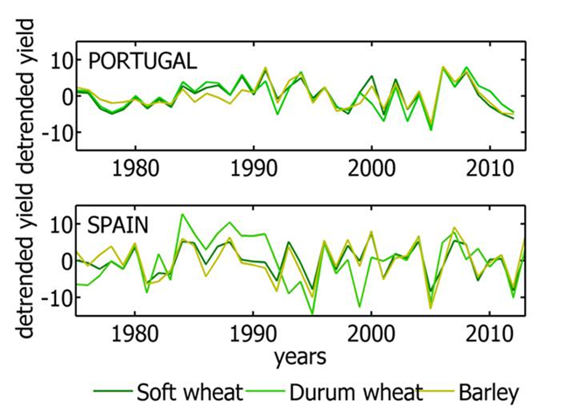
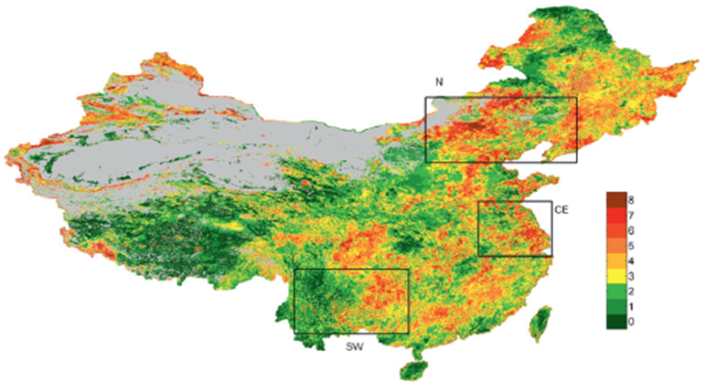
Monitoring Vegetation Conditions
  Vegetation Indices
  This methodology was applied for several different regions and biomes
2005
  … and related with
  crop productions
2010
Gouveia et al. (2012)
Trigo et al. (2010)
(Barriopedro et al., 2012)
SALGEE 2019, Darmstadt, 14-17 October 2019

Slide 11
Monitoring Vegetation Conditions
  Vegetation Indices: FVC from LSA –SAF
FVC Monthly anomalies
2005 2007
2018 2007
SALGEE 2019, Darmstadt, 14-17 October 2019

Slide 12
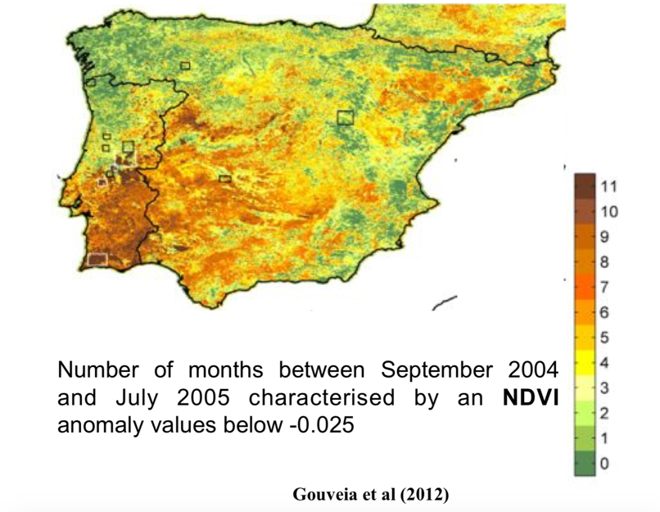
Monitoring Vegetation Conditions
  Vegetation Indices: FVC from LSA –SAF
2005
2007
8
7
6
5
4
3
2
1
2018
Number of months with FVC monthly anomalies lower than -0.025 (Gouveia et al., 2009, 2012)
SALGEE 2019, Darmstadt, 14-17 October 2019

Slide 13
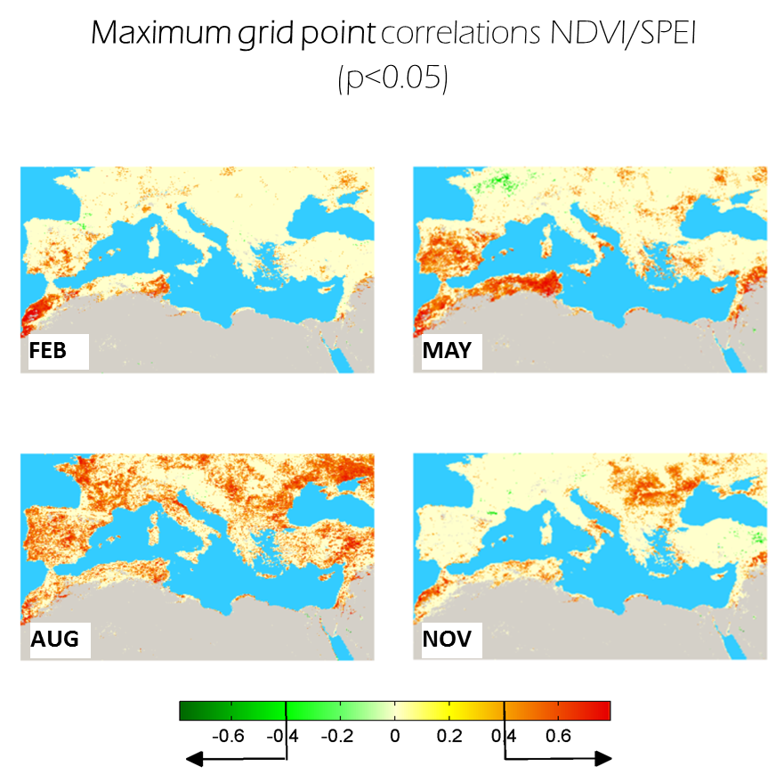
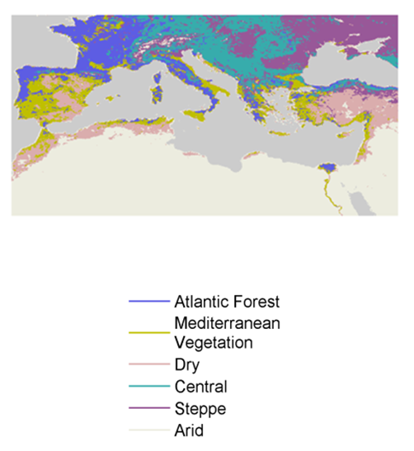
Monitoring Vegetation Disturbances: Droughts
  Vegetation indices and Drought
  NDVI and SPEI (Mediterranean Region)
Gouveia et al (2017, Global and Planetary Change)
SALGEE 2019, Darmstadt, 14-17 October 2019

Slide 14
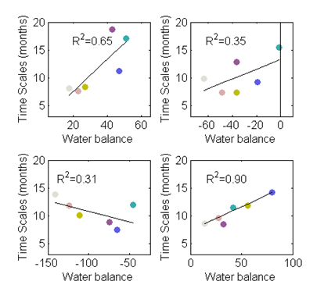
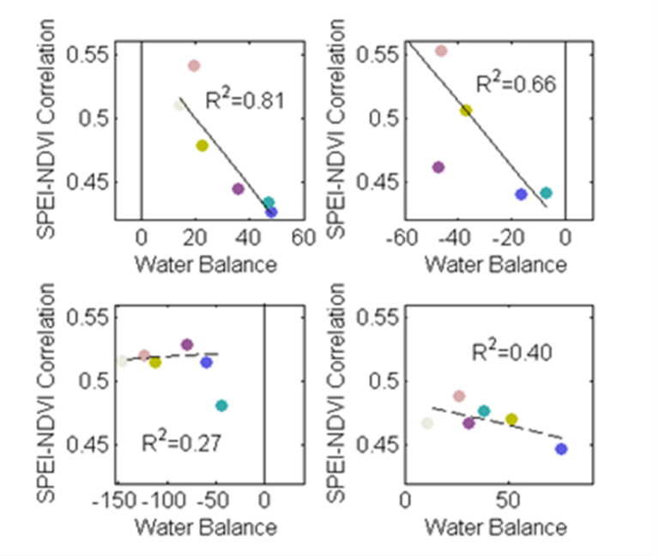
Monitoring Vegetation Disturbances: Droughts
  Vegetation indices and Drought
FEB
MAY
  NDVI and SPEI (Mediterranean Region)
AUG
NOV
Gouveia et al (2017, Global and Planetary Change)
Higher correlations in summer (other seasons) correspond to higher (lower) time scales.
Higher correlations for Mediterranean, Arid and Steppe clusters for lower values of WB
SALGEE 2019, Darmstadt, 14-17 October 2019

Slide 15
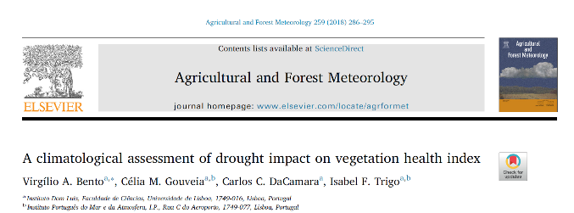

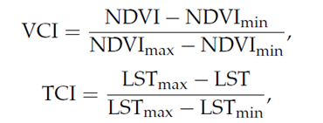
Monitoring Vegetation Disturbances: Droughts
  Vegetation indices and Drought
  VHI and SPEI (Mediterranean Region)
Kogan, 1997
GIMMS, 8 km, 15days
Princeton University, 0,5°, hourly
α = 0.5
(Kogan, 1997, 2001)
Significant correlations were found mainly in semiarid and dry sub-humid regions, i.e. vegetation health is more(less) determined by drought in semiarid (humid) regions, with the exception of the humid northern Iberia and some mountainous region
Spatial distribution of the Pearson’s linear correlation coefficient (a) between VHI of the maximum NDVI month and the SPEI time scale (b) for which the correlation is maximum.
SALGEE 2019, Darmstadt, 14-17 October 2019

Slide 16
Monitoring Vegetation Disturbances: Droughts
  Vegetation indices and Drought
  VHI and SPEI (Mediterranean Region)
The relative contribution of VCI and TCI depends mostly on vegetation cover: VCI more relevant in water dependent semiarid regions and TCI in solar radiation dependent humid regions.
The corresponding weights to VHI are not necessarily equal.
Distribution of α (top) for the different aridity classes and (bottom left) for the IGBP classes of landcover.
SALGEE 2019, Darmstadt, 14-17 October 2019

Slide 17
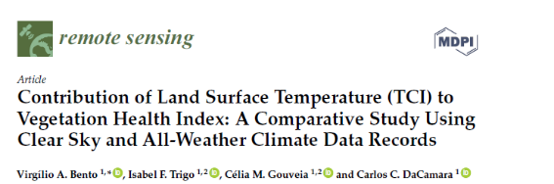
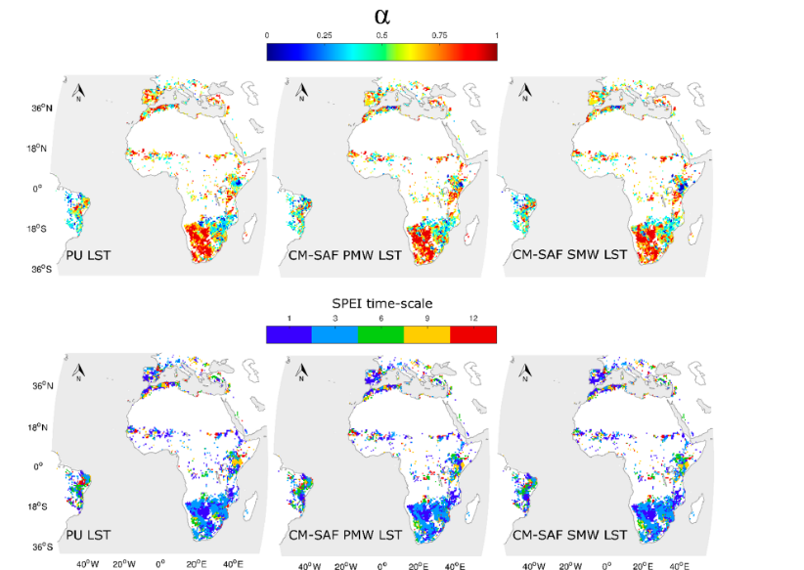

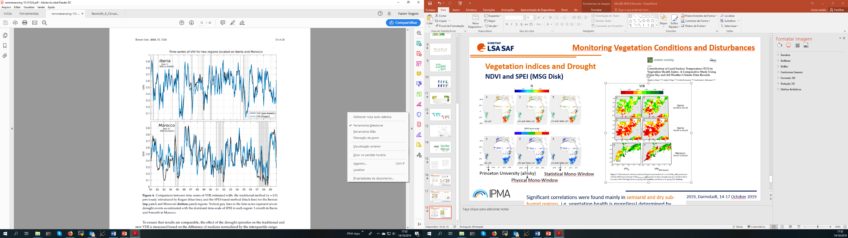
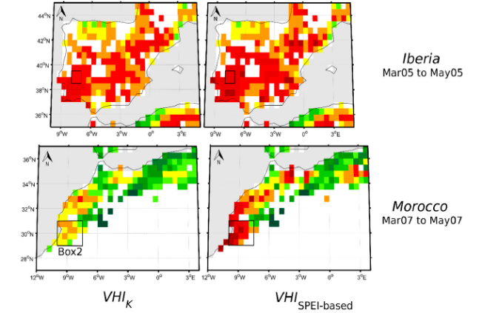
Monitoring Vegetation Disturbances: Droughts
  Vegetation indices and Drought
  NDVI and SPEI (MSG Disk)
Results may be viewed as a promising first step to the development of a future MSG/MTG SPEI-based VHI satellite drought monitoring based on a near-real time operational product, presenting the added benefit of taking into consideration the response in terms of vegetation health to moisture and temperature conditions over the area encompassed by the Meteosat viewing disk.
Princeton University (all-sky)
Statistical Mono-Window
A comparison between the traditional VHI and the VHI_{SPEI-based} by assessing the capability of capturing a drought event as identified by SPEI VHI_{SPEI-based} represents better the drought episodes.
Physical Mono-Window
SALGEE 2019, Darmstadt, 14-17 October 2019

Slide 18
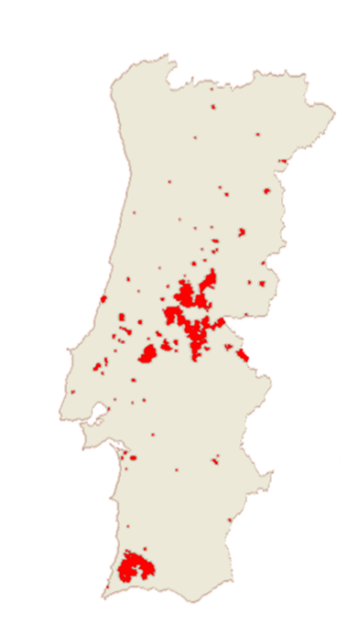
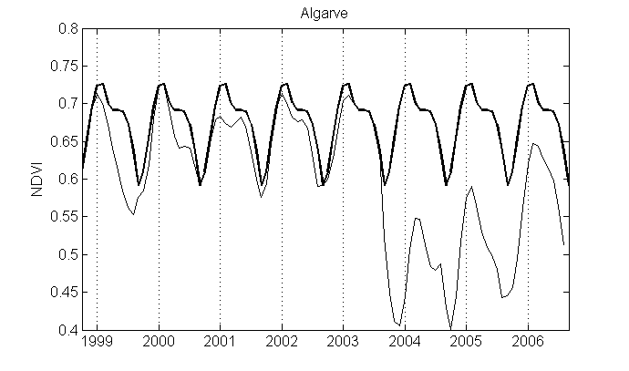


Monitoring Vegetation Disturbances: Fires
  Vegetation Recovery after large fires
NDVI from VEGETATION/SPOT
A mono-parametric model performed in order to fit the dynamics of the regeneration process
C
“year of monthly maxima”
a
“fire damage ”
Regression Model
SALGEE 2019, Darmstadt, 14-17 October 2019

Slide 19

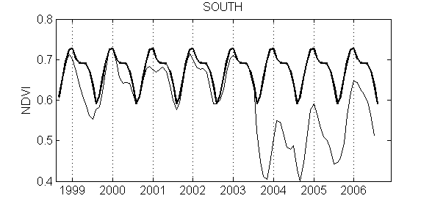
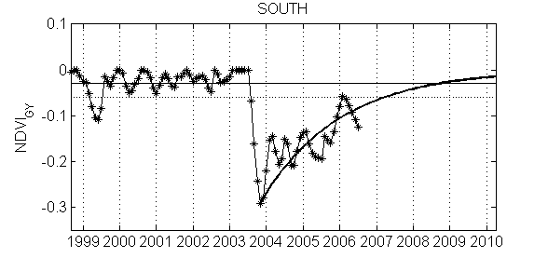

Monitoring Vegetation Disturbances: Fires
  Vegetation Recovery after large fires
y(t)=NDVI(t)−NDVI∗(t)
The level of recovery is defined as 90% of the mean value of y during the pre fire period.
y(t) = a.e^{−bt}
SALGEE 2019, Darmstadt, 14-17 October 2019

Slide 20
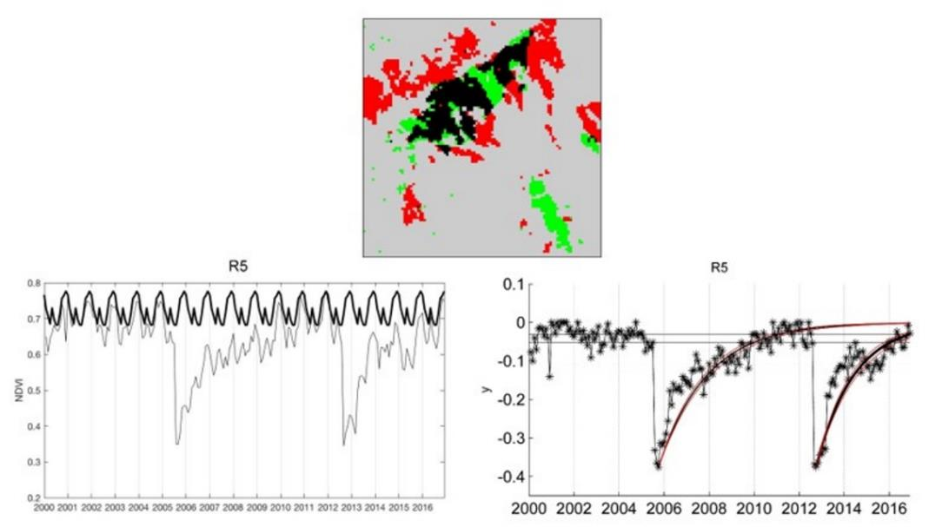
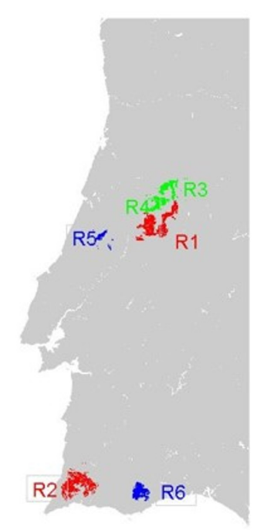

Monitoring Vegetation Disturbances: Droughts
Applications – NDVI MODIS DATA
The model is robust and may be applied to data from several sensors with different spatial resolutions.
The development of reliable techniques to assess post fire vegetation recovery features in conditions of recurrent fires revealed to be crucial
tR (2005) > tR (2012) ($\sim$30 months)
SALGEE 2019, Darmstadt, 14-17 October 2019

Slide 21
  Thank you for your attention!
celia.gouveia@ipma.pt
SALGEE 2019, Darmstadt, 14-17 October 2019

