Slide 1
Assessing drought impacts on vegetation activity and productivity using remote sensing data
Contributions
Carlos da Camara
Ricardo Trigo
Ana Bastos
Sergio Vicente-Serrano
Catarina Alonso
Patricia Páscoa
….
Célia M. Gouveia
celia.gouveia@ipma.pt
Instituto Português do Mar e da Atmosfera (IPMA), Lisbon, Portugal.
Instituto Dom Luiz (IDL), Faculdade de Ciências, Universidade de Lisboa, Lisbon, Portugal.
SALGEE 2019, Darmstadt, 14-17 October2019

Slide 2
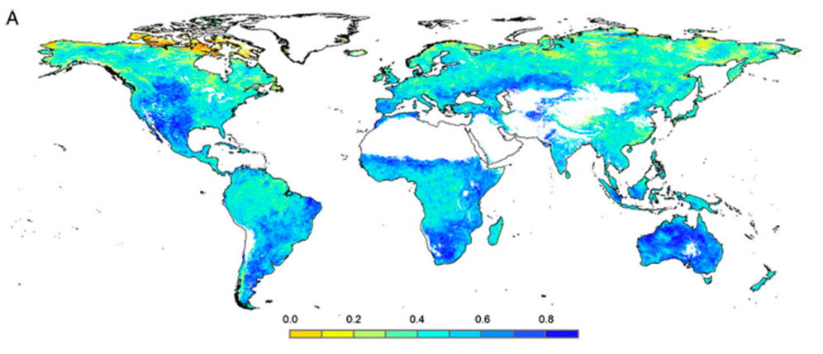
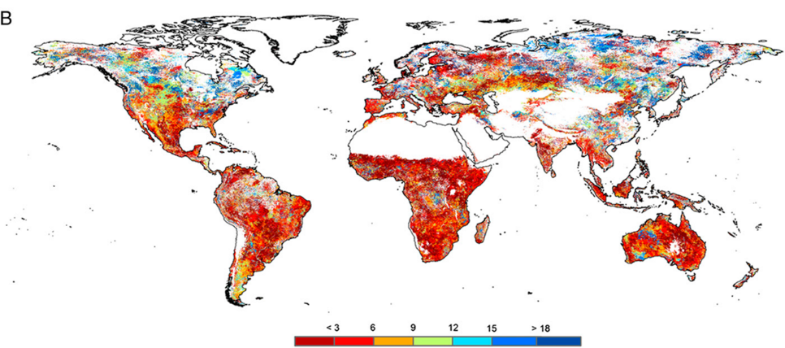
Drought impacts on vegetation
Vegetation indices and Drought
NDVI and SPEI (global)
maximum correlations between SPEI and GIMMS-NDVI for the period 1981–2006
… and correspondent time-scales
Vicente-Serrano et al (2013), PNAS
SALGEE 2019, Darmstadt, 14-17 October 2019

Slide 3
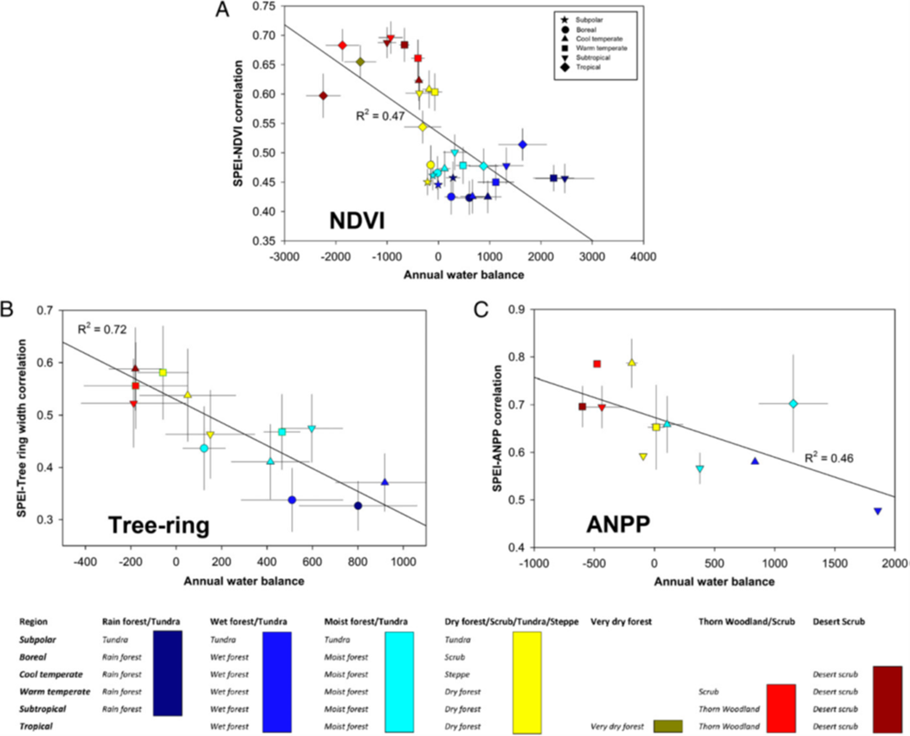
Drought impacts on vegetation
Vegetation indices and Drought
NDVI and SPEI (global)
… and the average annual water balance across the world biomes
Vicente-Serrano et al (2013), PNAS
SALGEE 2019, Darmstadt, 14-17 October 2019

Slide 4
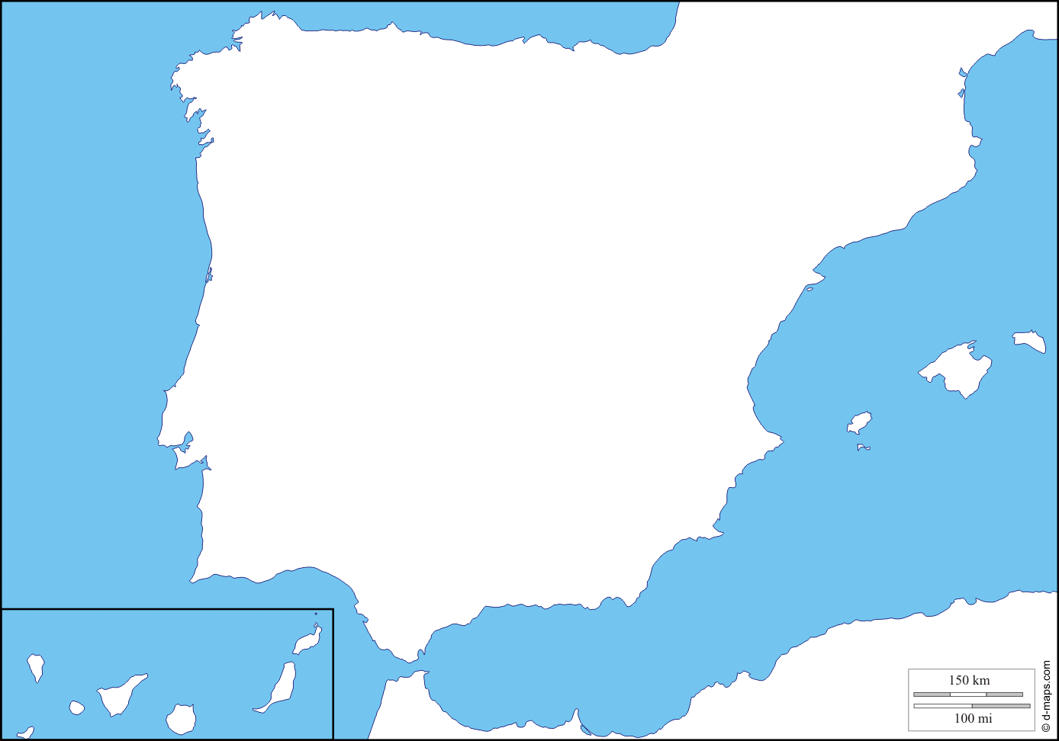
Vegetation Greenness/Browning
Vegetation trends
accumulated annual precipitation
annual NDVI
Temporal evolution averaged and corresponding linear trends
Spatial patterns of significant trends for the period 1982-2012 (GIMMS). Trend tests were chosen in accordance with the presence or absence of autocorrelation in the time series.
SALGEE 2019, Darmstadt, 14-17 October 2019

Slide 5
Vegetation Greenness/Browning
NDVI residual Trends
$${NDVI}_{sim}=a.{Prec}_{i }+b.{Prec}_{i−1}+c.{Prec}_{i−2}+d$$
$${NDVI}_{rediduals}={NDVI}_{}−{NDVI}_{sim}$$
Spatial patterns of significant trends of residuals of NDVI for the period 1982-2012.
Trend tests were chosen in accordance with the presence or absence of autocorrelation in the time series.
SALGEE 2019, Darmstadt, 14-17 October 2019

Slide 6
Vegetation Greenness/Browning
Land cover changes using Corine Land Cover map
2000-1990
2006-2000
% area land improvement is greater than the % area land degradation for forests and non-irrigated arable land;
% area land degradation exceeds % area land improvement for transitional woodland-shrub, arable irrigated and annual crops;

Slide 7
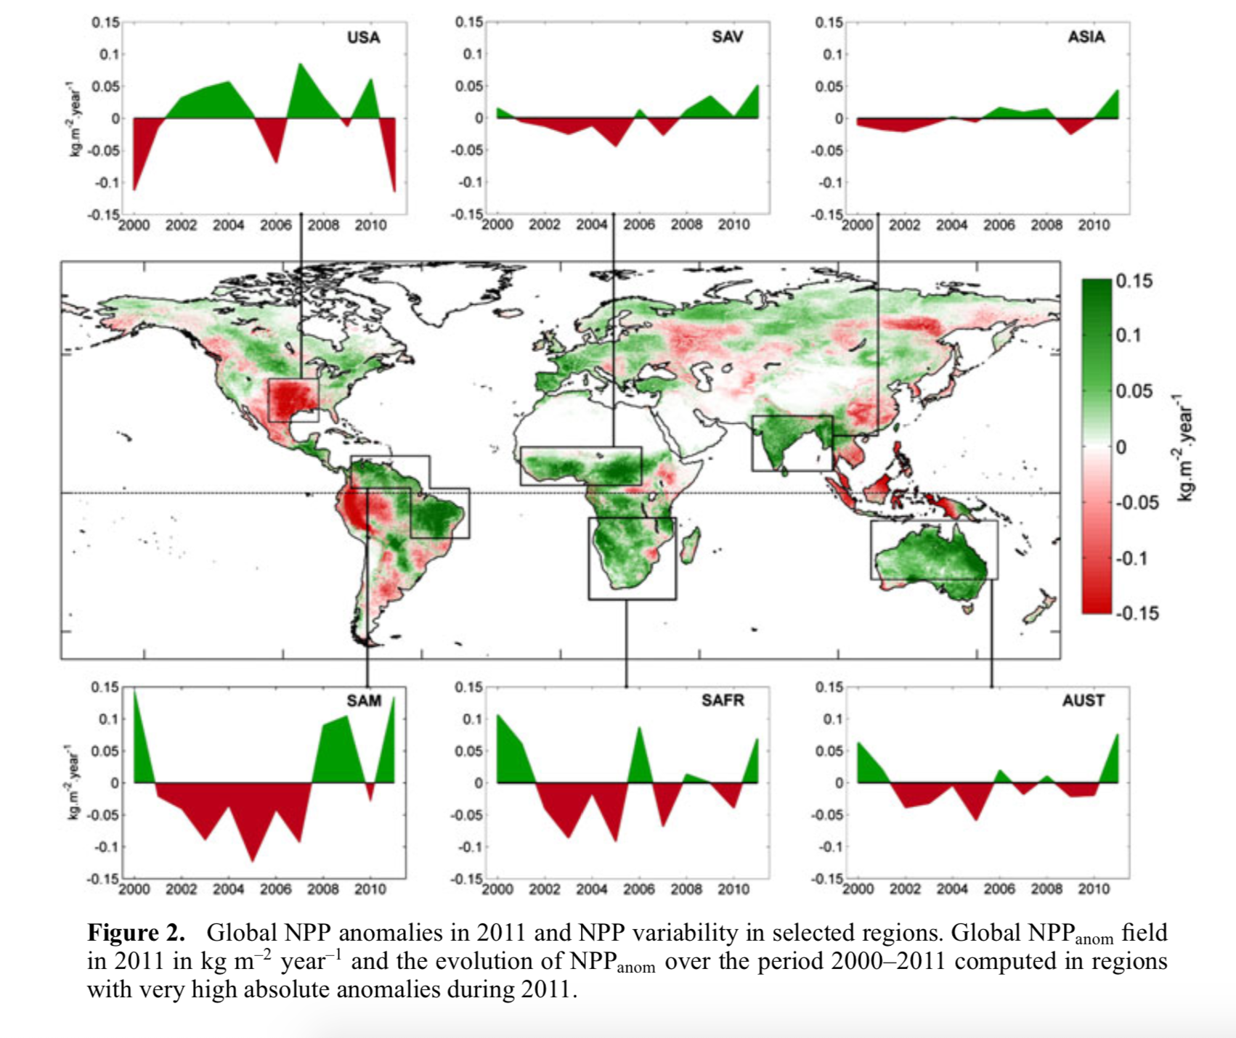
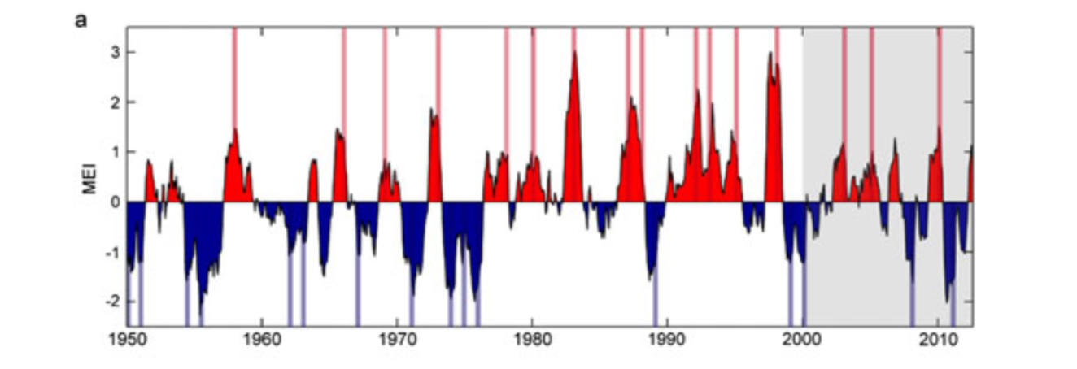
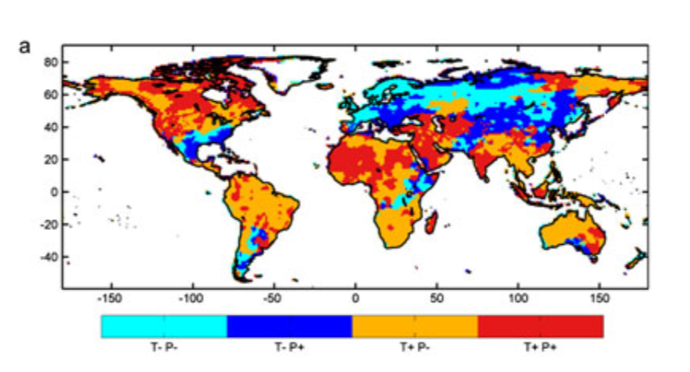
Drought impacts on vegetation productivity
NPP (MODIS)
Bastos et al (2013)
Positive values correspond to El Niño and negative values to La Niña.
SALGEE 2019, Darmstadt, 14-17 October 2019

Slide 8
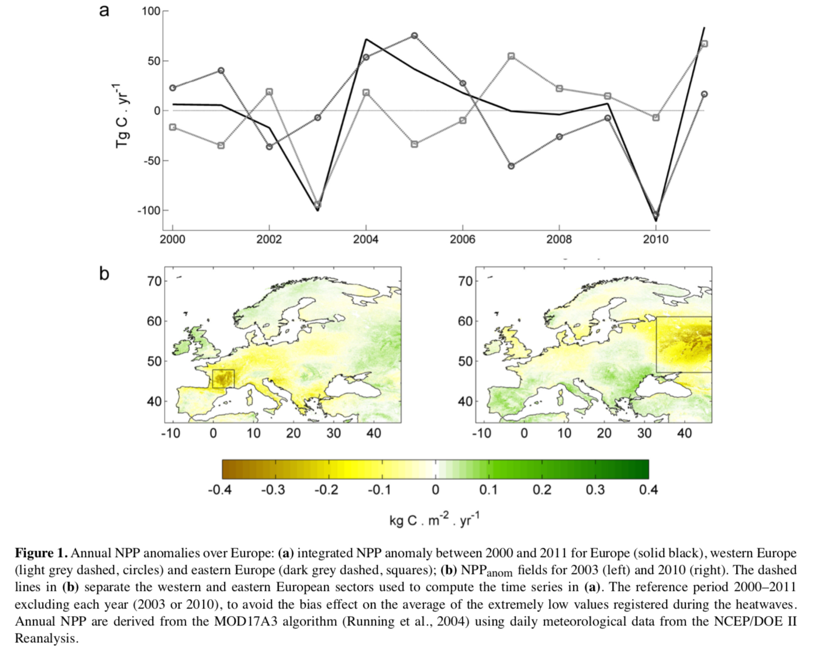
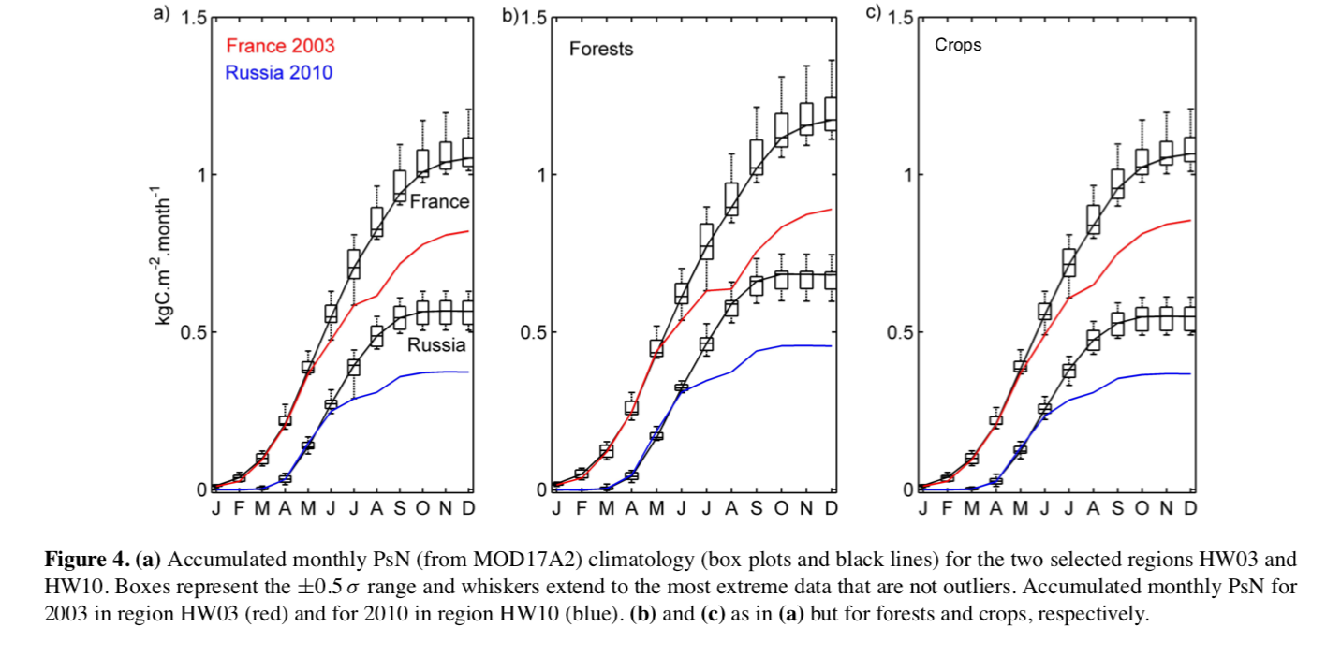
Drought impacts on vegetation productivity
NPP (MODIS)
Bastos et al (2014)
SALGEE 2019, Darmstadt, 14-17 October 2019

Slide 9
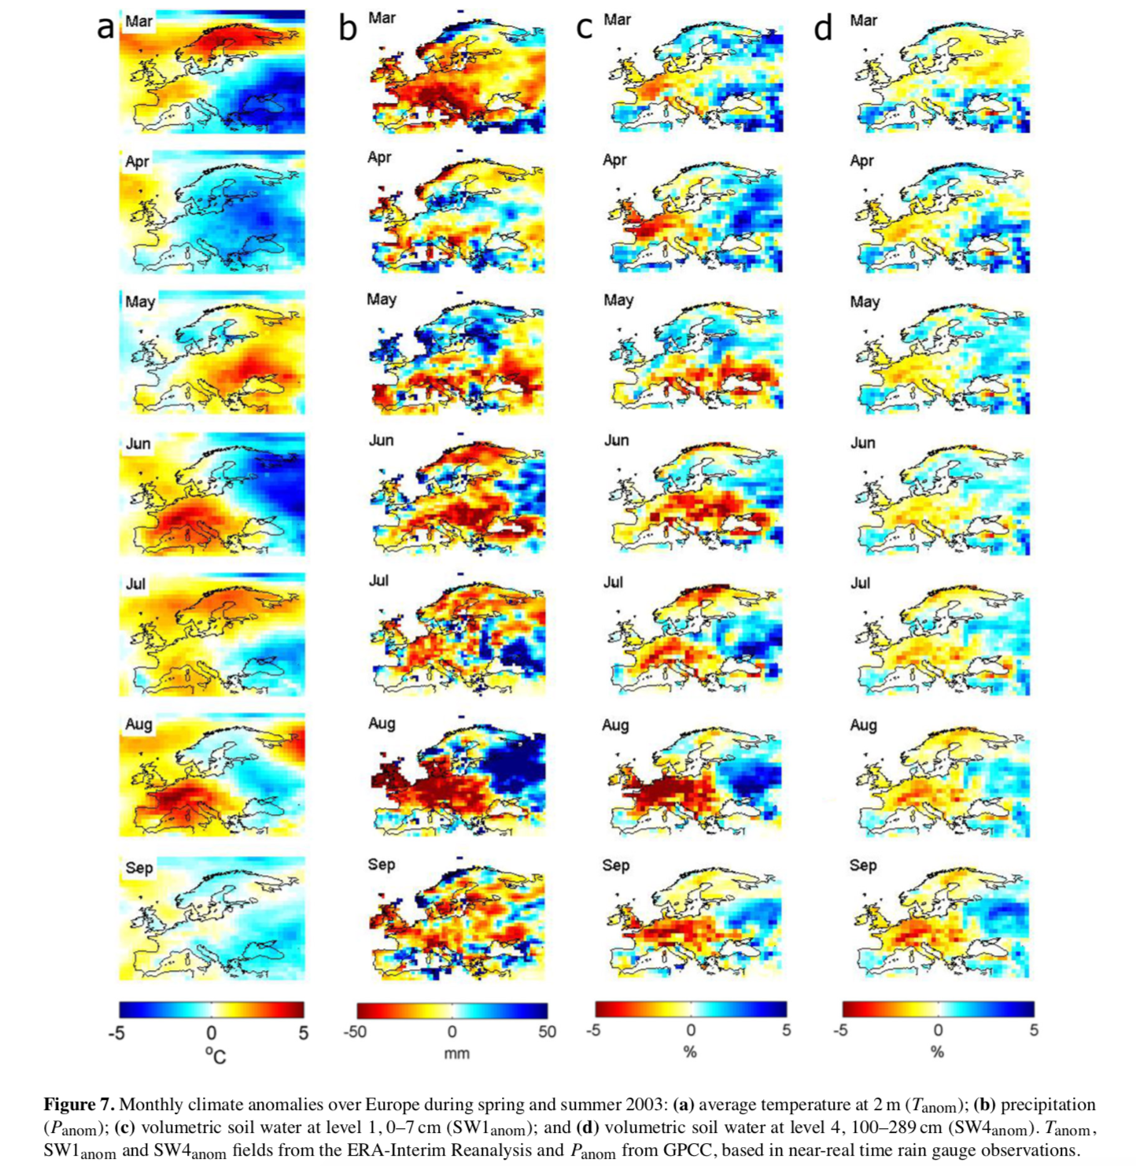
Drought impacts on vegetation productivity
NPP (MODIS)
Bastos et al (2014)
SALGEE 2019, Darmstadt, 14-17 October 2019

Slide 10
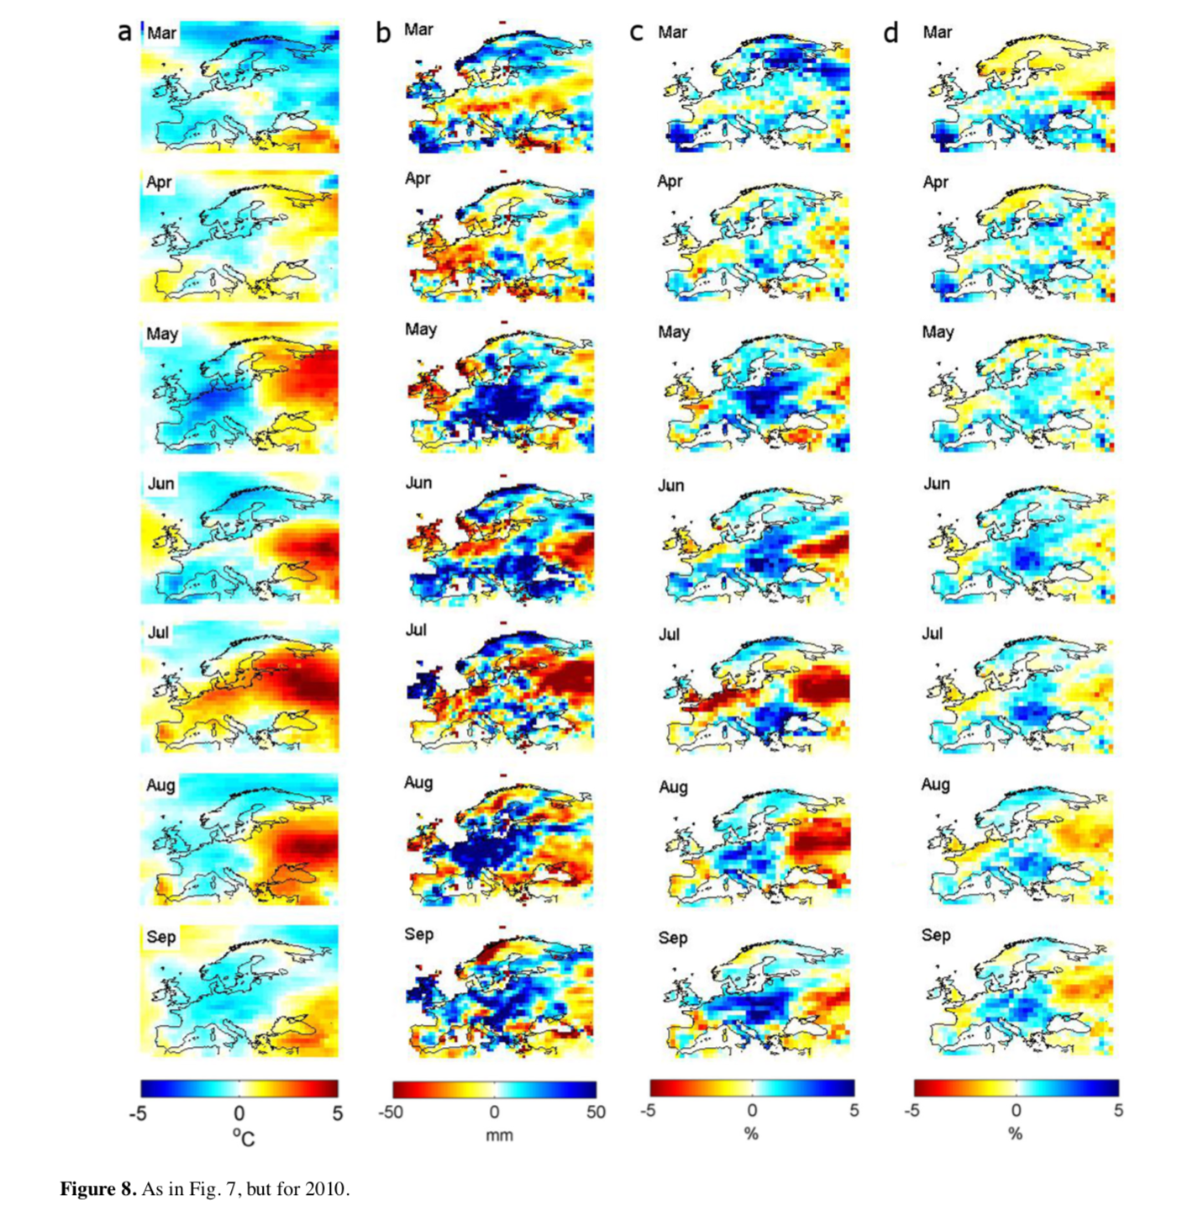
Drought impacts on vegetation productivity
NPP (MODIS)
Bastos et al (2014)
SALGEE 2019, Darmstadt, 14-17 October 2019

Slide 11
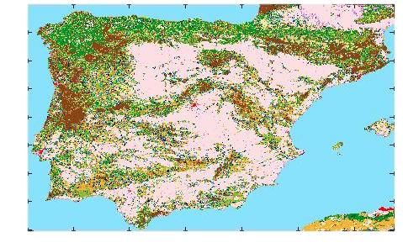
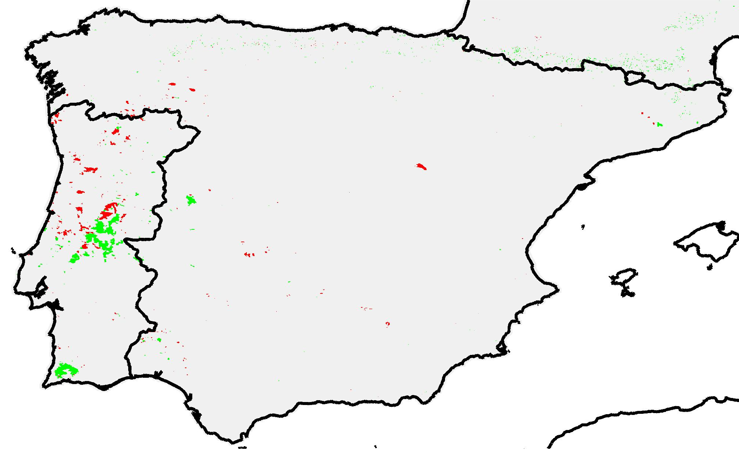
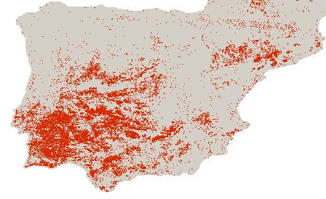
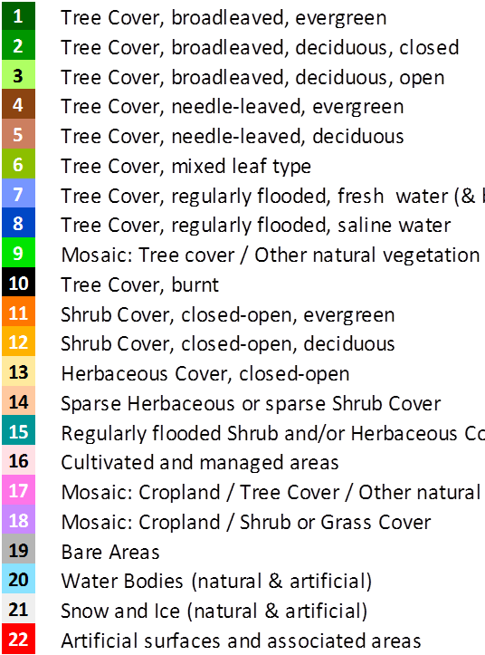
Drought impacts on vegetation productivity
Comparing the impacts of the 2003 and 2005 fire seasons and the 2004 drought on NPP in the Iberian Peninsula
Table 1. PsN anomaly values integrated over the total area of burnt scars from 2003 and 2005 and regions under severe drought stress in 2004/05. The first column indicates the percentage of pixels affected by each disturbance. Values are shown in tonC/yr
1. STUDY AREA
1. STUDY AREA
1. STUDY AREA
a)
b)
c)
a)
b)
c)
a)
b)
c)
The 2004 drought leads to very large decreases in photosynthetic activity and affected a much larger extent. Therefore, in total values (integrated area) and considering the years following disturbance, the drought had a much larger impact on the carbon balance of Iberian vegetation (0.24 MtonC) than the two fire seasons combined (0.02MtonC).
NPP (MODIS)
SALGEE 2019, Darmstadt, 14-17 October 2019
Figure 1. Study area and corresponding: a) land-cover composition assessed by GLC2000 ; b) burnt scars from 2003 (green) and 2005 (red) fire seasons; c) area affected by 9 or more months of drought stress in 2004/05 (dark red).
Figure 1. Study area and corresponding: a) land-cover composition assessed by GLC2000 ; b) burnt scars from 2003 (green) and 2005 (red) fire seasons; c) area affected by 9 or more months of drought stress in 2004/05 (dark red).
Figure 1. Study area and corresponding: a) land-cover composition assessed by GLC2000 ; b) burnt scars from 2003 (green) and 2005 (red) fire seasons; c) area affected by 9 or more months of drought stress in 2004/05 (dark red).

Slide 12
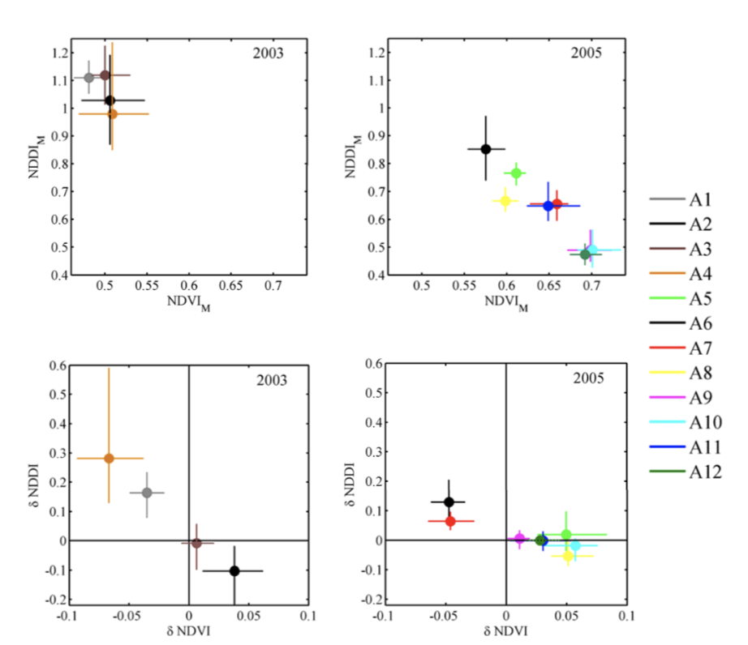
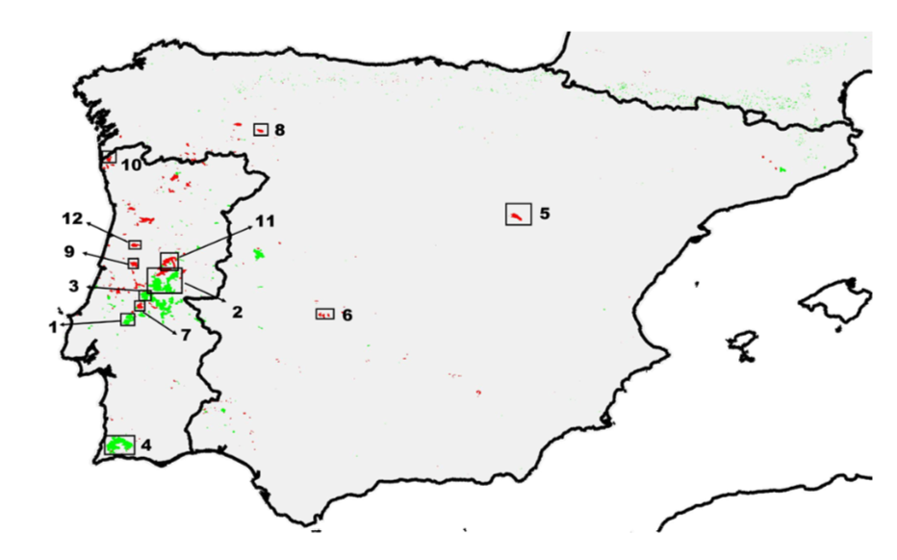
Vegetation Productivity and Fire Severity
Fire and Fuel Accumulation
NDVI from SPOT VEGETATION
Gouveia et al, 2012
SALGEE 2019, Darmstadt, 14-17 October 2019

Slide 13
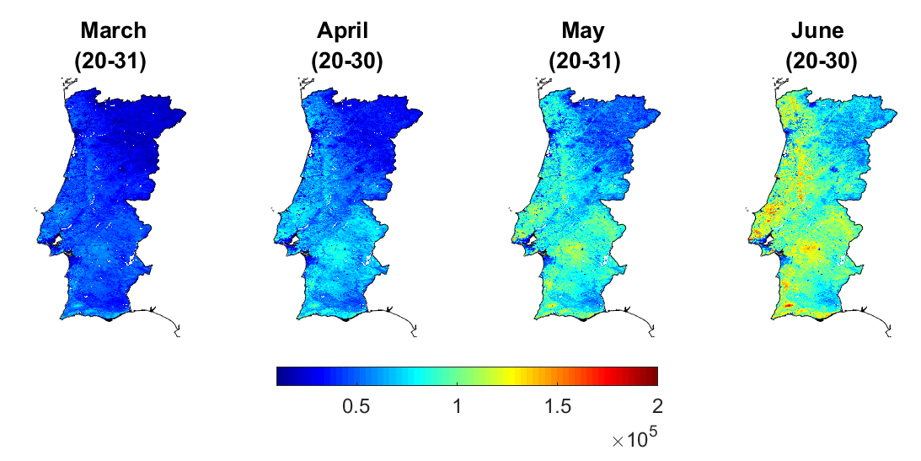
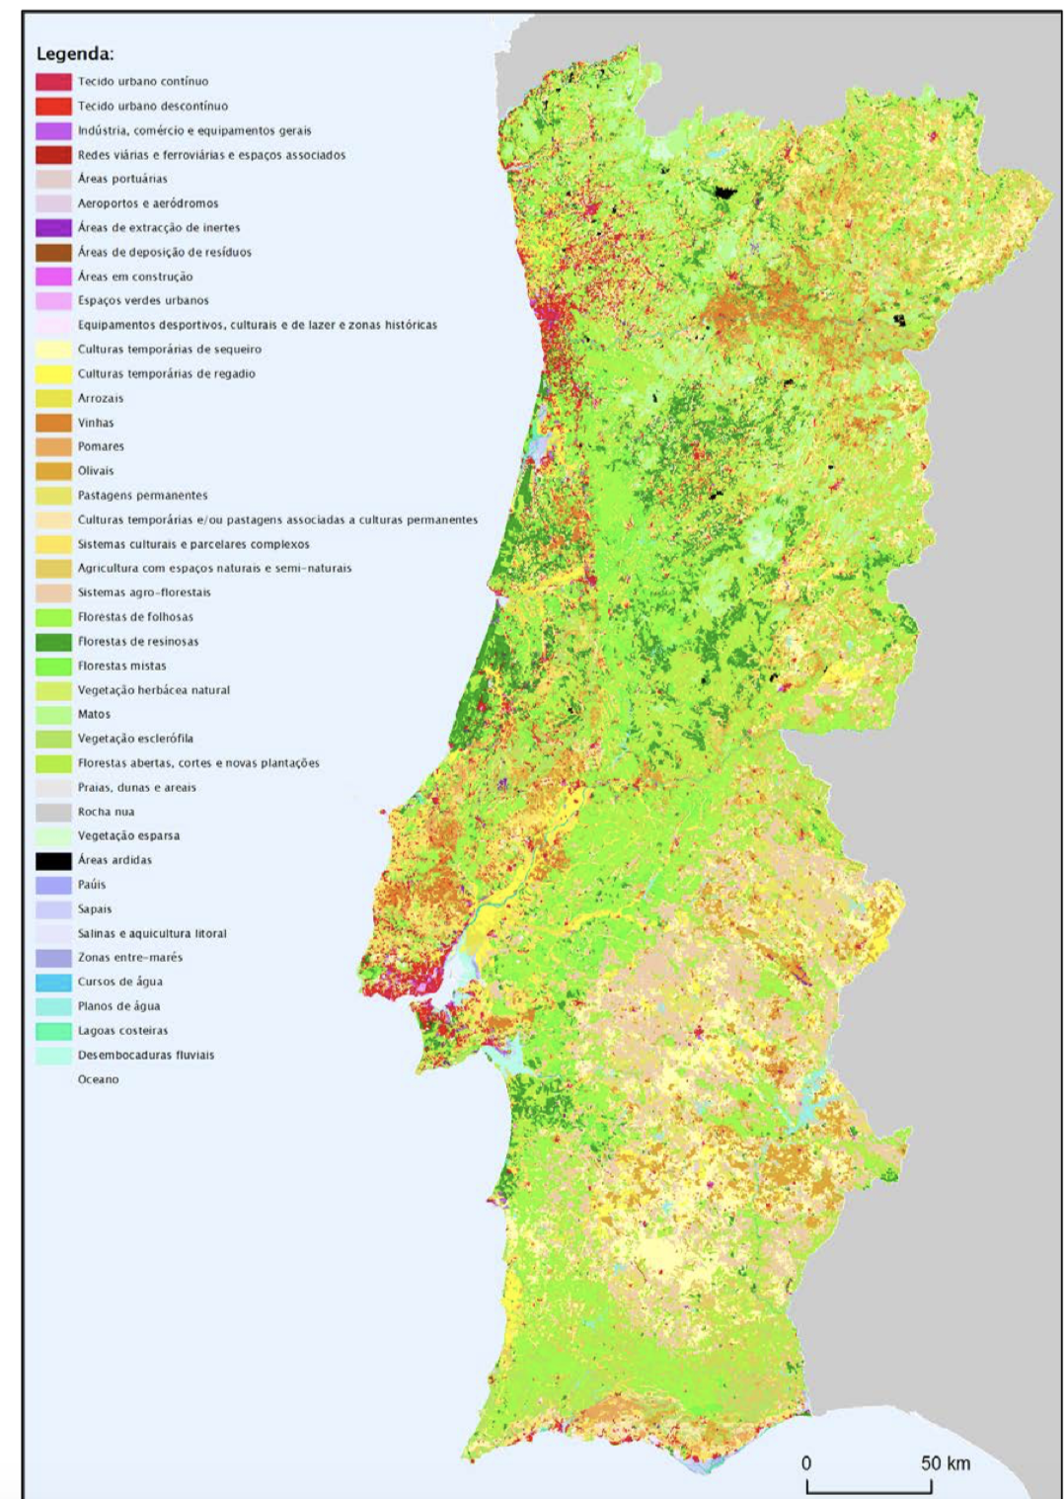
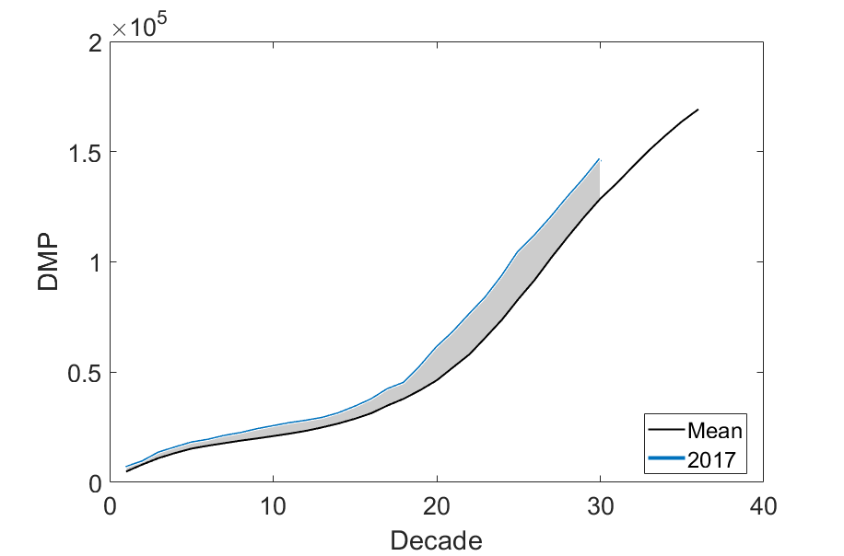
Vegetation Productivity and Fire Severity
CLC 2012
Burnt Areas 2017
Assessment of vegetation conditions and cumulated Biomass before Fire Season
DMP - Dry matter Productivity (SPOT VGT + PROBA-V) $\sim$NPP (Net Primary Productivity)
SALGEE 2019, Darmstadt, 14-17 October 2019
CLC 2012
Burnt Areas 2017
CLC 2012
Burnt Areas 2017
FIRE

Slide 14
Vegetation Productivity and Fire Severity
CLC 2012
Burnt Areas 2017
Assessment of vegetation conditions and cumulated Biomass before Fire Season
DMP - Dry matter Productivity (SPOT VGT + PROBA-V) $\sim$NPP (Net Primary Productivity)
LSA SAF GPP
Operational (MSG disk)
SALGEE 2019, Darmstadt, 14-17 October 2019
CLC 2012
Burnt Areas 2017
CLC 2012
Burnt Areas 2017
FIRE

Slide 15
Thank you!
celia.gouveia@ipma.pt
SALGEE 2019, Darmstadt, 14-17 October2019

