Slide 1



Quality monitoring of the new LSASAF Fire Risk Map product over south-eastern Europe
Julia Stoyanova, Christo Georgiev, Plamen Neytchev
National Institute of Meteorology and Hydrology, Bulgaria
6th SALGEE Workshop, 14 – 17 October, Darmstadt, EUMETSAT HQ, Germany
‘MSG Land Surface Applications: Connection of climate and biosphere’

Slide 2
OVERVIEW
The new LSASAF FRM product: Fire Danger Index (FDI)
Quality monitoring of LSA SAF FDI product’s behavior for SEE
  Fire Risk problem for South Eastern Europe (SEE)
  Available Fire Risk Indexes (FRIs) for SEE
  FDI evaluation in the context of a complex assessment of fire risk
  Advanced fire risk products for meteorological services

Slide 3
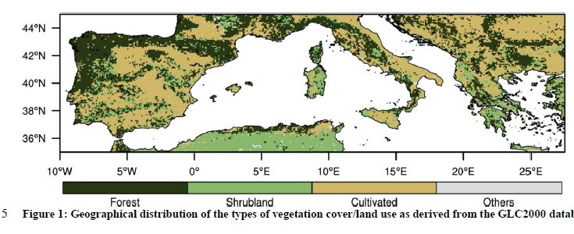
The new LSASAF FRM product
Fire danger Index (FDI)
Fire Danger Index, FDI developed at Instituto Dom Luiz, Faculty of Sciences, University of Lisbon .
  Fire danger classes are defined according fire activity in Portugal using radiative energy during biomass burning as..
  Pre-operational version of FDI was running (2016-2017)
  FDI operational: in the LSA SAF environment since 2019
Initial FDI domain and the vegetation cover map applied
FDI domain: extended so to cover Cyprus and the whole domain of Greece

Slide 4
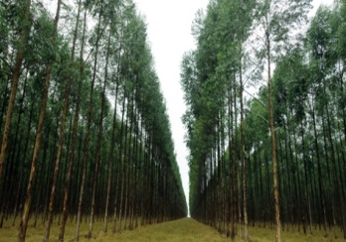


UNIVERSITY OF LISBON
An operational system of fire danger rating over Mediterranean Europe based on fire radiative power derived from Meteosat
Carlos C. DaCamara
with contributions from Miguel M. Pinto, Sílvia A. Nunes and Ricardo M. Trigo
Presented at
5th SALGEE Workshop 2017, Yerevan (Armenia),
Ani Plaza Hotel, 18 – 20 September 2017

Slide 5
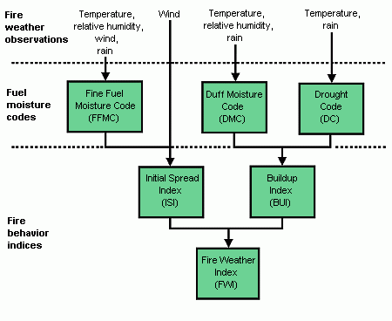
The Canadian Forest Fire Weather Index System (CFFWIS)
Carlos C. DaCamara, presented at 5th SALGEE Workshop 2017, Yerevan (Armenia)

Slide 6
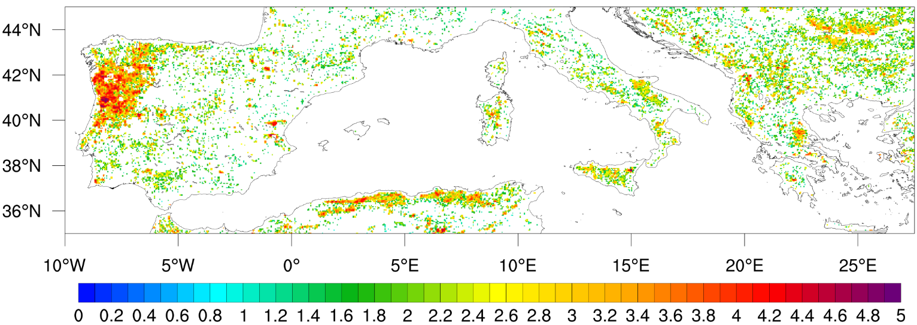
FDI classes definition Based on
Fire Radiative Energy 2010-2016 – FRP product, LSA SAF
decimal logarithm of energy (in GJ)
Carlos C. DaCamara, presented at 5th SALGEE Workshop 2017, Yerevan (Armenia)

Slide 7
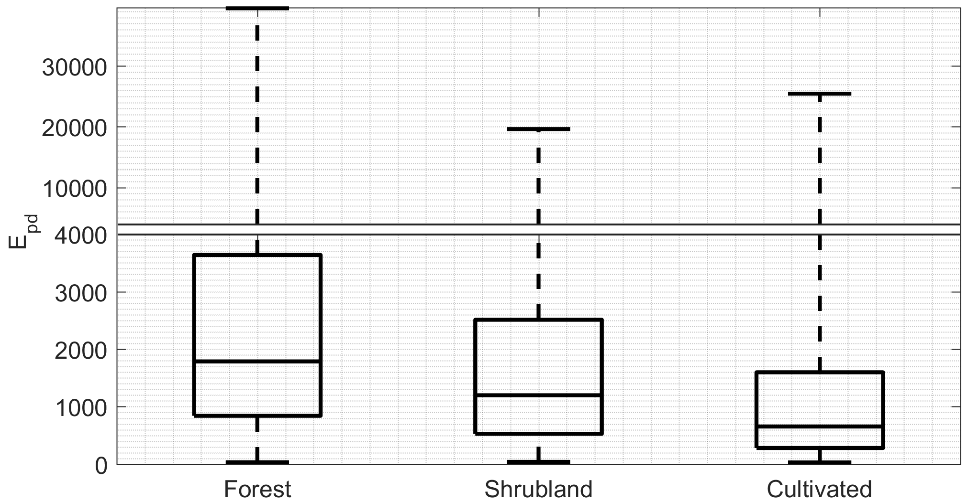
Daily Fire Radiative Energy per MSG pixel (2010-2016) – according to of Types of vegetation cover/land use
Carlos C. DaCamara, presented at 5th SALGEE Workshop 2017, Yerevan (Armenia)

Slide 8
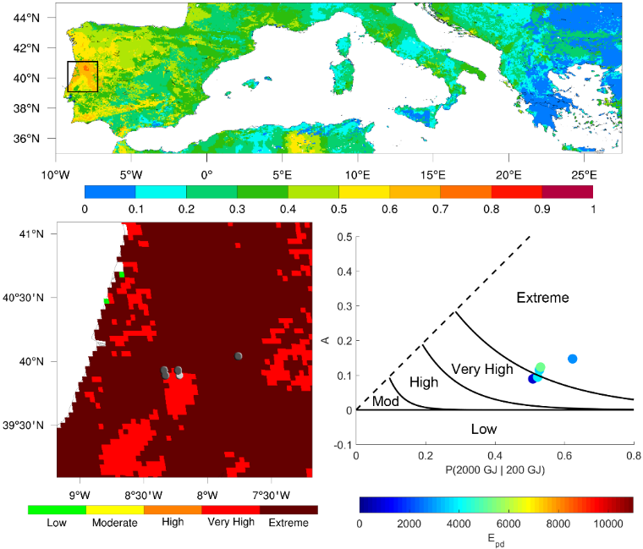
Carlos C. DaCamara, presented at 5th SALGEE Workshop 2017, Yerevan (Armenia)
June 18, 2017

Slide 9
Fire Risk Problem
The new LSASAF Fire Risk Map product, FDI is developed as a fire weather index but wildfires are complex phenomena that depend on a multitude of factors .
Vegetation will only ignite if their moisture content is sufficiently low and fuel moisture is governed by meteorological drivers (Westerling et al., 2006). The availability of burnable biomass is a precondition for wildfire activity (e.g. Liu and Wimberly, 2015).
Wildfire management therefore depends not only on knowledge of the meteorological conditions, but also on a robust quantification of changes in amount of burnable biomass.
The aim of this study is to provide a preoperational evaluation of the applicability of fire danger classes of the new LSA SAF Fire Danger Index (FDI, Miguel et al, 2018) in the context of a complex assessment of fire risk for the region of Eastern Mediterranean.

Slide 10
Quality monitoring (QM) of FDI, the new LSASAF FRM product in the context of a complex fire risk assessment for SEE
1. Three types of Indexes are compared for their scores in fire risk forecast
Meteorological fire risk: LSASAF FRM /LSASAF FRM New (FDI) based on FWI
Terrestrial drought and fire risk: SMDIFD, based on Soil Moisture Deficit assessment
Complex/ComplexNew , based on FRM/FDI & SMDIFD
2. The fire risk forecast efficiency is checked by two reference datasets
  Ground observations of actual fires
  Satellite detections of biomass burning
QM is performed in the frame of LSASAF CDOP-3 phase Project at NIMH Bulgaria, 2018

Slide 11
Data set
Quality monitoring (QM) of FDI behavior in the context of a complex fire risk assessment for SEE
Time series: June-August 2016 & 2017
Fire Risk Indexes (FRIs): LSASAF FWI, FRM and FDI
SMDIFD , Complex/ComplexNew
Reference data
  Ground observations
  Number of fires (databases of State Forest Agency, SFA; Ministry of Inner Affairs, MIA , Bulgaria)
  Type of burning vegetation (fuel types):
    Dry Grass, DG
    Forest Fires, FF
  Total burned area, TotR (according SFA & MIA)
    LSA SAF FRP-Pixel product
  https://landsaf.ipma.pt/en/products/fire-products/frppixel/
    detections of the location of biomass burning
    Emitted Fire Radiative Energy (FRE), MW.
Target region
Bulgaria, Southeastern Europe

Slide 12
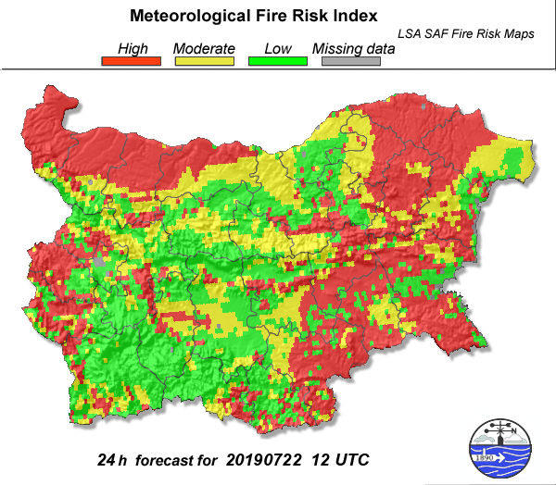
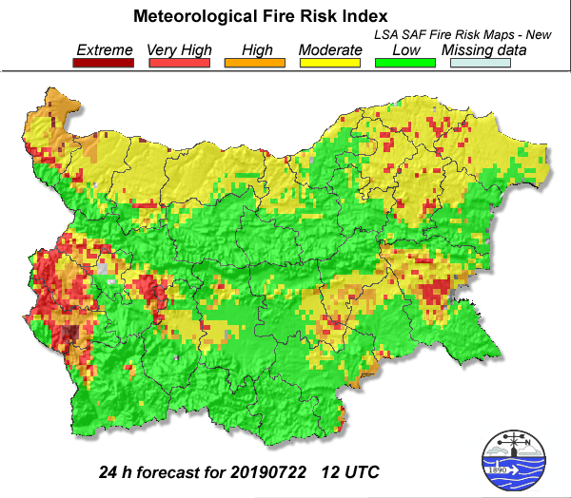
Fire Risk Indexes (FRIs)
Meteorological fire risk indexes based on FWI of CFFWIS
LSASAF Fire Risk Map product (FRM)
LSASAF FRM New (FDI)
Operational LSA SAF products via EUMETCast
Pre-operational version of FDI
  Fire Danger Index, FDI developed at Instituto Dom Luiz, Faculty of Sciences, University of Lisbon .

Slide 13
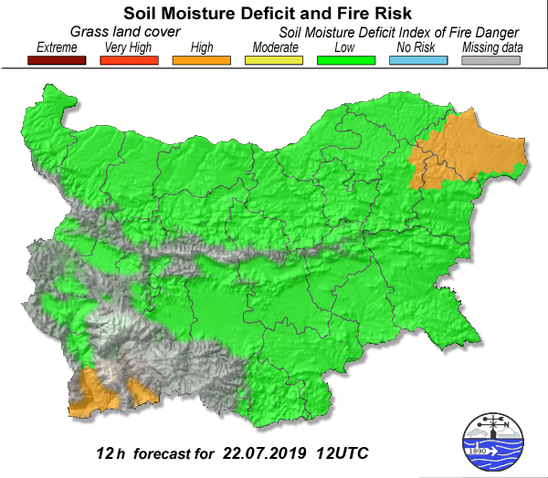
Fire Risk Indexes (FRIs)
Specially designed meteorological products
for diagnosing Land Surface State
Biogeophysical Index for assessment of agricultural drought, Soil Moisture Availability Index, SMAI
Biogeophysical Index for assessment of SMD – Fuel dryness related Fir e Risk , Soil Moisture Deficit Index of Fire Danger, SMDIFD
Soil Moisture Availability, SMA concept is accepted as a standpoint for land surface state estimates;
Environmental constrain of fire risk is evaluated in terms of the Soil Moisture Deficit, SMD severity/duration;
LSA SAF biogeophysical products based on space/time resolution of geostationary MSG SEVIRI data are applied.
Statistical modeling.
SMDIFD, Bulgarian SVAT approach, based on data from ECMWF NWP model

Slide 14
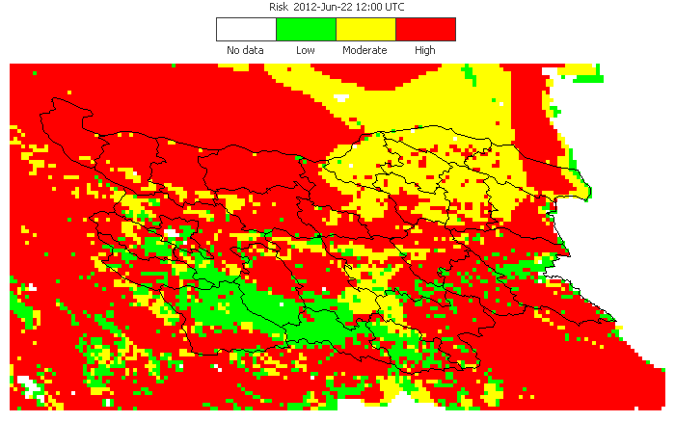
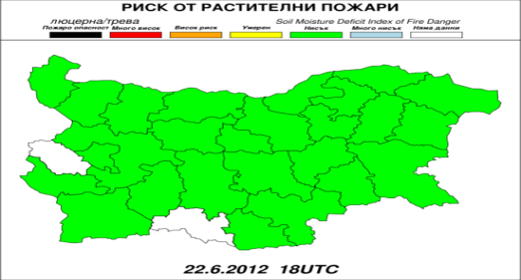
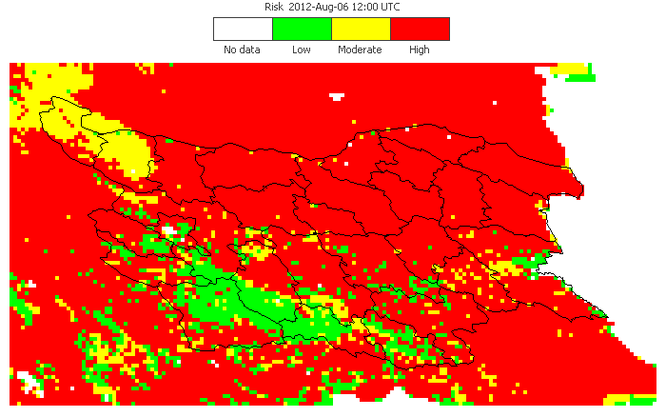
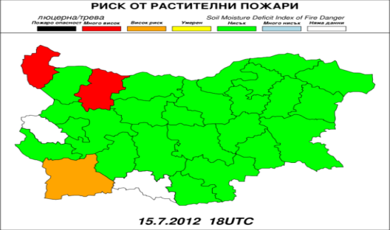
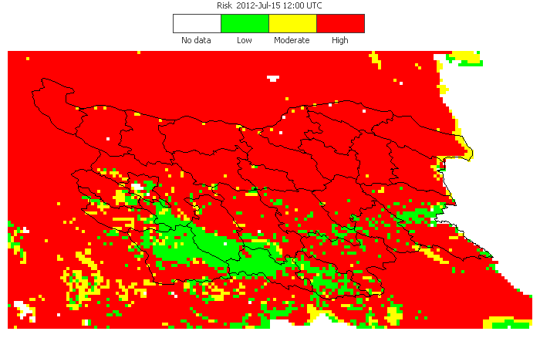
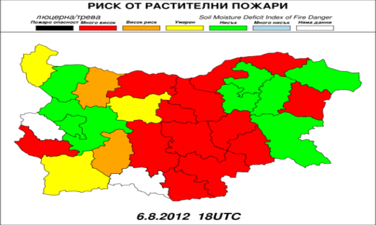
How drought impacts into fire risk and to the quality of early warning and forecasts?
Heat wave episodes in 2012 over SEE, Bulgaria and a set of fire risk indexes
15- 23 Jun 9-19 Jul 3-8 Aug 2012
  Atmosphere
  CFFWI/LSA SAF FRM
  product for characterising
  Meteorological fire risk
  Land surface
  SMDIFD
Variability of soil moisture deficit across the climate regimes of Bulgaria and related fuel dryness/Fire Risk according to SMDIFD
LSA SAF FRM 22 June 2012
Daily temperature records
  in June: 3 days
  in July: 17 days
  in August: 11 days
SMDFD FIRE RISK INDEX
High meteorological Fire Risk over BG
Low fuel dryness
For local/regional applications FRM indicates high meteorological fire danger due to weather extremes Tair=34.7°C, RH=23 %.
LSA SAF FRM 15 July 2012
High meteorological Fire Risk over BG
Low Fire Risk with some regions exception
  During hot days,
high level of meteorological fire risk can be present at a wide range of land surface state / dryness
LSA SAF FRM 6 August 2012
High meteorological Fire Risk over BG
High/Very high fuel dryness central N/S BG

Slide 15
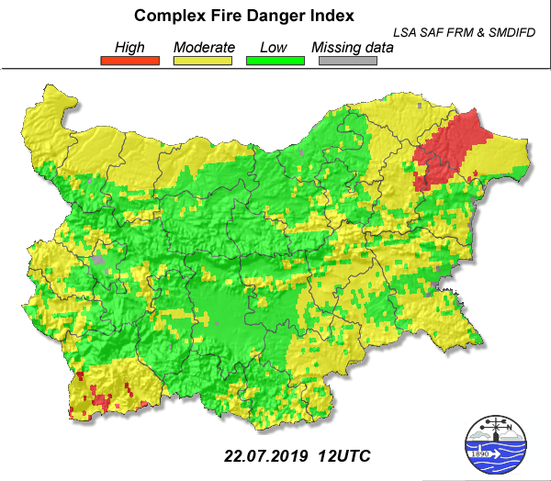
Complex Fire Danger Index to account for drought impacts into fire risk for early warning and forecasts
Advanced Fire Risk Indexes (FRIs)
Flowchart of composite indicator approach
Needs from composite Indicator of fire risk
Atmosphere conditions
Land surface state
Composite fire risk Index
Analyses & Forecasts
Validation
Operational
Complex Fire Danger Indexes, two versions:
  Complex (LSASAFFRM & SMDIFD); ComplexNew (FDI & SMDIFD)
Fire risk is a creeping phenomenon with no universal definition , definitions are region and application (impact) specific: drought impacts are a key indicator of vulnerability to fire risk in Mediterranean.

Slide 16
QM procedures
Evaluation of Indexes score
    Comparative analyses between indexes
    Comparative analyses Indexes vs. Reference data
    Qualitative & Quantitative approaches
  Statistical indicators and criteria
    Comparative analyses are based on using smoothed averaged courses of corresponding indexes versus the reference fire parameters.
      fire occurrence
      fire characteristics
    Contingency tables indicating different levels of fire danger probabilities in terms of ‘Yes/No’ of fire occurrence
    Sensitivity of risk rating towards actual fire situations: Overlaid graphical analyses of the seasonal (Jun-Aug) dynamics of Indexes curves towards actual fire characteristics the sensitivity of risk rating.

Slide 17
3. Quality monitoring methods
Ranking of fires
Small fires – Burned area less than 10 ha
Moderate fires – Burned area less than 100 ha
Large fires – Burned area greater or equal than 100 ha
Qualitative analyses of Interrelations between FRIs
  Seasonal fire distribution & FRIs variations
  Comparison between FRIs
  Behavior of FRIs towards actual fire characteristics
Quantitative analyses of Interrelations between FRIs
  SPEARMAN correlation matrix between FRIs
  Relation between FRIs and Number of fires occurrence
  Relation between FRIs and Burned area/Fuel type
  Sensitivity analyses of fire risk classes /contingency table characterizing fire occurrence/.

Slide 18
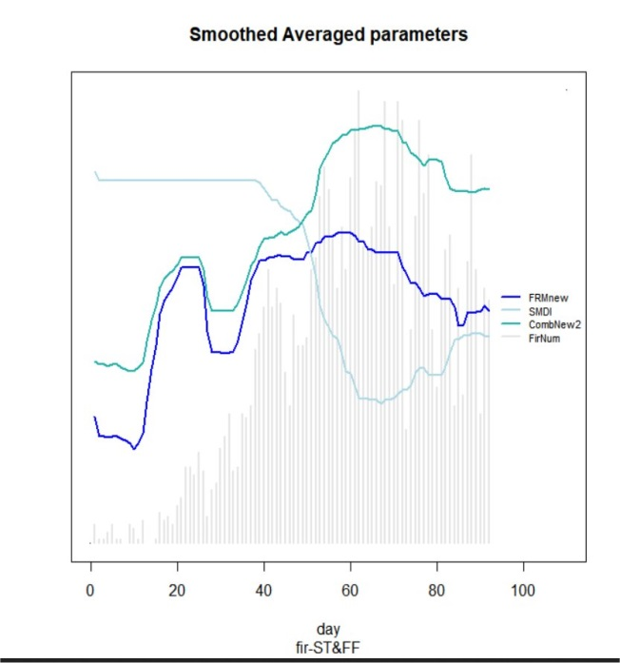
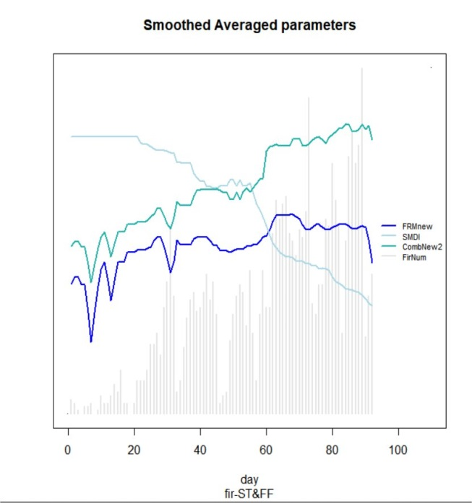
Comparison between FRIs
The course of FDI and ComplexNew (in a 5-level scale) are differing:
2016: ComplexNew and SMDIFD (in an opposite way) follow the dynamics of fires (Jun-Aug); FDI does not strictly follow the fire activity: Comparatively similar high values for June and Aug, whereas the number of fires varies significantly;
2017: ComplexNew shows an increasing trend in parallel to SMDIFD decreasing at the end of Aug along with increase of fire number; FDI is almost constant with a slightly descending trend;
SMDIFD for both years at the end of July starts to decrease along with increase of number of fires.
ComplexNew FRI course follows fire activity better than FDI.
ComplexNew
FDI
Number of fires
2016
2017
SMDIFD
ComplexNew
FDI
Number of fires

Slide 19
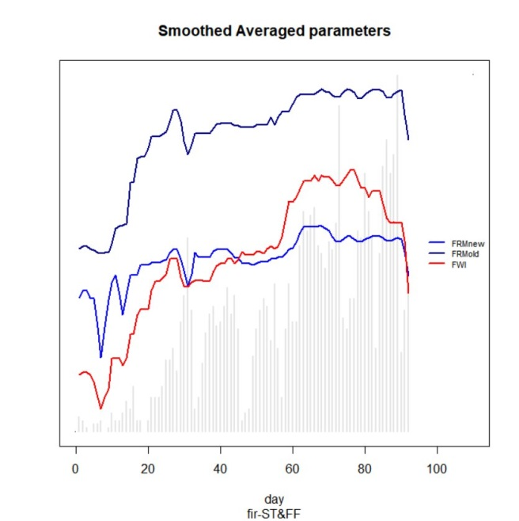
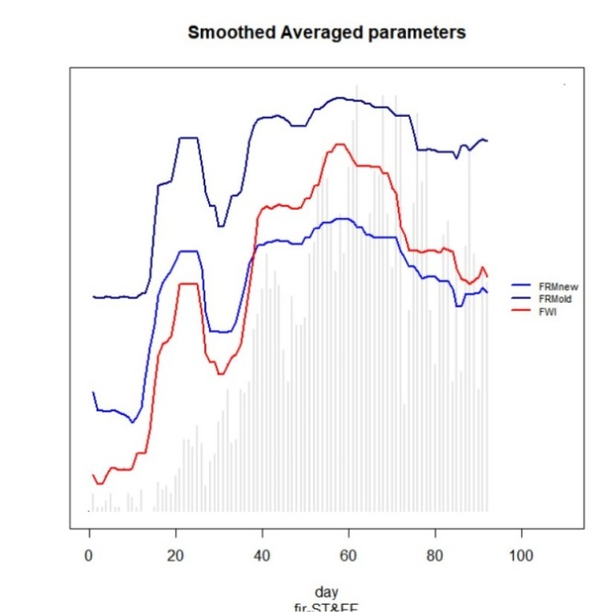
Comparison between FRM and FRM new (FDI)
2017
2016
FWI
FWI
FRM
FRM
FDI
FDI
Both, FDI and FRM follow FWI, i.e. meteorological conditions, a bit mitigating the extremes

Slide 20
Comparison between FRIs
2017
2016
FWI
FWI
FRM
FRM
FDI
FDI
Both, FDI and FRM follow FWI, i.e. meteorological conditions , while the Complex Index reflects also SMD (fuel dryness).
2017
SMDIFD
ComplexNew
SMDIFD
ComplexNew
FDI
FDI
2016

Slide 21
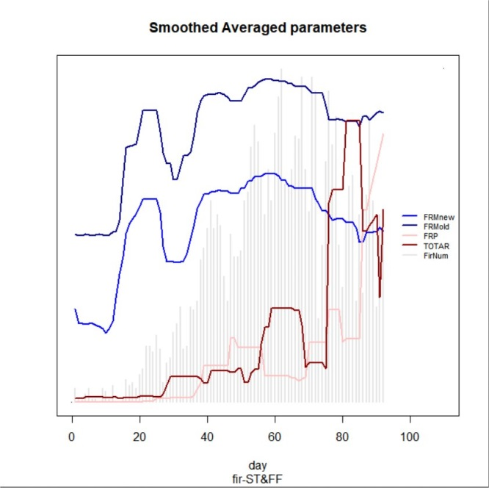
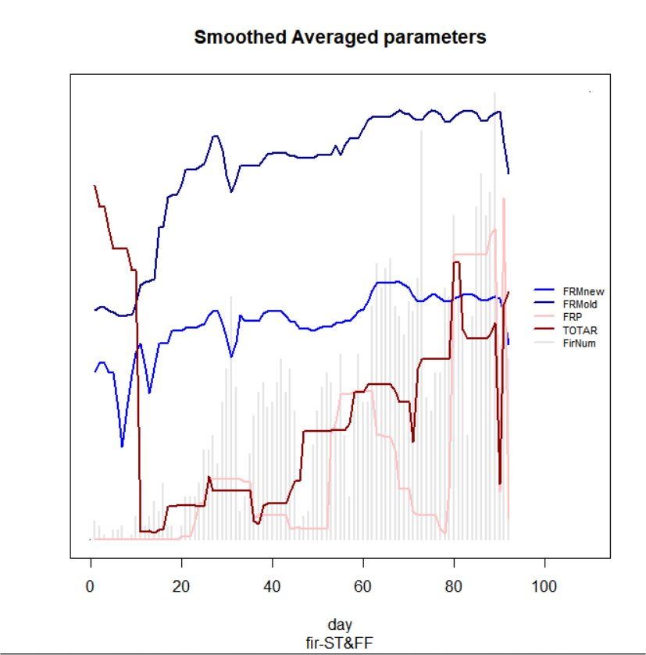
Behavior of FRIs towards actual fire characteristics
Burned area, ha
FRE, MW
ComplexNew
FRM
FRM
FDI
FDI
FRP, pink
Burned area, ha (brown)
Number of fires
2016
2017
The course of Indexes in parallel to fire characteristics:
- Number of all DG&FF fires (grey bars)
- Burned area (ha); Fire Radiative Energy (FRE, MW) according LSA SAF FRP-Pixel product
There is no strong relation between number of fires, total area burned and FRE.
  For 2017 these correspond to the peak of fire number.
  For 2016 there is no one to one correspondence between level of fire risk in respect to meteorological and land surface conditions and burned area.
The maxima of Burned area and FRE are at the end of August.

Slide 22
Quantitative analyses of Interrelations between FRIs
Initial dataset: Dataset of daily values of corresponding index for three months (Jun-Aug) for all locations/coordinates with fire occurrence in case of : Dry Grass, DG; Forest Fire, FF:
There is a high correlation between FDI and LSASAF FRM (0.6 -0.74) with a stronger correspondence in case of FF occurrence.
They may differ significantly each other in various situations of fire occurrence.
SMDI is slightly correlated with FDI and LSASAF FRM
  - The decreasing soil moisture leads to increase of fire risk and moderate negative correlation.
  1) Relation between FRIs
Table 1. SPEARMAN correlation matrix based on all INITIAL DATA in case of DG and FF fires for the test period
2016, DG, n = 180 973 |  |  |  | 2016, FF, n = 21 782
FRIs | FDI | LSASAF FRM | SMDIFD | FRIs | FDI | LSASAF FRM | SMDIFD
FDI | 1.00 | 0.69 | -0.35 | FDI | 1.00 | 0.74 | -0.40
FRM | 0.69 | 1.00 | -0.43 | FRM | 0.74 | 1.00 | -0.44
SMDIFD | -0.35 | -0.43 | 1.00 | SMDIFD | -0.40 | -0.44 | 1.00
2017 DG, n =128 121 |  |  |  | 2017 FF, n = 15 861
FDI | 1.00 | 0.60 | -0.35 | FDI | 1.00 | 0.66 | -0.36
FRM | 0.60 | 1.00 | -0.39 | FRM | 0.66 | 1.00 | -0.39
SMDIFD | -0.35 | -0.39 | 1.00 | SMDIFD | -0.36 | -0.39 | 1.00

Slide 23
  2) Relation between FRIs and Number of fires occurrence
Table 2. Correlation matrix based on SMOOTHED AVERAGED DATA, in case of DG and FF fires for the test period
FRIs | FDI | LSASAF FRM | SMDIFD | Complex | Complex New
2016_DG, n = 180 973 | 0.59 | 0.55 | -0.11 | 0.34 | 0.38
2017_DG, n = 128 121 | 0.77 | 0.84 | -0.83 | 0.89 | 0.91
2016_FF, n = 21 782 | 0.49 | 0.55 | -0.70 | 0.71 | 0.69
2017_FF, n = 15 861 | 0.63 | 0.68 | -0.76 | 0.75 | 0.79
Smoothed averaged data for FRIs on a 10 days quantitative bases are used.
Comparison between the indexes' sensitivity for two fire seasons
June – August 2016 characterised by a larger number of small fires (less than 10 ha) , 3964 .
June – August 2017 characterised by a much less number of small fires - 2454
Since the Indexes are not sensitive to indicate the risk of so small fires they are better correlated with number of fires in 2017 then in 2016, when a larger number of small fires (less than 10 ha) are observed ;
Among the indexes, SMDIFD shows the lowest score (-0.11) for 2016, because of its nature: It reflects the soil moisture availability in a deep layer and thus is not indicative of small DG-fires (the number of small DG fires: 3886 for 2016 vs. 2314 for 2017);

Slide 24
  2) Relation between FRIs and Number of fires occurrence
Table 2. Correlation matrix, Smoothed averaged data for FRIs on a 10 days quantitative bases of all DG and FF fires
FRIs | FDI | LSASAF FRM | SMDIFD | Complex | Complex New
2016_DG, n = 180 973 | 0.59 | 0.55 | -0.11 | 0.34 | 0.38
2017_DG, n = 128 121 | 0.77 | 0.84 | -0.83 | 0.89 | 0.91
2016_FF, n = 21 782 | 0.49 | 0.55 | -0.70 | 0.71 | 0.69
2017_FF, n = 15 861 | 0.63 | 0.68 | -0.76 | 0.75 | 0.79
FDI / LSASAF FRM are better correlated with the number of Dry Grass (DG) fires than with the number of Forest Fires (FF): DG-fires are more strongly influenced by weather conditions, i.e. from meteorological fire risk, while in case of FF, fuel dryness due to soil moisture deficit in a deep layer is also important;
The Complex FRI (all versions) is better correlated with the number of FF than LSA SAF indexes (all versions) with an exception for small DG fires in 2016. The Complex FRI accounts for SMD in addition to meteorological fire risk that significantly improves the correlation. The highest score is shown by CombNew index, which combines the weather conditions and vegetation state and reflects more efficiently the fire risk, especially regarding the FF.

Slide 25
Relation between FRIs and Burned area/Fuel type
- Small fires: All Indexes are not indicative for small fire occurrence.
- Moderate and Large fires: there is a progressively increase of a percentage of fire events with the increase the level of fire risk.
Examples: good / poor performance of Indexes
Score of the FDIs regarding fire severity
(Number of fires, Total burned area, FRE)
Table 3. Very good performance of FDI: all 3 months 2017, DG&FF
 | BURNED AREA, ha |  |  | Percentage of fire occurrence
FDI | <10 | <100 | ≥100 | %<10 | %<100 | %≥100
1 | 165 | 6 | 0 | 96.5 | 3.5 | 0
2 | 1110 | 76 | 14 | 92.5 | 6.3 | 1.2
3 | 892 | 63 | 14 | 92.1 | 6.5 | 1.4
4 | 261 | 21 | 5 | 90.9 | 7.3 | 1.7
5 | 26 | 4 | 1 | 83.9 | 12.9 | 3.2
Low fire risk
Moderate
High
Very high
Extreme

Slide 26
Relation between ComplexNew and Burned area/Fuel type
Table 4. Very good performance of ComplexNew:
all 3 months 2016&2017, DG&FF
 | BURNED AREA, ha |  |  | Percentage of fire occurrence
Complex New | <10 | <100 | ≥100 | %<10 | %<100 | %≥100
1 | 6 | 0 | 0 | 100 | 0 | 0
2 | 1739 | 112 | 8 | 93.5 | 6 | 0.4
3 | 2092 | 148 | 16 | 92.7 | 6.6 | 0.7
4 | 2277 | 222 | 47 | 89.4 | 8.7 | 1.8
5 | 304 | 45 | 8 | 85.2 | 12.6 | 2.2
Low fire risk
Moderate
High
Very high
Extreme
- Small fires: The Complex FDI is not indicative for small fire occurrence.
- Moderate and Large fires: percentage of fire events progressively increases with the increase the level of fire risk.

Slide 27
Relation between SMDIFD and Burned area/Fuel type
Table 6. Good performance of SMDIFD (in an opposite way than for the other indexes): all 3 months 2016, DG&FF
 | BURNED AREA, ha |  |  | Percentage of fire occurrence
SMDIFD | <10 | <100 | ≥100 | %<10 | %<100 | %≥100
1 | 1153 | 137 | 21 | 87.9 | 10.5 | 1.6
2 | 1240 | 122 | 16 | 90 | 8.9 | 1.2
3 | 147 | 15 | 0 | 90.7 | 9.3 | 0
4 | 1549 | 99 | 8 | 93.5 | 6 | 0.5
5 | 3 | 0 | 0 | 100 | 0 | 0
Extreme
Very high
High
Moderate
Low fire risk
- Small fires: SMDIFD indexes are not indicative for small fire occurrence.
- Moderate and Large fires: percentage of fire events progressively increases with the increase the level of fire risk.

Slide 28
Relation between FDI and Burned area/Fuel type
Poor performance of FDI: 2017_FF all 3 months
 | BURNED AREA, ha |  |  | Percentage of fire occurrence
FDI | <10 | <100 | ≥100 | %<10 | %<100 | %≥100
1 | 8 | 1 | 0 | 88.9 | 11.1 | 0
2 | 29 | 9 | 8 | 63.0 | 19.6 | 17.4
3 | 54 | 13 | 7 | 73.0 | 17.6 | 9.5
4 | 39 | 9 | 3 | 76.5 | 17.6 | 5.9
5 | 10 | 3 | 1 | 71.4 | 21.4 | 7.1
Low fire risk
Moderate
High
Very high
Extreme
There is not any link between the percentage of fire events and the level of fire risk.
P.S.: There is no good correspondence between released Fire Radiative Energy and the level of fire risk (not presented).

Slide 29
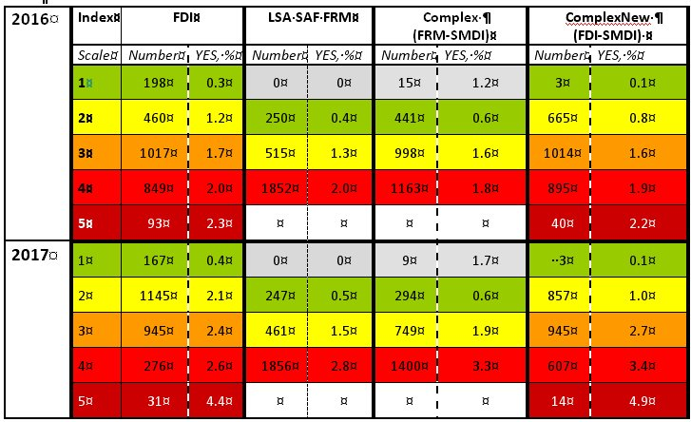
Sensitivity analyses of fire risk classes
Contingency table characterizing fire occurrence
(number of fires and % of all cases with corresponding level of fire risks)
Percentage of correspondence between fire occurrence and FRIs score progressively increases with the increase the level of fire risk

Slide 30
All Indexes indicate relevant distribution of fire occurrence according to the fire risk level (from green to red)
FDI gives less ‘false’ alarms than LSA SAF FRM in ‘green’ level, having better discrimination of fire risk environment
Complex Index gives less ‘false’ alarms than FDI at ‘green’ level of fire risk
Accounting for regional SMD and related fuel dryness can reduce the risk overestimation at low levels of fire risk (green/yellow) thus improving the indexes score.
Recommendation: SM or SMD to be considered somehow in FRI.

Slide 31
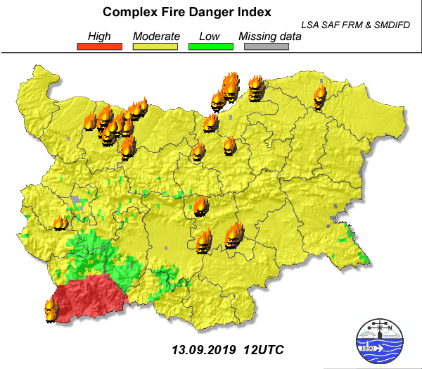
3.4. Operational applications
Advanced meteorological product of fire risk and fire detection: Complex assessment of fire risk and wild fires occurrence
A Complex index of fire risk developed at NIMH: combines meteorological fire risk (according LSA SAF FRM, Canadian Fire Weather Warning System, https://landsaf.ipma.pt/en/products/fire-products/frm) and land surface state (according Soil Moisture Deficit Index of Fire Danger).
Index is applied for meteorological services of national Authorities.
Increased number of potential fires at environment of high fire risk.
At environment of high fire risk, fires are persistent.
Advanced products facilitate fire risk forecast.

Slide 32
Conclusions and Recommendations
      Fire Danger Index (FDI) better discriminates fire danger classes than LSA SAF FRM product.
FDI tends to overestimates fire risk for the region of SEE in June ( especially at heat wave environment) and may underestimate fire risk in July and August, due to inability to account for dry vegetation state conditions.
      A combination between meteorological fire risk (characterised by FDI) and terrestrial drought (characterised by SMDIFD) is used to construct a ComplexNew FRI. CoNew index seems most relevant to reflect the course of fire activity and total burned area (for medium and large fires). Studies for further adjustment/improvement of the two versions of ComplexNew FRI with different weight of land surface state are needed.
      Accounting for Soil Moisture Deficit and related fuel dryness leads to a more realistic assessment of fire risk especially in low classes of fire risk (‘green/yellow’).
      No one of the tested FRIs (FDI, LSA SAF FRM, SMDIFD, Complex, ComplexNew) is efficient is case of small fires warnings (less than 10 ha).
      It is recommended, LSA SAF to start operational dissemination of FDI in 2019 in a larger domain including whole territories of Bulgaria, Greece and Cyprus.
      It would be reasonable information for Soil Moisture to be considered somehow in future work on the LSA SAF products for fire risk assessment/forecast.

Slide 33

Acknowledgements:
This study is funded by EUMETSAT, the European Organisation for the Exploitation of Meteorological Satellites in the frame of SALGEE Project 2016-2017. TSMS has developed software for processing and visualisation of archive S-VIIRS 750 m data (in the frame of this SALGEE Project).
LSA SAF is acknowledged for providing data for FRP-PIXEL product to fill the gaps for the test period. LSA SAF FRP-PIXEL new algorithm product for the test period was kindly provided by the CDOP-3 archive.
NASA is acknowledged for free access to archive MODIS –6 data.
State Forest Agency of Bulgaria has provided information for actual forest fires and their characteristics (used as a reference in this study). Thanks are due to the Regional Directorate Veliko Turnovo “Fire rescue and civil protection” for information about actual fires and assistance in validation process.
For the purposes of this study, new O1280 version of ECMWF model is introduced for use at NIMH, Bulgaria.

