Slide 1
African Landscape Fire Activities and Fuel Consumption from FRP Measurements
University of Southampton
Gareth Roberts, Martin J. Wooster, Weidong Xu,
And Jiangping He
SALGEE 2019 workshop Darmstadt
14-17 Oct 2019

Slide 2
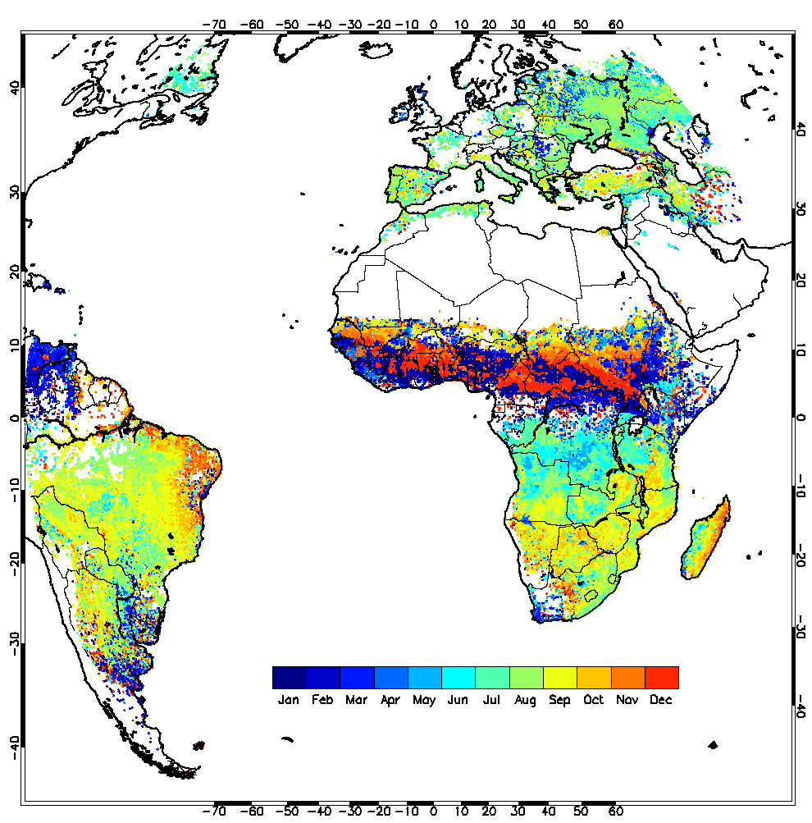
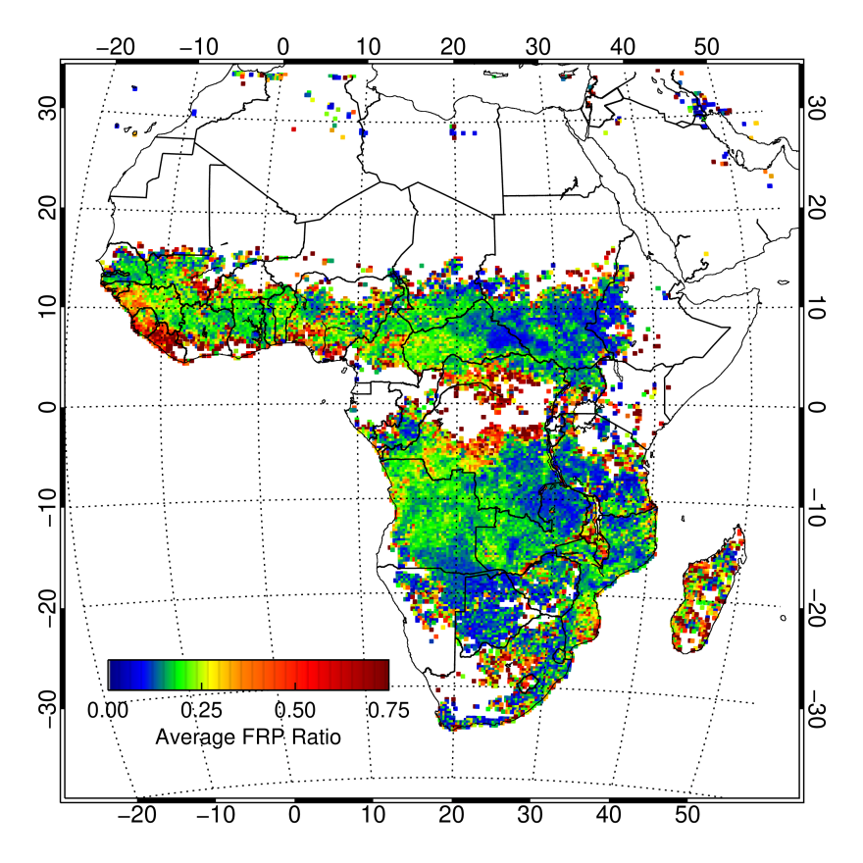
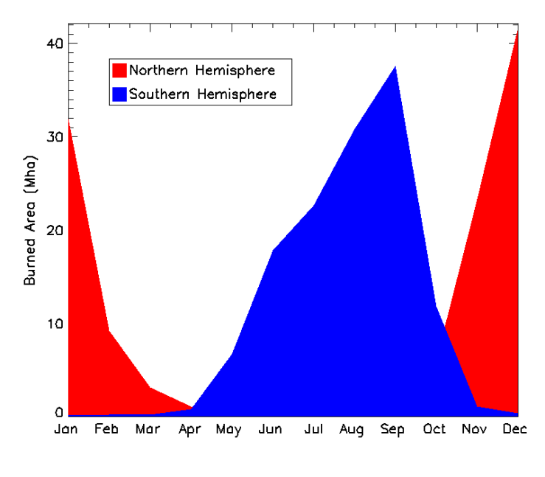
African Biomass Burning
Africa is largest continental BB emissions source
responsible for ~30-50% of total burned area
Most fires anthropogenic
land management practices
Strong diurnal and seasonal dynamics
Seasonal dynamics
Diurnal variation in fire activity :
Ratio between SEVIRI FRP measured at MODIS overpass times and SEVIRI FRP measured over the full diurnal cycle

Slide 3
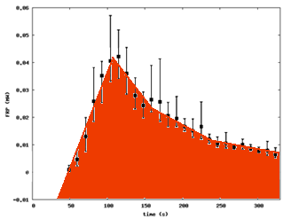
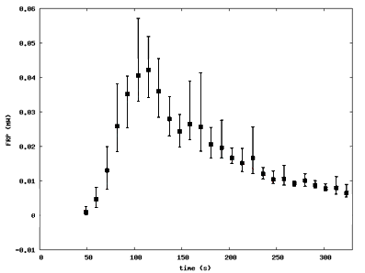
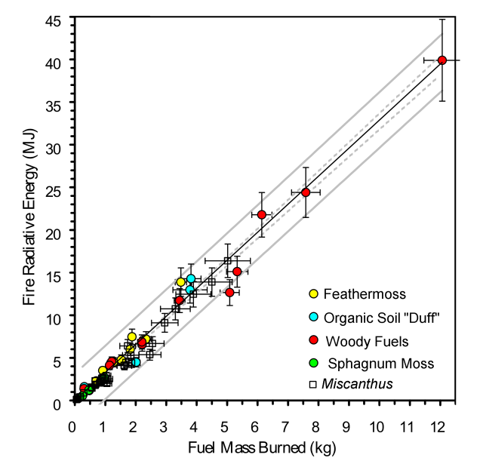
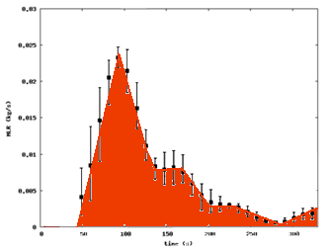
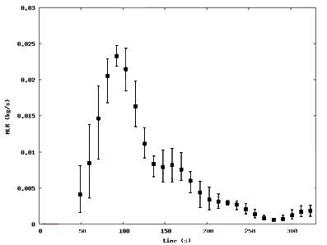
Relationship between Thermal Energy Emitted and Fuel Biomass Burned
Fire Radiative
Power (MW)
Fire Radiative Energy Emitted vs. Fuel Mass Burned
Fire Radiative
Energy (MJ)
FRP (MW)
Burnt Biomass
= Energy x CF
Combustion Factor (CF) ~ constant
Fuel Consumption
Rate (kg.s⁻¹)
Fuel Mass
Burned (kg)
Mass loss rate (kg/s)
Time (secs)
Notes:
The left hand graphs show timeseries of fire energy emission rate (called FRP – fire radiative power) and fuel consumption rate. Integrating under the curves gives total Fire Radiative Energy and Total fuel mass burned. This can then be plotted on the rhs scatterplot as one point. Do this for lots of different lab fires of different sized and different fuels – and you find strong linear relationship.
Thus by measuring the energy emitted we can estimate fuel consumption (which is related to the emissions of smoke as stated earlier)

Slide 4
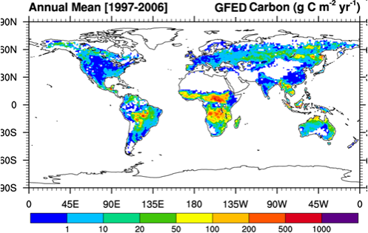
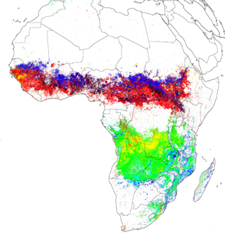
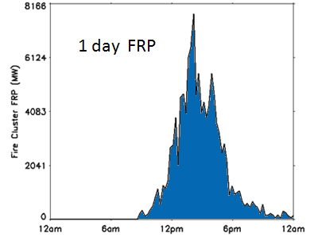
Biomass Burning Emissions Calculation
E_{i} = BA x FL x CC x EF_{i}
E_{i} = FRE x CF x EF_{i}
E_{i} = emission of species i [kg)]
“key uncertainties” (Reid et al. 2009)
(dynamic) veg. model
Global Fire Emissions
Database (GFED)
burnt biomass
land cover map
sat. obs.
Daily FRP
(single fire)
believed
~ constant
Geostationary FRE
(Roberts and Wooster, 2008)
E_{i} = emission of species i [kg(species i)] BA = burnt area [m²]
CC = combustion completeness [kg(burnt fuel) / kg (available fuel)]
EF_{i} = emission factor for species i [kg(species i) / kg(biomass)] FL = fuel load [kg(biomass) / m²]
FRP = fire radiative power [MW] FRE = Fire Radiative Energy [MJ] = ∫ FRP(t) dt
CF = combustion factor [kg(biomass) / MJ (FRE)]
Notes:
Possible drop this one?
This shows the eqn normally used for fire smoke emission calculations, vs that used when we take the fire enegery emissinon approach
Top line is burned area x fuel load x combustion completeness (i.e. how much of the available fuel actually burns)
Bottom line is simpler – Fire Radiaitve Enegry x the “Conversion Factor” defined via the lab experiments.
Both are then mutlitpied by the “EF” – the emissions factor that converts burned biomass into an amount of smoke

Slide 5
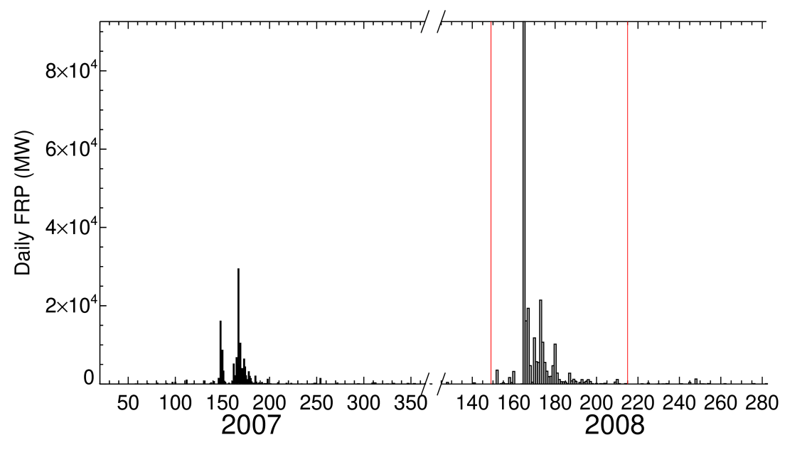
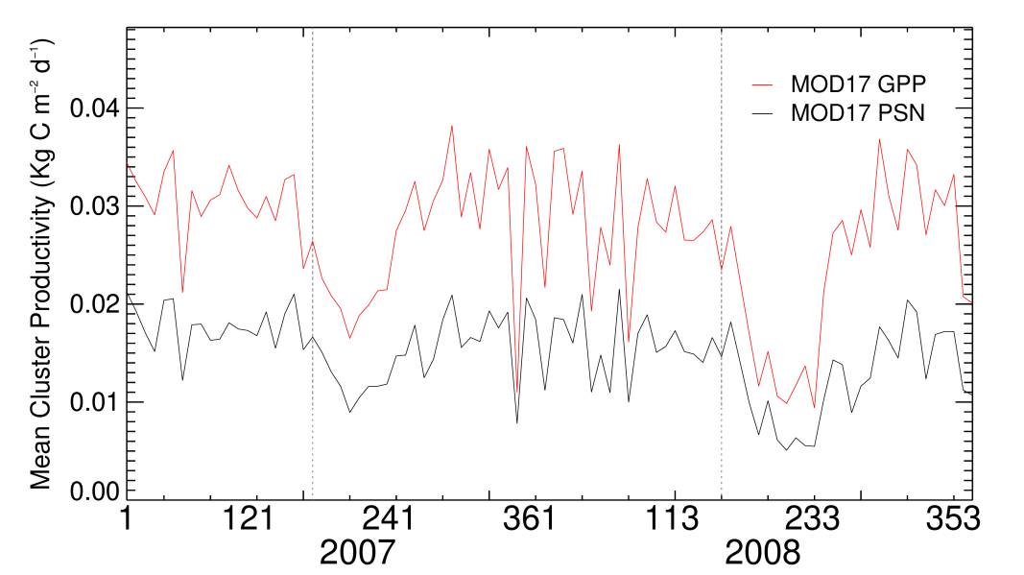
FRE-derived Fuel Consumption and Vegetation Productivity: Methodology
Vegetation Productivity
MCD64 burned area product (Giglio et al., 2013)
Define burned area ‘clusters’
Identify areas which burn in successive years
Integrate 500m MODIS Net Photosynthesis (MOD17)
last BA DOY (previous year) → first BA detection (current year)
Maintenance and growth respiration included
SEVIRI FRP
Integrate FRP over burned area
date of first BA detection → date of last BA detection (current year)
Est. FRE and total fuel consumption
FRP conversion factor 0.368 (Wooster et al., 2005)
Use ‘well observed’ fire clusters
>10 obs. per-pixel
Roberts et al., 2018

Slide 6
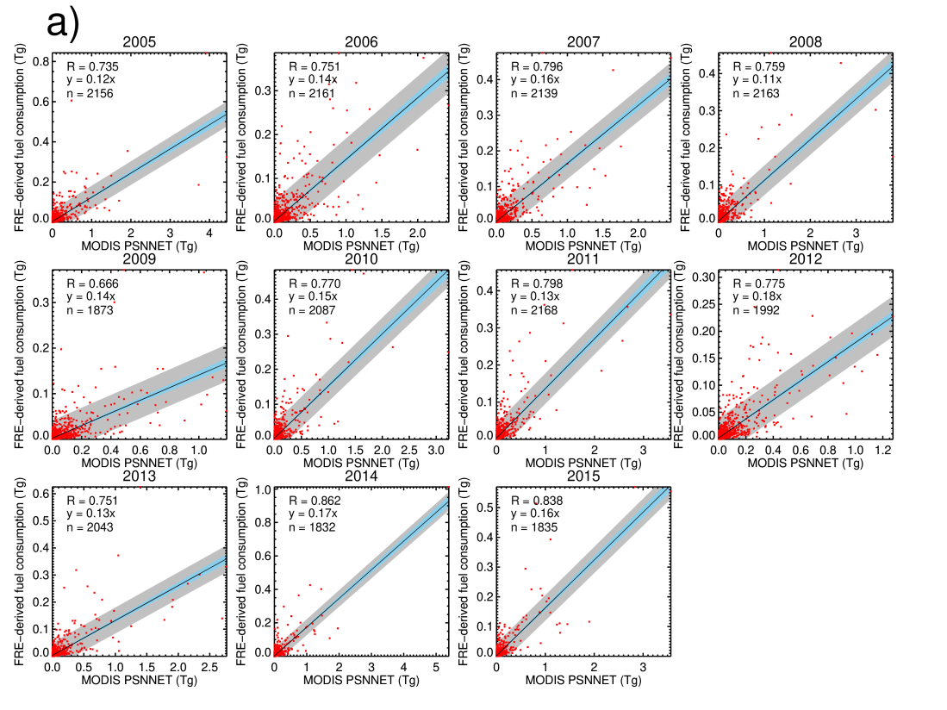
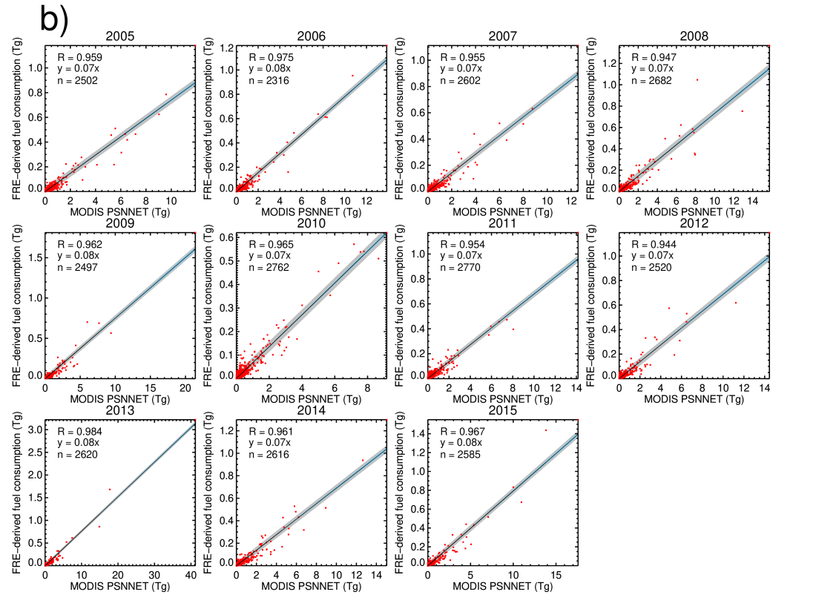
Fuel Consumption (FC) and MODIS Productivity
Northern Hemisphere Africa
Southern Hemisphere Africa
Correspondence between FRE-derived FC and productivity
Low and variable in northern hemisphere (mean r=0.75)
Strong in southern hemisphere (mean r=0.96)
Encouraging given very different methods
FRE-derived FC typically 7-14% of productivity BUT
Combustion completeness
PSN - maintenance respiration of live wood and growth respiration are not accounted for
All fuel remove in previous fire

Slide 7
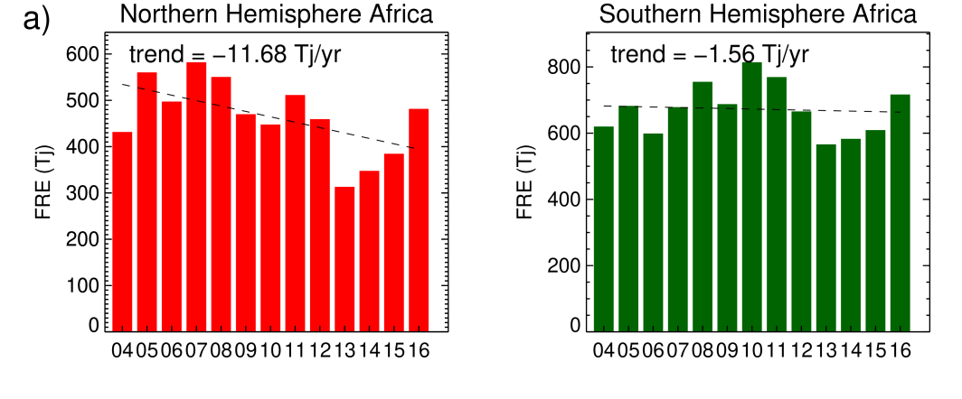
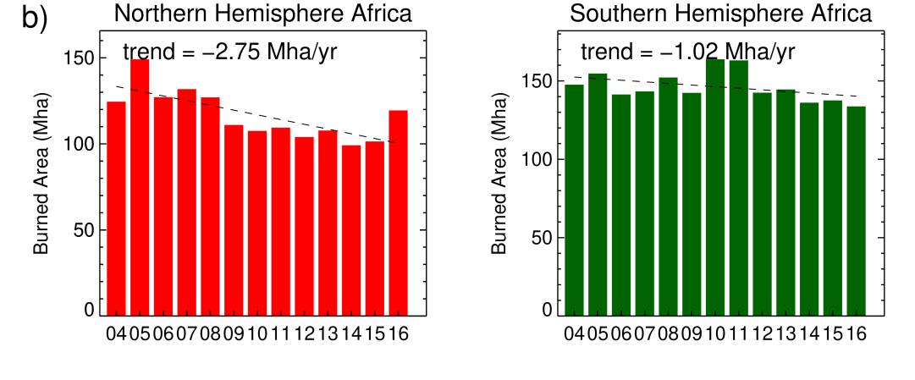
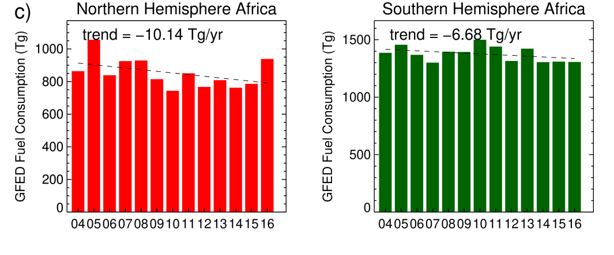
Africa : Annual Landscape Fire Dynamics
Fire Radiative Energy
Number of ways to characterise fire activity
Large –ve trends in northern hemisphere
Land cover change (Andela and van der Werf, 2016)
Small –ve trend in southern hemisphere
Validation of fuel consumption (FC) challenging
Limited field observations
Field FC m² may not capture burn heterogeneity
Alternative assessment is via comparison against EO productivity (‘fuel availability’)
Burned Area
Fuel Consumption

Slide 8
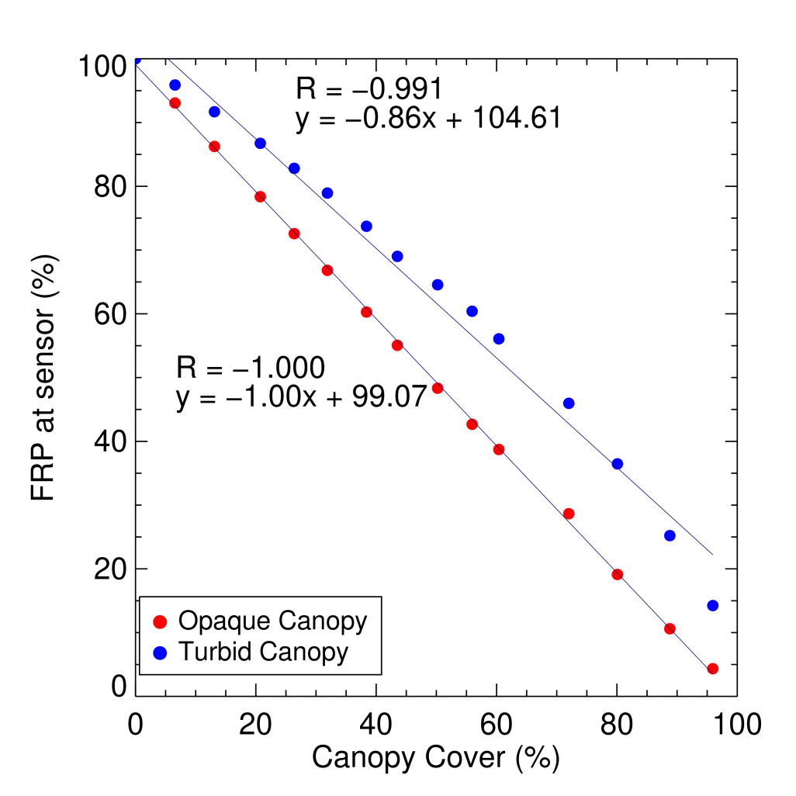
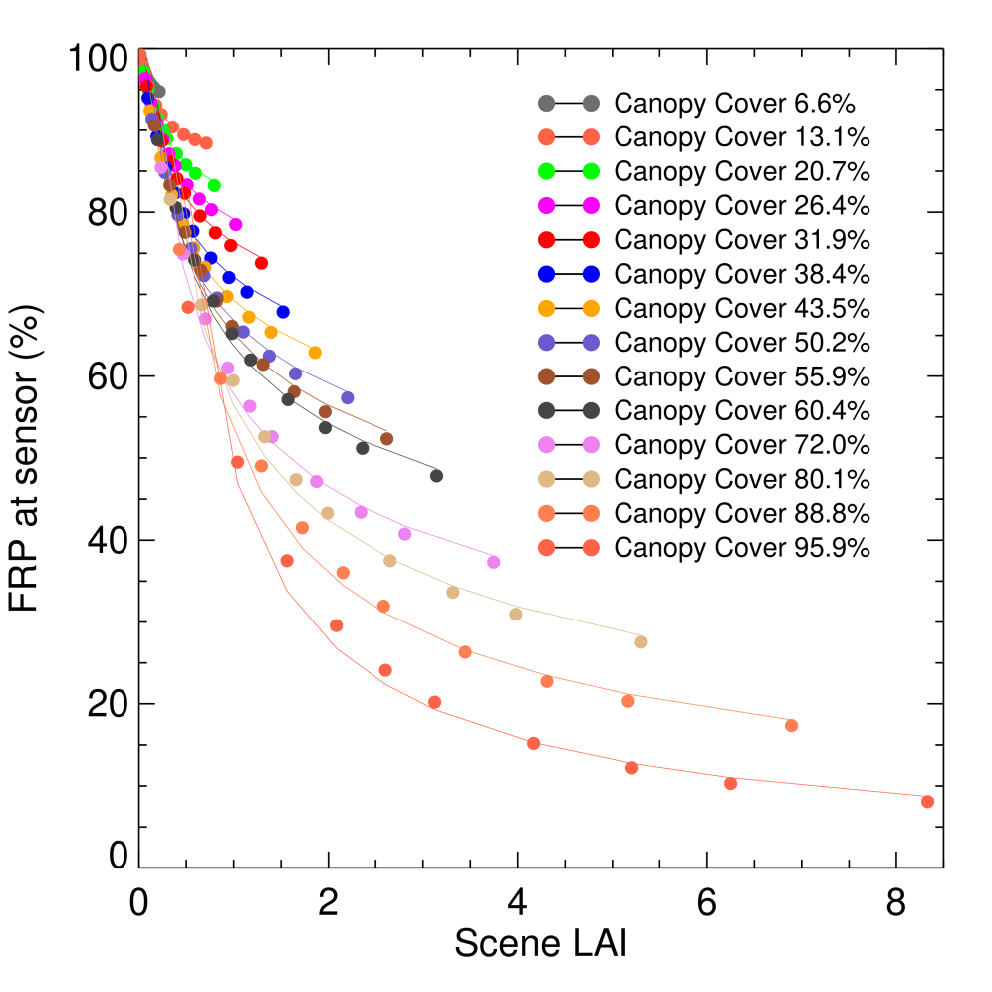
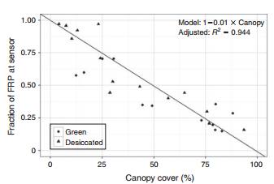
Impact of Canopy Structure (at nadir)
Opaque Canopy
FRP interception proportional to
canopy cover
No crown transmittance
LAI and canopy cover
Reduced by 6% when %cover and LAI low
Reduced by 92% at high %cover and LAI
RH limits fire under dense canopies
Turbid Canopy
FRP interception remains high & decreases by ~14%
more realistic representation
Mathews et al., (2016)

Slide 9
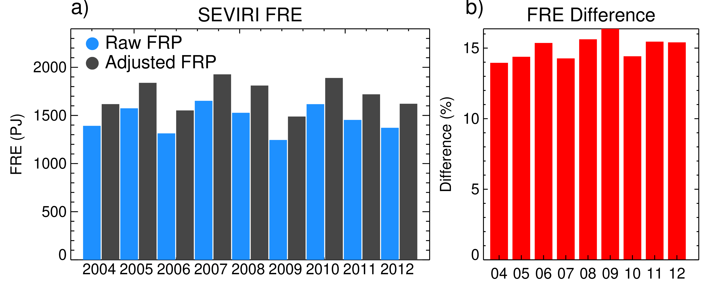
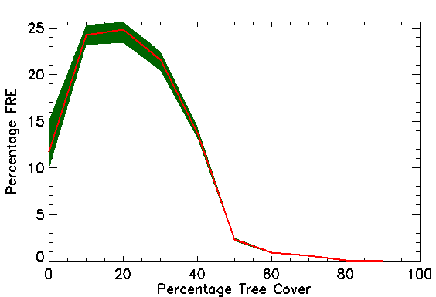
Correcting EO FRP for canopy interception
Correcting SEVIRI FRP for impact of canopy cover, view zenith and LAI
14-17% increase
~15% decrease in sensor FRP due to canopy interception
most fire activity in Africa occurs in areas <40% cover
Alone doesn’t account for FRP-derived fuel consumption underestimation compare to GFED, which may not be the real truth.

Slide 10
Conclusion
Strong Seasonality and Fire Diurnal Cycle
FRP-derived fuel consumption
Good agreement with fuel availability in southern hemisphere
Weaker relationship in the northern hemisphere
Correcting for canopy cover and LAI increases SEVIRI FRP over Africa by ~15% (most fires detected in regions <50% tree cover)
Not sufficient alone to account for FRP underestimation
Omission of low intensity fires main factor
Different landcover should have different emission coefficients instead the same FRP conversion factor (0.368) used in this paper

