Slide 1
New LSASAF Fire Emission product
Presenter: Tianran Zhang
Contribution from: Martin Wooster, Hannah Nguyen, Jiangping He, Weidong Xu, Tianran Zhang
Notes:
Exploti geo data since GFAS hasn’t done that

Slide 2
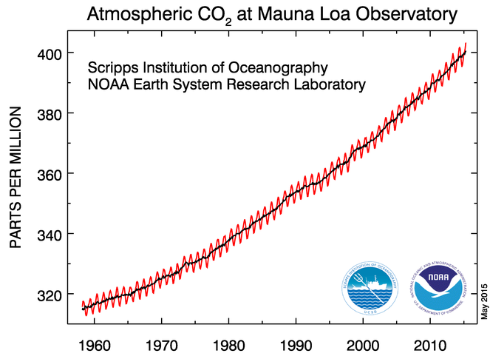
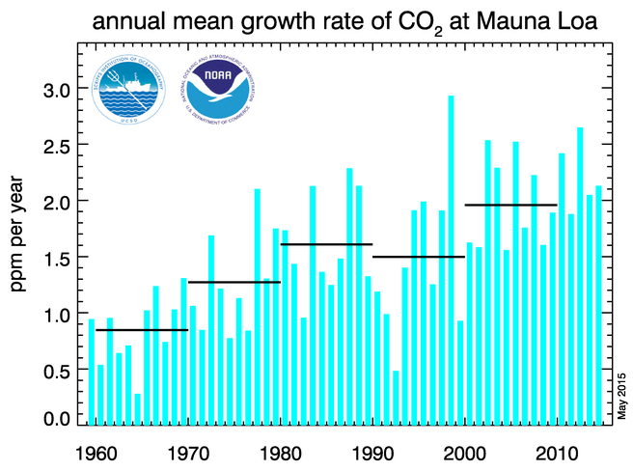
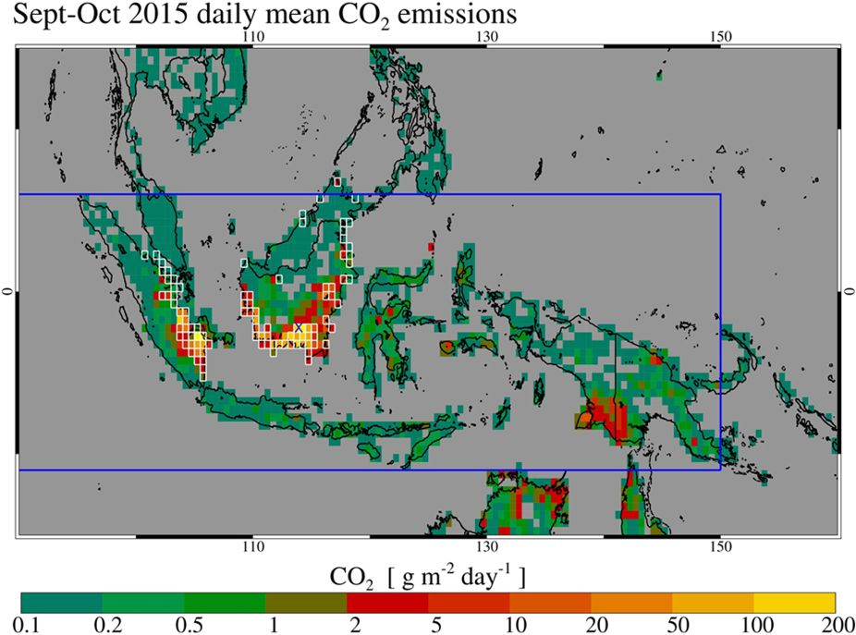
Background: Biomass Burning Atm. CO2 Contribution
Fire CO2 emissions average 2.0 Pg C yr-1
Deforestation & forest degradation is 2nd largest anthropogenic CO2 source after fossil fuel combustion.
Together estimated as ~ 15% of net global annual average CO2 emissions.
With a mean emission rate of 11.3 Tg CO₂ per day during Sept-Oct 2015, emissions from these fires exceeded the fossil fuel CO₂ release rate of the European Union (EU28) (8.9 Tg CO₂ per day).

Slide 3
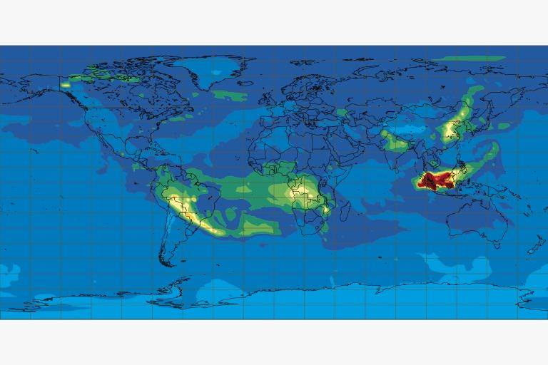
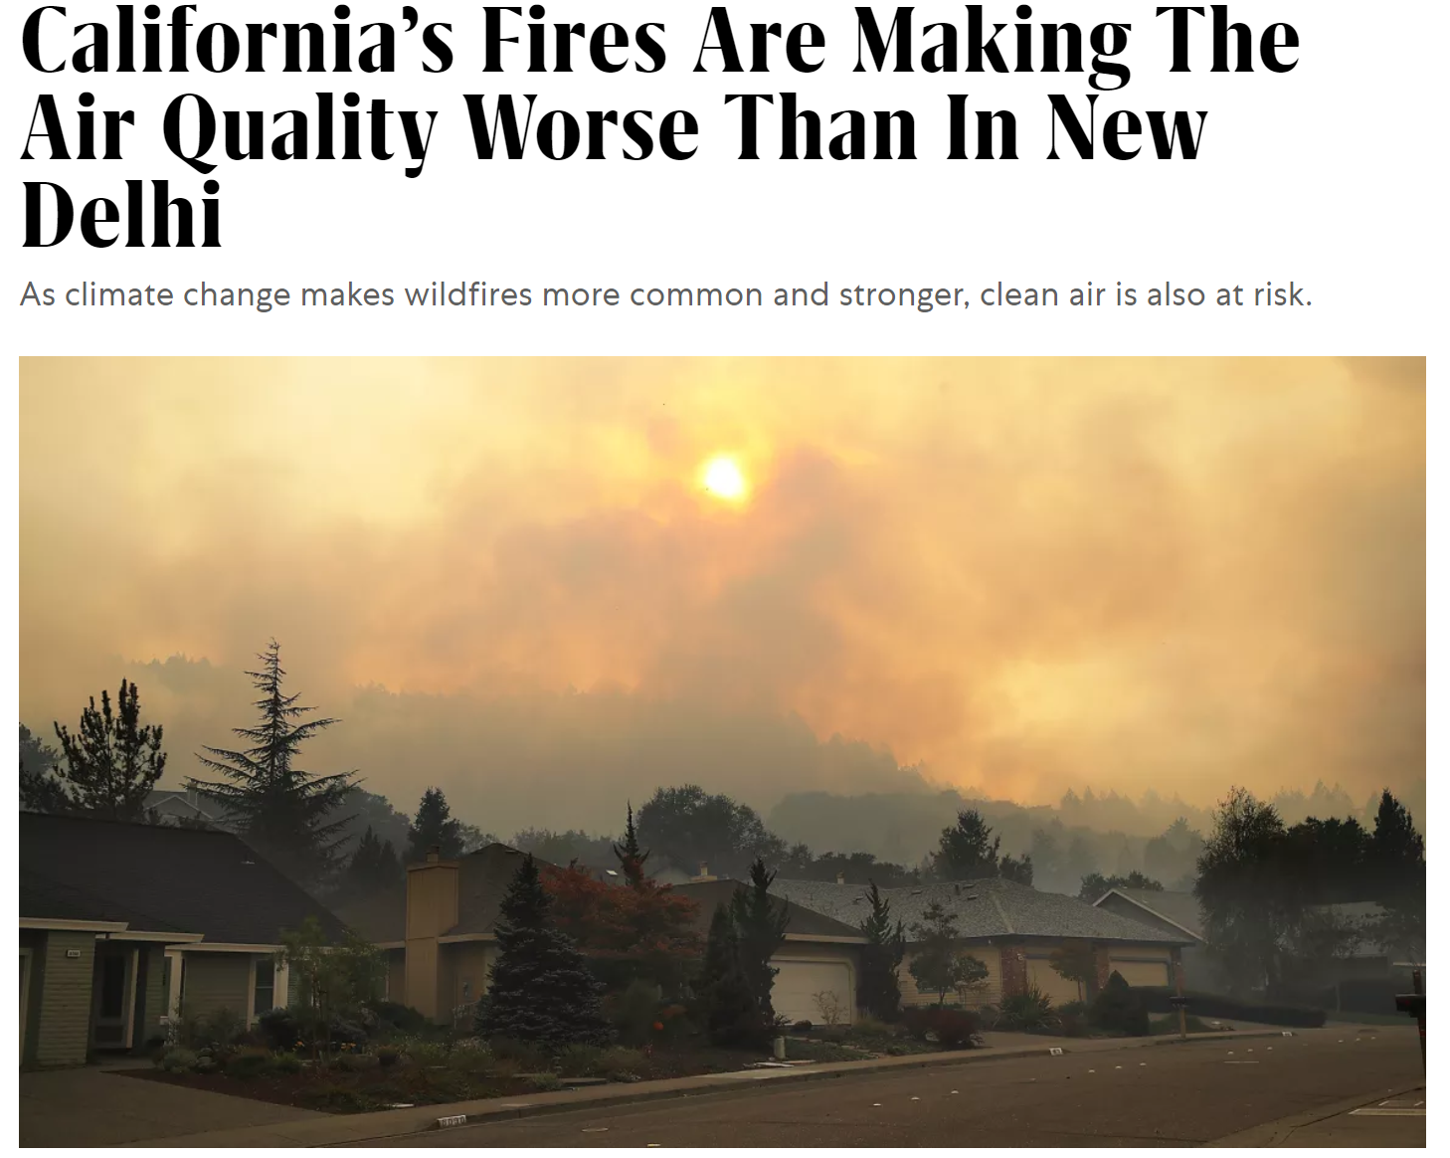
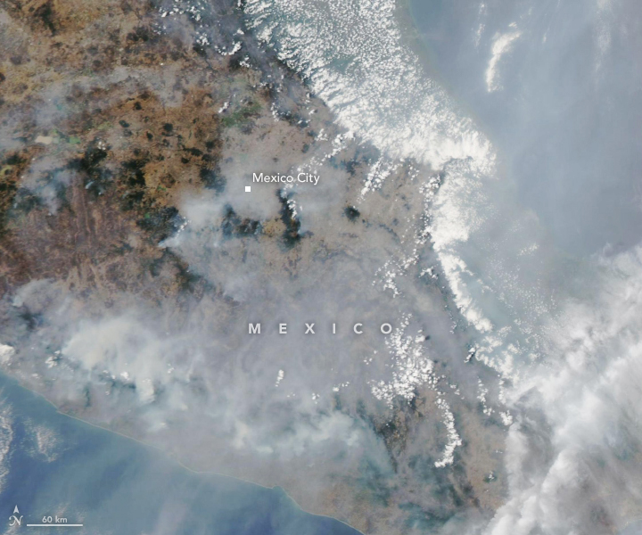
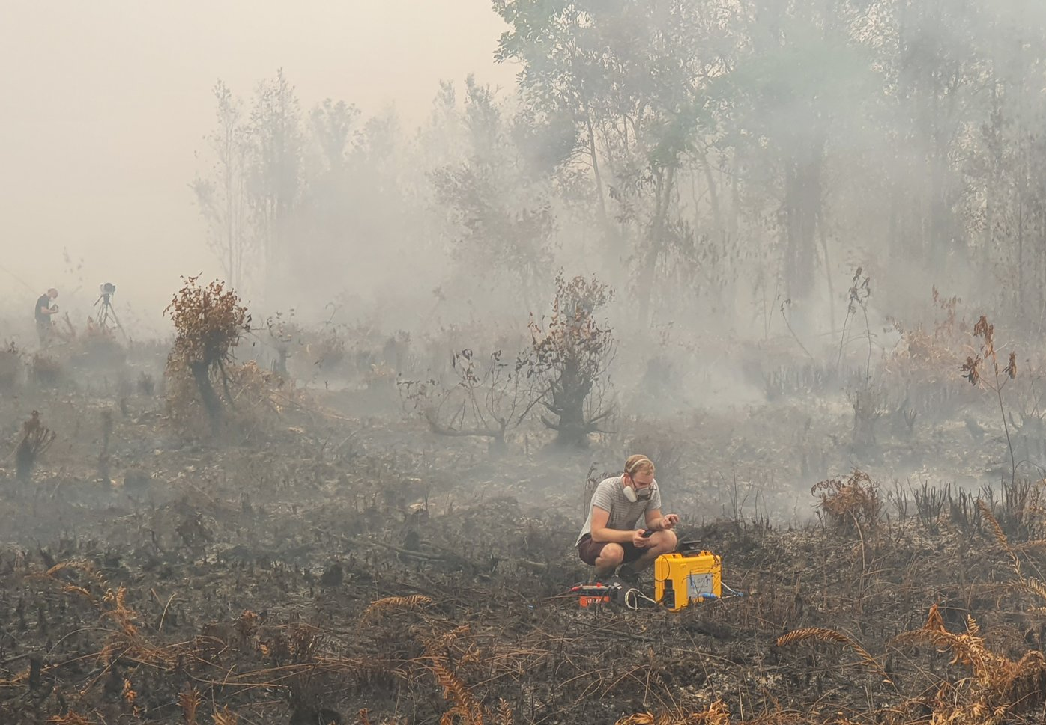
Background: Biomass Burning Emissions
Biomass burning a major air pollution source (PM2.5, VOCs, tropospheric O3, CO..).
Respiratory effects.
SE Asia + 200 days/yr-1 > WHO AQ targets.
Indonesia peat burning in 09/2019
Notes:
Main issue: aerosol emission

Slide 4
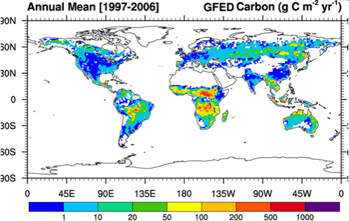
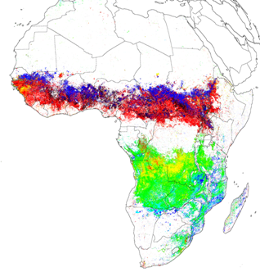
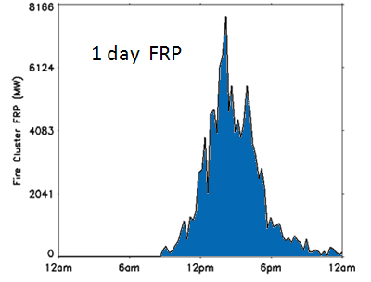
Biomass Burning Emissions Calculation
E_{i} = BA x FL x CC x EF_{i}
E_{i} = FRE x CF x EF_{i}
Global Fire Emissions
Database (GFED)
E_{i} = emission of species i [kg)]
“key uncertainties” (Reid et al. 2009)
(dynamic) veg. model
burnt biomass
sat. obs.
land cover map
Daily FRP
(single fire)
believed
~ constant
Geostationary FRE
(Roberts and Wooster, 2008)
E_{i} = emission of species i [kg(species i)] BA = burnt area [m²]
CC = combustion completeness [kg(burnt fuel) / kg (available fuel)]
EF_{i} = emission factor for species i [kg(species i) / kg(biomass)] FL = fuel load [kg(biomass) / m²]
FRP = fire radiative power [MW] FRE = Fire Radiative Energy [MJ] = ∫ FRP(t) dt
CF = combustion factor [kg(biomass) / MJ (FRE)]
Notes:
Gfed is not good for real time
Concersion factor is consistant (CF) no matter what you burn

Slide 5
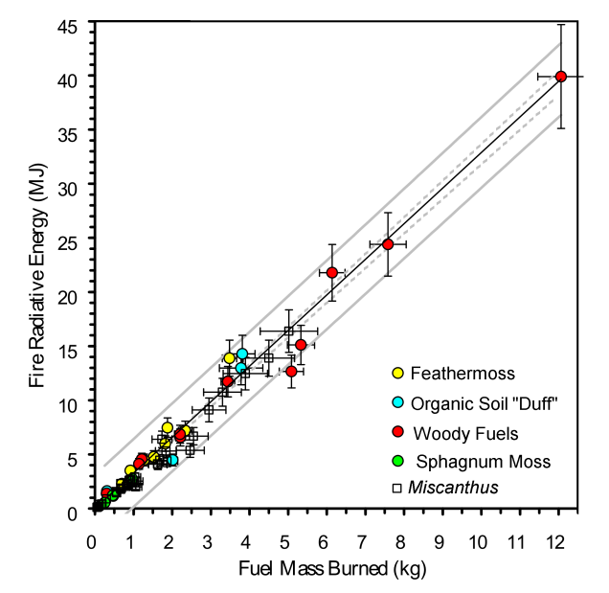
Fire Radiative Energy & Fuel Consumption
Slope is the “combustion factor” CF linking FRP directly to fuel consumption.
Fuel Consumption = Σ FRP × CF
CF = 0.37 kg.MJ⁻¹

Slide 6



GFAS MODIS-estimated FRE to GFED3.1 Fuel Consumption
SA: Savanna AG: Agricultural
DF: Tropical PE: Peat
EF: Extratropical
“OM” = with organic matter burning
Savanna
Forest
Derivation of conversion factors (CF) from linearly regressing monthly GFED3.1 DM with GFAS1.0 FRE
Cf_{small scale} = 0.37 g kJ⁻¹
Kaiser et al. (2012) Biogeosciences
Notes:
Small fires missed
Tree block
FRE from modis denial cycle might be not captured very well
GFAS get round by comparing FRE to GFED
This method is good but can only as good GFED ever

Slide 7
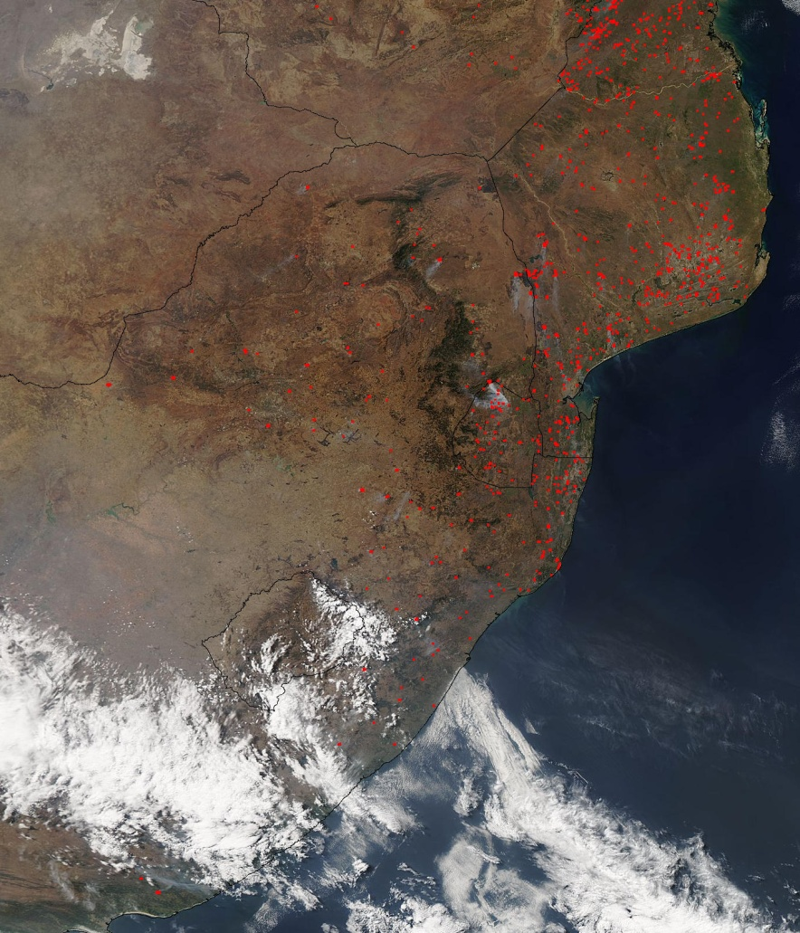
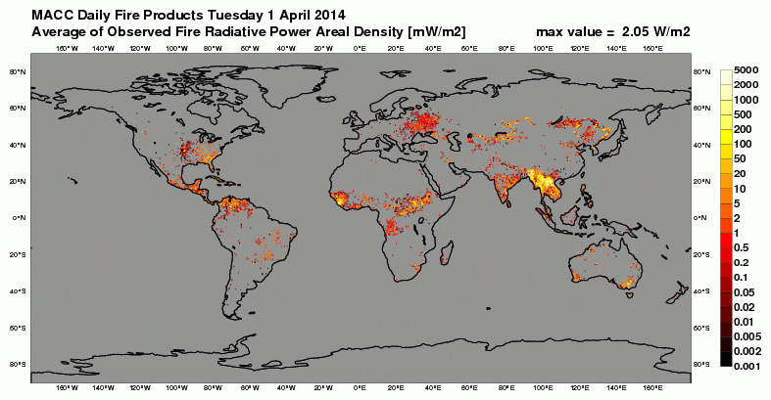
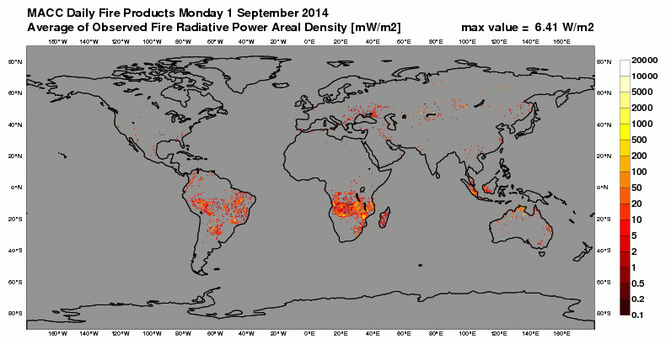
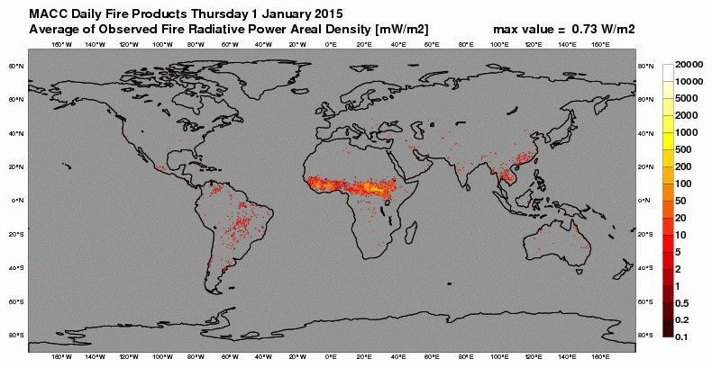
Aqua-MODIS
15 Sept 2014
April 2014
MODIS FRP Based
Sept 2014
Copernicus Atmosphere
Monitoring Service (CAMS)
Global Fire Assimilation System (GFAS)
Jan 2015

Slide 8
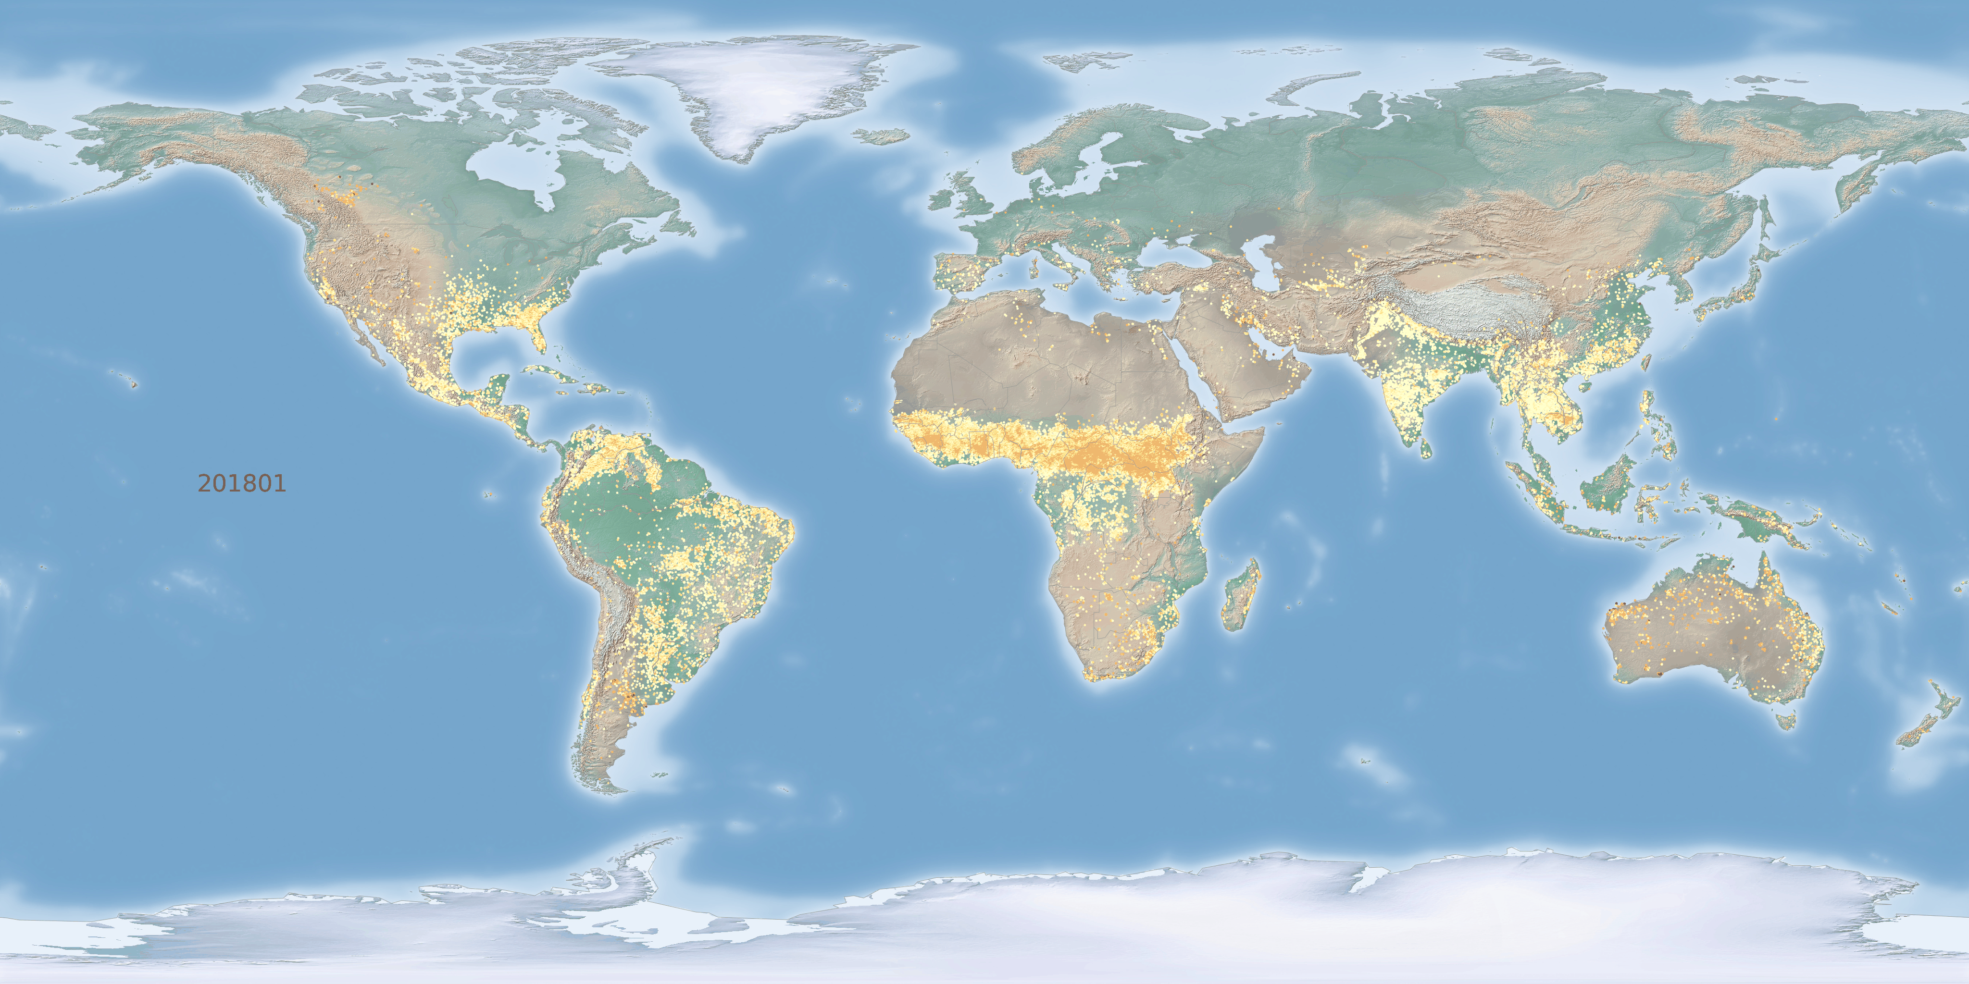
Biomass Burning Carbon Emission from CAMS-GFAS

Slide 9

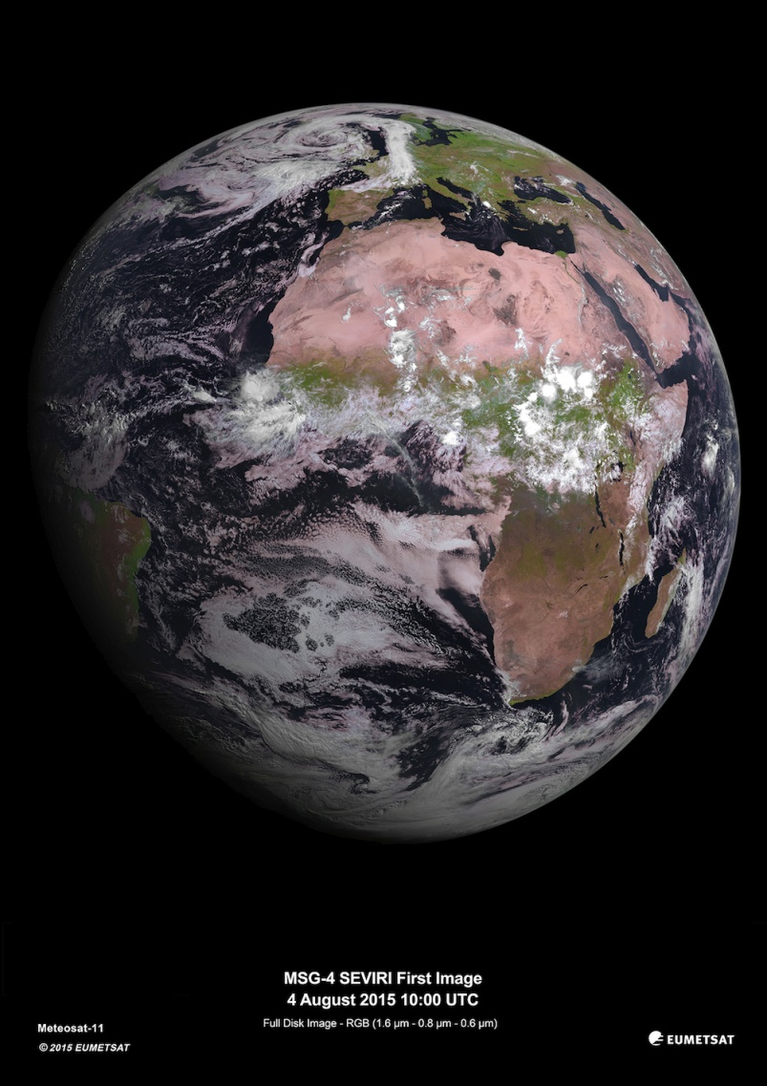
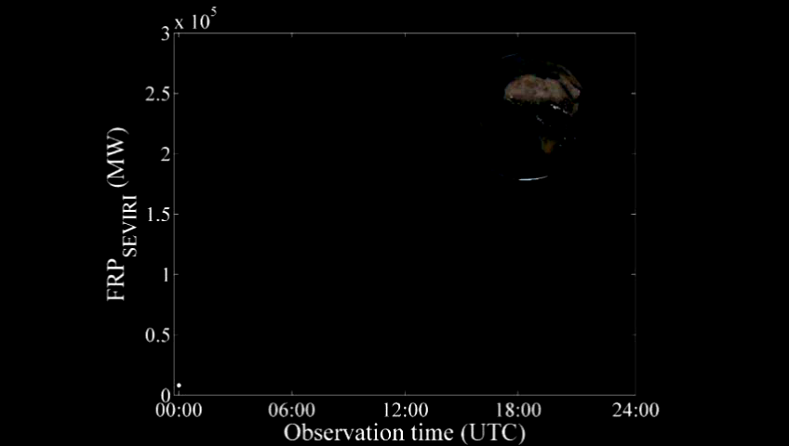
Meteosat SEVIRI and African
Fire Radiative Power Retrievals
LSA SAF Meteosat FRP-PIXEL Product
Wooster et al. (2015) ACP, 15, 13217-13239
Delivered by EUMETSAT LSA SAF every 15 mins - https://landsaf.ipma.pt/
Notes:
Ideal by bapass the method of GFAS

Slide 10
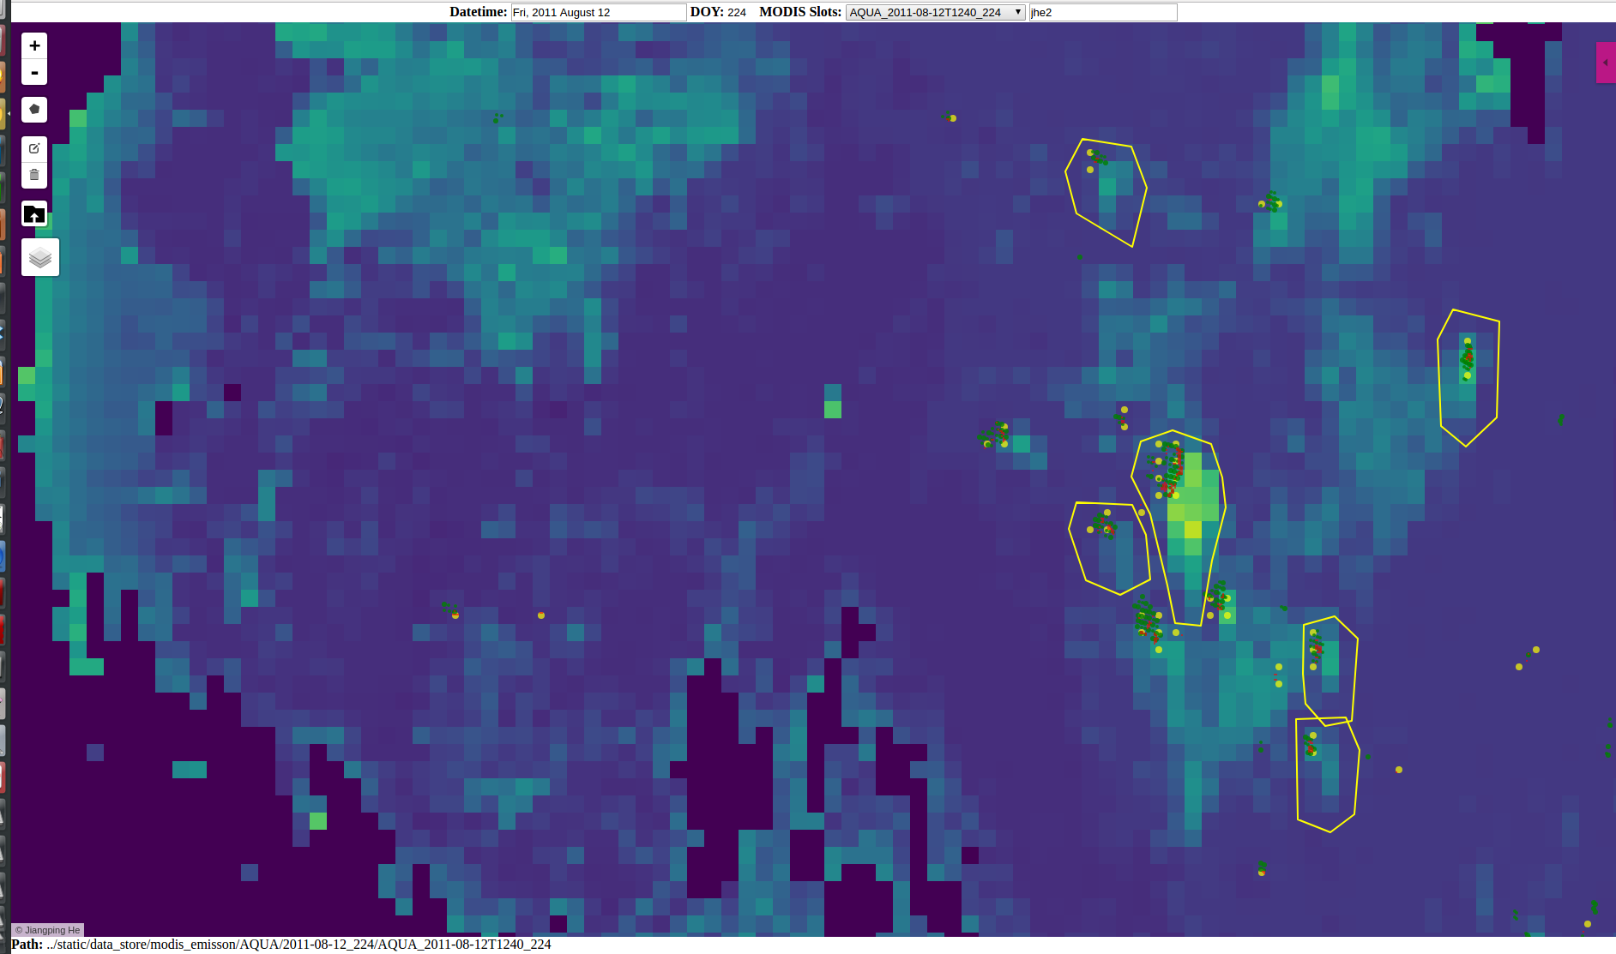
Smoke Plume Delineation
SEVIRI Active Fire Detections
MODIS AF Detections
MODIS AF Detections Remapped
MODIS 10 km AOD Product

Slide 11
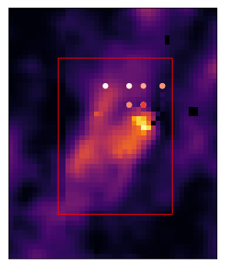
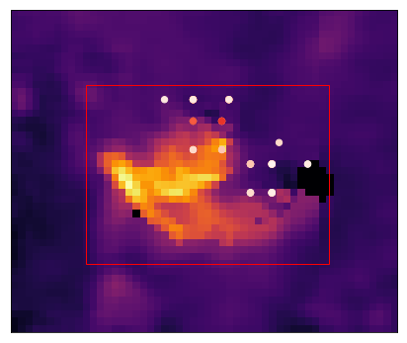
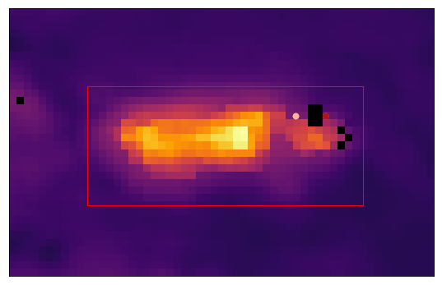
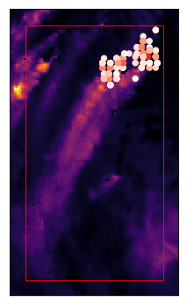
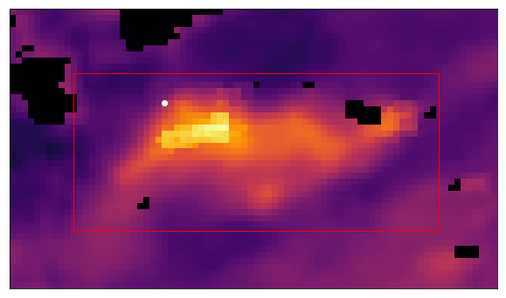
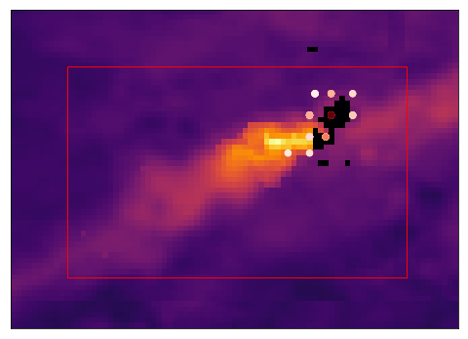
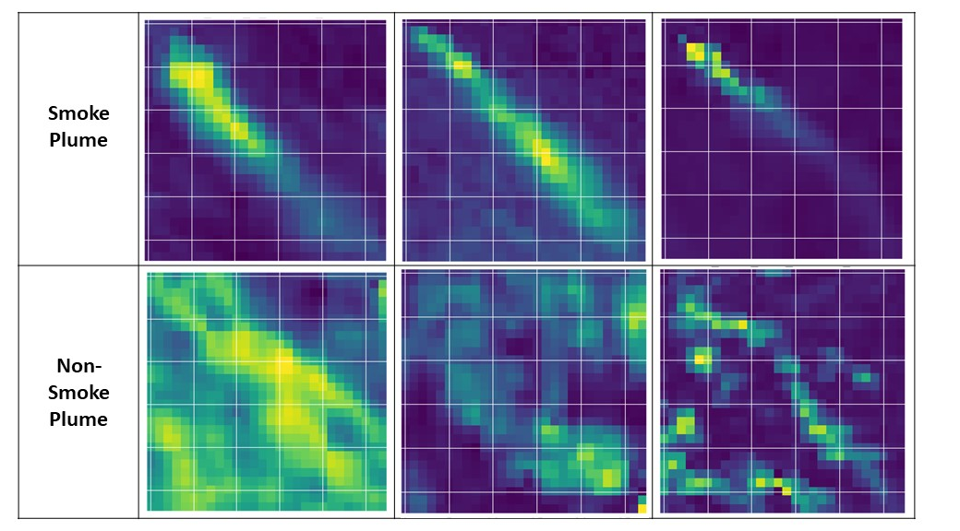
Developing and Evaluating a top-down approach for Emission Estimates
Methodology
1) Generate a dataset of match-ups between FRP and Total Particulate Matter derived from AOD measurements
2015
Notes:
Aod correlation with total particular matter
Controlled by a conversion value

Slide 12
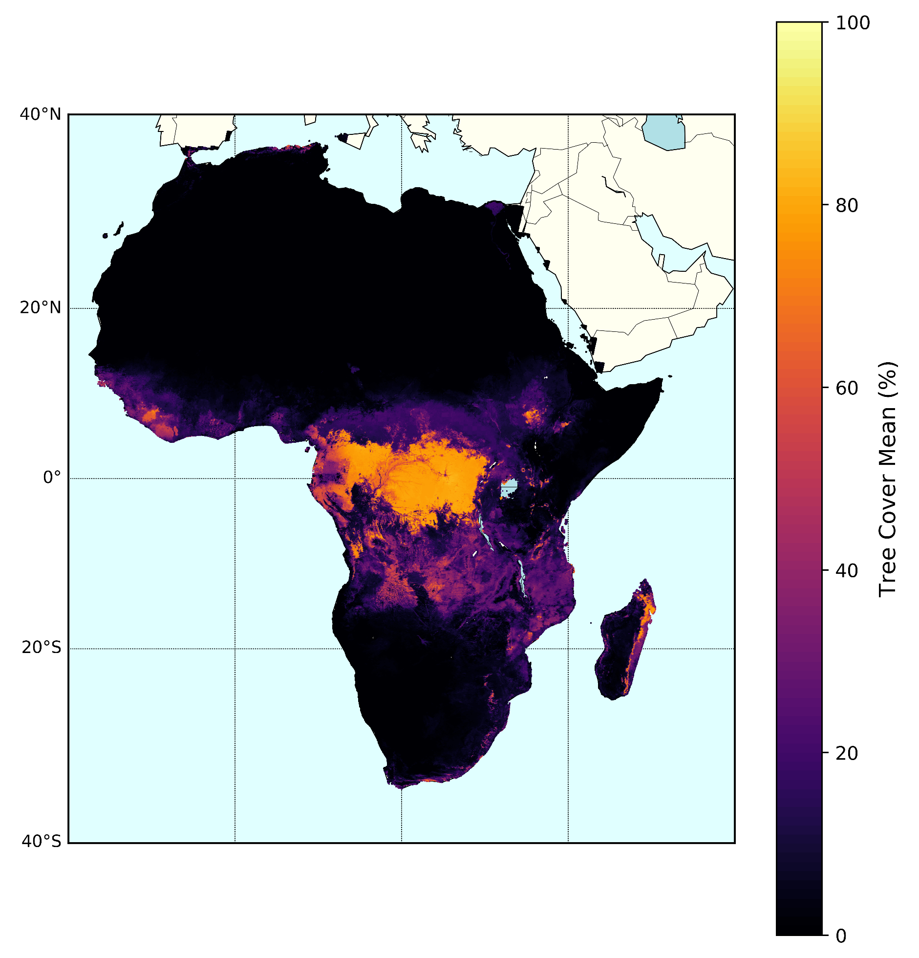
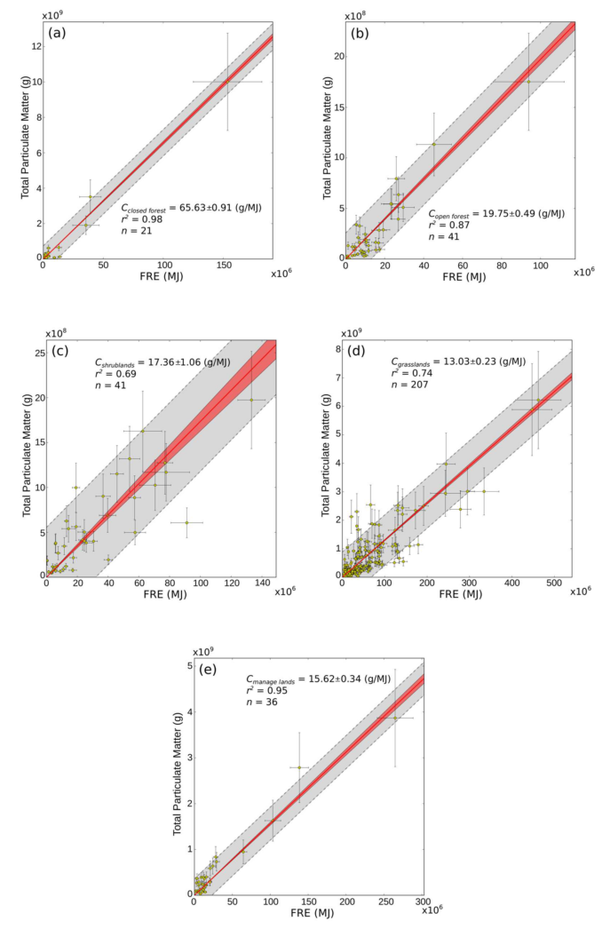
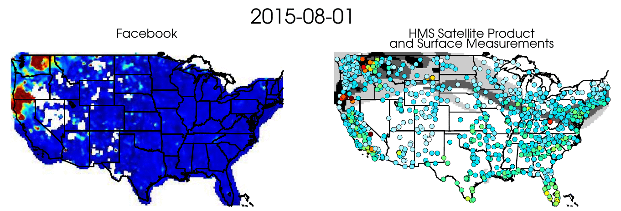
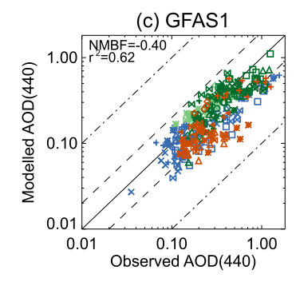
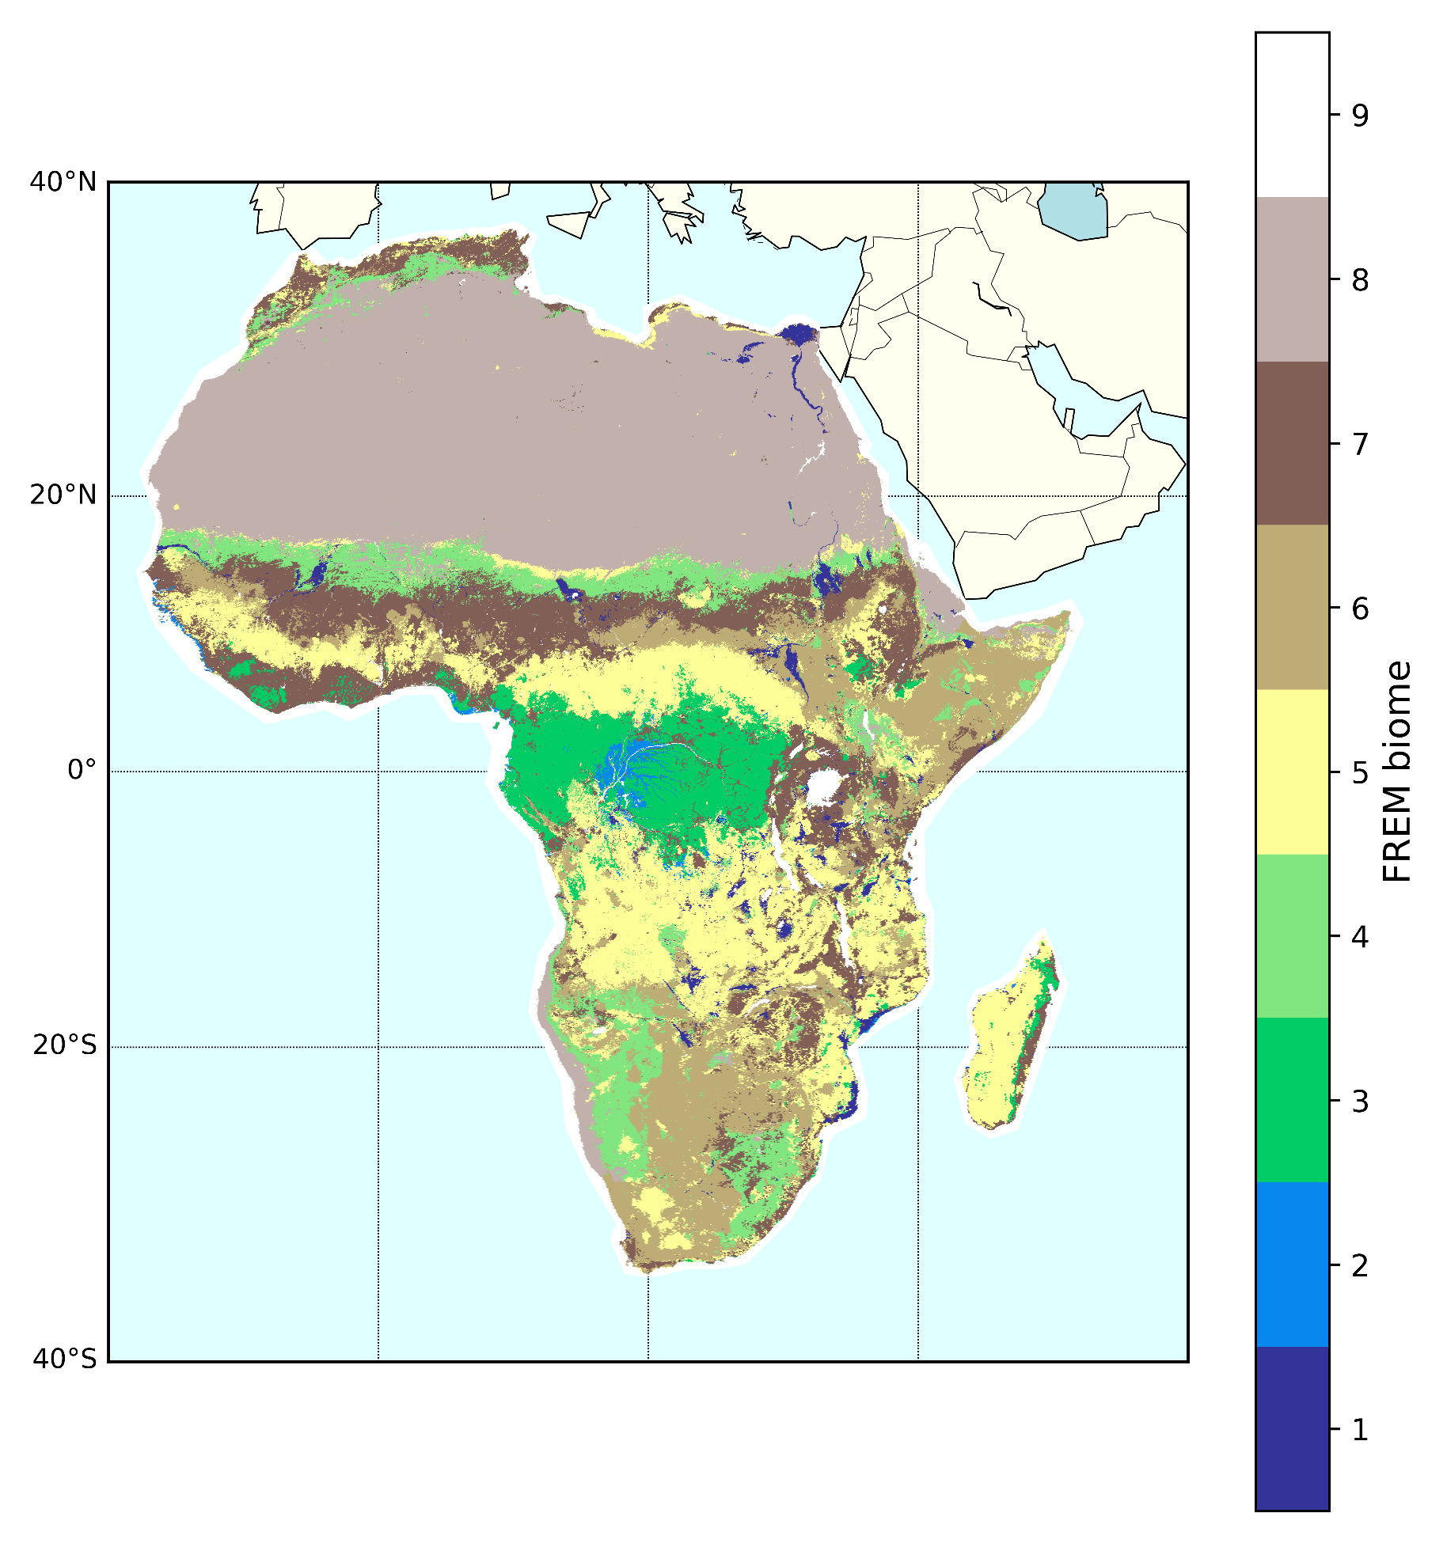
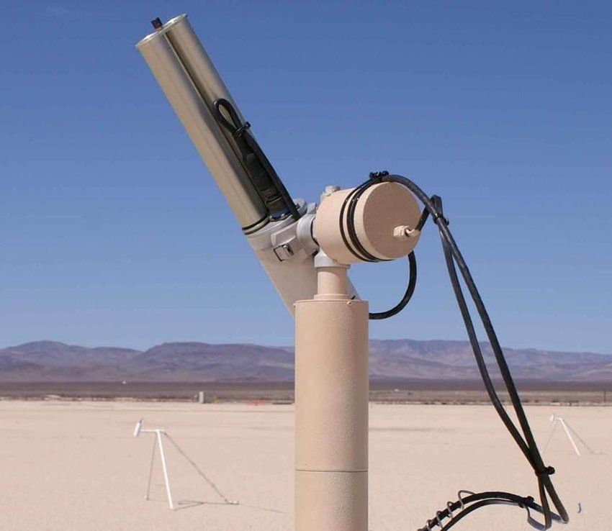
2) Combine EO Landcover and Tree cover maps
3) Classify plume-FRP match-ups by biome and use the relation between total TPM and FRP to derive biome specific emission coefficients
4) Use the derived Emission inventory in a CTM to evaluate the results against satellite and ground observations of AOD
Tree Cover Landsat-8 (30 m)
CCI Landcover (MERIS 300 m)
Notes:
5/6 classes
Cooffiecnt can just apply forward, not change in between years, only for landcover

Slide 13
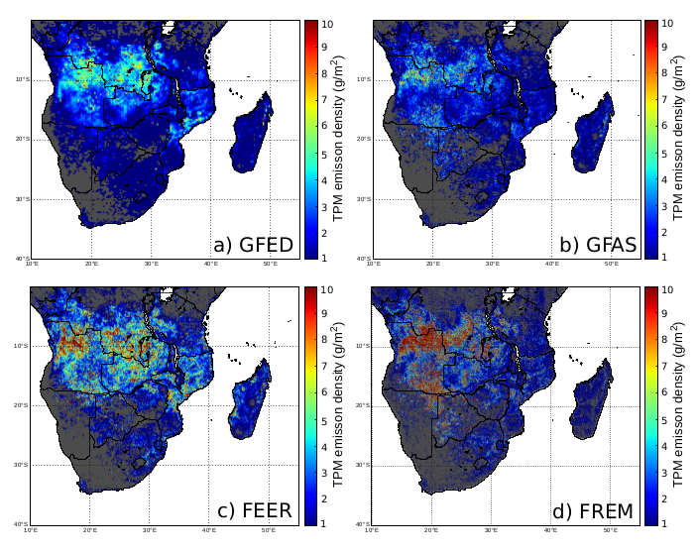
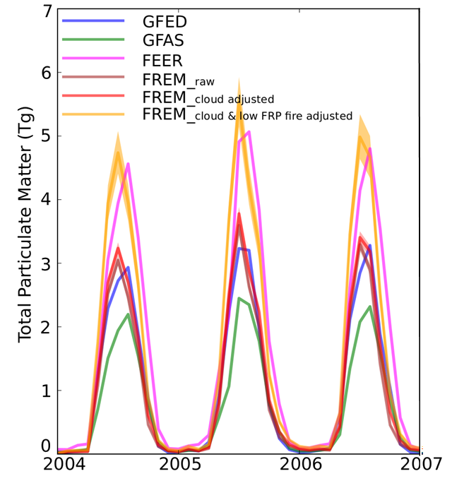
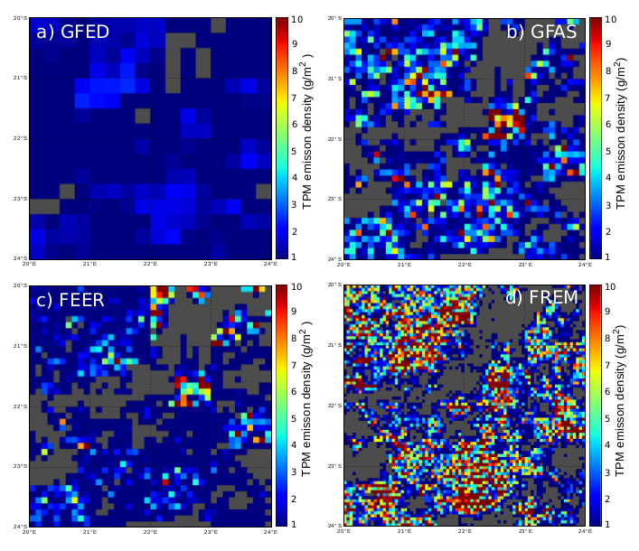
TPM Emission Product Density
TPM Emissions Density [g.m⁻²]
Notes:
GFAS a factor of 3 to match
So this is like to be correct

Slide 14
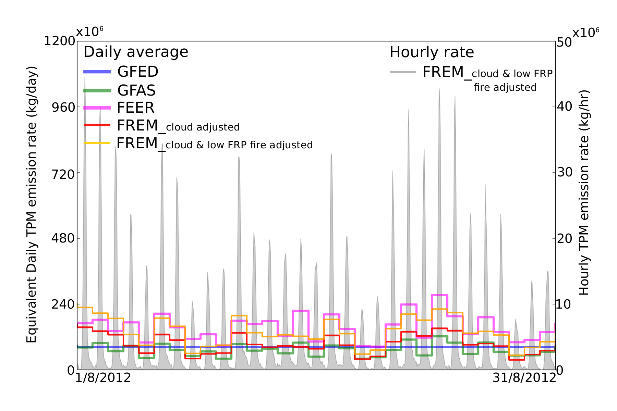
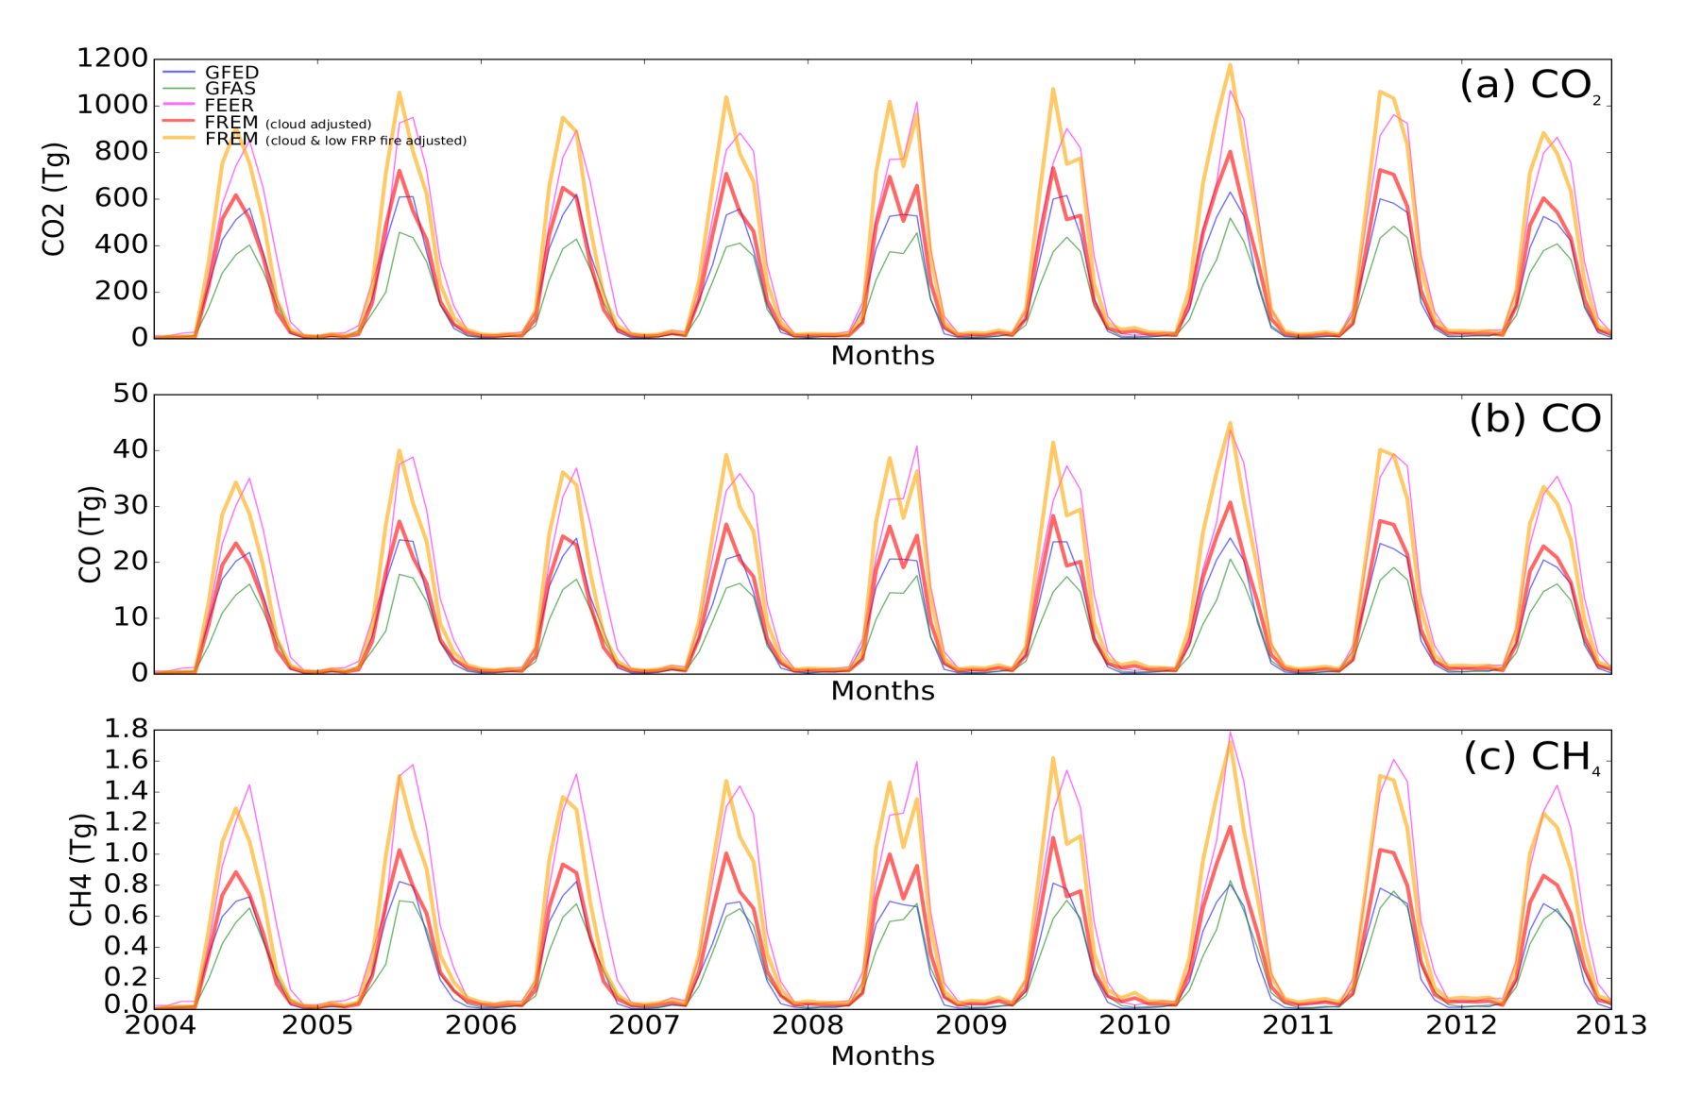
TPM Emission Rate - Southern Africa August 2012 Temporal Detail
Emission of species X = TPM Emissions . EF_{x} / EF_{TPM}
Notes:
Temporal detail, huge daily variety
Better for input in transport model
Convert total particulate to other emissions
CO, CO2, CH4, and total carbon 15min 1day
Next half year, demo mode.

