Slide 1
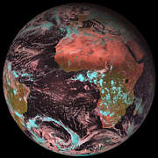
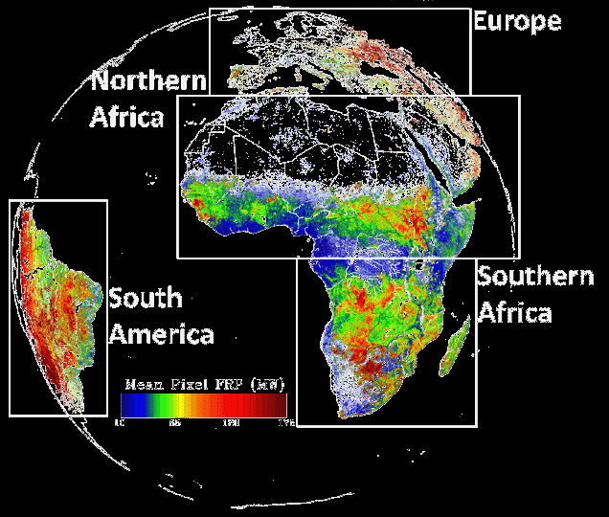
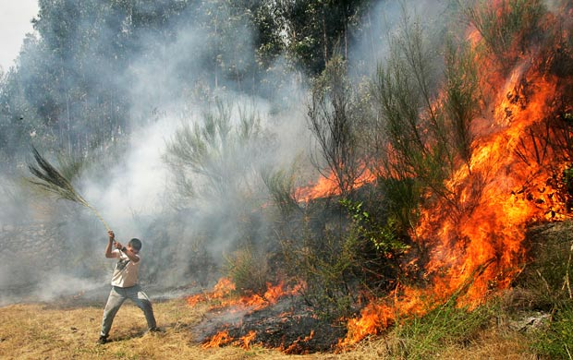
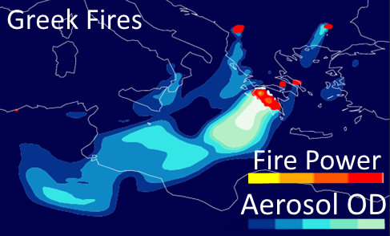
Major advances of LSA SAF FRP-PIXEL Product
Martin J. Wooster, Weidong Xu,
Gareth Roberts,
And Jiangping He
SALGEE 2019 workshop Darmstadt
14-17 Oct 2019
Background
SEVIRI
FRP-PIXEL
Applications

Slide 2
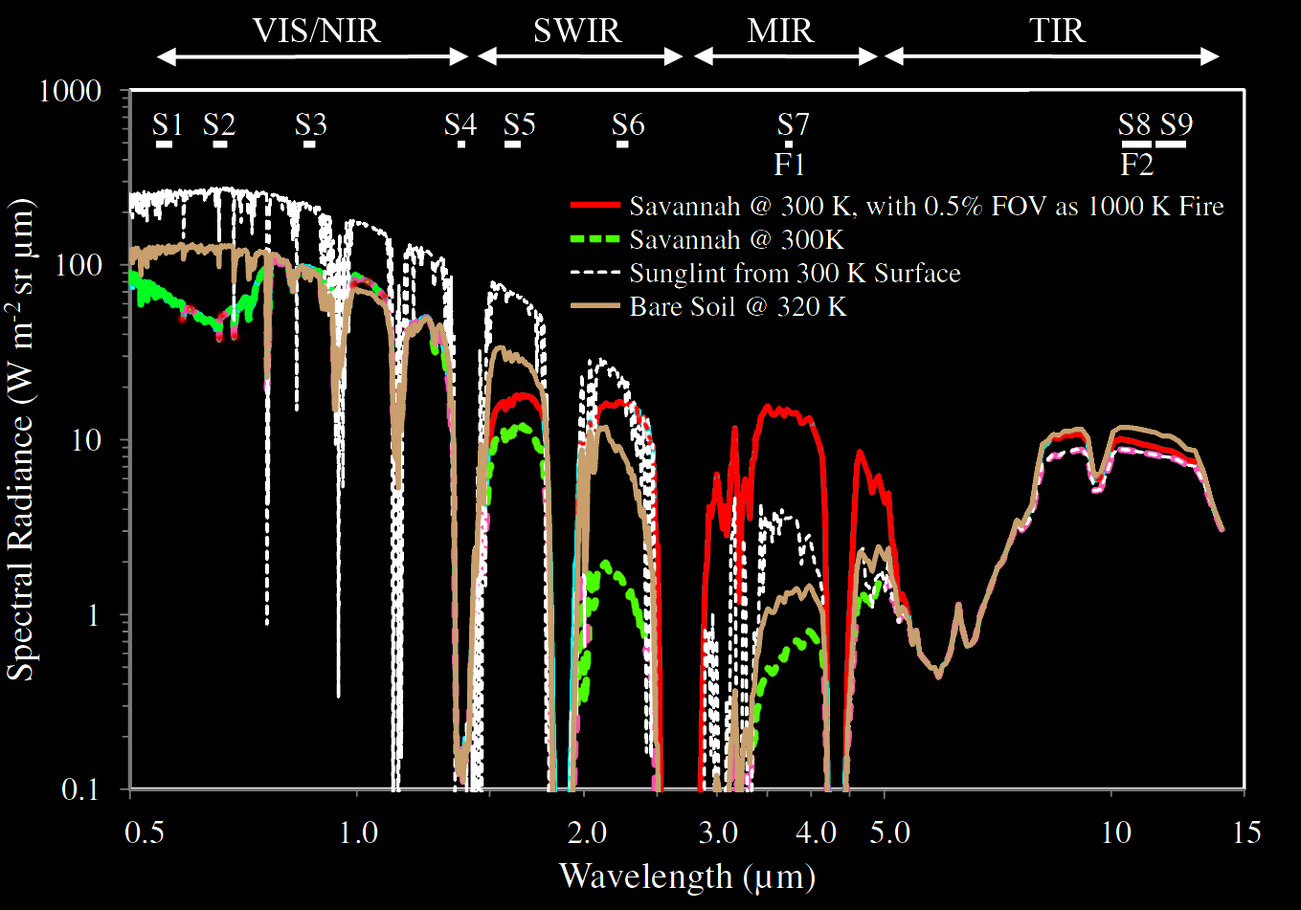
Radiative Transfer of Active Fire Detection

Slide 3
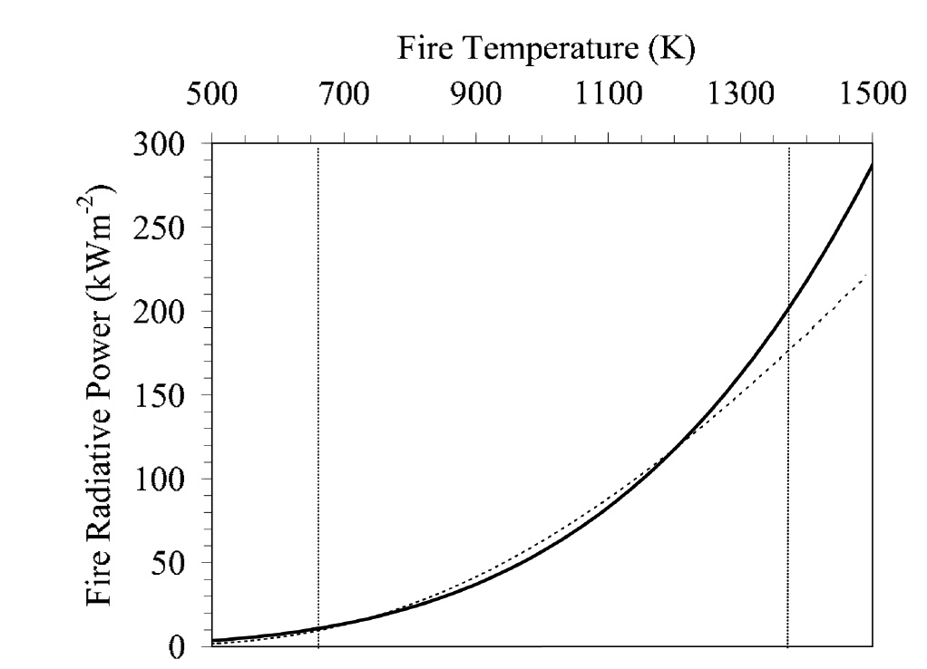
Fire Radiative Power Derivation
FRP (MW) corresponds to the ‘radiative strength’ of fire in a pixel, correlating to its rate of fuel combustion and smoke release.
Planck Function
MIR approach

Slide 4
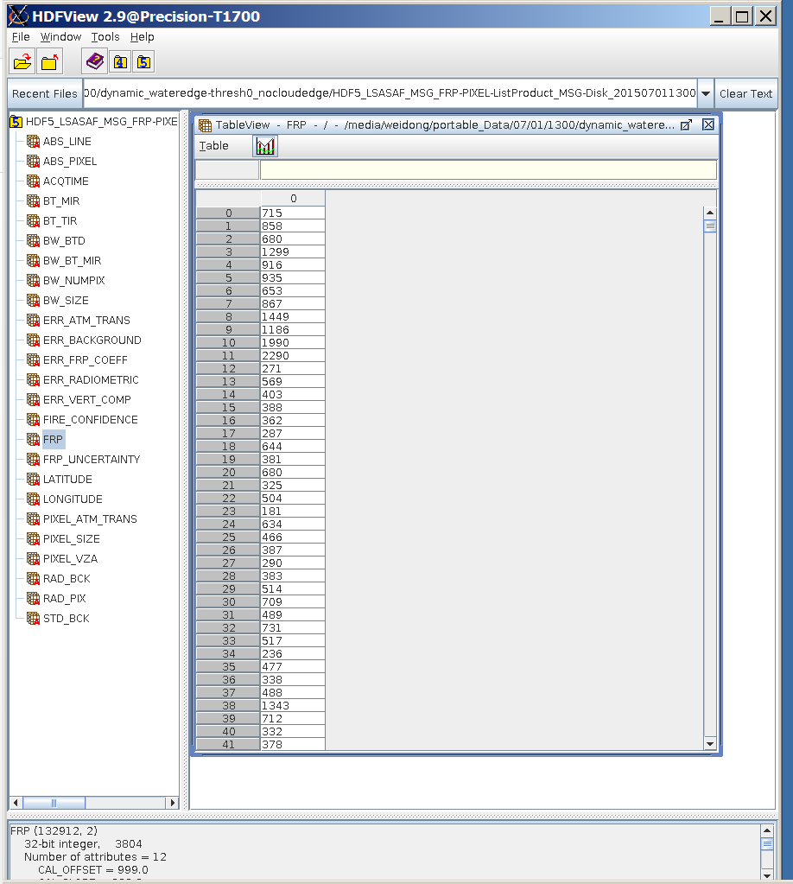
Operational SEVIRI FRP-PIXEL List Product
>99% process success
15 mins temporal resolution
Product available in 2 hours after overpass
Input to CAMS
Delivered operationally to all as part of EUMETSAT Land Surface Analysis Satellite Applications Facility (LSA SAF)
Landsaf.meteo.pt/

Slide 5
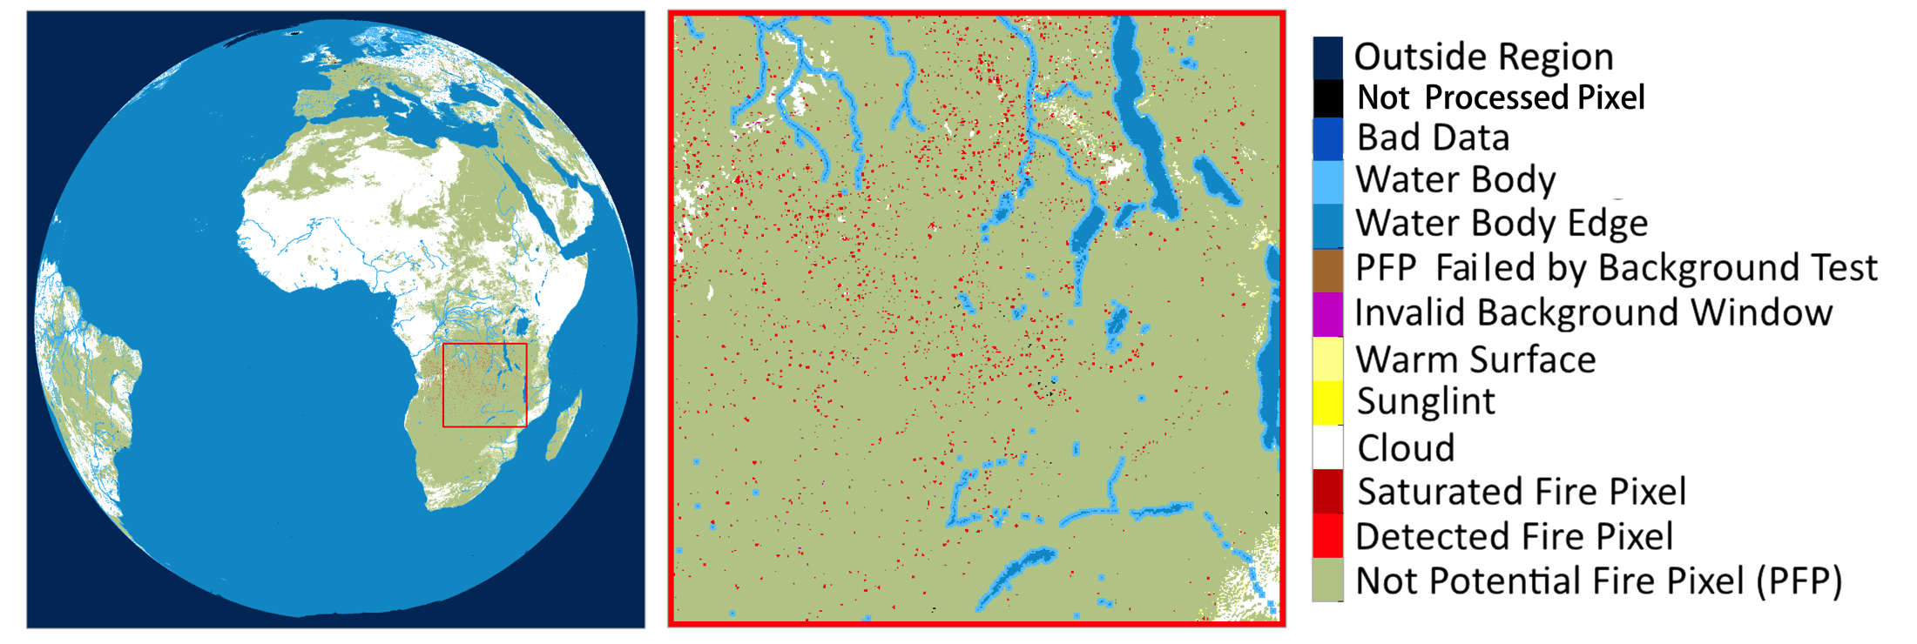
Operational SEVIRI FRP-PIXEL Quality Product
>99% successful process rate
15 mins temporal resolution
Product available in 2 hours after overpass
Delivered operationally to all as part of EUMETSAT Land Surface Analysis Satellite Applications Facility (LSA SAF)
Landsaf.meteo.pt/

Slide 6
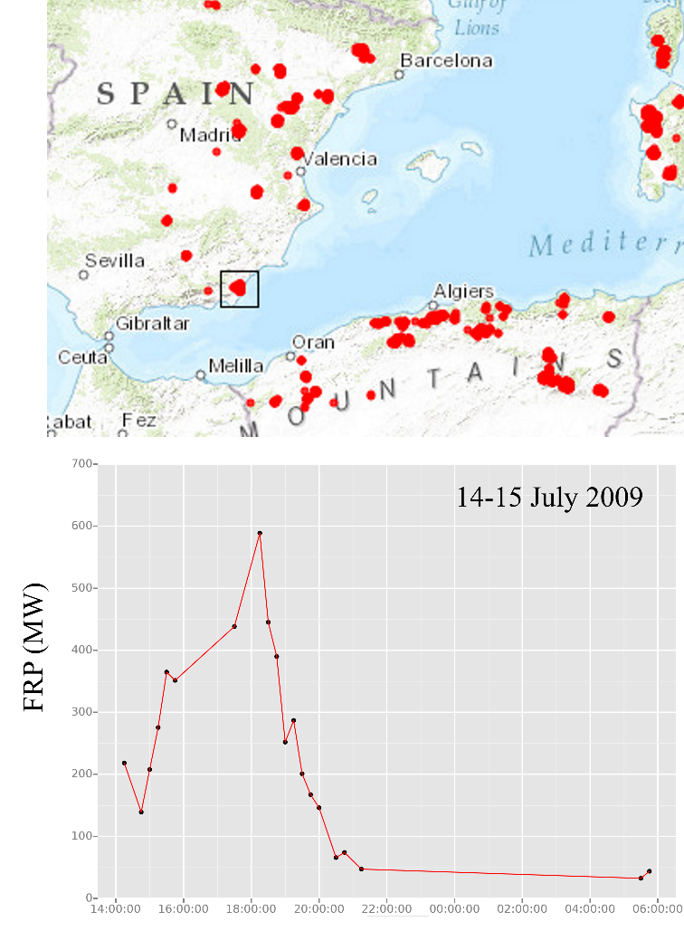
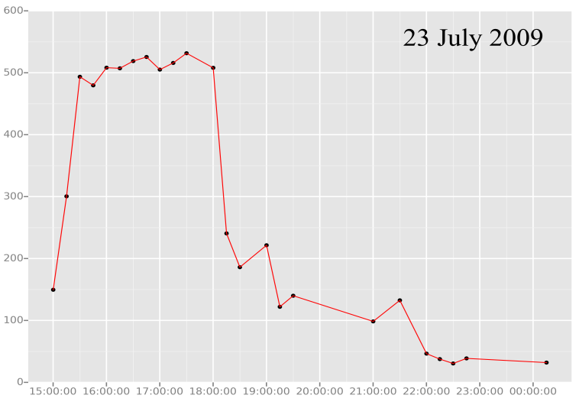
Example Wildfire - July ‘09 Spain
Fire expanded & burned initially exactly matching News reports.
^{Fire flared} again on 23rd July, as illustrated in FRP-PIXEL product.

Slide 7
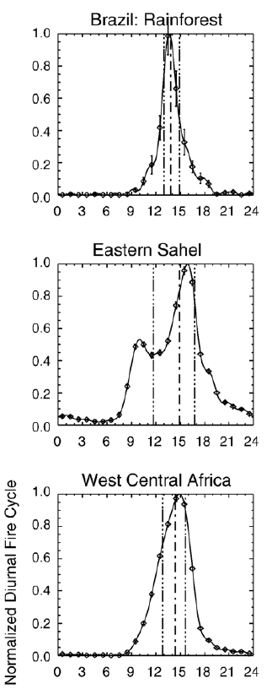
SEVIRI - Fire Diurnal Cycle
FROM MODIS
Fire Diurnal Cycles

Slide 8
Summery
FRP-PIXEL: A LSA SAF operational product for ~10 years now;
FRP-PIXEL provides the only genuine full fire diurnal cycle information over Africa and Europe;
The product is the only geostationary fire product operationally currently injected into the CAMS global fire assimilation system.

Slide 9
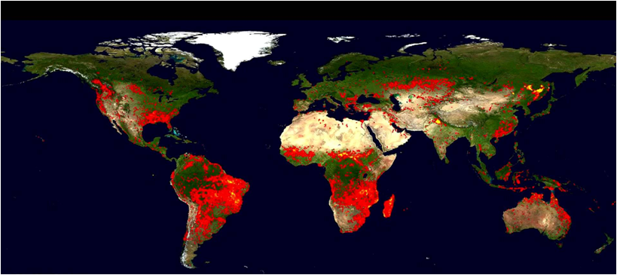
Global Fires from MODIS
1 km resolution – very sensitive to fires - but ONLY 4 passes per day.
Global database – useful for evaluation of other products.

Slide 10
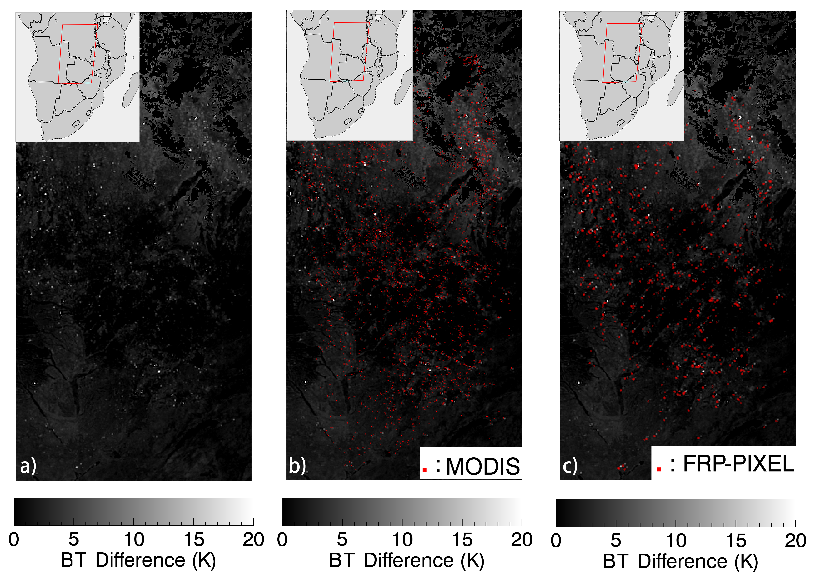
Diurnal cycles
Active Fire Pixel Comparison: FRP-PIXEL & MODIS
Error of omission: 67%
Error of commission: 8%

Slide 11
WFABBA filtered (201408)
FRP-Pixel: Comparison to Alternative SEVIRI Active Fire Products – 21 Aug 2014
FRP-Pixel
WFABBA
Active Fire Pixel Counts
False alarm from WFABBA show a random spatial pattern. No abrupt hot area in the map.
FRP-PIXEL : 1249
WFABBA : 686
FDeM : 346
FIR : 312
FDeM
FIR
All @ 13:15 UTC

Slide 12
Active Fire Detection Performance : SEVIRI Fire Products vs. MODIS
1 Month Active Fire Error of Omission

Slide 13
Active Fire Detection Performance : SEVIRI Fire Products vs. MODIS
1 Month Active Fire Error of Commission

Slide 14
Summery
FRP estimates agree well between MODIS and SEVIRI on ‘per fire’ basis;
FRP-PIXEL product is based on very sensitive Fire Thermal Anomaly (FTA) active fire detection algorithm, which detects far more active fire pixels than other products based on SEVIRI with similar false alarm rate;
FRP-PIXEL is the only product that provides an FRP value in addition to an active fire detection.

Slide 15
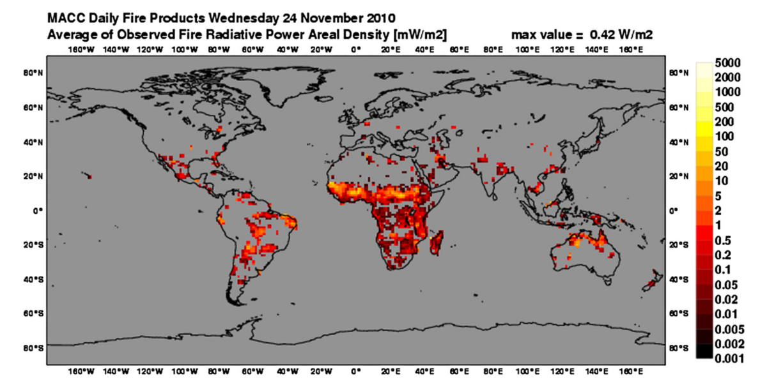
Operational Applications & Science Initiatives
Copernicus Atmosphere Monitoring Service
SALGEE Project
Advanced Fire Information System (afis.meraka.org.za)

Slide 16
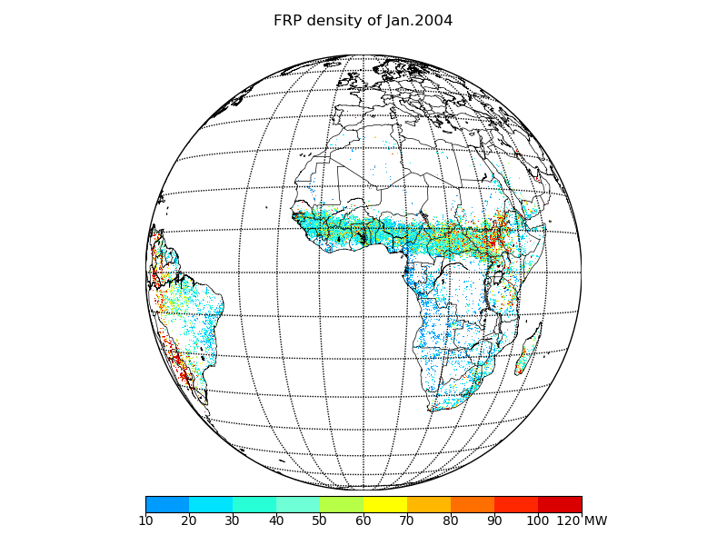
12 years Climatological reprocessed FRP-Pixel data (2004-2015)

Slide 17
New Operational FRP products over India Ocean
FRP-Pixel over Europe & Africa FRP-Pixel over India Ocean

Slide 18
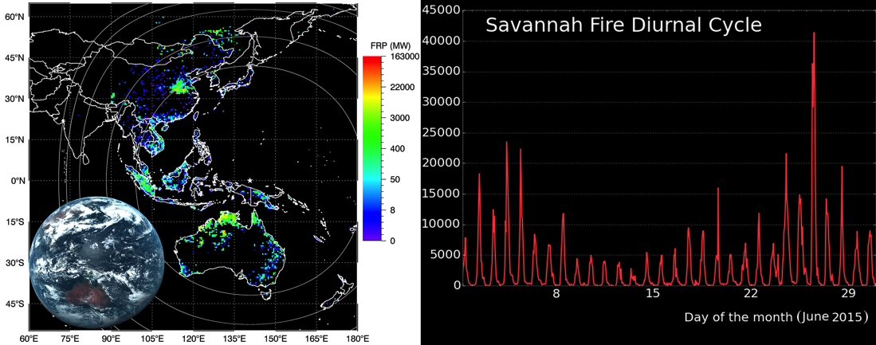
FRP from Himawari-8
Xu, W., Wooster, M. J., Kaneko, T., He, J., Zhang, T., & Fisher, D. (2017). Major advances in geostationary fire radiative power (FRP) retrieval over Asia and Australia stemming from use of Himarawi-8 AHI. REMOTE SENSING OF ENVIRONMENT, 193, 138-149.

Slide 19
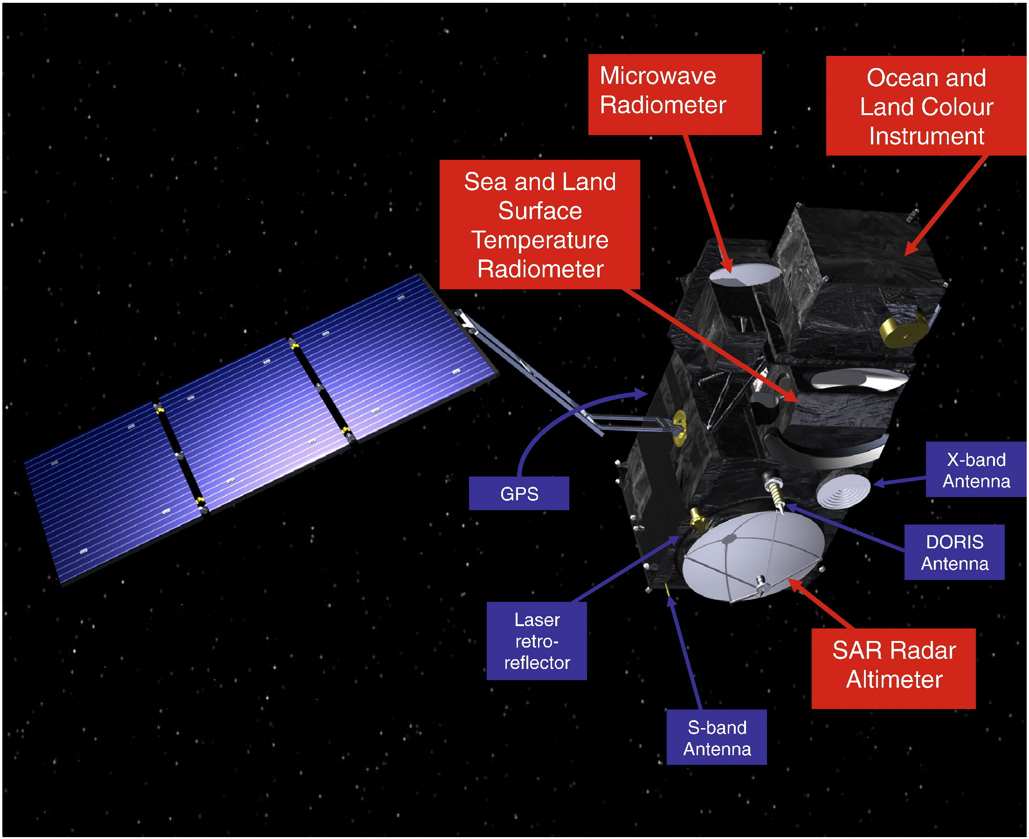
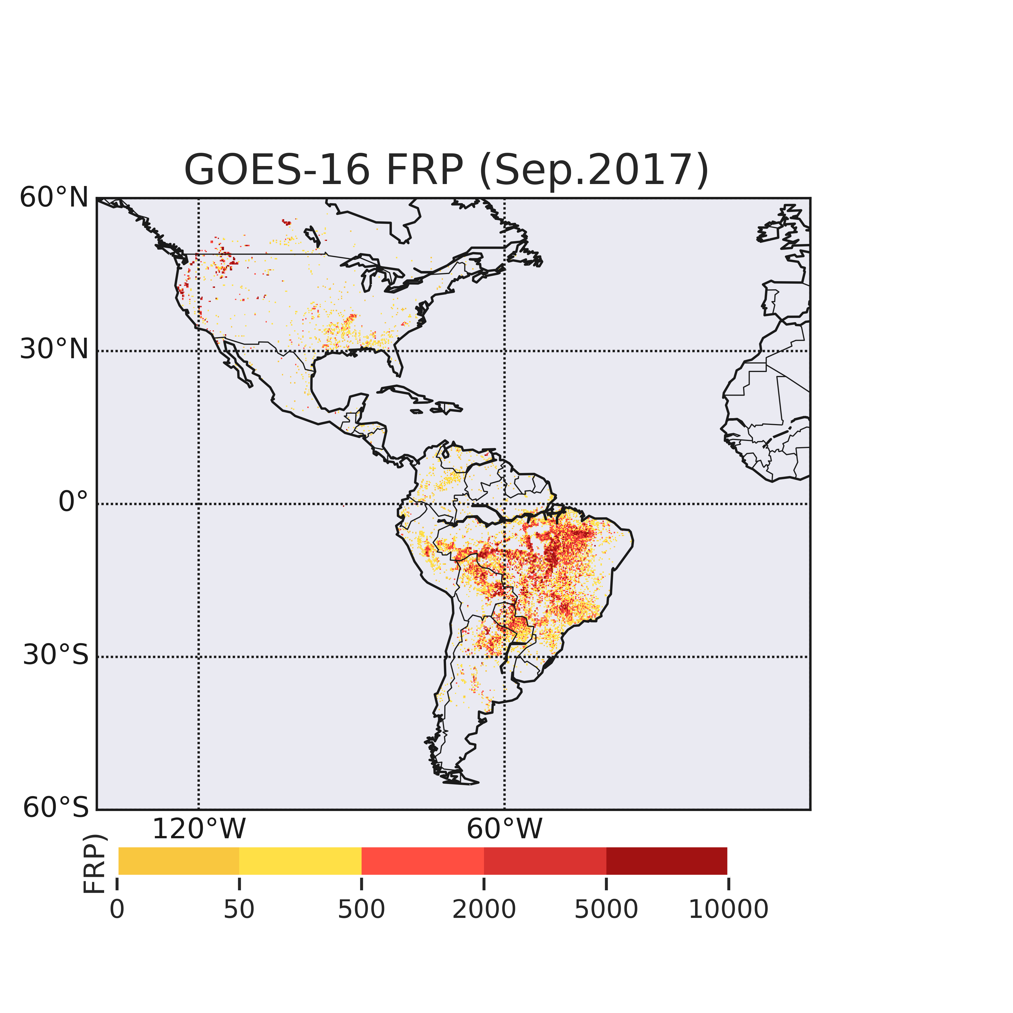
GOES-R & SLSTR FRP
Sentinel-3

Slide 20
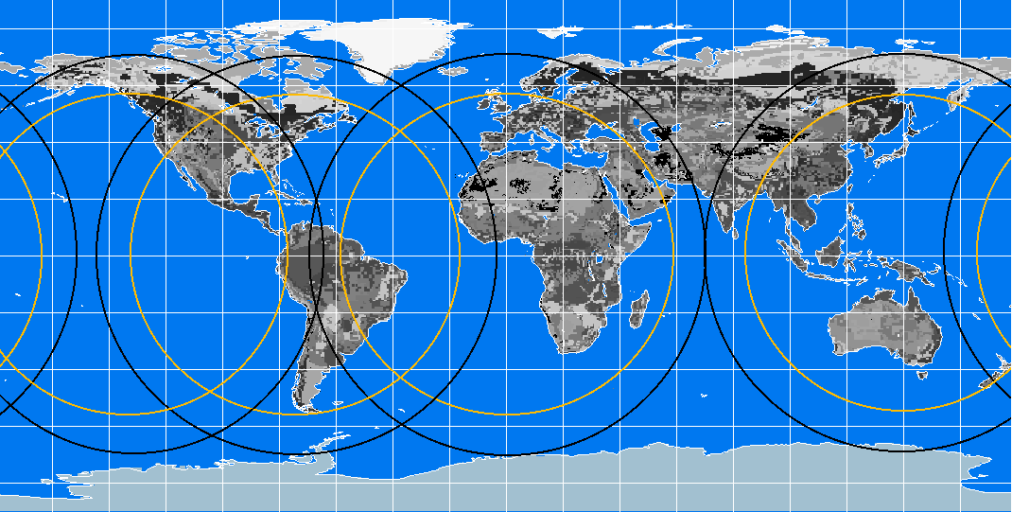
Global Geostationary FRP Observation System
80
-160
-120
-80
-40
0
40
80
120
160
60
GOES-W
GOES-E
MSG
MSG-India
Himawari-8
Satellite
View Angle
80°
65°
40
20
0
-20
-40
-60
-80
Satellite | Bands | SSR (KM) | Full Disk Coverage | MWIR Saturation Temperature (K)
GOES-16 ABI | 2 visible 4 near-IR 10 IR | 0.5 1.0 2.0 | 15 mins | 400
MSG SEVIRI | 3 visible 1 near-IR 7 IR | 1.0 3.0 3.0 | 15 mins | 335
Himawari-8 AHI | 3 visible 3 near-IR 10 IR | 0.5 1.0 2.0 | 10 mins | 400

Slide 21
Future Missions - Plan for CDOP-3
MTG FRP-PIXEL (Day 1: 2km product, followed by 1 km product testing for possible implementation).
MTG FRP-PIXEL European Rapid Scan (Day 2)
MTG FRP-GRID (Day 2)
MTG Fire <Carbon> Emissions (Day 2)

Slide 22
Applications
Fuel consumption;
Aerosol optical depth;
Smoke emissions;
Air quality monitoring.

