Slide 1
Practical use of H-SAF and Land-SAF products in agriculture service
Piotr Struzik – IMGW-PIB, Kraków

Slide 2
Tytuł prezentacji z tutaj
Presentation plan
Polish agrometeorological service – applied satellite products:
Land SAF DSSF - solar radiation
Land SAF ET - actual evapotranspiration
H-SAF H-14 - soil moisture
Land SAF LAI – Leaf Area Index
Land SAF FaPAR – Fraction of Absorbed Photosyntetical Active Radiation
Included subjective view on the products usefullness.
Why the satellite data are / than ground observations.
better
worse

Slide 3
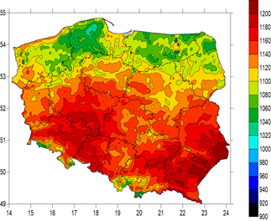
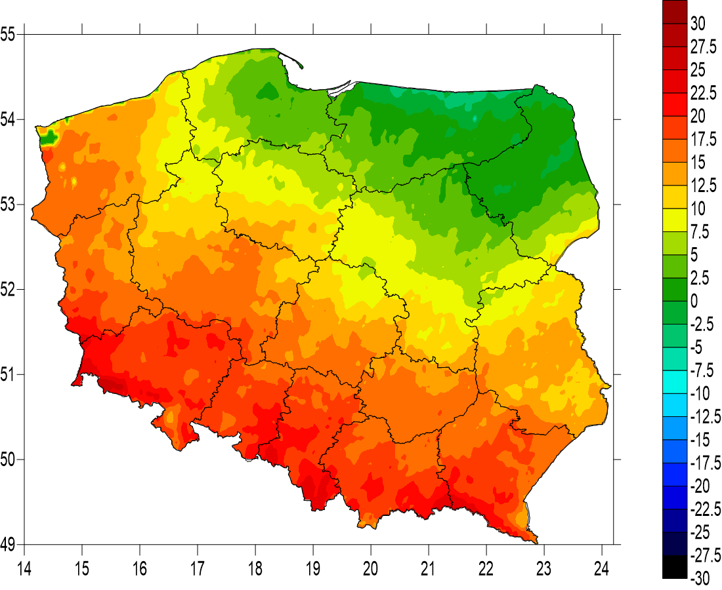
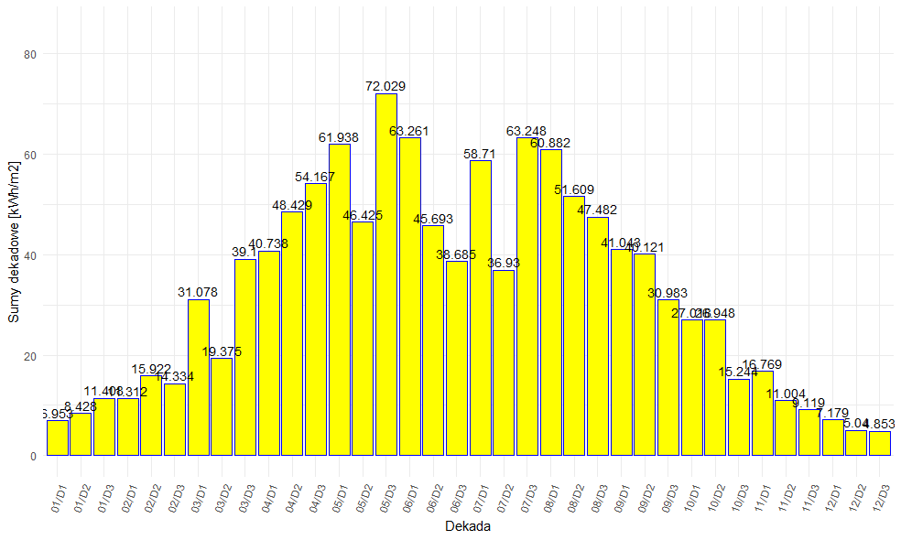
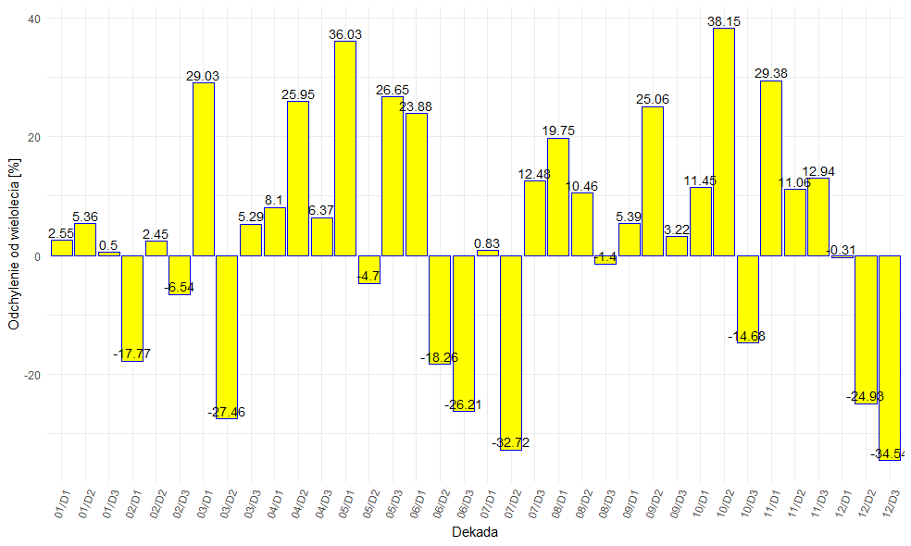
Tytuł prezentacji z tutaj
Solar radiation – Land SAF DSSF 2004-now used (implementation to web service ongoing)
Spatial distribution of solar radiation energy:
Daily values
Decadal values
Monthly values
Annual values
Multiannual mean 2004-2018
Spatail distribution of anomalies against multiannual mean:
Decades
Months
Years
Temporal variation (decadal) for the whole Poland, 16 provinces and 380 counties.
Temporal variation (decadal) of anomaly against multiannual for the whole Poland, 16 provinces and 380 counties.
Tabular classification (we call them „carpets”).
About 20 000 maps and diagrams in total

Slide 4
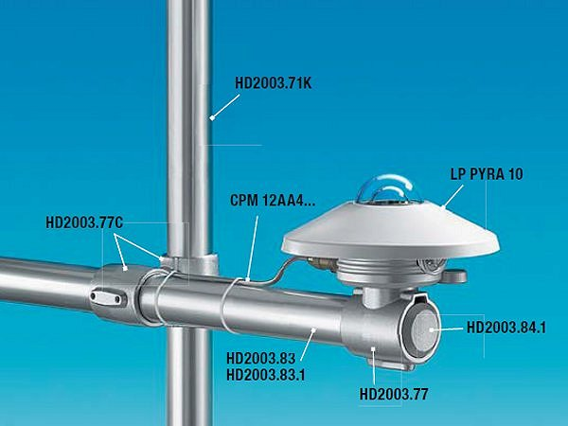
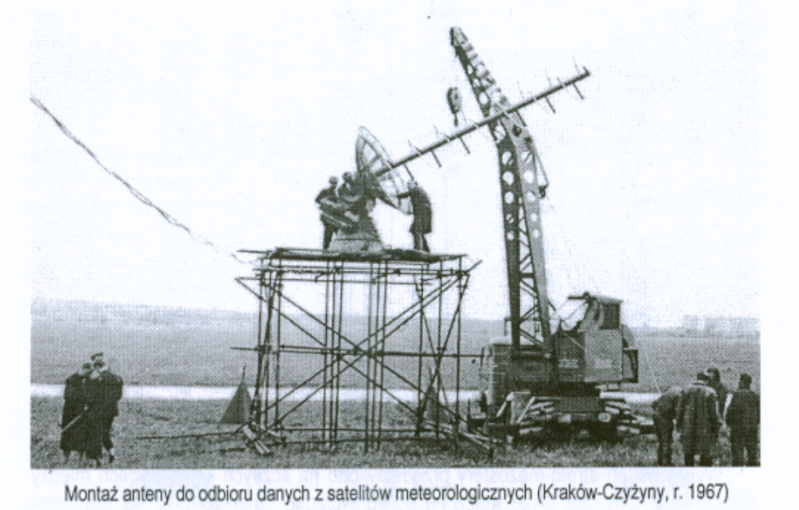
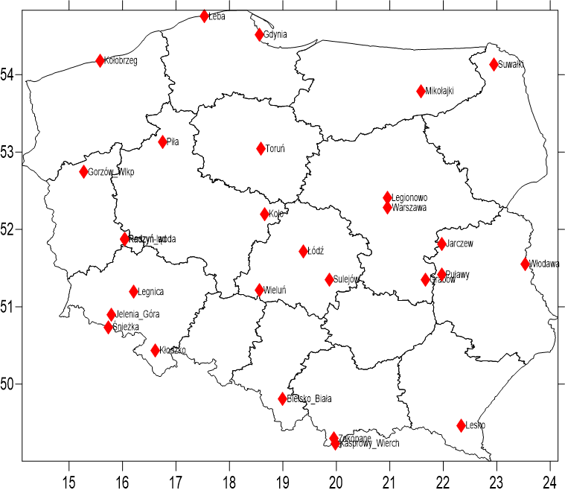
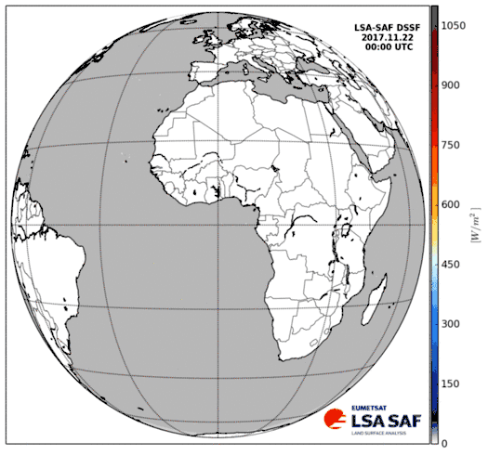
Ground observations vs. Satelite observations

Slide 5
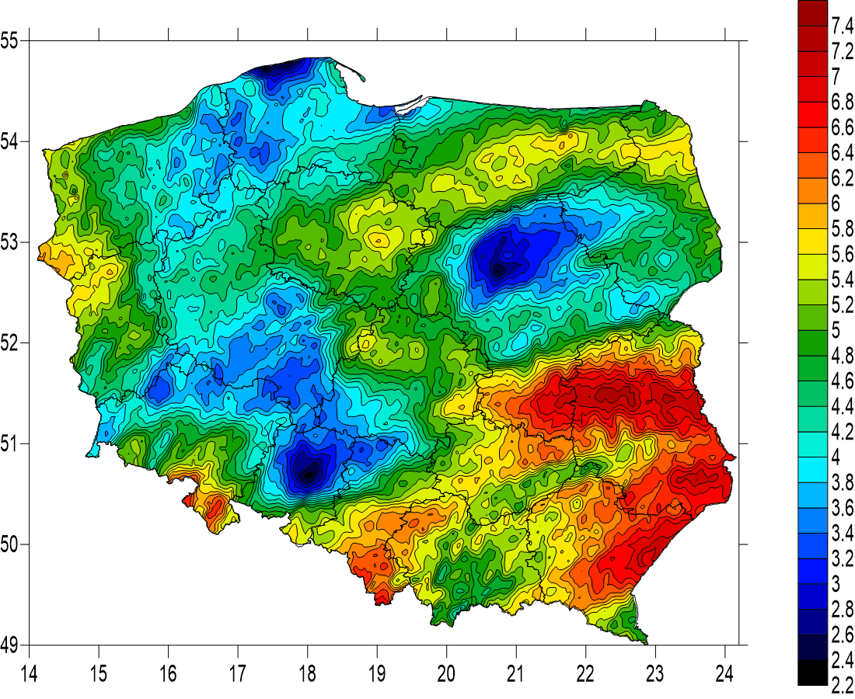
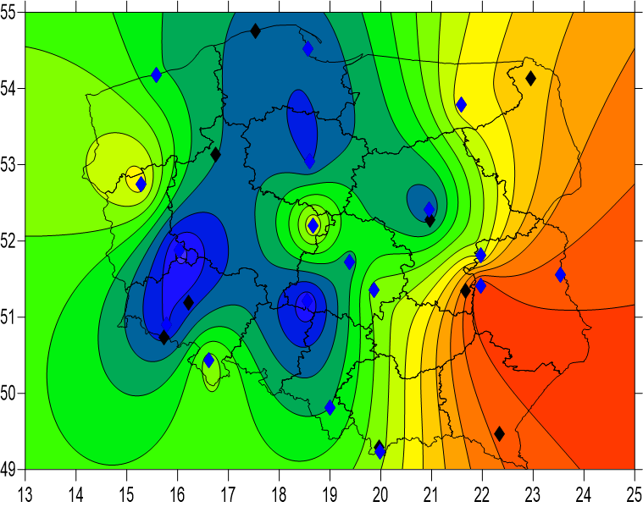
Spatail distribution of daily solar energy, based on ground and satellite observations (21.07.2007)
Satellite data
Approx. 24 000 pixels with size 5-6 km
Ground observations
19 stations
Data available
Data not available

Slide 6
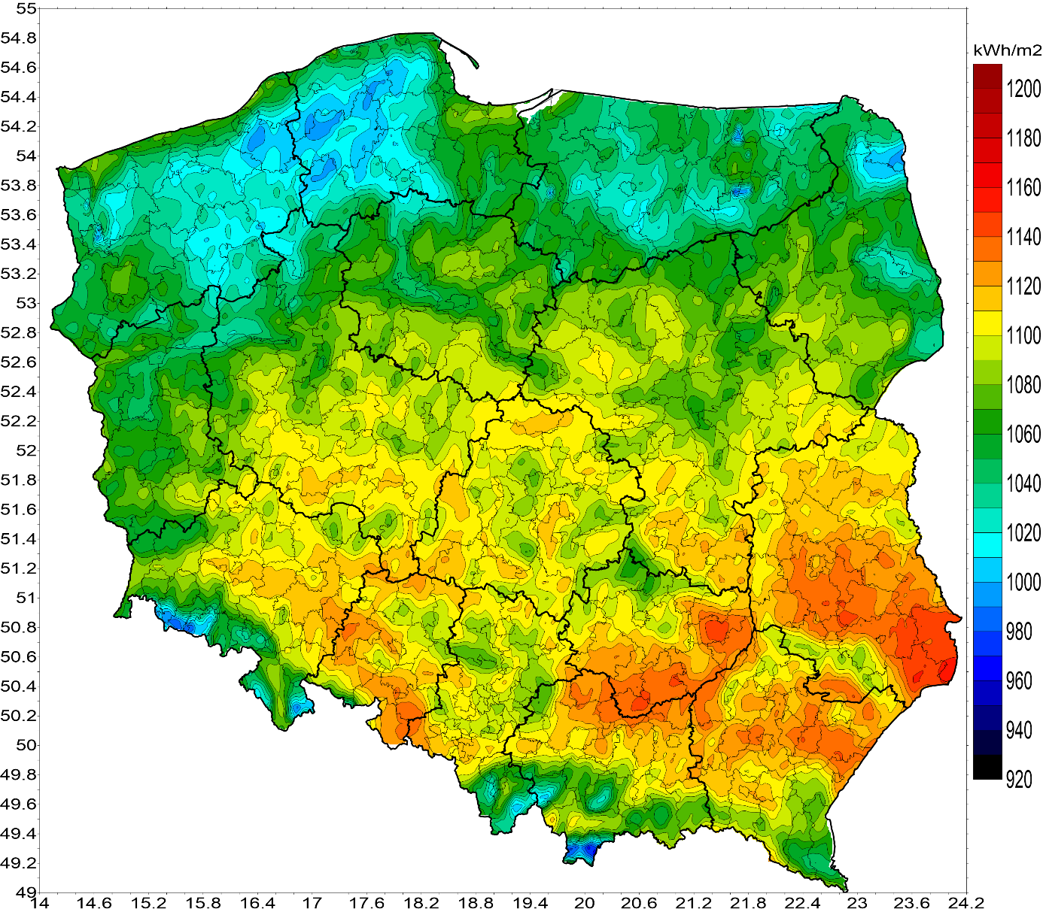
Spatial distribution of annual energy of solar radiation – mean value from the period of 2004-2018.

Slide 7
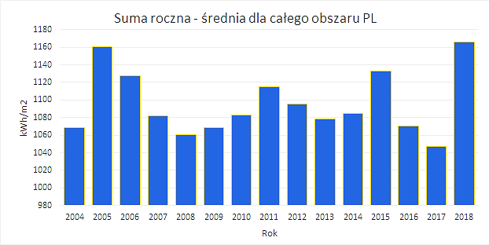
The annual amount of solar radiation energy for the area of Poland (mean value) for the following years 2004-2018.

Slide 8
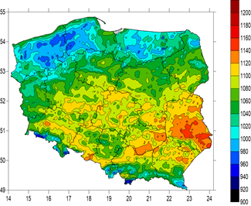
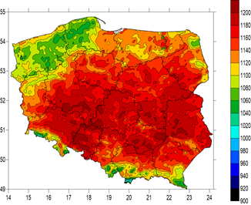
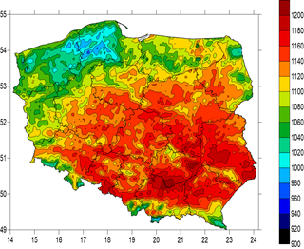
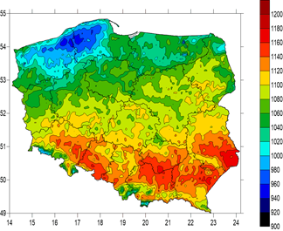
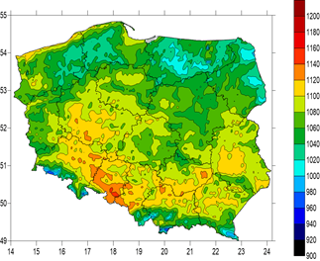
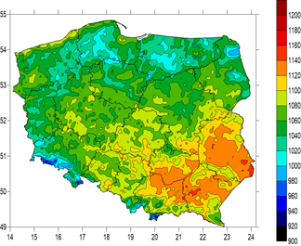
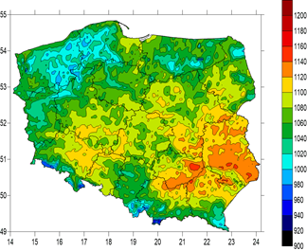
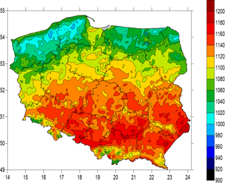
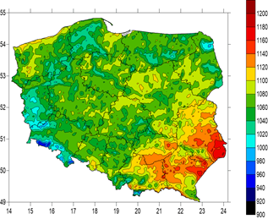
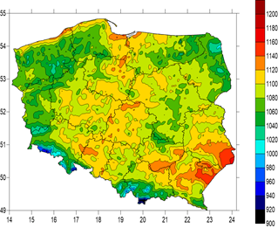
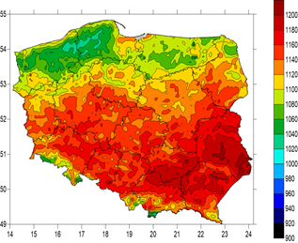
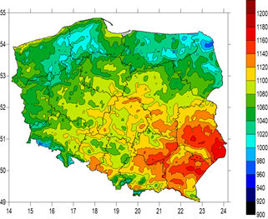
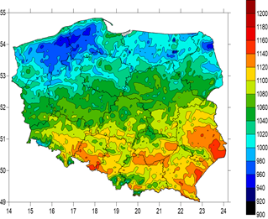
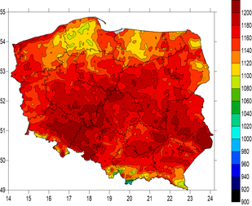
2004
2005
2006
The annual amounts of solar radiation energy, based on satellite products
(scale 920-1200 kWh/m²).
2007
2008
2009
2010
2011
2012
2013
2014
2015
2016
2017
2018

Slide 9
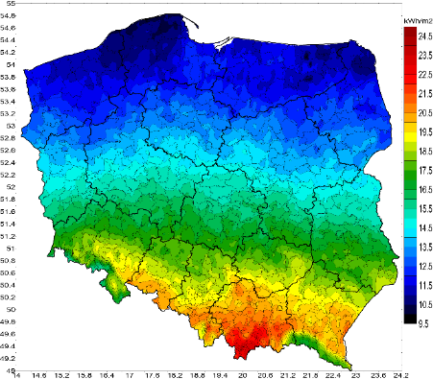
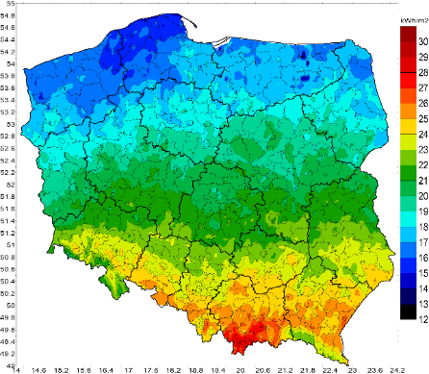
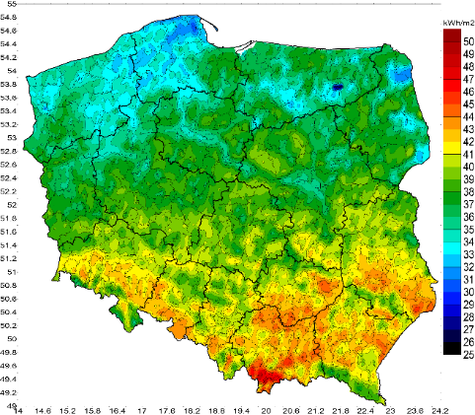
The monthly amount of solar radiation energy [kWh/m2] reaching the Earth surface in individual months of the year – mean value from multiannual 2004-2018
(the scale adjusted to individual months).
December
January
February

Slide 10
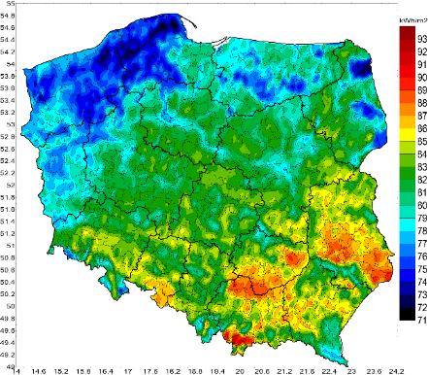
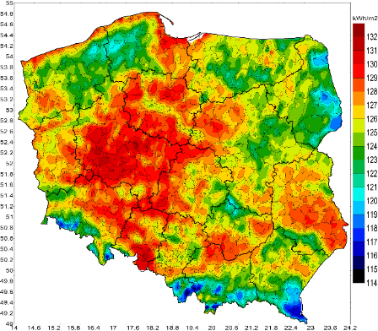
The monthly amount of solar radiation energy [kWh/m2] reaching the Earth surface in individual months of the year – mean value from multiannual 2004-2018
(the scale adjusted to individual months).
March
April
May

Slide 11
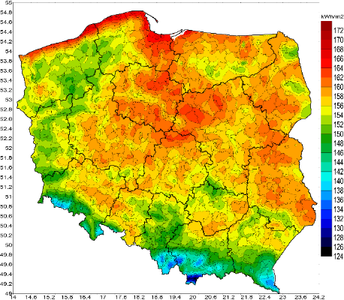
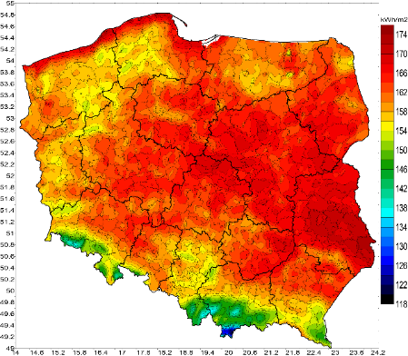
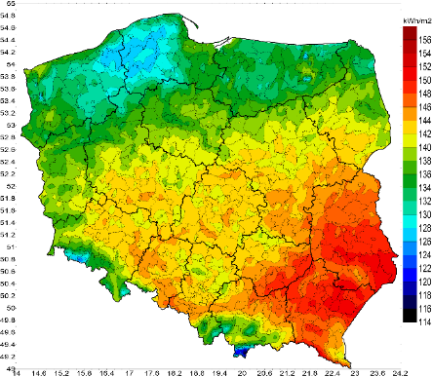
The monthly amount of solar radiation energy [kWh/m2] reaching the Earth surface in individual months of the year – mean value from multiannual 2004-2018
(the scale adjusted to individual months).
June
July
August

Slide 12
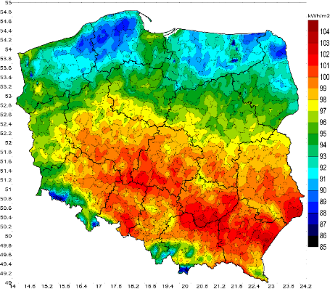
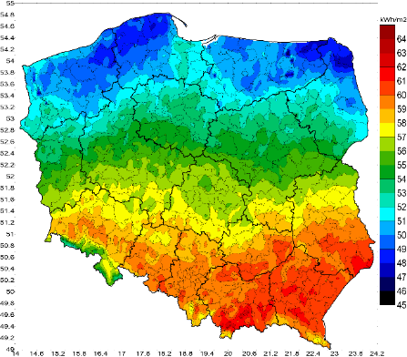
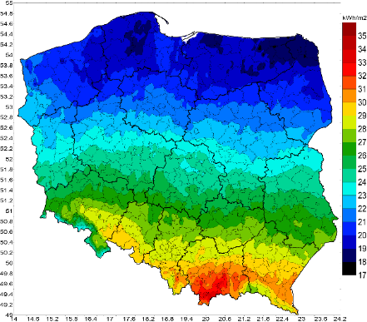
The monthly amount of solar radiation energy [kWh/m2] reaching the Earth surface in individual months of the year – mean value from multiannual 2004-2018
(the scale adjusted to individual months).
September
October
November

Slide 13
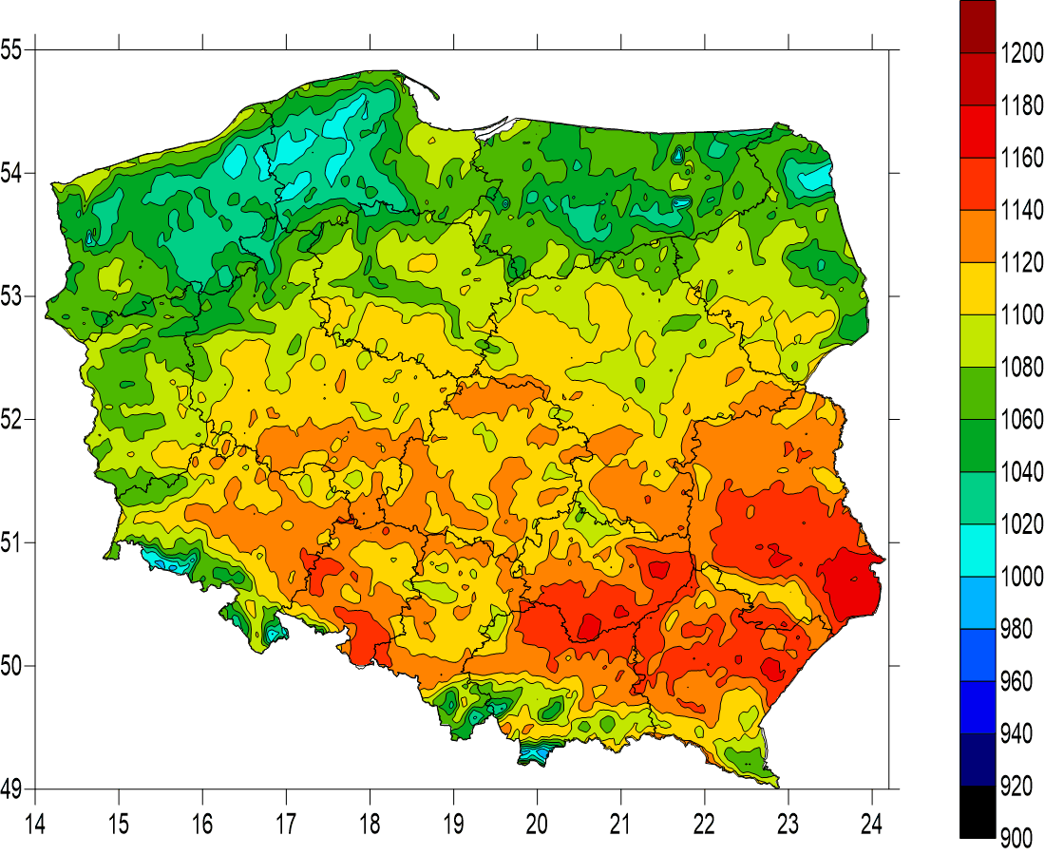
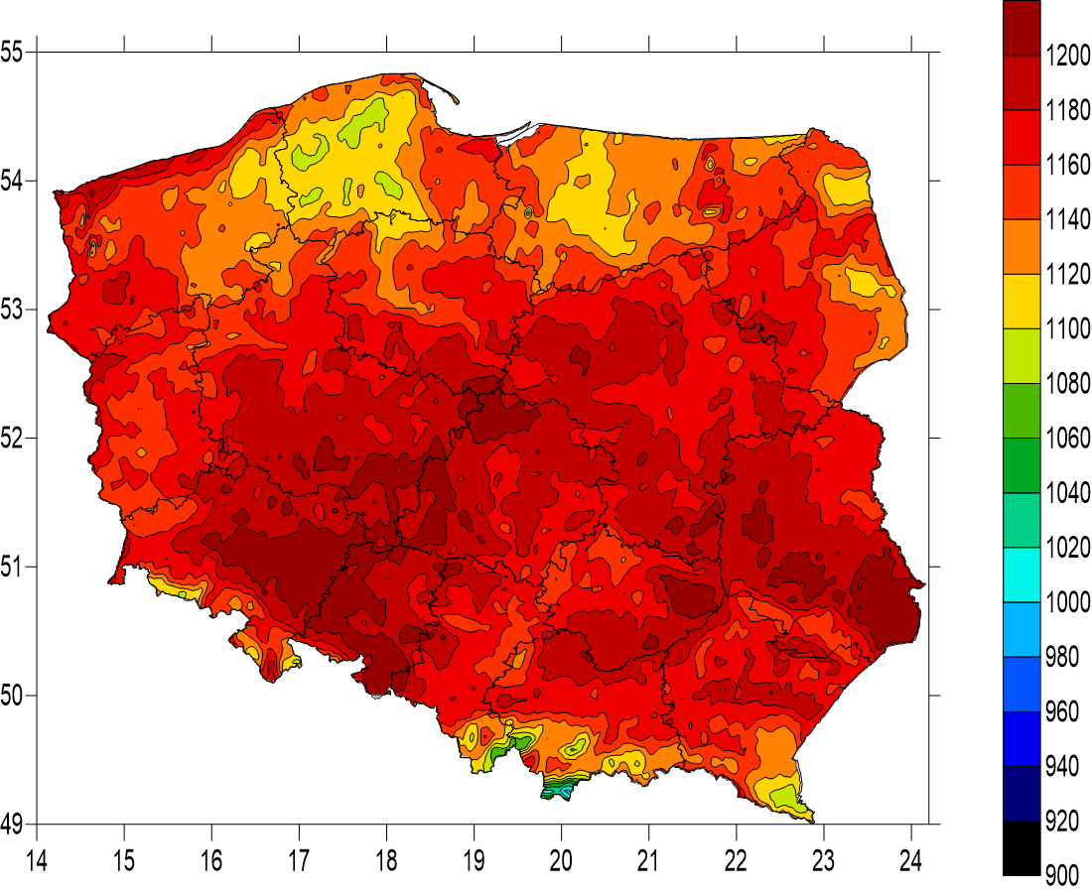
Year 2018 in comparison to annual mean 2004-2017
Annual mean 2004-2017 [kWh/m2]
Annual amount 2018 [kWh/m2]

Slide 14
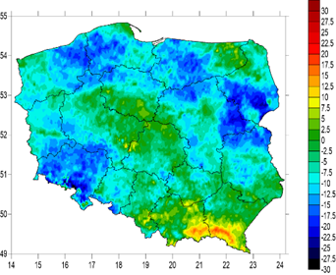
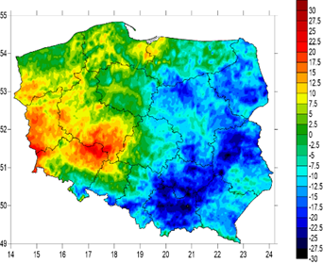
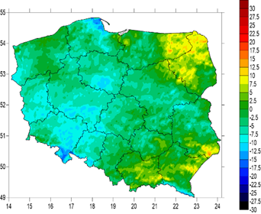
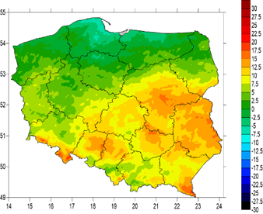
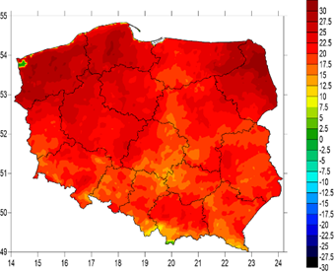
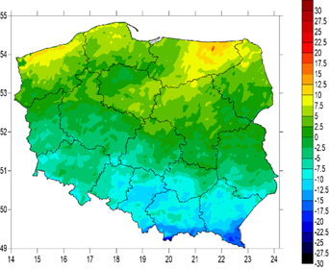
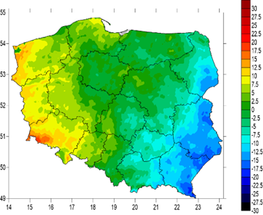
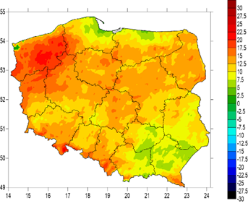
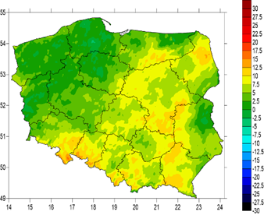
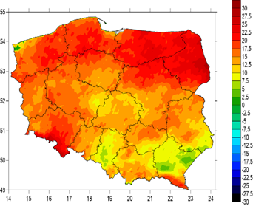
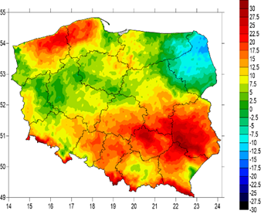
The spatial distribution of monthly insolation amounts in 2018 in comparison to multiannual period of 2004-2017 [scale ±30%].
January
February
March
April
May
June
July
August
September
October
November
December

Slide 15
Year 2019
January
February
March
April
Monitoring of actual situation in comparison to prevoius 15 years
Monthly amount of solar radiation energy - scale ±30%
May
June
July
August
September
Last decades of 2019 – difference to previous 15 years, scale ±50%
D3 of August
D1 of Sept.
D2 of Sept.
D3 of Sept
D1 of October

Slide 16
Comparison of satellite data and ground measurements
Minute variation of solar energy
station Koło (1.05.2017)
Land SAF DSSF –
observations every 30 min.
W/m2
W/m2

Slide 17
Comparison (???) of satellite data and ground measurements
station Koło 1-12.06.2016
W/m2

Slide 18
Use of cloud properties in DSSF product – is applied any paralax correction ???
In the mountainous region, areas with the lowest annual mean of solar energy are shifted to the NNE direction !
Małopolska Region (PL)
mean annual solar energy (2004-2018)
Małopolska Region Map

Slide 19
Actual evapotranspiration from satellite data Land SAF ET Product
Product generated operationally by EUMETSAT Land SAF;
Distributed in near real-time by EUMETCast system;
Area – hemisphere visible from 0 deg. geostationary satellite position, product divided into continenal areas;
Time step:
30 min (instantaneous value), 48 products per day;
24 hours (cumulated value).
Spatial resolution – MSG/SEVIRI pixel, 5-6 km in Poland;
[mm]
Example of decadal actual ET retrieved from Land SAF product Poland
(III decade of May 2012)

Slide 20
Evapotranspiration from satellite data Land SAF ET Product
Example of 30-min ET from Land SAF product
Scaling: ET * 10 000

Slide 21
Evapotranspiration from satellite data Land SAF ET Product
Example of ET spatial distribution retrieved for selected test site
in Wielkopolska region of Poland
- 11.06.2013
Penman-Monteith method
Land-SAF satellite product
Satellite product reflects actual type of surface cover – in the cities, ET is significantly decreesed !
CORINE land cover

Slide 22
Diagram of 10-days totals of ET_{o} (P-M) and ET_{a} (Sat) for Leszno station.

Slide 23
Volume of ET [thousands of m³], for the selected test site (Wielkopolska Region in Poland) determined from interpolated ET_{o} by Pennman-Monteith method from ground observations (P-M) and ET_{a} from Land-SAF satellite product
Differences between reference ETo (P-M) and actual ETa (sat) in case of
limited water resources in the soil or frozen soil!
Frozen soil
Dry soil

Slide 24
Diagram of ET_{o} retrieved by Penman-Monteith (P-M) formula and ET_{a} from Land-SAF product for Wielun area in Poland.
Added H-SAF soil moisture for 0-7 cm layer (SM1) and for 7-28 cm layer (SM2)
Periods of decreesed soil moisture are well correlated with differences between reference ET_{o} (P-M) and actual ET_{a} (sat)

Slide 25
Correlation coefficient between daily, 10-days and monthly reference evapotranspiration and actual evapotranspiration:
Synoptic station |  | Geographical location | daily | 10-days | monthly
Resko |  | 15.409E 53.770N | 0.96 | 0.99 | 1.00
Chojnice |  | 17.526E 53.709N | 0.96 | 0.99 | 0.99
Pila |  | 16.742E 53.125N | 0.94 | 0.97 | 0.99
Gorzow Wlkp. |  | 15.273E 52.738N | 0.92 | 0.96 | 0.97
Torun |  | 18.590E 53.039N | 0.92 | 0.94 | 0.97
Poznan |  | 16.835E 52.417N | 0.93 | 0.96 | 0.98
Plock |  | 19.721E 52.587N | 0.95 | 0.97 | 0.98
Kolo |  | 18.657E 52.200N | 0.95 | 0.96 | 0.98
Zielona Gora |  | 15.521E 51.925N | 0.92 | 0.94 | 0.97
Leszno |  | 16.536E 51.823N | 0.96 | 0.98 | 0.99
Kalisz |  | 18.076E 51.776N | 0.85 | 0.87 | 0.90
Lodz |  | 19.401E 51.723N | 0.92 | 0.94 | 0.96
Wroclaw |  | 16.901E 51.103N | 0.95 | 0.97 | 0.99
Wielun |  | 18.555E 51.207N | 0.91 | 0.93 | 0.96
 | significance level α= 0.001

Slide 26
Localization of Synop stations and MSG/SEVIRI pixel used for retrieval of ET overlaid
on CORINE Land Cover map.
Red and pink –urbanized and industrial areas, green –forests, yellow to light brown – agricultural land and pastures.
Kalisz
Wieluń
Synop station localization

Slide 27
Actual evapotranspiration – H-SAF H-14 product.
Time series with 10 days amount, 1.04-15.09.2015

Slide 28
Conclusions for ET:
Values of reference evapotranspiration (ET_{o}) calculated using Penman-Monteith method and actual evapotranspiration (ET_{a}) derived using the satellite data, showed a very strong correlation.
Generally, daily, decadal and monthly totals of reference evapotranspiration are higher than corresponding values of actual evapotranspiration. Penman-Monteith method assumes no shortage of soil water in the reference surface.
High differences between ET_{o} and ET_{a} also result from different land use. The Penman-Monteith method determines evaporation from a surface covered by green grass of uniform height (0.12 m). Satellite product, by including data from land cover base, provides a much better and more realistic representation of field conditions.
In case of the analyzed Wielkopolska region, the total magnitude of the differences in consecutive days for the entire area translates into thousands of cubic meters. Calculations based on overestimated values lead to excessive or unjustified water use, e.g. in irrigation, and poor management of water resources.
Application of satellite data for evapotranspiration assessment in catchment areas, appears to be the most efficient and economically optimal method.
Presented ET_{o}-ET_{a} relations and soil moisture retrieved by H-SAF product shown interesting relations, especially for soil wetness index in the upper two layers of soil.

Slide 29
Tytuł prezentacji z tutaj
Some issues related to Land SAF „old” and „new” Actual ET products
Daily ET – new Land SAF Product

Slide 30
Tytuł prezentacji z tutaj
Black holes in Actual Evapotranspiration – problen of both „new” and „old”
Between 11:00-15:00 many black holes – areas with code 0 = „sea” or „no data”

Slide 31
Tytuł prezentacji z tutaj
Comparison of values ET: „new” vs „old” version – 9.07-22.09.2019
Old
New

Slide 32
Tytuł prezentacji z tutaj
Comparison of values ET: „new” vs „old” version – 9.07-22.09.2019
Jelenia Góra
Mikołajki
Opole
Zamość

Slide 33
Tytuł prezentacji z tutaj
Soil Moisture service
Interesting applications of H-SAF and Land SAF products, for the area of Poland.
On click temporal course of Soil Moisture Index for last months in any of 380 counties in Poland
www.agrometeo.pogodynka.pl

Slide 34
Thank you
Piotr Struzik

